Slide 1
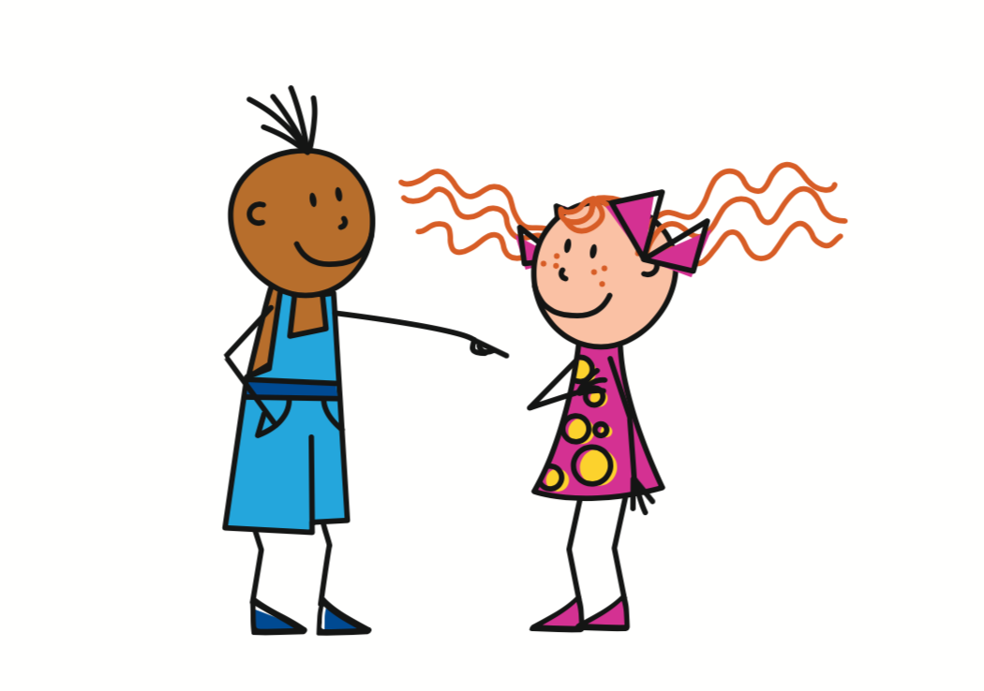
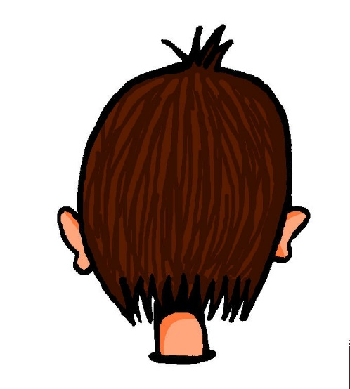
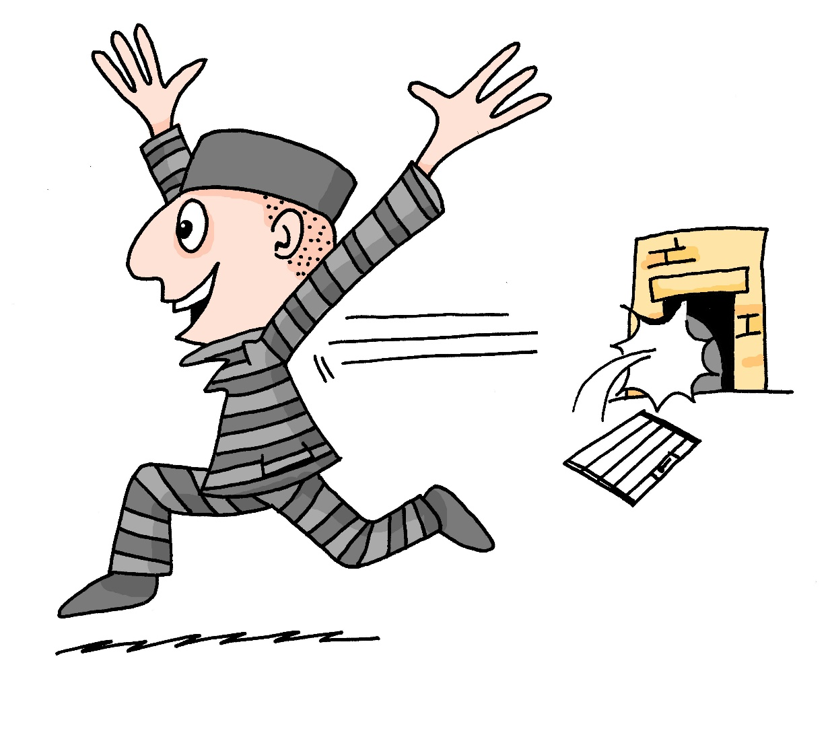
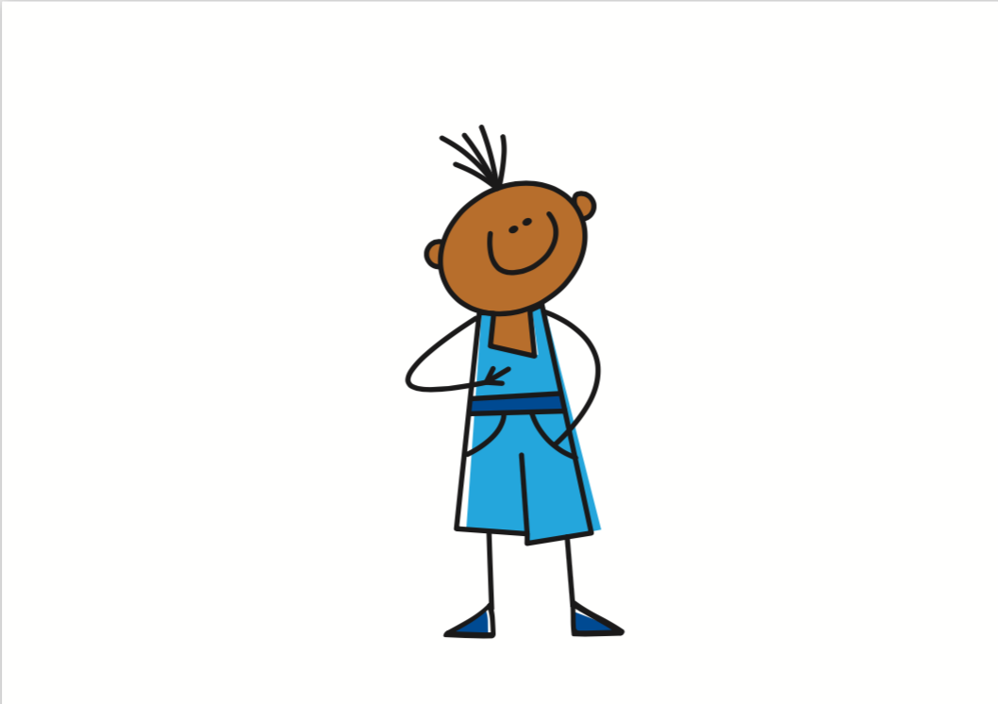
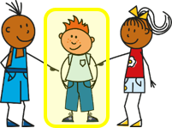
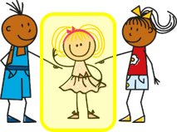
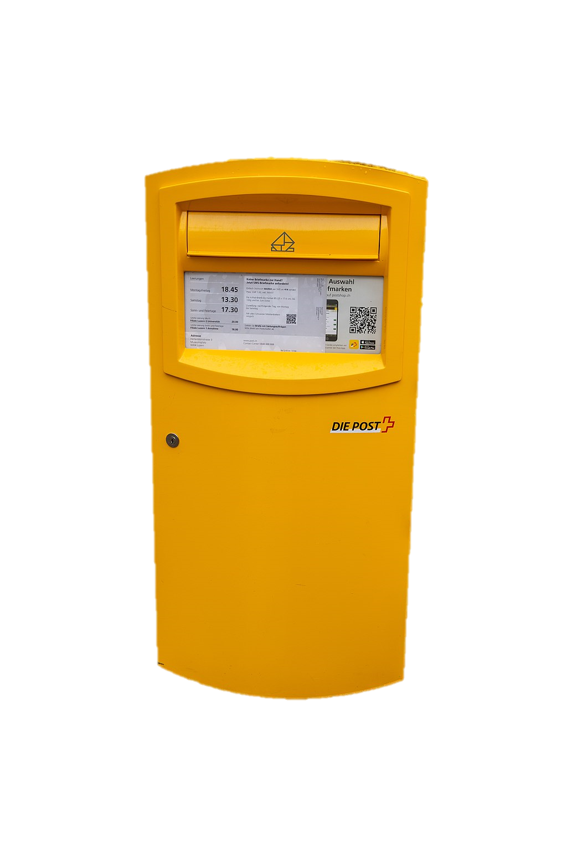
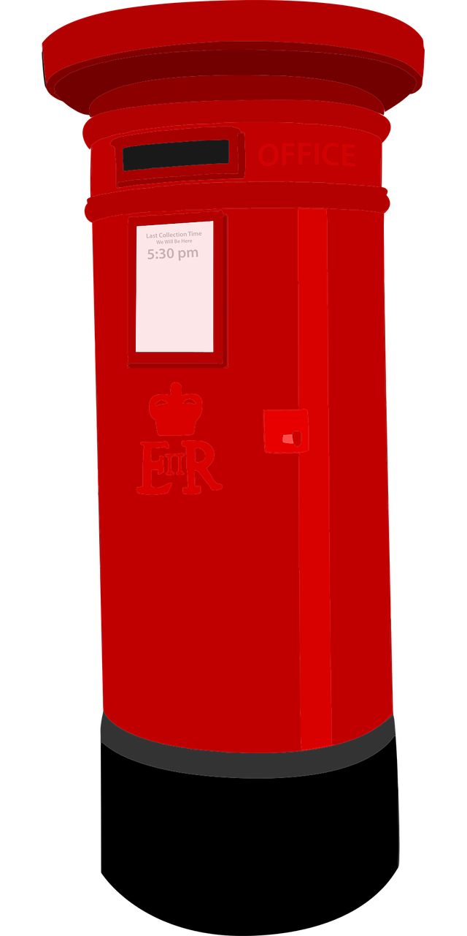
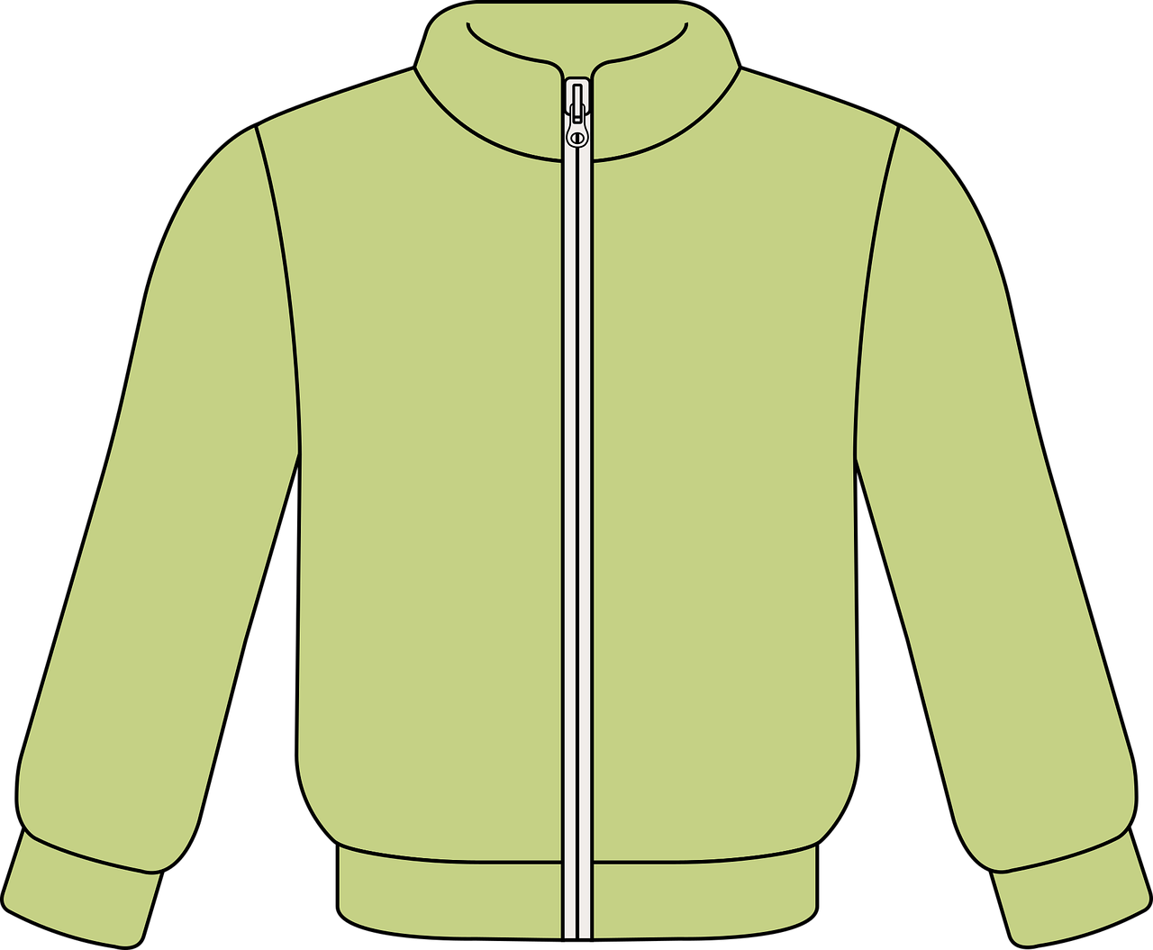
gelb Knowledge Organiser - Autumn Term A
Useful first words
ich – I
du - you
er – he
sie – she
es – it
sein – to be, being
ich bin – I am
du bist – you are
er/sie/es ist – he/she/it is
ja – yes
nein – no
der – the (m)
die – the (f)
das¹ – the (n)
und – and
oder - or
Hallo – hello
Guten Morgen – good morning
wo? – where?
was? – what?
England – England
die Schweiz – Switzerland
das² – that
Things and people
der Apfel – apple (m)
der Ball – ball (m)
der Ort – place (m)
die Farbe – colour (f)
die Jacke – jacket (f)
die Person – person (f)
die Uhr – watch, clock (f)
das Blatt – sheet (n)
das Butterbrot – sandwich (n)
das Ding – thing (n)
Describing things
da – there
falsch – false
grau – grey
grün – green
hier – here
klar - clear
richtig – right
schwarz – black
weiß – white
wunderbar – wonderful
Phonics
 | long [a] | short [a] | long [u] | short [u]
…
[there]
da
Hallo
du
Punkt
long [o] | short [o] | [ei] | long [e] | short [e]
wo?
Kopf
frei
geben
denken
long [i] | short [i]
🙏
Familie
bitte
Start with wo to make a where question:
Wo ist das?
Where is that?
Start with was to make a what question:
Was ist das?
What is that?
Personal pronouns ich ➜ I du ➜ you er ➜ he sie ➜ she es ➜ it | Describing people with the verb sein | Asking yes/ no questions
Capitalisation of nouns All German nouns start with a capital letter, wherever they are in a sentence: Das Blatt ist da. | Indefinite articles ein, eine, ein (a) | Definite articles der, die, das (the)
In English we swap ‘I am’ to ‘Am I’ to make yes/ no questions. In German we do the same:
ich bin
I am
es ist
du bist
sein
Ich bin Hannah.
it is
you are
I am Hannah.
sie ist
er ist
Bin ich Hannah?.
she is
he is
Am I Hannah?
Wo ist das?
German has two words for ‘a’. Ein (m), eine (f), ein(n) (‘a’) often introduces new information and identifies something to the listener:
German has three words for ‘the’. We say that nouns have grammatical gender: masculine, feminine, and neuter. Der (m), die (f), das (n) refers to something already mentioned or known.
The sheet is there.
Countries have different colours for some things.
Das ist in der Schweiz.
Proper nouns do this in English too: e.g. London, Monday, Emily.
Das ist eine Jacke.
This is a jacket.
Die Jacke ist grün.
The jacket is green.

Slide 2
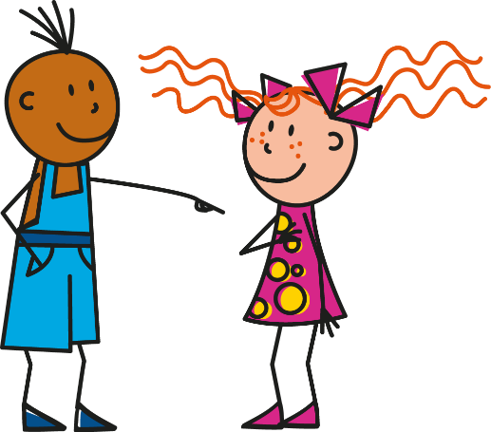
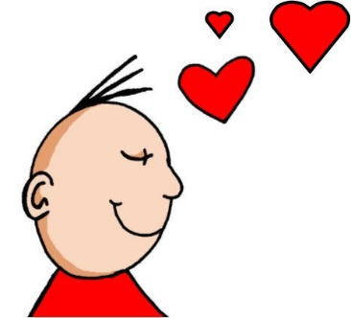
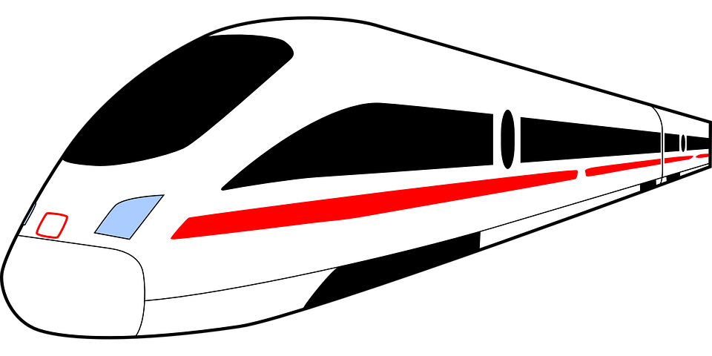
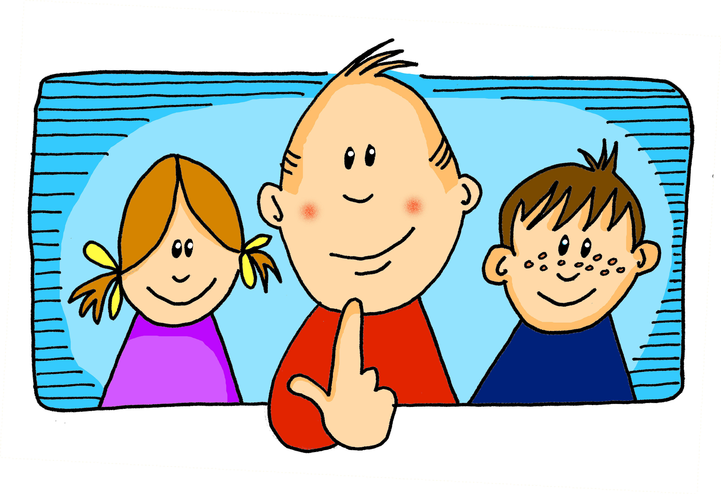
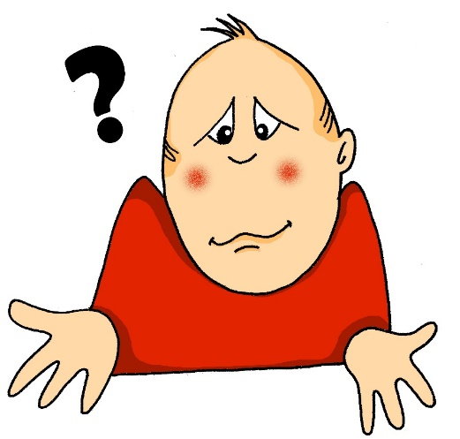
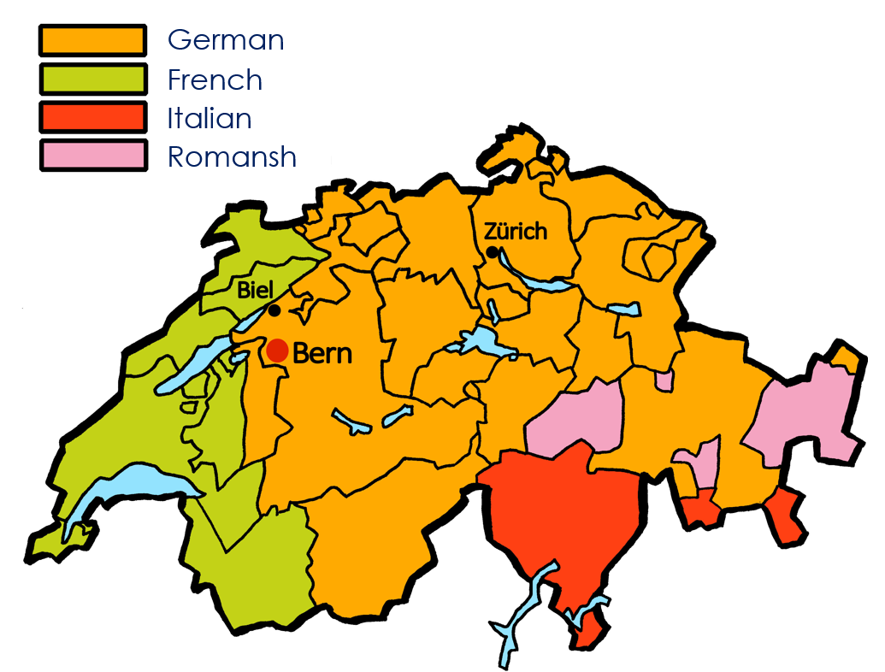
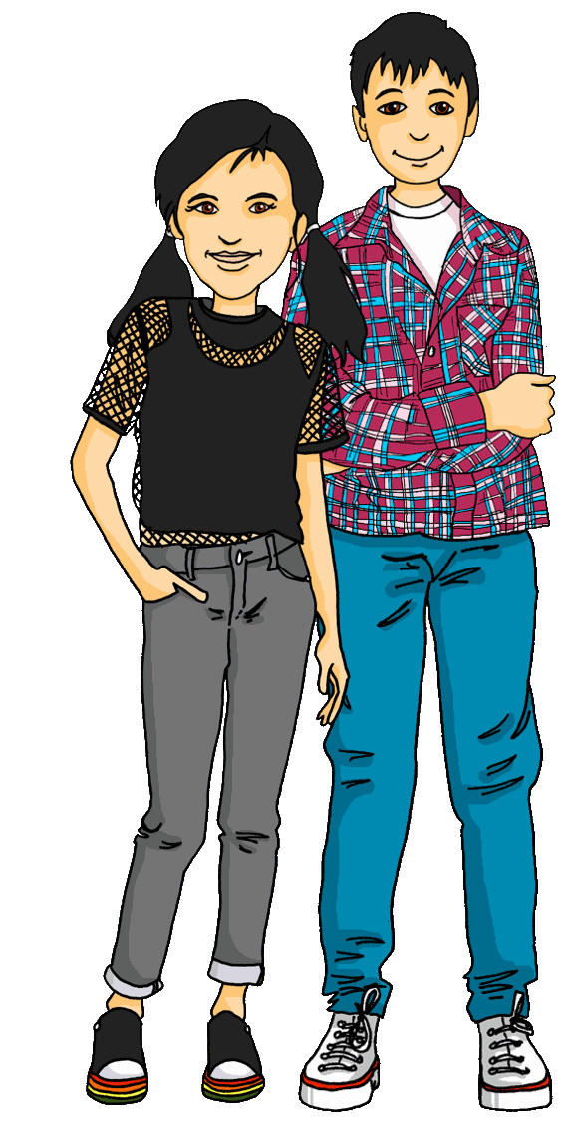
gelb Knowledge Organiser - Autumn Term B
More useful words
aber – but
auch – also
nicht – not
mein, meine, mein – my
dein, deine, dein – your
wie? – how?
wie geht’s? – how/s it going?
nicht wahr? – isn’t it? isn’t that right?
Auf Wiedersehen – goodbye
tschüss – bye
alt - old
einfach – easy, easily
gut – good, well
lang – long
neu – new
rund – round
schlecht – bad, badly
schwer – difficult
People and things
der Partner – (male) partner
der Preis – prize (m)
der Text – text (m)
die Aufgabe – task (f)
die Hausaufgabe – homework (f)
die Idee – idea (f)
die Karte – card (f)
die Kleidung – clothing (f)
die Liste – list (f)
die Partnerin – (female) partner
das Problem – problem (n)
Phonics
[ei] | [ie]: | [ei] | [ie] | [ei] | [ie]
frei
Liebe
sein
Brief
Bleistift
sie
[w] | [z] | soft [ch] | hard [ch]
Welt
Zug
ich
Buch
Hallo!
Guten Morgen!
Danke!
Das ist gut!
Learning languages is about making friends. You show kindness when you learn even a few words in another language.
Let’s remember some of the friendship sentences we have learnt already!
There are four official languages in Switzerland!
People speak different languages in different regions.
Das ist wunderbar!
Du bist wunderbar!
Du bist super!
Wie geht’s?
Start with wie to make a how question:
Wie ist das?
How is that? (What is that like?)
Asking ‘How are you?’ | Possessive adjectives mein/dein (my/ your) | Nicht (not)
There is no school Wednesday afternoons!
To ask someone how they are, you say: Wie geht’s?
Use nicht before an adjective or adverb to mean not:
masculine
feminine
neuter
Wie geht’s?
mein
meine
mein
I am not here.
The literal translation is ‘How goes it?’. A better translation in English is: ‘How’s it going?’ or ‘How are you?’
dein
deine
dein
Ich bin nicht hier.
We start primary school when we are 7 years old.
The words ‘mein’ (my) and ‘dein’ (your) must agree with the gender of the noun that follows. E.g.:
Use nicht before ‘der, die, das’ and a noun to mean not the:
gut!
schlecht
Das ist nicht der Preis.
good!
bad
meine Karte (f)
my card
That is not the prize.

