Slide 1
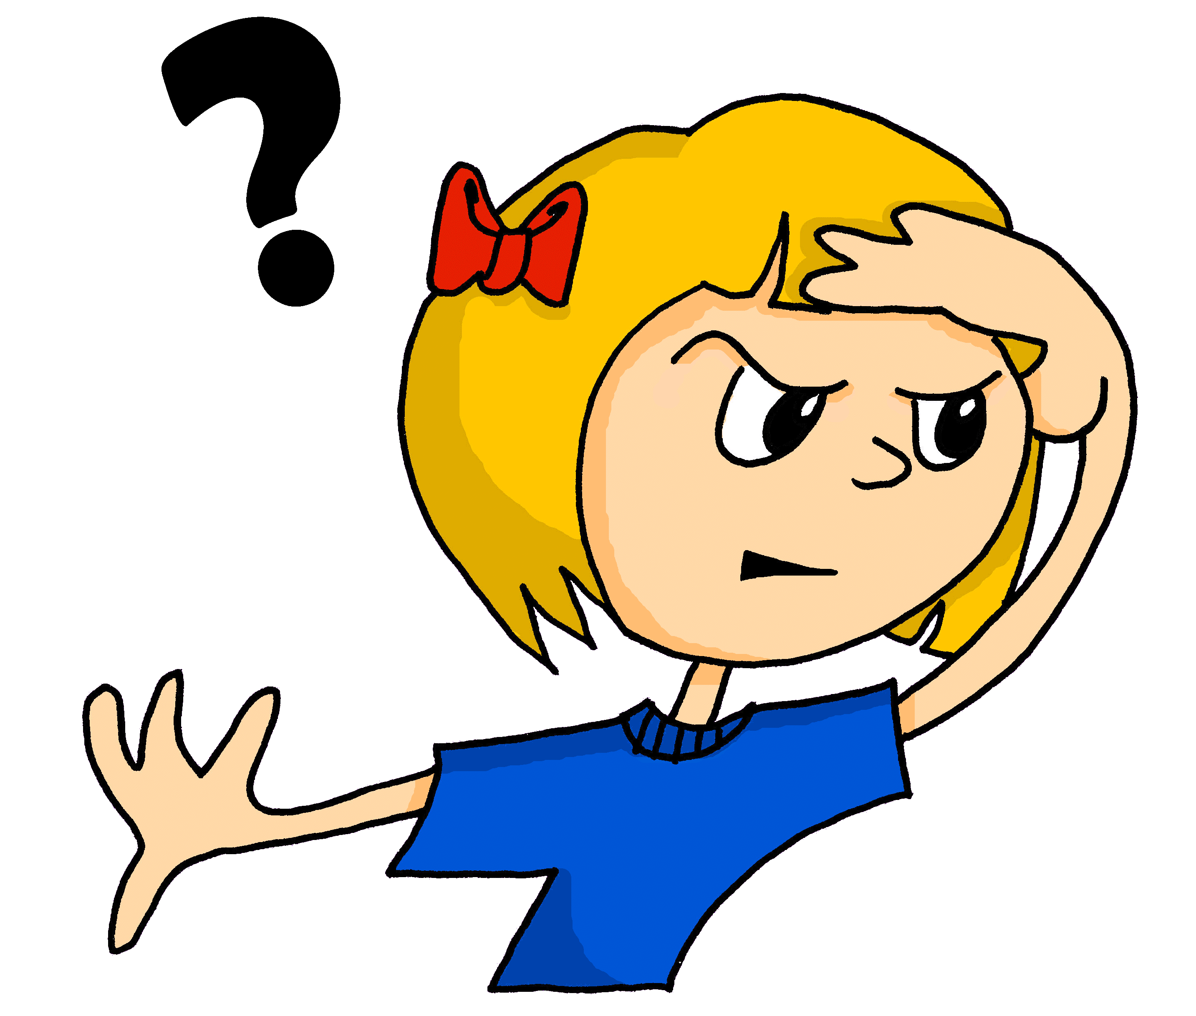
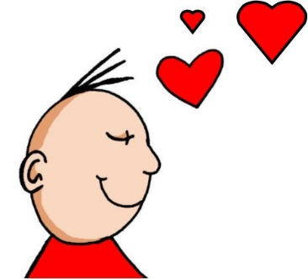
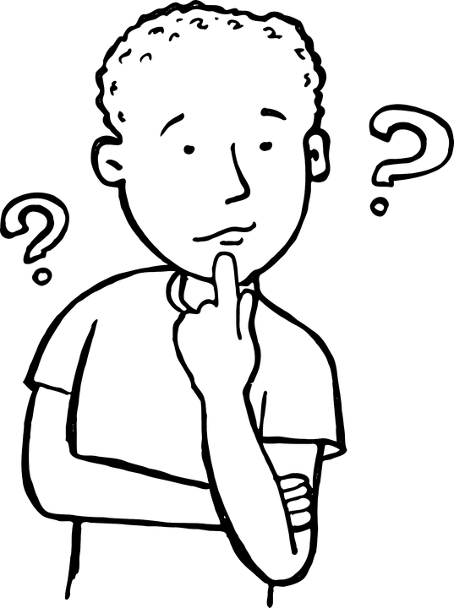
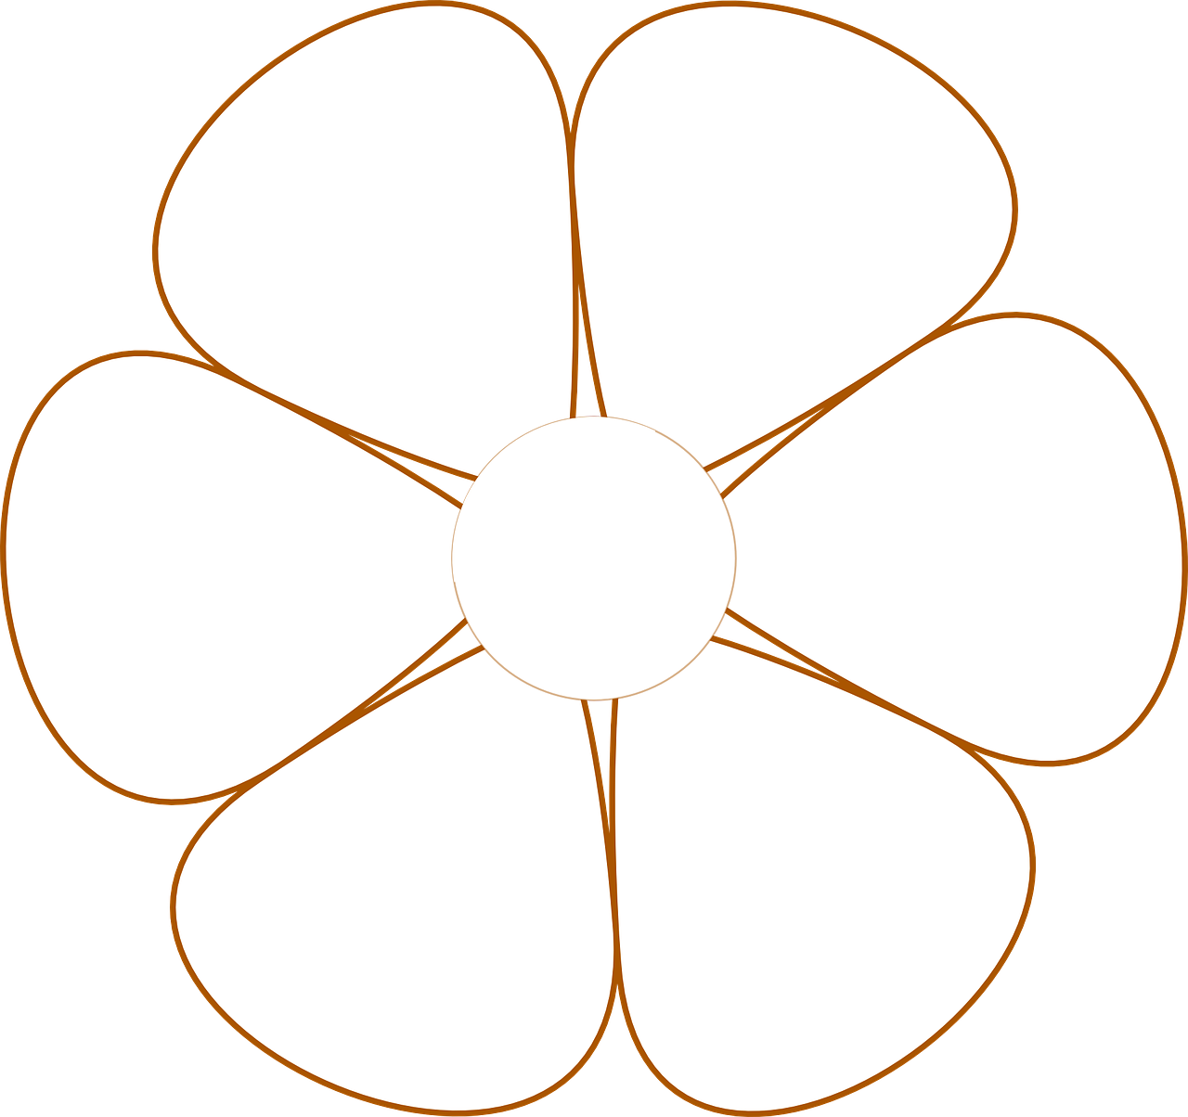
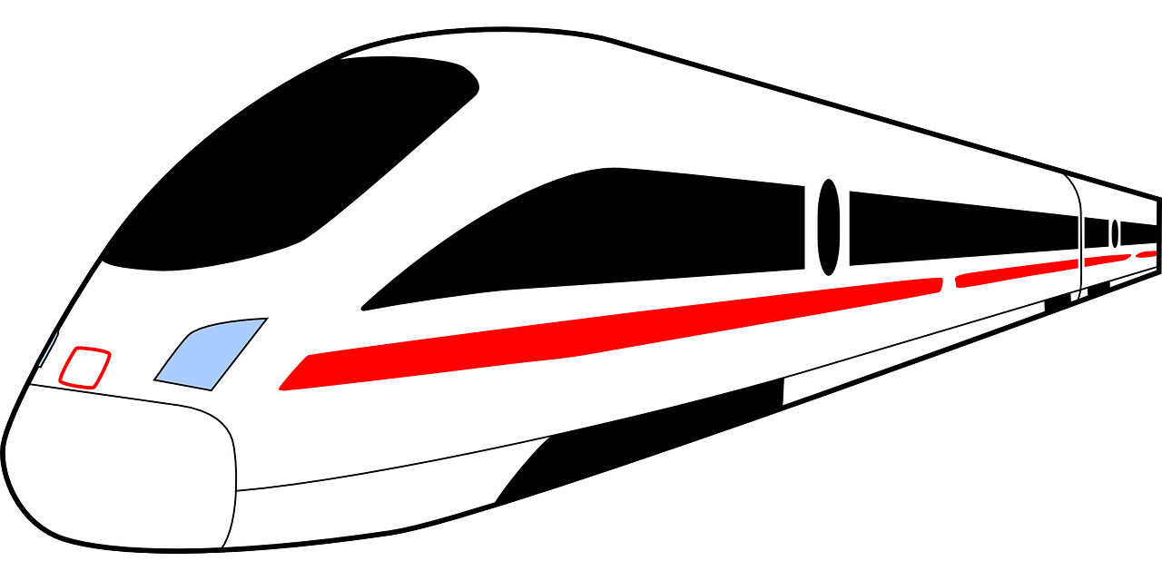
Useful words
wir – we
ihr – you (all)
an – on, at
durch – through
in – in
Österreich – Austria
Doing things
erklären – to explain, explaining
holen – to fetch, fetching
kennen – to know, knowing
lieben – to love, loving
stehen – to stand, standing
mögen – to like, liking
ich mag – I like
du magst – you like
er / sie / es mag – he / she / it likes
wir sind – we are
ihr seid – you (all) are
sie sind – they are
Things and people
der Musiker – musician (m)
der Park – park (m)
der Sportler – sportsman (m)
der Zug – train (m)
die Feier – celebration (f)
die Show – show (f)
die Stadt – town (f)
das Dorf – village (n)
das Geld – money (n)
das Konzert – concert (n)
das Land – country (n)
das Mädchen – girl (n)
das Restaurant – restaurant (n)
die Dörfer – villages (plural)
die Fahrräder – bicycles, bikes (plural)
die Häuser – houses (plural)
die Länder – countries (plural)
Describing things
schön – lovely, beautiful
fertig – ready, finished
Phonics
…
Grün Knowledge Organiser - Autumn Term A
long [a] | short [a] | long [u] | short [u] | long [o] | short [o]
[ei] | [ie] | long [e] | short [e] | long [i] | short [i]
[there]
da
Hallo
du
Punkt
wo?
Kopf
frei
Liebe
geben
denken
Familie
bitte
🙏
Asking questions
Yes/No questions:
Just swap the verb and subject!
Wir lieben Dörfer. → Lieben wir Dörfer?
We love villages. → Do we love villages?
Wh-questions:
Just add a question word in front!
Warum lieben wir Dörfer? Why do we love villages?
Plural patterns There are different ways to make a noun plural in German: Add –e: das Konzert → die Konzerte Add –n: die Schule → die Schulen Add –er (and an umlaut): das Geld → die Gelder das Dorf → die Dörfer Masculine and neuter words ending in –er/–en may not change: der Musiker → die Musiker | Describing people with the verb sein | The preposition ‘in’
Saying ‘which?’ and ‘this’ To ask ‘which?’, use ‘welch-’ with the endings below. To say ‘this’, use ‘dies-’ with the endings below. | Subject pronouns (it, they) | Verbs (plural) Regular verbs have endings which match the subject pronoun. With wir (we) and sie (they), regular verbs end in –en. Wir kennen Länder. Sie kennen Länder. With ihr (you all), regular verbs end in –t. Ihr kennt Länder.
To say ‘in the’, the words for ‘the’ (der, die, das) change:
ich bin
du bist
I am
you are
der Park:
in dem Park → im Park
das Land:
in dem Land → im Land
die Stadt:
in der Stadt
sie sind
sein
er/sie/es ist
they are
he/she/it is
ihr seid
wir sind
you (all) are
we are
The word used for ‘it’ depends on the gender of the noun that ‘it’ refers to:
er means he and it
sie means she and it
es means it
Sie means they.
Numbers 13-19 are simple sums: drei [3] (+) zehn [10] = dreizehn [13]
For numbers between 21 and 99, you always hear the second number first: siebenundzwanzig → ‘seven and twenty’ = twenty seven
For example:
Das ist der Zug. Er ist toll.
That is the train. It is great.
This is the same as the infinitive!
For dates, add –te to numbers 1-19 and –ste to numbers 20+
Heute ist… der neunte Juli (the 9th of July) / der zwanzigste Juli. (the 20th of July)
To say ‘on the’ use an + dem → am and add –n to the number:
Ich have am vierten Juni Geburtstag. (My birthday is on the 4th of June.)
masculine
feminine
neuter
der
welcher
dieser
die
welche
diese
das
welches
dieses

Slide 2
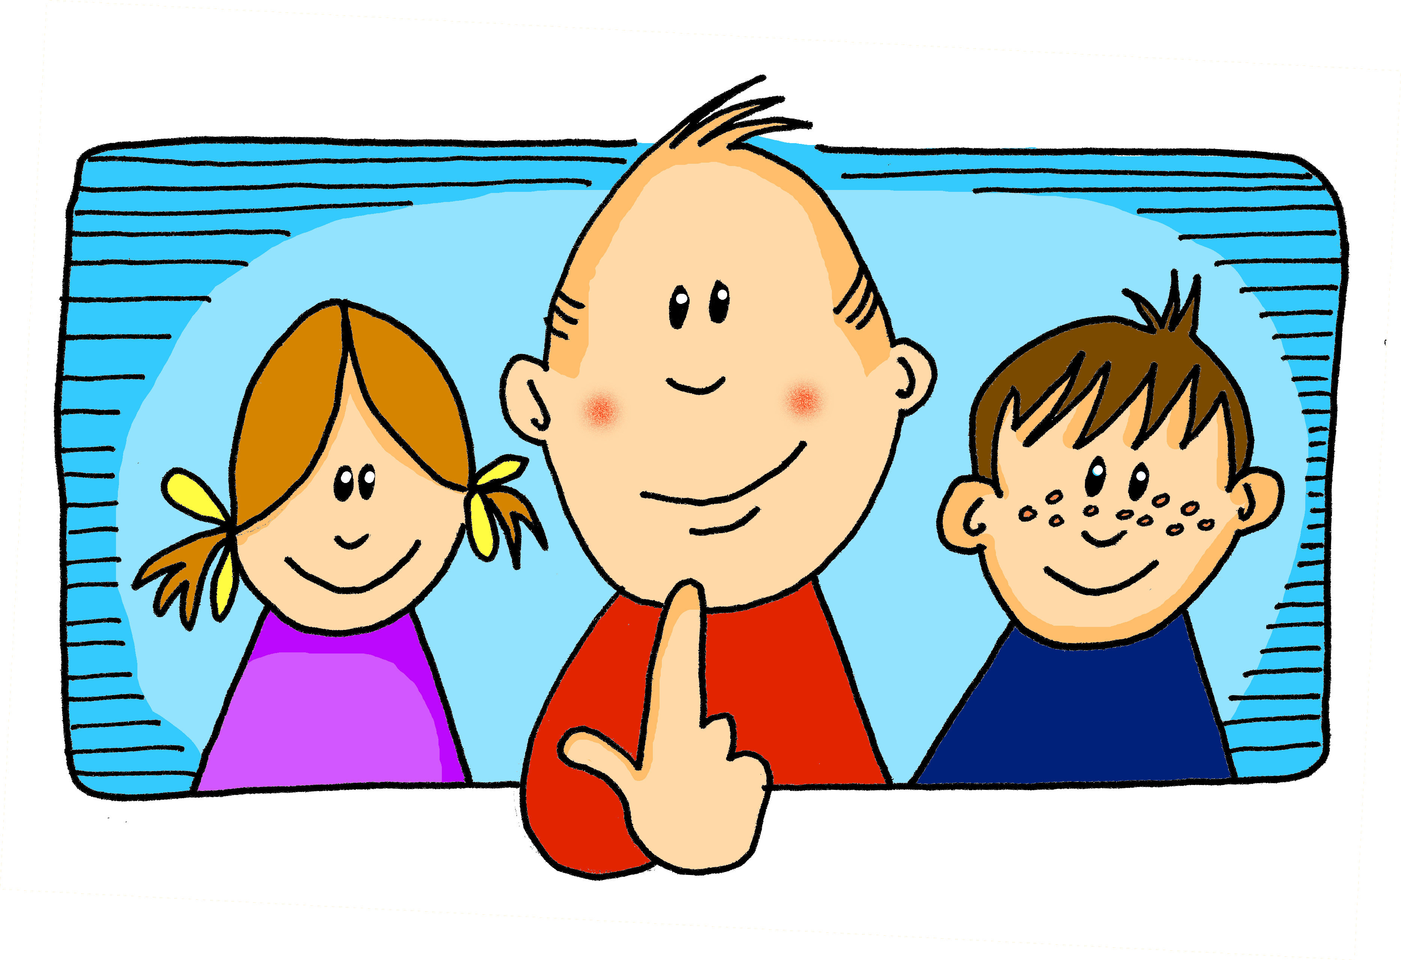
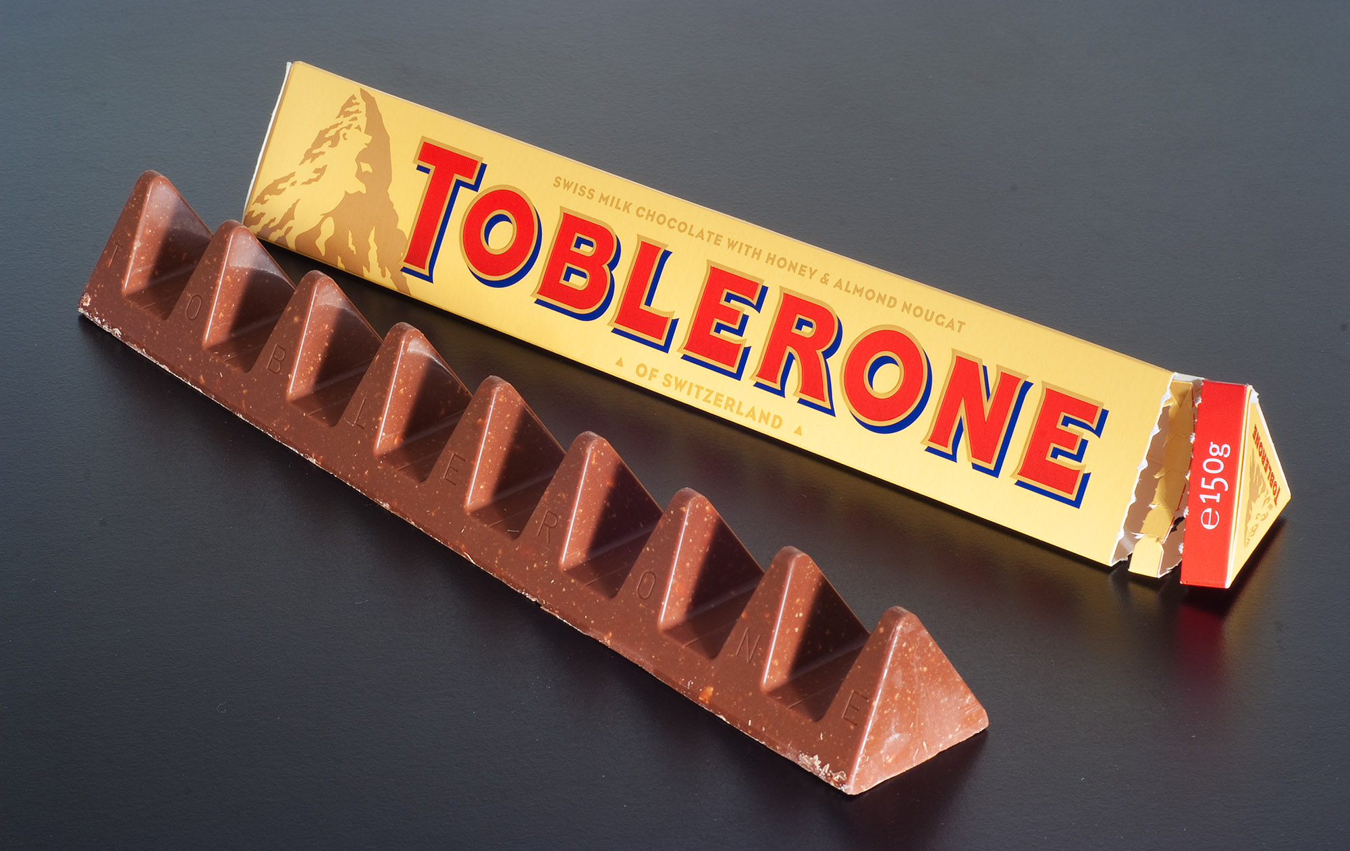
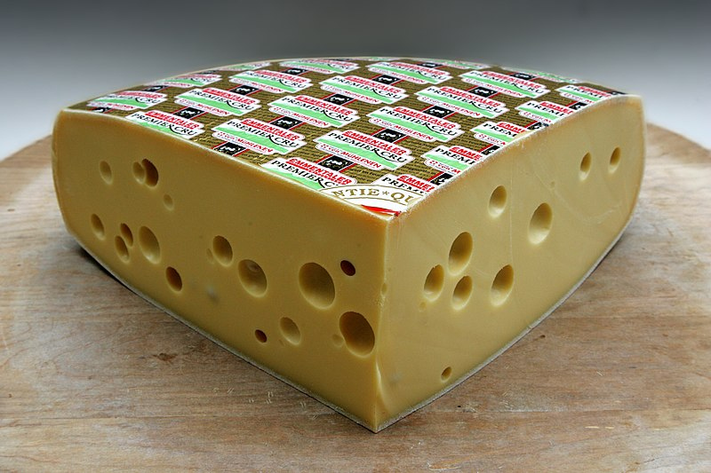
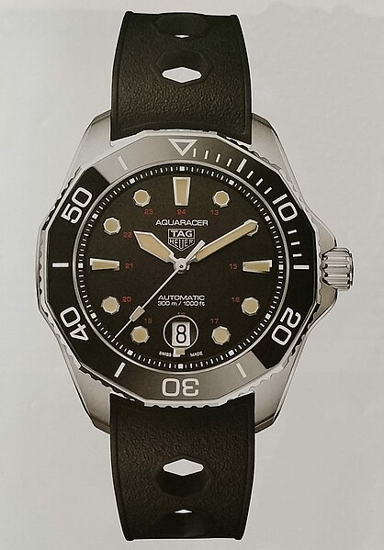
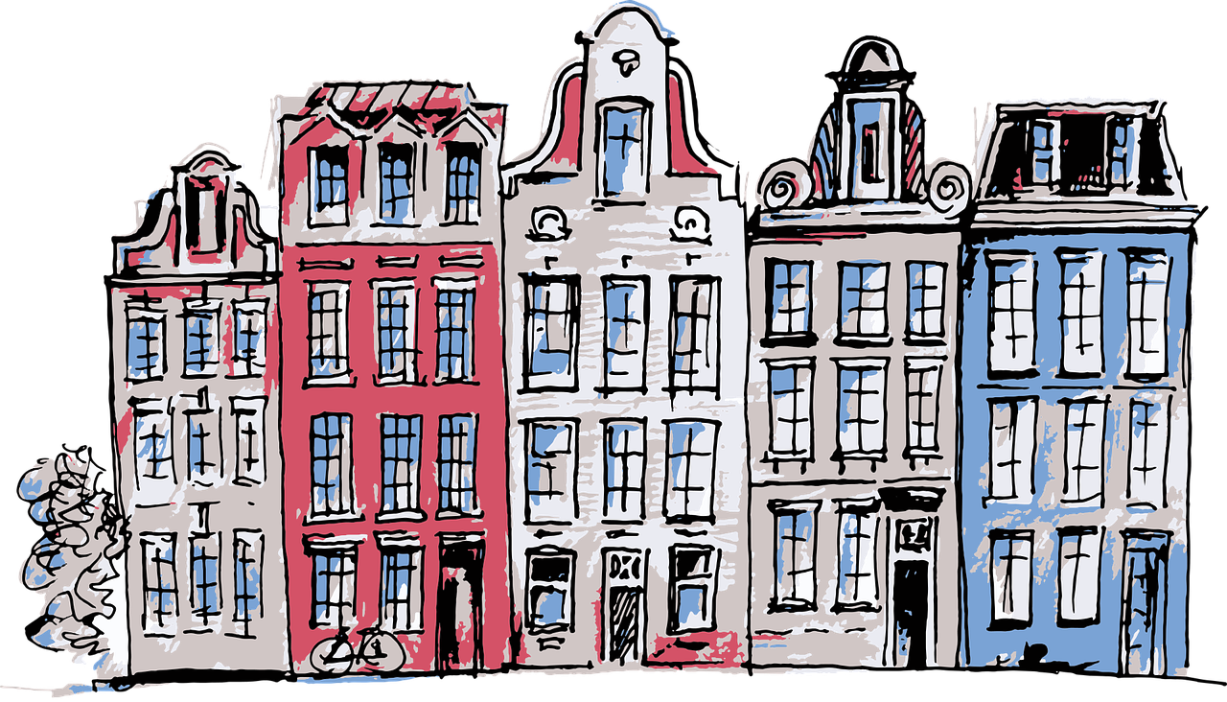
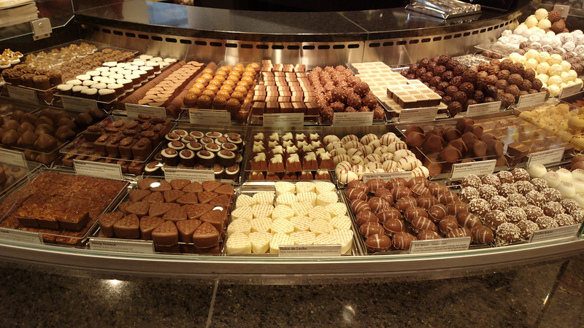
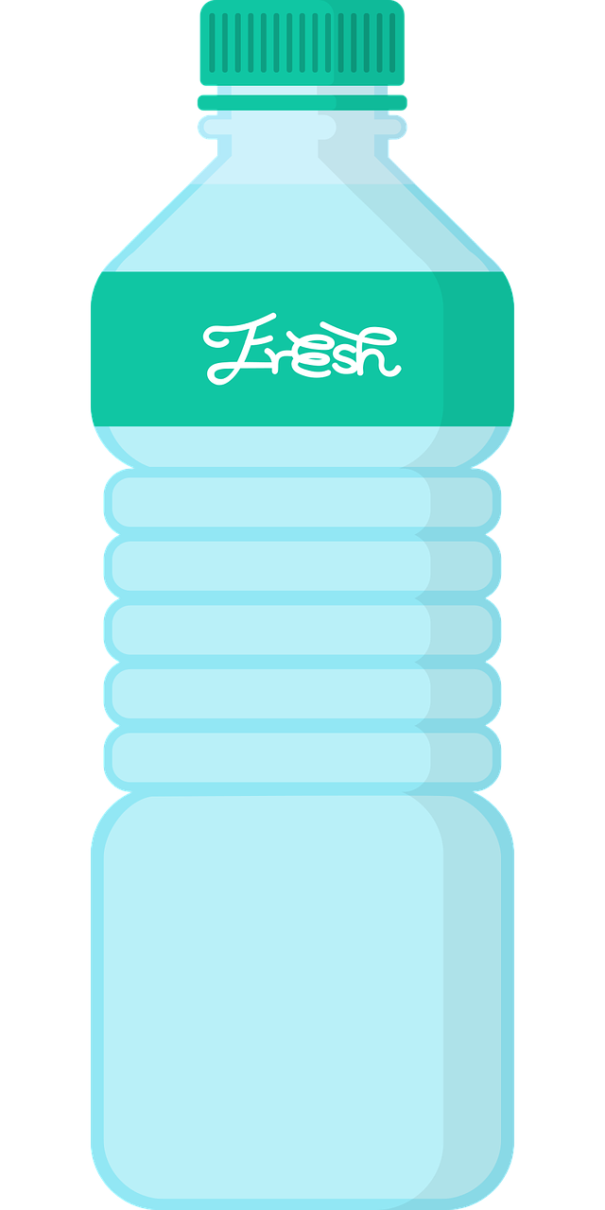
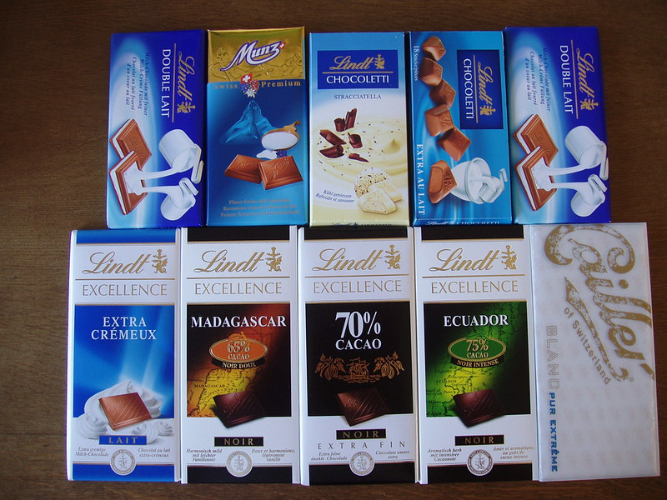
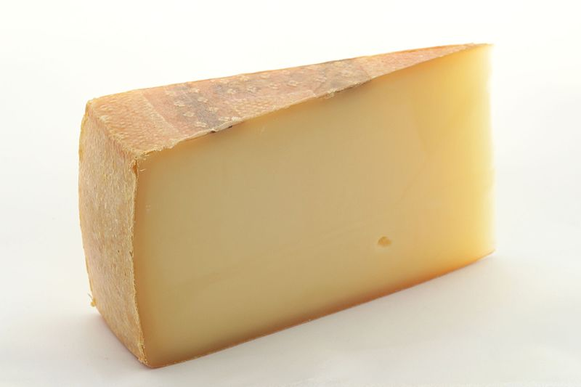
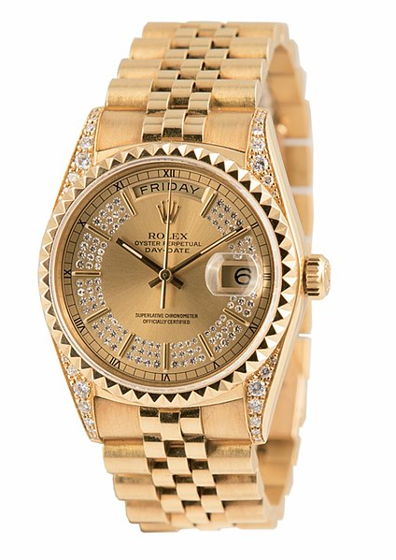
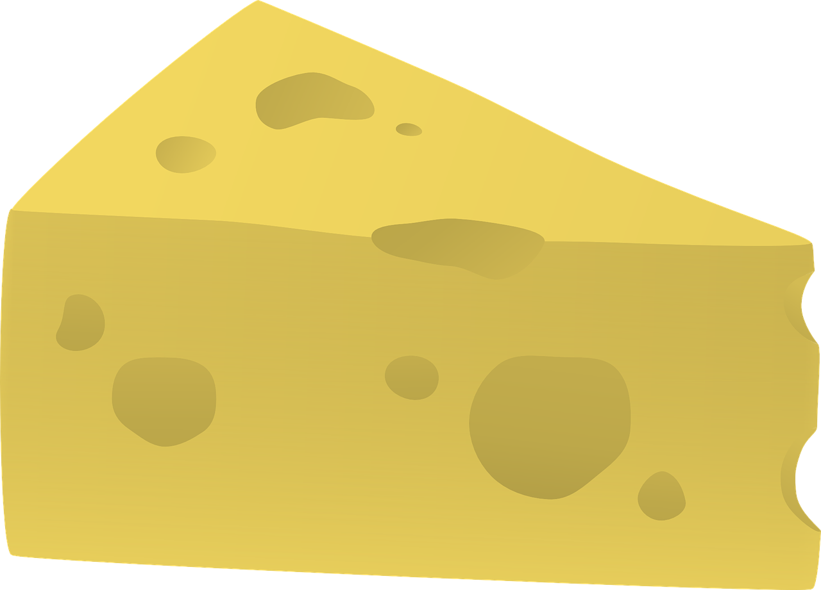
Useful words
alle – all (of the)
alles – everything
keine – not any, no (pl)
normalerweise – normally
viele – many, a lot
nichts - nothing
Doing things
bringen – to bring, bringing
essen – to eat, eating
geben – to give, giving
mitbringen – to bring with
mitnehmen – to take with
nehmen – to bring, take
reden – to talk, talking
sehen – to see, seeing
…
Grün Knowledge Organiser - Autumn Term B
Things and people
der Bus – bus (m)
der Käse – cheese (m)
der See – lake (m)
die Kultur – culture (f)
das Essen – food, meal (n)
das Land – countryside (n)
das Schwimmbad – swimming pool (n)
die Sachen – things (plural)
die Seen – lakes (plural)
die Schwimmbäder – swimming pools (plural)
Describing things
Deutsch – German
Englisch – English
Phonics
[ei] | [ie]: | [ei] | [ie] | [ei] | [ie]
frei
Liebe
sein
Brief
Bleistift
sie
[w] | [z] | soft [ch] | hard [ch]
Welt
Zug
Buch
ich
Guten Tag!
Negation with nicht and nichts nicht means not: Du siehst nicht. You do not see. nichts means nothing: Du siehst nichts. You see nothing. OR You don’t see anything. | Strong verbs (e → i, e → ie) Some German verbs change the vowel in the du & er/sie/es form. The ‘e’ changes to ‘i’: Ich helfe. I help. Sie hilft. She helps. The ‘e’ changes to ‘ie’: Ich sehe. I see. Er sieht. He sees. All plural forms keep the original vowel (like ich): Ihr helft. You (all) help.
Learning languages is about making friends. You show kindness when you learn even a few words in another language.
The verb endings are the same for all verbs in the present tense.
Du bist toll!
Kann ich helfen?
Switzerland is known for some famous brands of watches, chocolate and cheese!
Das ist kein Problem!
Negation with keine To say ‘not a/no’ with nouns, use ‘kein’. ‘kein’ works like ‘ein’ and matches the gender of the noun. Das ist keine Stadt. The is not a/no town. After most verbs, kein → keinen for masculine nouns. Ich habe keinen Käse. I have no cheese. Use keine with plural nouns. | viel, viele (lots of) alle (all of) Use viel with uncountable nouns: Ich habe viel Wasser! I have lots of water. Use viele with countable nouns: Du hast viele Flaschen. You have lots of bottles. Use alle to say ‘all of’: Du hast alle Flaschen! You have all (of) the bottles. | The verb haben (to have, having)
Toblerone
Emmentaler
Käse
Tagheuer
Schokolade
ich habe
du hast
I have
you have
Prima Donna
er/sie/es hat
Läderach
Uhr
sie haben
haben
Lindt
Rolex
they have
he/she/it
has
Appenzeller
ihr habt
wir haben
you (all)
have
we have

