Slide 1
Talking about things and things to do
gelb
Follow ups 1-5
Term 2 Week 1
Notes:
Artwork by Steve Clarke. Pronoun pictures from NCELP (www.ncelp.org). All additional pictures selected from Pixabay and are available under a Creative Commons license, no attribution required.
Phonics:
[ä] spät [171] zählen [680] wählen [64]
Vocabulary (new): kein, keine, kein [46] Fehler [861] Haus [147] Katze [2235] Schule [359]
Revisit 1: Aufgabe [256] Karte [1474] Liste [1792] Partner, Partnerin [1172] mein, meine [51] dein, deine [233]
Revisit 2: was [38] falsch [524] grau [1560] grün [682] richtig [177]schwarz [471] weiß [474] das2 [1]
Jones, R.L & Tschirner, E. (2019). A frequency dictionary of German: Core vocabulary for learners. London: Routledge.
The frequency rankings for words that occur in this PowerPoint which have been previously introduced in these resources are given in the SOW and in the resources that first introduced and formally re-visited those words.
For any other words that occur incidentally in this PowerPoint, frequency rankings will be provided in the notes field wherever possible.

Slide 2
aussprechen
Follow up 1
…
[ä]
spät
[late]
Notes:
Timing: 1 minute
Aim: To introduce SSC [ä]
Procedure:
Introduce the SSC and say the [ä] sound first, on its own. Pupils repeat it with you.
Present the source word ‘spät’ (with gesture, if using).
Click to bring on the picture and get pupils to repeat the word ‘spät’ (with gesture, if using).
Note:
A gesture for this could be to bring your left arm up to mime suddenly looking at your watch.
spät [171]
Jones, R.L & Tschirner, E. (2019). A frequency dictionary of German: Core vocabulary for learners. London: Routledge.
2

Slide 3
aussprechen
Follow up 1
…
[ä]
1, 2, 3, …100
spät
wählen
zählen
[to count]
[to choose]
Notes:
Timing: 1 minute
Aim: to introduce the SSC [ä].
Procedure:
Re-present the SSC and the source word ‘spät’ (with gesture, if using).
Click to bring on the picture and get pupils to repeat the word ‘spät’ (with gesture, if using).
Present the cluster words in the same way, bringing on the picture and getting pupils to pronounce the words.
spät [171] zählen [680] wählen [64]
Jones, R.L & Tschirner, E. (2019). A frequency dictionary of German: Core vocabulary for learners. London: Routledge.
3

Slide 4
Follow up 1
Tongue Twisters!
Sag den Satz.
aussprechen
How quickly can you say the sentence?
1
Apfel, Äpfel, Ball, Bälle, Blatt, Blätter
Apple, apples, ball, balls, sheet, sheets
2
3
Notes:
Timing: 5 minutes (for two slides) Aim: to apply SSC knowledge of [ä] and [a] in the oral production of longer sentences. Procedure: 1. Pupils read the tongue twister aloud. They try to say it as quickly as possible. 2. Listen and check (three different speeds). 3. Clarify meaning, using the English translation and pictures. 4. Repeat the steps for the next slide.
Word frequency of unknown or cognate words (1 is the most frequent word in German):
Mann [121] Tanz [3946] tanzen [1497]
Source: Jones, R.L. & Tschirner, E. (2019). A frequency dictionary of German: core vocabulary for learners. Routledge

Slide 5
Tongue Twisters!
Sag den Satz.
aussprechen
How quickly can you say the sentence?
1
Der Mann und die Männer tanzen Tänze.
The man and the men dance dances.
2
3
Notes:
[2/2]

Slide 6
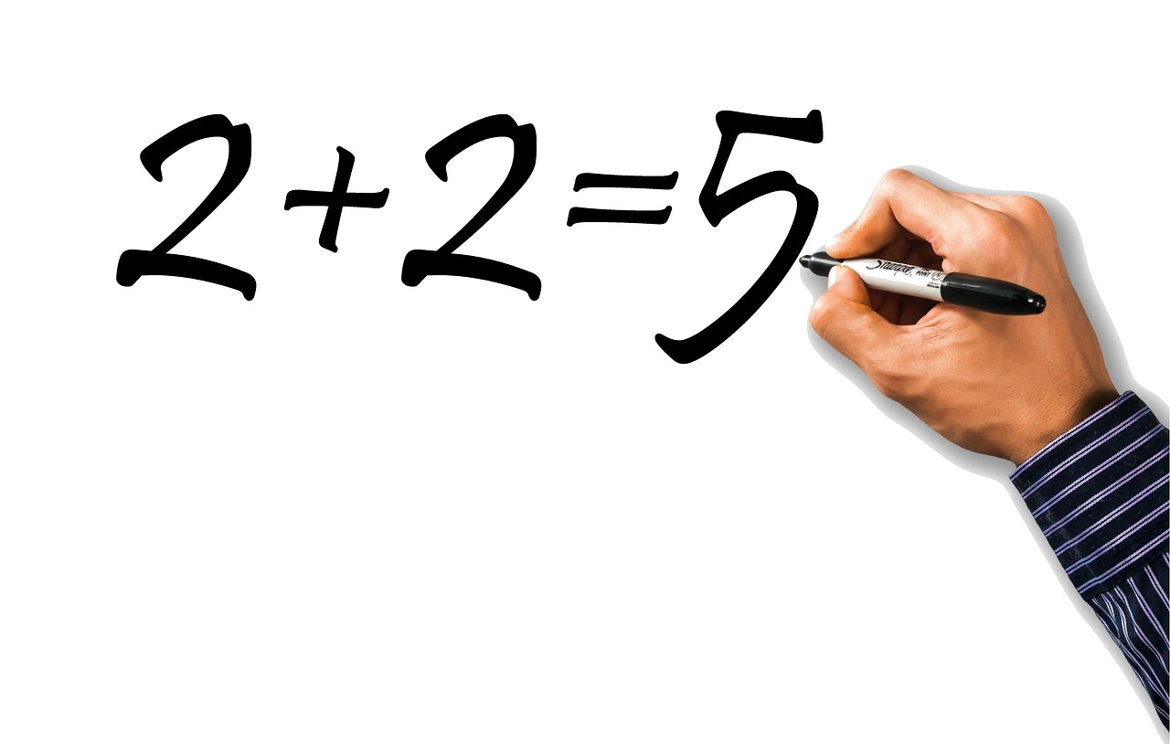
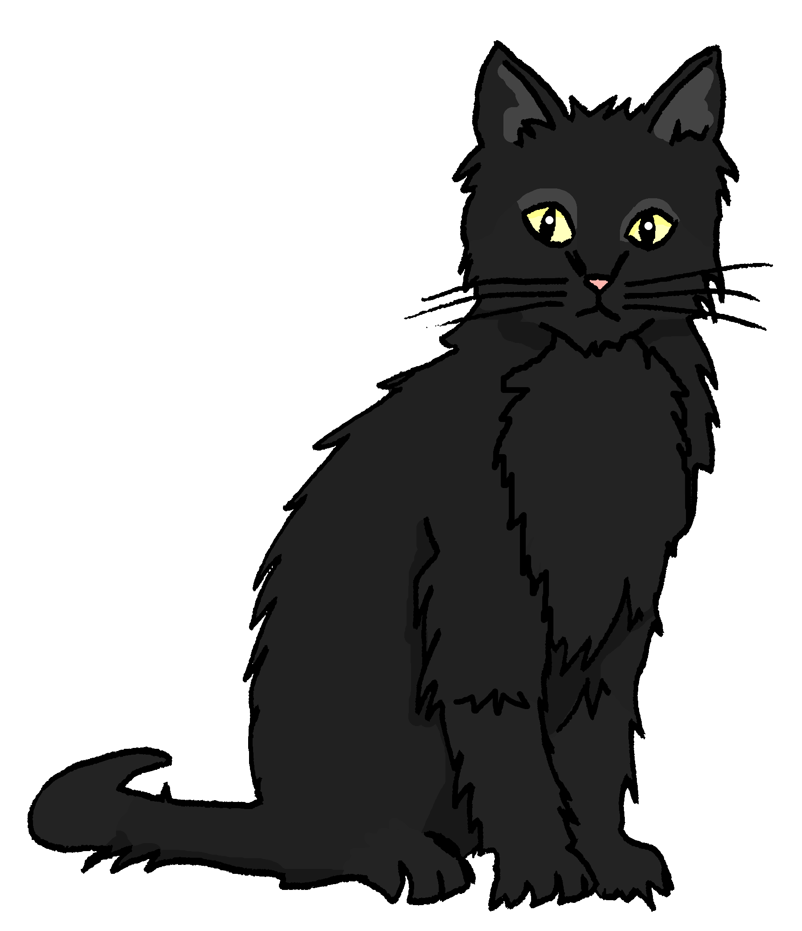
Follow up 2
Bingo
Hör zu.
1
2
3
4
5
6
7
8
9
10
hören
a mistake | not a mistake
not a cat | a cat
not a school | a school
a house | not a house
a card | not a card
Notes:
Timing: 5 minutes
Aim: to practise aural recognition of this week’s new language and revisited words for this week; to contrast ein and kein.
Procedure: 1. Pupils choose any 9 of the phrases from the English table and write them into their grid in English.
2. The teacher then clicks on an audio button to hear the German for an English option. Pupils cross off the English translation if they have it in their table.
3. Pupils call Bingo when they have any three in a row (vertical, horizontal, or diagonal) and then again for the first full house.
Transcript:
ein Haus
keine Katze
kein Fehler
eine Karte
eine Schule
ein Fehler
keine Karte
keine Schule
eine Katze
kein Haus

Slide 7
Follow up 3
Robbie can read German and English now, too. Can you?
lesen
Auf Wiedersehen!
Das ist keine Schule.
Das ist ein Haus.
Das ist kein Fehler!
Guten Morgen, Klasse 3!
Das ist eine Katze.
Ich bin dein Partner!
Ist das eine Liste?
Ich bin keine Person!
Bist du meine Partnerin?
Das ist keine Aufgabe.
Good morning, class 3!
Are you my partner? (f)
I am your partner! (m)
That isn’t a mistake!
That is not a task.
I am not a person!
That is not a school.
That is a house.
Is that a list?
That is a cat.
Goodbye!
Notes:
Timing: 5 minutes
Aim: to practise comprehension and translation of written phrases using ich bin/du bist/ das ist + ein/eine/ein and kein/keine/kein + a range of new and revisited nouns.
Procedure:
1. Click to bring up the first item.
2. Pupils to translate e.g. on mini whiteboards.
3. Click to bring up English translation (by Robbie).
4. Continue for items 2-11.

Slide 8
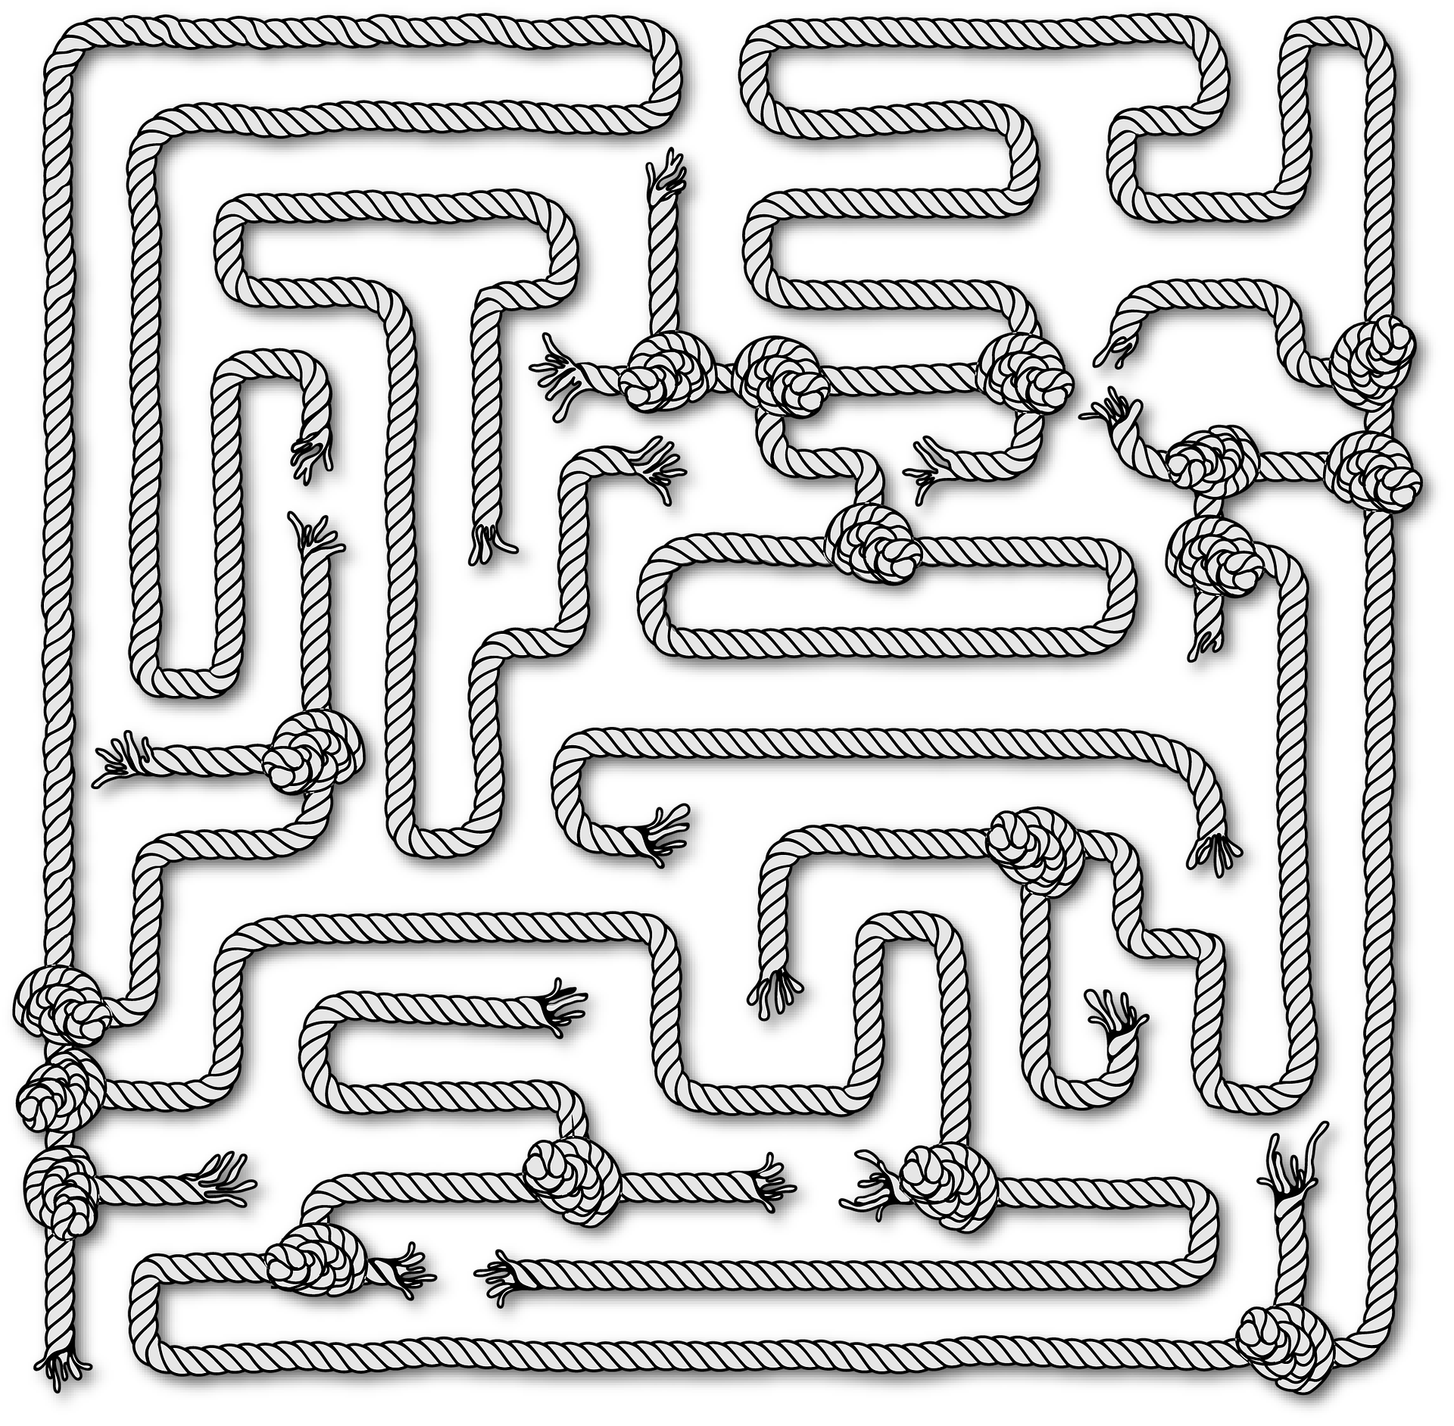
Follow up 4
Can you help Robbie through the maze?
…
Sag die Sätze*!
sprechen
Das ist eine Katze!
Das ist keine Katze?
Das ist kein Partner
Das ist keine Partner?
Sätze – sentences
Notes:
Timing: 5 minutes
Aim: to practise oral production of sentences with ein/eine/ein and kein/keine/kein and a range of new and revisited nouns.
Procedure: 1. Read the scenario: pupils are going to help Robbie find his way through the maze by producing correct German sentences using ein/eine/ein or kein/keine/kein. If there is a cross on the object, pupils must make a sentence with kein(e). If they only see the object, they use ein(e). They need to think about the gender of each noun to make accurate sentences e.g das ist kein Haus but das ist keine Aufgabe.
2. Click through the first two together- Robbie gets them wrong, can the class correct? In the first example he uses kein instead of ein. In the second he uses keine instead of kein.
3. In pairs, pupils take it in turns to say sentences to make their way from the bottom to the top of the maze. If they make a mistake, they go back to the start.
4. They then need to find their way back through the maze (top to bottom) using a different route.
5. If time, play a whole class version, with pupils listening out carefully for correct use of ein and kein words.
Correct sentences (bottom to top):
Das ist eine Katze.
Das ist keine Schule.
Das ist keine Aufgabe.
Das ist kein Partner.
Das ist eine Partnerin.
Das ist ein Fehler.
Das ist eine Liste.
Das ist ein Haus.
Das ist keine Partnerin.
Das ist keine Katze.
Das ist keine Karte.
Das ist eine Schule.
Das ist ein Haus.
Das ist keine Liste.

Slide 9
Follow up 5:

Schreib auf Englisch.
Can you get at least 15 points?
Wörter
 | was? | falsch | richtig
 | grau | das | grün
 | die Partnerin | mein | deine
 | die Aufgabe | die Karte | der Liste
 | kein | keine | das Haus
 | die Katze | der Fehler | die Schule
what?
wrong, false
right, true
Vokabeln
x3
grey
the (nt), that
green
(the) female partner
my (m,nt)
your (f)
x2
(the) task
(the) card
(the) list
not a/no (m, nt)
not a/no (f)
(the) house
x1
(the) cat
(the) mistake, error
(the) school
Notes:
Timing: 5 minutes
Aim: to practise written comprehension of vocabulary from this and revisited weeks.
Procedure: 1. Give pupils a blank grid. They fill in the English meanings of any of the words they know, trying to reach 15 points in total. 2. Remind pupils to think about genders (masculine/feminine/neuter) for nouns and kein/mein/dein.
Note: The most recently learnt and practised words are pink, words from the previous week are green and those from week 1 are blue, thus more points are awarded for them, to recognise that memories fade and more effort (heavy lifting!) is needed to retrieve them.

Slide 10
Follow up 5:

Schreib auf Deutsch.
Can you get at least 15 points?
Wörter
 | the (nt), that | black | white
 | what? | right, true | wrong, false
 | (the) male partner | (the) list | (the) card
 | my (f) | your (m, nt) | (the) task
 | (the) cat | (the) school | (the) mistake, error
 | not a/no (m,nt) | not a/no (f) | (the) house
das
schwarz
weiß
Vokabeln
x3
was?
richtig
falsch
der Partner
die Liste
die Karte
x2
meine
dein
die Aufgabe
die Katze
die Schule
der Fehler
x1
kein
keine
das Haus
Notes:
Timing: 5 minutes
Aim: to practise written production of vocabulary from this and revisited weeks.
Procedure: 1. Give pupils a blank grid. They fill in the German translations of any of the words they know, trying to reach 15 points in total. 2. Remind pupils to think about genders (masculine/feminine/neuter) for nouns and kein/mein/dein.
Note: The most recently learnt and practised words are pink, words from the previous week are green and those from week 1 are blue, thus more points are awarded for them, to recognise that memories fade and more effort (heavy lifting!) is needed to retrieve them.

Slide 11
Tschüss!
gelb
Notes:
11

Slide 12
Follow up 5:

Schreib auf Englisch.
Can you get at least 15 points?
Wörter
 | was? | falsch | richtig
 | grau | das | grün
 | die Partnerin | mein | deine
 | die Aufgabe | die Karte | der Liste
 | kein | keine | das Haus
 | die Katze | der Fehler | die Schule
Vokabeln
x3
x2
x1
Notes:
HANDOUT

Slide 13
Follow up 5:

Schreib auf Deutsch.
Can you get at least 15 points?
Wörter
 | the (nt), that | black | white
 | what? | right, true | wrong, false
 | (the) male partner | (the) list | (the) card
 | my (f) | your (m, nt) | (the) task
 | (the) cat | (the) school | (the) mistake, error
 | not a/no (m,nt) | not a/no (f) | (the) house
Vokabeln
x3
x2
x1
Notes:
HANDOUT

