Slide 1
Talking about things and things to do
Identifying things
Words for ‘not a/no’: kein, keine, kein
SSC [ä] and [a]
gelb
Term 2 Week 1
Notes:
Artwork by Steve Clarke. Pronoun pictures from NCELP (www.ncelp.org). All additional pictures selected from Pixabay and are available under a Creative Commons license, no attribution required.
Phonics:
[ä] spät [171] zählen [680] wählen [64]
Vocabulary (new): kein, keine, kein [46] Fehler [861] Haus [147] Katze [2235] Schule [359]
Revisit 1: Aufgabe [256] Karte [1474] Liste [1792] Partner, Partnerin [1172] mein, meine [51] dein, deine [233]
Revisit 2: was [38] falsch [524] grau [1560] grün [682] richtig [177]schwarz [471] weiß [474] das2 [1]
Jones, R.L & Tschirner, E. (2019). A frequency dictionary of German: Core vocabulary for learners. London: Routledge.
The frequency rankings for words that occur in this PowerPoint which have been previously introduced in these resources are given in the SOW and in the resources that first introduced and formally re-visited those words.
For any other words that occur incidentally in this PowerPoint, frequency rankings will be provided in the notes field wherever possible.
1

Slide 2
aussprechen
[ä]
…
spät
[late]
Notes:
Timing: 1 minute
Aim: To introduce SSC [ä]
Procedure:
Introduce the SSC and say the [ä] sound first, on its own. Pupils repeat it with you.
Present the source word ‘spät’ (with gesture, if using).
Click to bring on the picture and get pupils to repeat the word ‘spät’ (with gesture, if using).
Note:
A gesture for this could be to bring your left arm up to mime suddenly looking at your watch.
spät [171]
Jones, R.L & Tschirner, E. (2019). A frequency dictionary of German: Core vocabulary for learners. London: Routledge.
2

Slide 3
aussprechen
[ä]
…
1, 2, 3, …100
spät
wählen
zählen
[to count]
[to choose]
Notes:
Timing: 1 minute
Aim: to introduce the SSC [ä].
Procedure:
Re-present the SSC and the source word ‘spät’ (with gesture, if using).
Click to bring on the picture and get pupils to repeat the word ‘spät’ (with gesture, if using).
Present the cluster words in the same way, bringing on the picture and getting pupils to pronounce the words.
spät [171] zählen [680] wählen [64]
Jones, R.L & Tschirner, E. (2019). A frequency dictionary of German: Core vocabulary for learners. London: Routledge.
3

Slide 4
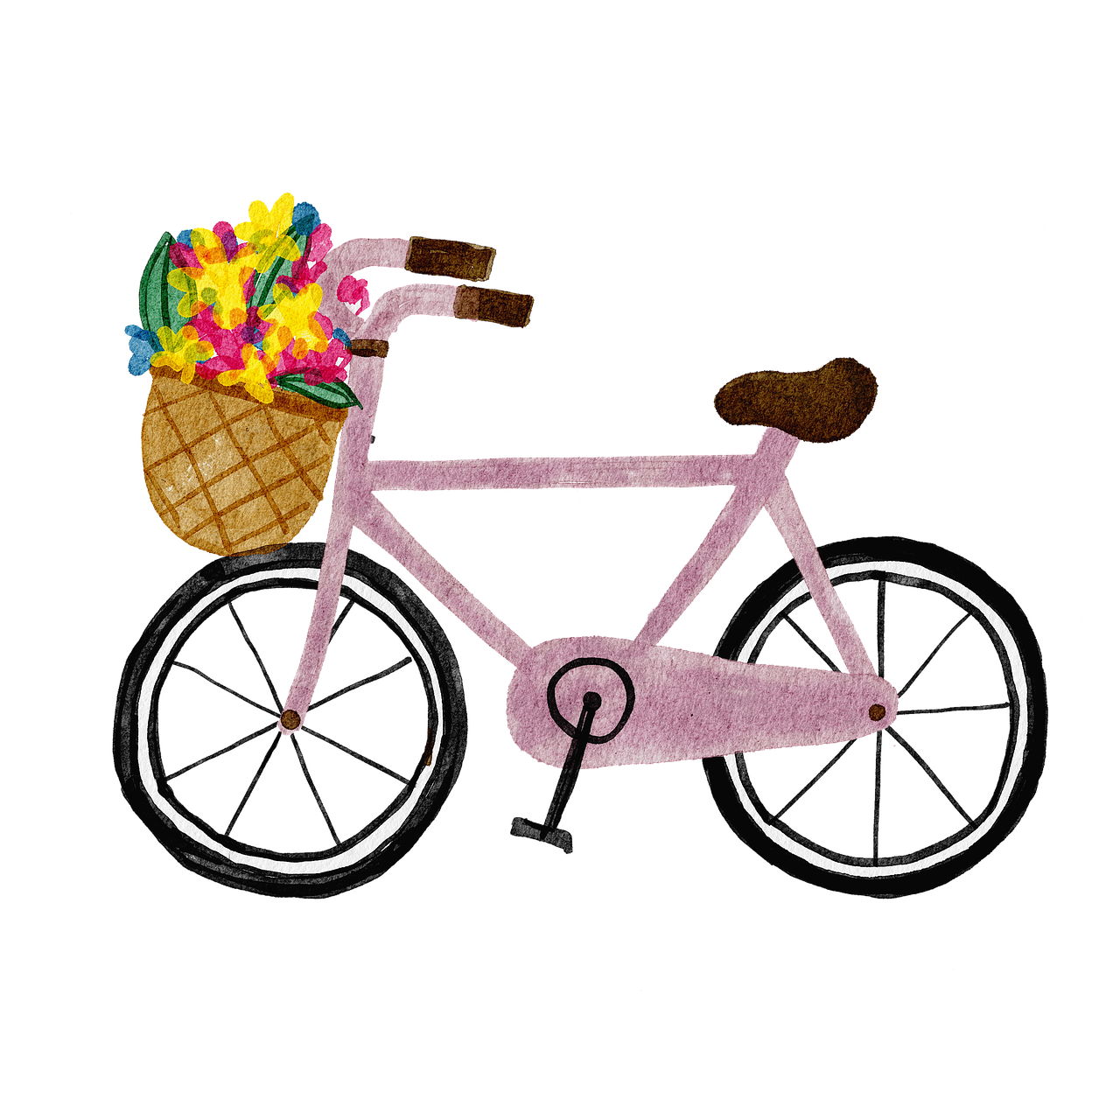
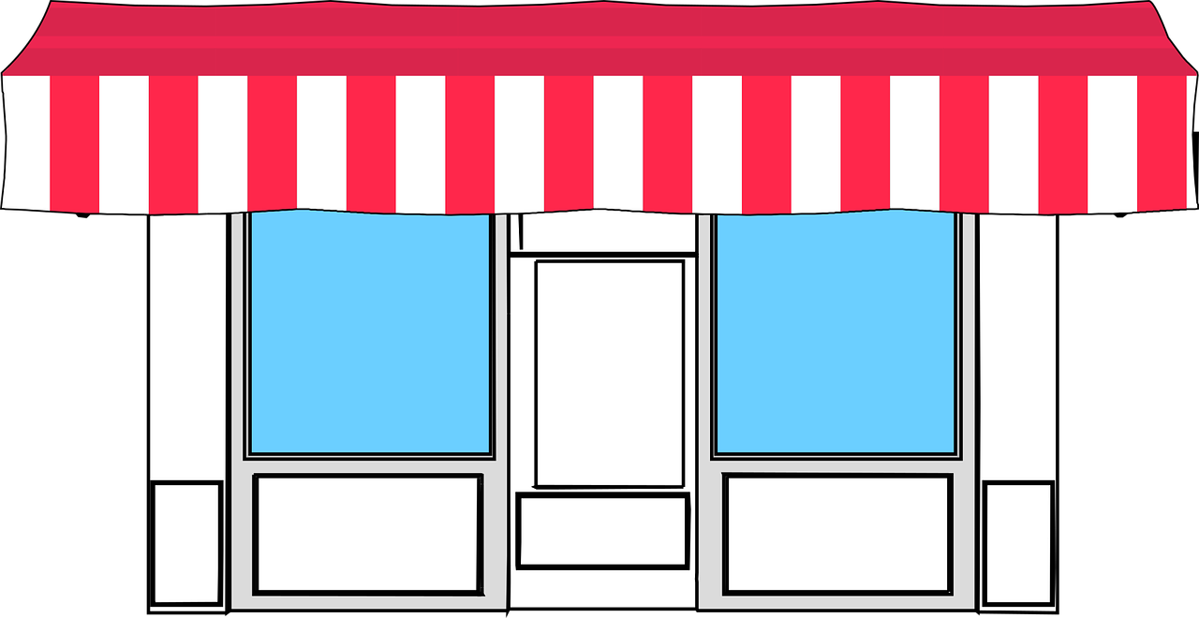
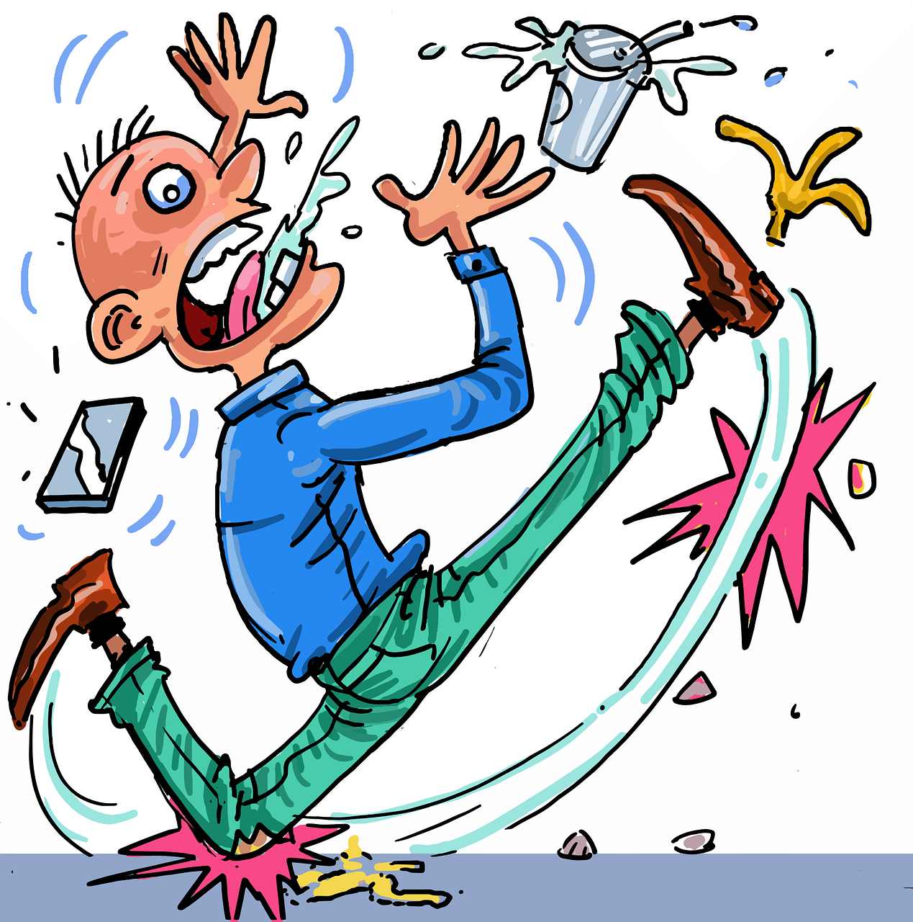
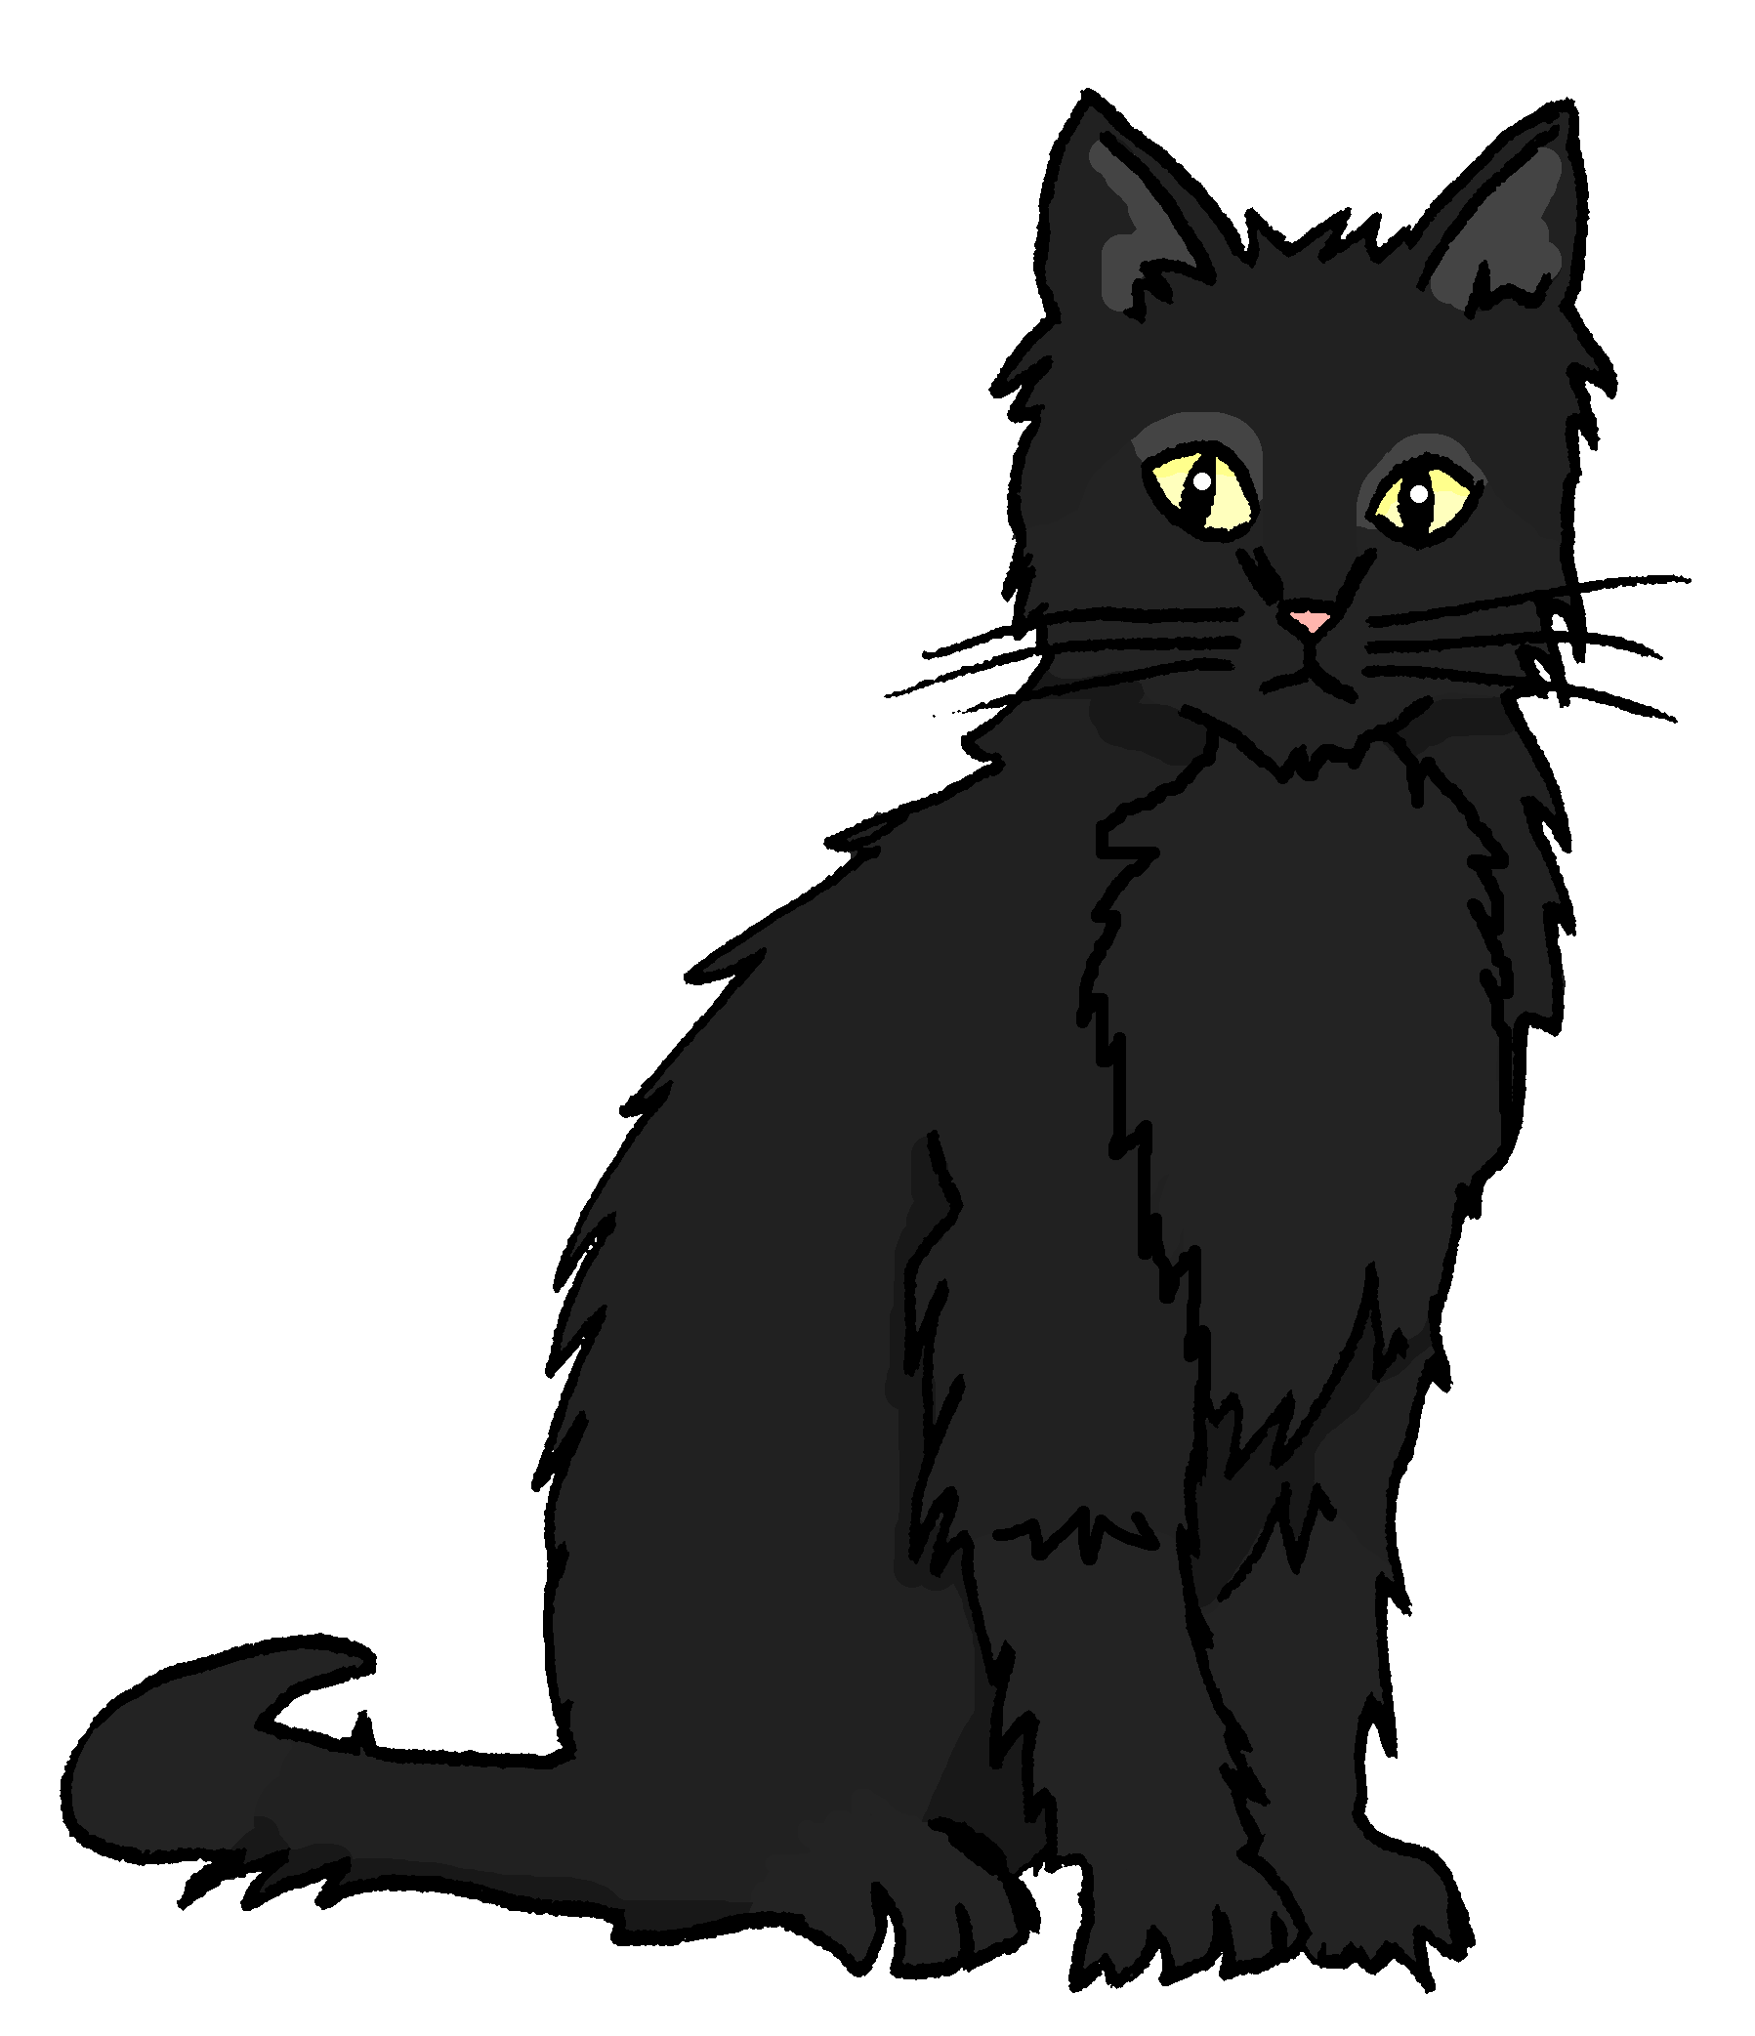
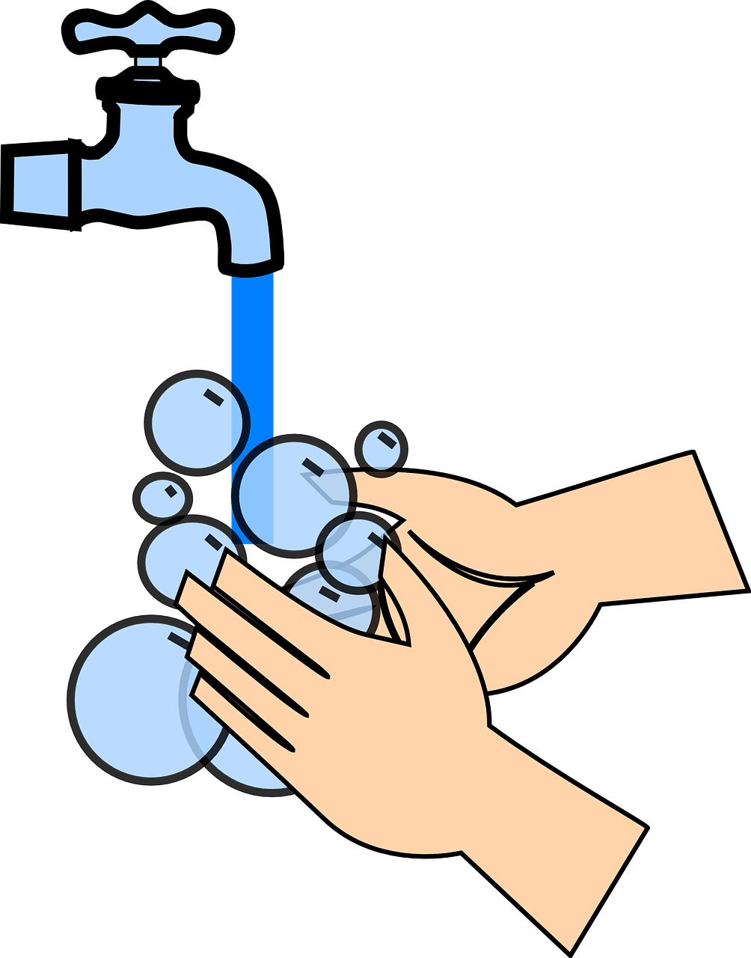
hören
Hör zu. Ist es [ä] oder [a]?
Can you work out the meanings ?
Schreib 1-9 und [ä] oder [a].
1 | 2 | 3
4 | 5 | 6
7 | 8 | 9
hören
G e s c h ä f t
F a h r r a d
M ä d c h e n
_
_
_
g l a t t
K a t z e
T r ä n e
_
_
_
l ä c h e l n
G e r ä t
w a s c h e n
_
_
_
Notes:
Timing: 5 minutes
Aim: to distinguish between the SSCs [ä] and [a] by listening to unknown words and identifying the sounds.
Procedure:
Click for instructions to come up.
Click audio button 1 to play the recording for item 1. Pupils need to decide is it [ä] or [a] and write down ä or a.
Elicit the answer.
Click to reveal the spelling of word 1.
Elicit the meaning, based on the image.
Continue for items 2-8.
Meanings: 1. das Geschäft – shop 2. das Fahrrad – bicycle 3. das Mädchen – girl 4. glatt – slippery
5. die Katze – cat
6. die Träne – tear
7. lächeln – to smile 8. das Gerät – tool 9. waschen – to wash Word frequency (1 is the most frequent word in German): Fahrrad [2138] Gerät [1646] Geschäft [765] glatt [2199] lächeln [807] Mädchen [602] Träne [2044] waschen [2315] Source: Jones, R.L. & Tschirner, E. (2019). A frequency dictionary of German: core vocabulary for learners. Routledge

Slide 5
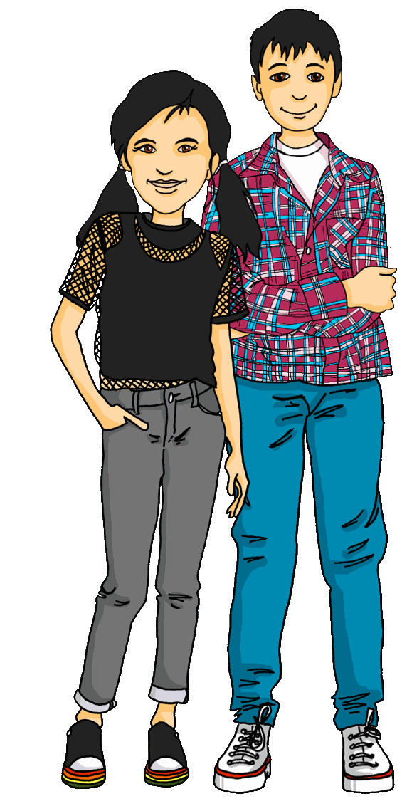
singen
Robbie der Roboter ist wieder da!
Hör zu und sing mit!
Hallo Robbie!
Hallo! Hallo! Guten Tag! Hallo! Hallo! Guten Tag!
Hallo! Ich bin hier,
Hallo! Du bist da, Hallo! Hallo! Guten Tag!
Robbie
Hallo!
Notes:
Timing: 2 minutes Aim: to revise and practise the Hallo song.
Procedure: 1. Click through the animation of the scenario.
2. Click to bring up speech bubble of Lias and Ronja saying hello Robbie.
3. Click to bring up speech bubble of Robbie saying hello.
4. Click to play the audio of the song, pupils join in.
Note: Depending on how often teachers have used the song since it last featured in a lesson, pupils may need to rehearse it again, line by line.
5

Slide 6
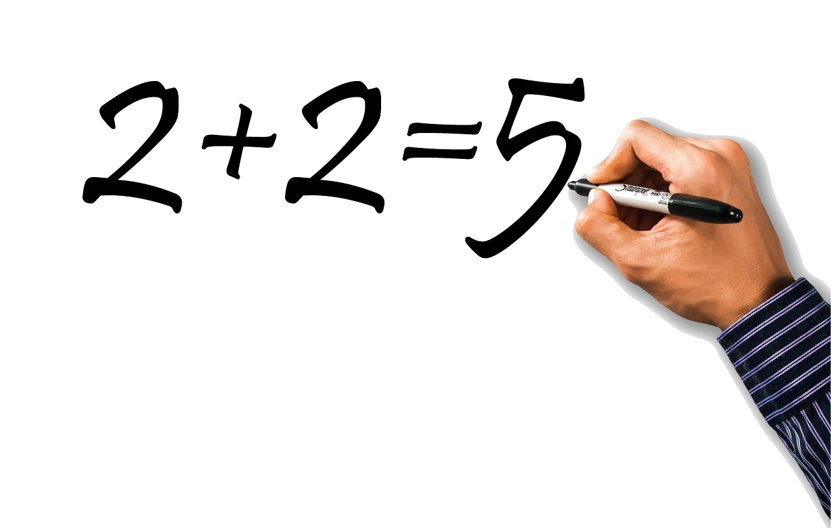
Vokabeln lernen
Wörter
der Fehler
die Katze
das Haus
die Schule
Notes:
[1/2]
Timing: 3 minutes
Aim: to introduce 4 new items of vocabulary for this week.
Procedure 1. Click to introduce the 4 new words and their pictures.
2. Ask pupils what the 4 words mean in English.
3. Draw attention to the der/die/das- what gender is each noun?
4. Practise pronouncing the 4 new nouns as a class and individually. 5. Then, on the next slide, pupils try to match the German and the pictures, then try to recall the German words.

Slide 7
Vokabeln lernen
das Haus
die Schule
die Katze
4
der Fehler
2
1
3
Notes:
2/2
Timing: 3 minutes (including previous slide) Aim: To provide production (speaking) practice with the new vocabulary.
Procedure: 1. Pupils match the German nouns to the pictures in their heads.
2. The teacher gives the pupils a number and the pupils must say the correct word in German. The number prompts are the trigger (i.e. click on the number) for the lines to connect the correct word to the picture.
3. Click to make each German word disappear in turn. Can pupils recall the 4 German nouns?

Slide 8
Vokabeln
Was ist das auf Englisch?
Schreib das Wort für ‘a/an’.
Wörter
Aufgabe | Karte | Fehler | Haus | Liste | Partner | Katze | Schule | Partnerin | Text
word for ‘a/an’
word for ‘a/an’
Englisch
Englisch
1
2
3
4
5
partner
ein
task
6
7
8
9
10
Aufgabe
eine
Partner
card
eine
eine
Karte
cat
Katze
Fehler
ein
Schule
eine
mistake, error
school
house
ein
Partnerin
eine
Haus
partner
list
eine
Text
ein
Liste
text
Notes:
Timing: 5 minutes
Aim: to practise written comprehension and spoken production of new & revisited vocabulary and its correct association with the appropriate indefinite article (word for ‘a/an’).
Procedure:
1. Read the instructions in German and establish that pupils are focusing on meaning and gender.
2. Pupils are to write down the English meanings of the nouns (in order as they appear from the left on the ‘tickertape’). Note: the tickertape is set to repeat until the next mouse click. Pupils may need to see as many as 3 – 4 repetitions to get all of the words.
3. Pupils can volunteer the answers orally. Written answers appear on clicks. 4. Teacher clicks to bring up the 2nd prompt ‘word for ‘a/an’’.
5. Pupils write in the indefinite articles.
6. Elicit word by word, prompt pupils for the German word as well, and click to reveal answers.
8

Slide 9
‘a’ (ein, eine, ein)
Remember that ‘ein, eine, ein’ means ‘a/an’ and often identifies something to the listener:
Das ist eine Katze.
Was ist das?
Robbie
Notes:
Timing: 4 minutes (2 slides) Aim: to revisit ‘ein, eine, ein’ and introduce ‘kein, keine, kein’. Procedure: 1. Click through the animations to present the explanation.
2. Check pupils’ understanding at each stage.
9

Slide 10
‘not a/no’ (kein, keine, kein)
You know that ‘not’ with adjectives is ‘nicht’:
‘kein’ works like ‘ein’ and matches the gender of the noun.
We sometimes use ‘no’ in English, too: That’s no problem! Das ist kein Problem!
Das ist grün.
That is green.
Das ist nicht grün.
That is not green. / That isn’t green.
To say ‘not a’ with nouns, use ‘kein’:
masculine
feminine
neuter
Das ist kein Ort.
Das ist keine Person.
Das ist kein Ding.
That is not a place.
That is not a person.
That is not a thing.
Notes:
Procedure: 1. Click through the animations to present the explanation.
2. Check pupils’ understanding at each stage.
10

Slide 11
hören
Hör zu. Ist das A or B?
Which noun completes the sentence correctly?
A
B
A
B
B.
4
1
5
2
6
3
Think carefully about the gender of each of these nouns. Would you expect to hear kein or keine before each? Why?
Notes:
Timing: 5 minutes
Aim: to practise aural comprehension of kein(e) used with different gender nouns.
Procedure:
1. Tell pupils they will hear sentences with kein(e) and the noun will be missing. They need to decide which of the two nouns given (A or B) would fit in the sentence, based on whether they hear kein or keine.
2. Give pupils 30s seconds to discuss the German for and the genders of the picture nouns before they listen.
3. Click to hear the example (B) and ask pupils to select A or B. Discuss why A is correct (Partner is masculine, Katze is feminine).
4. Pupils write down 1-6.
5. Play sentences 1-6 and ask pupils to choose A or B for each. It is important they can justify their answer!
6. Click to display answers. Click on ticks to hear complete versions of each sentence.
Note: An alternative version with more support is given on the next slide.
Transcript:
Beispiel: Das ist kein [Partner]
Das ist keine [Aufgabe]
Das ist kein [Haus]
Das ist keine [Schule]
Das ist kein [Problem]
Das ist kein [Preis]
Das ist keine [Katze]
11

Slide 12
hören
Hör zu. Ist das A or B?
Which noun completes the sentence correctly?
 | Partner | Katze
 | Fehler | Aufgabe
 | Haus | Partnerin
 | Text | Schule
 | Problem | Liste
 | Preis | Karte
 | Fehler | Katze
A
B
A
B
B.
4
1
5
2
6
3
Think carefully about the gender of each of these nouns. Would you expect to hear kein or keine before each? Why?
Notes:
This is the version with more support.
Timing: 5 minutes
Aim: to practise aural comprehension of kein(e) used with different gender nouns.
Procedure:
1. Tell pupils they will hear sentences with kein(e) and the noun will be missing. They need to decide which of the two nouns given (A or B) would fit in the sentence, based on whether they hear kein or keine.
2. Give pupils 30s seconds to discuss the genders of the nouns before they listen.
3. Click to hear the example (B) and ask pupils to select A or B. Discuss why A is correct (Partner is masculine, Katze is feminine).
4. Pupils write down 1-6.
5. Play sentences 1-6 and ask pupils to choose A or B for each. It is important they can justify their answer!
6. Click to display answers. Click on ticks to hear complete versions of each sentence. Click on individual pictures to hear correct pronunciation of each individual noun.
Transcript:
Beispiel: Das ist kein [Partner]
Das ist keine [Aufgabe]
Das ist kein [Haus]
Das ist keine [Schule]
Das ist kein [Problem]
Das ist kein [Preis]
Das ist keine [Katze]
12

Slide 13
lesen
Robbie is practising German.
Ist das richtig oder falsch?
Das ist keine Katze.
Notes:
Timing: 5 minutes (6 slides)
Aim: to contrast the difference in meaning between ein/e and kein/e.
Procedure:
Explain the task. Robbie is practising his German.
Pupils read what Robbie has said and decide whether the statement is true or false.
Click to reveal answers.
13

Slide 14
lesen
Robbie is practising German.
Ist das richtig oder falsch?
Das ist ein Haus.
Notes:
[2/6]
14

Slide 15
lesen
Robbie is practising German.
Ist das richtig oder falsch?
Das ist kein Haus.
Notes:
[3/6]
15

Slide 16
lesen
Robbie is practising German.
Ist das richtig oder falsch?
Das ist eine Schule.
Notes:
[4/6]
16

Slide 17
lesen
Robbie is practising German.
Ist das richtig oder falsch?
Das ist kein Fehler.
Notes:
[5/6]
17

Slide 18
lesen
Robbie is practising German.
Ist das richtig oder falsch?
Das ist keine Schule.
Notes:
[6/6]
18

Slide 19
Tschüss!
gelb
Notes:
19

