Slide 1
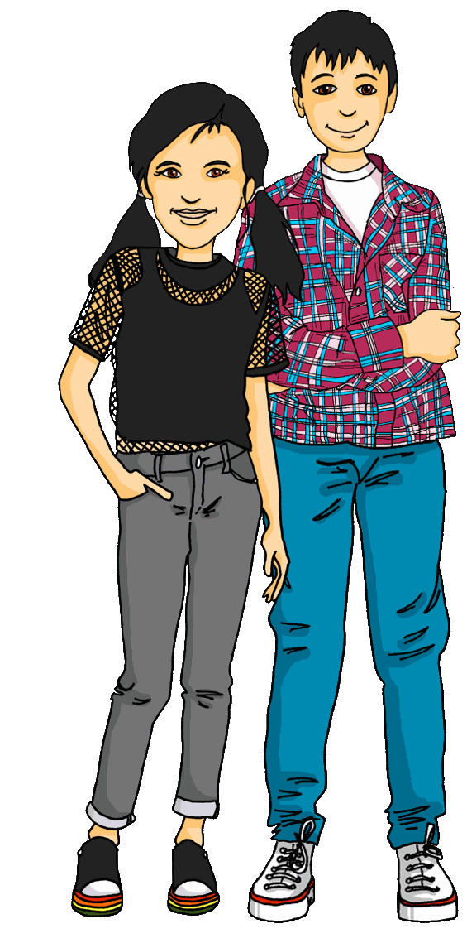
Talking about things and things to do
gelb
Follow ups 1-5
Term 2 Week 2
Notes:
Artwork by Steve Clarke. Pronoun pictures from NCELP (www.ncelp.org). All additional pictures selected from Pixabay and are available under a Creative Commons license, no attribution required.
Phonics:
[ö] König [1087] Österreich [707] Wörter [194]
Vocabulary (new): Frau [99] Herr [154] Mann [121] Schüler, Schülerin [556]
Revisit 1: Hausaufgabe [n/a] Kleidung [2820] Text [473] nicht wahr? [n/a]
Revisit 2: Ding [370] Farbe [1079] Ort [341] Person [357] klar [239] oder [35] ein, eine [5]
Jones, R.L & Tschirner, E. (2019). A frequency dictionary of German: Core vocabulary for learners. London: Routledge.
The frequency rankings for words that occur in this PowerPoint which have been previously introduced in these resources are given in the SOW and
in the resources that first introduced and formally re-visited those words.
For any other words that occur incidentally in this PowerPoint, frequency rankings will be provided in the notes field wherever possible.

Slide 2
aussprechen
long [o]
…
wo
wohnen
Million
Notes:
Timing: 1 minute
Aim: to consolidate the SSC long [o].
Procedure:
Re-present the SSC and the source word ‘wo’ (with gesture, if using).
Click to bring on the picture and get pupils to repeat the word ‘wo’ (with gesture, if using).
Present the cluster words in the same way, bringing on the picture and getting pupils to pronounce the words.
Word frequency (1 is the most frequent word in German): Million [206]] wo? [94] wohnen [380]
Jones, R.L & Tschirner, E. (2019). A frequency dictionary of German: Core vocabulary for learners. London: Routledge.

Slide 3
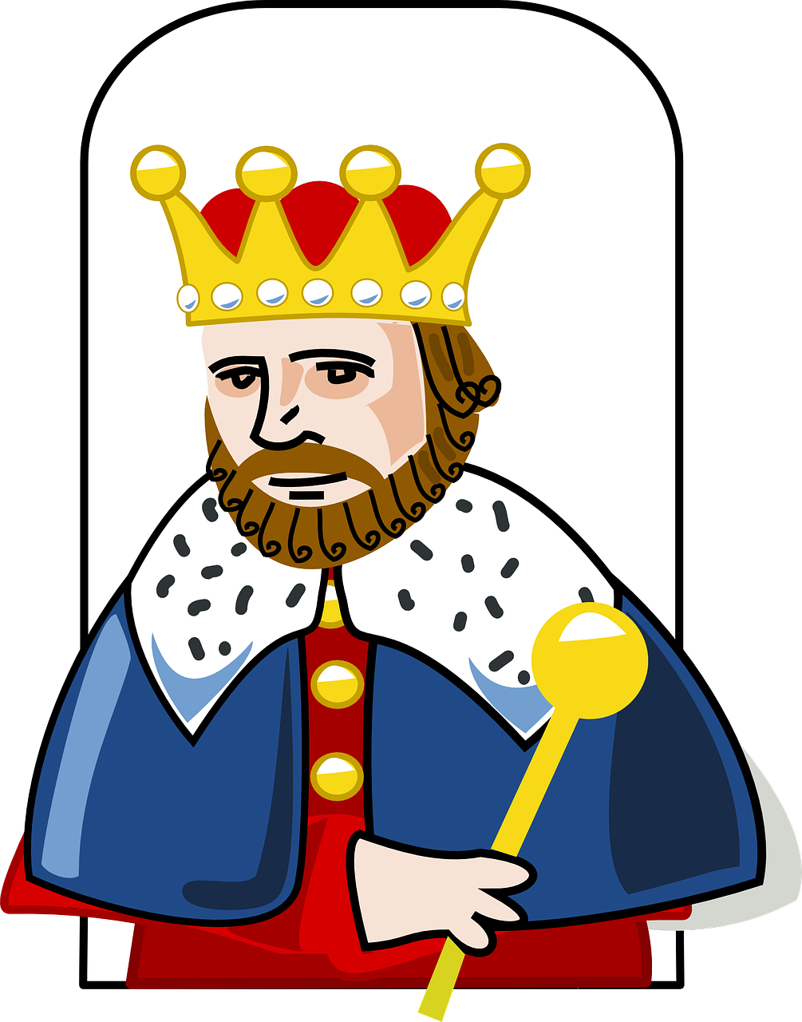
aussprechen
[ö]
…
To make the ö sound, say the letter ‘e’ and then round your lips as tightly as possible. Check your partner’s lips. Are they rounded?
König
[king]
Notes:
Timing: 1 minute
Aim: To introduce SSC [ö]
Procedure:
Introduce the SSC and and say the [ö] sound first, on its own. Pupils repeat it with you.
Present the source word ‘König’ (with gesture, if using).
Click to bring on the picture and get pupils to repeat the word ‘König’ (with gesture, if using).
Note:
A gesture for this could be to mime placing a crown on your head.
König [1087]
Jones, R.L & Tschirner, E. (2019). A frequency dictionary of German: Core vocabulary for learners. London: Routledge.
3

Slide 4
aussprechen
[ö]
…
Österreich
König
Wörter
[Austria]
[king]
[words]
Notes:
Timing: 1 minute
Aim: to introduce the SSC [ö].
Procedure:
Re-present the SSC and the source word ‘König’ (with gesture, if using).
Click to bring on the picture and get pupils to repeat the word ‘König’ (with gesture, if using).
Present the cluster words in the same way, bringing on the picture and getting pupils to pronounce the words.
König [1087] Österreich [707] Wörter [194]
Jones, R.L & Tschirner, E. (2019). A frequency dictionary of German: Core vocabulary for learners. London: Routledge.
4

Slide 5
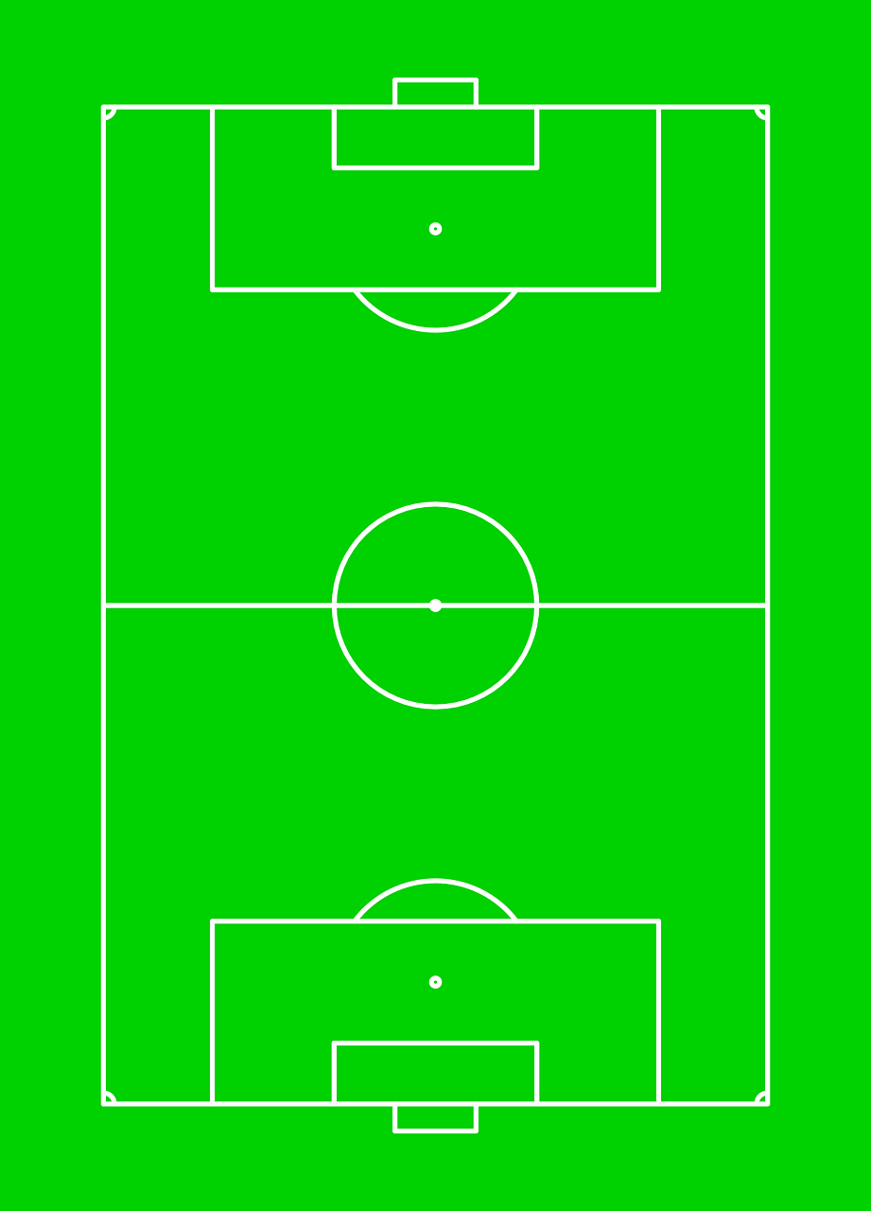
Follow up 1
Wo ist der Ball?
…
It’s match time! Who is on the ball?
aussprechen
Käthe
Konrad
Frau Möller
Bärbel
Herr Fähnrich
Herr Böhmer
Götz
Norbert
Herr Döhl
Frau Dorfman
Karola
Notes:
Timing: 5 minutes
Aim: to practise pronouncing unknown words with [ö] [ä] [o]
Procedure:
Explain the scenario: it is the teachers v students football game.
Click to pass the ball to a player.
Pupils commentate on the match by saying the name of the player who has the ball.
Click on the player’s name to listen and check the pronunciation.
Pupils repeat.
Click to pass the ball to the next player.

Slide 6
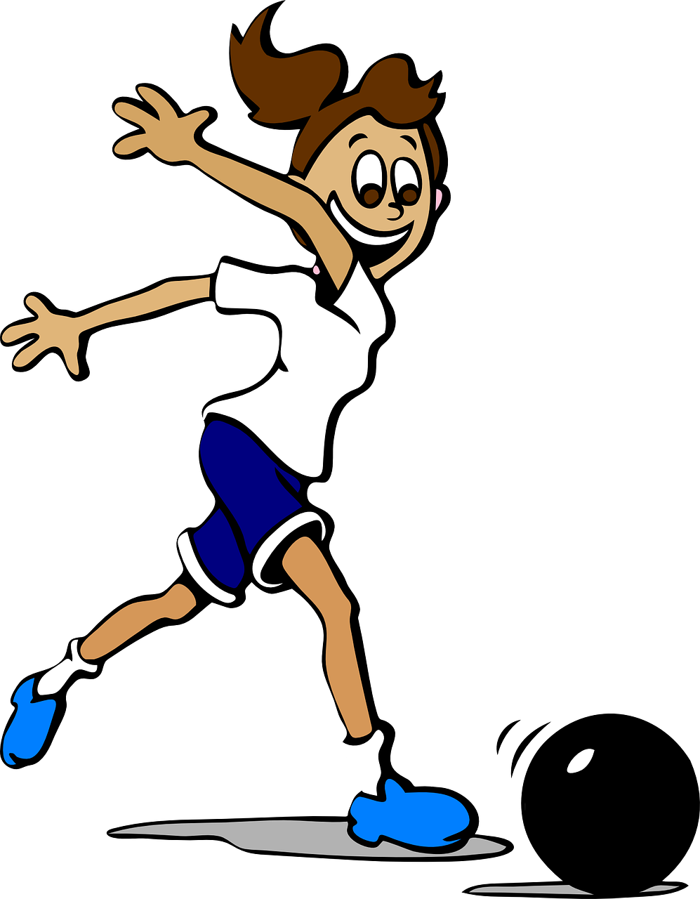
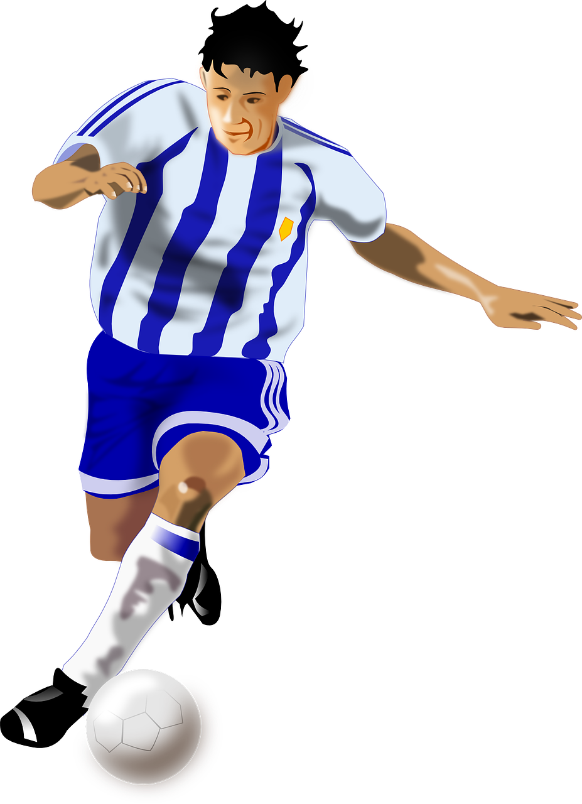
Follow up 2
What can Ronja see?
lesen
Hallo, Herr Lehmann!
__3__
Guten Morgen, Frau Fuhre!
__1__
Du bist eine Spielerin
__2__
Das ist eine Schülerin
__7__
Hier ist ein Spieler
__4__
Er ist ein Schüler
__5__
Das ist total wunderbar!
__6__
Spieler
Herr
Frau
total
Schüler
Spielerin
Schülerin
Notes:
Timing: 5 minutes Aim: to practise comprehension of this week’s new vocabulary.
Note: on the following slide there is a more challenging version of this activity, without the words at the bottom of the slide. Without words to choose from the task becomes a written recall activity.
Procedure:
Explain the task. Ronja is still at the pupils vs teachers football match.
Pupils fill in the blanks based on the pictures and grammar of the sentences.
Click to reveal answers.

Slide 7
Follow up 2
What can Ronja see?
schreiben
Hallo, Herr Lehmann!
__3__
Guten Morgen, Frau Fuhre!
__1__
Du bist eine Spielerin
__2__
Das ist eine Schülerin
__7__
Hier ist ein Spieler
__4__
Er ist ein Schüler
__5__
Das ist total wunderbar!
__6__
Notes:
ALTERNATIVE MORE CHALLENGING VERSION OF THE ACTIVITY Timing: 5 minutes Aim: to practise comprehension of this week’s new vocabulary.
Procedure:
Explain the task. Ronja is still at the pupils vs teachers football match.
Pupils fill in the blanks based on the pictures and grammar of the sentences.
Click to reveal answers.

Slide 8
Follow up 3
Ich bin…
…
sprechen
schreiben
Pilotin
Pilot
……..?
Notes:
Timing: 5 minutes (5 slides)
Aim: to practise written or spoken production of masculine and feminine nouns.
Procedure: 1. Using what they know about how to form feminine person nouns, pupils either write down or chorally suggest the noun to fill the gap.
2. Click to reveal answer.
3. Click to reveal the following slide.

Slide 9
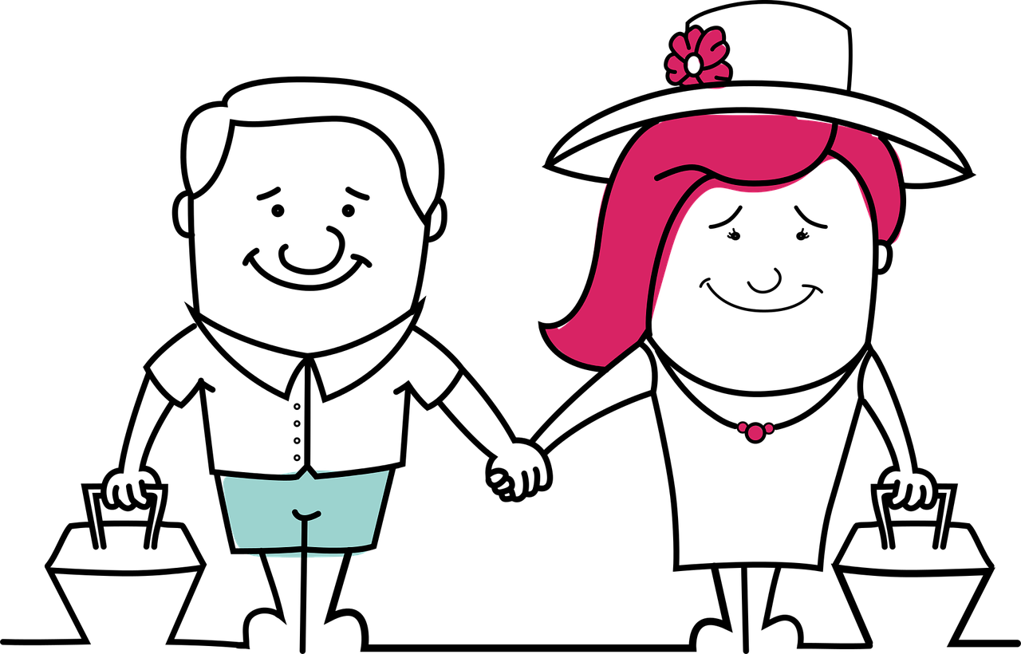
Follow up 3
Ich bin…
…
sprechen
schreiben
Touristin
……..?
Tourist
Notes:
[2/5]

Slide 10
Follow up 3
Ich bin…
…
sprechen
schreiben
Journalistin
……..?
Journalist
Notes:
[3/5]

Slide 11
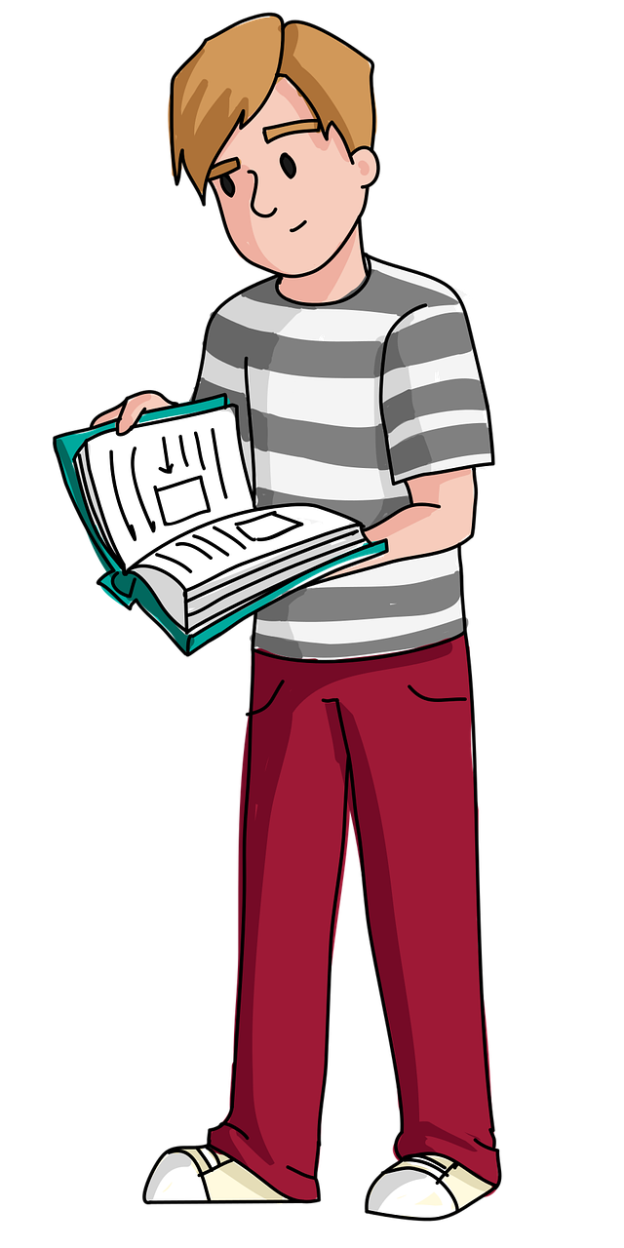
Follow up 3
Ich bin…
…
sprechen
schreiben
Student
……..?
Studentin
Notes:
[4/5]

Slide 12
Follow up 3
Ich bin…
…
sprechen
schreiben
……..?
Designer
Designerin
Notes:
[5/5]

Slide 13
Follow up 4
Grün is an adjective so we use nicht to make it negative.
…
Robbie is muddled yet again. Can you help to make German sentences?
Person A translates Robbie’s sentences into German.
Person B corrects the sentences by making them negative.
sprechen
 |  | Person A | Person B
1
2
3
4
5
6
7
I am green!
Ich bin grün!
Ich bin nicht grün!
She is there!
Remember to use ‘nicht’ with proper nouns
Sie ist da!
Sie ist nicht da!
She is a pupil.
Sie ist eine Schülerin.
Sie ist keine Schülerin.
Remember to use ‘nicht’ before der/die/das.
That is a man.
Das ist ein Mann.
Das ist kein Mann.
That is England.
Das ist England.
Das ist nicht England.
That is clear!
Das ist klar!
Das ist nicht klar!
He is the player.
Er ist der Spieler.
Er ist nicht der Spieler.
Notes:
Timing: 5 minutes
Aim: to practise sentence-building using language from this week, with a particular focus on use of nicht and kein.
Note:
There is an optional handout grid at the end of this presentation to offer pupils support with the translation. This grid is also on the next slide.
There is an alternative whole class version of this activity on the next slide.
Procedure:
Explain the scenario: Robbie is muddled and is making nonsense sentences. Person A translates the sentence as it is into German, and Person B then makes it negative (to make it true for the picture).
Click to bring up the English prompt and picture for number 1. Elicit the translation of the sentence and click to reveal. Discuss with pupils whether you need nicht or kein to make this sentence negative, then click to reveal answer.
Pupils continue to work through 2-7 in pairs.
Use the call-outs to highlight the trickier rules in 5 and 7.
Additional task suggestions:
Pupils could also correct the sentences e.g. Sie ist nicht da. Sie ist hier! This would provide further practice of vocab.
Pupils could make their own incorrect sentences, which their partner must then correct using a negative e.g. Das ist eine Person (pointing at a sheet of paper). Das ist keine Person. Das ist ein Blatt!

Slide 14
Follow up 4
Grün is an adjective so we use nicht to make it negative.
…
Robbie is muddled yet again. Can you help to make German sentences?
Translate Robbie’s English sentence into German.
Make the sentence negative to make it true!
sprechen
Remember to use ‘nicht’ with proper nouns
Ich bin Du bist Er ist Sie ist Das ist | nicht ein eine kein keine nicht der nicht die nicht das | grün/schwarz/da/hier/klar
 |  | England/die Schweiz
 |  | Schüler/Schülerin/Mann/Frau Spieler/Spielerin
I am green!
She is there!
She is a pupil.
That is a man.
That is England.
He is the player.
That is clear!
Ich bin nicht grün!
Das ist nicht England.
Sie ist nicht da!
Das ist nicht klar.
Er ist nicht der Spieler.
Sie ist keine Schülerin.
Ich bin grün!
Das ist kein Mann.
Sie ist da!
Das ist klar.
Er ist der Spieler.
Sie ist eine Schülerin.
Das ist ein Mann.
Das ist England.
Notes:
This is the alternative whole class version of the activity.
Timing: 5 minutes
Aim: to practise sentence-building using language from this week, with a particular focus on use of nicht and kein.
Procedure:
Explain the scenario: Robbie is muddled and is making nonsense sentences. Pupils first translate the sentence as it is into German, using the grid, and then they make it negative (to make it true for the picture) by adding in a word from the middle column of the grid.
Click to bring up the English prompt and picture for the first sentence. Elicit the translation of the sentence (pointing at the options in the table) and click to reveal. Discuss with pupils whether you need nicht or kein to make this sentence negative, then click to reveal answer.
Continue to work through 2-7 in pairs. Pupils could answer orally, discuss in pairs, or on mini whiteboards.
Use the call-outs to highlight the trickier rules.
Note: There is an alternative paired speaking version of this activity on the previous slide. Additional task suggestions: 1. Pupils could also correct the sentences e.g. Sie ist nicht da. Sie ist hier! This would provide further practice of vocab.
2. Pupils could make their own incorrect sentences, which their partner must then correct using a negative e.g. A: Das ist eine Person (pointing at a sheet of paper). B: Das ist keine Person. Das ist ein Blatt!

Slide 15
Follow up 5:

Schreib auf Englisch.
Can you get at least 15 points?
Wörter
 | die Person | ein, eine | die Farbe
 | der Ort | klar | oder
 | die Hausaufgabe | der Mann | der Spieler
 | die Kleidung | nicht wahr? | der Text
 | die Frau | total | die Spielerin
 | der Schüler | Herr | die Schülerin
Vokabeln
x3
(the) person
a/an (m), a/an (f)
(the) colour
(the) place
clear
or
x2
(the) homework
(the) man
(the) [male] player
(the) clothing
Isn’t it? Isn’t that right?
(the) text
(the) woman, Mrs,Ms
totally
(the) [female] player
x1
(the) [male] pupil
Mr
(the) [female] pupil
Notes:
Timing: 5 minutes
Aim: to practise written comprehension of vocabulary from this and revisited weeks.
Procedure: 1. Give pupils a blank grid. They fill in the English meanings of any of the words they know, trying to reach 15 points in total. 2. Remind pupils to think about the male and female person nouns (-in added for feminine) when translating.
Note: The most recently learnt and practised words are pink, words from the previous week are green and those from week 1 are blue, thus more points are awarded for them, to recognise that memories fade and more effort (heavy lifting!) is needed to retrieve them.

Slide 16
Follow up 5:

Schreib auf Deutsch.
Can you get at least 15 points?
Wörter
 | clear | or | a/an (m), a/an (f)
 | (the) colour | (the) place | (the) thing
 | (the) [female] pupil | Isn’t it? Isn’t that right? | (the) clothing
 | (the) text | (the) [male] pupil | (the) homework
 | totally | (the) [male] player | Mr
 | (the) woman, Mrs, Ms | (the) man | (the) [female] player
klar
oder
ein, eine
Vokabeln
x3
die Farbe
der Ort
das Ding
die Schülerin
nicht wahr?
die Kleidung
x2
der Text
der Schüler
die Hausaufgabe
total
der Spieler
Herr
x1
der Mann
die Frau
die Spielerin
Notes:
Timing: 5 minutes
Aim: to practise written production of vocabulary from this and revisited weeks.
Procedure: 1. Give pupils a blank grid. They fill in the German meanings of any of the words they know, trying to reach 15 points in total. 2. Remind pupils to think about the gender of the nouns (and in particular here how the female person nouns change).
Note: The most recently learnt and practised words are pink, words from the previous week are green and those from week 1 are blue, thus more points are awarded for them, to recognise that memories fade and more effort (heavy lifting!) is needed to retrieve them.

Slide 17
Tschüss!
gelb
Notes:
17

Slide 18
Notes:
HANDOUT
Optional handout for Follow up 4. There are 5 copies of the grid on the page.

Slide 19
Follow up 4:

Schreib auf Englisch.
Can you get at least 15 points?
Wörter
 | die Person | ein, eine | die Farbe
 | der Ort | klar | oder
 | die Hausaufgabe | der Mann | der Spieler
 | die Kleidung | nicht wahr? | der Text
 | die Frau | total | die Spielerin
 | der Schüler | Herr | die Schülerin
Vokabeln
x3
x2
x1
Notes:
HANDOUT

Slide 20
Follow up 4:

Schreib auf Deutsch.
Can you get at least 15 points?
Wörter
 | clear | or | a/an (m), a/an (f)
 | (the) colour | (the) place | (the) thing
 | (the) [female] pupil | Isn’t it? Isn’t that right? | (the) clothing
 | (the) text | (the) [male] pupil | (the) homework
 | totally | (the) [male] player | Mr
 | (the) woman, Mrs, Ms | (the) man | (the) [female] player
Vokabeln
x3
x2
x1
Notes:
HANDOUT

