Slide 1
Talking about things and things to do
gelb
Follow ups 1-5
Term 2 Week 3
Notes:
Artwork by Steve Clarke. Pronoun pictures from NCELP (www.ncelp.org). All additional pictures selected from Pixabay and are available under a Creative Commons license, no attribution required.
Phonics:
[ü] – Tür [375] grün [682] müde [2000]
Vocabulary: Wer? [149] haben, ich habe, er, sie, es hat [6] Baum [1013] Computer [1252] Fahrrad [2138] Papier [1163] Spiel [328]
Revisit 1: revisit a selection of previously taught words
Revisit 2: Idee [451] Preis [334] Problem [210] einfach [131] gut [76] schwer [257] Auf Wiedersehen [n/a] tschüss [3766]
Jones, R.L & Tschirner, E. (2019). A frequency dictionary of German: Core vocabulary for learners. London: Routledge.
The frequency rankings for words that occur in this PowerPoint which have been previously introduced in these resources are given in the SOW and in the resources that first introduced and formally re-visited those words. For any other words that occur incidentally in this PowerPoint, frequency rankings will be provided in the notes field wherever possible.
Note that the first three lessons of the year teach language that can be continuously recycled as lesson routine every lesson in Y3/4.
The idea would be that the class teacher (whether or not s/he teaches the class German can re-use the language as part of the daily routine with the class.

Slide 2
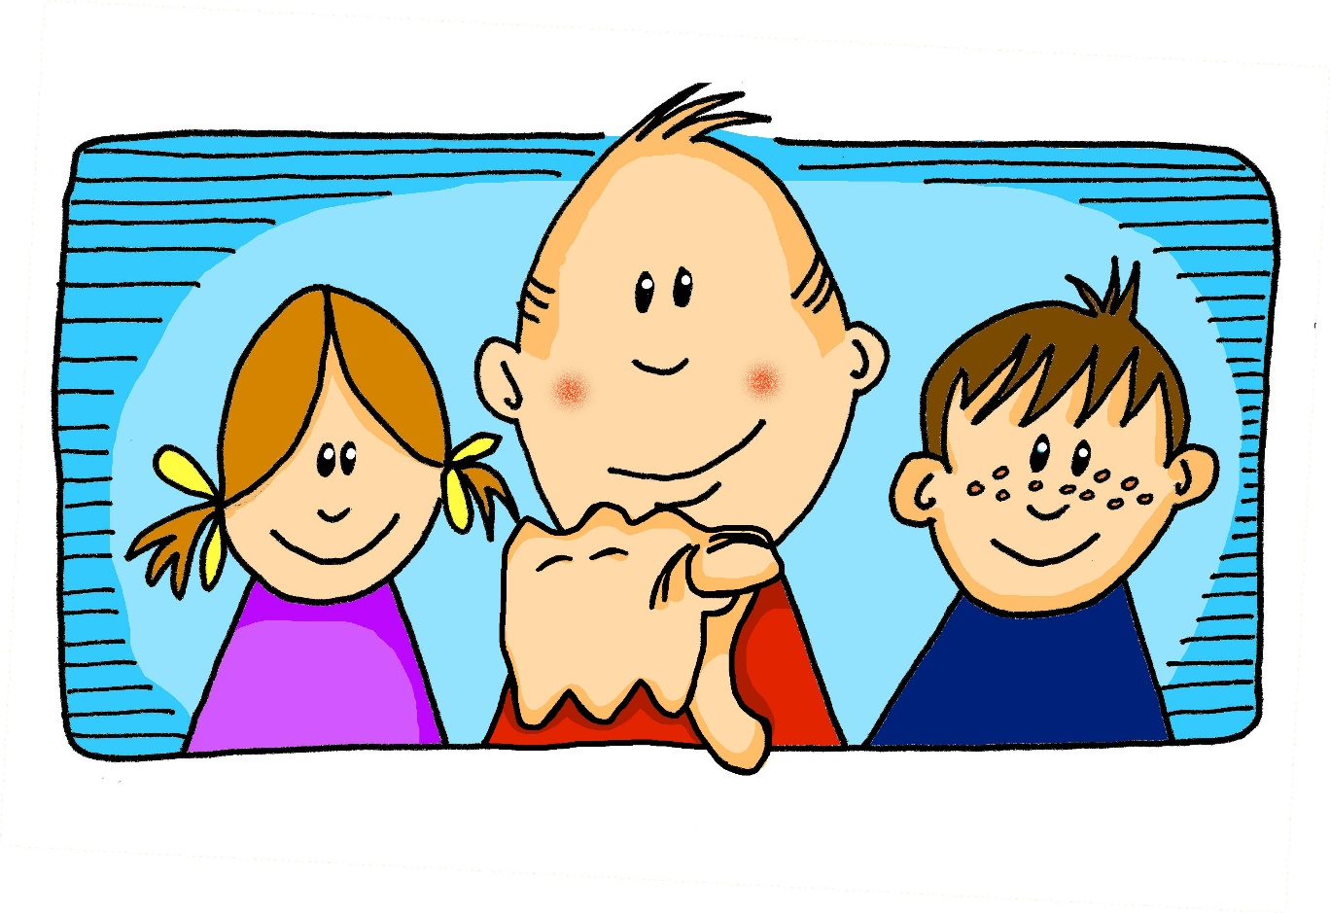
aussprechen
long[u]
…
du
Notes:
Timing: 1 minute
Aim: to recap the SSC long [u].
Procedure:
Introduce the SSC and present the source word ‘du’ (with gesture, if using).
Click to bring on the picture and get pupils to repeat the word ‘du’ (with gesture, if using).
Note: a gesture for ‘du’ might be to point at someone.
2

Slide 3
aussprechen
long[u]
…
gut
du
super
[good]
[you]
Notes:
Timing: 2 minutes
Aim: to consolidate the SSC long [u].
Procedure:
Re-present the SSC and the source word ‘du’ (with gesture, if using).
Click to bring on the picture and get pupils to repeat the word ‘du’ (with gesture, if using).
Present the cluster words in the same way, bringing on the picture and getting pupils to pronounce the words.
Note:
a gesture for ‘du’ might be to point at someone else.
3

Slide 4
aussprechen
[ü]
…
Tür
Notes:
Timing: 1 minute
Aim: to introduce the SSC [ü].
Procedure:
Introduce the SSC and present the source word ‘Tür’ (with gesture, if using).
Click to bring on the picture and get pupils to repeat the word ‘Tür’ (with gesture, if using).
Note:
a gesture for ‘Tür’ might be miming the opening of a door by using one hand as the ‘hinges’ and the second hand to move out away from the first making a right-angled action of opening and closing.
4

Slide 5
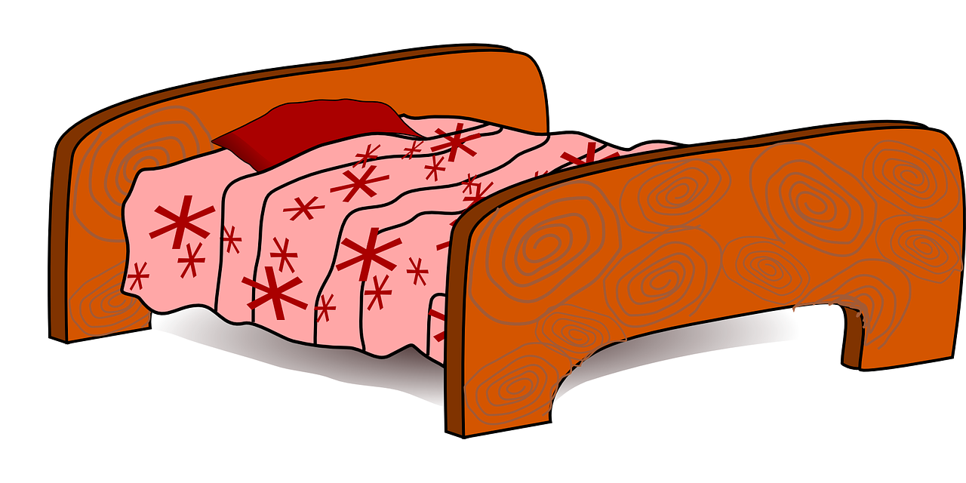
aussprechen
[ü]
…
grün
müde
Tür
[tired]
Notes:
Timing: 1 minute
Aim: to introduce the SSC [ü].
Procedure:
Introduce the SSC and present the source word ‘Tür’ (with gesture, if using).
Click to bring on the picture and get pupils to repeat the word ‘Tür’ (with gesture, if using).
Note:
a gesture for ‘Tür’ might be miming the opening of a door by using one hand as the ‘hinges’ and the second hand to move out away from the first making a right-angled action of opening and closing.
ii) as with all vowels, there are long and short versions of [ü]. This week we focus on differentiating [ü] from previously taught [u] and we mainly work with longer versions of the vowels as it is easier to hear the difference. In Y5/6 we will focus more on long/short versions of the vowels.
5

Slide 6
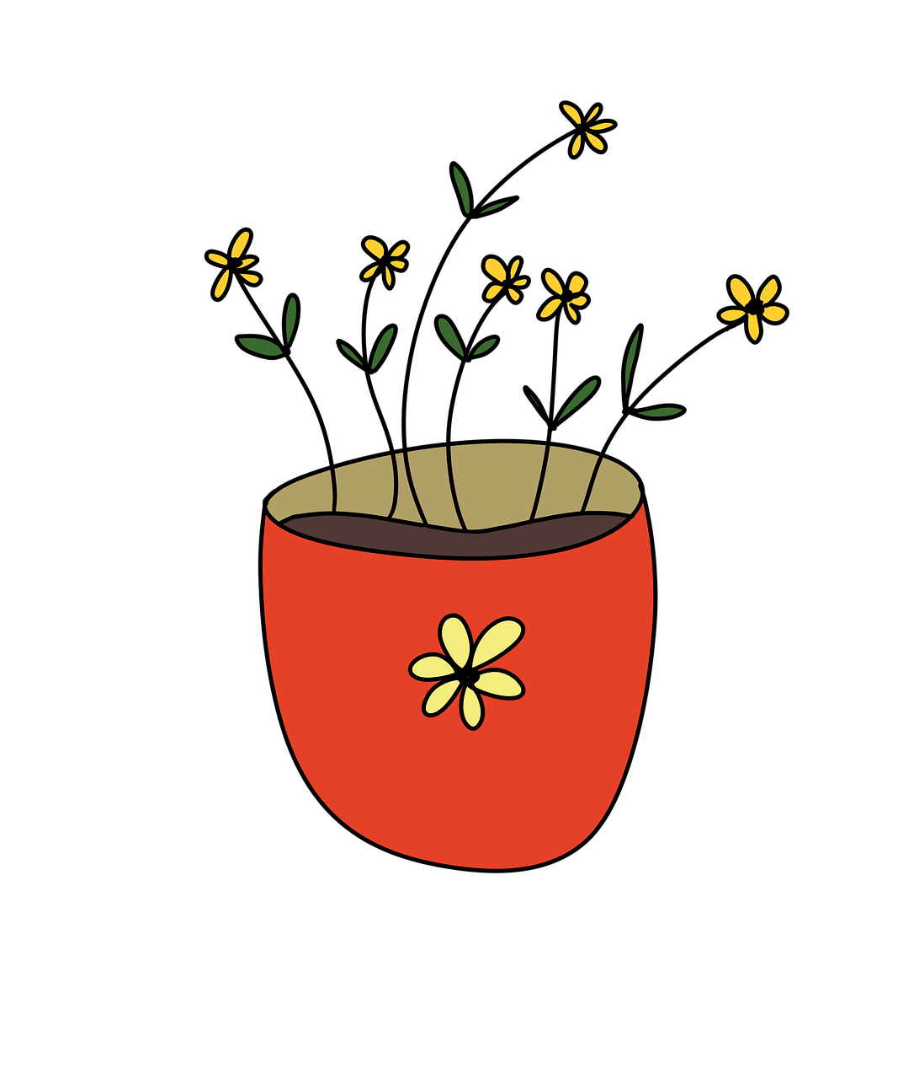
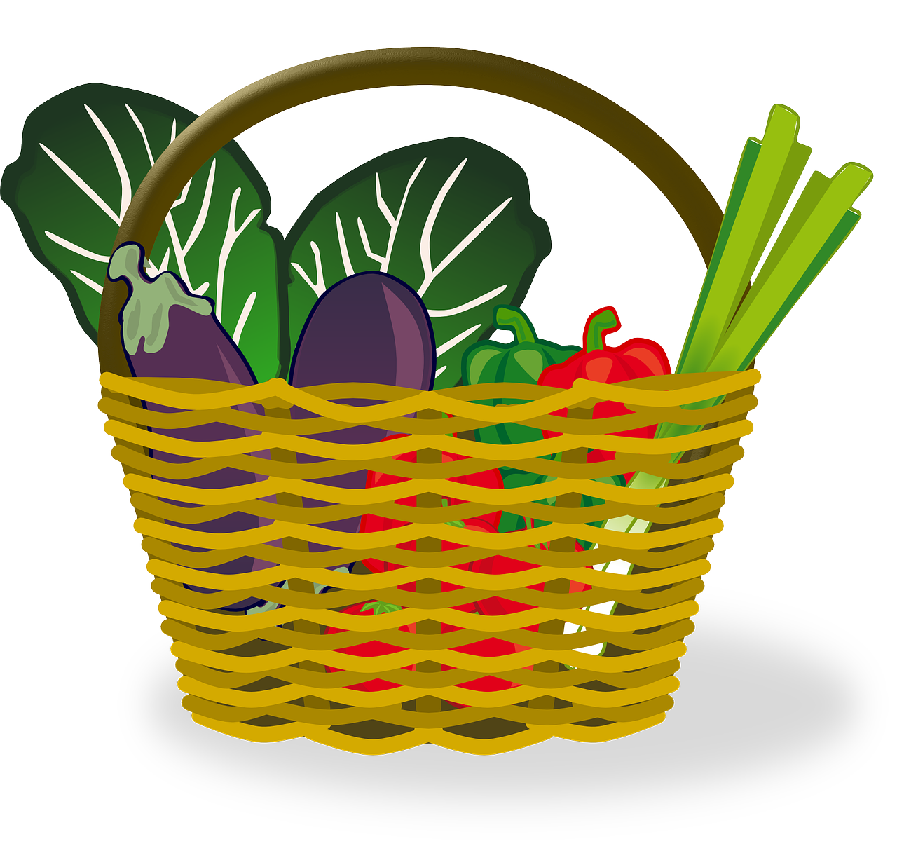
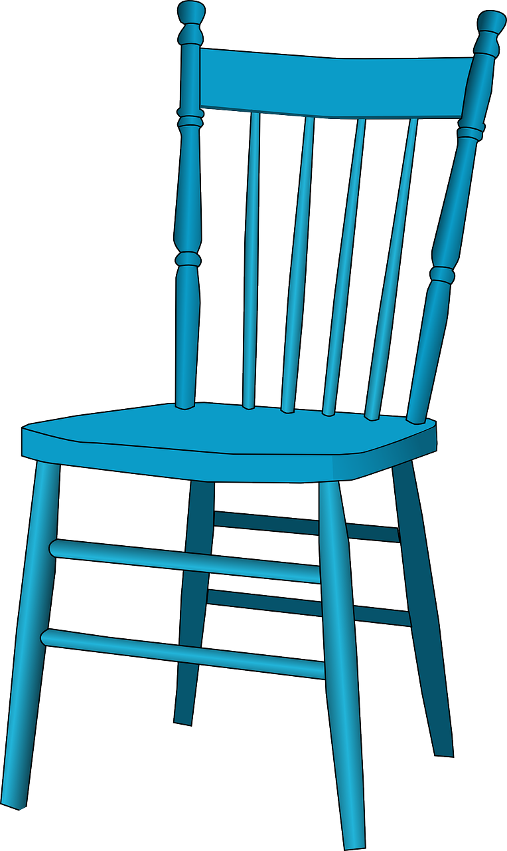
Follow up 1
Sag die Wörter
What would you donate to the charity sale?
aussprechen
60
2
Hut
Gürtel
Mütze
Blume
S
Gemüse
Würfel
Tücher
Kuchen
0
Buch
Stuhl
START
Notes:
Timing: 5 minutes
Aim: to practise applying knowledge of [ü] and [u] pronunciation to unknown words.
Procedure: 1. Pupils work in pairs. Partner A secretly chooses an item that they would donate to the charity sale.
2. Partner B tries to work out what the item is by saying the words on the slide. They have 60 seconds! If they pronounce [u] or [ü] incorrectly, their partner can impose a 2-second penalty.
3. Partners then swap roles.
Word frequency (1 is the most frequent word in German): Blume [2463] Buch [300] Gemüse [3650] Gürtel [>5000] Hut [2763] Kuchen [4381] Mütze [4697] Stuhl [1661] Tuch [4034] Würfel [>5000]

Slide 7
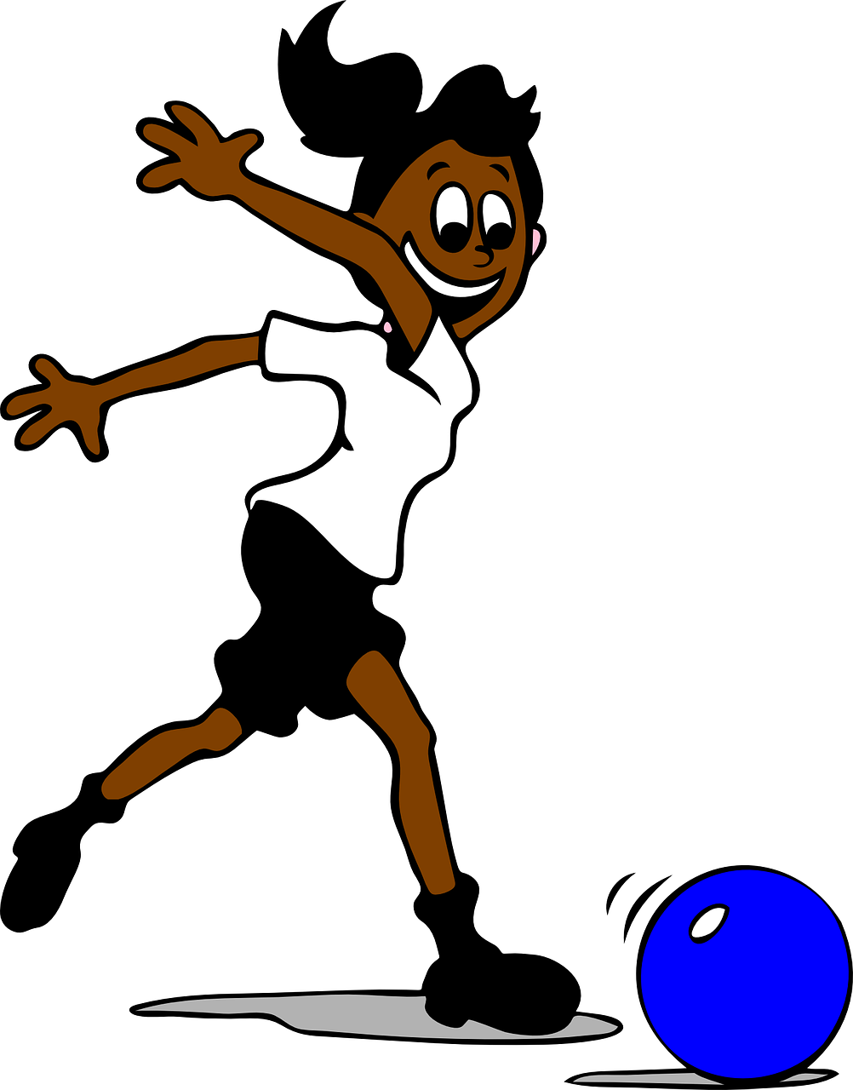
Compound words
Follow up 2a
Wörter
Robbie is remembering some of the German nouns we have learnt. Can you remember what they mean?
der Ball
der Computer
der Apfel
der Baum
die Schule
die Aufgabe
die Spielerin
das Spiel
das Haus
Notes:
Timing: 5 minutes
Slide 1 of 10
Aim: to revise some key vocabulary needed for compound words.
Procedure:
Click through the German nouns one by one, asking pupils to think about a) their meaning and b) their gender.
Give pupils 30 seconds in pairs to discuss meanings of nouns and what the colours represent.
Click to reveal pictures to check meaning.
Ask pupils what the difference is between blue, red and green words. (blue= masculine; red=feminine; green=neuter)
7

Slide 8
Compound words
Follow up 2b
Hey Robbie! In German, you can put two or more words together to make one long word! This is called a compound word.
masculine
neuter
neuter!
der Computer
das Spiel
das Computerspiel
(the) game
(the) computer game
(the) computer
The gender of a compound noun is always the gender of the last word.
The German compound word is usually written as two words in English. But not always! Can you think of some English compound words?
Notes:
Timing: 5 minutes
Slide 2 of 10
Aim: to introduce the concept of compound words.
Procedure:
Click through the animations to present the new information.
Using the question mark animations, elicit English translation for the German examples provided.
Encourage pupils to look at the gender rule and to think about compound nouns in English.
8

Slide 9
Follow up 2c:
Robbie lernt Deutsch.
Help Robbie to translate these compund words. Was ist das auf Englisch?
lesen
die Hausaufgabe
home task
= homework
Notes:
Slide 3 of 10
Timing: 5 minutes
Aim: to practise written vocabulary recognition of compound words
Procedure:
Click to bring up German compound word.
Elicit meaning in English.
Click to bring up English meaning. There are 8 compound words in total.

Slide 10
Follow up 2:
Robbie lernt Deutsch.
Help Robbie to translate these compund words. Was ist das auf Englisch?
lesen
die Schuluniform
school uniform
Notes:
[4/10]

Slide 11
Follow up 2:
Robbie lernt Deutsch.
Help Robbie to translate these compund words. Was ist das auf Englisch?
lesen
das Ballspiel
ball game
Notes:
[5/10]

Slide 12
Follow up 2:
Robbie lernt Deutsch.
Help Robbie to translate these compund words. Was ist das auf Englisch?
lesen
der Golfball
golf ball
Notes:
[6/10]

Slide 13
Follow up 2:
Robbie lernt Deutsch.
Help Robbie to translate these compund words. Was ist das auf Englisch?
lesen
der Apfelbaum
apple tree
Notes:
[7/10]

Slide 14
Follow up 2:
Robbie lernt Deutsch.
Help Robbie to translate these compund words. Was ist das auf Englisch?
lesen
die Hausparty
house party
Notes:
[8/10]

Slide 15
Follow up 2:
Robbie lernt Deutsch.
Help Robbie to translate these compund words. Was ist das auf Englisch?
lesen
der Schulbus
school bus
Notes:
[9/10]

Slide 16
Follow up 2:
Robbie lernt Deutsch.
Help Robbie to translate these compund words. Was ist das auf Englisch?
lesen
die Handballspielerin
handball player
Notes:
[10/10]

Slide 17
Words for ‘the’ (der, die, das)
Follow up 3a
After haben and most other verbs, the words for ‘the’ are:
Remember! After haben and most other verbs der → den.
masculine
feminine
neuter
Ich habe
den Baum
die Hausaufgabe
das Fahrrad
I have
the tree
the homework
the bicycle
Er hat
den Computer
die Kleidung
das Papier
He has
the computer
the clothing
the paper
Sie hat
den Preis
die Karte
das Spiel
She has
the prize
the card
the game
But don’t forget. After sein, use ‘der’ to mean ‘the’ with masculine nouns.
Notes:
Timing: 5 minutes (2 slides)
Aim: to consider the definite singular articles after ‘haben’ (and most other verbs)
Procedure:
Click through the animations to present the information.
Elicit English translations for the German examples provided.
Move on to the next slide to check understanding with the reading activity.
17

Slide 18
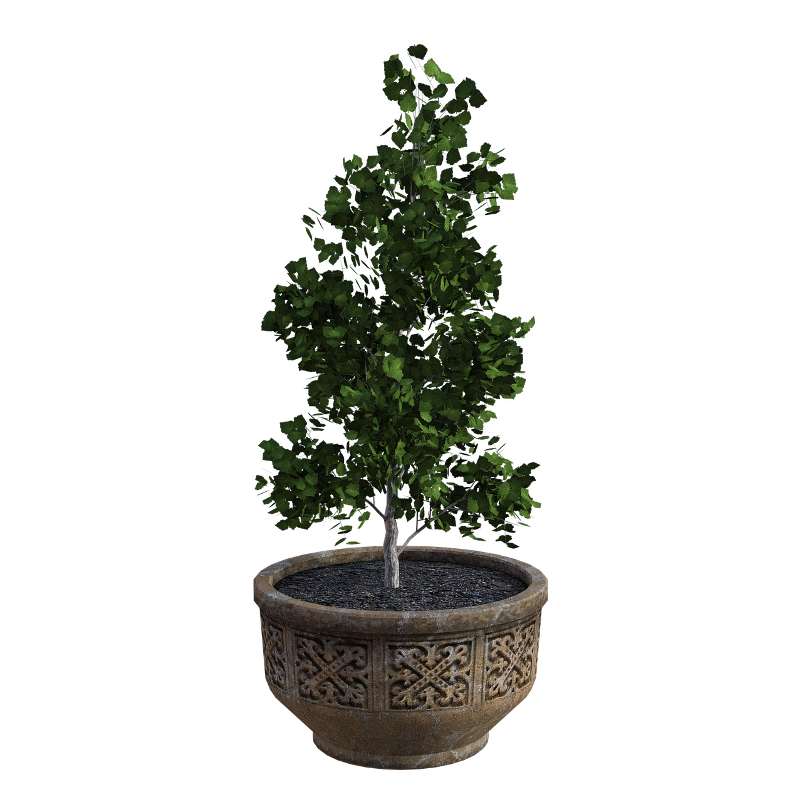
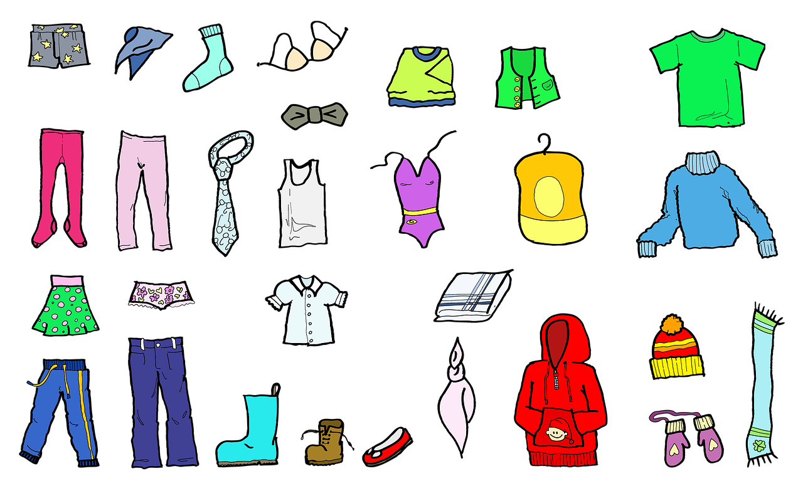
Follow up 3b
Lias has brought things to the charity sale.
Does he have the object (ich habe) or is it already on the table (das ist)? Look carefully at the word for ‘the’ in each sentence.
lesen
Both could be correct
here. The feminine and neuter words for ‘the’ don’t change after most verbs.
…den Preis
…der Ball
…den Computer
…das Papier
…der Baum
…die Kleidung
The word den here tells us that it is NOT following sein (to be). Das ist is part of sein, so we choose ich habe.
Ich habe…
Das ist…
Notes:
Timing: 5 minutes (2 slides)
Slide 2/2
Aim: to recognise in written form words for ‘the’, contrasting the masculine form after sein (der) and after most other verbs (den).
Procedure:
Tell pupils they need to decide between haben and sein to start each sentence, remembering that the masculine word for ‘the’ changes after most verbs, but not sein.
Click to reveal the first noun. Pupils note down or chorally suggest the sentence starter.
Click to reveal the answer.
Click to bring up the next 5 nouns.
Discuss 5 and 6- these nouns are feminine and neuter so we don’t need to worry about the change- this only applies to masculine der changing to den. Can they translate the two different sentences? E.g. Ich habe die Kleidung= I have the clothing; Das ist die Kleidung= that is the clothing.
Additional task suggestions: 1. Ask pupils to translate each sentence, as well as choosing the correct option.

Slide 19
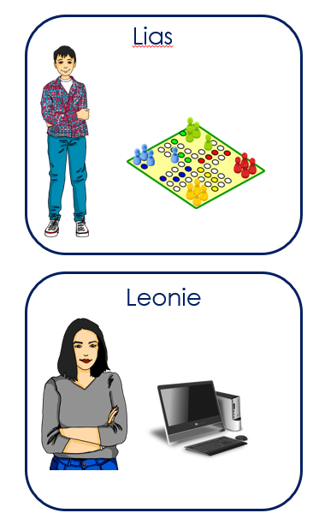
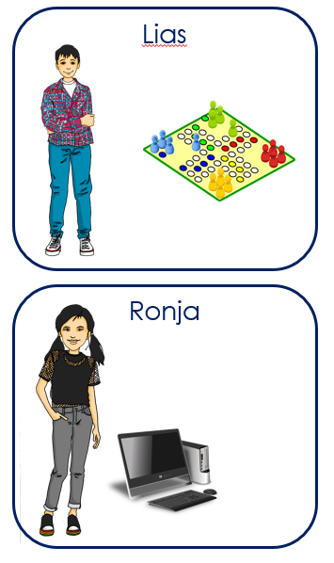
Follow up 4
Wer hat… ?
Spot the difference!
sprechen
Wer hat das Spiel?
Lias hat das Spiel.
Ja!
Wer hat den Computer?
Ronja hat den Computer.
Nein! Leonie hat den Computer!
Notes:
Timing: 5 minutes
Aim: to practise oral production of haben + words for ‘the’ + nouns.
Procedure:
Pupils work in pairs. Hand each partner a handout (found at the end of this powerpoint)– pupils must keep their handout hidden! By asking ‘wer hat…’ questions, partners need to work out the 3 differences between their sheets.
Model the exercise using the example on this slide.

Slide 20
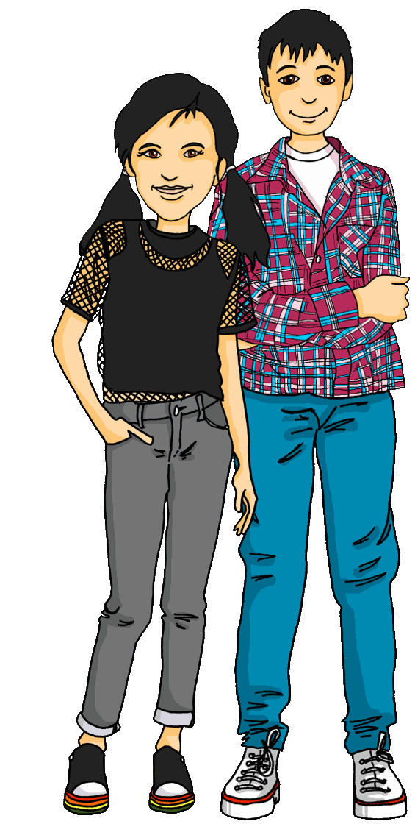
Hör zu und sing mit!
It’s time for Robbie to head home for a while. Can you remember
how to sing the goodbye song to him?
Tschüss, Tschüss, Tschüss, Tschüss,
Tschüss, Tschüss, Auf Wiedersehen!
Bis bald, bis bald, bis bald, bis bald.
Tschüss, Tschüss, Tschüss, Tschüss, Auf Wiedersehen!
Tschüss Robbie!
Auf Wiedersehen!
Notes:
Timing: 2 minutes
Aim: to revise some previously learnt vocabulary in a simple song (to the tune of ‘Hi ho Hi ho it’s off to work we go’)
Procedure: 1. Set the scene: Robbie is going home for a while.
2. Click to play the audio of the song and encourage pupils join in.
3. Click to bring up a speech bubble of Lias and Ronja saying ‘’bye Robbie’’ and click again for a speech bubble of Robbie saying ‘’goodbye’’.
4. Click on spaceship to send it flying back into space/ home.
Note: You could challenge pupils to turn away from the board if they feel they can remember the words.

Slide 21
Follow up 5:

Schreib auf Englisch.
Can you get at least 15 points?
Wörter
 | Auf Wiedersehen | Tschüss | die Idee
 | der Preis | das Problem | einfach
 | gut | schwer | wie?
 | das Papier | wo? | was?
 | sie hat | der Baum | der Computer
 | haben | ich habe | er hat
 | wer? | das Fahrrad | das Spiel
goodbye
bye
(the) idea
Vokabeln
x3
(the) prize
(the) problem
easy
good, well
difficult
how?
x2
(the) paper
where?
what?
she has
(the) tree
(the) computer
to have, having
I have
he has
x1
who?
(the) bicycle, bike
(the) game
Notes:
Timing: 5 minutes
Aim: to practise written comprehension of vocabulary from this and revisited weeks.
Procedure: 1. Give pupils a blank grid. They fill in the English meanings of any of the words they know, trying to reach 15 points in total.
Note: The most recently learnt and practised words are pink, words from the previous week are green and those from week 1 are blue, thus more points are awarded for them, to recognise that memories fade and more effort (heavy lifting!) is needed to retrieve them.

Slide 22
Follow up 5:

Schreib auf Deutsch.
Can you get at least 15 points?
Wörter
 | good, well | goodbye | bye
 | difficult | easy | (the) prize
 | how? | what? | where?
 | (the) tree | (the) idea | (the) problem
 | (the) paper | (the) bicycle, bike | (the) game
 | she has | (the) computer | who?
 | to have, having | I have | he has
gut
Auf Wiedersehen
Tschüss
Vokabeln
x3
schwer
einfach
der Preis
wie?
was?
wo?
x2
der Baum
die Idee
das Problem
das Papier
das Fahrrad
das Spiel
sie hat
der Computer
wer?
x1
haben
ich habe
er hat
Notes:
Timing: 5 minutes
Aim: to practise written production of vocabulary from this and revisited weeks.
Procedure: 1. Give pupils a blank grid. They fill in the German meanings of any of the words they know, trying to reach 15 points in total.
Note: The most recently learnt and practised words are pink, words from the previous week are green and those from week 1 are blue, thus more points are awarded for them, to recognise that memories fade and more effort (heavy lifting!) is needed to retrieve them.

Slide 23
Tschüss!
gelb
Notes:
23

Slide 24
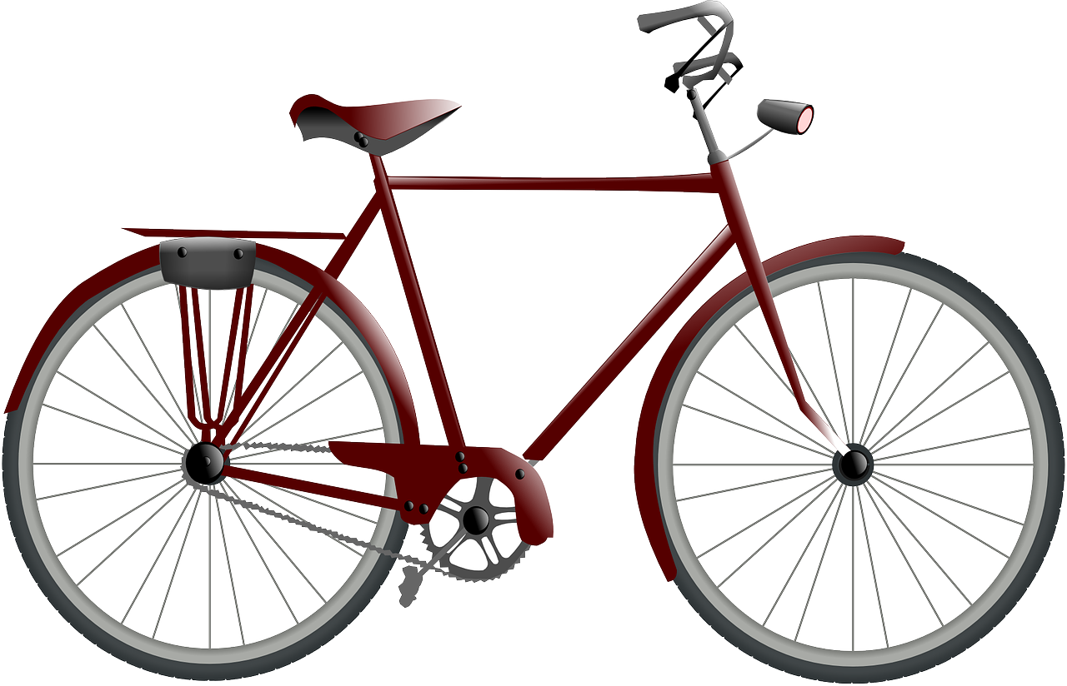
Leonie
Lias
Gabriel
Mariem
Lothar
Ronja
Notes:
HANDOUT PARTNER A

Slide 25
Leonie
Lias
Gabriel
Mariem
Lothar
Ronja
Notes:
HANDOUT PARTNER B

Slide 26
Follow up 5:

Schreib auf Englisch.
Can you get at least 15 points?
Wörter
 | Auf Wiedersehen | Tschüss | die Idee
 | der Preis | das Problem | einfach
 | gut | schwer | wie?
 | das Papier | wo? | was?
 | sie hat | der Baum | der Computer
 | haben | ich habe | er hat
 | wer? | das Fahrrad | das Spiel
Vokabeln
x3
x2
x1
Notes:
HANDOUT

Slide 27
Follow up 5:

Schreib auf Deutsch.
Can you get at least 15 points?
Wörter
 | good, well | goodbye | bye
 | difficult | easy | (the) prize
 | how? | what? | where?
 | (the) tree | (the) idea | (the) problem
 | (the) paper | (the) bicycle, bike | (the) game
 | she has | (the) computer | who?
 | to have, having | I have | he has
Vokabeln
x3
x2
x1
Notes:
HANDOUT

