Slide 1
Talking about things and things to do
gelb
haben – to have
‘the’ – den, die, das
SSC [ü] vs [u]
Term 2 Week 3
Notes:
Artwork by Steve Clarke. Pronoun pictures from NCELP (www.ncelp.org). All additional pictures selected from Pixabay and are available under a Creative Commons license, no attribution required.
Phonics:
[ü] – Tür [375] grün [682] müde [2000]
Vocabulary: Wer? [149] haben, ich habe, er, sie, es hat [6] Baum [1013] Computer [1252] Fahrrad [2138] Papier [1163] Spiel [328]
Revisit 1: revisit a selection of previously taught words
Revisit 2: Idee [451] Preis [334] Problem [210] einfach [131] gut [76] schwer [257] Auf Wiedersehen [n/a] tschüss [3766]
Jones, R.L & Tschirner, E. (2019). A frequency dictionary of German: Core vocabulary for learners. London: Routledge.
The frequency rankings for words that occur in this PowerPoint which have been previously introduced in these resources are given in the SOW and in the resources that first introduced and formally re-visited those words. For any other words that occur incidentally in this PowerPoint, frequency rankings will be provided in the notes field wherever possible.
Note that the first three lessons of the year teach language that can be continuously recycled as lesson routine every lesson in Y3/4.
The idea would be that the class teacher (whether or not s/he teaches the class German can re-use the language as part of the daily routine with the class.
1

Slide 2
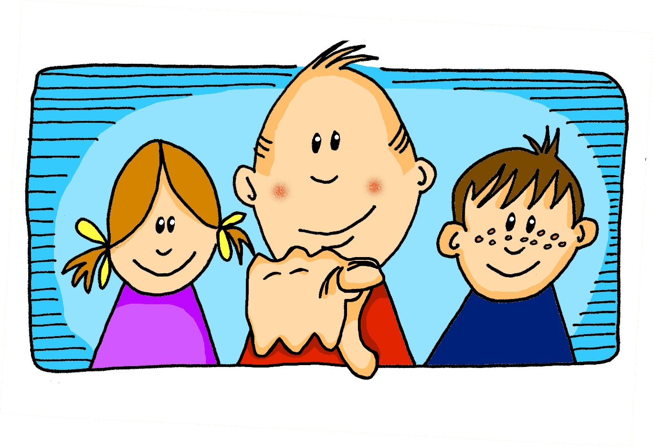
aussprechen
long[u]
…
du
Notes:
Timing: 1 minute
Aim: to recap the SSC long [u].
Procedure:
Introduce the SSC and present the source word ‘du’ (with gesture, if using).
Click to bring on the picture and get pupils to repeat the word ‘du’ (with gesture, if using).
Note: a gesture for ‘du’ might be to point at someone.
2

Slide 3
aussprechen
long[u]
…
gut
du
super
[good]
[you]
Notes:
Timing: 2 minutes
Aim: to consolidate the SSC long [u].
Procedure:
Re-present the SSC and the source word ‘du’ (with gesture, if using).
Click to bring on the picture and get pupils to repeat the word ‘du’ (with gesture, if using).
Present the cluster words in the same way, bringing on the picture and getting pupils to pronounce the words.
Note:
a gesture for ‘du’ might be to point at someone else.
3

Slide 4
aussprechen
[ü]
…
Tür
Notes:
Timing: 1 minute
Aim: to introduce the SSC [ü].
Procedure:
Introduce the SSC and present the source word ‘Tür’ (with gesture, if using).
Click to bring on the picture and get pupils to repeat the word ‘Tür’ (with gesture, if using).
Note:
a gesture for ‘Tür’ might be miming the opening of a door by using one hand as the ‘hinges’ and the second hand to move out away from the first making a right-angled action of opening and closing.
4

Slide 5
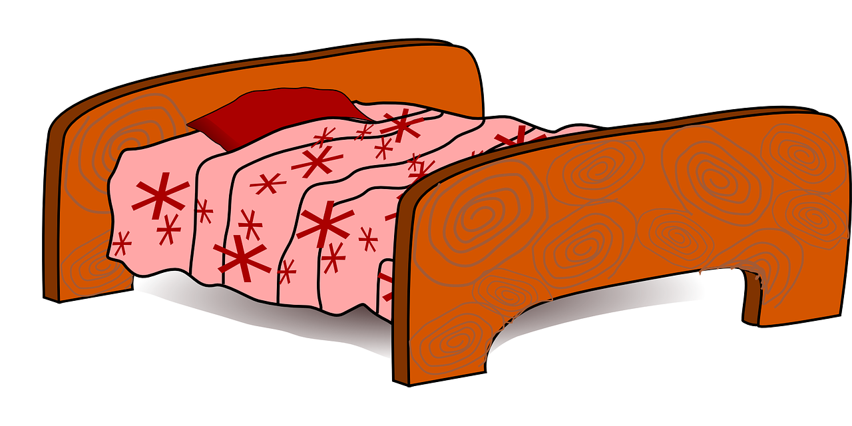
aussprechen
[ü]
…
grün
müde
Tür
[tired]
Notes:
Timing: 1 minute
Aim: to introduce the SSC [ü].
Procedure:
Introduce the SSC and present the source word ‘Tür’ (with gesture, if using).
Click to bring on the picture and get pupils to repeat the word ‘Tür’ (with gesture, if using).
Note:
a gesture for ‘Tür’ might be miming the opening of a door by using one hand as the ‘hinges’ and the second hand to move out away from the first making a right-angled action of opening and closing.
ii) as with all vowels, there are long and short versions of [ü]. This week we focus on differentiating [ü] from previously taught [u] and we mainly work with longer versions of the vowels as it is easier to hear the difference. In Y5/6 we will focus more on long/short versions of the vowels.
5

Slide 6
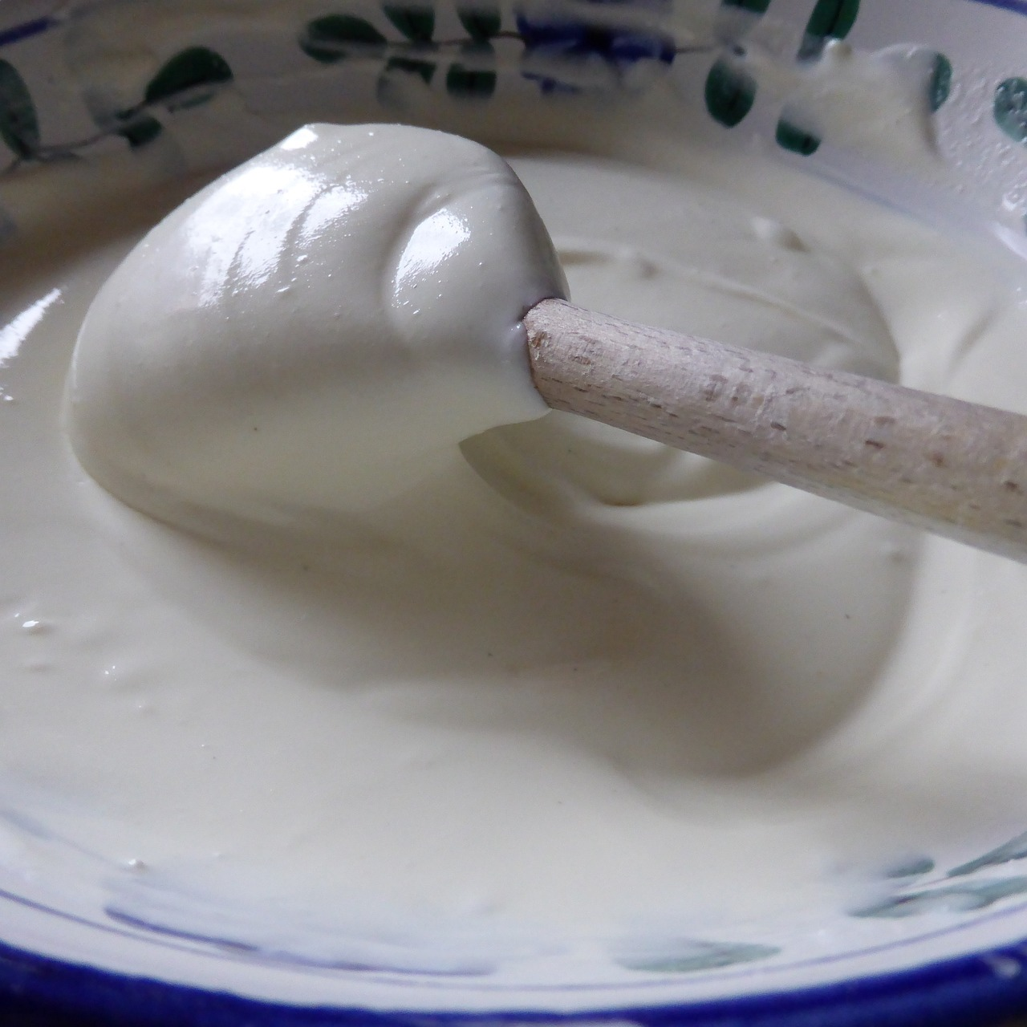
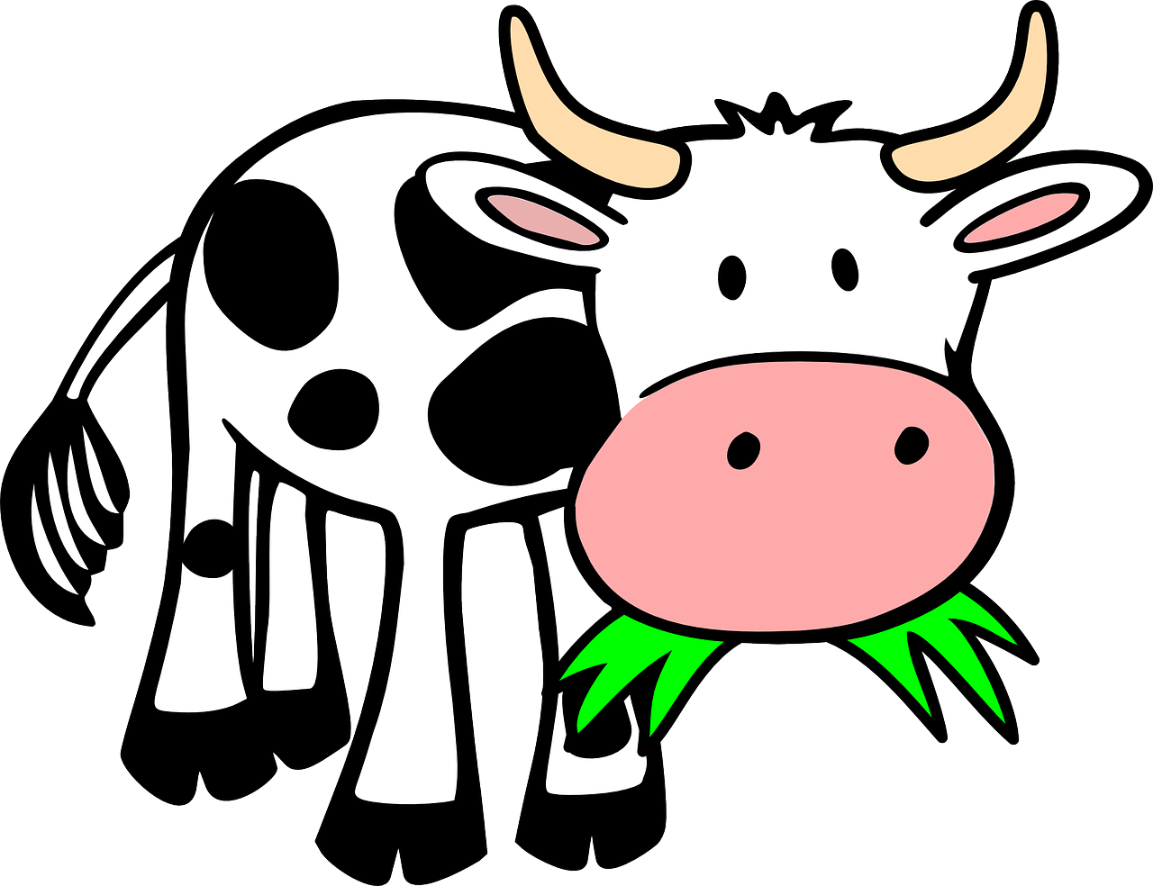
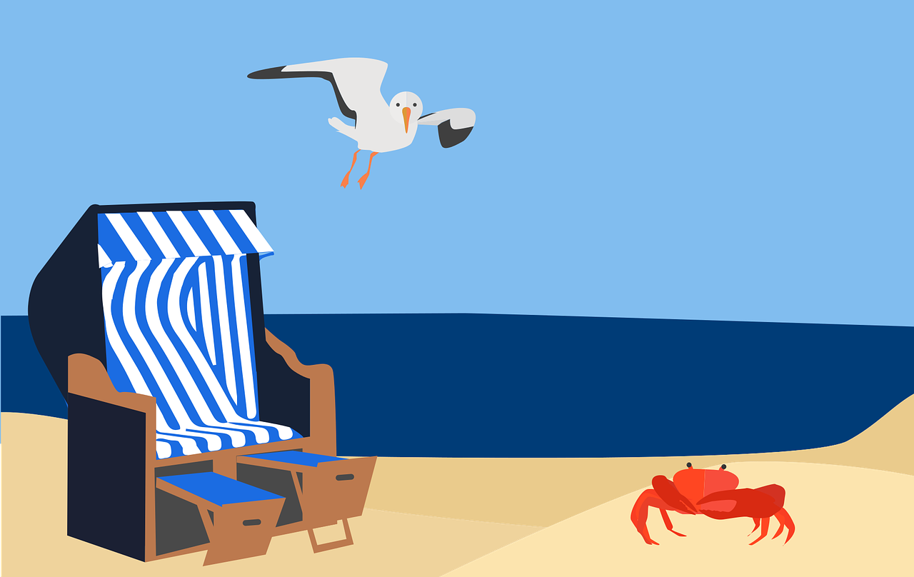
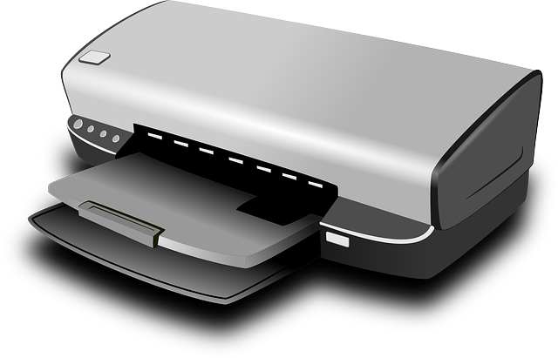
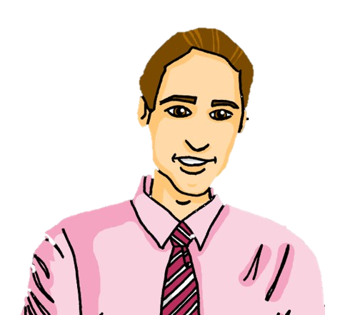
[ü] oder [u]?
Hör zu. Ist es [u] oder [ü]? Schreib A – B oder B – A.
 | A | B
B. | Ruhe | rühren
1 | Kuh | kühl
2 | Kuss | Küste
3 | kurz | Kürze [brevity]
4 | Drucker | drücken
5 | Mund | Münze
6 | Bruder | Brüder
A - B
B - A
A - B
A - B
B - A
B - A
A - B
Notes:
Timing: 5 minutes
Aim: to consolidate the SSC [ü] by aurally differentiating between pairs of similar sounding words.
Procedure:
1. Click to listen to the example (Beispiel). Both words are heard. Pupils decide which order they hear the words in and write either A – B OR B – A.
2. Click to correct the example.
3. Continue with items 1-6 and click to correct.
Transcript: Beispiel: Ruhe – rühren. kühl – Kuh Kuss – Küste
kurz – Kürze
drücken – Drucker
Münze – Mund
Bruder – Brüder
Word frequency (1 is the most frequent word in German): Bruder [730] Drucker [>5000] drücken [924] Kuh [2935] kühl [2730] kurz [176] Kürze [>5000] Kuss [>5000] Küste [2628] Mund [856] Münze [3904] Ruhe [989] rühren [2151] Source: Jones, R.L. & Tschirner, E. (2019). A frequency dictionary of German: core vocabulary for learners. Routledge

Slide 7
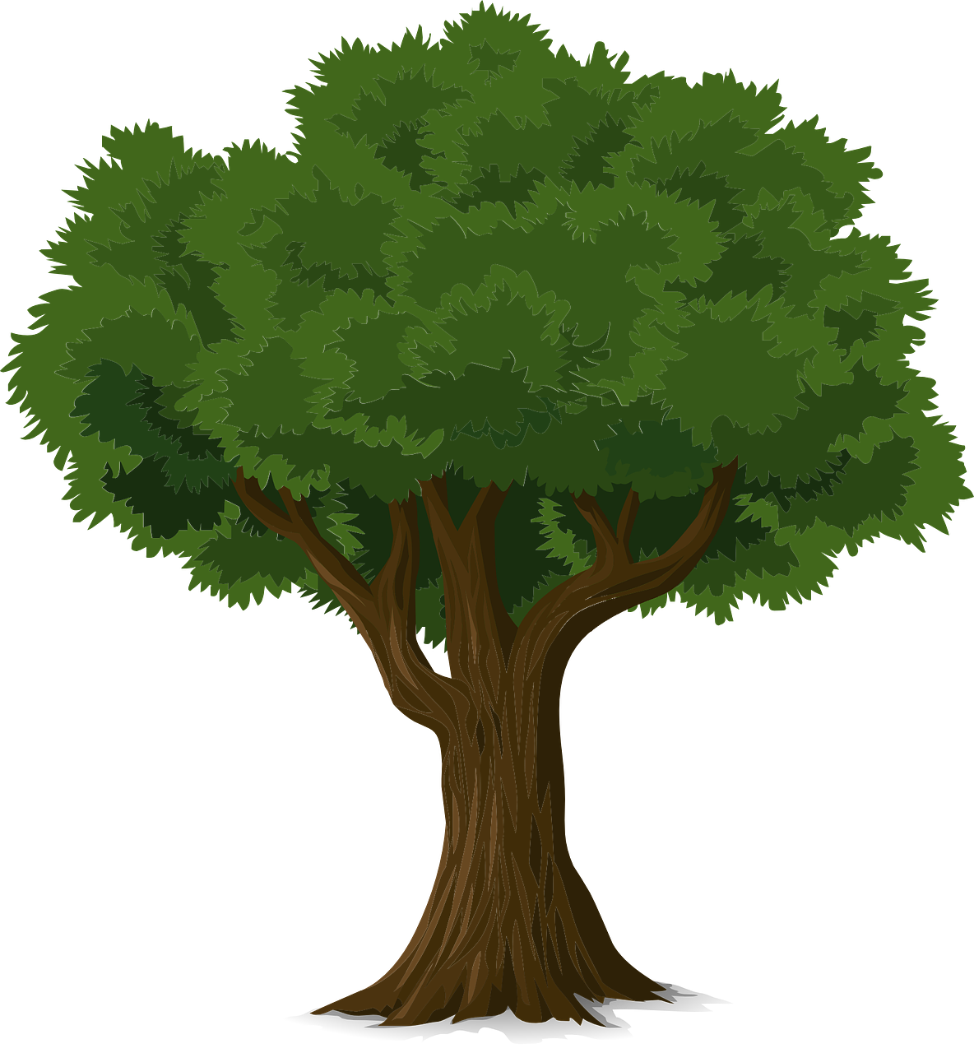
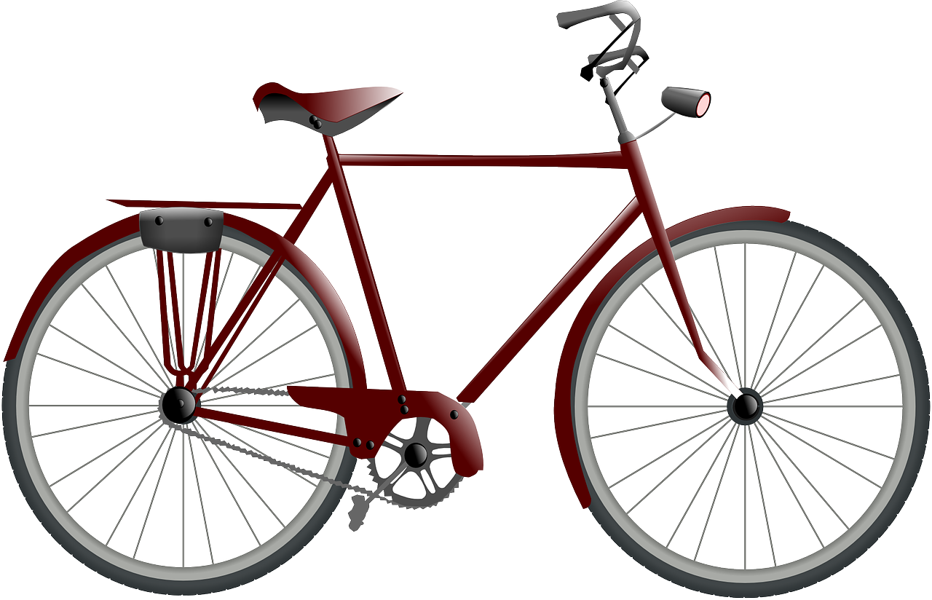
Vokabeln
Vokabeln lernen
Are these nouns masculine, feminine or neuter?
You now know 4 question words: wo (where), was (what), wie (how) and wer (who).
Wörter
Sag die Wörter auf Deutsch. Was ist das auf Englisch?
der Baum
das Fahrrad
Wer?
das Papier
der Computer
das Spiel
Notes:
Timing: 5 minutes
Aim: to present and practise new vocabulary for this week
Procedure:
Pupils either work by themselves or in pairs, reading out the words and thinking about their English meanings (30 seconds).
Click to make an image disappear. Pupils do a quick sketch of the missing picture or write the English. Click again for the picture to return for pupils to check. Repeat for all pictures.
Click for the words to disappear one by one. This time pupils say the missing word in chorus then try to write it in the air with their finger. Focus on just the noun (not the article) to keep it simpler, but ask pupils at the end which gender each of the new nouns is.
7

Slide 8
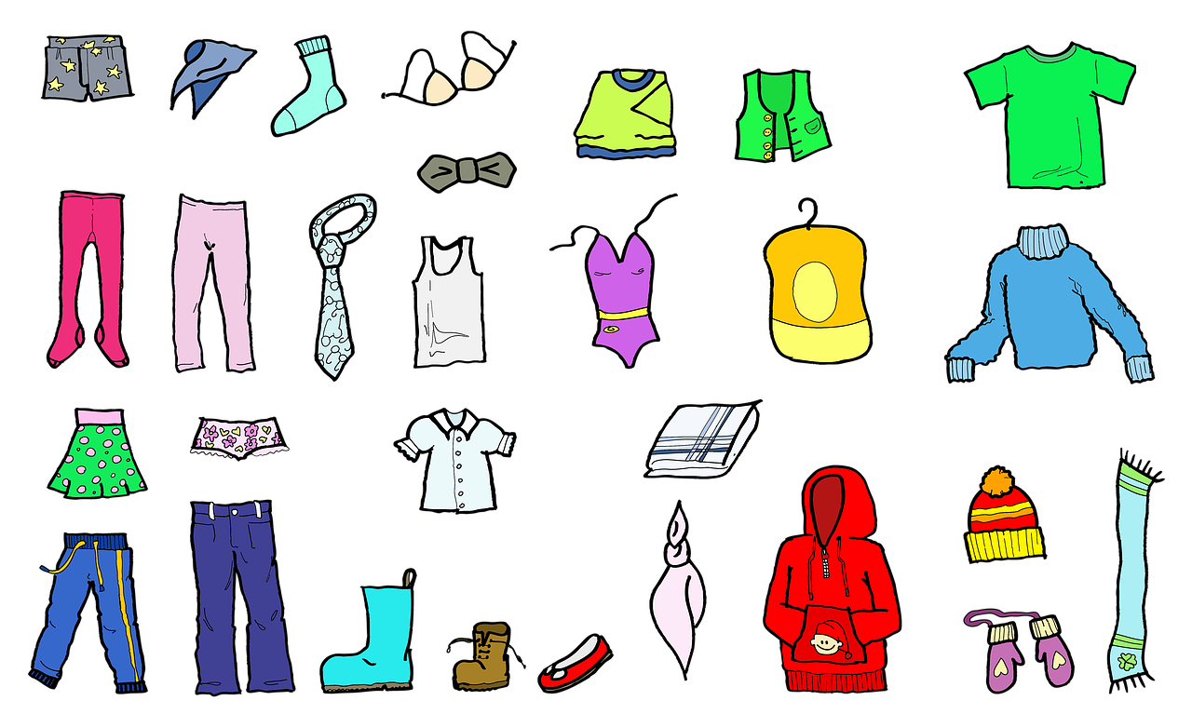
haben
After most verbs the masculine word for ‘the’, der, changes its spelling to den. It still means ‘the’.
to have | having
In German the verb haben means ‘to have’.
I have, he has and she has are parts of the verb ‘to have’.
ich habe
I have
er hat
he has
sie hat
she has
Ich habe das Fahrrad.
Er hat die Kleidung.
Sie hat den Computer.
I have the bicycle.
He has the clothing.
She has the computer.
Notes:
Timing: 3 minutes
Procedure:
Read the grammar explanation about haben. Make sure pupils are clear about the ‘I’, ‘he’ and ‘she’ pictures.
Elicit English translation for the German examples provided.
Draw attention to the den used here after haben for masculine nouns.
8

Slide 9
lesen
Wer hat das?
Lias and Ronja are donating things to a charity sale. Lias texts his mum. What does he have and what does Ronja have?
Schreib 1 – 6 und ‘I have’ oder ‘he has’.
1
I have
4
Sie hat das Fahrrad.
I have
Sie hat den
Computer.
She has
She has
2
She has
5
Have I
Ich habe das Spiel.
Habe ich den Preis?
I have
Has she
3
6
Has she
Sie hat den Baum.
She has
Hat sie das Papier?
I have
Have I
Notes:
Timing: 6 minutes (2 slides)
1/2
Aim: to practise written comprehension of first and third person singular forms of the verb haben (to have).
Procedure:
Pupils write 1-6 and the correct English meaning from the two options given. Encourage them to look at the verb form: habe or hat? Items 5 and 6 are questions, but pupils still just need to look for the verb form.
Click to reveal answers.
9

Slide 10
lesen
Wer hat das?
Make 2 lists. What does Lias (I) have? What does Ronja (she) have?
Schreib auf Englisch.
1
4
Sie hat den
Computer.
Sie hat das Fahrrad.
Lias (I) | Ronja (she)
2
5
Ich habe das Spiel.
Habe ich den Preis?
game
computer
prize
tree
bicycle
Remember that the masculine word for ‘the’ changes to den after most verbs.
3
Sie hat den Baum.
6
paper
Hat sie das Papier?
Notes:
Timing: 5 minutes
2/2
Aim: to practise written comprehension of new and revisited vocabulary as well as the first and 3rd person forms of haben.
Procedure:
Pupils write English lists for Lias and Ronja to show which items each person has.
Click to reveal answers.
Additional task suggestion:
1. Pupils translate the whole sentence, including thinking about how to translate the questions ‘Has she the paper?’ into correct English.
10

Slide 11
hören
Lias, Ronja, and Gabriel are donating things to a charity sale.
Was ist das? Wer hat das?
I
she
he
Notes:
Slide 1 of 6
Timing: 5 minutes (6 slides) Aim: To practise knowledge of Row 2 accusative definite articles (words for ‘the’) in German; to practise comprehension of haben in first and third persons. Procedure: 1. Click on the audio button to hear a sentence starter. Pupils listen for the definite article and finish the sentence with the appropriate noun by pointing to the left or the right.
2. Click to reveal answer.
3. Pupils listen to the sentence again and decide whether it refers to Lias, Ronja or Gabriel. Note, Lias is speaking in this activity, so ‘ich’ refers to him.
4. Click to reveal answer.
5. Click for following slide.
Transcript:
Ich habe den…
11

Slide 12
hören
Lias, Ronja, and Gabriel are donating things to a charity sale.
Was ist das? Wer hat das?
I
she
he
Notes:
[2/6]
Transcript:
Er hat die…
12

Slide 13
hören
Lias, Ronja, and Gabriel are donating things to a charity sale.
Was ist das? Wer hat das?
I
she
he
Notes:
[3/6]
Transcript:
Sie hat den…
13

Slide 14
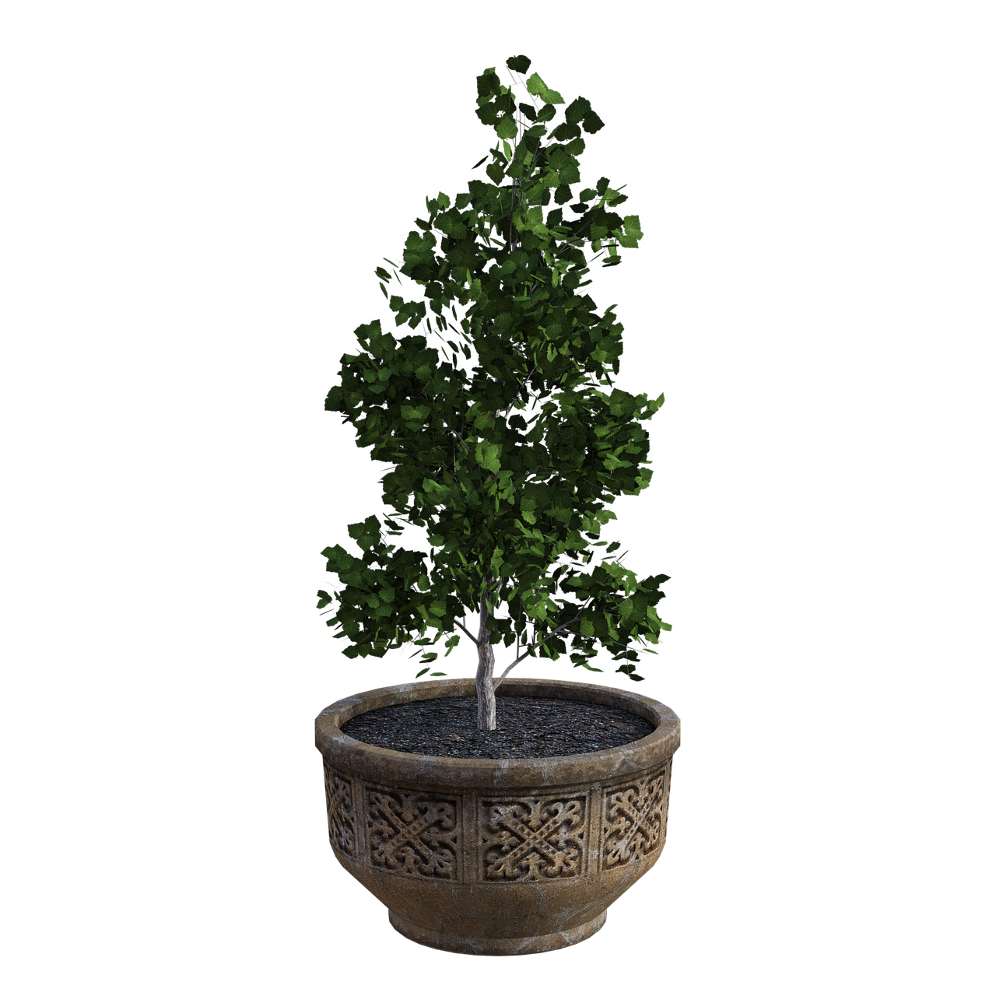
hören
Lias, Ronja, and Gabriel are donating things to a charity sale.
Was ist das? Wer hat das?
I
she
he
Notes:
[4/6]
Transcript:
Er hat das…
14

Slide 15
hören
Lias, Ronja, and Gabriel are donating things to a charity sale.
Was ist das? Wer hat das?
I
she
he
Notes:
[5/6]
Transcript:
Ich habe das…
15

Slide 16
hören
Lias, Ronja, and Gabriel are donating things to a charity sale.
Was ist das? Wer hat das?
I
she
he
Notes:
[6/6]
Transcript:
Sie hat den…
16

Slide 17
Tschüss!
gelb
Notes:
17

