Slide 1
Talking about things and things to do
gelb
haben, du hast
‘a’ – einen, eine, ein
SSC [au] + [eu]
Term 2 Week 4
Notes:
Artwork by Steve Clarke. Pronoun pictures from NCELP (www.ncelp.org). All additional pictures selected from Pixabay and are available under a Creative Commons license, no attribution required.
Phonics: SSC [au] Haus [147] blau [948] laufen [252]; SSC [eu] Deutschland [140] Freund [273] heute [116]
Vocabulary: du hast [7]
Revisit 1: kein, keine, kein [46] Fehler [861] Haus [147] Katze [2235] Schule [359]
Revisit 2: schlecht [327] aber [31] auch [18] nicht [11] wie [25] wie geht's? [n/a]
Jones, R.L & Tschirner, E. (2019). A frequency dictionary of German: Core vocabulary for learners. London: Routledge.
The frequency rankings for words that occur in this PowerPoint which have been previously introduced in these resources are given in the SOW and in the resources that first
introduced and formally re-visited those words.
For any other words that occur incidentally in this PowerPoint, frequency rankings will be provided in the notes field wherever possible.
1

Slide 2
aussprechen
[au]
…
Haus
Notes:
Timing: 1 minute
Aim: to introduce the SSC [au].
Procedure:
Introduce the SSC and present the source word ‘Haus’ (with gesture, if using).
Click to bring on the picture and get pupils to repeat the word ‘Haus’ (with gesture, if using).
Note:
a gesture for ‘Haus’ might be to make a roof above your head with two hands.
2

Slide 3
aussprechen
[au]
…
Haus
[to run, running]
blau
laufen
Notes:
Timing: 1 minute
Aim: to consolidate the SSC [au].
Procedure:
Re-present the SSC and the source word ‘Haus’ (with gesture, if using).
Click to bring on the picture and get pupils to repeat the word ‘Haus’ (with gesture, if using).
Present the cluster words in the same way, bringing on the picture and getting pupils to pronounce the words.
3

Slide 4
aussprechen
[eu]
…
Deutschland
Notes:
Timing: 1 minute
Aim: to introduce the SSC [eu].
Procedure:
Re-present the SSC and the source word ‘Deutschland’
Click to bring on the picture and get pupils to repeat the word ’Deutschland’

Slide 5
aussprechen
[eu]
…
[today]
[friend]
Freund
heute
Deutschland
Notes:
Timing: 1 minute
Aim: to consolidate the SSC [eu].
Procedure:
Re-present the SSC and the source word ‘Deutschland’
Click to bring on the picture and get pupils to repeat the word ’Deutschland’
Present the cluster words in the same way, bringing on the picture and getting pupils to pronounce the words.

Slide 6
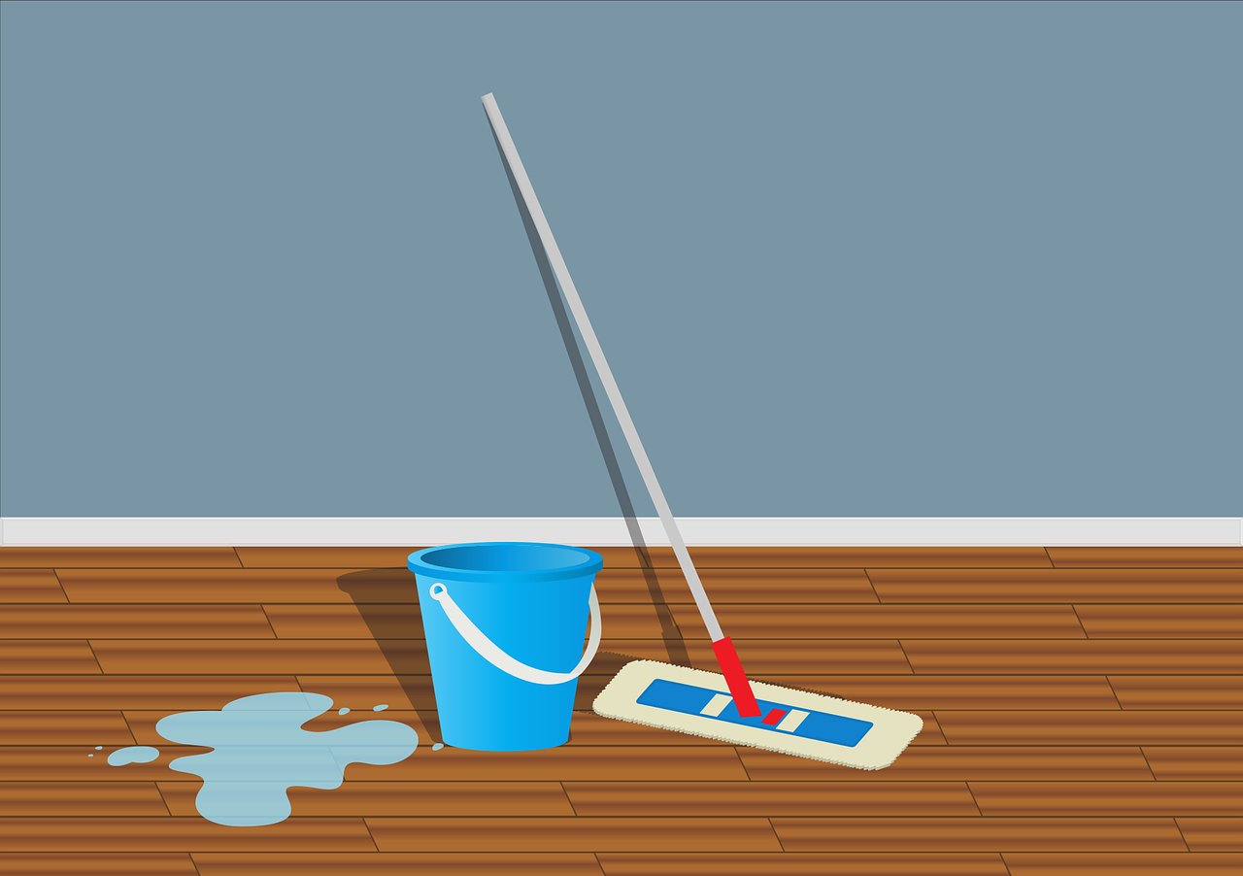
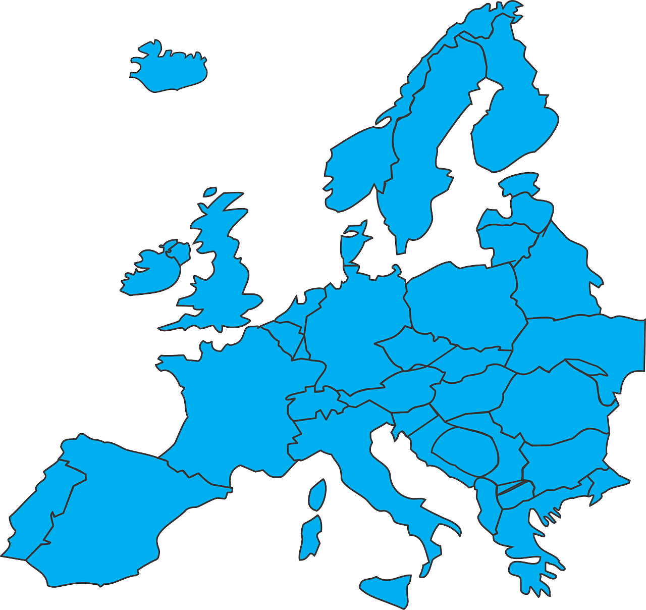
Hör zu. Ist es [au] oder [eu]?
Can you work out the meanings ?
Schreib 1-10 und [au] oder [eu].
eu
au
6. fr___en
7. ___sflug
8. s___ber
9. Fl___gzeug
10. Z___gnis
1. k___fen
2. t___er
3. P___se
4. l___fen
5. ___ropa
eu
Au
$$$$$$
au
au
au
eu
au
eu
Eu
eu
Notes:
Timing: 5 minutes
Aim: to practise recognising aurally the SSCs [au] and [eu].
Procedure:
Click to bring up instructions. Pupils write down 1-10 and will write either ‘eu’ or ‘au’ based on what they hear.
Click the audio button to hear the first word, elicit the answer from pupils and click to display answer.
Repeat for items 2-10.
Transcript: 1. kaufen 2. teuer 3. Pause 4. laufen 5. Europa
6. freuen
7. Ausflug 8. sauber 9. Flugzeug
10. Zeugnis
Meanings: 1. kaufen – to buy 2. teuer – expensive 3. die Pause – pause,break 4. laufen – to run 5. das Europa – Europe
6. freuen – to be happy
7. der Ausflug – excursion, trip 8. sauber - clean 9. das Flugzeug – aeroplane
10. das Zeugnis – certificate
Word frequency (1 is the most frequent word in German): Ausflug [4014] Europa [294] Flugzeug [1776] freuen [589] kaufen [506] laufen [252] Pause [1441] sauber [2026] teuer [950] Zeugnis [4456]
Source: Jones, R.L. & Tschirner, E. (2019). A frequency dictionary of German: core vocabulary for learners. Routledge

Slide 7
Vokabeln
Mariem is moving house and is packing her things
What is she bringing?
Wörter
Schreib auf Englisch.
ein Baum ein Fahrrad ein Preis
5
eine Jacke ein Butterbrot eine Liste ein Ball
4
eine Karte ein Apfel eine Uhr ein Haus
3
2
ein Computer eine Katze ein Spiel
1
Notes:
Timing: 5 minutes (two slides)
Aim: to practise written comprehension of previously taught nouns that we will be using this lesson.
Procedure:
Tell pupils to be ready to write the English meanings of words they have learnt before. There will be 14 altogether and they should prepare to work from the bottom of the slide, left to right.
Explain the scenario – Mariem is packing her things for moving house. As she packs her things into boxes they will disappear. Pupils need to write the meanings before the words get covered. Tell them they will have 5 seconds to get a headstart.
Click to start animation.
Don’t click again or all the boxes will appear at once.
When finished move to the next slide to check answers.
7

Slide 8
Vokabeln
Sag die Wörter auf Deutsch.
Which words are masculine, which are feminine, and which are neuter?
Wörter
ein Baum
ein Fahrrad
ein Preis
a tree | a bicycle | a prize
eine Jacke
ein Butterbrot
eine Liste
ein Ball
a jacket | a sandwich | a list | a ball
eine Karte
ein Apfel
eine Uhr
ein Haus
a card | an apple |a watch, clock|a house
ein Computer
eine Katze
ein Spiel
a computer | a cat | a game
Notes:
Timing: 5 minutes (slide 2/2)
Aim: to practise written comprehension of previously taught vocab and then oral production of the same vocab.
Procedure:
Elicit English translations of the words seen on previous slide row by row. Click to display English answers for pupils to check.
Ask pupils why 3 different colours have been used (masculine, feminine, neuter).
Then give pupils time in pairs to see how many of the words they can translate orally back into German. The colours on the English words can help them decide whether to say ein or eine before the noun.
Click to display the German words again and give pupils time to recognise any they missed.
8

Slide 9
haben
After most verbs the masculine word for ‘a’, ein, changes its spelling to einen. It still means ‘a’.
to have | having
As you know, the verb haben means ‘to have’.
You have already seen I have, he has and she has.
I have
ich habe
he has
er hat
she has
sie hat
To say you have, we say du hast.
Ich habe ein Haus.
Du hast eine Katze.
Sie hat einen Baum.
I have a house.
You have a cat.
She has a tree.
Notes:
Timing: 3 minutes
Procedure:
Read the grammar explanation about haben. Make sure pupils are clear about the ‘I’, ‘you’, ‘he’ and ‘she’ pictures.
Elicit English translation for the German examples provided.
Draw attention to the einen used here after haben for masculine nouns.
9

Slide 10
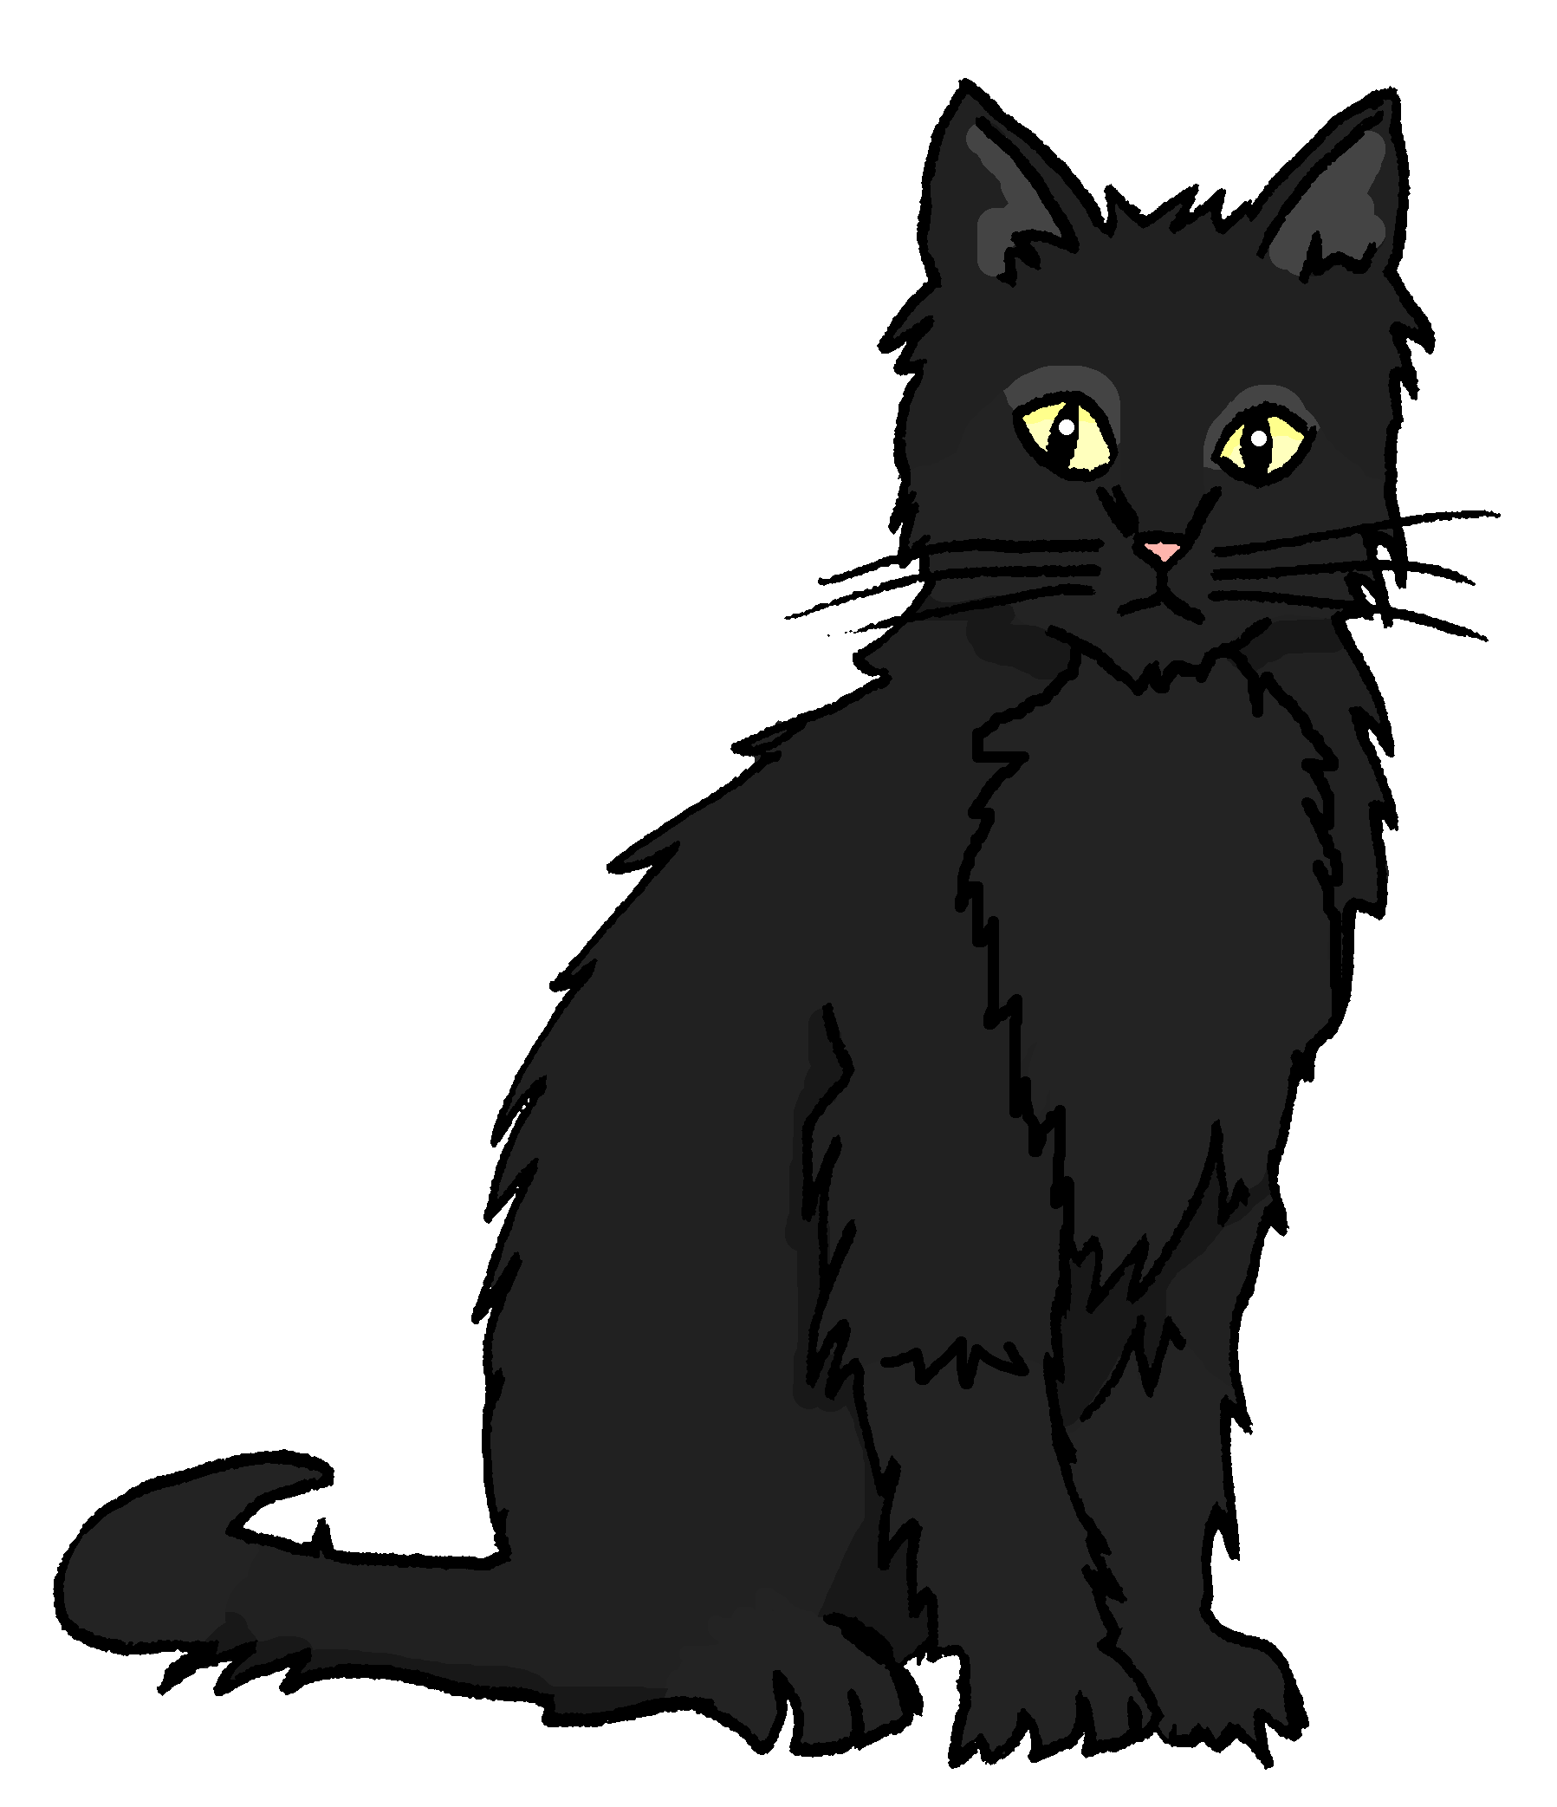
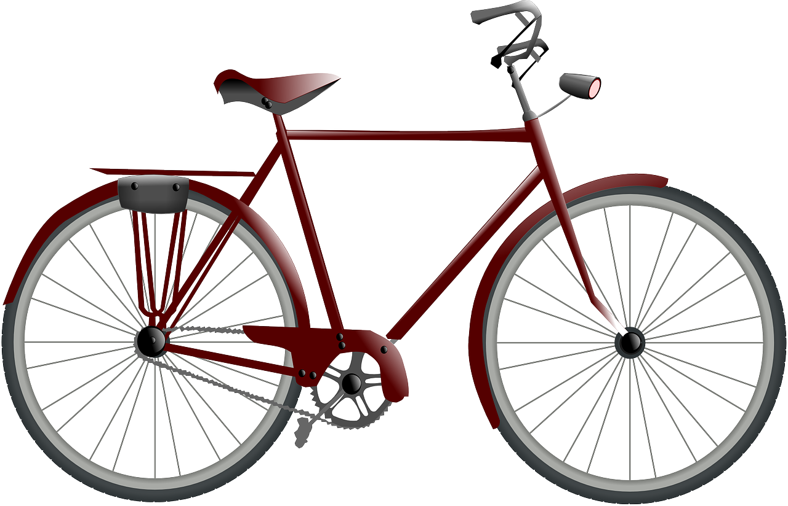
hören
Mariem has moved house! She shows Ronja around on video call.
Hör zu? Ist das in Ronjas Haus (ich) oder Mariems Haus (du)?
R
M
M
R
R
M
R
B.
1
2
3
4
5
6
Notes:
Timing: 5 minutes
Aim: to practise aural comprehension of the first and second persons of the verb haben.
Procedure:
1. Explain the scenario. Ronja is chatting with Mariem, who has just moved house.
2. Play the example (B). From the verb they hear (habe or hast), pupils decide whether ‘I’ have it or ‘you’ have it. ‘I have’ is Ronja as she is speaking and ‘you have’ is Mariem.
3. Play items 1-6 and pupils write R or M for each one.
4. Click to reveal answers.
Transcript
B: [Ich] habe eine Katze. 1. [Du] hast ein Spiel. 2. [Du] hast ein Fahrrad. 3. [Ich] habe einen Computer. 4. [Ich] habe eine Karte.
5. Hast [du] einen Preis? Ja? Wunderbar!
6. [Ich] habe eine Uhr.
10

Slide 11
einen and keinen
As you know, there are 3 words for ‘a’ in German: ein, eine, ein.
You also know that kein, meaning ‘not a’,changes in the same way:
Das ist ein Apfel.
Das ist eine Katze.
Das ist ein Haus.
You have already seen that der changes to den after haben & most other verbs. This is a similar change.
Das ist kein Apfel.
Das ist keine Katze.
Das ist kein Haus.
After the verb haben and most other verbs, the masculine ein changes to einen and the masculine kein changes to keinen.
Ich habe einen Apfel.
Ich habe eine Katze.
Ich habe ein Haus.
I have an apple.
I have a cat.
I have a house.
Ich habe keinen Apfel.
Ich habe keine Katze.
Ich habe kein Haus.
I don’t have a cat.
I don’t have a house.
I don’t have an apple.
Notes:
Timing: 2 minutes
Procedure:
Click through the animations to recap ‘ein’ and kein’ and to present the new information.
Elicit English translation for the German examples provided.
Using the call-out, remind pupils that they have seen something similar with der→den after haben & most verbs.
11

Slide 12
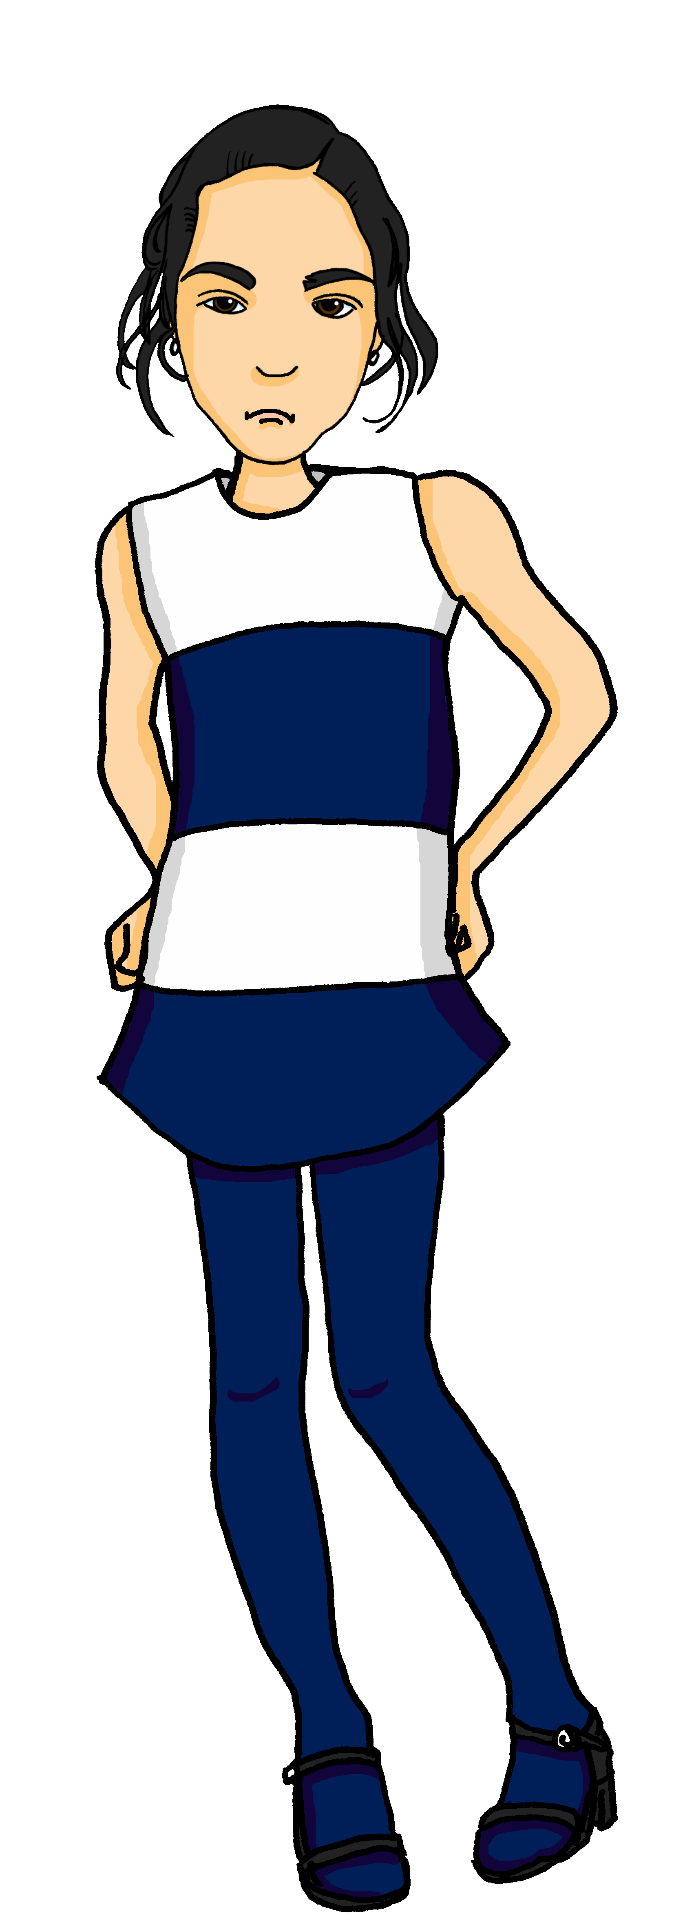
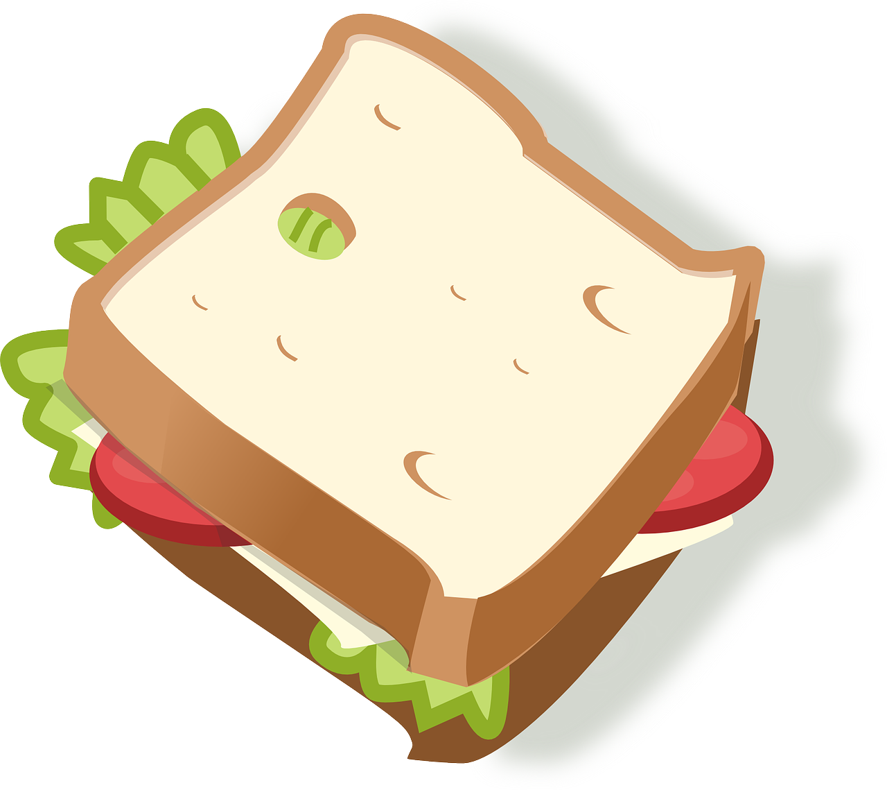
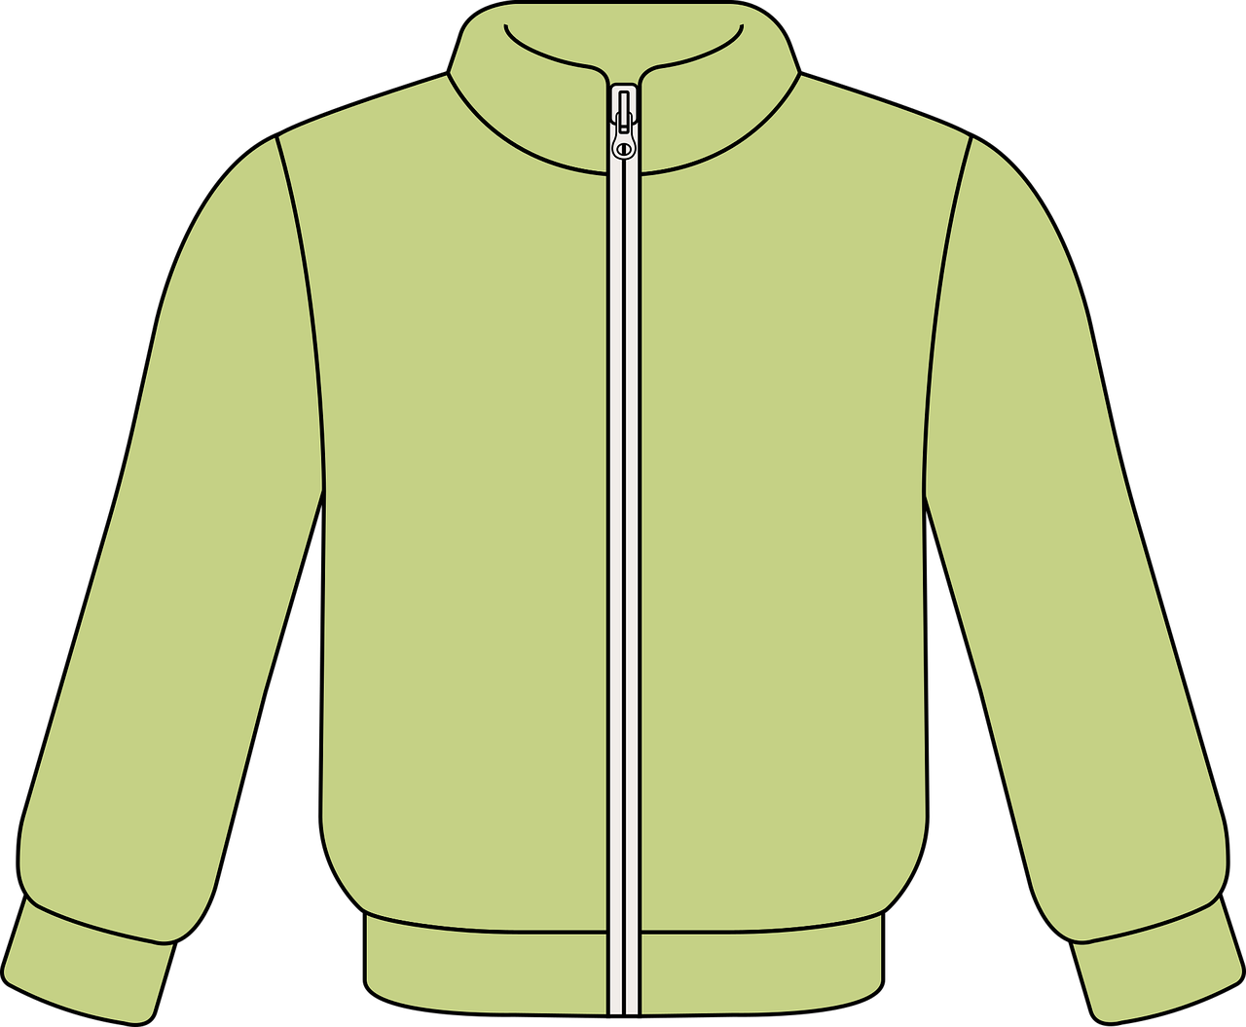
lesen
Mariem’s things are muddled in her new house
Ronja writes a list to help Mariem keep track of her things.
Ist das A oder B? Hat sie das Ding oder nicht?
Wie geht’s Mariem?
 |  | A | B
1 | Du hast einen
2 | Du hast keine
3 | Du hast keinen
4 | Du hast kein
5 | Du hast einen
6 | Du hast auch eine
/
Schlecht!
1
2
3
4
5
6
Notes:
Timing: 5 minutes
Aim: to practise aural comprehension of einen/eine/ein and keinen/keine/kein.
Procedure:
Explain the scenario. Mariem’s things are muddled after moving house. Ronja has written a list to help her.
Pupils read the sentence starters and based on the ending of ein… or kein… they decide which of the two objects Ronja is referring to.
Click to reveal answers.
Click to reveal a second column. Pupils read the sentences again and decide whether Mariem has the object or not.
Click to reveal answers. In the audio version, click the blue buttons to hear the full sentences.
12

Slide 13
Vokabeln
Freundschaft*
die Freundschaft - friendship
As you know, learning languages is about making friends.
You show kindness when you learn even a few words in another language.
Mariem has moved next door to Jana. What kind things could they say to each other as new neighbours?
Wie geht’s?
Guten Morgen!
Hallo!
_ _ _ _ _ _ _’_?
Danke!
_ _ _ _ _ _ _ _ _ _ _!
_ _ _ _ _!
D_ _ _ _!
Du bist wunderbar!
Du hast eine Katze. Sie ist super!
You are wonderful!
Dein Haus ist super!
Dein Fahrrad ist gut!
Your house is super!
Your bicycle is good!
You have a cat. She is super!
Notes:
Timing: 3 minutes
Aim: to continue the idea that learning other languages opens the door to new friendships, and that a few kind words go a long way; to revisit some previously-taught language from this term that fits our category of ‘friendship sentences’.
Procedure:
Click to present the information on the slide.
Elicit the German from pupils for the English greetings and friendly statements.
Allow pupils a few moments to turn to those around them and greet them and say something kind about their work or about themselves.
13

Slide 14
Tschüss!
gelb
Notes:
14

