Slide 1
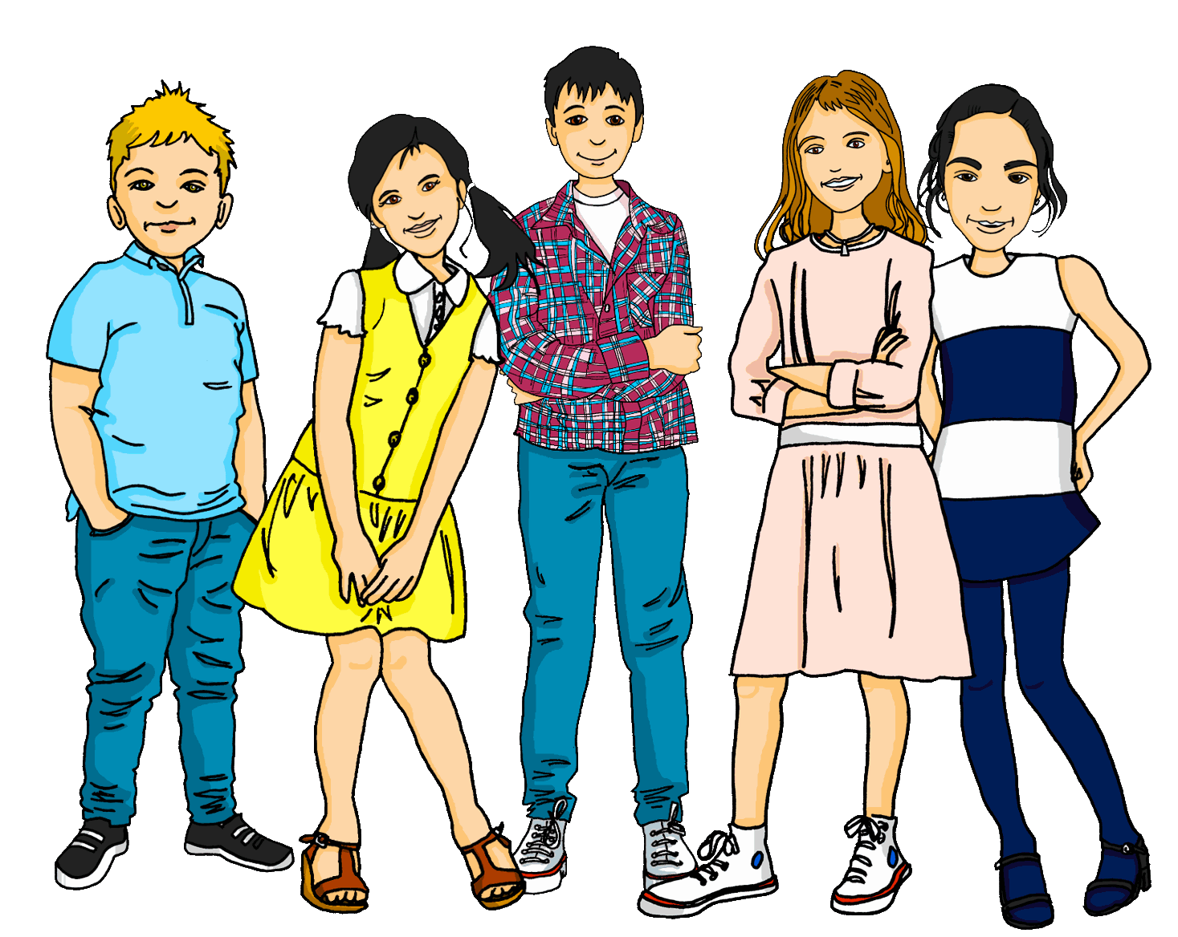
Talking about things and things to do
gelb
Follow ups 1-5
Term 2 Week 5
Notes:
Artwork by Steve Clarke. Pronoun pictures from NCELP (www.ncelp.org). All additional pictures selected from Pixabay and are available under a Creative Commons license, no attribution required.
Phonics:
Introduce [äu] Häuser [Haus-147] Mäuse [Maus-3463], träumen [1793]
Revisit [au] Haus [147] blau [948] laufen [252]
Vocabulary: Gruppe [369] Lieblings- [n/a] Song [3373]
Revisit 1: Frau [99] Herr [154] Mann [121] Schüler, Schülerin [556] Spieler, Spielerin [822] total [1021]
Revisit 2: alt [138] neu [84] lang [97] rund [296]
Jones, R.L & Tschirner, E. (2019). A frequency dictionary of German: Core vocabulary for learners. London: Routledge.
The frequency rankings for words that occur in this PowerPoint which have been previously introduced in these resources are given in the SOW and in the resources that first introduced and formally re-visited those words.
For any other words that occur incidentally in this PowerPoint, frequency rankings will be provided in the notes field wherever possible.
Note that the first three lessons of the year teach language that can be continuously recycled as lesson routine every lesson in Y3/4.
The idea would be that the class teacher (whether or not s/he teaches the class German can re-use the language as part of the daily routine with the class).
Image attribution:
Eurovision logo By European Broadcasting Union - https://eurovision.tv/about/brand (under &quot;Downloads&quot; &gt; &quot;Generic logo&quot;, converted from EPS format), Public Domain, https://en.wikipedia.org/w/index.php?curid=46362823

Slide 2
aussprechen
[au]
…
Haus
Notes:
Timing: 1 minute
Aim: to revisit the SSC [au].
Procedure:
Introduce the SSC and present the source word ‘Haus’ (with gesture, if using).
Click to bring on the picture and get pupils to repeat the word ‘Haus’ (with gesture, if using).
Note:
a gesture for ‘Haus’ might be to make a roof above your head with two hands.
2

Slide 3
aussprechen
[au]
…
Haus
[to run, running]
blau
laufen
Notes:
Timing: 1 minute
Aim: to consolidate the SSC [au].
Procedure:
Re-present the SSC and the source word ‘Haus’ (with gesture, if using).
Click to bring on the picture and get pupils to repeat the word ‘Haus’ (with gesture, if using).
Present the cluster words in the same way, bringing on the picture and getting pupils to pronounce the words.
3

Slide 4
aussprechen
[äu]
The sound [äu] is the same as the sound [eu] in Deutschland.
…
Häuser
This is the plural of the word Haus. For more than one Haus, use Häuser.
Notes:
Timing: 1 minute
Aim: to introduce the SSC [äu].
Procedure:
Introduce the SSC and present the source word ‘Häuser’ (with gesture, if using).
Click to bring on the picture and get pupils to repeat the word ‘Häuser’ (with gesture, if using).
Use the call-outs to explain that Häuser is the plural of Haus and to demonstrate that the new sound [äu] is the same sound as last week’s [eu].
4

Slide 5
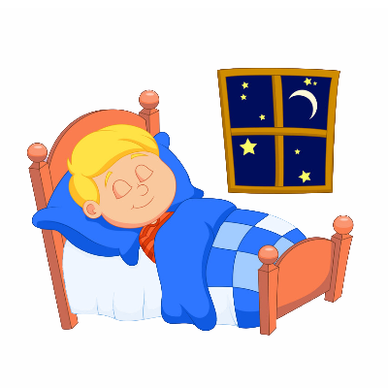
aussprechen
[äu]
The sound [äu] here is the same as the sound [eu] in Deutschland, Freund and heute.
…
Häuser
[to dream]
[mice]
träumen
Mäuse
Notes:
Timing: 1 minute
Aim: to consolidate the SSC [äu].
Procedure:
Re-present the SSC and the source word ‘Häuser’ (with gesture, if using).
Click to bring on the picture and get pupils to repeat the word ‘Häuser’ (with gesture, if using).
Present the cluster words in the same way, bringing on the picture and getting pupils to pronounce the words.
Use the call-out to remind pupils of other words with the [eu] sound from last week, which sound the same as the new [äu].
Word frequency:
Haus [147] Maus [3463] träumen [1793]
Jones, R.L & Tschirner, E. (2019). A frequency dictionary of German: Core vocabulary for learners. London: Routledge.
5

Slide 6
Follow up 1
Lies die Wörter. Ist das [au] oder [äu]?
au
äu
aussprechen
Käufer
Baum
Gebäude
Traum
Säule
Maus
gläubig
sauber
läuten
Haus
träumen
Staub
Fäuste
braun
Mäuse
laufen
Räume
aufwachen
Urlaub
Häuser
Notes:
HANDOUT at the end of this presentation.
Timing: 5 minutes Slide 1/2
Aim: To provide practice in distinguishing between this week’s SSC [äu] and the SSC [au]. Procedure: 1. This is a paired read aloud task. The pupils use 2 different coloured pencils (1 each) to play on the same sheet. Pupil A says one of the words/phrases and pupil B has 3 seconds to locate it and cross it off with their colour. If the pupil takes longer than 3 seconds pupil A can ‘steal’ the point.
2. Alternatively, they can do it more slowly and carefully, scrutinising each other’s pronunciation. If one makes a mistake, then the other pupil corrects and crosses off in his/her colour.
3. Use the next slide to check/discuss the meanings of the words if time.
Word frequency (1 is the most frequent word in German):
aufwachen [2851] Baum [1013] braun [2320] Haus [147] laufen [252] Maus [3463] Staub [3932] Traum [992] Urlaub [1570]
Fäuste [3250] Gebäude [1386] gläubig [4910] Käufer [2051] läuten [4517] Räume [403] Säule [3340] träumen [1793]
Source: Jones, R.L. & Tschirner, E. (2006). A frequency dictionary of German: core vocabulary for learners. Routledge

Slide 7
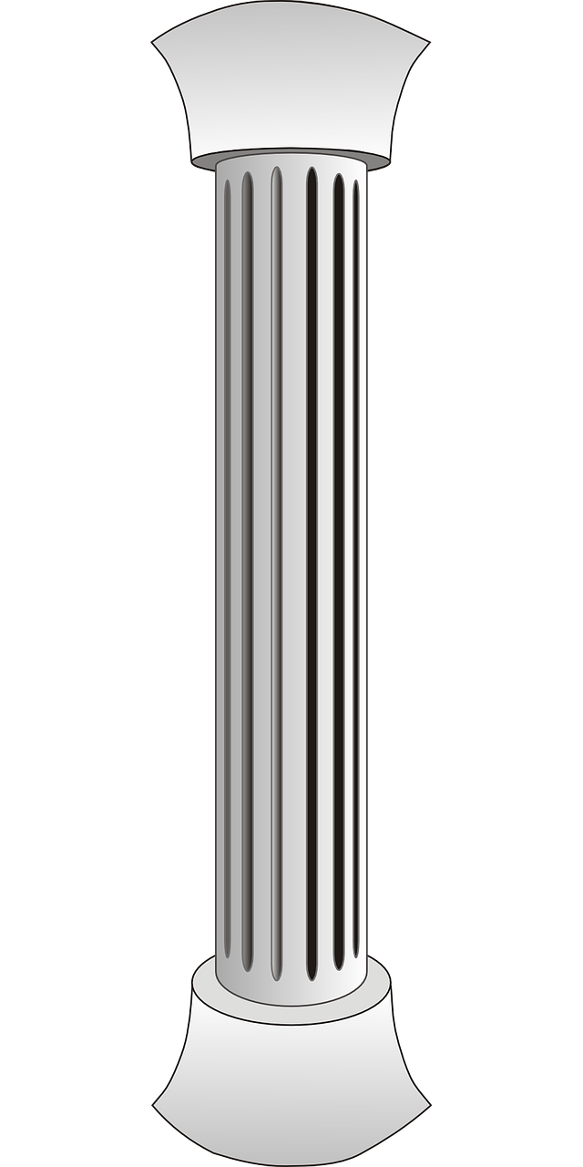
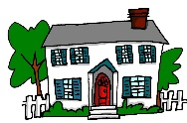
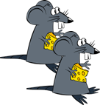
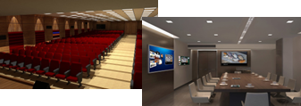
Follow up 1
Lies die Wörter. Ist das [au] oder [äu]?
au
äu
aussprechen
Käufer
[buyer]
Baum
Gebäude
Traum
Säule
Maus
gläubig
sauber
läuten
Haus
träumen
Staub
Fäuste
braun
Mäuse
laufen
Räume
aufwachen
Urlaub
Häuser
Notes:
Slide 2/2
Meanings:
Baum- tree
Maus- mouse
Traum- dream
sauber- clean
Staub- dust
Haus-house
braun- brown
laufen- to run
aufwachen- to wake up
Urlaub- holiday
Käufer- buyer
Säule- column, pillar
Gebäude- building(s)
läuten- to ring
gläubig- religious
träumen- to dream
Mäuse-mice
Fäuste- fists
Häuser- houses
Räume - rooms

Slide 8
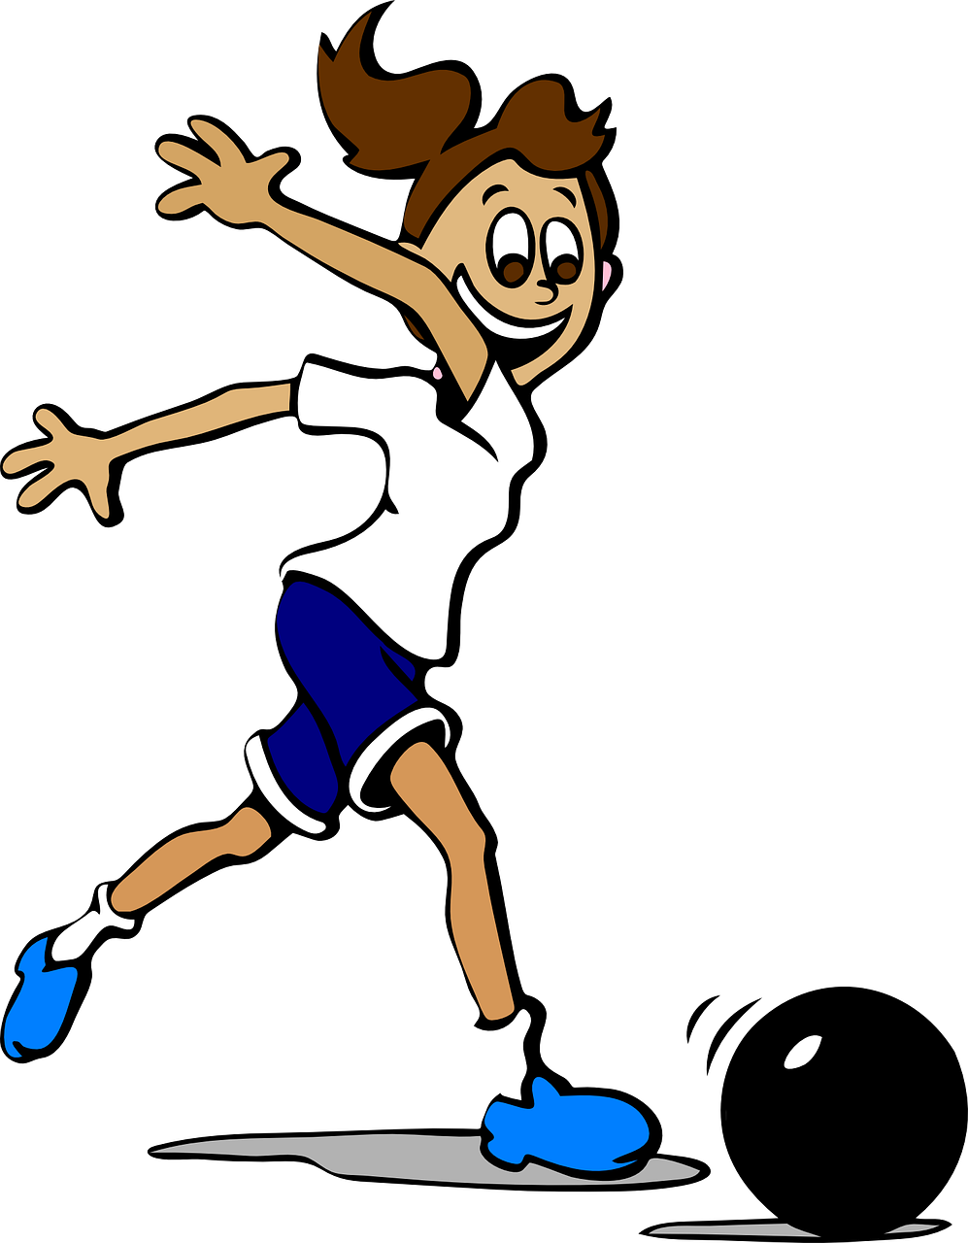
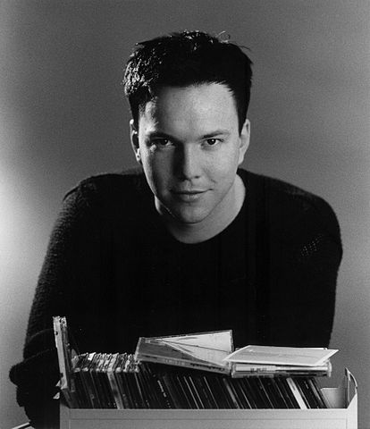
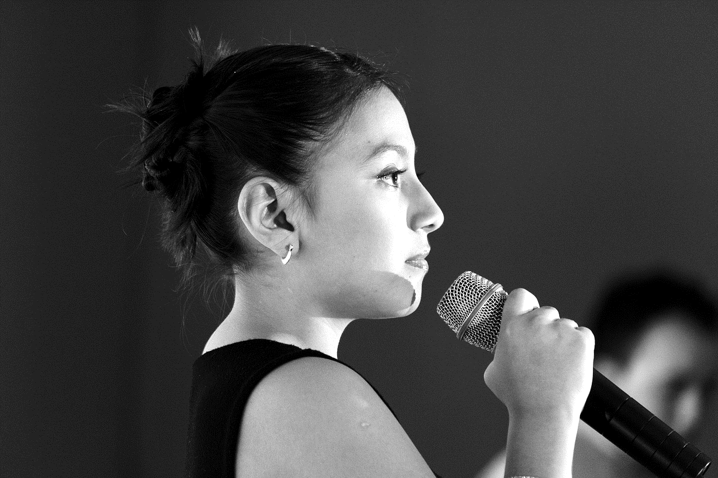
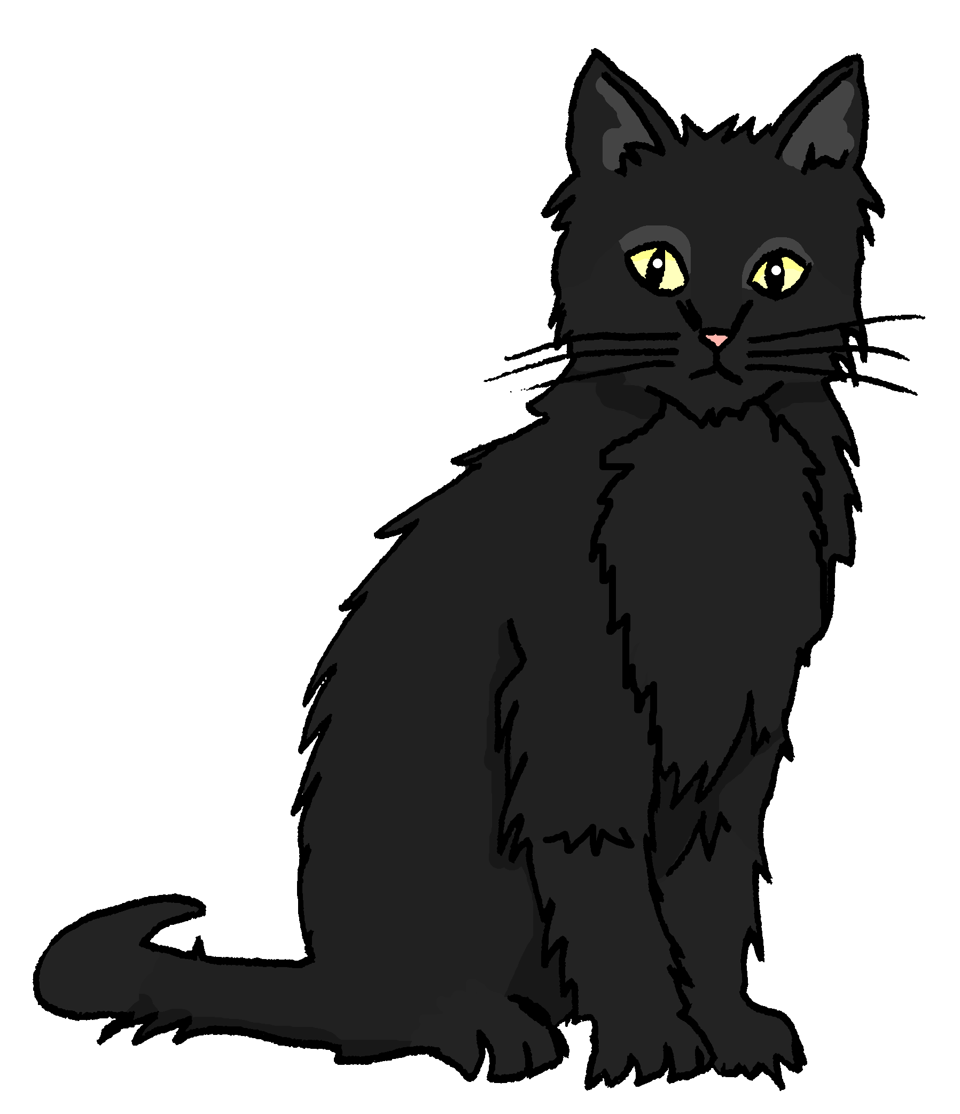
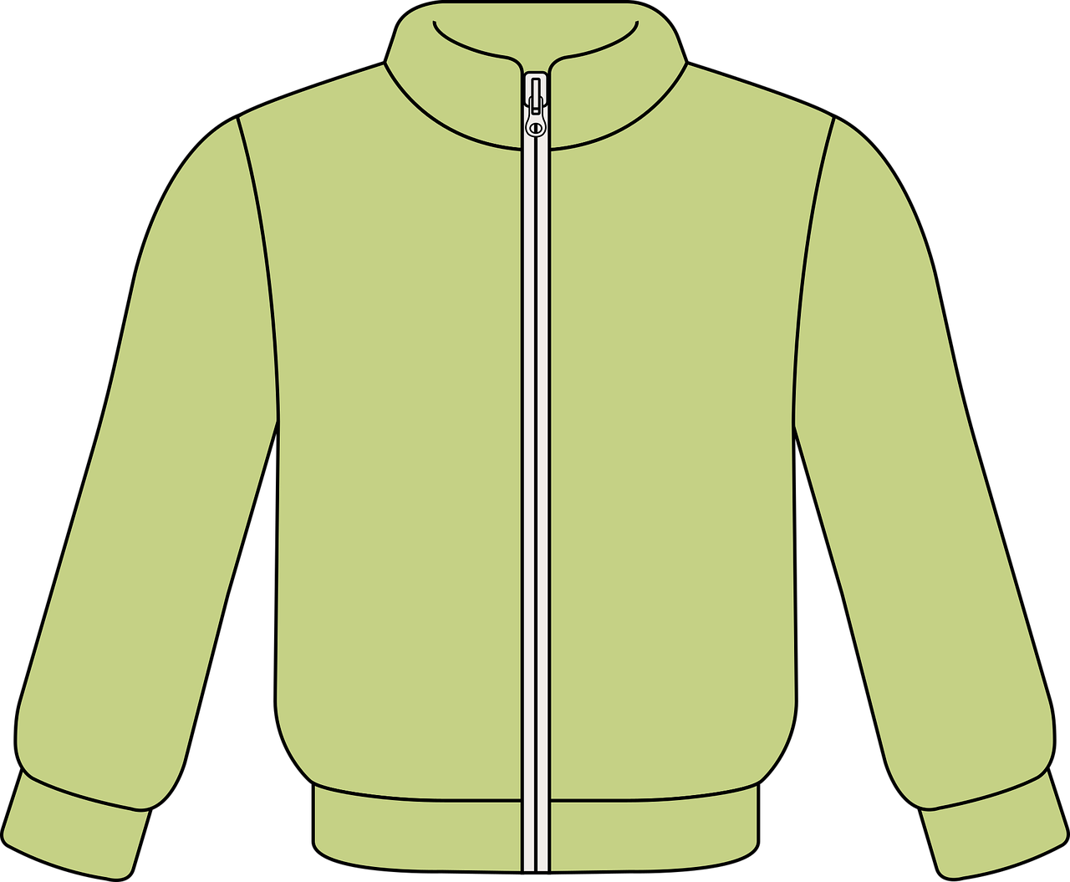
Follow up 2
*Dinge-things
Lieblingsdinge*. Was hat Frau Anspach?
Herr Epiney is asking Frau Anspach, one of the singers for Switzerland this year, about her favourite things.
Does (✔ ) or doesn’t (x) she have a favourite?
hören
A
A. Ich habe keine Lieblingsgruppe aber ich habe einen Lieblingssong.
B
Have you got … ?
I’ve got / I haven’t got …
C
D
E
F
Notes:
Timing: 5 minutes Aim: To provide practice in noticing negation with kein and to practise the use of Lieblings- with new and revisited vocabulary.
Procedure:
Explain the scenario. Frau Anspach is talking about whether or not she has favourite things. Pupils need to listen out for ein or kein in each sentence and identify which of the two pictures she has a favourite of, and which she doesn’t. The pictures could be mentioned left then right or right then left.
Ask pupils to write down letters A-F
Listen to A together and click to show sentence on board. Pupils should draw a tick and cross in the correct order, based on which thing Frau Anspach has a favourite of.
Click to listen to each of sentences B-F and ask pupils to decide on their answers independently.
Click to display answer ticks and crosses.
Transcript
A. Ich habe keine Lieblingsgruppe aber ich habe einen Lieblingssong.
B. Ich habe keine Lieblingsspielerin aber ich habe einen Lieblingsort.
C. Ich habe ein Lieblingsspiel aber ich habe keine Lieblingsfarbe.
D. Ich habe keine Lieblingsperson aber ich habe ein Lieblingsding.
E. Ich habe keinen Lieblingsbaum aber ich habe eine Lieblingskatze.
F. Ich habe eine Lieblingsjacke aber ich habe keinen Lieblingscomputer.
Note: While Herr Epiney is real, Frau Anspach is fictitious.

Slide 9
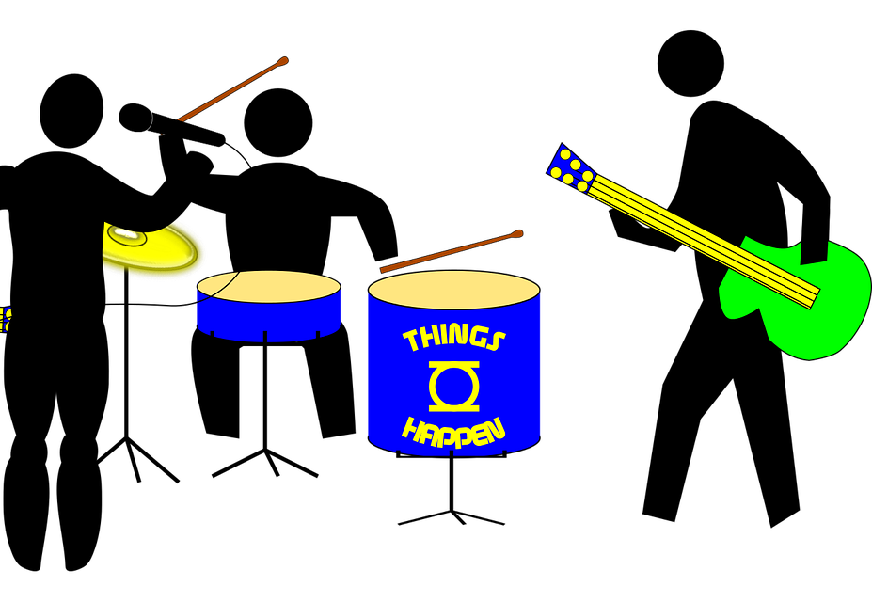
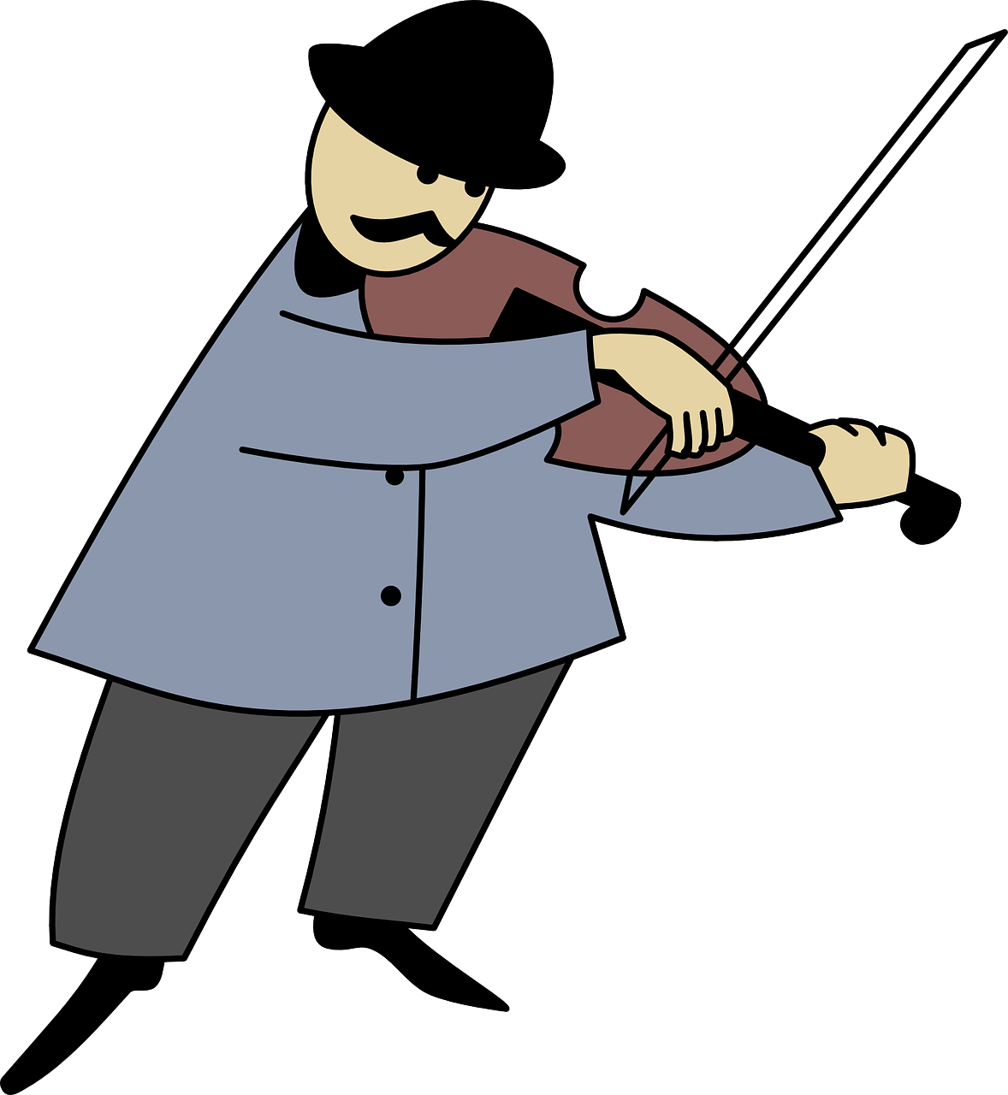
Follow up 3
Lies die Sätze*.
schreiben
lesen
Oh je! Ronja has listed everyone’s favourite things from the show, but she smudged the articles and can’t remember some of the words! Help her complete the sentences.
spiel
song.
1. Lias hat kein Lieblings aber er hat einen Lieblings .
band
ding.
2. Mariem hat keine Lieblings aber sie hat ein Lieblings .
spieler
gruppe.
3. Gabriel hat einen Lieblings aber er hat keine Lieblings .
[player]
person.
text
4. Jana hat einen Lieblings aber sie hat keine Lieblings .
blue= masculine
red=feminine
green=neuter
*Sätze- sentences
Notes:
Timing: 5 minutes
Aim: to practise building sentences using the correct form of ein/kein words and recalling vocab and genders.
Procedure:
Explain the scenario. Pupils need to help Ronja complete her sentences by recalling the vocabulary given in pictures and by inserting the correct ein/kein words based on the gender of the nouns. The colour of the words Lieblings in each case indicates the gender of the nouns. Pupils could write out full sentences or just 4 words e.g. 1. kein/Spiel/einen/Song.
Click to reveal ein/kein words beneath smudges and to call up vocabulary spellings.
Additional task suggestions: 1. Ask pupils to change the sentences to be about themselves. E.g. 1. Ich habe ein Lieblingsspiel aber ich habe keinen Lieblingssong. A partner could then report back to the class E.g. 1. Elliot hat ein Lieblingsspiel aber er hat keinen Lieblingssong.

Slide 10
Follow up 4a
Hast du einen/eine/ein Lieblings…?
Partnerbarbeit*!
sprechen
Ask your partner if they have a favourite of each of the things below.
If yes, write (✔) and their answer.
If no, write (✘).
Hast du einen Lieblingssong?
Have you got a favourite song?
1. Favourite song?
2. Favourite group?
3. Favourite [female] player?
4. Favourite game?
5. Favourite thing?
6. Favourite place?
7. Favourite colour?
Ja. Mein Lieblingssong ist Can’t Stop the Feeling!
Yes. My favourite song is Can’t Stop the Feeling!
Nein. Ich habe keinen Lieblingssong.
No. I don’t have a favourite song.
blue= masculine
red=feminine
green=neuter
*Arbeit- work
Notes:
Timing: 5 minutes
Aim: to provide practice (speaking) in asking and answering questions about having (favourite things).
Procedure:
Demonstrate the conversations pupils will have using Lias and Ronja’s speech bubbles. Try to translate them into German as a class, thinking about the gender of Song and discussing words for ein/kein/mein needed. Demonstrate how pupils would note down a tick and Can’t Stop the Feeling! for the first answer, or just a cross for the second answer.
Draw attention to the blue/red/green English nouns to help pupils with the genders of the remaining nouns. Ask ‘How will the question be different in number 2?’ Pupils will need to use eine, meine, keine for feminine and ein, mein and kein for neuter.
Give pupils time in pairs to both ask and answer all questions, noting down their partner’s answers as they go.
If time allows, hear some of the conversations as a class to ensure pupils are not only recalling the vocabulary but also thinking about gender.
Additional task suggestions:
1. See next slide for follow up writing task. 2. Alternatively, pupils could report back to the teacher/rest of class using the 3rd person of haben e.g. Lucy hat keinen Lieblingssong aber sie hat eine Lieblingsspielerin. Lucys Lieblingsspielerin ist Mary Earps.

Slide 11
Follow up 4b
Schreib Sätze!
sprechen
Write sentences to describe your partner’s favourite things.
Hast du einen Lieblingssong?
1. Favourite song? | Happy
2. Favourite [female] player? | Mary Earps
3. Favourite game? | X
Ja. Mein Lieblingssong ist Happy.
Ronjas Lieblingssong ist Happy.
Hast du ein Lieblingsspiel?
Ronjas Lieblingsspielerin ist Mary Earps.
Nein. Ich habe kein Lieblingsspiel.
Ronja hat kein Lieblingsspiel.
Ronjas Lieblingssong [Ronja’s favourite song]. No apostrophe in German.
Notes:
Timing: 3 minutes
Aim: to provide written practice of favourite things vocabulary and use of kein/keine/keinen.
Procedure:
Remind pupils of the conversation between Lias and Ronja and click to bring up the table showing Ronja’s answers.
Click again for each example sentence to come up. Draw attention to use of kein in the third sentence and lack of apostrophe in German for possession in the first two sentences.
Ask pupils to write a few sentences about their partner’s favourite things.
Hear a few sentences written by pupils and use these as an opportunity to identify errors and correct as a class.

Slide 12
Follow up 5:

Schreib auf Englisch.
Can you get at least 15 points?
Wörter
 | lang | rund | die Spielerin
 | der Spieler | alt | neu
 | der Schüler | total | Herr
 | die Schülerin | (die) Frau | der Mann
 | die Gruppe | der Song | keine
 | nicht | haben | Lieblings-
Vokabeln
long
round
(the) [female] player
x3
(the) [male] player
old
new
(the) [male] pupil
totally
Mr
x2
(the) woman/ Mrs, Miss, Ms
(the) [female] pupil
(the) man
(the) group
(the) song
not a, no (f)
x1
not
to have, having
favourite
Notes:
Timing: 5 minutes
Aim: to practise written production of vocabulary from this and revisited weeks.
Procedure: 1. Give pupils a blank grid. They fill in the English meanings of any of the words they know, trying to reach 15 points in total.
Note: The most recently learnt and practised words are pink, words from the previous week are green and those from week 1 are blue, thus more points are awarded for them, to recognise that memories fade and more effort (heavy lifting!) is needed to retrieve them.

Slide 13
Follow up 5:

Schreib auf Deutsch.
Can you get at least 15 points?
Wörter
 | old | long | new
 | (the) [female] pupil | up, above | (the) [male] pupil
 | (the) [female] player | (the) man | totally
 | (the) woman/ Mrs, Miss, Ms | Mr | (the) [male] player
 | (the) song | not | to have, having
 | (the) group | favourite | not a, no (m) (nt)
alt
lang
neu
Vokabeln
x3
die Schülerin
rund
der Schüler
die Spielerin
der Mann
total
x2
die Frau
Herr
der Spieler
der Song
nicht
haben
x1
die Gruppe
Lieblings-
kein
Notes:
Timing: 5 minutes
Aim: to practise written production of vocabulary from this and revisited weeks.
Procedure: 1. Give pupils a blank grid. They fill in the German meanings of any of the words they know, trying to reach 15 points in total.
Note: The most recently learnt and practised words are pink, words from the previous week are green and those from week 1 are blue, thus more points are awarded for them, to recognise that memories fade and more effort (heavy lifting!) is needed to retrieve them.

Slide 14
Tschüss!
gelb
Notes:
14

Slide 15
Follow up 1
Lies die Wörter. Ist das [au] oder [äu]?
au
äu
aussprechen
Käufer
Baum
Gebäude
Traum
Säule
Maus
gläubig
sauber
läuten
Haus
träumen
Staub
Fäuste
braun
Mäuse
laufen
Räume
aufwachen
Urlaub
Häuser
Notes:
HANDOUT (1 between 2)

Slide 16
Follow up 5:

Schreib auf Englisch.
Can you get at least 15 points?
Wörter
 | lang | rund | die Spielerin
 | der Spieler | alt | neu
 | der Schüler | total | Herr
 | die Schülerin | (die) Frau | der Mann
 | die Gruppe | der Song | keine
 | nicht | haben | Lieblings-
Vokabeln
x3
x2
x1
Notes:
HANDOUT

Slide 17
Follow up 5:

Schreib auf Deutsch.
Can you get at least 15 points?
Wörter
 | old | long | new
 | (the) [female] pupil | up, above | (the) [male] pupil
 | (the) [female] player | (the) man | totally
 | (the) woman/ Mrs, Miss, Ms | Mr | (the) [male] player
 | (the) song | not | to have, having
 | (the) group | favourite | not a, no (m) (nt)
Vokabeln
x3
x2
x1
Notes:
HANDOUT

