Slide 1
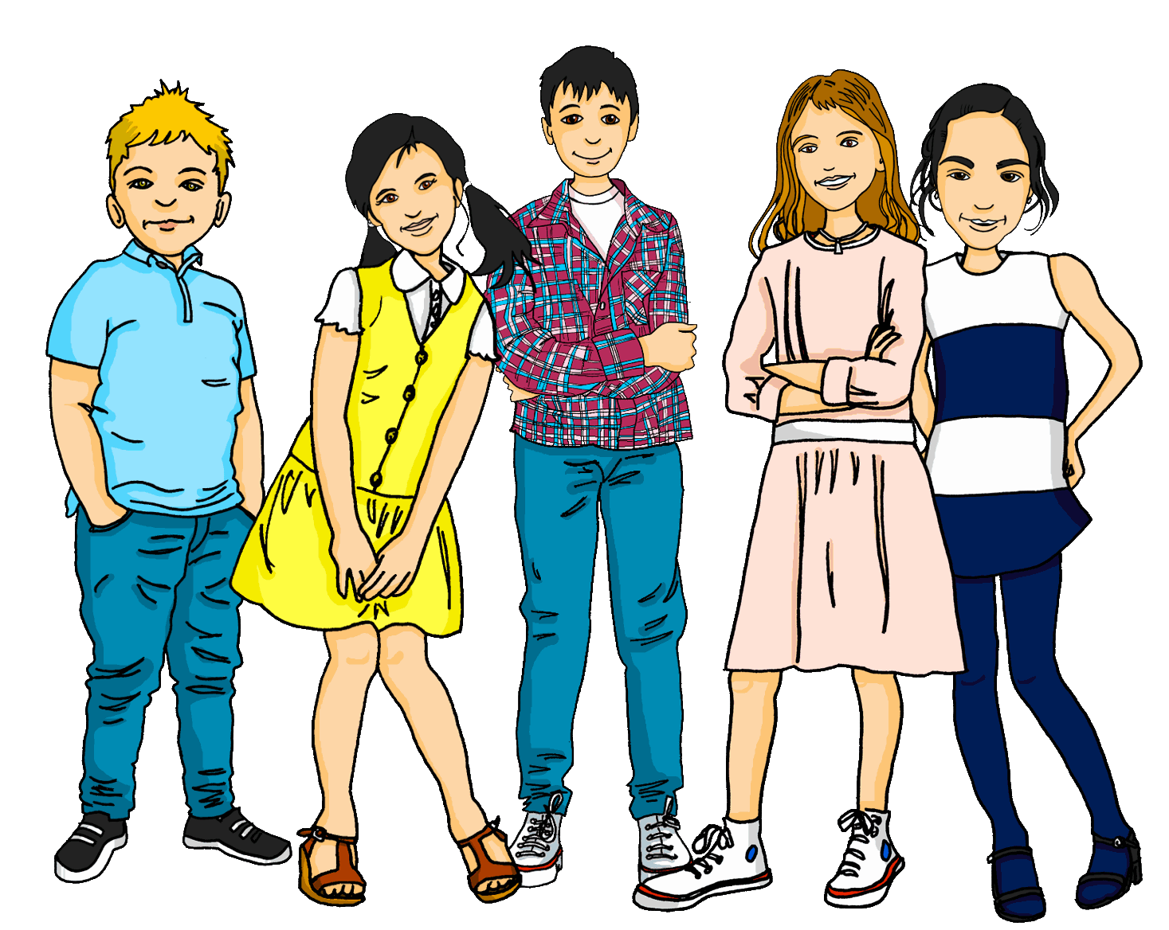
Talking about things and things to do
Favourite things (Lieblings-)
Cognates
SSC [äu] vs. [au]
gelb
Term 2 Week 5
Notes:
Artwork by Steve Clarke. Pronoun pictures from NCELP (www.ncelp.org). All additional pictures selected from Pixabay and are available under a Creative Commons license, no attribution required.
Phonics:
Introduce [äu] Häuser [Haus-147] Mäuse [Maus-3463], träumen [1793]
Revisit [au] Haus [147] blau [948] laufen [252]
Vocabulary: Gruppe [369] Lieblings- [n/a] Song [3373]
Revisit 1: Frau [99] Herr [154] Mann [121] Schüler, Schülerin [556] Spieler, Spielerin [822] total [1021]
Revisit 2: alt [138] neu [84] lang [97] rund [296]
Jones, R.L & Tschirner, E. (2019). A frequency dictionary of German: Core vocabulary for learners. London: Routledge.
The frequency rankings for words that occur in this PowerPoint which have been previously introduced in these resources are given in the SOW and in the resources that first introduced and formally re-visited those words.
For any other words that occur incidentally in this PowerPoint, frequency rankings will be provided in the notes field wherever possible.
Note that the first three lessons of the year teach language that can be continuously recycled as lesson routine every lesson in Y3/4.
The idea would be that the class teacher (whether or not s/he teaches the class German can re-use the language as part of the daily routine with the class).
Image attribution:
Eurovision logo By European Broadcasting Union - https://eurovision.tv/about/brand (under &quot;Downloads&quot; &gt; &quot;Generic logo&quot;, converted from EPS format), Public Domain, https://en.wikipedia.org/w/index.php?curid=46362823
1

Slide 2
aussprechen
[au]
…
Haus
Notes:
Timing: 1 minute
Aim: to revisit the SSC [au].
Procedure:
Introduce the SSC and present the source word ‘Haus’ (with gesture, if using).
Click to bring on the picture and get pupils to repeat the word ‘Haus’ (with gesture, if using).
Note:
a gesture for ‘Haus’ might be to make a roof above your head with two hands.
2

Slide 3
aussprechen
[au]
…
Haus
[to run, running]
blau
laufen
Notes:
Timing: 1 minute
Aim: to consolidate the SSC [au].
Procedure:
Re-present the SSC and the source word ‘Haus’ (with gesture, if using).
Click to bring on the picture and get pupils to repeat the word ‘Haus’ (with gesture, if using).
Present the cluster words in the same way, bringing on the picture and getting pupils to pronounce the words.
3

Slide 4
aussprechen
[äu]
The sound [äu] is the same as the sound [eu] in Deutschland.
…
Häuser
This is the plural of the word Haus. For more than one Haus, use Häuser.
Notes:
Timing: 1 minute
Aim: to introduce the SSC [äu].
Procedure:
Introduce the SSC and present the source word ‘Häuser’ (with gesture, if using).
Click to bring on the picture and get pupils to repeat the word ‘Häuser’ (with gesture, if using).
Use the call-outs to explain that Häuser is the plural of Haus and to demonstrate that the new sound [äu] is the same sound as last week’s [eu].
4

Slide 5
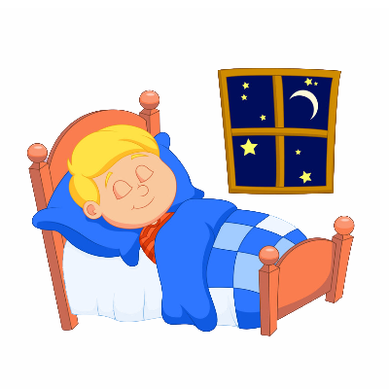
aussprechen
[äu]
The sound [äu] here is the same as the sound [eu] in Deutschland, Freund and heute.
…
Häuser
[to dream]
[mice]
träumen
Mäuse
Notes:
Timing: 1 minute
Aim: to consolidate the SSC [äu].
Procedure:
Re-present the SSC and the source word ‘Häuser’ (with gesture, if using).
Click to bring on the picture and get pupils to repeat the word ‘Häuser’ (with gesture, if using).
Present the cluster words in the same way, bringing on the picture and getting pupils to pronounce the words.
Use the call-out to remind pupils of other words with the [eu] sound from last week, which sound the same as the new [äu].
Word frequency:
Haus [147] Maus [3463] träumen [1793]
Jones, R.L & Tschirner, E. (2019). A frequency dictionary of German: Core vocabulary for learners. London: Routledge.
5

Slide 6
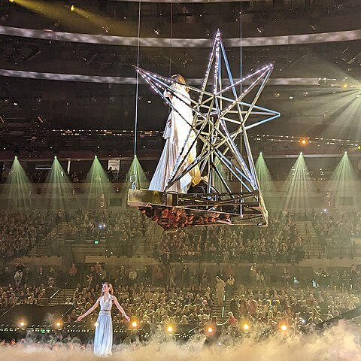
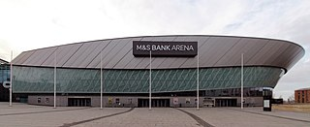
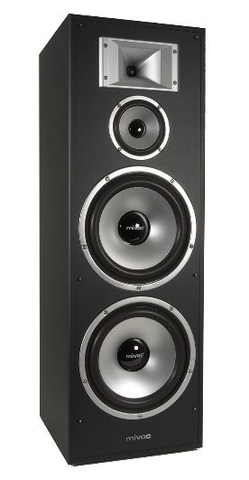
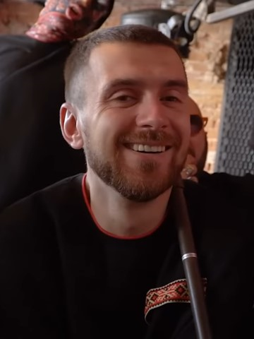
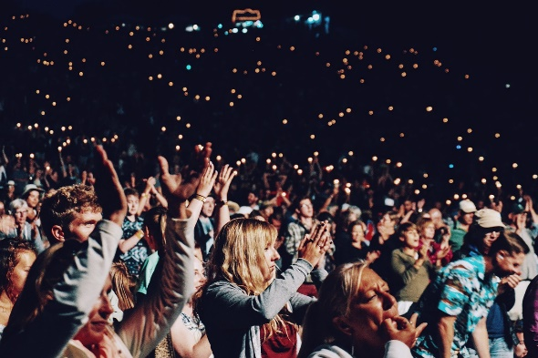
[au] oder [äu]?
Hör zu. Ist es [au] oder [äu]?
We’re having a Eurovision party!
Gebäude
Auftritt
Zuschauer
[building]
[spectators]
[performance]
Geräusch
Bräuche
Applaus
[traditions]
[noise]
Notes:
Timing: 5 minutes
Aim: to consolidate the SSCs [äu] and [au] by aurally differentiating between the two sounds.
Procedure:
1. Click on a picture to hear a word. Pupils decide whether they hear [au] as in Haus or [äu] as in Häuser and write down the correct sound.
2. Pupils can listen again and try to write the whole word if appropriate – this could be done on mini whiteboards (or air writing).
3. Click to reveal the answer. See below for the English meanings in brackets.
Transcript: Gebäude (building) Auftritt (performance)
Zuschauer (spectators)
Applaus (applause)
Geräusch (noise)
Bräuche (traditions)
Word frequency (1 is the most frequent word in German): Auftritt [2076] Applaus [3643] Brauch [>5000] Gebäude [1386] Geräusch [1931] Zuschauer [1410]
Source: Jones, R.L. & Tschirner, E. (2019). A frequency dictionary of German: core vocabulary for learners. Routledge
Image attributions:
M&S Bank Arena By Phil Nash from Wikimedia Commons CC BY-SA 4.0
"Music Unites Generations“ By Michael Doherty - Own work, CC BY-SA 4.0, https://commons.wikimedia.org/w/index.php?curid=132036547
Stage and green room in the arena By Michael Doherty - Own work, CC BY-SA 4.0, https://commons.wikimedia.org/w/index.php?curid=118239003
Tymofiy Muzychuk with Telenka By Ukraine Media, CC BY 3.0, https://commons.wikimedia.org/w/index.php?curid=118676353

Slide 7
Vokabeln
Vokabeln lernen
Sag die Wörter auf Deutsch. Was ist das auf Englisch?
Wörter
die Gruppe
der Song
Lieblings-
Cognates are words in which all or most of the letters are the same in two languages. The meaning is the same, too. Which of these new words are cognates?
Lieblings- means ‘favourite’. We can add it to any noun to make a compound noun:
e.g. Lieblingssong=favourite song
Notes:
Timing: 3 minutes
Aim: to present and practise new vocabulary for this week
Procedure:
1. Click to introduce the new words and their pictures. Practise pronouncing the words as a class and individually.
2. Ask pupils what they think the words mean in English.
3. Use the callout to draw attention to use of Lieblings.
4. Use the 2nd callout to talk about cognates. See if they can make some more compound nouns with Lieblings e.g. Lieblingsgruppe= favourite group, Lieblingssong= favourite song.
5. Click for individual words to disappear and to elicit them from the class. Click again for them to reappear.
6. Click on the images to listen and check pronunciation, if required.
7

Slide 8
Vokabeln
Vokabeln lernen
Wörter
Was ist das auf Englisch?
13. die Frau
6. der Spieler
3. die Jacke
7. die Farbe
14. die Schülerin
8. Lieblings
2. der Preis
4. das Butterbrot
11. die Band
1. die Person
5. das Spiel
9. der Contest
10. die Show
12. der Ort
Notes:
Timing: 5 minutes
Slide 1/2
Aim: to practise new and revisited vocabulary; to recognise new cognates.
Procedure:
1. Click to make the words disappear one by one. Pupils write down the number and the English translation. They have 4 seconds before the word disappears completely.
2. Use the next slide to elicit and then display the English translations.
8

Slide 9
Vokabeln
Vokabeln lernen
Which of these words are cognates?
Wörter
Was ist das auf Englisch?
1. die Person
1. (the) person
8. Lieblings
8. favourite
2. der Preis
2. (the) prize
9. der Contest
9. (the) contest
3. die Jacke
3. (the) jacket
10. die Show
10. (the) show
4. das Butterbrot
4. (the) sandwich
11. die Band
11. (the) band
5. das Spiel
5. (the) game
12. der Ort
12. (the) place
13. die Frau
13. (the) woman
6. der Spieler
6. (the) [male] player
14. (the) [female] pupil
7. die Farbe
7. (the) colour
14. die Schülerin
Notes:
2/2
Procedure
Elicit and display the English translations one by one.
Ask pupils to think about which words here are cognates. Some of them will be new words for pupils.
Click for all the German words to disappear.
Ask pupils to work in pairs to recall the words in German. They should try to remember genders too.
Click again for all words to reappear for pupils to check.
Click on each word to hear the audio, if required.
9

Slide 10
Saying you have / don’t have a thing
As you know, after the verb haben and most other verbs, the masculine
ein changes to einen and the masculine kein changes to keinen.
When we make a compound word, for example by adding Lieblings- to the noun, the new compound word takes its gender from the final noun.
Ich habe einen Lieblingssong.
Ich habe eine Lieblingsgruppe.
Ich habe ein Lieblingsspiel.
I have a favourite song.
I have a favourite group.
I have a favourite game.
Ich habe keinen Lieblingsort.
Ich habe keine Lieblingsfarbe.
Ich habe kein Lieblingsding.
I don’t have a favourite
colour.
I don’t have a favourite thing.
I don’t have a favourite place.
Notes:
Timing: 2 minutes
Procedure:
Click through the animations to recap ‘ein’ and kein’ changes after haben and most verbs, and to remind pupils of the gender of compound nouns.
Elicit English translation for the German examples provided.
10

Slide 11
Ist das mein Lieblingsding?
Everyone is chatting while watching Eurovision. Do they mention “favourite”?
lesen
 | ? | /
Do they have the thing or not?
Ich habe keine Lieblingsperson.
Ich habe ein Spiel.
Ich habe eine Lieblingsgruppe.
Ich habe keine Band.
Ich habe kein Butterbrot.
Ich habe einen Lieblingssong.
1
2
3
4
5
6
Notes:
Timing: 5 minutes Aim: To provide practice in noticing negation with kein and to practise the use of Lieblings- with new and revisited vocabulary.
Procedure:
Explain the task. The friends are discussing Eurovision.
Pupils read the sentences and decide whether a favourite is mentioned.
Click to reveal answers.
Click to reveal a second question and column.
Pupils read the sentences again and based on the use of kein and ein, decide whether the friends have the thing.
Click to reveal answers.

Slide 12
Meine Lieblingsdinge/ My favourite things
As you know, to say ‘my’ we use mein or meine:
masculine
feminine
neuter
mein Preis
meine Jacke
mein Ding
my prize
my jacket
my thing
You can add the prefix Lieblings- to a noun to talk about your favourite things. Introduce them using mein/meine. to talk about your favourite things. Introduce them using …
d the prefix Lie to a noun to talk about your favourite things. Introduce them using.
Mein …
Mein Lieblingspreis ist…
Meine Lieblingsjacke ist…
Mein Lieblingsding ist…
My favourite prize is…
My favourite jacket is…
My favourite thing is…
Ronja, hast du einen Lieblingssong?
Mein Lieblingssong ist Happy.
Hast du eine Lieblingsjacke?
Ja, meine Lieblingsjacke ist neu.
Notes:
Timing: 2 minutes
Aim: to recap the possessive adjective ‘mein’ and to introduce its use with Lieblings- compound nouns.
Procedure:
Click through the animations to present the new information.
Elicit English translation for the German examples provided.
Click to show examples of questions and answers between Ronja and Lias.
12

Slide 13
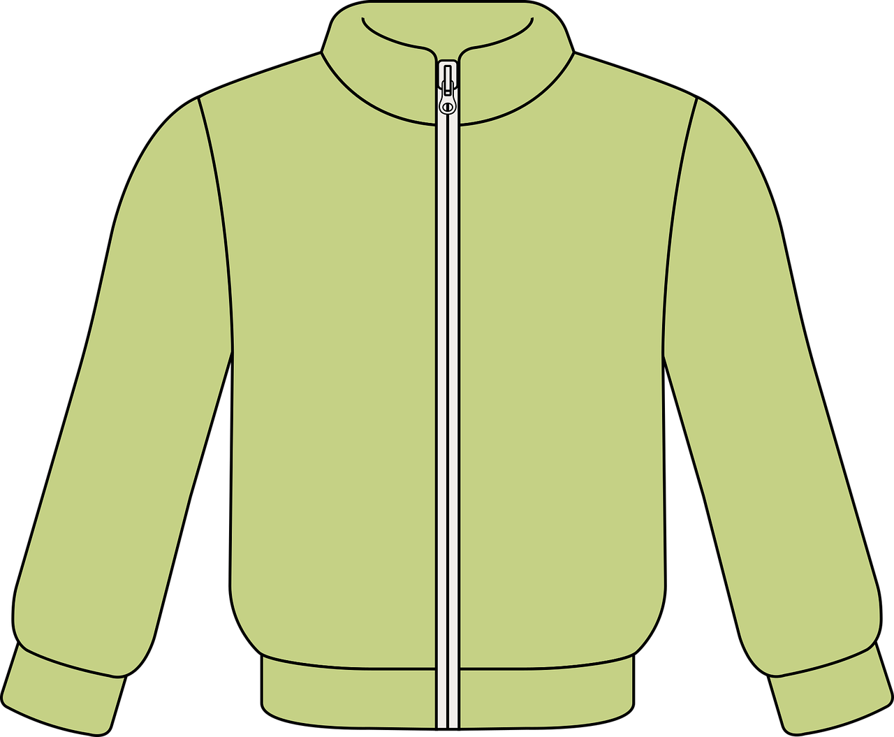
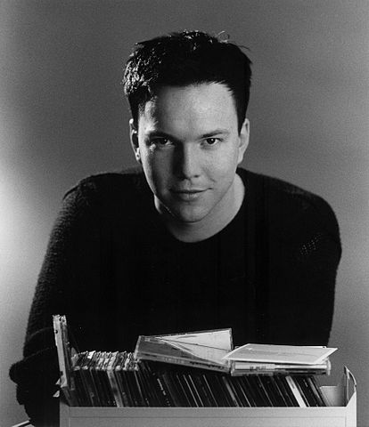
hören
Sven Epiney is the Swiss commentator for Eurovision. What does he think about Eurovision this year?
Interview mit* Sven Epiney
Hör zu. Schreib A oder B.
 | A | B | Yes or no?
 |  |  | Yes (Switzerland)
 |  |  | Yes (also Switzerland)
 |  |  | No
 |  |  | No
 |  |  | Yes (the show)
 |  |  | No
1
Herr Epiney, hast du einen Lieblingscontest?
2
3
Ja, mein Lieblingscontest ist Eurovision!
4
5
6
*mit – with
Notes:
Timing: 5 minutes
Aim: to practise aural comprehension of ein, mein and kein forms in the context of favourite things.
Procedure:
Explain the scenario. Sven Epiney, the Swiss Eurovision commentator is being interviewed about his favourite things for this year’s contest. Pupils must note down A or B based on the gender of the ein/mein/kein words they hear. They must then write Yes or No for whether or not Sven has a favourite. Note: Ja/Nein have been omitted in these short dialogues to avoid pupils relying on these cues for the answers.
2. Click to play number 1. Discuss as a class how to decide which noun is being discussed. (It is einen and mein so the missing word must be Song (m) not Gruppe (f).) Discuss also whether they heard a favourite song or whether Sven doesn’t have one. Click to display answers.
3. Play items 2-6.
4. Click to correct. Bonus points if anybody can name the favourite things!
Transcript
1. Hast du einen Lieblings[song]?
Mein Lieblings[song] ist die Schweiz.
2, Hast du eine Lieblings[gruppe]?
Meine Lieblings[gruppe] ist auch die Schweiz!
3. Hast du eine Lieblings[person]?
Ich habe keine Lieblings[person].
4. Hast du einen Lieblings[preis]?
Ich habe keinen Lieblings[preis]
5. Hast du ein Lieblings[ding]?
Mein Lieblings[ding] ist die Show!
6. Hast du eine Lieblings[jacke]?
Ich habe keine Lieblings[jacke].
Image attribution
Sven Epiney By Monica Boirar - Own work, CC BY-SA 3.0, https://commons.wikimedia.org/w/index.php?curid=24190785
13

Slide 14
Tschüss!
gelb
Notes:
14

