Slide 1
Talking about things and things to do
Konrad Duden Schule
gelb
Follow ups 1-5
Term 2 Week 6
Notes:
Artwork by Steve Clarke. Pronoun pictures from NCELP (www.ncelp.org). All additional pictures selected from Pixabay and are available under a Creative Commons license, no attribution required.
Phonics:
Introduce [sch] schreiben [245] falsch [638] schnell [233] Mensch [104] schwarz [451]
[sp] spielen [197] Sprache [367] sprechen [157] Sport [845] Spiel [500]
[st] stark [207] Straße [355] stehen [87] verstehen [222] Stadt [186]
Vocabulary: brauchen [179] bekommen [212] machen [58] schreiben [184] Brief [838] Geschichte [262] Hilfe [481] ich weiß (es) nicht [n/a] wie sagt man…? [n/a]
Revisit 1: Wer? [149] haben, ich habe, er, sie, es hat [6] Baum [1013] Computer [1252] Fahrrad [2138] Papier [1163] Spiel [328]
Revisit 2: Aufgabe [256] Karte [1474] Liste [1792] Partner, Partnerin [1172] mein, meine [51] dein, deine [233]
Jones, R.L & Tschirner, E. (2019). A frequency dictionary of German: Core vocabulary for learners. London: Routledge.
The frequency rankings for words that occur in this PowerPoint which have been previously introduced in these resources are given in the SOW and in the resources that first
introduced and formally re-visited those words.
For any other words that occur incidentally in this PowerPoint, frequency rankings will be provided in the notes field wherever possible.
Note that the first three lessons of the year teach language that can be continuously recycled as lesson routine every lesson in Y3/4.
The idea would be that the class teacher (whether or not s/he teaches the class German can re-use the language as part of the daily routine with the class.

Slide 2
aussprechen
[sch]
…
schreiben
Notes:
Timing: 1 minute
Aim: To introduce/consolidate SSC [sch]
Procedure: 1. Present the letter(s) and say the [sch] sound first, on its own. Pupils repeat it with you. 2. Bring up the word ”schreiben” on its own, say it, pupils repeat it, so that they have the opportunity to focus all of their attention on the connection between the written word and its sound.
3. A possible gesture for this would be to mime writing.
4. Roll back the animations and work through 1-3 again, but this time, dropping your voice completely to listen carefully to the pupils saying the [sch] sound, pronouncing ”schreiben” and, if using, doing the gesture. Word frequency (1 is the most frequent word in German):
schreiben [245] Source: Jones, R.L. & Tschirner, E. (2006). A frequency dictionary of German: core vocabulary for learners. Routledge
2

Slide 3
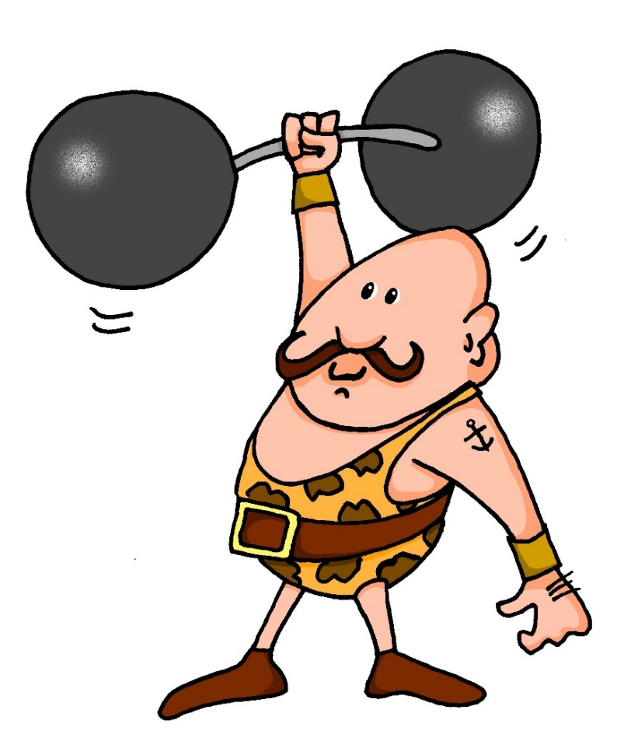
aussprechen
[st]
…
stark
Notes:
Timing: 1 minute
Aim: To introduce/consolidate SSC [st-]
Procedure: 1. Present the letter(s) and say the [st-] sound first, on its own. Pupils repeat it with you. 2. Bring up the word ”stark” on its own, say it, pupils repeat it, so that they have the opportunity to focus all of their attention on the connection between the written word and its sound.
3. A possible gesture for this would be to mime lifting dumbells by clenching your fists and raising them above your head.
4. Roll back the animations and work through 1-3 again, but this time, dropping your voice completely to listen carefully to the pupils saying the [st-] sound, pronouncing ”stark” and, if using, doing the gesture. Word frequency (1 is the most frequent word in German): stark [207] Source: Jones, R.L. & Tschirner, E. (2006). A frequency dictionary of German: core vocabulary for learners. Routledge
3

Slide 4
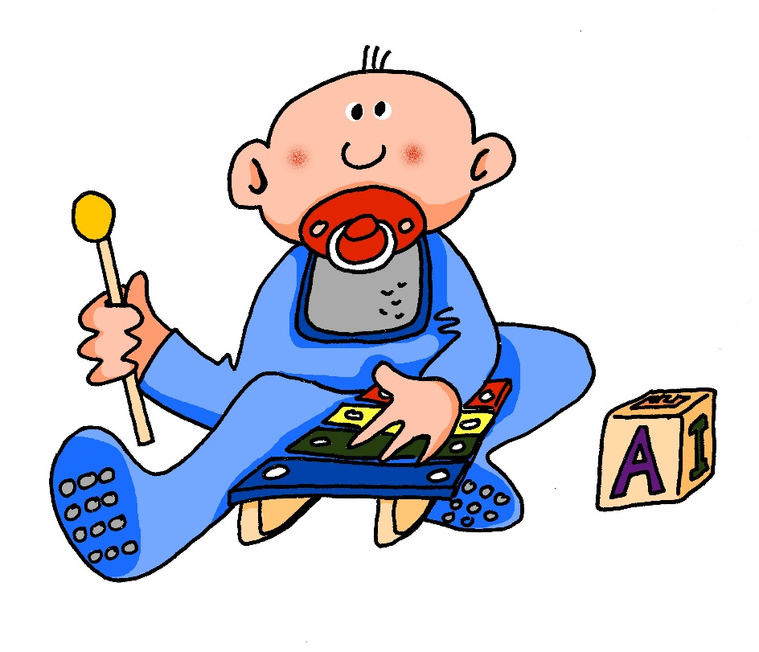
[sp]
…
aussprechen
spielen
Notes:
Timing: 1 minute
Aim: To introduce/consolidate SSC [sp-]
Procedure: 1. Present the letter(s) and say the [sp-] sound first, on its own. Pupils repeat it with you. 2. Bring up the word ”spielen” on its own, say it, pupils repeat it, so that they have the opportunity to focus all of their attention on the connection between the written word and its sound.
3. A possible gesture for this would be to mime playing an instrument or sport.
4. Roll back the animations and work through 1-3 again, but this time, dropping your voice completely to listen carefully to the pupils saying the [sp-] sound, pronouncing ”spielen” and, if using, doing the gesture. Word frequency (1 is the most frequent word in German): spielen [197] Source: Jones, R.L. & Tschirner, E. (2006). A frequency dictionary of German: core vocabulary for learners. Routledge

Slide 5
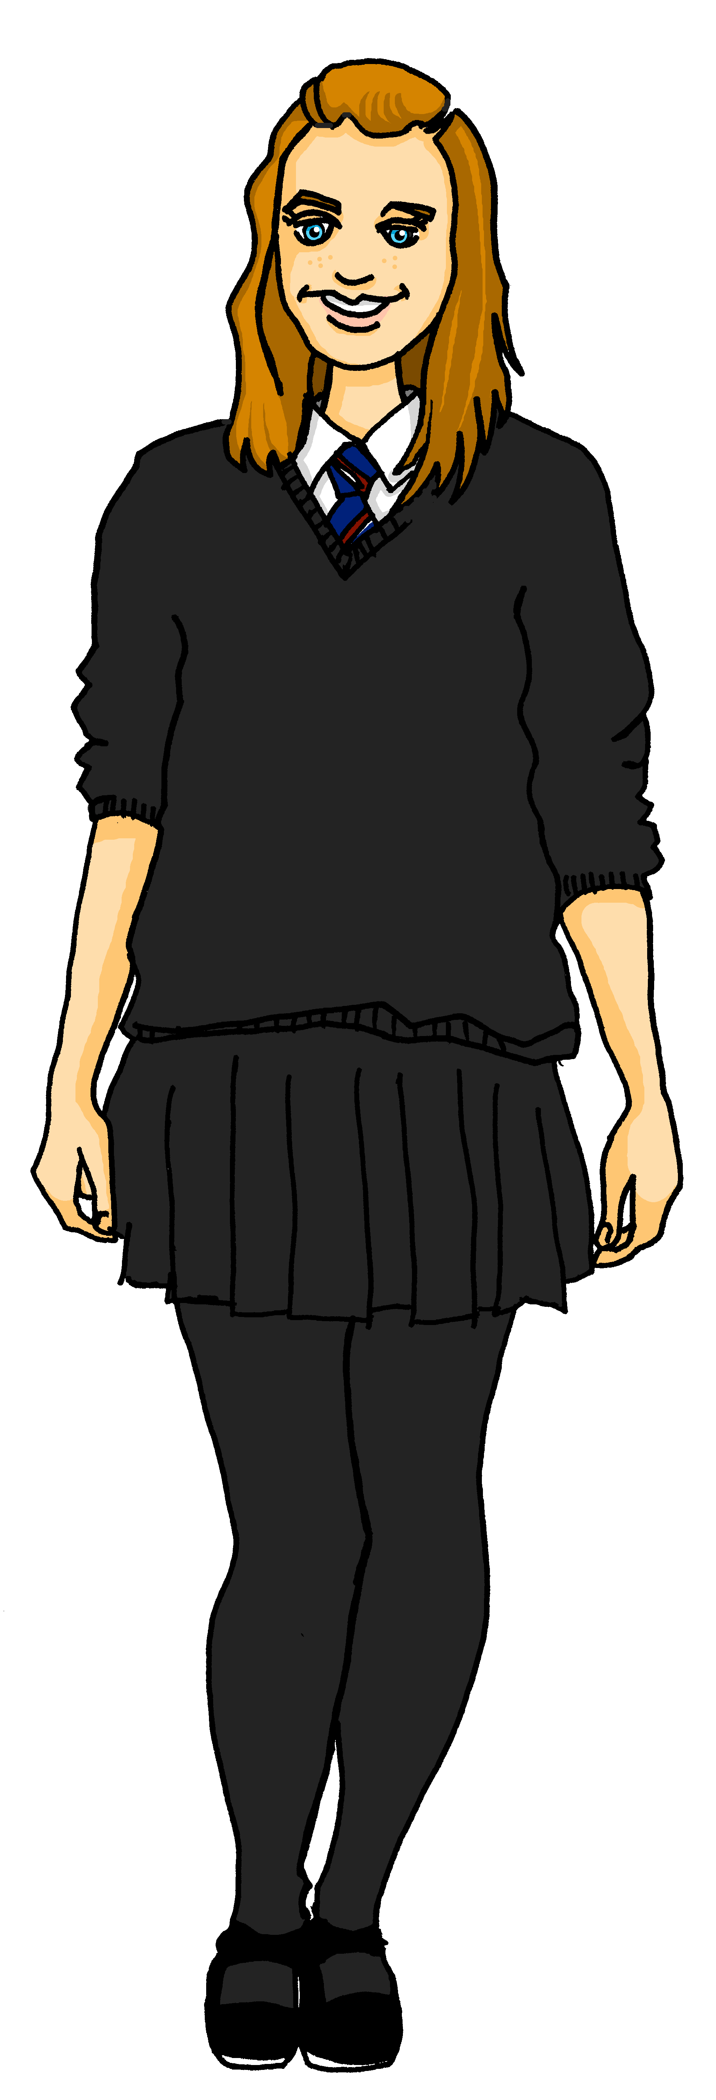
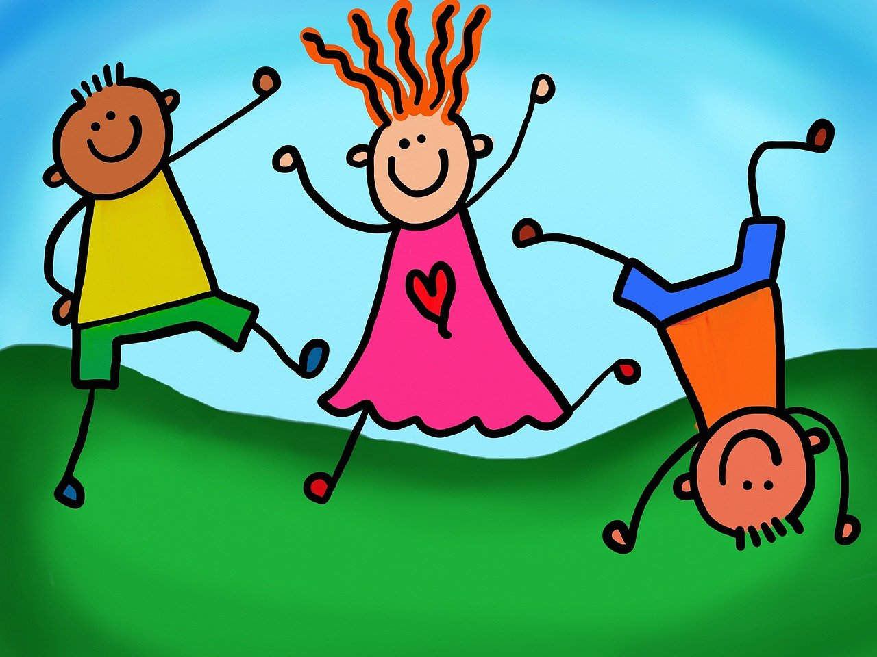
Follow up 1
Lies die Sätze. Ist das [sp],[st] oder [sch]?
Olivia did the spelling bee last year. Ronja is asking advice.
aussprechen
Hallo Olivia, ist die Bee schwierig?
[difficult]
Nein. Es macht Spaß.
Zum Beispiel. Wie sagt man “language” auf Deutsch?
[is fun]
Sprache.
Gut! Du bist schnell.
Du bekommst einen Stern.
[fast]
Danke! Das ist nicht schlimm.
[bad]
Ich bin stolz auf dich.
[proud of you]
Notes:
Timing: 5 minutes Aim: to provide practice in recognising and producing this week’s SSCs [sp], [st] and [sch] Procedure: 1. This is a paired read aloud task. Pupils pay attention to the letters in bold. Pupil A reads aloud Ronja’s speech bubbles and Pupil B reads aloud Olivia’s speech bubbles.
2. Pupils swap roles.
Word frequency (1 is the most frequent word in German):
Beispiel [94], schnell [203], schlimm [762], schwierig [580], Spaß [1045], Sprache [421], Stern [1677], stolz [1372]
Source: Jones, R.L. & Tschirner, E. (2006). A frequency dictionary of German: core vocabulary for learners. Routledge

Slide 6
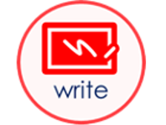
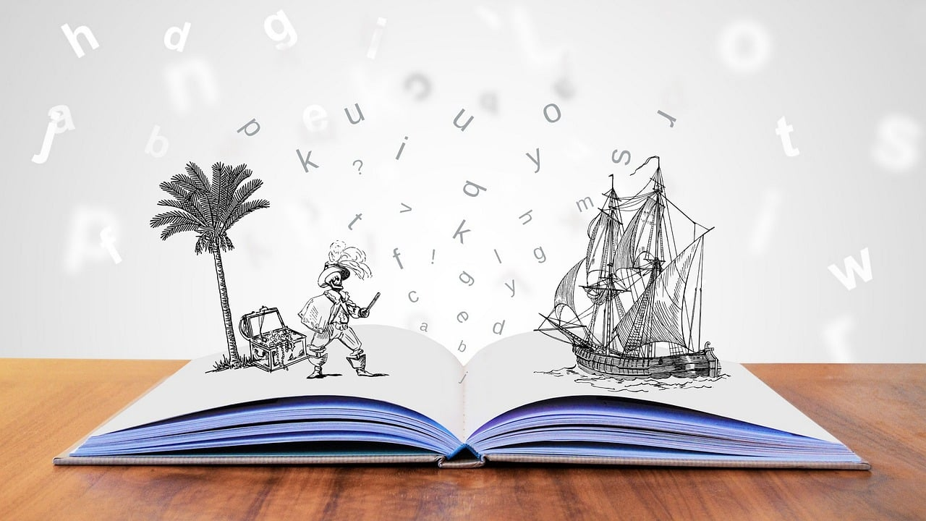
Follow up 2
Wer macht was?
Ronja is telling Olivia what her friends are doing at school today. Who is Ronja talking about?
lesen
Jana
Gabriel
Mariem
Lias
Leon
…... schreibt einen Brief.
…... braucht Hilfe.
…... bekommt eine Geschichte.
…... macht eine Aufgabe.
…... ist mein Partner.
Leon
Lias
Mariem
Jana
Gabriel
Notes:
Timing: 5 minutes
Aim: to practise comprehension of this week’s vocabulary.
Procedure:
Explain the task. Ronja is telling Olivia what her friends are doing at school.
Pupils read the text boxes at the bottom of the slide and decide who is doing what activity based on the pictures above.
Click to reveal answers.

Slide 7
Follow up 3
Hör zu. Was macht Ronja und was macht Olivia?
 | I | she | Activity?
 |  |  | to receive | to make/do
 |  |  | to need | to have
 |  |  | to need | to make/do
 |  |  | to have | to write
 |  |  | to write | to have
 |  |  | to make/do | to receive
 |  |  | to need | to have
hören
B.
B.
1
1
2
2
3
3
4
4
5
5
6
6
Notes:
Timing: 5 minutes
Aim: to practise recognition of the ‘I’ and ‘he/she’ parts of weak verbs and of the new vocabulary.
Procedure:
1. Explain the scenario: Ronja is talking about what she does (I) and what Olivia does (she).
2. Click the B to play the example. Pupils write ‘I’ or ‘she’. Play it again and pupils decide which of the two items of vocabulary is mentioned, writing the English word.
3. Repeat for items 2-6.
4. Click to display answers (and click the gold audio buttons to hear full audio, if desired). They appear after the first answer has been revealed.
5. Optional – if students have attempted to write full sentences in German (see below), click the gold audio buttons to listen and check full sentences. Additional task suggestions: 1. Pupils could try to rewrite the sentences in German from their answers. See transcript below for answers.
Trancript:
[Ich] bekomme Hilfe.
[Sie] braucht Papier.
[Sie] macht eine Liste.
[Ich] habe einen Brief.
[Ich] schreibe eine Geschichte.
[Sie] bekommt einen Baum.
[Ich] brauche ein Fahrrad.

Slide 8
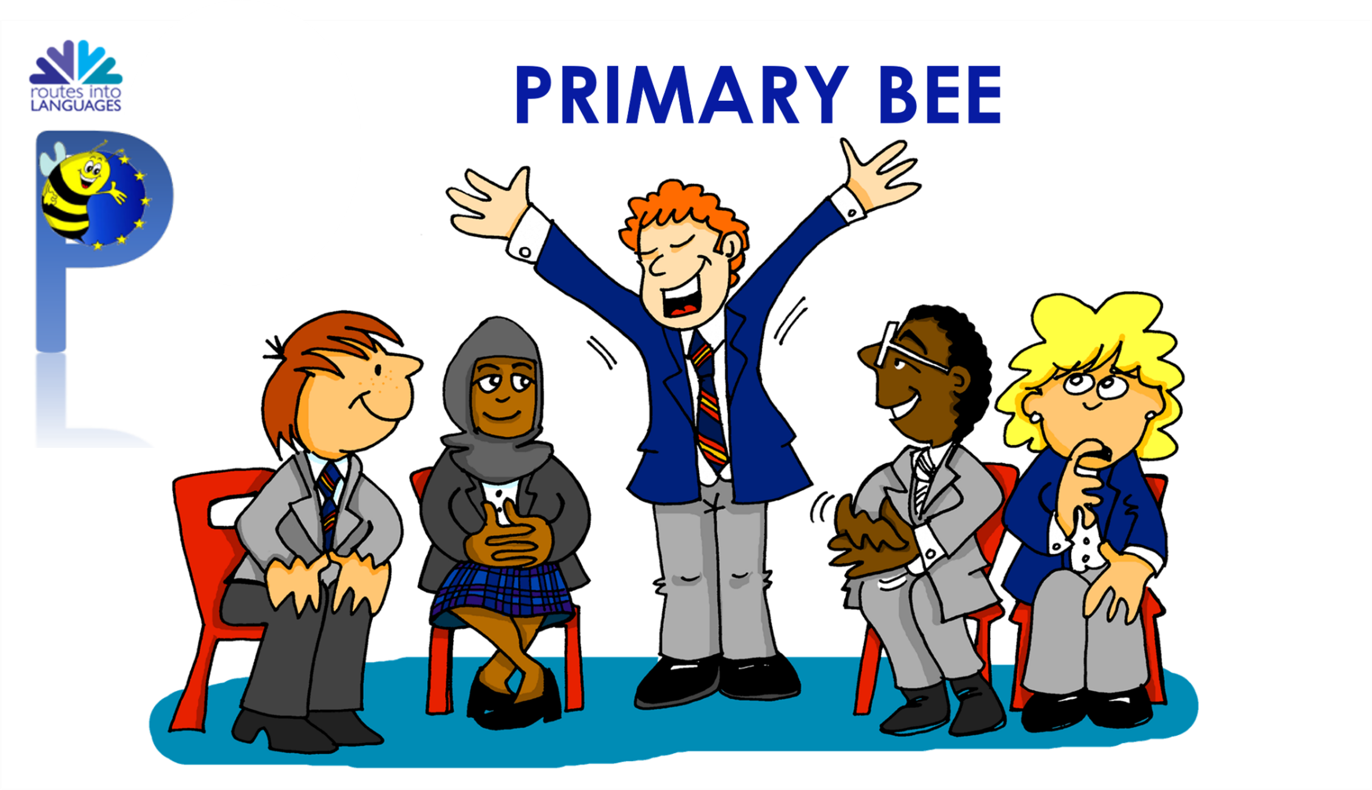
Follow up 4a
Primary Bee
Wie sagt man…auf Deutsch?
sprechen
Lias is preparing for the German Primary Bee.
Gabriel is helping him.
Wie sagt man ‘to need’ auf Deutsch?
brauchen?
Richtig!
If you don’t know, say ‘Ich weiß es nicht!’
Notes:
Timing: 2 mins
Aim: to introduce the concept of the Primary Bee & to practise oral translation of new vocabulary (English into German).
Procedure:
Click through the information on the slide and the example with Gabriel and Lias.
2. Share the key messages as follows: Open to pupils in Years 5 and 6; tests word knowledge; there are three stages: school, regional, national and pupils are given 40 words to learn and practise at each stage.
Note:
The aim of the Primary Bee is for pupils in Years 5 & 6 who have started learning a foreign language ab initio in KS2 to practise and improve their vocabulary, pronunciation and memory skills in the target language (French, Spanish and German). Native or bilingual students, as well as those who communicate in or are exposed to the language on a regular basis at home (speaking and/or listening), are not eligible to compete. It is the classroom teacher’s responsibility, with careful consideration of the ethos of the competition, to decide whether or not a student falls into this category.
Words and phrases have been selected according to the work of NCELP (National Centre for Excellence in Language Pedagogy) which highlights the importance of word frequency in informing vocabulary learning, particularly during the early stages of language development. The list includes many high-frequency words (e.g., some numbers, some colours, some verbs, days of the week, question words and a number of common verbs to help early learners to acquire a robust knowledge of verb vocabulary. These most common verbs are included in the infinitive and 3rd person singular forms; these two verb forms have been shown to provide a very useful linguistic core that can subsequently be further developed. For information we publish the word lists, indicating the word frequency.

Slide 9
Follow up 4b
Wie sagt man … auf Deutsch?
Partnerbarbeit!
sprechen
Wie sagt man ‘to need’ auf Deutsch?
B
1. to need
2. he does
3. I receive
4. to write
5. (the) letter
6. who?
7. She has
8. (the) tree
9. my
10. (the) task
1. to receive
2. she writes
3. I need
4. to make
5. (the) story
6. (the) [female] partner
7. It has
8. (the) bicycle
9. your
10. (the) game
brauchen?
Richtig!
If you don’t know, say ‘Ich weiß es nicht!’
Notes:
Timing: 5 minutes
Aim: to provide oral practice of this week’s vocabulary and to familiarise pupils with the concept of the Primary Bee.
Procedure:
Demonstrate the conversations pupils will have using Lias and Gabriel’s speech bubbles.
Ask pupils to decide who is Person A and who is Person B. Person A will be asked to translate items 1-10 on the left hand list and Partner B will translate items 1-10 on the right hand list. It is important that pupils use ‘Wie sagt man…auf Deutsch’ and ‘Ich weiß es nicht’ if unsure, as these two key phrases are part of this week’s vocabulary to practise too.
Give pupils time in pairs to ask and answer the 10 items of vocabulary each.
If time allows, pupils could choose a new partner or swap lists.
Note:
Some of the verbs are given in the infinitive, some in the ‘I’ form and some in the ‘he/she’ form. Discuss what pupils will need to think about for these before they start.
Additional task suggestions:
1. Pupils could continue using any other vocabulary covered this term. Follow Up 5 sheets from previous week could support this.

Slide 10
Follow up 5:

Schreib auf Englisch.
Can you get at least 15 points?
Wörter
 | die Aufgabe | dein, deine | die Liste
 | die Karte | die Partnerin | mein, meine
 | der Computer | es hat | das Fahrrad
 | der Baum | wer? | das Papier
 | schreiben | die Geschichte | die Hilfe
 | der Brief | machen | bekommen
 | brauchen | Wie sagt man..? | ich weiß es nicht
(the) task
your
(the) list
Vokabeln
x3
(the) card
(the) [female] partner
my
(the) computer
it has
(the) bicycle, bike
x2
(the) tree
who?
(the) paper
to write, writing
(the) story
(the) help
to do, make, doing, making
(the) letter
to receive, receiving
x1
to need, needing
How do you say?
I don’t know
Notes:
Timing: 5 minutes
Aim: to practise written comprehension of vocabulary from this and revisited weeks.
Procedure: 1. Give pupils a blank grid. They fill in the English meanings of any of the words they know, trying to reach 15 points in total.
Note: The most recently learnt and practised words are pink, words from the previous week are green and those from week 1 are blue, thus more points are awarded for them, to recognise that memories fade and more effort (heavy lifting!) is needed to retrieve them.

Slide 11
Follow up 5:

Schreib auf Deutsch.
Can you get at least 15 points?
 | my | your | (the) [male] partner
 | (the) task | (the) list | (the) card
 | (the) game | (the) bicycle, bike | (the) paper
 | Who? | I have | (the) tree
 | I don’t know | How do you say? | to need, needing
 | to do, make, doing, making | (the) help | (the) letter
 | to write, writing | to receive, receiving | (the) story
Wörter
mein, meine
dein, deine
der Partner
Vokabeln
x3
die Aufgabe
die Liste
die Karte
das Spiel
das Fahrrad
das Papier
x2
der Baum
wer?
ich habe
Ich weiß es nicht
Wie sagt man..?
brauchen
machen
die Hilfe
der Brief
x1
schreiben
bekommen
die Geschichte
Notes:
Timing: 5 minutes
Aim: to practise written production of vocabulary from this and revisited weeks.
Procedure: 1. Give pupils a blank grid. They fill in the German meanings of any of the words they know, trying to reach 15 points in total.
Note: The most recently learnt and practised words are pink, words from the previous week are green and those from week 1 are blue, thus more points are awarded for them, to recognise that memories fade and more effort (heavy lifting!) is needed to retrieve them.

Slide 12
Tschüss!
gelb
Notes:
12

Slide 13
Follow up 5:

Schreib auf Englisch.
Can you get at least 15 points?
Wörter
 | die Aufgabe | dein, deine | die Liste
 | die Karte | die Partnerin | mein, meine
 | der Computer | es hat | das Fahrrad
 | der Baum | wer? | das Papier
 | schreiben | die Geschichte | die Hilfe
 | der Brief | machen | bekommen
 | brauchen | Wie sagt man..? | ich weiß es nicht
Vokabeln
x3
x2
x1
Notes:
Timing: 5 minutes
Aim: to practise written comprehension of vocabulary from this and revisited weeks.
Procedure: 1. Give pupils a blank grid. They fill in the English meanings of any of the words they know, trying to reach 15 points in total.
Note: The most recently learnt and practised words are pink, words from the previous week are green and those from week 1 are blue, thus more points are awarded for them, to recognise that memories fade and more effort (heavy lifting!) is needed to retrieve them.

Slide 14
Follow up 5:

Schreib auf Deutsch.
Can you get at least 15 points?
 | my | your | (the) [male] partner
 | (the) task | (the) list | (the) card
 | (the) game | (the) bicycle, bike | (the) paper
 | Who? | I have | (the) tree
 | I don’t know | How do you say? | to need, needing
 | to do, make, doing, making | (the) help | (the) letter
 | to write, writing | to receive, receiving | (the) story
Wörter
Vokabeln
x3
x2
x1
Notes:
Timing: 5 minutes
Aim: to practise written production of vocabulary from this and revisited weeks.
Procedure: 1. Give pupils a blank grid. They fill in the German meanings of any of the words they know, trying to reach 15 points in total.
Note: The most recently learnt and practised words are pink, words from the previous week are green and those from week 1 are blue, thus more points are awarded for them, to recognise that memories fade and more effort (heavy lifting!) is needed to retrieve them.

