Slide 1
Interacting
Wie ist dein Alltag*?
grün
Present tense strong verbs (e→i, e→ ie)
SSC soft/hard [ch]
der Alltag – everyday life, daily routine
Term 1 Week 11
Notes:
Artwork by Steve Clarke. Pronoun pictures from NCELP (www.ncelp.org). All additional pictures selected from Pixabay and are available under a Creative Commons license, no
attribution required.
Phonics:
soft [ch] ich [10] leicht [311] sprechen [161]
hard [ch] Buch [300] Woche [219] machen [58]
Vocabulary: bringen [163] essen [323] mitbringen [1828] reden [368] nichts [109] Deutsch [112] Englisch [662] (plus language from Week 10)
Revisit 1: alles [36] alle [36] viele [56] Baum [1013] Blume [2463] Buch [300] Essen1 [323] Fußballspieler [n/a] Haus [147] Käse [4094] Kultur [594] Land2 [134] Satz [432] Schule [359] See [1317] Seen [1317] Song [3373] Sport [945]
Revisit 2: mögen, ich mag, du magst, er/sie/es mag [168] Fahrräder [2138] Feier [n/a] Häuser [147] Länder [134] Mädchen [602] Musiker [2577] Sportler [2565]
Jones, R.L & Tschirner, E. (2019). A frequency dictionary of German: Core vocabulary for learners. London: Routledge.
The frequency rankings for words that occur in this PowerPoint which have been previously introduced in these resources are given in the SOW and in the resources that first introduced and formally re-visited those words.
For any other words that occur incidentally in this PowerPoint, frequency rankings will be provided in the notes field wherever possible.
Remember that at the start of the course (first three lessons of Rot/Gelb) pupils learnt language (for greetings and register taking) that can still be part of the lesson routines in upper KS2 (Blau/Grün). They are not re-taught, as we anticipate that teachers have built these in from early in lower KS2.
1

Slide 2
aussprechen
soft [ch]
…
ich
Notes:
NOTE: Use of these 4 phonics slides is an optional priming/preparation activity before Follow Up 1. They can be omitted, if teachers decide they are not needed.
Timing: 1 minute
Aim: to introduce the SSC soft [ch].
Procedure:
Introduce the SSC and present the source word ‘ich’ (with gesture, if using).
Click to bring on the picture and get pupils to repeat the word ‘ich’ (with gesture, if using).
Note:
a gesture for ‘ich’ might be to point to yourself.
2

Slide 3
aussprechen
soft [ch]
…
ich
leicht
sprechen
Notes:
Timing: 1 minute
Aim: to consolidate the SSC soft [ch].
Procedure:
Re-present the SSC and the source word ‘ich’ (with gesture, if using).
Click to bring on the picture and get pupils to repeat the word ‘ich’ (with gesture, if using).
Present the cluster words in the same way, bringing on the picture and getting pupils to pronounce the words.
Vocabulary: leicht [311] sprechen [161]
Jones, R.L & Tschirner, E. (2019). A frequency dictionary of German: Core vocabulary for learners. London: Routledge.

Slide 4
aussprechen
hard [ch]
…
Buch
Notes:
Timing: 1 minute
Aim: to introduce the SSC hard [ch].
Procedure:
Introduce the SSC and present the source word ‘Buch’ (with gesture, if using).
Click to bring on the picture and get pupils to repeat the word ‘Buch’ (with gesture, if using).
Note:
a gesture for ‘Buch’ might be to fan out your hands as if opening up a book.
Vocabulary: Buch [300]
Jones, R.L & Tschirner, E. (2019). A frequency dictionary of German: Core vocabulary for learners. London: Routledge.
4

Slide 5
aussprechen
hard [ch]
…
Buch
Woche
machen
Notes:
Timing: 1 minute
Aim: to consolidate the SSC hard [ch].
Procedure:
Re-present the SSC and the source word ‘Buch’ (with gesture, if using).
Click to bring on the picture and get pupils to repeat the word ‘ich’ (with gesture, if using).
Present the cluster words in the same way, bringing on the picture and getting pupils to pronounce the words.
Vocabulary: Woche [219] machen [58]
Jones, R.L & Tschirner, E. (2019). A frequency dictionary of German: Core vocabulary for learners. London: Routledge.

Slide 6
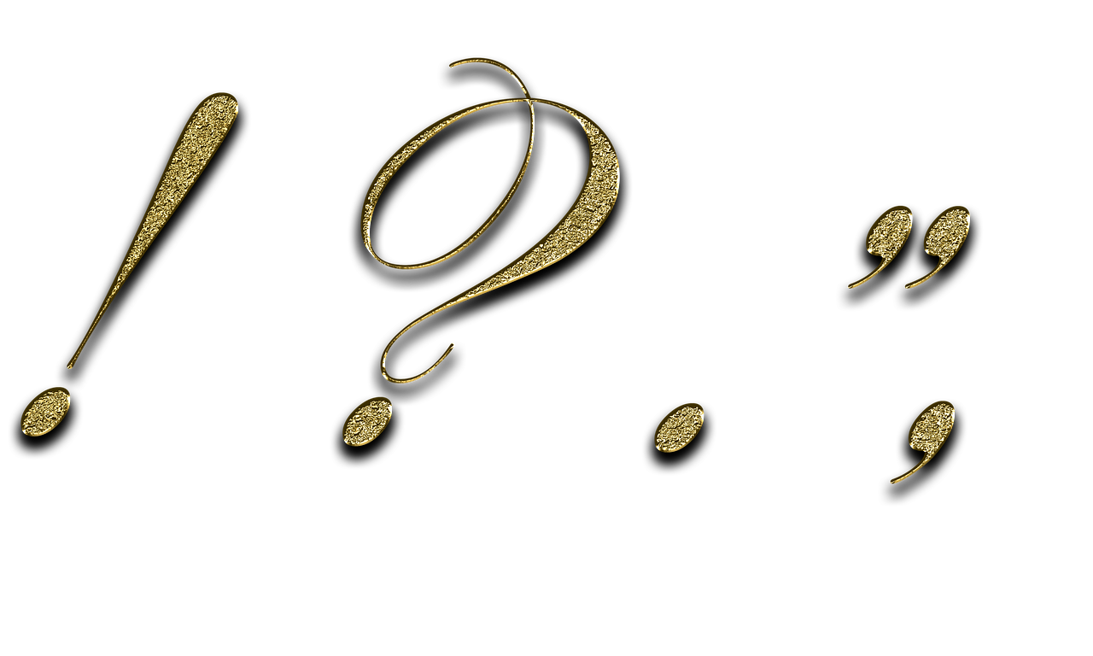
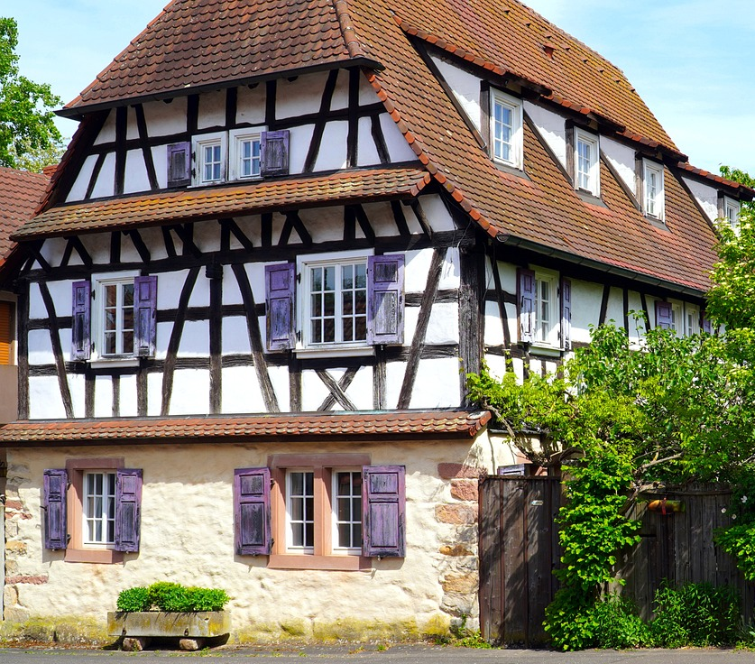
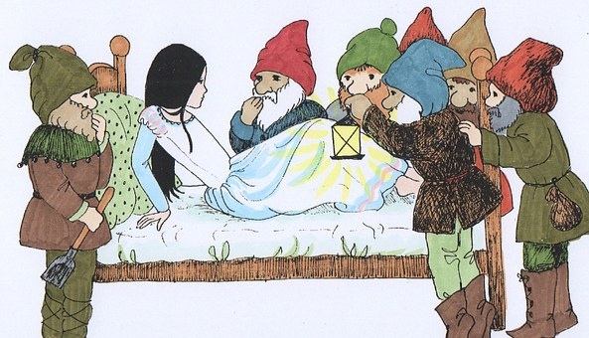
Follow up 1:
Sag die Wörter!
Over to you! Can you pronounce each of the words below, first slowly and carefully, then against the clock?
deutschsprachig
aussprechen
[German-speaking]
10
To pronounce longer words like this one, try breaking them down into the different syllables. Pronounce each syllable separately, thinking carefully about the sounds you have learnt, then together!
Satzzeichen
Fachwerkhaus
[punctuation mark]
[half-timbered house]
Fahrradlicht
S
Englischunterricht
[bicycle light]
[English lessons]
Schneewittchen
Hochhaus
[skyscraper, tower block]
0
[Snow White]
START
Notes:
Timing: 5 minutes
Aim: to practise the SSC [ch] by reading aloud some tricky to pronounce words.
Procedure:
Click to show pupils how to break down a tricky word into different syllables. Highlight the [ch] sound that they have been learning this week.
Give pupils a couple of minutes in pairs or individually to try breaking down and pronouncing the other words. Teachers could either use the handout (at the end of this presentation) so pupils can draw in the syllable divisions OR elicit them physically (as an arm gesture top to bottom) from pupils, along with choral pronunciation of each word.
Click to reveal the syllable division lines for each word.
Click on the words to hear the them pronounced first carefully and slowly. Then click on the pictures to hear them pronounced quickly.
Ask pupils to have another go at pronouncing the words, this time against the 10 second timer. Can they pronounce all words correctly in time?

Slide 7
Compound words
Remember that in German, you can put several words together to make one long word! This is called a compound word.
masculine
neuter
neuter!
der Baum
das Haus
das Baumhaus
(the) tree
(the) house
(the) treehouse
The gender of a compound noun is always the gender of the last word.
Notes:
Timing: 2 minutes
Aim: to recap the concept of compounds.
Procedure:
Click through the animations to present the new information.
Using the question mark animations, elicit English translation for the German examples provided.
7

Slide 8
Follow up 2: [1/9]
Olivia lernt Deutsch.
lesen
die Deutschstunde
German lesson
Notes:
Slide 1 of 9
Timing: 5 minutes
Aim: to practise written vocabulary recognition of compound words
Procedure:
Explain the context: Ronja and Lias are helping Olivia learn German over Skype.
Click to bring up German compound word.
Elicit meaning in English.
Click to bring up English meaning. There are 9 compound words in total.

Slide 9
Follow up 2: [2/9]
Olivia lernt Deutsch.
lesen
die Sportsachen
sports things/gear
Notes:
Slide 1 of 9
Timing: 5 minutes
Aim: to practise written vocabulary recognition of compound words
Procedure:
Explain the context: Ronja and Lias are helping Olivia learn German over Skype.
Click to bring up German compound word.
Elicit meaning in English.
Click to bring up English meaning. There are 9 compound words in total.

Slide 10
Follow up 2: [3/9]
Olivia lernt Deutsch.
lesen
der Popsong
pop song
Notes:
Slide 1 of 9
Timing: 5 minutes
Aim: to practise written vocabulary recognition of compound words
Procedure:
Explain the context: Ronja and Lias are helping Olivia learn German over Skype.
Click to bring up German compound word.
Elicit meaning in English.
Click to bring up English meaning. There are 9 compound words in total.

Slide 11
Follow up 2: [4/9]
Olivia lernt Deutsch.
lesen
die Wasserflasche
water bottle
Notes:
Slide 1 of 9
Timing: 5 minutes
Aim: to practise written vocabulary recognition of compound words
Procedure:
Explain the context: Ronja and Lias are helping Olivia learn German over Skype.
Click to bring up German compound word.
Elicit meaning in English.
Click to bring up English meaning. There are 9 compound words in total.

Slide 12
Follow up 2: [5/9]
Olivia lernt Deutsch.
lesen
der Tischfußball
table football
Notes:
Slide 1 of 9
Timing: 5 minutes
Aim: to practise written vocabulary recognition of compound words
Procedure:
Explain the context: Ronja and Lias are helping Olivia learn German over Skype.
Click to bring up German compound word.
Elicit meaning in English.
Click to bring up English meaning. There are 9 compound words in total.

Slide 13
Follow up 2: [6/9]
Olivia lernt Deutsch.
lesen
das Landhaus
country house
Notes:
Slide 1 of 9
Timing: 5 minutes
Aim: to practise written vocabulary recognition of compound words
Procedure:
Explain the context: Ronja and Lias are helping Olivia learn German over Skype.
Click to bring up German compound word.
Elicit meaning in English.
Click to bring up English meaning. There are 9 compound words in total.

Slide 14
Follow up 2: [7/9]
Olivia lernt Deutsch.
lesen
der Rockmusiker
rock musician
Notes:
Slide 1 of 9
Timing: 5 minutes
Aim: to practise written vocabulary recognition of compound words
Procedure:
Explain the context: Ronja and Lias are helping Olivia learn German over Skype.
Click to bring up German compound word.
Elicit meaning in English.
Click to bring up English meaning. There are 9 compound words in total.

Slide 15
Follow up 2: [8/9]
Olivia lernt Deutsch.
lesen
die Winterjacke
winter jacket
Notes:
Slide 1 of 9
Timing: 5 minutes
Aim: to practise written vocabulary recognition of compound words
Procedure:
Explain the context: Ronja and Lias are helping Olivia learn German over Skype.
Click to bring up German compound word.
Elicit meaning in English.
Click to bring up English meaning. There are 9 compound words in total.

Slide 16
Follow up 2: [9/9]
Olivia lernt Deutsch.
lesen
das Haustier
pet (literally: house animal)
Notes:
Slide 1 of 9
Timing: 5 minutes
Aim: to practise written vocabulary recognition of compound words
Procedure:
Explain the context: Ronja and Lias are helping Olivia learn German over Skype.
Click to bring up German compound word.
Elicit meaning in English.
Click to bring up English meaning. There are 9 compound words in total.

Slide 17
Follow up 3
Olivia’s German is improving, but she finds it difficult to hear the difference between ihr (you all) and er (he). Can you help?
??
Hör zu. Ist das you (all) oder he?
hören
 | you (all) | he | English?
1
Do you (all) often talk with family?
2
Does he eat everything?
3
Do you (all) often take the train?
4
Does he normally get homework?
5
Do you (all) see this/that footballer?
6
Aren’t you eating anything? / Don’t you eat anything?
Notes:
Timing: 5 minutes Aim: to practise comprehension of questions and differentiating between the ihr and er forms of strong and weak verbs.
Procedure:
1. Pupils write down 1-6. 2. Click on the audio buttons to play each question 1-6.
3. Pupils write down you (all) or he, depending on which pronoun and verb form they hear.
4. Pupils listen again to each question and try to translate the question into English. 5. Elicit answers and click to display answers. Discuss different variations for question translation as in main lesson e.g. Does he take or Is he taking…?
Note: With strong verbs pupils are given two clues: ihr versus er and the vowel e.g. er nimmt/ihr nehmt. With weak verbs, pupils just need to focus on the pronoun ihr or er.
Transcript:
Redet ihr oft mit Familie?
Isst er alles?
Nehmt ihr oft den Zug?
Bekommt er normalerweise Hausaufgaben?
Seht ihr diesen Fußballspieler?
Esst ihr nichts?

Slide 18
Follow up 4
Rede mit deinem Partner/deiner Partnerin.
sprechen
Beispiel:
I
A
B
Siehst du?
1 | Do you see? Are you seeing?
2 | ……….. ……….
I
A
Notes:
Example slide.
Timing: 5 minutes (two slides)
Aim: to practise asking questions with strong verbs using du and ihr forms of you.
Procedure:
Click through the animations to explain the task. Person A says Siehst du?
Person B chooses the correct letter from two and writes down the letter.
Person A continues to ask the remaining eight questions in Round 1.
At the end, Person B will have a nine-letter phrase to read out to Person A who should recognise and translate it.
Then pupils swap and repeat the task. Person B will now make the questions using Round 2.

Slide 19
Follow up 4
Rede mit deinem Partner/deiner Partnerin.
1
2
3
sprechen
F
R
O
A
C
H
4
5
6
R
K
R
M
U
Ä
7
8
9
S
D
I
E
R
K
Notes:
Timing: 5 minutes
Aim: to practise asking questions with strong verbs using du and ihr forms of you.
Procedure:
Give out handouts to pupils. Both face the board. Display this slide.
Pupil A translates English prompts into German questions, working in numerical order from 1 – 9.
Pupils B identifies the correct letter according to his/her understanding of what A says.
After all nine questions have been asked by Pupil A, Pupil B reads aloud the word produced by the answer letters.
It should read ‘Fahrräder’.
Pupils swap roles and repeat the activity. Pupil A’s sentence should read: ‘Rockmusik’.

Slide 20
Follow up 5:

Schreib auf Englisch.
Can you get at least 15 points?
Wörter
 | mögen | sie mag | das Mädchen
 | Häuser | Länder | der Sportler
 | der See | die Kultur | alle
 | der Satz | die Blume | viele
 | Deutsch | mitbringen | essen
 | nichts | Englisch | reden
 | bringen | Sachen | mitnehmen
to like, liking
she likes
(the) girl
Vokabeln
x3
(the) houses
(the) countries
(the) sportsman
(the) lake
(the) culture
all (of the)
x2
(the) sentence
(the) flower
many, a lot
German
to bring with
to eat
nothing
English
to talk
x1
to bring
(the) things
to take/bring with
Notes:
Timing: 5 minutes
Aim: to practise written production of vocabulary from this and revisited weeks.
Procedure: 1. Give pupils a blank grid. They fill in the English meanings of any of the words they know, trying to reach 15 points in total.
Note: The most recently learnt and practised words are pink, words from the previous week are green and those from week 1 are blue, thus more points are awarded for them, to recognise that memories fade and more effort (heavy lifting!) is needed to retrieve them.

Slide 21
Follow up 5:

Schreib auf Deutsch.
Can you get at least 15 points?
Wörter
 | (the) girl | (the) countries | (the) sportsman
 | she likes | to like, liking | (the) houses
 | all (of the) | many, a lot | (the) flower
 | (the) culture | (the) lake | (the) sentence
 | nothing | English | (the) things
 | to bring | German | to take/bring with
 | to bring with | to eat | to talk
das Mädchen
die Länder
der Sportler
Vokabeln
x3
sie mag
mögen
die Häuser
alle
viele
die Blume
x2
die Kultur
der See
der Satz
nichts
Englisch
die Sachen
bringen
Deutsch
mitnehmen
x1
mitnehmen
essen
reden
Notes:
Timing: 5 minutes
Aim: to practise written production of vocabulary from this and revisited weeks.
Procedure: 1. Give pupils a blank grid. They fill in the German meanings of any of the words they know, trying to reach 15 points in total.
Note: The most recently learnt and practised words are pink, words from the previous week are green and those from week 1 are blue, thus more points are awarded for them, to recognise that memories fade and more effort (heavy lifting!) is needed to retrieve them.

Slide 22
Tschüss!
grün
Notes:
22

Slide 23
Follow up 1:
deutschsprachig
aussprechen
[German-speaking]
Satzzeichen
Fachwerkhaus
[punctuation mark]
[half-timbered house]
Fahrradlicht
Englischunterricht
[bicycle light]
[English lessons]
Schneewittchen
Hochhaus
[skyscraper, tower block]
[Snow White]
Notes:
HANDOUT

Slide 24
Follow up 4
Follow up 4
Round 1
Round 2
A
…
B
…
1 | Do you (all) eat? Are you (all) eating?
2 | Do you give? Are you giving?
3 | Do you (all) take? Are you (all) taking?
4 | Do you help? Are you helping?
5 | Do you see? Are you seeing?
6 | Do you (all) help? Are you (all) helping?
7 | Do you take? Are you taking?
8 | Do you eat? Are you eating?
9 | Do you (all) see? Are you (all) seeing?
1 | Do you eat? Are you eating?
2 | Do you (all) give? Are you (all) giving?
3 | Do you take? Are you taking?
4 | Do you (all) help? Are you (all) helping?
5 | Do you (all) see? Are you (all) seeing?
6 | Do you help? Are you helping?
7 | Do you (all) take? Are you (all) taking?
8 | Do you (all) eat? Are you eating?
9 | Do you see? Are you seeing?
Notes:
HANDOUT

Slide 25
Follow up 5:

Schreib auf Englisch.
Can you get at least 15 points?
Wörter
 | mögen | sie mag | das Mädchen
 | die Häuser | die Länder | der Sportler
 | der See | die Kultur | alle
 | der Satz | die Blume | viele
 | Deutsch | mitbringen | essen
 | nichts | Englisch | reden
 | bringen | die Sachen | mitnehmen
Vokabeln
x3
x2
x1
Notes:
HANDOUT

Slide 26
Follow up 5:

Schreib auf Deutsch.
Can you get at least 15 points?
Wörter
 | (the) girl | (the) countries | (the) sportsman
 | she likes | to like, liking | (the) houses
 | all (of the) | many, a lot | (the) flower
 | (the) culture | (the) lake | (the) sentence
 | nothing | English | (the) things
 | to bring | German | to take/bring with
 | to bring with | to eat | to talk
Vokabeln
x3
x2
x1
Notes:
HANDOUT

