Slide 1
Interacting
Wie ist dein Alltag*?
grün
Present tense strong verbs (e→i, e→ ie)
SSC soft/hard [ch]
der Alltag – everyday life, daily routine
Term 1 Week 11
Notes:
Artwork by Steve Clarke. Pronoun pictures from NCELP (www.ncelp.org). All additional pictures selected from Pixabay and are available under a Creative Commons license, no attribution required.
Phonics:
soft [ch] ich [10] leicht [311] sprechen [161]
hard [ch] Buch [300] Woche [219] machen [58]
Vocabulary: bringen [163] essen [323] mitbringen [1828] reden [368] nichts [109] Deutsch [112] Englisch [662] (plus language from Week 10)
Revisit 1: alles [36] alle [36] viele [56] Baum [1013] Blume [2463] Buch [300] Essen1 [323] Fußballspieler [n/a] Haus [147] Käse [4094] Kultur [594] Land2 [134] Satz [432] Schule [359] See [1317] Seen [1317] Song [3373] Sport [945]
Revisit 2: mögen, ich mag, du magst, er/sie/es mag [168] Fahrräder [2138] Feier [n/a] Häuser [147] Länder [134] Mädchen [602] Musiker [2577] Sportler [2565]
Jones, R.L & Tschirner, E. (2019). A frequency dictionary of German: Core vocabulary for learners. London: Routledge.
The frequency rankings for words that occur in this PowerPoint which have been previously introduced in these resources are given in the SOW and in the resources that first introduced and formally re-visited those words.
For any other words that occur incidentally in this PowerPoint, frequency rankings will be provided in the notes field wherever possible.
Remember that at the start of the course (first three lessons of Rot/Gelb) pupils learnt language (for greetings and register taking) that can still be part of the lesson routines in upper KS2 (Blau/Grün). They are not re-taught, as we anticipate that teachers have built these in from early in lower KS2.
1

Slide 2
aussprechen
soft [ch]
…
ich
Notes:
Timing: 1 minute
Aim: to introduce the SSC soft [ch].
Procedure:
Introduce the SSC and present the source word ‘ich’ (with gesture, if using).
Click to bring on the picture and get pupils to repeat the word ‘ich’ (with gesture, if using).
Note:
a gesture for ‘ich’ might be to point to yourself.
2

Slide 3
aussprechen
soft [ch]
…
ich
leicht
sprechen
Notes:
Timing: 1 minute
Aim: to consolidate the SSC soft [ch].
Procedure:
Re-present the SSC and the source word ‘ich’ (with gesture, if using).
Click to bring on the picture and get pupils to repeat the word ‘ich’ (with gesture, if using).
Present the cluster words in the same way, bringing on the picture and getting pupils to pronounce the words.
Vocabulary: leicht [311] sprechen [161]
Jones, R.L & Tschirner, E. (2019). A frequency dictionary of German: Core vocabulary for learners. London: Routledge.

Slide 4
aussprechen
hard [ch]
…
Buch
Notes:
Timing: 1 minute
Aim: to introduce the SSC soft [ch].
Procedure:
Introduce the SSC and present the source word ‘Buch’ (with gesture, if using).
Click to bring on the picture and get pupils to repeat the word ‘Buch’ (with gesture, if using).
Note:
a gesture for ‘Buch’ might be to fan out your hands as if opening up a book.
Vocabulary: Buch [300]
Jones, R.L & Tschirner, E. (2019). A frequency dictionary of German: Core vocabulary for learners. London: Routledge.
4

Slide 5
aussprechen
hard [ch]
…
Buch
Woche
machen
Notes:
Timing: 1 minute
Aim: to consolidate the SSC soft [ch].
Procedure:
Re-present the SSC and the source word ‘ich’ (with gesture, if using).
Click to bring on the picture and get pupils to repeat the word ‘ich’ (with gesture, if using).
Present the cluster words in the same way, bringing on the picture and getting pupils to pronounce the words.
Vocabulary: Woche [219] machen [58]
Jones, R.L & Tschirner, E. (2019). A frequency dictionary of German: Core vocabulary for learners. London: Routledge.

Slide 6
aussprechen
[ch]
Sprich mit einem/einer Partner(in). Hard [ch] dann soft [ch]…
30
brauchen
machen
achtzehn
durch
welche
ich möchte
Kuchen
Österreich
S
Mädchen
Buch
auch
Mittwoch
Geschichte
Sachen
0
START
Notes:
Timing: 2 minutes
Aim: to consolidate the SSC hard and soft [ch] in a paired read aloud task. As a general rule, words in which [ch] follows o, a or u are a hard [ch], otherwise it will be a soft [ch].
Procedure:
Pupils work in pairs.
Pupil A selects a word with a hard [ch] and says it aloud.
Pupil B needs to select a word with soft [ch] to pronounce.
Pupils continue alternating until all words have been said or the time has run out, whichever comes soonest.
They can repeat the activity with Partner B starting with a different word.
If a pupil says a word with the same [ch] sound as the one before they need to start from the beginning.
Click on individual words to hear correct pronunciation.

Slide 7
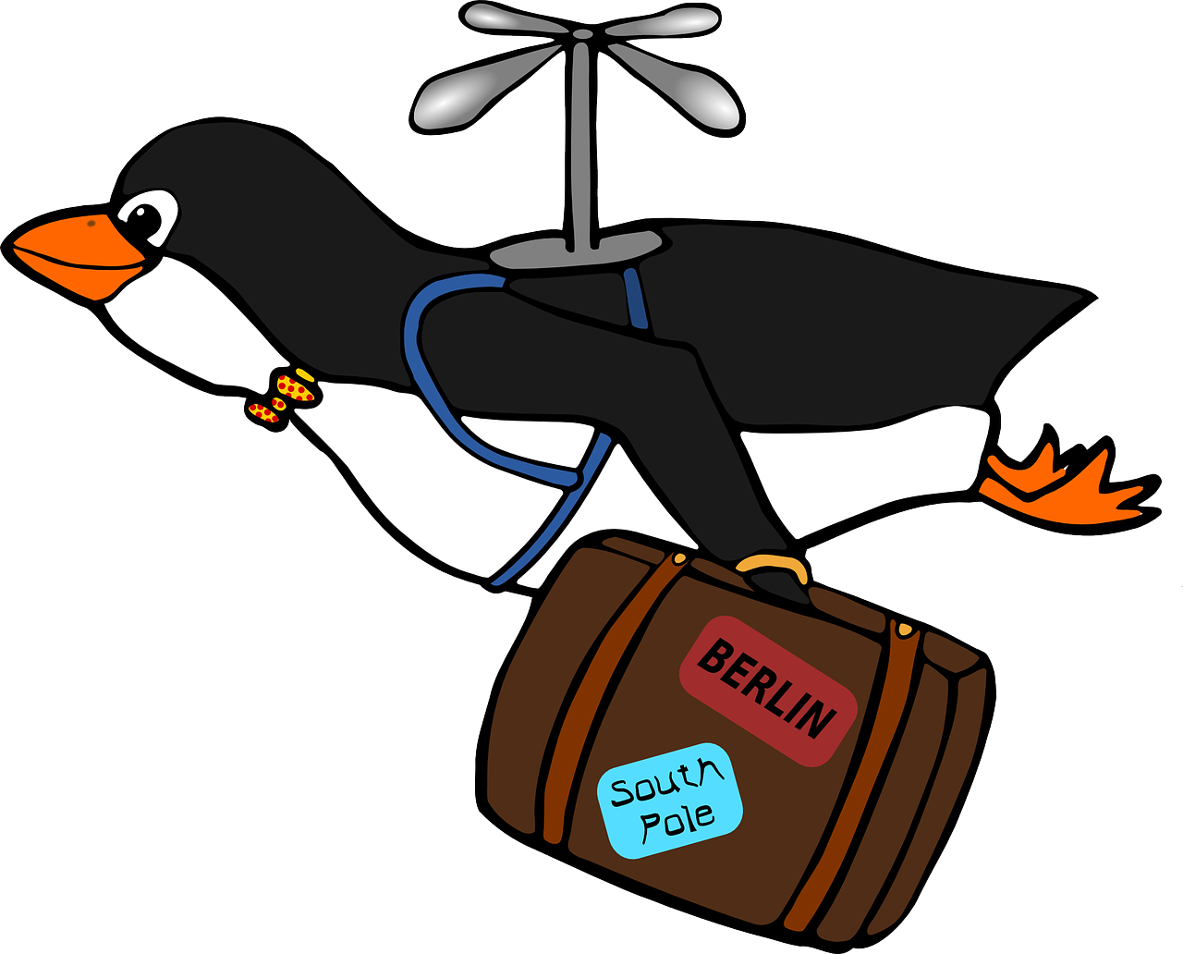
Sag die Wörter auf Deutsch. Was ist das auf Englisch?
Wörter
Vokabeln
1.bringen
2.reden
[to bring]
[German]
…
3.essen
4.nichts
[to eat]
[to bring with]
5.mitbringen
6.Deutsch
[to talk]
[nothing]
Notes:
Timing: 3 minutes
Aim: to introduce the vocabulary for this week.
Procedure 1. Pupils either write down numbers 1-6 and match the German and English words, or they discuss the matching pairs with a partner.
2. Click to highlight the German and English pairs and practise pronunciation as a class. 3. Click to cover up the English/pictures one by one. Can pupils say the German word (on the board) for each English word that disappears? 4. Click to make the English reappear, then repeat with the German words disappearing.
5. Finally, click to cover up all 6 words in German and English (Click 3 times in succession to cover up row by row). How many words can pupils remember? Answers: 1. bringen (to bring), 2. reden (to talk), 3.essen (to eat), 4.nichts (nothing), 5. mitbringen (to bring with), 6. Deutsch (German).
6. Ask pupils to find the German for ‘English’ elsewhere on the slide (’Englisch’). Elicit the difference in spelling (extra ‘c’) and pronunciation of the ‘E’.

Slide 8
Vokabeln
Organisere die Wörter in Paare. Was ist das auf Englisch? Sag die Wörter auf Deutsch.
Wörter
essen
das Essen
nehmen
mitnehmen
nichts
nicht
…
bringen
mitbringen
reden
sagen
mitnehmen
nicht
mitbringen
das Essen
sagen
Notes:
Timing: 7 minutes
Aim: to link new vocabulary with known vocabulary and notice their similarities and differences.
Procedure 1. Explain the task. Pupils need to organise these words into five pairs, the first of each pair is provided. 2. They can talk in pairs (think-pair-share style) and should be thinking about the meaning AND the form of the words. What do they mean? What (if anything) makes these words look similar?
3. Teacher elicits pupils’ thoughts (in order left to right, top to bottom) and clicks to provide the answers.
4. Pause after each answer reveal to conduct some follow up talk about these words. For example: i) essen / das Essen – which one of these is a noun? How do you know? (capital letter, article (word for ‘the’) in front of it) - why does the other word ‘essen’ look like a verb? (no capital, end in –en). What is the difference in meaning? ii) nehmen – mitnehmen What difference in meaning is there between these two verbs? In a 1-verb sentence, where does the ‘mit’ go? E.g. I take my bag with me. What would this be in German? And what about I bring my bag with me?
iii) nichts - nicht Use one of these to tell me the German for ‘I don’t eat’? (Ich esse nicht) and how would you say ‘I eat nothing’ (Ich esse nichts).
iv) reden – sagen. These two verbs don’t look anything like each other. What makes them a pair? They are both about communicating in speech. Which one means ‘to say, tell’? And which one means ‘to talk’? What would ‘Ich rede mit Freunden’ mean?
8

Slide 9
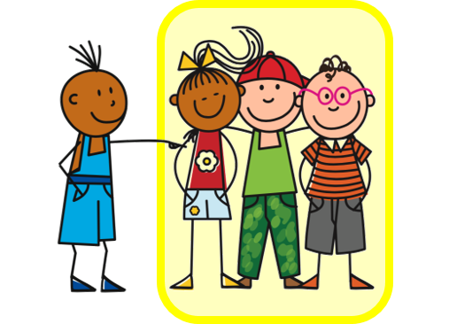
Present tense: strong verbs e→ i, e→ ie
In German, strong verbs change the stem vowel in the er/sie/es form and also the du form:
Can you remember any other strong verbs with ‘e’ from last lesson?
Ich esse.
I eat/am eating.
Du isst.
You eat/are eating.
e → i
helfen, nehmen, sprechen, geben
e → ie
sehen, lesen
Sie isst.
She eats/is eating.
All plural forms (you all, we, they) keep the original vowel, like ich:
Ihr esst.
You (all) eat/are eating.
Notes:
Timing: 3 minutes (two slides)
Aim: to recap singular forms of strong verbs with e→i and e→ie change.
Procedure:
Click through the animations to present the information.
Elicit English translation for the German examples provided.
9

Slide 10
Present tense: yes/no questions
This is the same for all verbs, weak and strong.
Remember that to ask yes/no questions, the verb and subject swap:
Du siehst.
You see/are seeing.
Do you see? Are you seeing?
Siehst du…?.
And remember, there is no vowel change in plural forms (you all, we, they):
Seht ihr…?
Do you (all) see? Are you (all) seeing?
Notes:
Aim: to recap formation of yes/no questions, this time with strong verbs.
Procedure:
Click through the animations to present the information.
Elicit English translation for the German examples provided.
10

Slide 11
hören
Olivia
Olivia spricht mit Ronja und Lias über Skype.
Hör zu. Fragt sie Ronja (du) oder Ronja und Lias (ihr)?
ihr (you both)
Do you (both) help at home?
Do you often read books?
Do you (both) often eat cheese?
Do you normally eat at school?
Do you bring food with you to school?
Do you (both) see many lakes in Switzerland?
Do you (both) take the train?
du (you)
Was? Schreib auf Englisch.
B.
1
2
3
4
5
6
Notes:
Timing: 8 minutes
Aim: to practise aural comprehension of strong verbs in 2nd person singular and plural, as well as vocabulary for this week.
Procedure:
Ensure that the scenario is clear: Olivia is speaking to Ronja and Lias over Skype. Is she asking one or both of them a question?
Explain that pupils need to listen out for the verb form to decide if Olivia is asking just Ronja (du) or both Ronja and Lias (ihr). The pronouns are bleeped so they need to listen out for vowel changes in the strong verbs.
Explain that they will listen again and write the action/activity in English.
Complete the example (B). Click to share answers.
Repeat steps 1-4 for items 1 – 6.
Click to share answers.
Note:
Here we are contrasting the ihr (you all) form e.g. seht with the er/sie form e.g. sieht, to focus pupils solely on the vowel change in strong verbs. This differs from the listening in Week 10, where pupils were able to use the verb ending to make their decision.
English translations given here are the most likely, but encourage pupils to think about the simple and continuous translations of each. E.g. Do you (all) help at home? Are you (all) helping at home? Do both work here? What about if we add the word normalerweise?
Transcript:
Beispiel: Helft [ihr] zu Hause?
Liest [du] oft Bücher?
Esst [ihr] oft Käse?
Isst [du] normalerweise in der Schule?
Nimmst [du] Essen in die Schule mit?
Seht [ihr] viele Seen in der Schweiz?
Nehmt [ihr] den Zug?
11

Slide 12
lesen
Olivia textet mit Johanna. Johanna fährt zur Familienfeier.
Was fragt Olivia? Schreib 1 – 6, ihr oder du, und die Sätze auf Englisch.
 | Was fragt Olivia?
1 | Do you (all) often see the family?
2 | Are you bringing flowers with you to the celebration?
3 | Do you (all) often talk with Grandma and Grandad?
4 | Do you (all) eat German food?
5 | Don’t you bring anything back home with you? (Literally: Do you bring nothing with you back home with you?)
6 | Are you taking the bus?
4.
1. Seht ihr oft die Familie?
Esst ihr normalerweise deutsches Essen?
1
4
Bringst du Blumen zur Feier mit?
2.
5.
2
5
Nimmst du nichts mit nach Hause?
Redest du oft mit Oma und Opa?
Nehmt ihr den Bus?
3.
6.
3
6
Notes:
Timing: 5 minutes
Aim: to practise recognising stem changes between du and ihr in written form.
Note: there are two clues here – the verb ending –st or –t, and the stem change. The pronouns have been removed to focus all of the attention on the verb forms.
Procedure:
Explain the context – having found out lots about daily life in Switzerland, Olivia is curious about life in Germany. Ronja suggests she talks to her cousin Johanna. Johanna is going to a family celebration at a lake in Germany. Olivia is now texting Johanna and asking what she and her brother, Moritz usually do for family celebrations.
Pupils write down 1 to 6.
Pupils read Olivia’s messages, and for each message say whether it applies to du (Johanna) or ihr (Johanna und Moritz), based on whether or not there is a stem change.
Pupils then try to translate each question.
Elicit full phrase answers from pupils in German, clicking to reveal written messages, and then elicit the translation in English. The audio for each answer can be played by clicking on the numbered buttons.
Note: Pupils may have varying translations of the questions e.g. ‘Are you taking flowers?’ instead of ‘Do you bring flowers?’ Discuss the possibilities here and what is more likely in the context. i.e. routine present tense as we are talking about family parties in general.
12

Slide 13
Tschüss!
grün
Notes:
13

