Slide 1
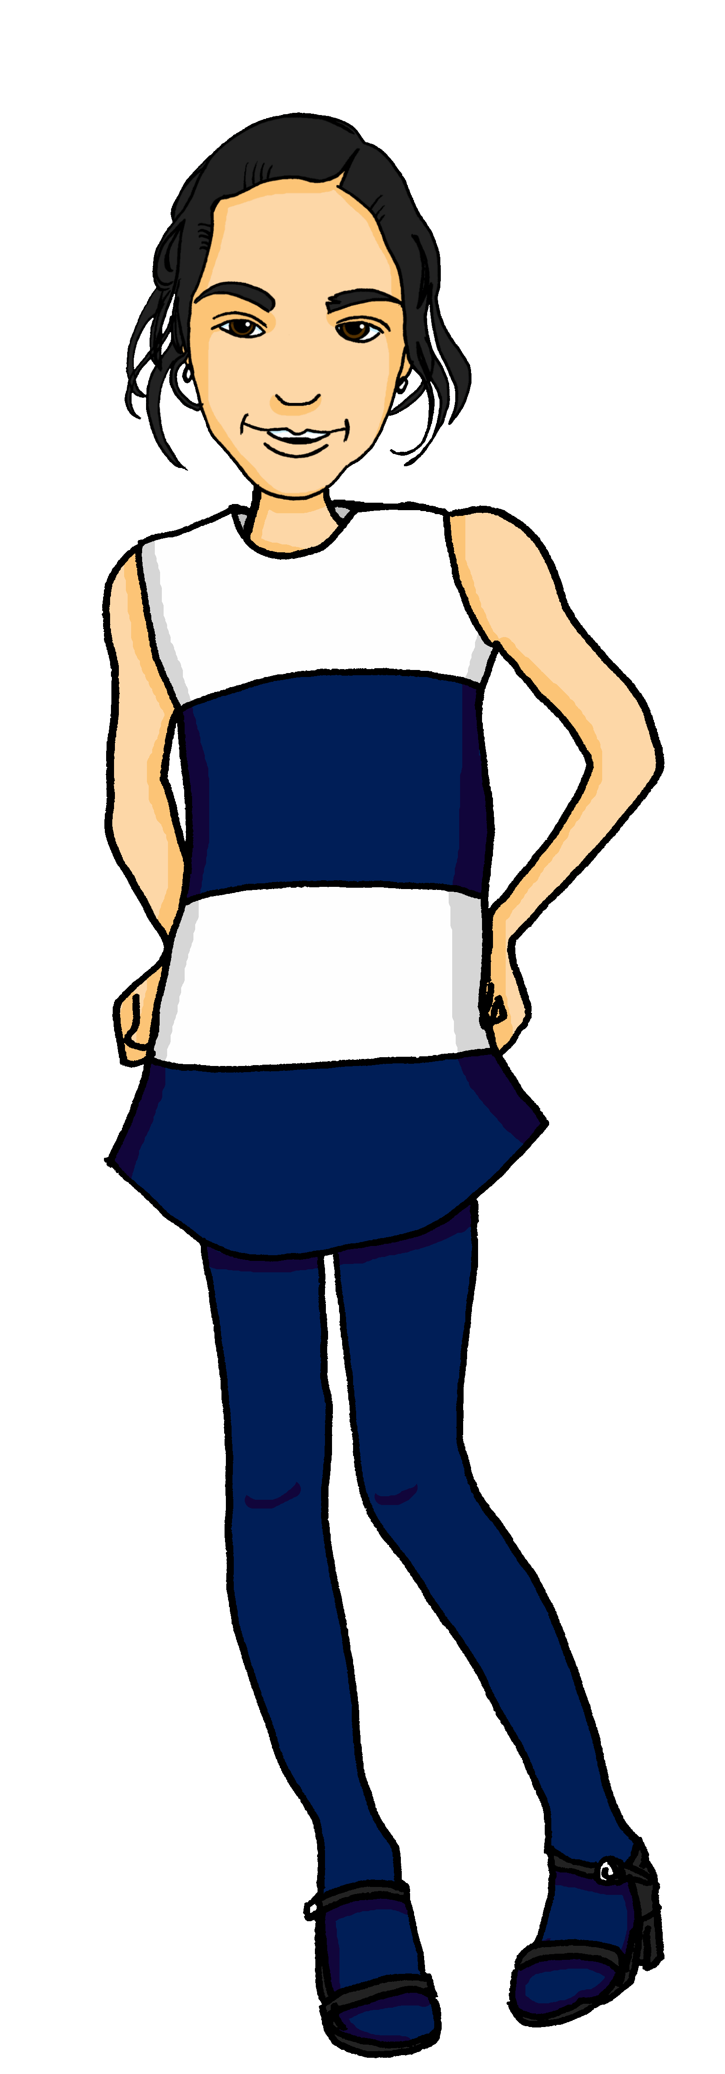
Describing me and others
gelb
Hausaufgabe
Follow ups 1-5
Term 1 Week 11
Notes:
Artwork by Steve Clarke. Pronoun pictures from NCELP (www.ncelp.org). All additional pictures selected from Pixabay and are available under a Creative Commons license, no attribution required.
Phonics:
soft [ch] ich [10] leicht [311] sprechen [161]
hard [ch] Buch [300] Woche [219] machen [58]
Vocabulary:
New words in bold: Hausaufgabe [n/a] Kleidung [2820] Text [473] nicht wahr? [n/a]
Revisit 1: schlecht [327] aber [31] auch [18] nicht [11] wie [25] wie geht's? [n/a]
Revisit 2: es [12] wo [94] England [1762] Schweiz [763] wunderbar [1603] und [2]
Jones, R.L & Tschirner, E. (2019). A frequency dictionary of German: Core vocabulary for learners. London: Routledge.
The frequency rankings for words that occur in this PowerPoint which have been previously introduced in these resources are given in the SOW and in the resources that first introduced and formally re-visited those words.
For any other words that occur incidentally in this PowerPoint, frequency rankings will be provided in the notes field wherever possible.
Note that the first three lessons of the year teach language that can be continuously recycled as lesson routine every lesson in Y3/4.
The idea would be that the class teacher (whether or not s/he teaches the class German can re-use the language as part of the daily routine with the class.

Slide 2
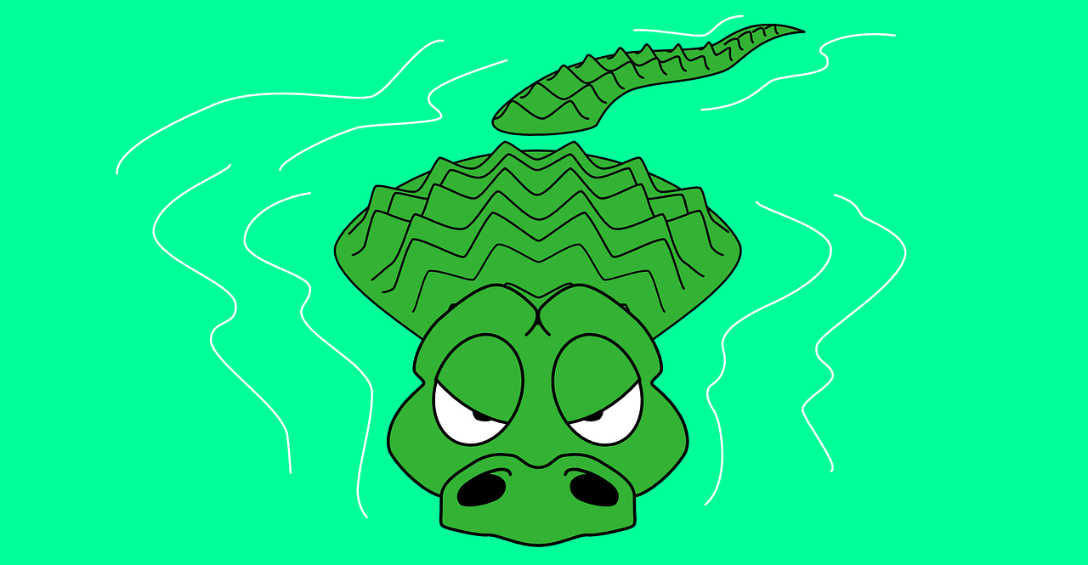
Follow up 1: Sag die Wörter.
Can you safely cross the river?
‘ch’ sounds like ‘Buch’ after a, o, u.
Otherwise, it sounds like ‘ich’.
aussprechen
Buch
suchen
Milch
Woche
Licht
ich
sprechen
Sprache
Recht
Nacht
1
2
3
4
5
Notes:
Timing: 5 minutes Aim: To practise contrasting soft and hard [ch] in a read aloud and listening task.
Procedure: 1. Pupils read the explanation about when to use soft and hard [ch].
2. Click on the first audio button to hear either a soft or hard [ch].
3. Pupils suggest which of the two words above matches the [ch] they have heard. They need to be careful! Some of the stones are unstable and if they choose the wrong answer, they will fall into the river with the crocodiles!
4. Click on the stone the pupils have suggested to reveal the answer.
5. Repeat for numbers 2-5.
Transcript:
Hard [ch]
Soft [ch]
Hard [ch]
Soft [ch]
Soft [ch]
Frequency of unknown words/cognates:
Buch [300] Licht [436] Milch [2276] Nacht [325] Recht [242] Sprache [421] sprechen [161] suchen [293] Woche [219] Jones, R.L & Tschirner, E. (2019). A frequency dictionary of German: Core vocabulary for learners. London: Routledge.

Slide 3
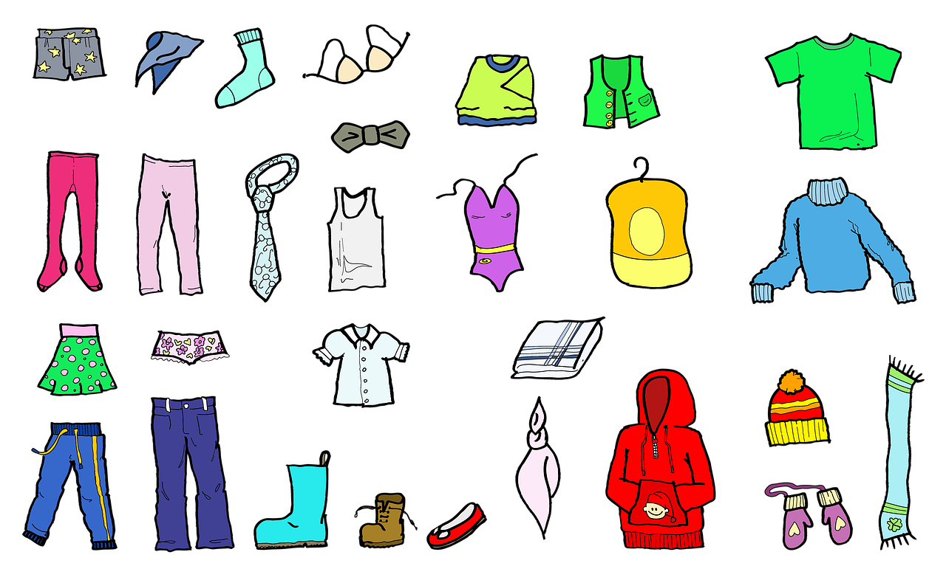
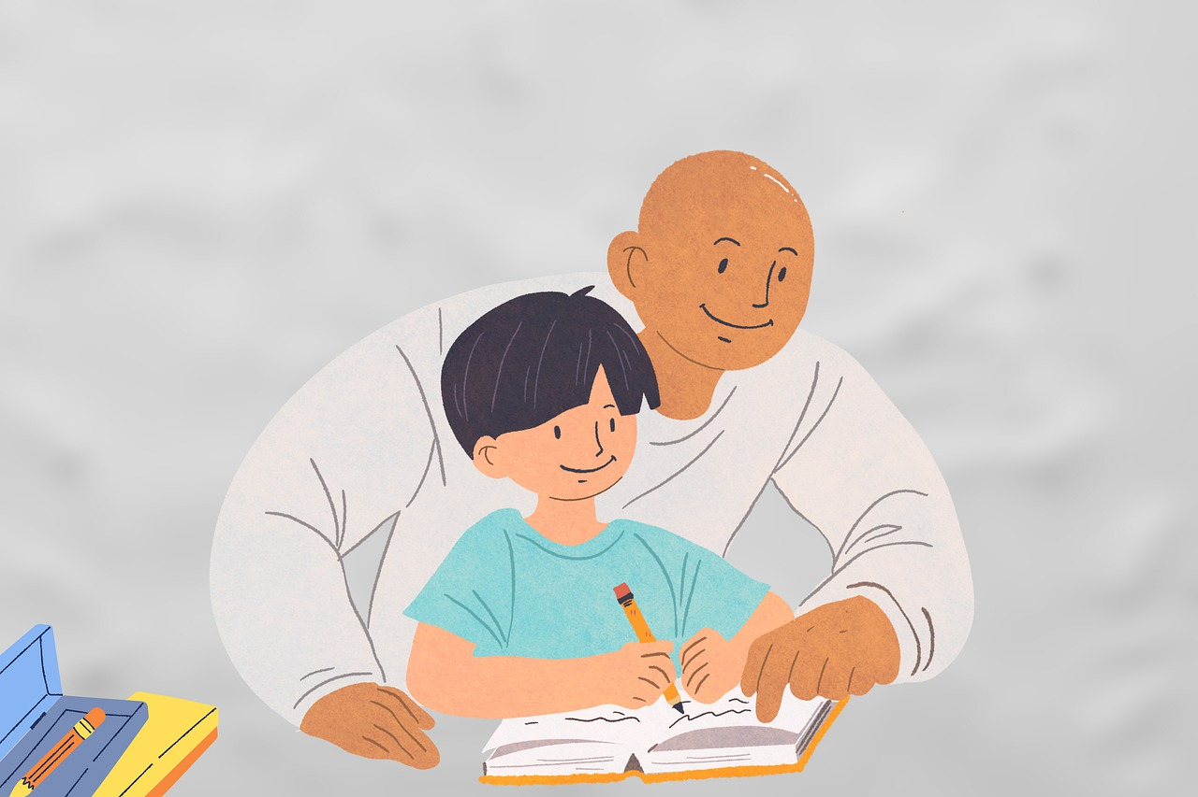
Follow up 2
Mariem ist Ronjas Partnerin
Hör zu
Wörter
Ronja left some of her things at Mariem’s house.
Das ist nicht mein…
Vokabeln
1
E
A
B
C
2
F
3
D
4
A
D
E
F
5
B
6
C
Notes:
Timing: 5 minutes
Aim: to practise this week’s vocabulary and recognition of nicht and mein/e, dein/e
Procedure:
Explain the task. Ronja has left some of her things at Mariem’s house. Mariem is talking about what she can see. Make it clear that for this exercise, a picture of Ronja represents dein/e and a picture of Mariem represents mein/e. So picture A represents Das ist nicht mein Text.
Click on the audio buttons to hear a sentence. Pupils write down which picture it represents.
Click to reveal answers.
Transcript:
Das ist dein Text.
Das ist meine Kleidung.
Das ist nicht meine Hausaufgabe.
Das ist nicht mein Text.
Das ist nicht deine Kleidung.
Das ist nicht deine Hausaufgabe.

Slide 4
Follow up 3

Schreib die Wörter auf Deutsch und auf Englisch.
Das ist _______ _____________.
Ist das _____ ____?
Das ist _____ _____ Problem.
Das ist _____ _____ ______.
Sie ist ______ Partnerin, _____ _____?
___ ___my homework.
__ ____ your text?
_____ _ not my _________.
____ __ not your card.
____ __ my ________ isn’t she?
schreiben
meine Hausaufgabe
That is
dein Text
‘nicht wahr’ works for any ‘tag’ question so here we say: ‘isn’t she?’
Is that
nicht mein
That is
Problem
nicht deine Karte
That is
meine
nicht wahr
She is
partner
Notes:
Timing: 5 minutes
Aim: to practise written production of nicht mein/e, dein/e and some of this week’s vocabulary.
Procedure:
Pupils write the missing words in both German and English to complete the sentences.
Teacher clicks to provide the written answers.

Slide 5
Follow up 4a
Mariem ist Ronjas Partnerin
Mariem’s mum is asking her which things are hers and which are Ronja’s. Is there a ‘nicht wahr’ at the end of her questions, or not?
lesen
1.
Das ist deine Hausaufgabe ,nicht wahr ?
2.
Ist das deine Kleidung ?
3.
Das ist dein Text ,nicht wahr ?
4.
Das ist deine Karte ,nicht wahr ?
5.
Ist das deine Liste ?
6.
Ist das dein Blatt ?
Notes:
Timing: 5 minutes
Aim: to identify two types of question types by syntax: Ist das…+ nicht wahr, and Das ist … .
Procedure:
Explain that pupils have to read the questions and decide, based on the syntax, whether there is a nicht wahr at the end or not.
Elicit the answers, then click to reveal.
Pupils read the dialogue in pairs to practise the pronounciation.

Slide 6
Follow up 4b:
Noughts and Crosses
Ist das die Schweiz?
Das ist ein Partner, nicht wahr?
sprechen
Das ist ein Text, nicht wahr?
nicht wahr?
?
?
?
nicht wahr?
nicht wahr?
nicht wahr?
?
?
Notes:
Timing: 5 minutes
Aim: to practise asking inversion questions and nicht wahr questions.
Procedure:
Explain the task by using the model.
Pupils work in pairs. Each pair is given a handout (there are two different versions to enable pupils to play two rounds). One person takes circles, the other crosses.
Pupils take it in turns to claim a square by saying what they can see in that square. If a square contains nicht wahr, they need to use a statement followed by nicht wahr. If the square contains a question mark, then they need to use an inversion.
The aim is to get three in a row.

Slide 7
Follow up 5:

Schreib auf Englisch.
Can you get at least 15 points?
Wörter
 | England | und | wunderbar
 | wo? | es | die Schweiz
 | schlecht | auch | aber
 | nicht | wie geht’s? | wie?
 | die Kleidung | nicht wahr? | die Liste
 | der Text | die Hausaufgabe | die Karte
Vokabeln
England
and
wonderful
x3
where?
it
Switzerland
bad, badly
also, too
but
x2
not
how’s it going?
how?
(the) clothing
isn’t it/isn’t that right?
(the) list
x1
(the) text
(the) homework
(the) card
Notes:
Timing: 5 minutes
Aim: to practise written comprehension of vocabulary from this and revisited weeks.
Procedure: 1. Give pupils a blank grid. They fill in the English meanings of any of the words they know, trying to reach 15 points in total. 2. Remind pupils that adjectives can refer to male or female persons and they should note this in their translations. E.g. pleased (f), short (m).
Note: The most recently learnt and practised words are pink, words from the previous week are green and those from week 1 are blue, thus more points are awarded for them, to recognise that memories fade and more effort (heavy lifting!) is needed to retrieve them.

Slide 8
Follow up 5:

Schreib auf Deutsch.
Can you get at least 15 points?
Wörter
 | Switzerland | wonderful | and
 | it | where? | England
 | not | how? | how’s it going?
 | bad, badly | but | also, too
 | (the) list | isn’t it/isn’t that right? | (the) clothing
 | (the) card | (the) text | (the) homework
Vokabeln
die Schweiz
wunderbar
und
x3
es
wo?
England
nicht
wie?
wie geht’s?
x2
schlecht
aber
auch
die Liste
nicht wahr?
die Kleidung
x1
die Karte
der Text
die Hausaufgabe
Notes:
Timing: 5 minutes
Aim: to practise written production of vocabulary from this and revisited weeks.
Procedure: 1. Give pupils a blank grid. They fill in the German meanings of any of the words they know, trying to reach 15 points in total. 2. Remind pupils that adjectives can refer to male or female persons and they should note this in their translations. E.g. pleased (f), short (m).
Note: The most recently learnt and practised words are pink, words from the previous week are green and those from week 1 are blue, thus more points are awarded for them, to recognise that memories fade and more effort (heavy lifting!) is needed to retrieve them.

Slide 9
Tschüss!
gelb
Notes:
9

Slide 10
Follow up 5:

Schreib auf Englisch.
Can you get at least 15 points?
Wörter
 | England | und | wunderbar
 | wo? | es | die Schweiz
 | schlecht | auch | aber
 | nicht | wie geht’s? | wie?
 | die Kleidung | nicht wahr? | die Liste
 | der Text | die Hausaufgabe | die Karte
Vokabeln
x3
x2
x1
Notes:
HANDOUT

Slide 11
Follow up 5:

Schreib auf Deutsch.
Can you get at least 15 points?
Wörter
 | Switzerland | wonderful | and
 | it | where? | England
 | not | how? | how’s it going?
 | bad, badly | but | also, too
 | (the) list | isn’t it/isn’t that right? | (the) clothing
 | (the) card | (the) text | (the) homework
Vokabeln
x3
x2
x1
Notes:
HANDOUT

Slide 12
Follow up 4 Handout
nicht wahr?
nicht wahr?
?
nicht wahr?
?
?
nicht wahr?
nicht wahr?
?
Notes:
HANDOUT ROUND 1

Slide 13
Follow up 4 Handout
nicht wahr?
nicht wahr?
?
nicht wahr?
?
?
nicht wahr?
nicht wahr?
?
Notes:
HANDOUT ROUND 2

