Slide 1
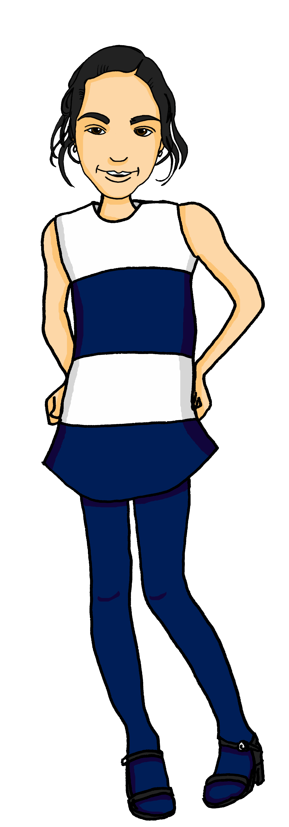
Describing me and others
Hausaufgabe
gelb
Nicht + mein, meine, dein, deine
SSC soft and hard [ch]
Term 1 Week 11
Notes:
Artwork by Steve Clarke. Pronoun pictures from NCELP (www.ncelp.org). All additional pictures selected from Pixabay and are available under a Creative Commons license, no
attribution required.
Phonics:
soft [ch] ich [10] leicht [311] sprechen [161]
hard [ch] Buch [300] Woche [219] machen [58]
Vocabulary:
New words in bold: Hausaufgabe [n/a] Kleidung [2820] Text [473] nicht wahr? [n/a]
Revisit 1: schlecht [327] aber [31] auch [18] nicht [11] wie [25] wie geht's? [n/a]
Revisit 2: es [12] wo [94] England [1762] Schweiz [763] wunderbar [1603] und [2]
Jones, R.L & Tschirner, E. (2019). A frequency dictionary of German: Core vocabulary for learners. London: Routledge.
The frequency rankings for words that occur in this PowerPoint which have been previously introduced in these resources are given in the SOW and in the resources that first
introduced and formally re-visited those words.
For any other words that occur incidentally in this PowerPoint, frequency rankings will be provided in the notes field wherever possible.
Note that the first three lessons of the year teach language that can be continuously recycled as lesson routine every lesson in Y3/4.
The idea would be that the class teacher (whether or not s/he teaches the class German can re-use the language as part of the daily routine with the class.
1

Slide 2
aussprechen
soft [ch]
…
ich
Notes:
Timing: 1 minute
Aim: to introduce the SSC soft [ch].
Procedure:
Introduce the SSC and present the source word ‘ich’ (with gesture, if using).
Click to bring on the picture and get pupils to repeat the word ‘ich’ (with gesture, if using).
Note:
a gesture for ‘ich’ might be to point to yourself.
2

Slide 3
aussprechen
soft [ch]
…
ich
leicht
sprechen
Notes:
Timing: 1 minute
Aim: to consolidate the SSC soft [ch].
Procedure:
Re-present the SSC and the source word ‘ich’ (with gesture, if using).
Click to bring on the picture and get pupils to repeat the word ‘ich’ (with gesture, if using).
Present the cluster words in the same way, bringing on the picture and getting pupils to pronounce the words.
Vocabulary: leicht [311] sprechen [161]
Jones, R.L & Tschirner, E. (2019). A frequency dictionary of German: Core vocabulary for learners. London: Routledge.

Slide 4
aussprechen
hard [ch]
…
Buch
Notes:
Timing: 1 minute
Aim: to introduce the SSC soft [ch].
Procedure:
Introduce the SSC and present the source word ‘Buch’ (with gesture, if using).
Click to bring on the picture and get pupils to repeat the word ‘Buch’ (with gesture, if using).
Note:
a gesture for ‘Buch’ might be to fan out your hands as if opening up a book.
Vocabulary: Buch [300]
Jones, R.L & Tschirner, E. (2019). A frequency dictionary of German: Core vocabulary for learners. London: Routledge.
4

Slide 5
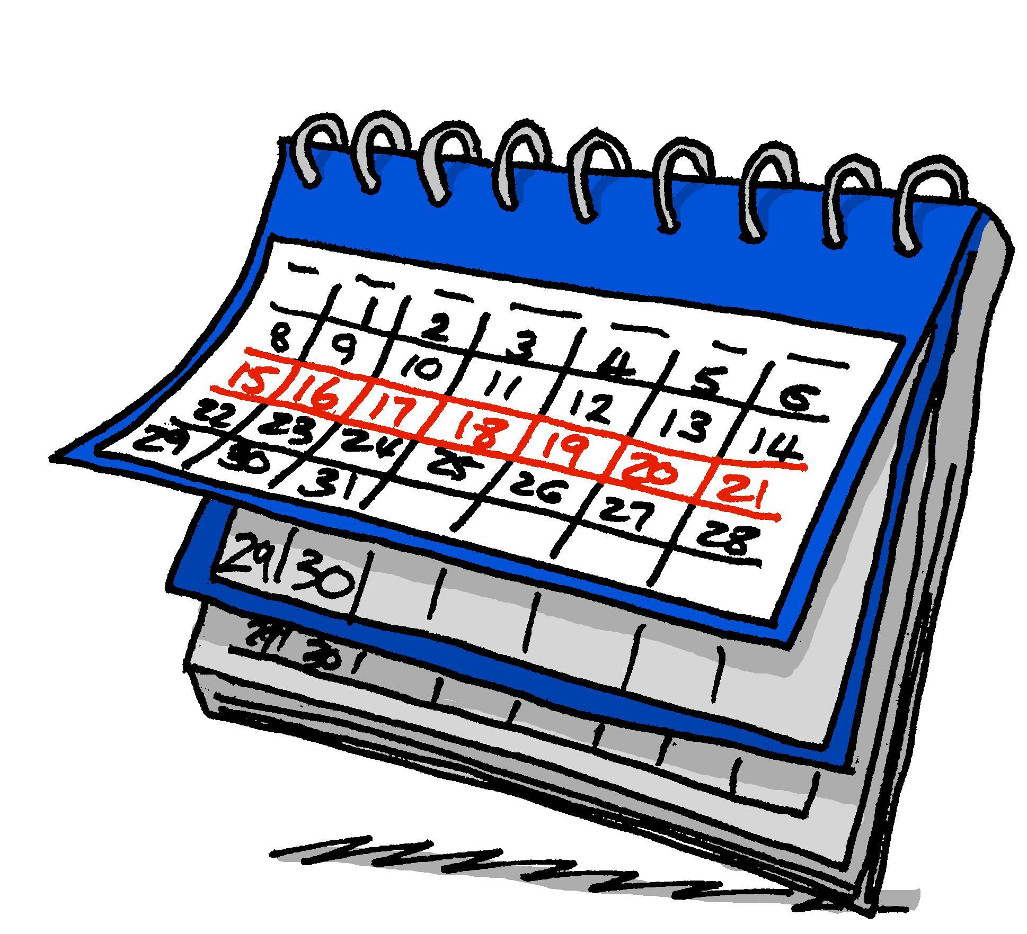
aussprechen
hard [ch]
…
Buch
Woche
machen
Notes:
Timing: 1 minute
Aim: to consolidate the SSC soft [ch].
Procedure:
Re-present the SSC and the source word ‘ich’ (with gesture, if using).
Click to bring on the picture and get pupils to repeat the word ‘ich’ (with gesture, if using).
Present the cluster words in the same way, bringing on the picture and getting pupils to pronounce the words.
Vocabulary: Woche [219] machen [58]
Jones, R.L & Tschirner, E. (2019). A frequency dictionary of German: Core vocabulary for learners. London: Routledge.

Slide 6
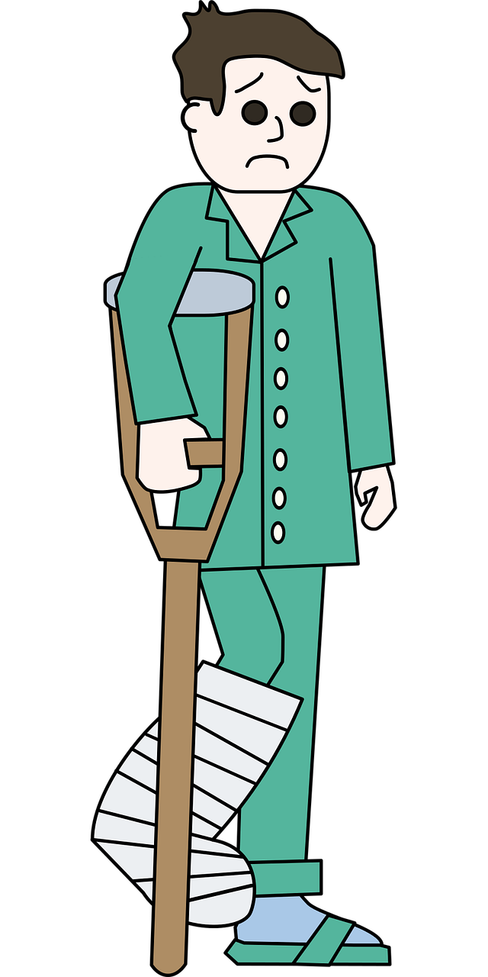
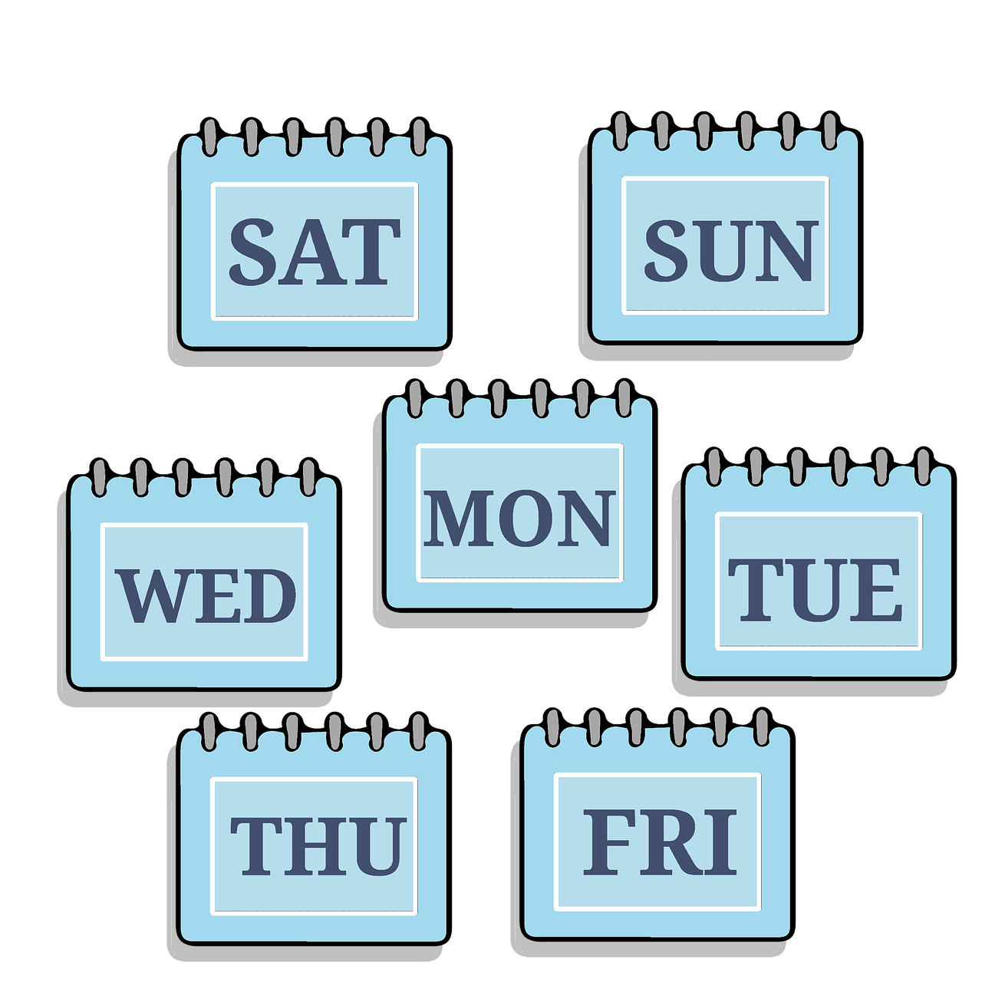
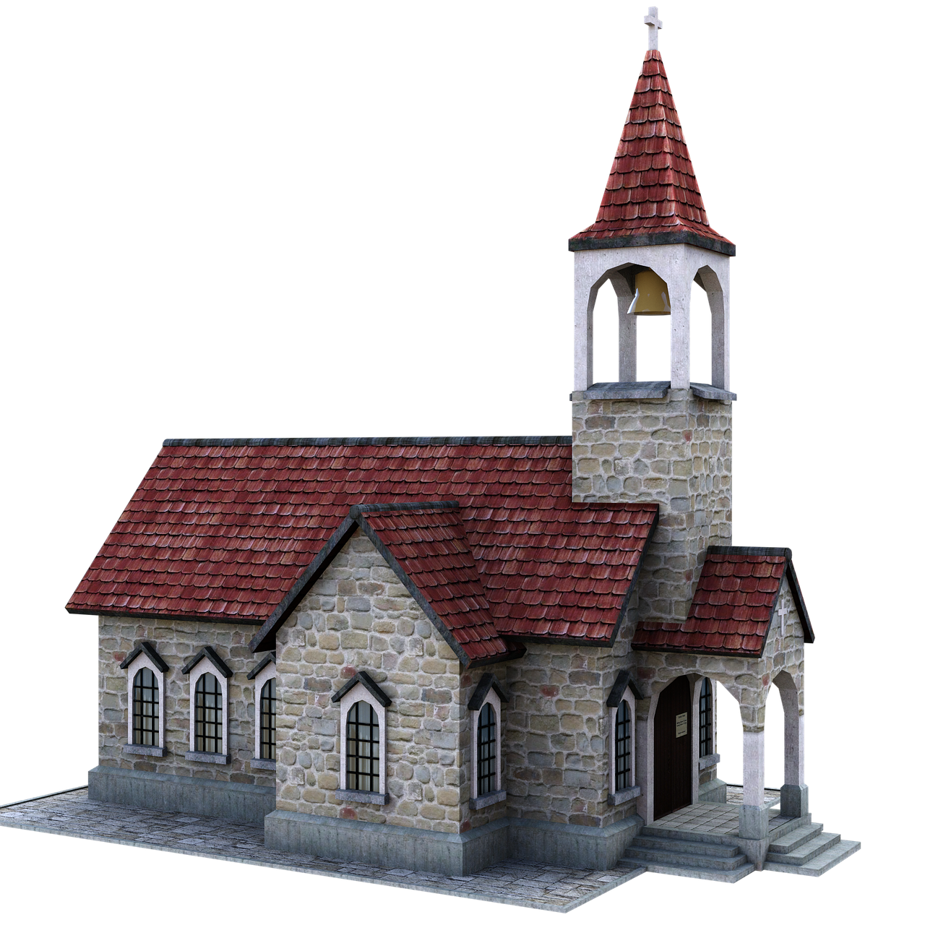
aussprechen
Hör zu.
Soft [ch]: ich, leicht, sprechen.
Hard [ch]: Buch, Woche, machen.
Is it soft or hard [ch]?
 | soft [ch] | hard [ch]
1 |  |  | Macht
2 |  |  | Besuch
3 |  |  | brechen
4 |  |  | China
5 |  |  | Woche
6 |  |  | Kirche
Notes:
Timing: 2 minutes
Aim: to distinguish between the SSCs soft [ch] and hard [ch] in the listening modality.
Procedure:
1. Click to bring up instructions.
2. Click for reminder callout bubble about the difference between hard and soft [ch].
3. Click sound button to play recording for item 1. Pupils decide whether it is soft or hard [ch].
4. Click for answer tick, then for written version, then for picture.
5. Continue for items 2-6.
Transcript:
Macht
Besuch
brechen
China
Woche
Kirche
Frequency of unknown words/cognates: Besuch [1106] brechen [1143] China [846] Kirche [892] Macht [1098] Woche [219]
Jones, R.L & Tschirner, E. (2019). A frequency dictionary of German: Core vocabulary for learners. London: Routledge.

Slide 7
Vokabeln
Was ist das auf Deutsch?
Wörter
die Aufgabe
die Karte
die Liste
der Partner
die Partnerin
Notes:
1/6
Timing: 5 minutes (5 slides)
Aim: revisit previously taught vocabulary.
Procedure:
Pupils read the words and decide which word relates to the picture shown.
Teacher asks ‘Was ist das auf Deutsch?’
Click to bring up answer.
If needed, the teacher can prompt for the English meaning ‘Was ist das auf Englisch?’ but it is likely that the meaning is transparently given by the pictures on this occasion.
7

Slide 8
Vokabeln
Was ist das auf Deutsch?
Wörter
die Aufgabe
die Karte
die Liste
der Partner
die Partnerin
Notes:
[2/5]
8

Slide 9
Vokabeln
Was ist das auf Deutsch?
Wörter
die Aufgabe
die Karte
die Liste
der Partner
die Partnerin
Notes:
[3/5]
9

Slide 10
Vokabeln
Was ist das auf Deutsch?
Wörter
die Aufgabe
die Karte
die Liste
der Partner
die Partnerin
Notes:
[4/5]
10

Slide 11
Vokabeln
Was ist das auf Deutsch?
Wörter
die Aufgabe
die Karte
die Liste
der Partner
die Partnerin
Notes:
[5/5]
11

Slide 12
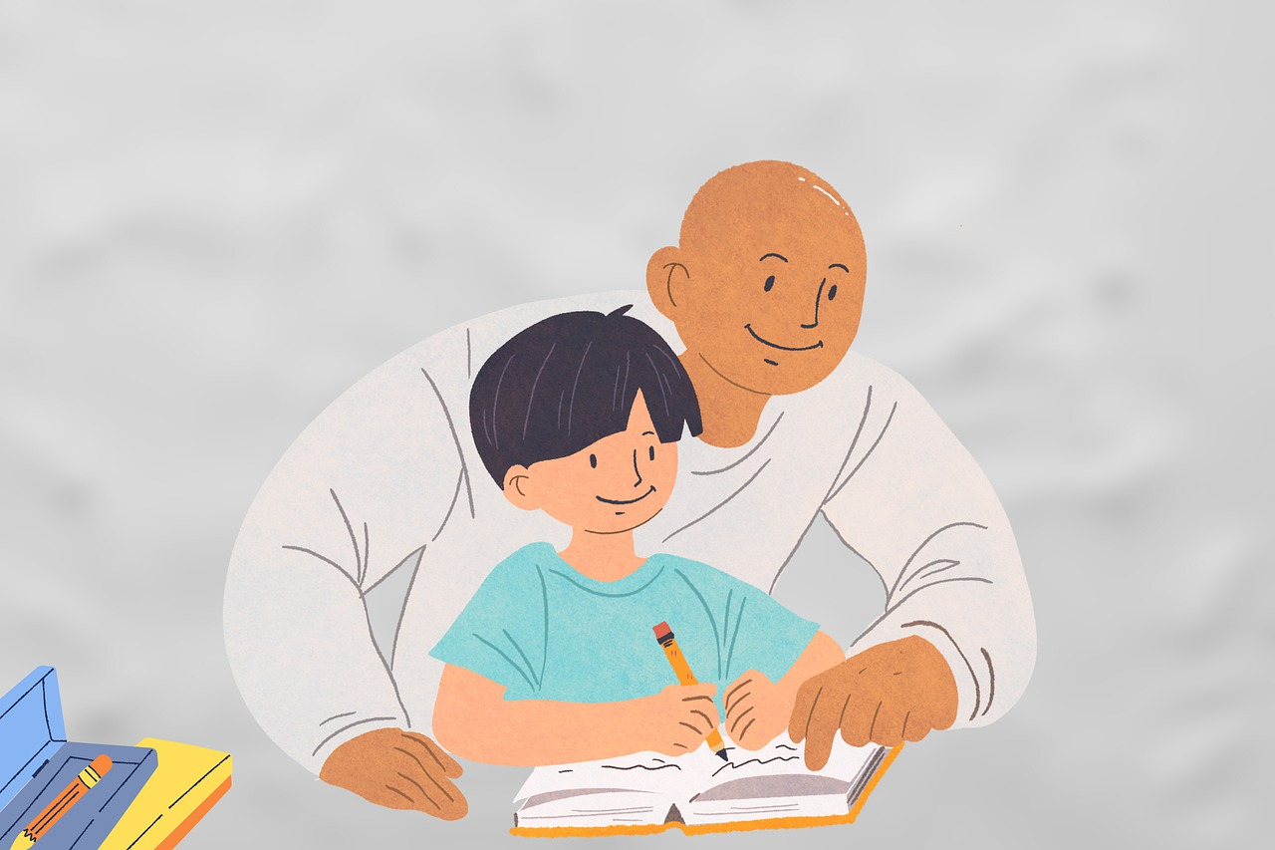
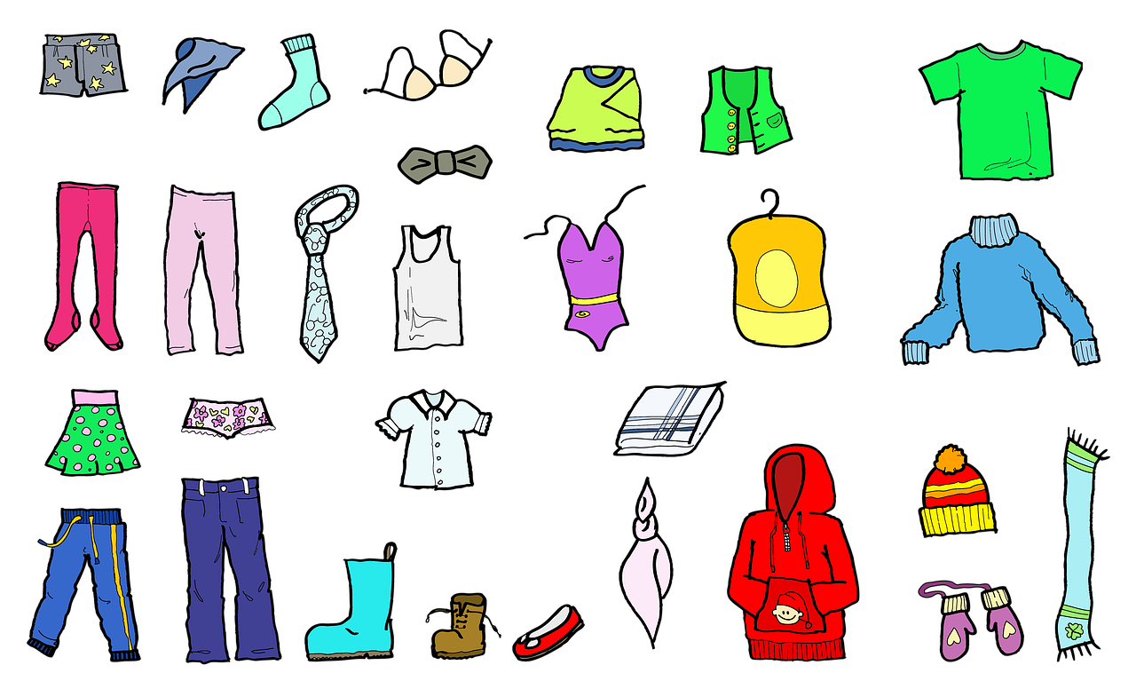
Vokabeln
Wörter
die Hausaufgabe
homework
nicht wahr?
die Kleidung
Nicht wahr literally means ‘not true?’ and is used as a tag question.
Die Kleidung ist schwarz, nicht wahr?
The clothing is black, isn’t it? (isn’t that true)?
der Text
Notes:
Timing: 5 minutes
Aim: to introduce this week’s new vocabulary.
Procedure:
Click to trigger the picture and word together. Say the German word (or play the recording) and get students to repeat.
Click again to repeat an animation of the word, to elicit students’ production of the word without the teacher.
Repeat with the other four items.
After the last item, click to bring up callout to explain the use of ‘nicht wahr’.
12

Slide 13
Vokabeln
Wörter
Das ist ein Text, nicht wahr?
Notes:
1/5
Timing: 5 minutes (5 slides)
Aim: to practise this week’s new vocabulary and ‘nicht wahr’.
Procedure:
Click to bring up Herr Lehmann’s speech bubble asking ‘This is a …, isn’t it?’
Click to bring up the picture.
Pupils say either ja or nein.
Click to bring up the answer.
Repeat for the next four slides.
13

Slide 14
Vokabeln
Wörter
Das ist meine Kleidung, nicht wahr?
Notes:
2/5
14

Slide 15
Vokabeln
Wörter
Das ist deine Hausaufgabe, nicht wahr?
Notes:
3/5
15

Slide 16
Vokabeln
Wörter
Das ist meine Kleidung, nicht wahr?
Notes:
4/5
16

Slide 17
Vokabeln
Wörter
Das ist meine Hausaufgabe, nicht wahr?
Notes:
5/5
17

Slide 18
Nicht (not)
You already know how to use nicht (not):
Use nicht before an adjective or adverb to mean not:
Ich bin hier.
Ich bin nicht hier.
I am here.
I am not here.
Use nicht before ‘der, die, das’ and a noun to mean not:
Das ist der Text.
Das ist nicht der Text.
That is the text.
That is not the text.
Use nicht before proper nouns to mean not:
Das ist die Schweiz.
Das ist nicht die Schweiz.
That is Switzerland.
That is not Switzerland.
Notes:
Timing: 2 minutes
Aim: to revise the already known uses of nicht.
Procedure:
Click through the animations to recap uses of nicht.
Elicit English translation for the German examples provided.
18

Slide 19
Nicht (not)
We also use nicht to mean not before ‘my’ and ‘your’:
Das ist meine Kleidung.
Das ist nicht meine Kleidung.
That is my clothing.
That is not my clothing.
Das ist deine Hausaufgabe.
Das ist nicht deine Hausaufgabe.
That is your homework.
That is not your homework.
Notes:
Timing: 2 minutes
Aim: to introduce the use of ‘nicht’ with ‘mein’ and ‘dein’.
Procedure:
Click through the animations to present the new information.
Elicit English translation for the German examples provided.
19

Slide 20
lesen
Das ist mein… Das ist nicht mein… Das ist meine… Das ist nicht meine
Ronja and Mariem had a sleepover, but their things have got muddled!
Help Ronja work out what is hers and what is Mariem’s.
1
Das ist mein Text.
M
R
R
2
Das ist nicht meine Kleidung.
3
Das ist meine Hausaufgabe.
4
Das ist meine Karte.
R
M
M
5
Das ist nicht meine Liste.
6
Das ist nicht mein Blatt.
Notes:
Timing: 6 minutes
Aim: to practise contrasting nicht mein(e) with mein(e).
Procedure:
Explain the task. Ronja is working out which objects are hers and which are Mariem’s. If she says ‘das ist mein(e)’, then the object is hers, if she says ‘das ist nicht mein(e)’, then the object is Mariem’s.
Pupils write 1 to 6 and R for Ronja and M for Mariem.
Click to reveal answers.
20

Slide 21
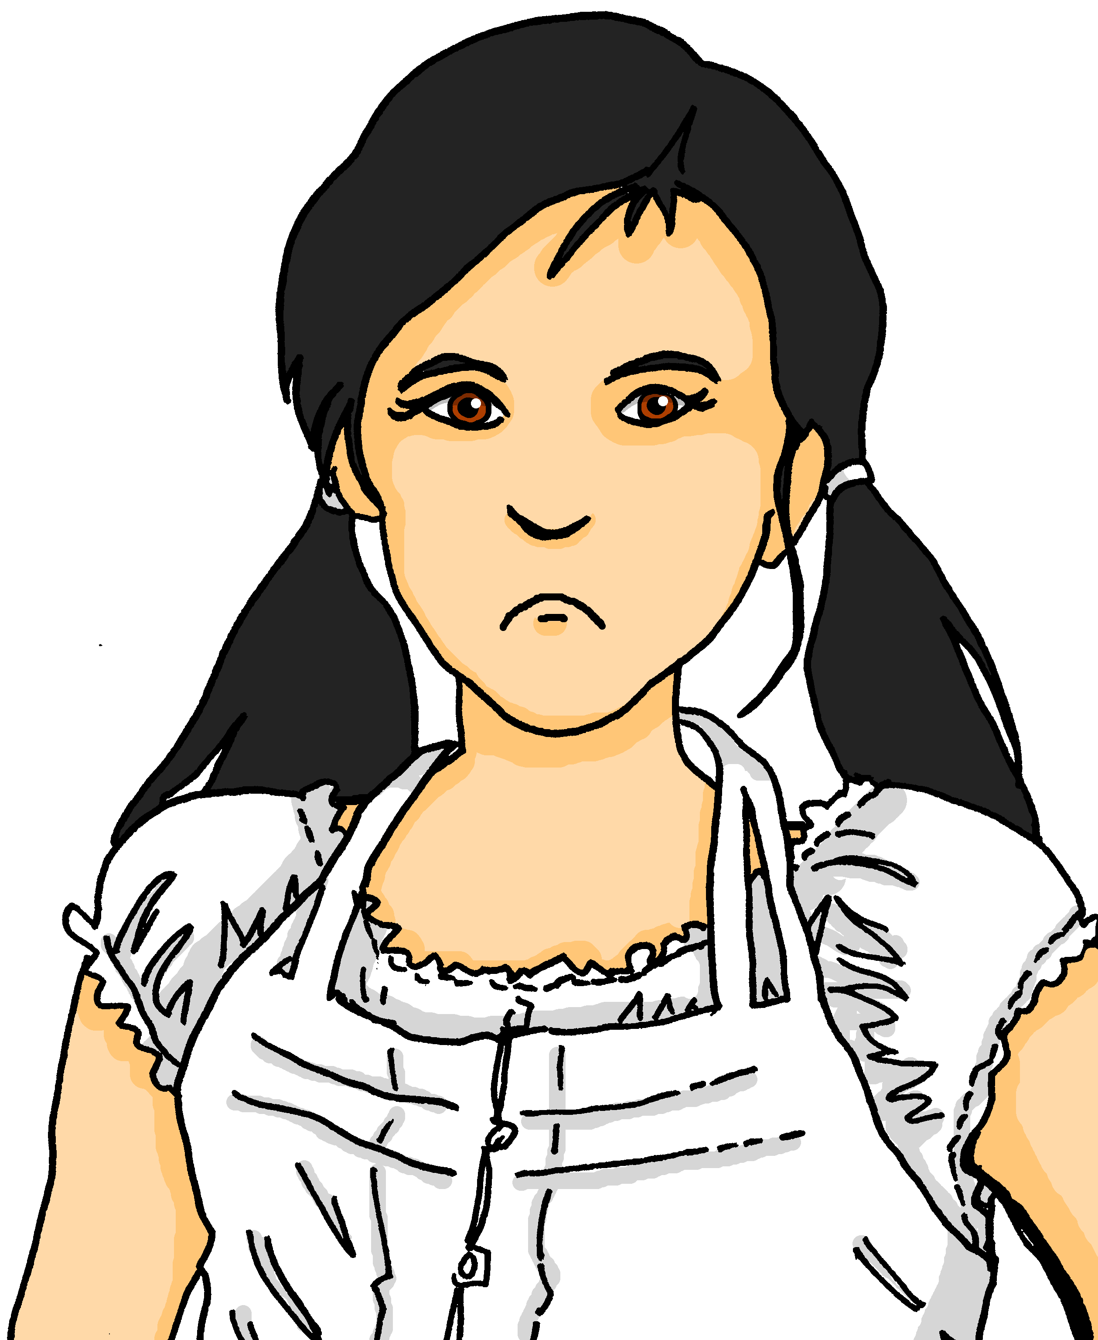
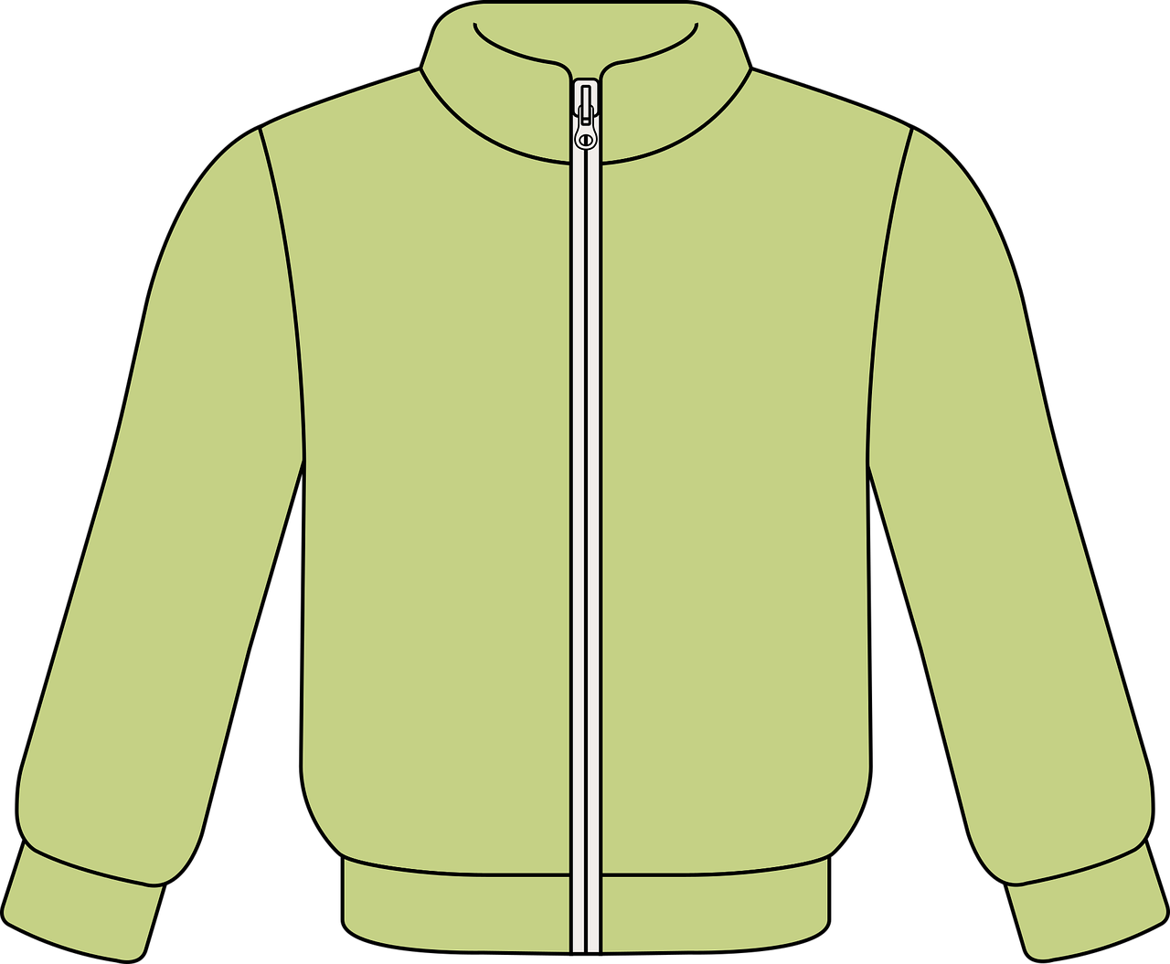
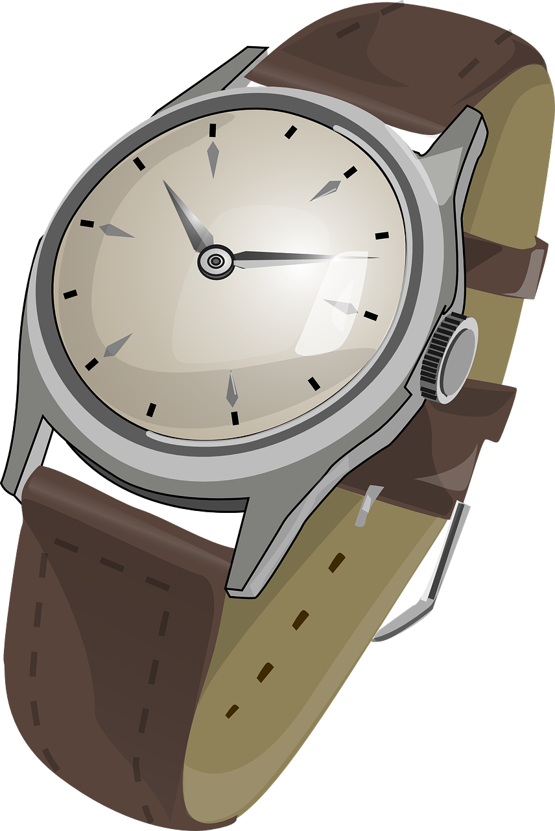
hören
Ronja und Leonie
Ronja has come home but her things are still muddled! Her mum helps her.
Hör zu. Was ist das?
A | B
Text | Hausaufgabe
Blatt | Kleidung
Ball | Liste
Ding | Karte
Butterbrot | Jacke
Preis | Uhr
Blatt | Aufgabe
Ja oder nein?
Ex
1
2
3
4
5
6
Notes:
Timing: 8 minutes
Aim: to practise aural comprehension of ‘dein’ and ‘deine’ and relate them to the gender of nouns. To listen out for negation with ‘nicht’.
Procedure:
Explain the pupils need to listen out for dein or deine and decide which thing Leonie is talking about, A or B.
Click the example audio button. Elicit answer. Click for green answer border and picture to appear.
Explain that pupils have to now listen out for whether the thing talked about is a yes or a no. Click the picture in the’ Ja oder nein’ column to play the recording.
Elicit the answer, click to bring up correct answer.
Continue for items 1-6.
Transcript:
Das ist dein [Text].
Das ist nicht deine [Kleidung].
Das ist nicht dein [Ball].
Das ist deine [Karte].
Das ist nicht deine [Jacke].
Das ist deine [Uhr], nicht wahr? Nein!
Das ist dein [Blatt], nicht wahr? Ja!
21

Slide 22
Tschüss!
gelb
Notes:
22

