Slide 1
Describing me and others
Frohe Weihnachten
gelb
Vocabulary & grammar quiz
Christmas acitivities
Term 1 Week 13
Notes:
Artwork by Steve Clarke. Pronoun pictures from NCELP (www.ncelp.org). All additional pictures selected from Pixabay and are available under a Creative Commons
license, no attribution required.
1

Slide 2
hören
Robbie is from another planet. He likes Earth and speaking German but often forgets word meanings, spellings and things like gender and verb forms. Help Robbie by answering the questions in this quiz.
Vocabulary
A For each question, put a cross (x) under the English meaning that matches what you hear. You will hear each German word twice. Choose one correct answer only. (4 points on this slide)
 | A | B | C | D
 | my | Germany | to be | goodbye
 | ☐ | ☐ | ☐ | ☐
2. | white | hello | yes | bye
 | ☐ | ☐ | ☐ | ☐
3. | no | grey | right | she
 | ☐ | ☐ | ☐ | ☐
4. | he | thing | colour | bad
 | ☐ | ☐ | ☐ | ☐
1
2
3
4
Notes:
1/2.
Timing: 20-25 minutes (all assessment slides)
Aim: to practise aural comprehension of vocabulary taught in weeks 1-12 of the course.
Procedure:
1. Click the audio buttons to play each item. (The words are recorded twice with a pause to allow pupils to process the information).
2. Pupils can either write 1C, etc.. or if they have the assessment on a print out they can put a X in the correct box.
3. After items 1-4, continue to the next slide to complete the remainder of the task.
Transcript:
1. Deutschland
2. Tschüss
3. richtig
4. die Farbe
2

Slide 3
hören
A - continued. (4 points on this slide)
 | A | B | C | D
 | how | where | what | that
 | ☐ | ☐ | ☐ | ☐
 | good | false | it | and
 | ☐ | ☐ | ☐ | ☐
 | place | sheet | person | clothing
 | ☐ | ☐ | ☐ | ☐
 | also | not | or | but
 | ☐ | ☐ | ☐ | ☐
5
6
7
8
Notes:
2/2.
Transcript:
5. wo
6. gut
7. die Kleidung
8. auch
3

Slide 4
hören
B For each question, put a cross (x) under the type of word you hear. You will hear each German word twice. Choose one correct answer only. (4 points on this slide)
This word is a good example of …
 | A | B | C | D
1. | a colour ☐ | a person ☐ | a verb ☐ | an object ☐
2. | an object ☐ | a description ☐ | a person ☐ | a country ☐
3. | a food ☐ | an object ☐ | a greeting ☐ | a place ☐
4. | a question word ☐ | a person ☐ | a location ☐ | an object ☐
1
2
3
4
Notes:
1/2
Procedure:
1. Click the audio buttons to play each item. (The words are recorded twice with a pause to allow pupils to process the information).
2. Pupils can either write 1C, etc.. or if they have the assessment on a print out they can put a X in the correct box.
3. Continues on next slide.
Transcript:
1. schwarz
2. ich
3. Auf Wiedersehen
4. was
4

Slide 5
hören
B continued. (4 points on this slide)
This word is a good example of …
 | A | B | C | D
1. | an object ☐ | a food ☐ | a colour ☐ | a verb ☐
2. | a greeting ☐ | a country ☐ | an verb ☐ | a person ☐
3. | a verb ☐ | a country ☐ | a greeting ☐ | a description ☐
4. | an object ☐ | a food ☐ | a person ☐ | a colour ☐
5
6
7
8
Notes:
2/2
Transcript:
5. sein
6. die Schweiz
7. wunderbar
8. das Butterbrot
5

Slide 6
lesen
C Help Robbie to translate the underlined German word(s) to complete each English sentence. (6 points on this slide)
lesen
1. Guten Morgen Frau Schmidt! ___________ Mr Schmidt!
2. Wo ist dein Butterbrot? Where is ___________ sandwich?
3. Die Uhr ist da. The ___________ is there.
4. Der Ball ist neu. ___________ ball is new.
5. Wie geht’s? __________ __________ __________?
6. Das Problem ist schwer. The problem is ___________.
Notes:
Aim: to practise written recall of previously taught vocabulary.
Procedure:
Ensure that the task is clear.
Pupils could write 1 – 6 and the individual English word meanings (or they could fill in if they have printed assessment sheets).
If necessary, explain that ‘Schmidt’ is a common German surname.
6

Slide 7
schreiben
D Translate the underlined English words to complete the German sentence. (10 points on this slide, 2 each for items 2, 3, 5 and 6)
schreiben
1. The homework is easy. Die Hausaufgabe ist ___________. (write one word)
2. The apple is there. Der ___________ ist da. (write one word)
3. The jacket is not green. Die Jacke ist ___________ ___________. (write two words)
4. The task is clear. Die Aufgabe ___________ klar. (write one word)
5. My (female) partner is here. Meine ___________ ist hier. (write one word)
6. The list is long. Die ___________ ist ___________. (write one word)
Notes:
Aim: to practise written recall of previously taught vocabulary.
Procedure:
Ensure that the task is clear.
Pupils could write 1 – 6 and the individual English word meanings (or they could fill in if they have printed assessment sheets).
7

Slide 8
lesen
Grammar
A Put a (X) next to the person the sentence is about. (3 points on this slide)
lesen
1 | ☐ I ☐ you _{[singular]} ☐ she/he | … bin alt.
2 | ☐ I ☐ you _{[singular]} ☐ she/he | … ist hier.
3 | ☐ I ☐ you _{[singular]} ☐ she/he | … bist neu.
Notes:
Aim: to practise written understanding of previously taught grammar features.
Procedure:
Ensure that the task is clear.
Pupils could write 1 – 3 and the correct English pronoun (or they could fill in if they have printed assessment sheets).
8

Slide 9
lesen
B Add a full stop (.) or a question mark (?) next to each sentence to show whether it is a statement or a question. (2 points on this slide)
lesen
1. Ist die Karte rund
2. Der Preis ist da
Notes:
Aim: to practise understanding of previously taught grammar (word order) features.
Procedure:
Ensure that the task is clear.
Pupils could write 1 – 3 and the correct punctuation mark, or they could fill in the boxes if they have printed assessment sheets).
9

Slide 10
lesen
C Choose which noun completes each phrase. (3 points on this slide)
lesen
1 | mein | ☐ Hausaufgabe (f) ☐ Problem (nt)
2 | meine | ☐ Partner (m) ☐ Idee (f)
3 | mein | ☐ Text (m) ☐ Aufgabe (f)
Notes:
Aim: to practise written understanding of previously taught grammar features.
Procedure:
Ensure that the task is clear.
Pupils could write 1 – 3 and the correct word, or they could fill in the boxes if they have printed assessment sheets.
10

Slide 11
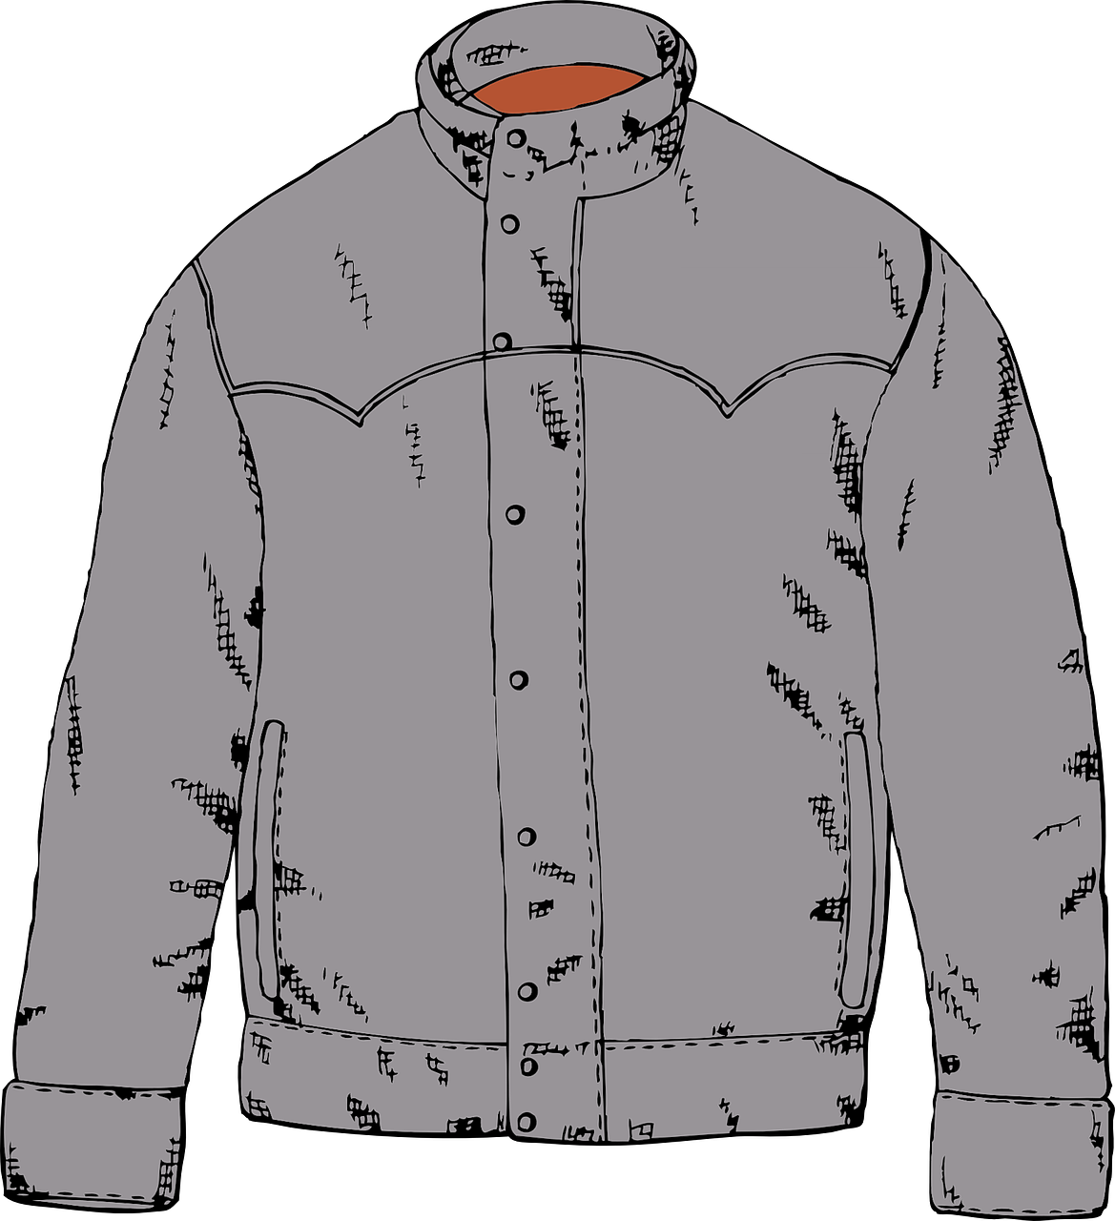
lesen
D Decide whether each sentence is true or false based on the picture. (2 points on this slide)
lesen
1. Das ist nicht die Jacke. True False
2. Der Ball ist rund. True False
Notes:
Aim: to practise written understanding of previously taught grammar features.
Procedure:
Ensure that the task is clear.
Pupils could write 1 – 2 and true or false, or they could circle one of true or false if they have printed assessment sheets.
11

Slide 12
schreiben
E Write the German word for ‘a’.
(3 points for section E)
schreiben
1. ________ Preis (m) 2. ________ Karte (f)
3. ________ Blatt (nt)
F Write the German word for ‘the’.
(3 points for section F)
1. ________ Partner (m) 2. ________ Ding (nt)
3. ________ Person (f)
Notes:
Aim: to practise written recall of previously taught vocabulary.
Procedure:
Ensure that the task is clear.
Pupils could write 1 – 6 and the individual English word meanings (or they could fill in if they have printed assessment sheets).
12

Slide 13
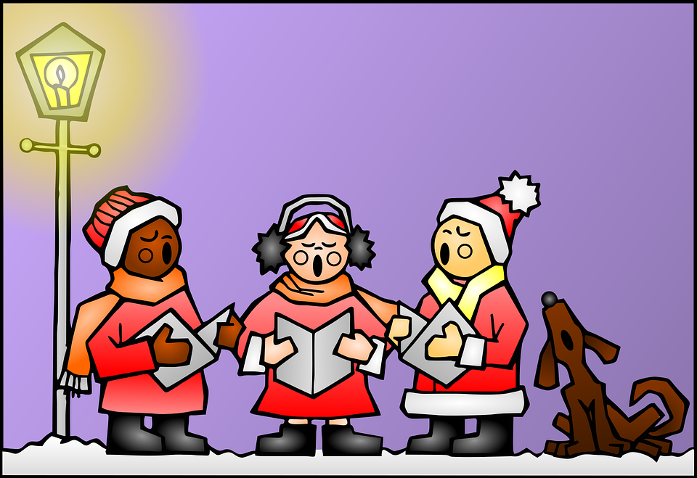
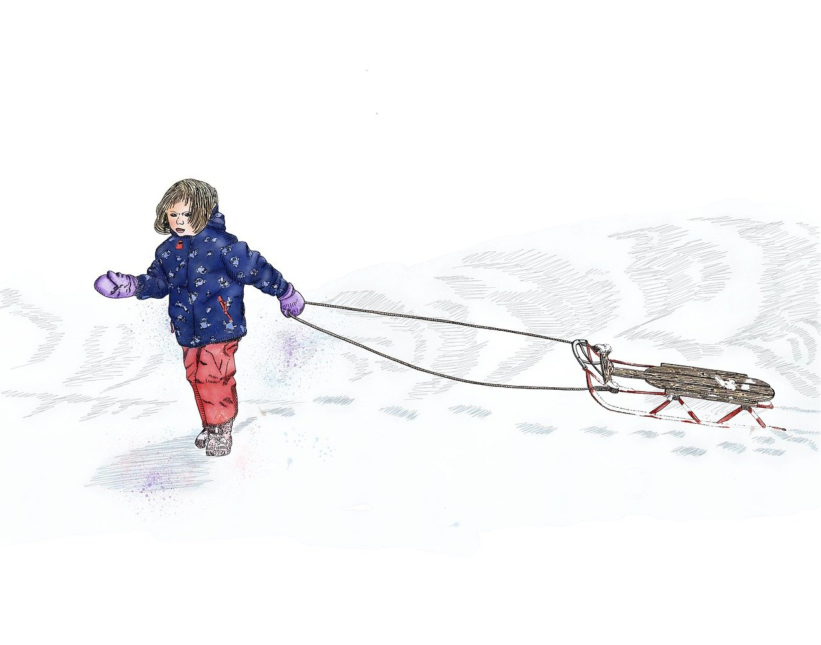
hören
Ein Weihnachtslied!
A Listen and fill in.
B Then, read and sing!
Es schn ei t! Es schn ei t!
K o mmt alle aus dem Haus!
Die Welt, die Welt
s ie ht wie gepudert aus.
Es schneit! Es schneit!
Das müsst ihr einfach sehn!
Kommt m i t! Kommt m i t!
Wir wollen rodeln g e hn.
It’s snowing! It’s snowing!
Everyone come out of the house!
The world, the world,
looks powdered.
It’s snowing! It’s snowing!
You simply have to see it!
Come with us! Come with us!
We want to go sledging.
__
__
_
_
_
__
__
_
_
_
Notes:
Timing: flexible
Note: the majority of this lesson will be taken up with the vocabulary and grammar parts of the assessment. However, this Christmas carol can fit in either at the end of this week’s lesson or in the follow up time this week. There are no other follow up materials this week, as we anticipate schools will be busy at this time of term. The song would make a good addition to a Christmas assembly.
Aim: to enjoy a German Christmas song; to listen out for key SSC and transcribe them; to join in with the song whilst listening and reading.
NB: creative, not literal translation.
Song with text:
Procedure: 1. Play the first verse of the YouTube video with sound only (without showing the video). Pupils listen and fill in the missing letters. 2. Click to reveal answers. 3. Play whole video so pupils can join in with the song.
Link to YouTube video: https://www.youtube.com/watch?v=4_p8B0s2mW0
13

Slide 14
Tschüss!
gelb
Notes:
14

Slide 15
hören
Robbie is from another planet. He likes Earth and speaking German but often forgets word meanings, spellings and things like gender and verb forms. Help Robbie by answering the questions in this quiz.
Vocabulary
A For each question, put a cross (x) under the English meaning that matches what you hear. You will hear each German word twice. Choose one correct answer only. (4 points on this slide)
 | A | B | C | D
 | my | Germany | to be | goodbye
 | ☐ | ☒ | ☐ | ☐
2. | white | hello | yes | bye
 | ☐ | ☐ | ☐ | ☒
3. | no | grey | right | she
 | ☐ | ☐ | ☒ | ☐
4. | he | thing | colour | bad
 | ☐ | ☐ | ☒ | ☐
1
2
3
4
Notes:
Answers 1/2
Transcript:
1. Deutschland
2. Tschüss
3. richtig
4. die Farbe
15

Slide 16
hören
A - continued. (4 points on this slide)
 | A | B | C | D
 | how | where | what | that
 | ☐ | ☒ | ☐ | ☐
 | good | false | it | and
 | ☒ | ☐ | ☐ | ☐
 | place | sheet | person | clothing
 | ☐ | ☐ | ☐ | ☒
 | also | not | or | but
 | ☒ | ☐ | ☐ | ☐
5
6
7
8
Notes:
Answers 2/2
Transcript:
5. wo
6. gut
7. die Kleidung
8. auch
16

Slide 17
hören
B For each question, put a cross (x) under the type of word you hear. You will hear each German word twice. Choose one correct answer only. (4 points on this slide)
This word is a good example of …
 | A | B | C | D
1. | a colour ☒ | a person ☐ | a verb ☐ | an object ☐
2. | an object ☐ | a description ☐ | a person ☒ | a country ☐
3. | a food ☐ | an object ☐ | a greeting ☒ | a place ☐
4. | a question word ☒ | a person ☐ | a location ☐ | an object ☐
1
2
3
4
Notes:
Answers 1/2
Transcript:
1. schwarz
2. ich
3. Auf Wiedersehen
4. was
17

Slide 18
hören
B continued. (4 points on this slide)
This word is a good example of …
 | A | B | C | D
1. | an object ☐ | a food ☐ | a colour ☐ | a verb ☒
2. | a greeting ☐ | a country ☒ | an verb ☐ | a person ☐
3. | a verb ☐ | a country ☐ | a greeting ☐ | a description ☒
4. | an object ☐ | a food ☒ | a person ☐ | a colour ☐
5
6
7
8
Notes:
Answers 2/2
Transcript:
5. sein
6. die Schweiz
7. wunderbar
8. das Butterbrot
18

Slide 19
lesen
C Help Robbie to translate the underlined German word(s) to complete each English sentence. (6 points on this slide)
lesen
1. Guten Morgen Frau Schmidt! Good morning Mr Schmidt!
2. Wo ist dein Butterbrot? Where is your sandwich?
3. Die Uhr ist da. The watch/clock is there.
4. Der Ball ist neu. The ball is new.
5. Wie geht’s? How’s it going?
6. Das Problem ist schwer. The problem is difficult.
Notes:
Answers
19

Slide 20
schreiben
D Translate the underlined English words to complete the German sentence. (10 points on this slide, 2 each for items 2, 3, 5 and 6)
schreiben
1. The homework is easy. Die Hausaufgabe ist einfach. (write one word)
2. The apple is there. Der Apfel ist da. (write one word)
3. The jacket is not green. Die Jacke ist nicht grün. (write two words)
4. The task is clear. Die Aufgabe ist klar. (write one word)
5. My (female) partner is here. Meine Partnerin ist hier. (write one word)
6. The list is long. Die Liste ist lang. (write one word)
Notes:
Answers
20

Slide 21
lesen
Grammar
A Put a (X) next to the person the sentence is about. (3 points on this slide)
lesen
1 | ☒ I ☐ you _{[singular]} ☐ she/he | … bin alt.
2 | ☐ I ☐ you _{[singular]} ☒ she/he | … ist hier.
3 | ☐ I ☒ you _{[singular]} ☐ she/he | … bist neu.
Notes:
Answers
21

Slide 22
lesen
B Add a full stop (.) or a question mark (?) next to each sentence to show whether it is a statement or a question. (2 points on this slide)
lesen
?
1. Ist die Karte rund
.
2. Der Preis ist da
Notes:
Answers
22

Slide 23
lesen
C Choose which noun completes each phrase. (3 points on this slide)
lesen
1 | mein | ☐ Hausaufgabe (f) ☒ Problem (nt)
2 | meine | ☐ Partner (m) ☒ Idee (f)
3 | mein | ☒ Text (m) ☐ Aufgabe (f)
Notes:
Answers
23

Slide 24
lesen
D Decide whether each sentence is true or false based on the picture. (2 points on this slide)
lesen
1. Das ist nicht die Jacke. True False
2. Der Ball ist rund. True False
Notes:
Answers
24

Slide 25
schreiben
E Write the German word for ‘a’.
(3 points for section E)
schreiben
1. ein Preis (m) 2. eine Karte (f)
3. ein Blatt (nt)
F Write the German word for ‘the’.
(3 points for section F)
1. der Partner (m) 2. das Ding (nt)
3. die Person (f)
Notes:
Answers
25

