Slide 1
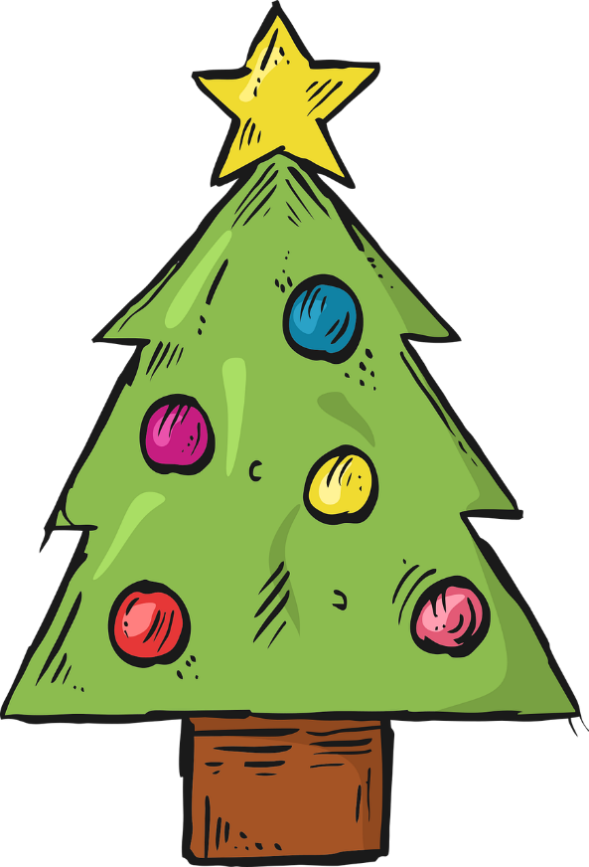
Describing me and others
Frohe Weihnachten
gelb
Phonics quiz
Christmas acitivities
Term 1 Week 14
Notes:
Artwork by Steve Clarke. Pronoun pictures from NCELP (www.ncelp.org). All additional pictures selected from Pixabay and are available under a Creative Commons
license, no attribution required.
1

Slide 2
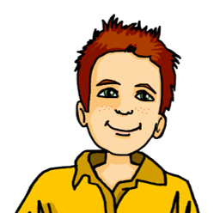
aussprechen
long
[u]
short
[u]
aussprechen
Grund
Bruder
[reason]
[brother]
Notes:
1/8
slides 2-9: Phonics assessment slides.
Procedure:
1. Pupils pronounce SSCs of unknown words. Assessment sheet is provided on slide 10. Independent work activity is provided on slide 10.
Word frequency (1 is the most frequent word in German):
Grund [249] Bruder [730]
2

Slide 3
aussprechen
long
[a]
short
[a]
aussprechen
Monday
Montag
kann
[Monday]
[to be able to, can]
Notes:
2/8
Word frequency (1 is the most frequent word in German):
Montag [1044] kann [23]
3

Slide 4
aussprechen
long
[o]
short
[o]
aussprechen
froh
Sonne
[glad, happy]
[sun]
Notes:
3/8
Word frequency (1 is the most frequent word in German):
froh [1424] Sonne [864]
4

Slide 5
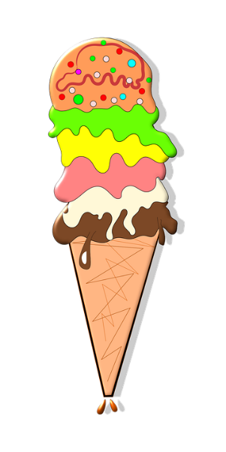
aussprechen
[ei]
[ie]
aussprechen
Tuesday
Eis
Dienstag
[ice cream]
[Tuesday]
Notes:
4/8
Word frequency (1 is the most frequent word in German):
Eis [1874] Dienstag [1356]
5

Slide 6
aussprechen
long
[e]
short [e]
aussprechen
Fehler
nett
[mistake]
[nice]
Notes:
5/8
Word frequency (1 is the most frequent word in German):
Fehler [861] nett [1565]
6

Slide 7
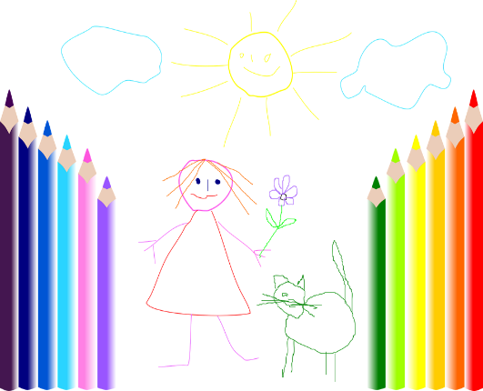
aussprechen
long
[i]
short
[i]
aussprechen
ihr
Bild
[her]
[picture]
Notes:
6/8
Word frequency (1 is the most frequent word in German):
ihr [27] Bild [253]
7

Slide 8
aussprechen
[w]
[z]
aussprechen
Wetter
zehn
[weather]
[ten]
Notes:
7/8
Word frequency (1 is the most frequent word in German):
Wetter [1881] zehn [333]
8

Slide 9
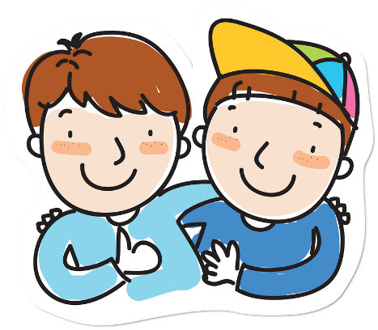
aussprechen
soft [ch]
hard [ch]
aussprechen
freundlich
Kuchen
[friendly]
[cake]
Notes:
8/8
Word frequency (1 is the most frequent word in German):
freundlich [1566] Kuchen [4381]
9

Slide 10
aussprechen
Pupil name:
Pupil name:
SSC and word | px
Grund
Bruder
Montag
kann
froh
Sonne
Eis
Dienstag
Fehler
nett
ihr
Bild
Wetter
Zehn
freundlich
Kuchen
SSC and word | px
Grund
Bruder
Montag
kann
froh
Sonne
Eis
Dienstag
Fehler
nett
ihr
Bild
Wetter
Zehn
freundlich
Kuchen
Notes:
Pupil feedback and assessment sheet
10

Slide 11
aussprechen
Teacher audio version
SSC and word | px
Grund
Bruder
Montag
kann
froh
Sonne
Eis
Dienstag
SSC and word | px
Fehler
nett
ihr
Bild
Wetter
Zehn
freundlich
Kuchen
Notes:
Teacher audio version
11

Slide 12
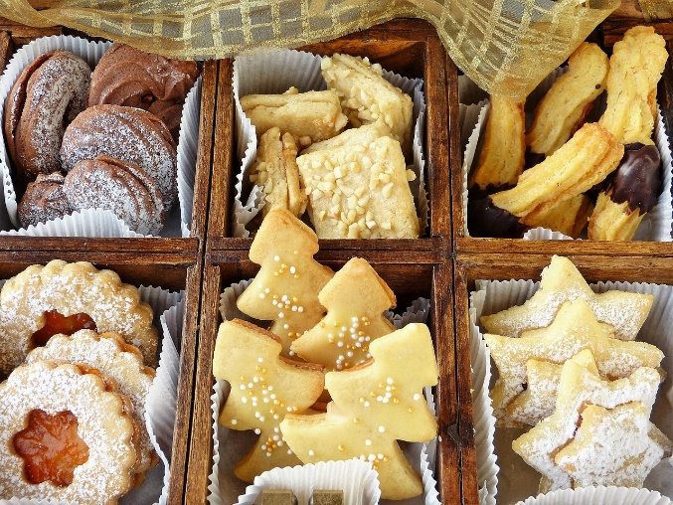
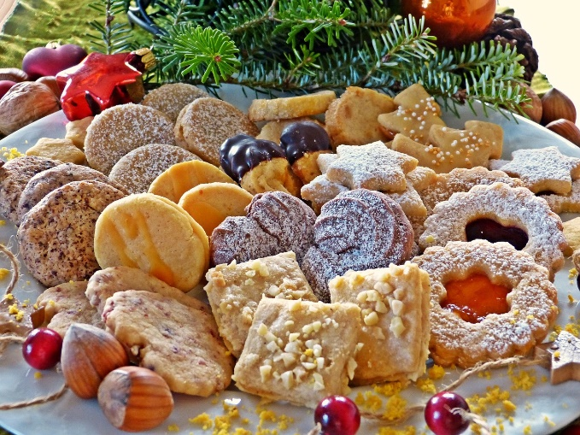
Christmas cookies!
Christmas cookies are popular in Germany!
In Switzerland, the cookies are called Guetzli.
1. Use the colours to learn what they are called in German:
h
n
l
i
e
d
c
P
ä
z
d
i
e
2. Make a poster using the German or Swiss word and draw a picture of the cookies.
P
l
ä
t
z
c
h
e
n
Notes:
A Christmas activity for pupils to work on independently while teacher conducts Phonics assessment.

Slide 13
Tschüss!
gelb
Notes:
13

