Slide 1
Talking about things and things to do
zu Hause
gelb
Follow ups 1-5
Term 2 Week 7
Notes:
Artwork by Steve Clarke. Pronoun pictures from NCELP (www.ncelp.org). All additional pictures selected from Pixabay and are available under a Creative Commons license, no attribution required.
Phonics:
[s-] [-s-] singen [1063] Person [357] langsam [526] sehr [81] besuchen [820]
vs. [z] Zug [675] sitzen [231] Platz [326] Zimmer [665] zehn [333]
Vocabulary: benutzen [1119] spielen [205] Sport [945] zu Hause [n/a]
Revisit 1: du hast [7]
Revisit 2: Hausaufgabe [n/a] Kleidung [2820] Text [473] nicht wahr? [n/a]
Jones, R.L & Tschirner, E. (2019). A frequency dictionary of German: Core vocabulary for learners. London: Routledge.
The frequency rankings for words that occur in this PowerPoint which have been previously introduced in these resources are given in the SOW and in the resources that first introduced and formally re-visited those words.
For any other words that occur incidentally in this PowerPoint, frequency rankings will be provided in the notes field wherever possible.
Note that the first three lessons of the year teach language that can be continuously recycled as lesson routine every lesson in Y3/4.
The idea would be that the class teacher (whether or not s/he teaches the class German can re-use the language as part of the daily routine with the class.

Slide 2
aussprechen
[s]
Before a vowel, German 's' sounds like English ‘z’.
…
singen
Notes:
Timing: 1 minute
Aim: to present the SSC [s] before a vowel.
Procedure:
Present the SSC and the source word ‘singen’ (with gesture, if using).
Click to bring on the picture and get pupils to repeat the word ‘singen’ (with gesture (a gesture might be to sing ‘lalala’) if using).
Frequency:
singen [1063]

Slide 3
aussprechen
[s]
Before a vowel, German 's' sounds like English ‘z’.
…
singen
[slow]
langsam
besuchen
sehr
Person
other words: Person langsam sehr
besuchen
(we then have all the vowels represented)
Notes:
Timing: 1 minute
Aim: to consolidate the SSC [s] before a vowel.
Procedure:
Re-present the SSC and the source word ‘singen’ (with gesture, if using).
Click to bring on the picture and get pupils to repeat the word ‘singen’ (with gesture, if using).
Present the cluster words in the same way, bringing on the picture and getting pupils to pronounce the words.
Frequency:
singen [1063] Person [357] langsam [526] sehr [81] besuchen [820]

Slide 4
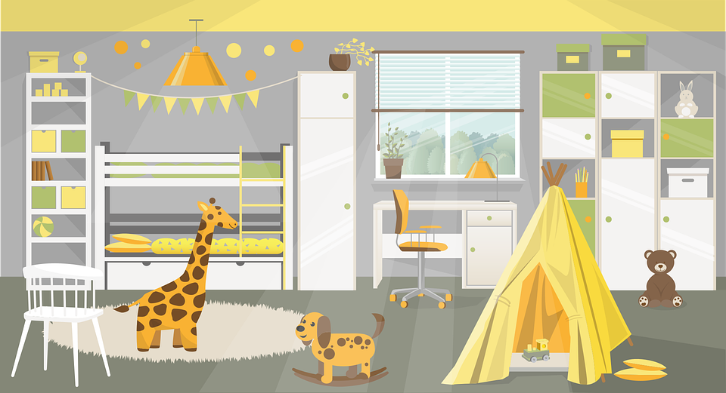
aussprechen
[z]
Remember: German ‘z’ sounds like English ‘ts’, like at the end of boots.
…
Zug
sitzen
Platz
[place]
Zimmer
zehn
Notes:
Timing: 1 minute
Aim: to consolidate the SSC [z].
Procedure:
Re-present the SSC and the source word ‘Zug’ (with gesture, if using).
Click to bring on the picture and get pupils to repeat the word ‘Zug’ (with gesture, if using).
Present the cluster words in the same way, bringing on the picture and getting pupils to pronounce the words.
Click to bring up call-out explaining the pronounciation of ‘z’.
Click to bring up the prompt to identify the nouns (the ones with capital letters). This is still very new knowledge for pupils, so it’s good to revisit this as often as we can. Plus, it gives an additional opportunity to pronounce the words.
Click to highlight the 3 x nouns.
Vocabulary:
sitzen [231] Platz [326] Zimmer [665] zehn [333] Zug [675]
Jones, R.L & Tschirner, E. (2019). A frequency dictionary of German: Core vocabulary for learners. London: Routledge.

Slide 5
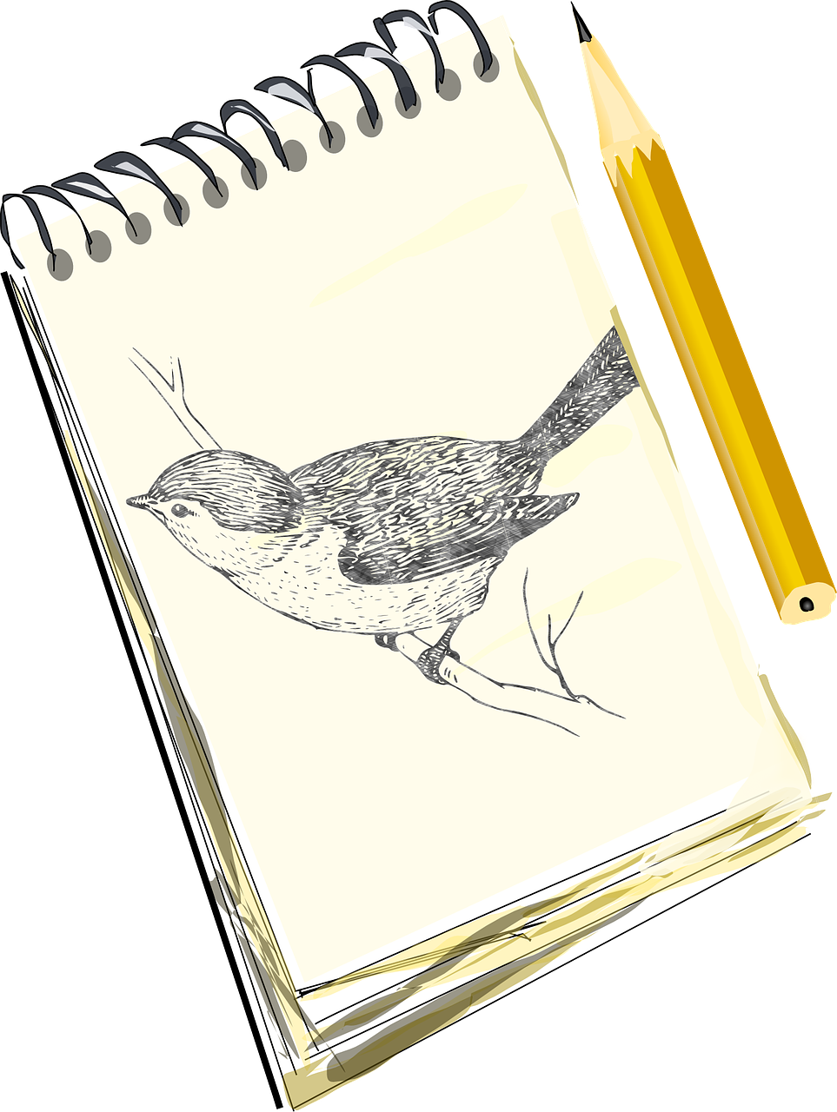
Follow up 1
Wer macht das?
Ich sehe was*…
Wer macht das?
Ronja macht das…
singen?
reisen?
Falsch!
Richtig!
was – what?, something
reisen
tanzen
grinsen
singen
zeichnen
zahlen
sehen
sitzen
zeigen
Notes:
Timing: 5 minutes
Aim: to practise distinguishing between [s], pronounced like an English ‘z’, and [z], pronounced like English ‘ts’
Procedure: 1. Pupils are going to play a speaking game like I spy with the words. Explain that Ich sehe means ‘I see’ or here, ‘I spy’. 2. Click to bring up the example conversation between Herr Lehmann and Lias. Explain that the pupils will take on Lias’ role first of all, and you will be the teacher. 3. Play the game as a class, with you saying the teacher role and the pupils guessing the word, based on whether you say Ronja/Leon/Olivia. Check that pupils are applying the pronunciation rules for [s] and [z] in each word. Repeat a few times with different words.
4. Pupils can then play in pairs, with one pupil taking on the teacher role and choosing a word and the other guessing the word.
Word frequency (1 is the most frequent word in German): grinsen [2386] reisen [933] sehen [79] singen [1063] sitzen [231] tanzen [1497] zahlen [832] zeichnen [1259] zeigen [136]
Source: Jones, R.L. & Tschirner, E. (2006). A frequency dictionary of German: core vocabulary for learners. Routledge

Slide 6
Follow up 2
Was ist richtig? Was ist falsch?
Olivia is writing an email to Ronja. Help her decide which sentences work and which don’t.
lesen
1
Hast du
3
Bekommst du
Spielst du
Benutzt du
einen Text?
zu Hause?
Machst du
Schreibst du
Spielst du
5
Schreibt xier
Bekommst du
Spielt xier
einen Brief?
2
Ich mache
4
Ich spiele
Hat xier
Ich schreibe
Sport
Ich bekomme
Hilfe.
Bekommt xier
Ich benutze
Ich mache
Ich habe
Ich brauche
Notes:
Timing: 5 minutes
Aim: to practise recognition of verbs and vocabulary from this and previous weeks.
Procedure:
Explain to pupils that they need to decide which verbs could be correct starters to each of the 5 sentences, based on their meaning. Sometimes all verbs might make sense.
Pupils discuss in pairs and write down 1-5 and the verbs they think work for each sentence.
Elicit answers and click for ticks to appear next to correct verbs. Discuss meanings of each question/statement as you correct.
Note: Ensure pupils know the meanings of the 5 words in red boxes, as without this knowledge they will struggle to access the task. Also point out the questions and statements. Additional task suggestions: 1. Pupils make up their own sense and nonsense sentences and questions, and their partner or the class must decide whether or not they make sense.

Slide 7
Follow up 3
Hör zu. Wer ist das? I, you oder he/she?
1
2
3
4
5
6
7
8
9
10
hören
5. brauche
4. benutzt
4. benutzt
3. schreibe
6. bekommst
er/sie/xier
Ich
du
9. benutze
7. machst
8. spielt
10. habe
1. spielst
We can’t tell if benutzt is du or er/sie/es because it is the same word for both!
2. macht
Notes:
Timing: 5 minutes
Aim: to practise understanding of 1st, 2nd and 3rd person singular verb endings.
Procedure:
Explain that pupils will hear 10 verb forms and need to decide if they belong in the ich, du or er/sie/xier category, based on the endings.
Pupils write down 1-10.
Play the first audio and discuss as a class why the verb belongs in the ‘you’ circle.
Repeat for items 2-10.
Click for answers to appear in the correct circle.
Ensure pupils know what each verb is in the infinitive and how they have been changed for the different persons of the verb.
Note: haben is included here in the ‘ich’ form as it follows the regular pattern, but not in the ‘du’ and ‘er/sie/xier’ forms.
Transcript:
[du] spielst
[er] macht
[ich] schreibe
[du/sie] benutzt
[ich] brauche
[du] bekommst
[du] machst
[xier] spielt
[ich] benutze
[ich] habe

Slide 8
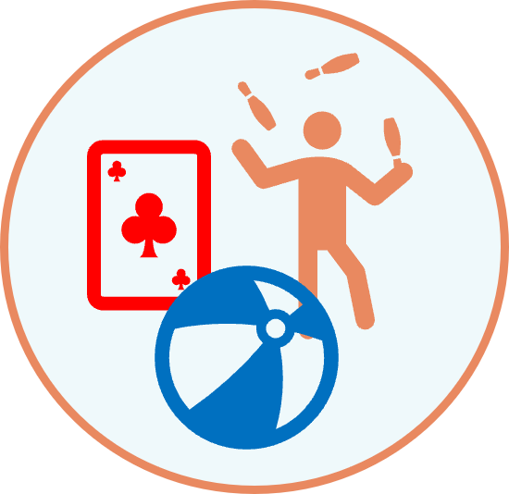
Follow up 4:
Wer macht was?
Ronja (ich) is sending photos and texting Olivia (du) about her day with Leon (xier).
schreiben
Ich spiele ein Spiel.
______ ______
Notes:
Timing: 5 minutes (6 slides)
Aim: to practise written production of singular person forms of a regular verb in statements and questions.
Procedure: 1. Explain the task. Ronja is sending photos and texting Olivia.
2. Pupils will need to write the correct pronoun (based on who is in the picture that Ronja has sent) and verb for each text. Remind pupils how verbs change their ending depending who is ‘doing’ the verb and how the syntax changes for a question.
3. Click to reveal answers.

Slide 9
Follow up 4:
Wer macht was?
Ronja (ich) is sending photos and texting Olivia (du) about her day with Leon (xier).
schreiben
Du machst deine Hausaufgabe.
______ ______
Notes:
[2/6]

Slide 10
Follow up 4:
Wer macht was?
Ronja (ich) is sending photos and texting Olivia (du) about her day with Leon (xier).
schreiben
Xier benutzt den Computer.
______ ______
Notes:
[3/6]

Slide 11
Follow up 4:
Wer macht was?
Ronja (ich) is sending photos and texting Olivia (du) about her day with Leon (xier).
schreiben
Bekomme ich einen Brief?
______ ______
Notes:
[4/6]

Slide 12
Follow up 4:
Wer macht was?
Ronja (ich) is sending photos and texting Olivia (du) about her day with Leon (xier).
schreiben
Brauchst du Hilfe?
______ ______
Notes:
[5/6]

Slide 13
Follow up 4:
Wer macht was?
Ronja (ich) is sending photos and texting Olivia (du) about her day with Leon (xier).
schreiben
Schreibt xier eine Geschichte?
______ ______
Notes:
[6/6]

Slide 14
Follow up 5:

Schreib auf Englisch.
Can you get at least 15 points?
Wörter
Vokabeln
 | die Kleidung | die Hausaufgabe | nicht wahr?
 | der Text | brauchen | nicht
 | zu Hause | benutzen | spielen
 | du | du hast | der Sport
Isn’t it? Isn’t that right?
(the) clothing
(the) homework
x2
(the) text
to need, needing
not
at home
to use, using
to play, playing
x1
you
you have
(the) sport
Notes:
Timing: 5 minutes
Aim: to practise written comprehension of vocabulary from this and revisited weeks.
Procedure: 1. Give pupils a blank grid. They fill in the English meanings of any of the words they know, trying to reach 15 points in total.
Note: The most recently learnt and practised words are pink and revisited words are green.

Slide 15
Follow up 5:

Schreib auf Deutsch.
Can you get at least 15 points?
Wörter
 | (the) text | Isn’t it? Isn’t that right? | not
 | (the) clothing | (the) homework | to write, writing
 | at home | you | you have
 | (the) sport | to play, playing | to use, using
Vokabeln
x2
der Text
nicht wahr?
nicht
die Kleidung
die Hausaufgabe
schreiben
zu Hause
du
du hast
x1
der Sport
spielen
benutzen
Notes:
Timing: 5 minutes
Aim: to practise written production of vocabulary from this and revisited weeks.
Procedure: 1. Give pupils a blank grid. They fill in the German meanings of any of the words they know, trying to reach 15 points in total.
Note: The most recently learnt and practised words are pink and revisited words are green.

Slide 16
Tschüss!
gelb
Notes:
16

Slide 17
Follow up 5:

Schreib auf Englisch.
Can you get at least 15 points?
Wörter
Vokabeln
 | die Kleidung | die Hausaufgabe | nicht wahr?
 | der Text | brauchen | nicht
 | zu Hause | benutzen | spielen
 | du | du hast | der Sport
x2
x1
Notes:
Timing: 5 minutes
Aim: to practise written comprehension of vocabulary from this and revisited weeks.
Procedure: 1. Give pupils a blank grid. They fill in the English meanings of any of the words they know, trying to reach 15 points in total.
Note: The most recently learnt and practised words are pink and revisited words are green.

Slide 18
Follow up 5:

Schreib auf Deutsch.
Can you get at least 15 points?
Wörter
 | (the) text | Isn’t it? Isn’t that right? | not
 | (the) clothing | (the) homework | to write, writing
 | at home | you | you have
 | (the) sport | to play, playing | to use, using
Vokabeln
x2
x1
Notes:
Timing: 5 minutes
Aim: to practise written production of vocabulary from this and revisited weeks.
Procedure: 1. Give pupils a blank grid. They fill in the German meanings of any of the words they know, trying to reach 15 points in total.
Note: The most recently learnt and practised words are pink and revisited words are green.

