Slide 1
Talking about things and things to do
zu Hause
gelb
Present tense (I, you)
Yes/ no questions
SSC [s-] [-s-] vs. [z]
Term 2 Week 7
Notes:
Artwork by Steve Clarke. Pronoun pictures from NCELP (www.ncelp.org). All additional pictures selected from Pixabay and are available under a Creative Commons license, no attribution required.
Phonics:
[s-] [-s-] singen [1063] Person [357] langsam [526] sehr [81] besuchen [820]
vs. [z] Zug [675] sitzen [231] Platz [326] Zimmer [665] zehn [333]
Vocabulary: benutzen [1119] spielen [205] Sport [945] zu Hause [n/a]
Revisit 1: du hast [7]
Revisit 2: Hausaufgabe [n/a] Kleidung [2820] Text [473] nicht wahr? [n/a]
Jones, R.L & Tschirner, E. (2019). A frequency dictionary of German: Core vocabulary for learners. London: Routledge.
The frequency rankings for words that occur in this PowerPoint which have been previously introduced in these resources are given in the SOW and in the resources that first introduced and formally re-visited those words.
For any other words that occur incidentally in this PowerPoint, frequency rankings will be provided in the notes field wherever possible.
Note that the first three lessons of the year teach language that can be continuously recycled as lesson routine every lesson in Y3/4.
The idea would be that the class teacher (whether or not s/he teaches the class German can re-use the language as part of the daily routine with the class.
1

Slide 2
aussprechen
[s]
Before a vowel, German 's' sounds like English ‘z’.
…
singen
Notes:
Timing: 1 minute
Aim: to present the SSC [s] before a vowel.
Procedure:
Present the SSC and the source word ‘singen’ (with gesture, if using).
Click to bring on the picture and get pupils to repeat the word ‘singen’ (with gesture (a gesture might be to sing ‘lalala’) if using).
Frequency:
singen [1063]

Slide 3
aussprechen
[s]
Before a vowel, German 's' sounds like English ‘z’.
…
singen
[slow]
langsam
besuchen
sehr
Person
other words: Person langsam sehr
besuchen
(we then have all the vowels represented)
Notes:
Timing: 1 minute
Aim: to consolidate the SSC [s] before a vowel.
Procedure:
Re-present the SSC and the source word ‘singen’ (with gesture, if using).
Click to bring on the picture and get pupils to repeat the word ‘singen’ (with gesture, if using).
Present the cluster words in the same way, bringing on the picture and getting pupils to pronounce the words.
Frequency:
singen [1063] Person [357] langsam [526] sehr [81] besuchen [820]

Slide 4
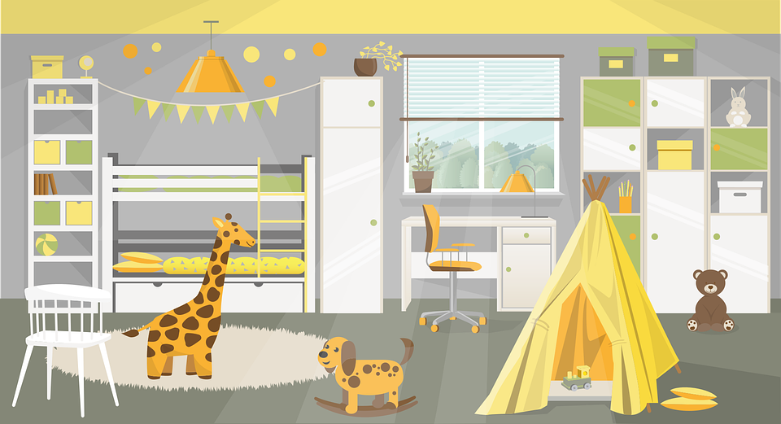
aussprechen
[z]
Remember: German ‘z’ sounds like English ‘ts’, like at the end of boots.
…
Zug
sitzen
Platz
[place]
Zimmer
zehn
Notes:
Timing: 1 minute
Aim: to consolidate the SSC [z].
Procedure:
Re-present the SSC and the source word ‘Zug’ (with gesture, if using).
Click to bring on the picture and get pupils to repeat the word ‘Zug’ (with gesture, if using).
Present the cluster words in the same way, bringing on the picture and getting pupils to pronounce the words.
Click to bring up call-out explaining the pronounciation of ‘z’.
Click to bring up the prompt to identify the nouns (the ones with capital letters). This is still very new knowledge for pupils, so it’s good to revisit this as often as we can. Plus, it gives an additional opportunity to pronounce the words.
Click to highlight the 3 x nouns.
Vocabulary:
sitzen [231] Platz [326] Zimmer [665] zehn [333] Zug [675]
Jones, R.L & Tschirner, E. (2019). A frequency dictionary of German: Core vocabulary for learners. London: Routledge.

Slide 5
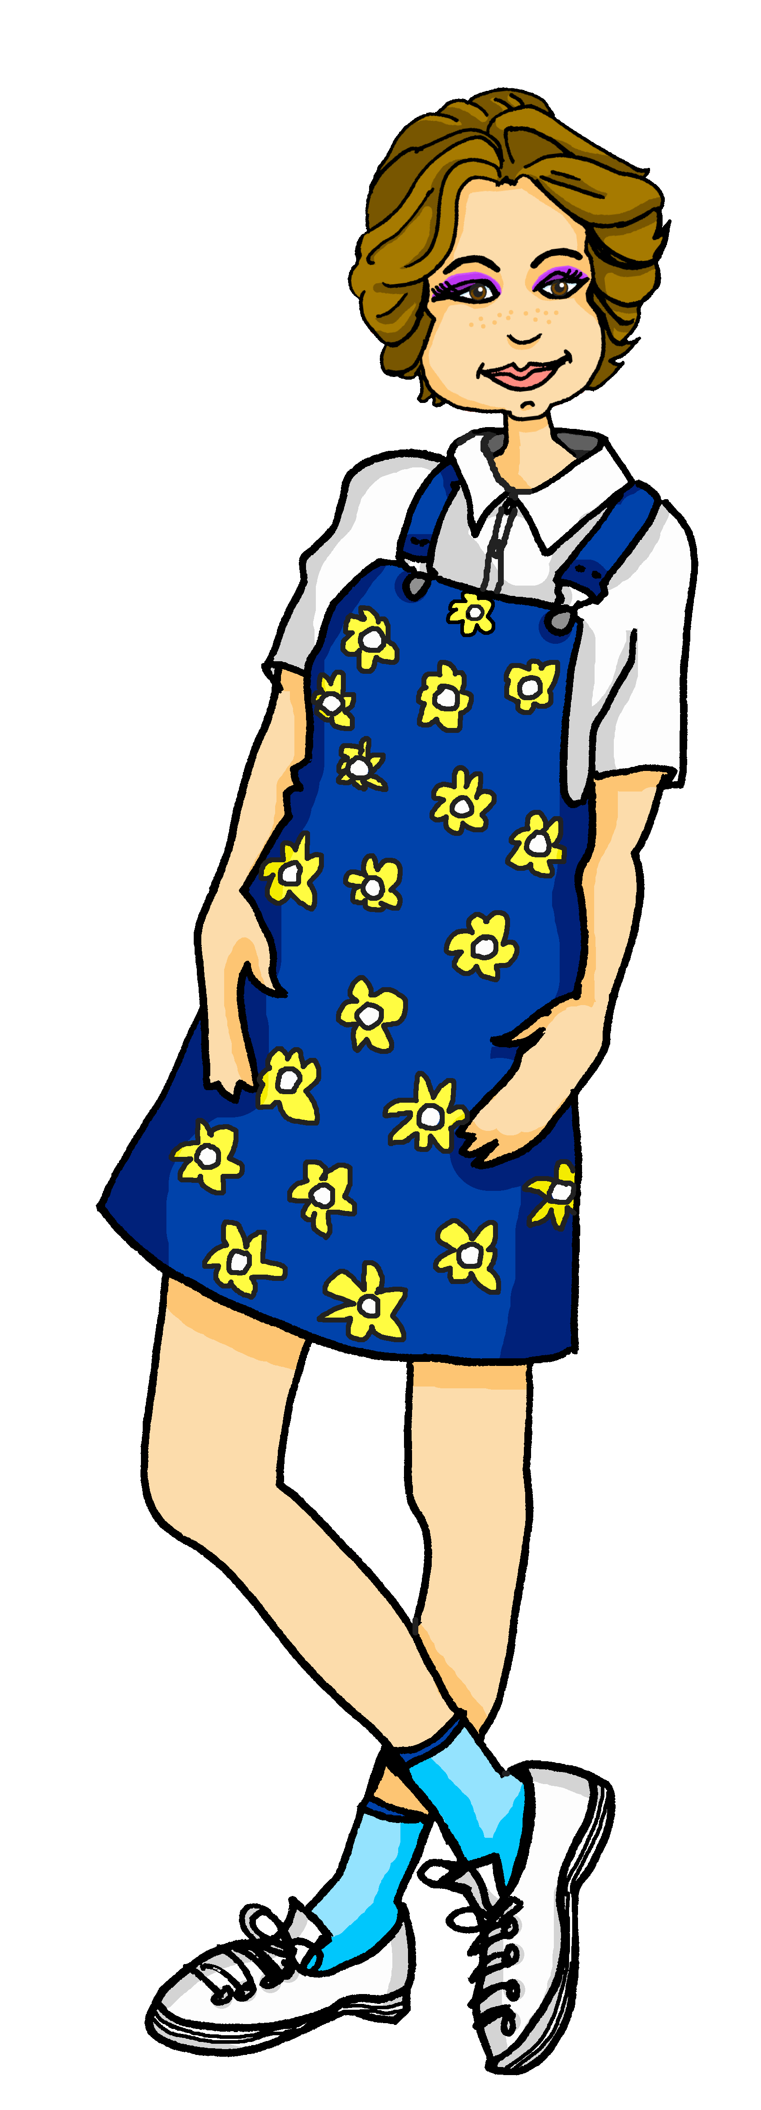
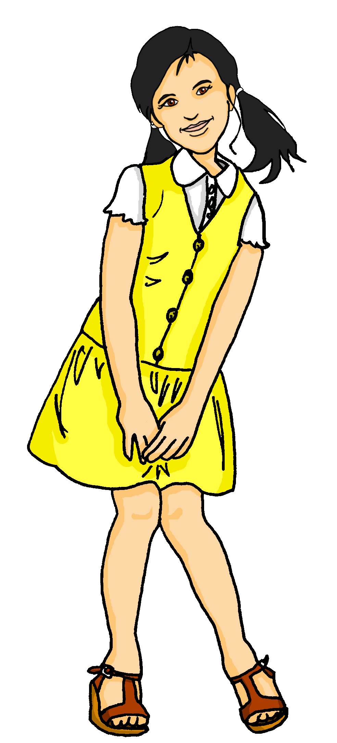
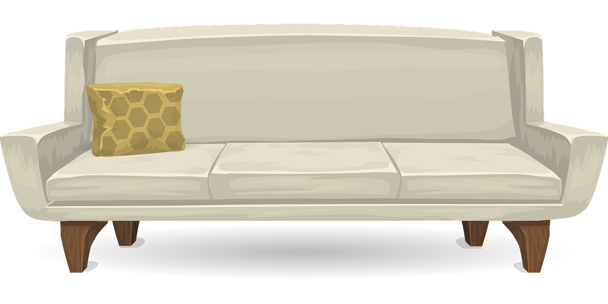
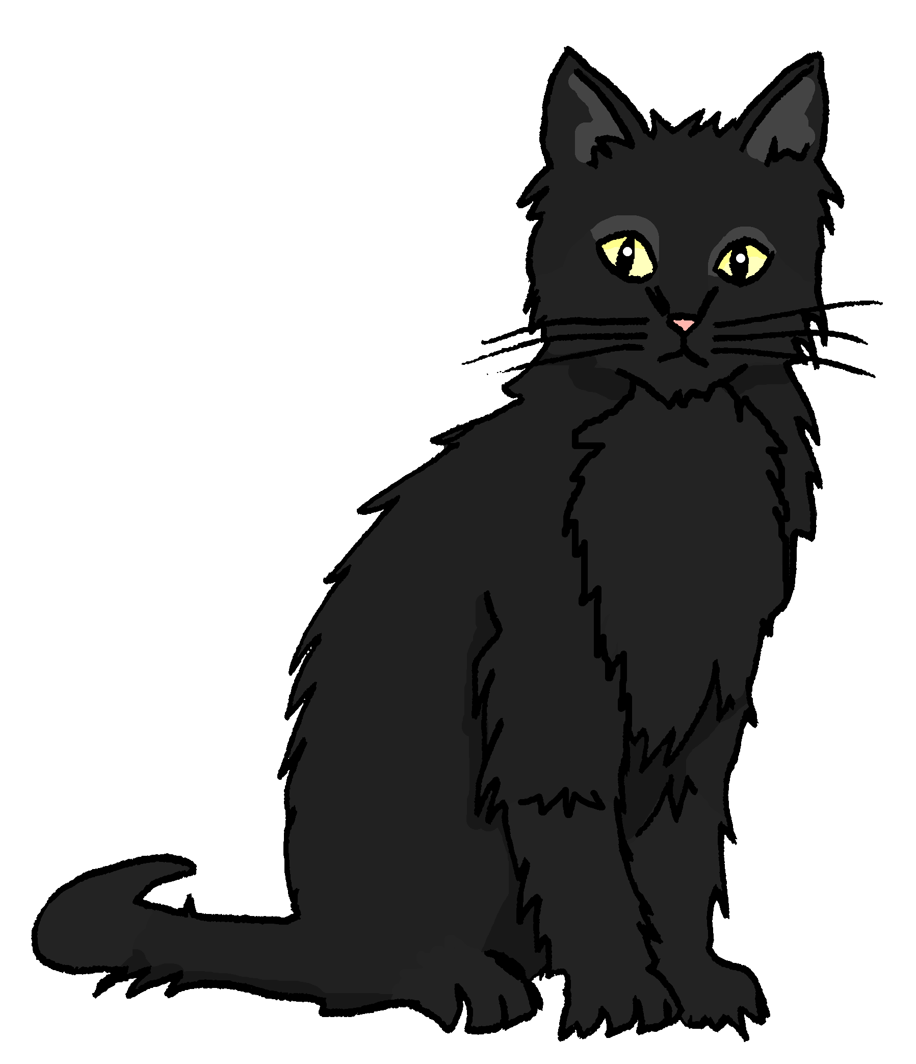
Ist das [s] oder [z]?
Ronja is showing her friend Leon around her house.
Hör zu. Schreib 1-9 und [s] oder [z].
German ‘s’ before a vowel sounds like English ‘z’. German ‘z’ sounds like ‘ts’ in English ‘boots’.
hören
3
Zaun
_
1
Sofa
_
2
Heizung
_
6
Rasen
Sessel
_
4
_
5
Wohnzimmer
_
9
Minze
_
7
Fernseher
8
Staubsauger
_
_
Notes:
Timing: 5 minutes
Aim: to practise recognising aurally the SSCs [z] and [s].
Procedure:
Click to bring up a reminder about distinguishing [s] and [z].
Pupils write down 1-9 and will write the full word with [s] or [z], based on what they hear.
3. Click the audio button to hear the first word, elicit the answer from pupils and click to display answer.
Repeat for items 2-9.
Transcript:
Sofa
Heizung
Zaun
Sessel
Wohnzimmer
Rasen
Fernseher
Staubsauger
Minze
Word frequency (1 is the most frequent word in German): Fernseher [2827] Heizung [>5000], Rasen [4521], Sessel [3999], Sofa [3572], Staubsauger [>5000] Wohnzimmer [2555], Zaun [3279],
Source: Jones, R.L. & Tschirner, E. (2019). A frequency dictionary of German: core vocabulary for learners. Routledge

Slide 6
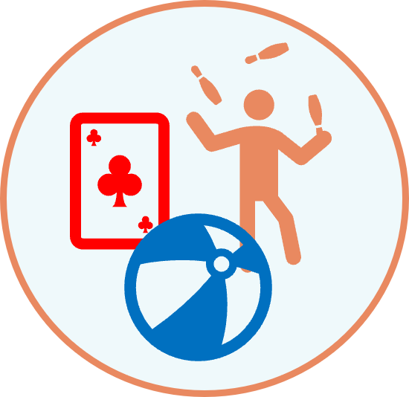
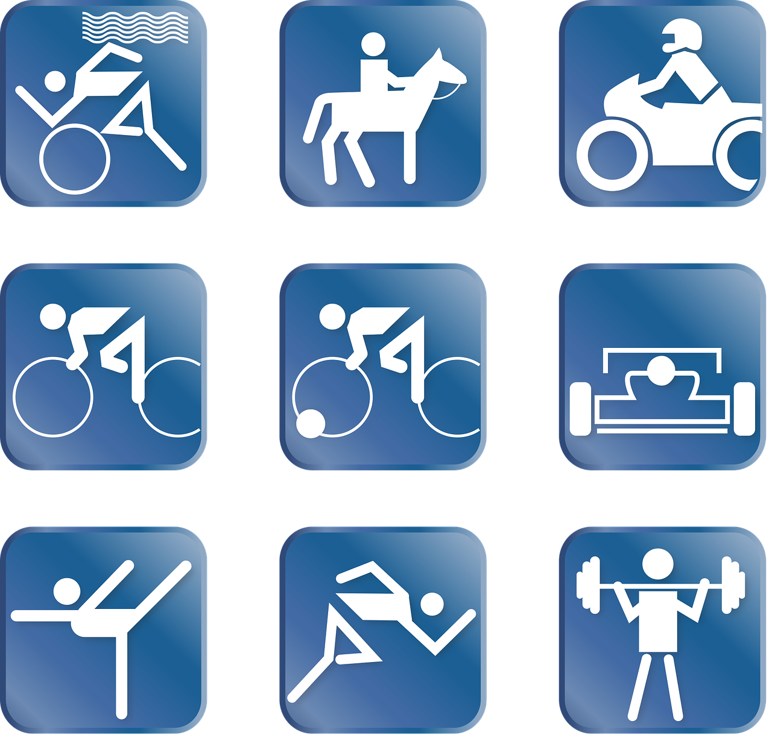
Vokabeln
Hör zu. Sag das Wort.
Wörter
Two of these new words are verbs.
benutzen
spielen
What do the infinitive verbs have in common?
der Sport
zu Hause
Notes:
Timing: 5 minutes
Aim: to present and practise 4 new items of vocabulary for this week
Procedure:
Click for each new word to appear, and again for the picture. Practise repeating the 4 words as a class and ensure pupils understand the meanings.
Click to bring up the call-out to discuss which items are verbs, and how we can tell. Pupils will be using verbs this lesson, and need to recognise them in their infinitive form here.
6

Slide 7
Was ist das?
Wörter
schreiben
Notes:
Slide 1 of 7
Timing: 2 minutes (7 slides) Aim: To elicit understanding of verbs met so far, including new verbs this week.
Procedure: 1. Click to bring up the infinitive.
2. Ask pupils to decide which picture represents the correct meaning, pointing to the left or right hand side of the classroom/board. 3. Click again to bring up answer.
4. Repeat for slides 2-7.
7

Slide 8
Was ist das?
Wörter
machen
Notes:
2/7
8

Slide 9
Was ist das?
Wörter
spielen
Notes:
3/7
9

Slide 10
Was ist das?
Wörter
bekommen
Notes:
4/7
10

Slide 11
Was ist das?
Wörter
haben
Notes:
5/7
11

Slide 12
Was ist das?
Wörter
brauchen
Notes:
6/7
12

Slide 13
Was ist das?
Wörter
benutzen
Notes:
7/7
13

Slide 14
Who does what: weak verbs ‘you’
You know that German verb endings often tell us who a statement is about:
I
she/he
Ich spiele das Spiel.
Sie/Er spielt zu Hause.
= I play the game.
= She/He plays at home.
Remember: ‘Weak’ is another word for ‘regular’.
To say ‘you’ with weak German verbs:
you
Du spielst gut.
= You play well.
Remove –en and add –st.
machen →
mach- →
du machst →
you do/make
Benutzen is an exception to this rule!
Du benutzst would be too hard to say, so we just add a t:
Du benutzt
Notes:
Timing: 2 minutes
Aim: To recap verb knowledge about the 1st and 3rd persons singular of weak verbs, and to introduce the 2nd person singular.
Procedure:
Click through the animations to recap 1st and 3rd person forms of verbs and to introduce 2nd person form.
Elicit the English meanings from pupils.
14

Slide 15
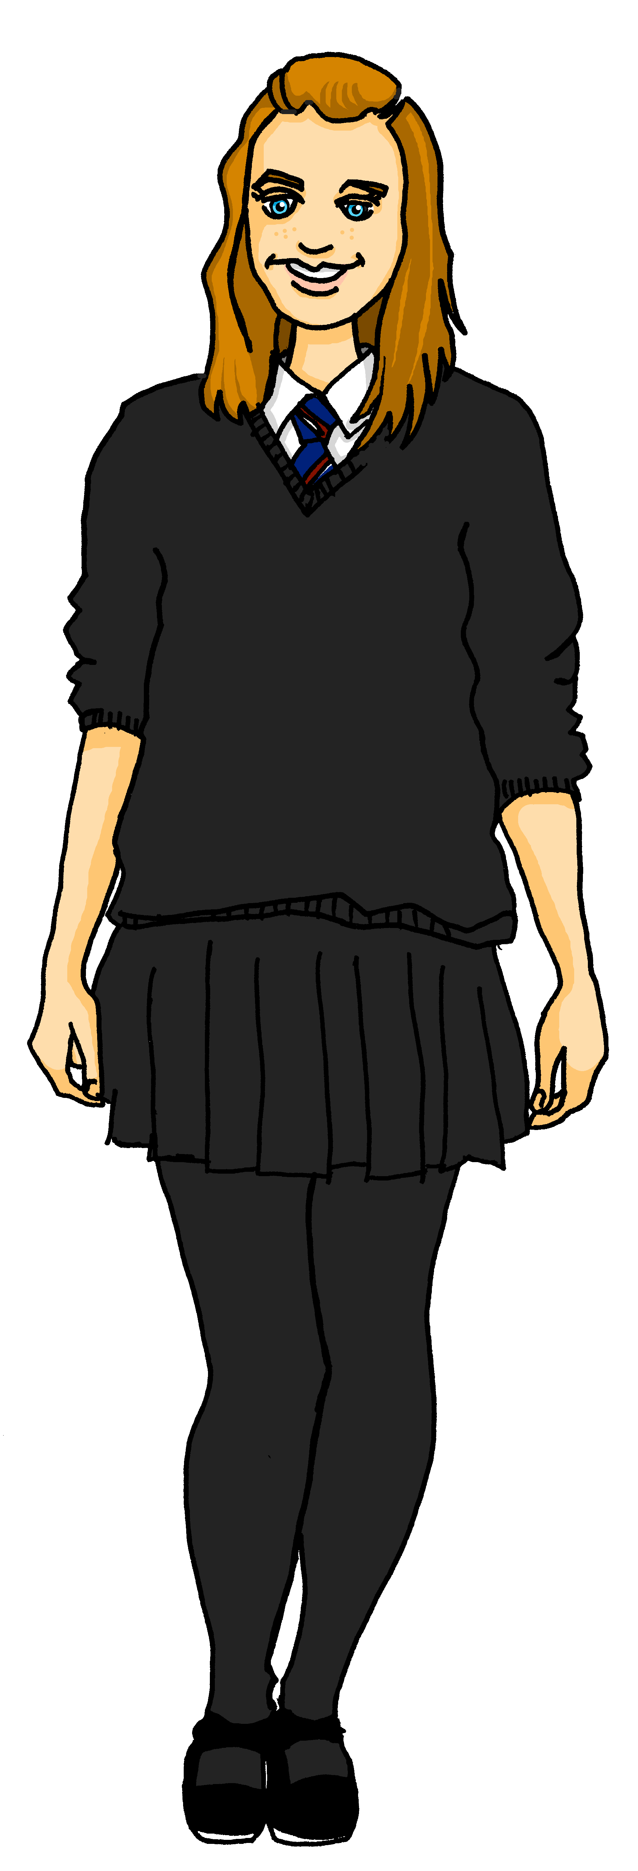
Kultur
Ich bin Leon!
In German-speaking countries, non-binary people sometimes use the pronoun “xier”.
Verbs with xier work the same as er/sie:
benutzen → benutz- → benutzt
Lies die Sätze
They are Leon. They use “they”.
Xier ist Leon. Xier benutzt „xier“.
I am Leon. I use “they”.
Ich bin Leon. Ich benutze „xier“
Hello Olivia! How do you say “xier” in English?
Hallo Olivia! Wie sagt man „xier“ auf Englisch?
You are Ronja. You use “she”.
Du bist Ronja. Du benutzt „sie“.
In English we often say “they” for “xier”!
Notes:
Timing: 3 minutes
Aim: to learn about non-binary pronouns in German; to recognise “benutzen” in 1st, 2nd and 3rd persons.
Procedure:
Click through the speech bubbles. Pupils read along.
Ask pupils to orally translate the speech bubbles into English.
Click to reveal answers.
Note: “xier” is not the only pronoun used by non-binary people in German-speaking countries, but like the English “they”, it is the most common.
15

Slide 16
lesen
Leon is hanging out at Ronja’s house. Ronja has written down what they’re doing.
Wer macht was? Ronja (I) oder Leon (you)?
… spiele ein Spiel.
… benutze eine Liste.
1
Ich
5
Ich
 | ich (I) | du (you)
1
2
3
4
5
6
7
8
2
… machst Sport.
6
Du
Du
… spielst mit* Minze.
3
… benutzt den Computer.
Du
4
7
Ich
… schreibe einen Text.
… bekommst einen Brief.
Du
8
… mache meine Hausaufgabe.
Ich
*mit-with
Notes:
Timing: 5 minutes
Aim: to practise written comprehension of verb endings in the first and second person singular (ich and du).
Procedure:
Explain the scenario and that pupils need to identify which verbs are in the ‘I’ form (written by Ronja about herself) and which verbs are in the ‘you’ form (written by Ronja for Leon).
Pupils write down numbers 1-8 and either ‘I’ or ‘you’ for each sentence, depending on the verb ending.
Click for ticks to appear and again for the ‘ich’ or ‘du’ to appear to complete each sentence.
16

Slide 17
Yes / no questions
You know to swap verb and subject to make a yes/no question:
Statement
Du machst Sport.
= You do sport.
= You are doing sport.
Question
Machst du Sport?
= Do you do sport?
= Are you doing sport?
Remember! German has no word for ‘do’ or ‘are’ in questions.
Note that when you hear questions, you get an extra clue from the intonation, and when you read, you see the question mark.
Notes:
Timing: 3 minutes Aim: to revisit knowledge that pupils were taught in 1.1.7 on the formation of closed questions.
Procedure: 1. Click to animate the explanation.
2. Highlight that German does not have a word for do/does, or the continuous equivalent are/is, and that inversion must be used to translate these.
3. Ensure pupils’ understanding at each stage.
17

Slide 18
Question or statement?
Hör zu. Schreib 1-10 und [?] oder [.]
When you are listening to a question, you have two clues: the intonation of the speaker and the word order.
Ronja is finding out more about Leon. Is she asking a question or saying a statement?
hören
For numbers 1-5, I’ll give you both clues!
For numbers 6-10, I’m afraid I’ve forgotten my intonation…
 | ? oder .
 |  | Spielst du ein Spiel?
 |  | Du machst deine Hausaufgabe.
 |  | Machst du Sport?
 |  | Schreibst du eine Geschichte?
 |  | Du benutzt xier.
 | ? oder .
 |  | Du spielst zu Hause.
 |  | Brauchst du Hilfe?
 |  | Du bekommst eine Jacke.
 |  | Hast du einen Lieblingssport?
 |  | Bekommst du einen Preis?
?
6
.
1
.
?
2
7
?
.
3
8
?
?
4
9
.
?
5
10
Notes:
Timing: 5 minutes
Aim: to practise recognising aurally questions and statements.
Procedure:
Click to bring up reminders about how to recognise a question in German. Pupils are going to identify questions and statements, first by listening to natural intonation and word order to decide, then relying solely on recognising the word order.
Pupils write down 1-10 and will write down either ? or . for each item.
Click the audio button to hear the first sentence, elicit the answer from pupils and click to display answer and then the German sentence. Translate into English to check comprehension and remind pupils that English questions start with ‘Do you’ and there is no word for ‘do’ in German.
Repeat for items 2-5.
Explain that they now have to rely solely on the grammar i.e. verb before pronoun and repeat for items 6-10.
Transcript:
Spielst du ein Spiel?
Du machst deine Hausaufgabe.
Machst du Sport?
Schreibst du eine Geschichte?
Du benutzt xier.
Du spielst zu Hause.
Brauchst du Hilfe?
Du bekommst eine Jacke.
Hast du einen Lieblingssport?
Bekommst du einen Preis?
Additonal Task Suggestions:
Pupils turn the questions into statements and statements into questions.

Slide 19
Tschüss!
gelb
Notes:
19

