Slide 1
Talking about things and things to do
gelb
Follow ups 1-5
Term 2 Week 8
Notes:
Artwork by Steve Clarke. Pronoun pictures from NCELP (www.ncelp.org). All additional pictures selected from Pixabay and are available under a Creative Commons license, no attribution required.
Phonics: SSC [ß-] [-ss-] [-s]
Vocabulary: Nummer [806] null [1680] eins [774] zwei [70] drei [106] vier [200] fünf [274] sechs [428] sieben [611] acht [645] neun [1053] zehn [333] elf [1507] zwölf [1080] es gibt [n/a]
Revisit 1: Gruppe [369] Lieblings - [n/a] Song [3373]
Revisit 2: revisit all language learnt so far
Jones, R.L & Tschirner, E. (2019). A frequency dictionary of German: Core vocabulary for learners. London: Routledge.
The frequency rankings for words that occur in this PowerPoint which have been previously introduced in these resources are given in the SOW and in the resources that first introduced and formally re-visited those words.
For any other words that occur incidentally in this PowerPoint, frequency rankings will be provided in the notes field wherever possible.
Note that the first three lessons of the year teach language that can be continuously recycled as lesson routine every lesson in Y3/4.
The idea would be that the class teacher (whether or not s/he teaches the class German can re-use the language as part of the daily routine with the class.

Slide 2
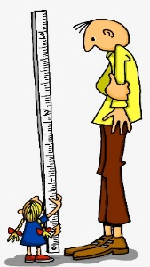
aussprechen
[s][ss][ß]
…
You know that ‘s’ in front of a vowel sounds like the English ‘z’.
ß is just a special way of writing ‘ss’ after a long vowel.
At all other times German ‘s’, ‘ss’ and ‘ß’ sound like English ‘s’.
groß
[big, tall]
Notes:
Timing: 1 minute
Aim: To introduce SSC [s/ss/ß] when not in front of a vowel.
Procedure:
Introduce the SSC and and say the [s/ss/ß] sound first, on its own. Pupils repeat it with you.
Present the source word ‘groß’ (with gesture, if using).
Click to bring on the picture and get pupils to repeat the word ‘groß’ (with gesture, if using).
Use the callouts to emphasise the difference between ‘s’ in front of a vowel and ‘s’ at all other times and to explain about the new letter ß.
Note:
A gesture for this could be to reach high above your head.
groß [67]
Jones, R.L & Tschirner, E. (2019). A frequency dictionary of German: Core vocabulary for learners. London: Routledge.
2

Slide 3
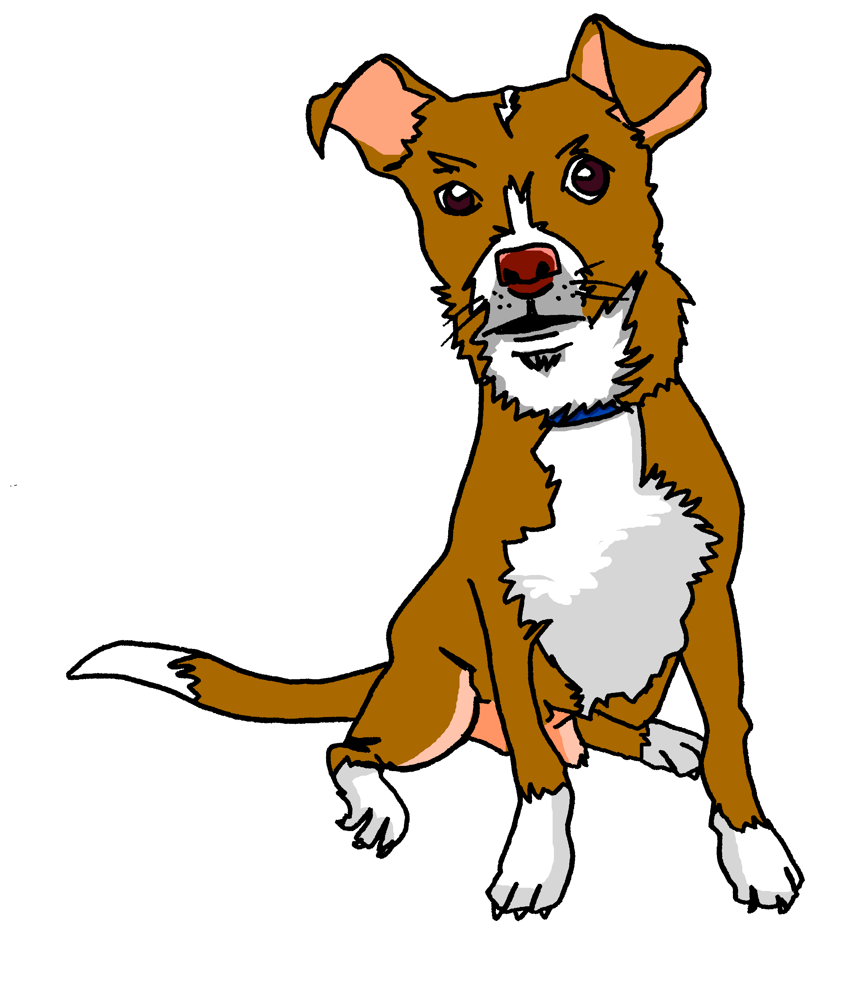
aussprechen
[s][ss][ß]
…
Tasso
Fußball
heißen
groß
essen
tschüss
This can be written with ‘s’ or ‘ss’ at the end.
[to eat, eating]
Notes:
Timing: 1 minute
Aim: to introduce the SSC [s/ss/ß].
Procedure:
Re-present the SSC and the source word ‘groß’ (with gesture, if using).
Click to bring on the picture and get pupils to repeat the word ‘groß’ (with gesture, if using).
Present the cluster words in the same way, bringing on the pictures and getting pupils to pronounce the words.
Note: It’s very important that pupils start to recognise ß as an ‘s’ sound, and don’t confuse it with a B.
essen [323] Fußball [1277] tschüss [3766] heißen [126]
Jones, R.L & Tschirner, E. (2019). A frequency dictionary of German: Core vocabulary for learners. London: Routledge.
3

Slide 4
Follow up 1a
Lies die Wörter..
Song
weiß
sein
Person
groß
sechs
bist
massiv
Liste
Notes:
Timing: 5 minutes (two slides)
Aim: to practise distinguishing between [s] or [ss] pronounced as English ‘s’, or [s] pronounced as English ‘z’.
Note: Words for this task are taken from previously taught words and cognates.
Procedure: 1. Pupils must decide whether the sounds in the words match to the bee (buzz) or the snake (hiss). 2. Teachers can elicit the sound [zzzz] or [ssss] first from the pupils, then the full word. 3. Answers are animated one by one to move to the correct image.
Word frequency (1 is the most frequent word in German): groß [67] massiv [1763] Monster [>5000] Professor [282] singen [1063] super [1772]
Source: Jones, R.L. & Tschirner, E. (2006). A frequency dictionary of German: core vocabulary for learners. Routledge

Slide 5
Follow up 1b
Snap?
Monster
weiß
singen
Person
ist
groß
massiv
tschüss
super
sehr
Song
Professor
sie
was
Liste
zu Hause
sieben
Notes:
Procedure: 1. Pupils identify if the sounds circled are a match, ‘snap’ (like the card game) by pronouncing the words aloud and comparing them. 2. Play FOUR times with class and give pupils a few seconds to pronounce in pairs and decide, before taking the class answer each time. The answers are animated with a tick or cross. 3. Then pairs can play against each other – one pupil choosing and pronouncing two words from any on the slide, and the other pupil deciding whether they make a matching snap pair or not.
Note: Words chosen are from previously taught language or they are cognates.

Slide 6
Follow up 2a
Ach nein! Es gibt Monster!
Can you safely follow the path without landing on a monster?
sprechen
60
0
START
Notes:
Timing: 5 minutes
Aim: to practise oral production of numbers 1-12.
Procedure:
Explain the task. Pupils have to follow the path, stopping only on spaces that don’t have a monster. Pupils count the number of stops between where they are and the next safe space.
Click to start the timer. Pupils have a minute to successfully navigate the path.
They chorally suggest in German the number of stops to the next safe space.
Click to reveal the answer (in the audio version click on the number to hear a native speaker). If pupils have said the correct German number, they then count the number of stops to the next safe space. If they have said the incorrect number, click on the monster! They can’t move on to the next stop until they have got past the monster (once the monster stops growing).

Slide 7
Follow up 2b
Ach nein! Es gibt Monster!
Partner A
sprechen
Can you safely follow the path without landing on a monster?
60
0
START
Notes:
Timing: 5 minutes (2 slides)
Aim: to practise oral production of numbers 1-12.
Procedure:
Pupils work in pairs.
Partner A counts the stops to the safe spaces and says the number in German.
Partner B listens. If Partner A says the wrong number, Partner B imposes a 3-second penalty.
The aim is for Partner A to reach the end of the path before the timer runs out.
Click to reveal the following slide, partners swap roles.

Slide 8
Follow up 2b
Ach nein! Es gibt Monster!
Partner B
sprechen
Can you safely follow the path without landing on a monster?
60
0
START
Notes:
[2/2]

Slide 9
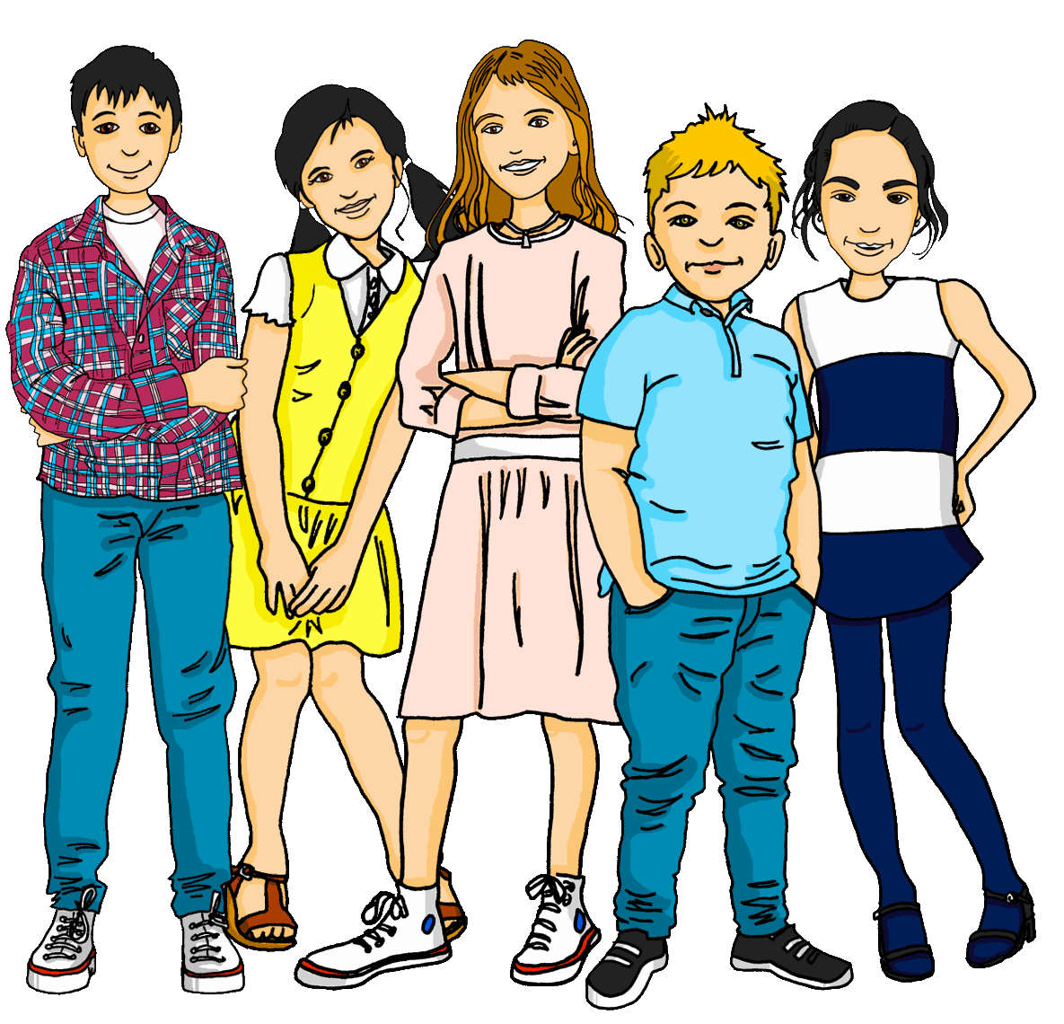
Follow up 3
Hör zu. Was gibt es? Richtig oder falsch?
The monsters are learning about life on Earth. They describe what they see in the picture. Are they right or wrong?
hören
There is a group.
Notes:
Timing: 5 minutes (7 slides)
Aim: to practise aural comprehension of numbers and previously taught vocabulary.
Procedure:
Explain the scenario: the monsters are learning about life on Earth. Pupils need to translate their sentences into English, focusing on whether the noun is singular or plural.
Click the sound button to listen to number 1. Pupils write the English translation.
Pupils compare what they have written with the picture on the slide and decide whether the monsters were right or wrong.
Click to reveal answers.
Repeat for the following 6 slides.
Transcript:
Es gibt eine Gruppe.

Slide 10
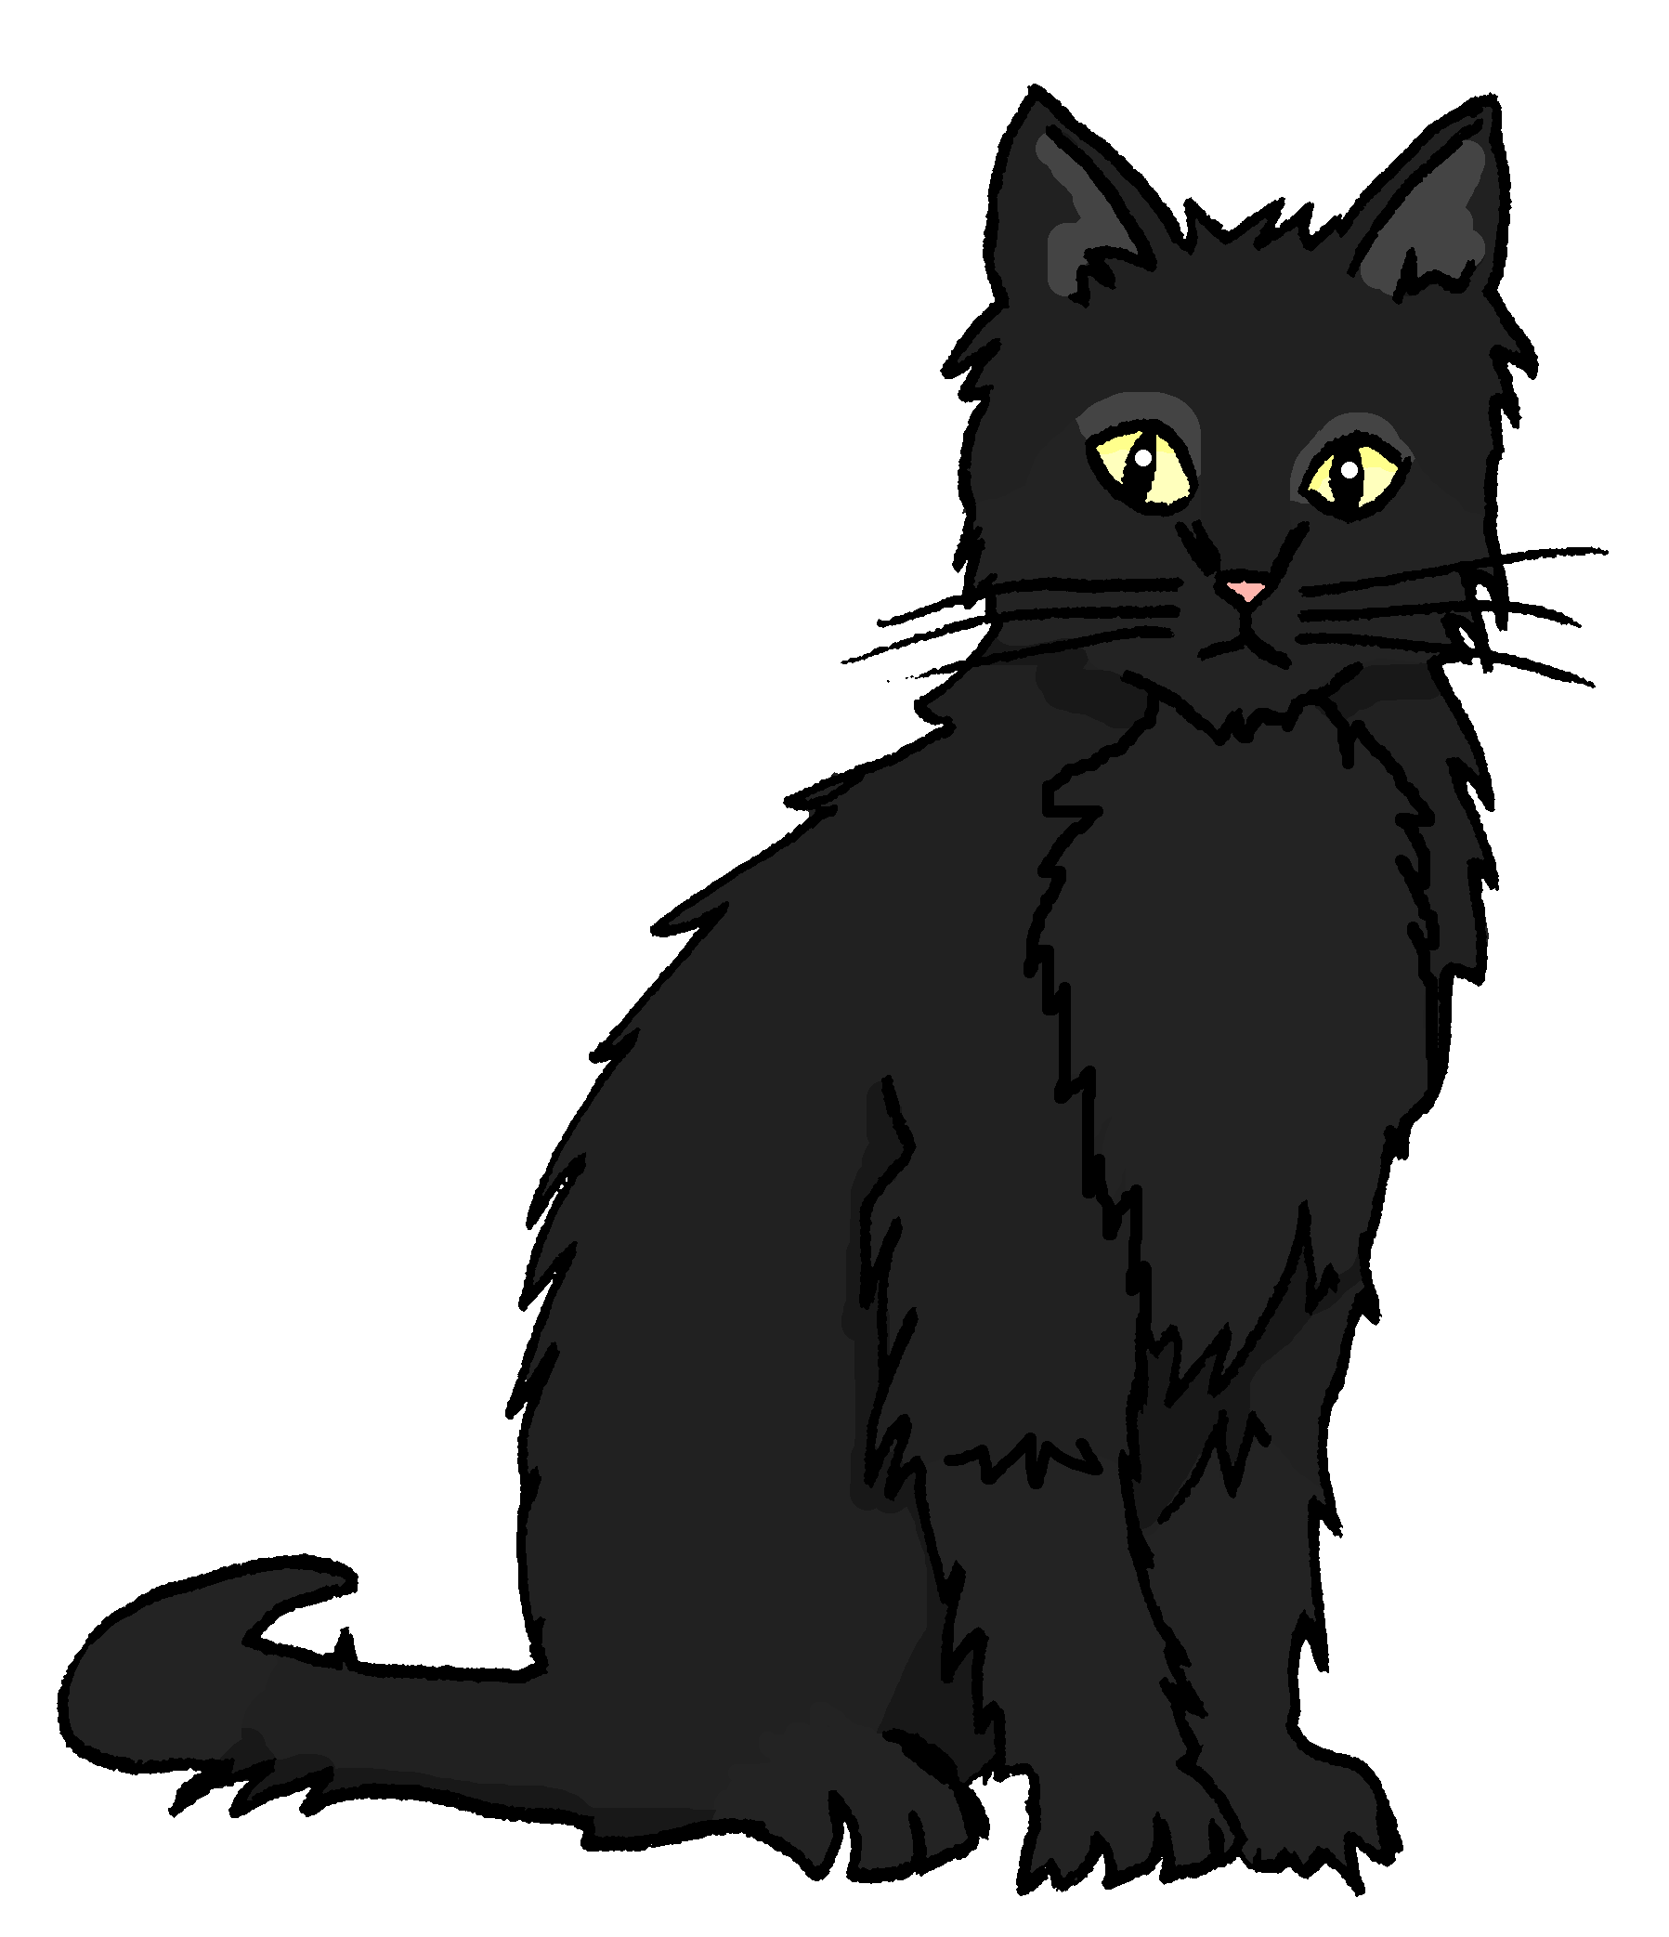
Follow up 3
Hör zu. Was gibt es? Richtig oder falsch?
The monsters are learning about life on Earth. They describe what they see in the picture. Are they right or wrong?
hören
There are four cats.
Notes:
[2/7]
Transcript:
Es gibt vier Katzen.

Slide 11
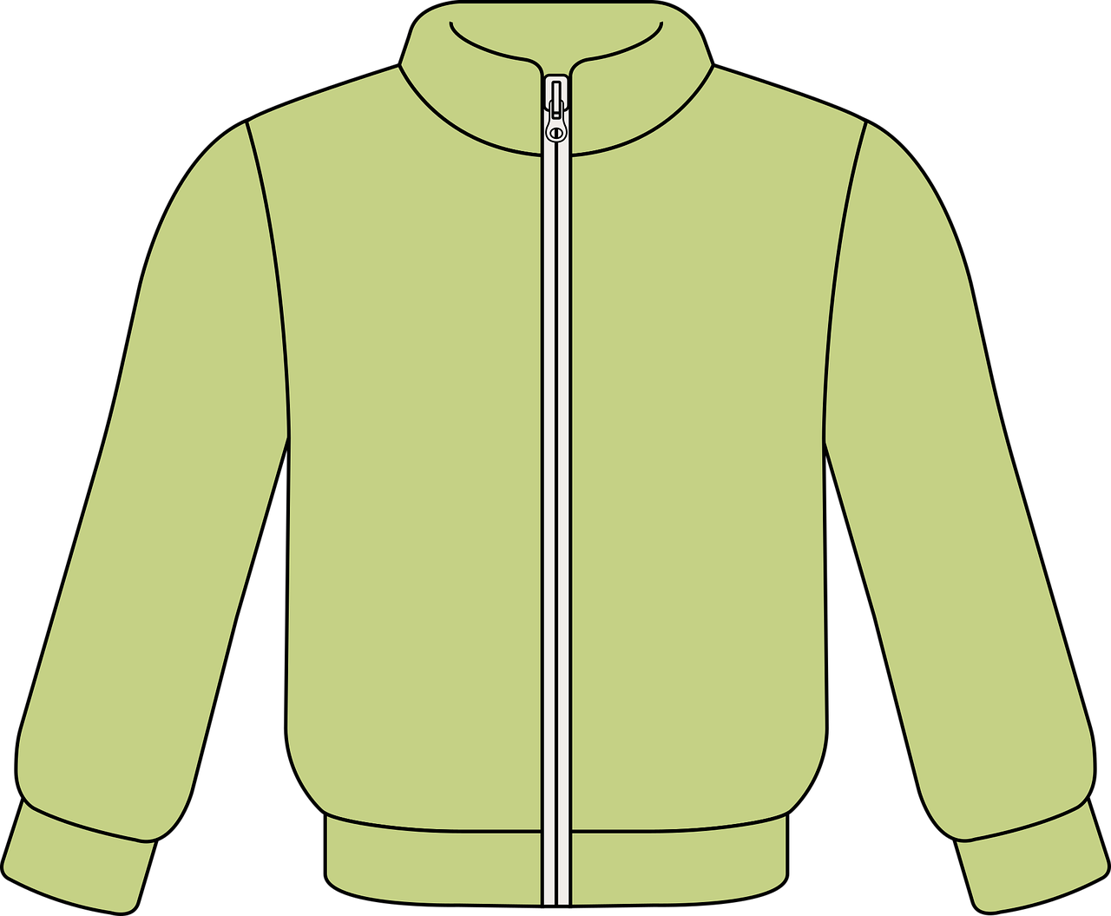
Follow up 3
Hör zu. Was gibt es? Richtig oder falsch?
The monsters are learning about life on Earth. They describe what they see in the picture. Are they right or wrong?
hören
There are twelve jackets.
Notes:
[3/7]
Transcript:
Es gibt zwölf Jacken.

Slide 12
Follow up 3
Hör zu. Was gibt es? Richtig oder falsch?
The monsters are learning about life on Earth. They describe what they see in the picture. Are they right or wrong?
hören
There are three trees.
Notes:
[4/7]
Transcript:
Es gibt drei Bäume.

Slide 13
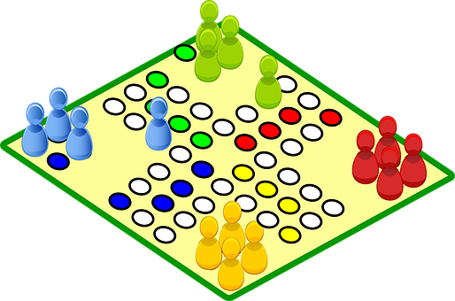
Follow up 3
Hör zu. Was gibt es? Richtig oder falsch?
The monsters are learning about life on Earth. They describe what they see in the picture. Are they right or wrong?
hören
There is one game.
Notes:
[5/7]
Transcript:
Es gibt ein Spiel.

Slide 14
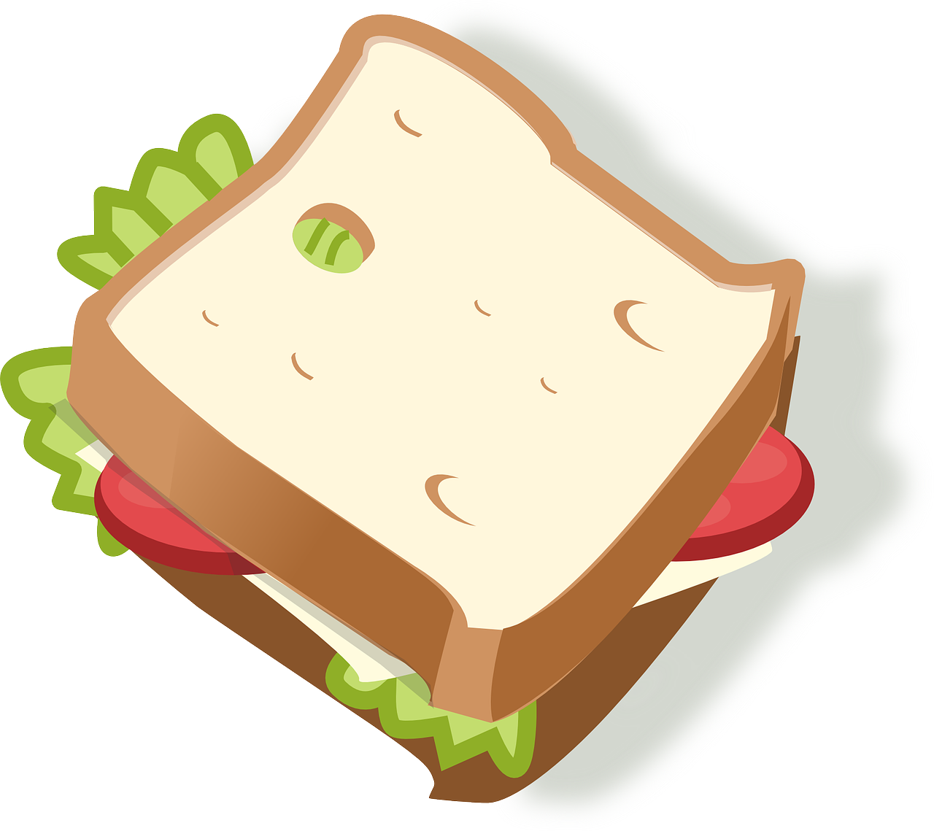
Follow up 3
Hör zu. Was gibt es? Richtig oder falsch?
The monsters are learning about life on Earth. They describe what they see in the picture. Are they right or wrong?
hören
There are six sandwiches.
Notes:
[6/7]
Transcript:
Es gibt sechs Butterbrote.

Slide 15
Follow up 3
Hör zu. Was gibt es? Richtig oder falsch?
The monsters are learning about life on Earth. They describe what they see in the picture. Are they right or wrong?
hören
There are five prizes.
Notes:
[7/7]
Transcript:
Es gibt fünf Preise.

Slide 16
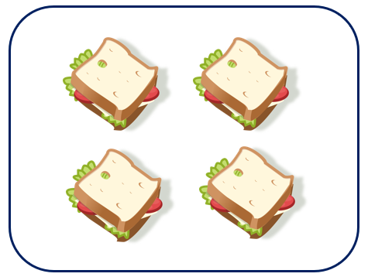
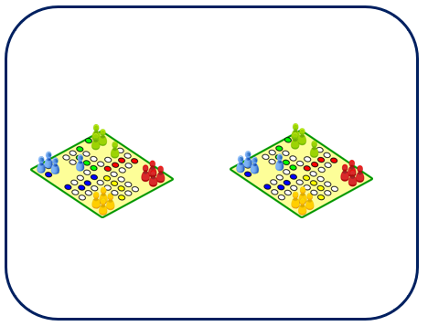
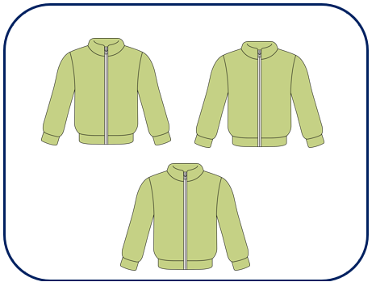
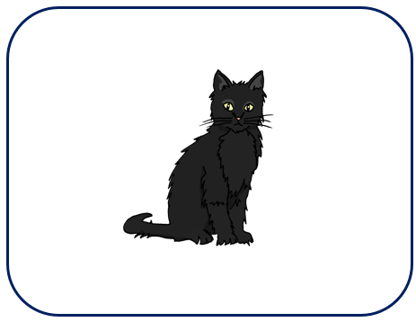
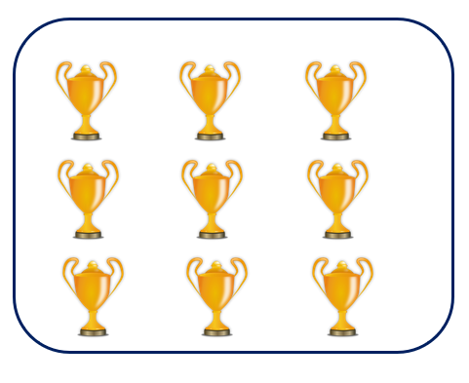
Follow up 4:
Schreib auf Deutsch
The monsters got these items wrong! Help them out, what should they have said?
schreiben
Es gibt vier Butterbrote.
Es gibt zwei Spiele.
Es gibt drei Jacken.
You know two plural patterns: -e for masculine and some neuter nouns, -(e)n for feminine. Take care to choose the correct ending!
Es gibt eine Katze.
Es gibt neun Preise.
Notes:
Timing: 5 minutes
Aim: to practise written production of plural masculine and feminine nouns, es gibt and numbers.
Procedure:
Pupils look at the pictures and write what they can see in German. Remind pupils of the different rules learnt about forming plurals so far.
Click to reveal answers.

Slide 17
Follow up 5:

Schreib auf Englisch.
Can you get at least 15 points?
Wörter
 | Lieblings- | die Gruppe | der Song
 | die Kleidung | die Hausaufgabe | die Hilfe
 | acht | eins | elf
 | zwei | neun | zwölf
 | vier | zehn | die Nummer
 | fünf | sechs | null
 | sieben | drei | es gibt
favourite
(the) group
(the) song
Vokabeln
x2
(the) clothing
(the) homework
(the) help
eight
one
eleven
two
nine
twelve
four
ten
(the) number
x1
five
six
zero
seven
three
there is, there are
Notes:
Timing: 5 minutes
Aim: to practise written comprehension of vocabulary from this and revisited weeks.
Procedure: 1. Give pupils a blank grid. They fill in the English meanings of any of the words they know, trying to reach 15 points in total.
Note: The most recently learnt and practised words are pink and revisited words are green.

Slide 18
Follow up 5:

Schreib auf Deutsch.
Can you get at least 15 points?
Wörter
 | (the) group | (the) clothing | (the) homework
 | (the) help | favourite | (the) song
 | eleven | twelve | there is, there are
 | eight | nine | ten
 | five | six | seven
 | two | three | four
 | (the) number | zero | one
die Gruppe
die Kleidung
die Hausaufgabe
Vokabeln
x2
die Hilfe
Lieblings-
der Song
elf
zwölf
es gibt
acht
neun
zehn
fünf
sechs
sieben
zwei
drei
vier
x1
die Nummer
null
eins
Notes:
Timing: 5 minutes
Aim: to practise written production of vocabulary from this and revisited weeks.
Procedure: 1. Give pupils a blank grid. They fill in the German meanings of any of the words they know, trying to reach 15 points in total.
Note: The most recently learnt and practised words are pink and revisited words are green.

Slide 19
Tschüss!
gelb
Notes:
19

Slide 20
Follow up 5:

Schreib auf Englisch.
Can you get at least 15 points?
Wörter
 | Lieblings- | die Gruppe | der Song
 | die Kleidung | die Hausaufgabe | die Hilfe
 | acht | eins | elf
 | zwei | neun | zwölf
 | vier | zehn | die Nummer
 | fünf | sechs | null
 | sieben | drei | es gibt
Vokabeln
x2
x1
Notes:
Timing: 5 minutes
Aim: to practise written comprehension of vocabulary from this and revisited weeks.
Procedure: 1. Give pupils a blank grid. They fill in the English meanings of any of the words they know, trying to reach 15 points in total.
Note: The most recently learnt and practised words are pink and revisited words are green.

Slide 21
Follow up 5:

Schreib auf Deutsch.
Can you get at least 15 points?
Wörter
 | (the) group | (the) clothing | (the) homework
 | (the) help | favourite | (the) song
 | eleven | twelve | there is, there are
 | eight | nine | ten
 | five | six | seven
 | two | three | four
 | (the) number | zero | one
Vokabeln
x2
x1
Notes:
Timing: 5 minutes
Aim: to practise written production of vocabulary from this and revisited weeks.
Procedure: 1. Give pupils a blank grid. They fill in the German meanings of any of the words they know, trying to reach 15 points in total.
Note: The most recently learnt and practised words are pink and revisited words are green.

