Slide 1
What I can do
Ich kann das!
gelb
Phonics, Vocabulary and Grammar revision
Follow ups 1-5
Term 2 Week 9
Notes:
Artwork by Steve Clarke. Pronoun pictures from NCELP (www.ncelp.org). All additional pictures selected from Pixabay and are available under a Creative Commons license, no attribution required.
Phonics: Revisit SSC: [ä] [ö] [ü] [au] [eu| [äu] [sch] [sp] [st] [s-] [-s-] [ß] [ss] [-s]
Vocabulary: Revisit words from lessons Term 2 Lessons 1 - 8
Revisit 1: brauchen [179] bekommen [212] machen [58] schreiben [184] Brief [838] Geschichte [262] Hilfe [481] ich weiß (es) nicht [n/a] wie sagt man…? [n/a]
Revisit 2: kein, keine, kein [46] Fehler [861] Haus [147] Katze [2235] Schule [359]
Jones, R.L & Tschirner, E. (2019). A frequency dictionary of German: Core vocabulary for learners. London: Routledge.
The frequency rankings for words that occur in this PowerPoint which have been previously introduced in these resources are given in the SOW and in the resources that first introduced and formally re-visited those words.
For any other words that occur incidentally in this PowerPoint, frequency rankings will be provided in the notes field wherever possible.

Slide 2
Phonics Revision
Hör zu und sag die Wörter.
Help Robbie to remember all of the sounds from this term.
groß
spät
aussprechen
essen
König
singen
Tür
spielen
Which sounds sound the same as each other?
stark
Haus
schreiben
Häuser
Deutschland
Notes:
Timing: 2 minutes
Aim: to remind pupils of previously taught SSCs and to practise pronunciation of these key sounds.
Procedure:
1. Explain that pupils are going to revise the key sounds learnt this term with Robbie.
2. Click to make the first word appear. Pupils listen to the correct pronunciation and repeat. The audio has the sound on its own, then the full word.
3. Repeat to bring up and practise all sounds covered this term.
4. Click to bring up the callout about similar sounds. Click again to highlight words that have the same sounds but different spellings. Emphasise the ß as a double ‘s’ sound after a long vowel.
5. Move to the next slide to practise recognition of these sounds in unknown words.

Slide 3
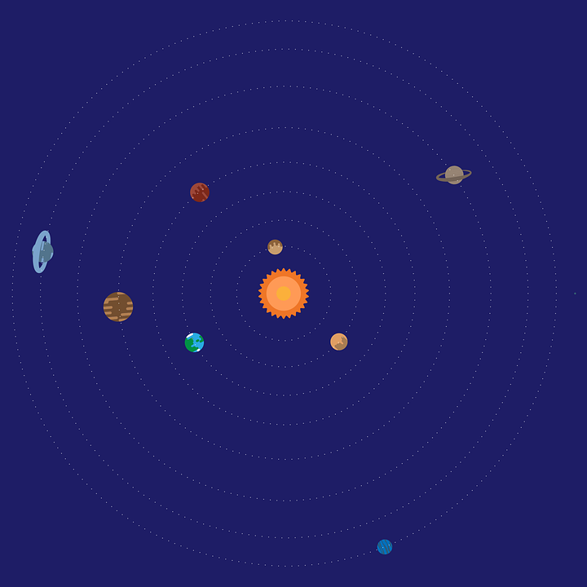
Follow up 1:
Runde 1: Person A 🗣
Person B 📝✅
…
Wie sagt man das richtig?
aussprechen
Sprung
räumen
fressen
Schreck
aufsetzen
Sänger
Möbel
Stolz
fügen
Notes:
Timing: 5-7 minutes [3 slides]
Aim: To practise the pronunciation of words containing sounds covered in Term 2.
Procedure:
Pupils work in pairs, as Person A and Person B. One pupil will pronounce words whilst the other checks pronunciation. There are 9 words for Person A to pronounce on this slide, and 9 more words for Person B to pronounce on the next slide. There is a handout at the end of the presentation for the checker to use, or pupils can simply write 1-9 in their books and tick or cross.
Click once to make the spaceship appear (This animation is timed - don’t click again until all words have appeared). Pupil A pronounces all of the words. Pupil B ticks the words pronounced correctly.
Move to next slide for Pupil B’s turn and repeat.
Frequency of unknown words and cognates:
aufsetzen [3018] Ausmaß [2666] Erlebnis [2703] fressen [2927] fügen [4311] leuchten [1847] Möbel [3609] nämlich [425] nötig [1038] räumen [2916] Sänger [3029] schlafen [679] Schreck [2970] Silber [4783] Sprung [2727] stecken [688] Stolz [3853] über [47]
Source: Jones, R.L. & Tschirner, E. (2019). A frequency dictionary of German: core vocabulary for learners. Routledge

Slide 4
Follow up 1:
Runde 2: Person B 🗣
Person A📝✅
…
aussprechen
nämlich
über
schlafen
stecken
nötig
leuchten
Erlebnis
Silber
Ausmaß
Notes:
Procedure:
Pupil A now checks pronunciation, as Pupil B pronounces the 9 words.
Click to start the animation as on previous slide.
Move to slide 3 to show the ‘value’ of each word. Pupils can compare their results and see who earned the most.
Frequency of unknown words and cognates:
aufsetzen [3018] Ausmaß [2666] Erlebnis [2703] fressen [2927] fügen [4311] leuchten [1847] Möbel [3609] nämlich [425] nötig [1038] räumen [2916] Sänger [3029] schlafen [679] Schreck [2970] Silber [4783] Sprung [2727] stecken [688] Stolz [3853] über [47]
Source: Jones, R.L. & Tschirner, E. (2019). A frequency dictionary of German: core vocabulary for learners. Routledge

Slide 5
Follow up 1
…
How much are your words worth?
aussprechen
Person B
Person A
nämlich 💰
über💰💰
schlafen 💰
stecken 💰
nötig 💰💰
leuchten 💰💰
Erlebnis 💰
Silber💰💰
Ausmaß 💰
Sprung 💰💰
räumen 💰
fressen 💰
Schreck 💰💰
aufsetzen💰💰
Sänger 💰
Möbel 💰
Stolz 💰
fügen 💰💰
Notes:
1. Pupils can add up and compare their results.
2. Repeat the activity with pupils swapping slides, if time allows.
3. Click on the audio buttons to check pronunciation of individual words.
Frequency of unknown words and cognates:
aufsetzen [3018] Ausmaß [2666] Erlebnis [2703] fressen [2927] fügen [4311] leuchten [1847] Möbel [3609] nämlich [425] nötig [1038] räumen [2916] Sänger [3029] schlafen [679] Schreck [2970] Silber [4783] Sprung [2727] stecken [688] Stolz [3853] über [47]
Source: Jones, R.L. & Tschirner, E. (2019). A frequency dictionary of German: core vocabulary for learners. Routledge

Slide 6
sprechen
Follow up 2a
Sag die Nummern 1-12.
lesen
60
S
- - - - - - - - - - - - - - - - - - - - - - - - - - - - - - -
eins
zwei
drei
vier
fünf
sechs
sieben
neun
zehn
elf
zwölf
0
acht
START
Notes:
Timing: 3 minutes
Aim: to consolidate numbers in oral production in preparation for the next activity.
Procedure:
Pupils work in pairs to say the numbers in order (1-12). They have one minute.
Click to trigger the timer.
To bring up the answers, each number disappears on click, and the correct answer appears.
6

Slide 7
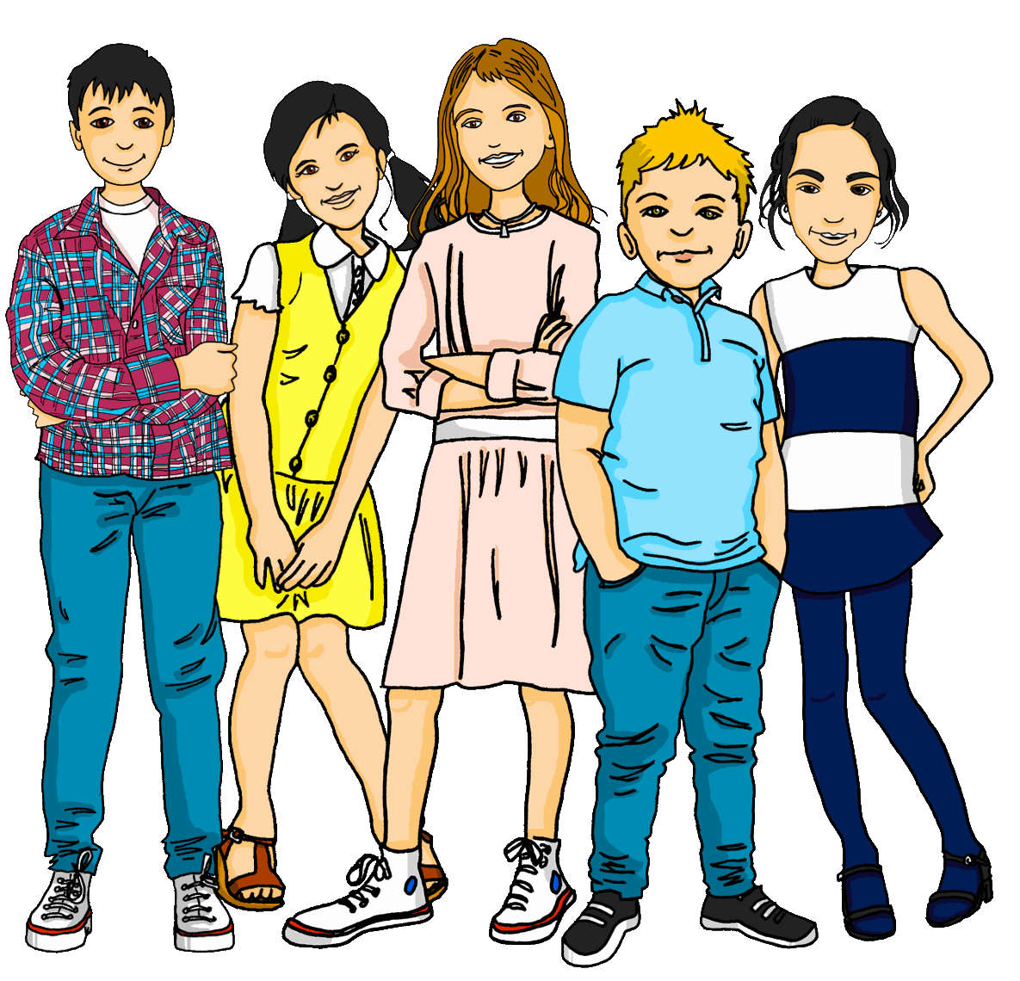
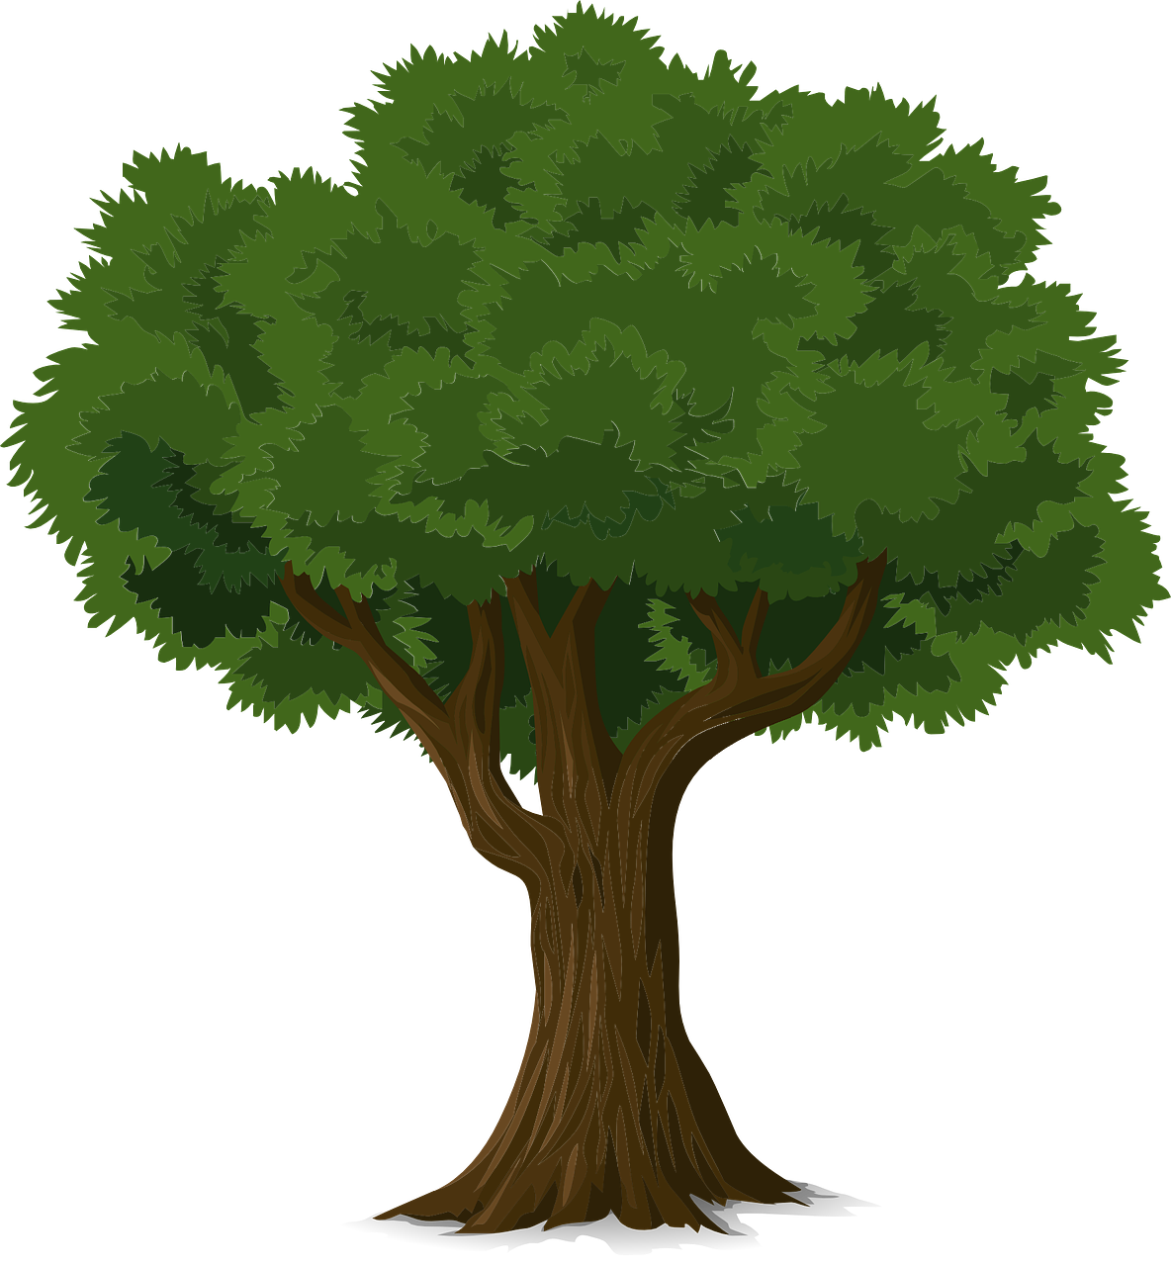
Follow up 2b
Wie sagt man das auf Deutsch?
Remember: 1) to make most masculine nouns plural add –e at the end. 2) to make most feminine nouns plural add –n or –en at the end.
schreiben
1. Es gibt
1. Es gibt zwei Frauen.
2. Es gibt
2. Es gibt acht Schulen.
3. Es gibt
3. Es gibt zehn Spiele.
4. Es gibt fünf Briefe.
Remember: Some masculine nouns also add an umlaut in the plural.
4. Es gibt
5. Es gibt
5. Es gibt drei Gruppen.
6. Es gibt
6. Es gibt elf Bäume.
Notes:
Timing: 6 minutes
Aim: to practise written production of numbers and plural forms of nouns.
Procedure:
Recap the 2 plural rules met so far and remind pupils that ‘es gibt’ can mean ‘there is’ or ‘there are’. Here, because we are using plurals, it means ‘there are’.
Elicit how to say ‘two women’ for item 1. Click to display the full sentence answer.
Pupils complete items 2-6 independently in written form.
Elicit answers and click to display. Number 6 requires the addition of an umlaut, as is the case for some masculine nouns with a/o/u.

Slide 8
hören
Follow up 3
Hör zu. Ist das A oder B?
Which word(s) complete the sentence correctly?
Justify your answer!
I heard ‘einen’ which means it must be a masculine noun.
 | Brief | Geschichte
 | Farbe | Baum
 | Ball | Bälle
 | zu Hause | der Brief
 | Spielerin | Spieler
 | Fehler | Fahrrad
 | A | B
 | Schüler | Schülerin
 | kein | acht
 | Katzen | Katze
 | Computer | Schule
 | Hilfe | den Fehler
 | Geschichte | Geschichten
A
B
A
B
B.
6
6
1
7
2
8
3
9
4
10
5
11
B.
1
2
3
4
5
6
7
8
9
10
11
Notes:
Timing: 5 minutes
Aim: to practise aural comprehension of a range of grammatical features and vocabulary met this term.
Procedure:
1. Tell pupils they will hear sentences but the ending will be missing. They need to decide which of the two options given (A or B) would fit in the sentence. Their decision can be based on grammatical features e.g. gender, plurals, definite and indefinite articles, negation OR on the meaning.
2. Give pupils 30 seconds to discuss the words on the board before they listen.
3. Click to hear the example (B) and ask pupils to select A or B. Discuss why A is correct then click for the callout to appear.
4. Pupils write down 1-11.
5. Play sentences 1-11 and ask pupils to choose A or B for each. It is important they can justify their answer!
4. Click to display answers.
5. Click to bring up yellow audio buttons with full sentences. If desired, click to listen to each full sentence and elicit the English meaning for further comprehension practice.
Transcript:
Beispiel: Ich habe einen [Brief]. (I have a [letter].)
Das ist kein [Baum]. (That is not a [tree].)
Es gibt vier [Bälle]. (There are four [balls].)
Ich spiele [zu Hause]. (I play [at home].)
Bist du eine [Spielerin]? (Are you a [[female] player]?)
Hast du ein [Fahrrad]? (Do you have a [bicycle]?)
Wo ist der [Schüler]? (Where is the [[male] pupil]?)
Meine Lieblingsnummer ist [acht] (My favourite number is [eight].)
Es gibt sechs [Katzen]. (There are six [cats].)
Sie hat keinen [Computer]. (She has no [computer].)
Er braucht [Hilfe]. (He needs [help].)
Du hast drei [Geschichten]. (You have three [stories].)
8

Slide 9
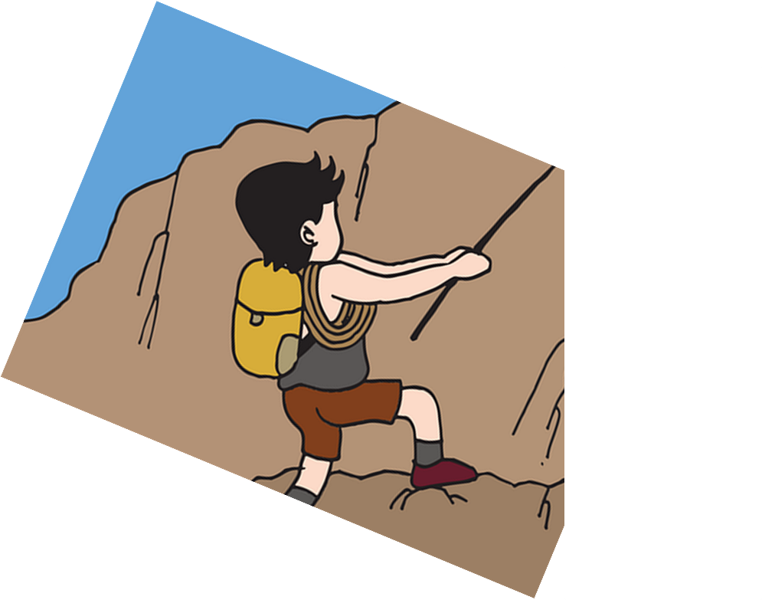
Follow up 4
Wie schreibt man das auf Deutsch?.
[1-5]
You use the bicycle.
I need four cats.
There isn’t a school.
Mr Lehmann has a house.
She makes a mistake.
Katzen
Haus
Fahrrad
Fehler
Schule
einen
vier
das
ein
keine
benutzt
gibt
hat
macht
brauche
es
sie
ich
du
Herr Lehmann
Notes:
Timing: 5-10 minutes
Aim: to practise singular verb forms, key vocabulary & definite and indefinite articles in writing.
Procedure:
Tell students they need to use the words, starting from the bottom, to climb up the mountain (so that they translate the sentence into German!).
Ask students to work in pairs and to write their translation for the first sentence on a mini whiteboard.
Ask a volunteer from a pair to say the English sentence out loud and to read their German translation. Discuss any incorrect answers and ask pupils to explain their choice of verb, article etc. Click to highlight the correct German words for each sentence.
Repeat for items 2-5.
If time allows, ask pupils to recreate the sentences as questions e.g. Do you use the bicycle? Do I need four cats? (They should recognise that the bottom two lines of the wall will swap over for questions).
Using the original sentences, ask pupils to change 1 or more elements of the sentence- they could change the verb or the vocabulary (and as a result might need to change the article or pronoun). E.g. 1) Du benutzt den Computer; Sie benutzt den Computer; Er braucht einen Computer.
Note: to hear the full German sentence answers, click on each English sentence in the audio version only.

Slide 10
hören
Follow up 5a
Hör zu. Was ist das?
For each question, put a cross (x) under the type of word you hear. You will hear each German word twice. Choose one correct answer only.
This word is a good example of …
 | A | B | C | D
1. | a number ☐ | a person ☐ | an animal ☐ | an object ☐
2. | an animal ☐ | a number ☐ | a question word ☐ | a country ☐
3. | an animal ☐ | an object ☐ | a person ☐ | a verb ☐
4. | a verb ☐ | an animal ☐ | a number ☐ | a greeting ☐
5. | a country ☐ | a plural noun ☐ | a question word ☐ | an animal ☐
6. | an object ☐ | a place ☐ | a question word ☐ | a sport ☐
1
2
3
4
5
6
Notes:
Timing: 5 minutes
Procedure:
Pupils write 1-6 and write down A, B, C, or D for each word that they hear.
Click to reveal answers 1-6 in turn.
Transcript:
der Mann
die Katze
brauchen
eins
Schulen
Wer?
10

Slide 11
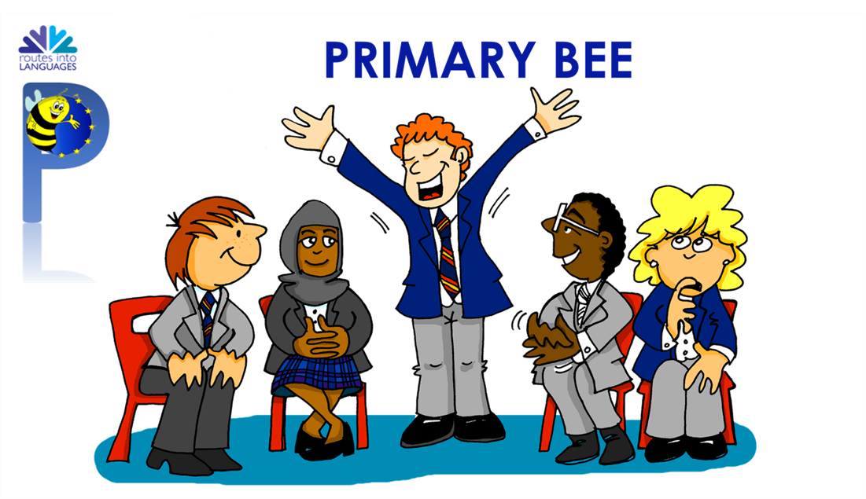
Follow up 5b
Wie sagt man … auf Deutsch?
Partnerarbeit!
sprechen
B
Wie sagt man ‘to do, make’ auf Deutsch?
1. to do, make
2. Does he play?
3. I need
4. to write
5. totally
6. (the) paper
7. She has
8. (the) [male] pupil
9. not a, no (m, nt)
10. I don’t know
1. to use
2. Does she write?
3. I receive
4. to play
5. favourite
6. (the) song
7. You have
8. (the) [female] player
9. the (f)
10. How do you say?
machen?
Richtig!
If you don’t know, say ‘Ich weiß es nicht!’
Notes:
Timing: 5 minutes
Aim: to provide oral practice of this term’s vocabulary and verbs and to remind pupils of the concept of the Primary Bee.
Procedure:
Demonstrate the conversations pupils will have using Lias and Ronja’s speech bubbles.
Ask pupils to decide who is Person A and who is Person B. Person A will be asked to translate items 1-10 on the left hand list and Partner B will translate items 1-10 on the right hand list. It is important that pupils use ‘Wie sagt man…auf Deutsch’ and ‘Ich weiß es nicht’ if unsure.
Give pupils time in pairs to ask and answer.
Note:
Some of the verbs are given in the infinitive, some in the ‘I’ form, ‘you’ form, ‘he/she’ form or questions. Discuss what pupils will need to think about for these before they start.
Additional task suggestions:
Pupils could continue using any other vocabulary covered this term. Follow Up 5 sheets from all previous weeks could support this.

Slide 12
Tschüss!
gelb
Notes:
12

Slide 13
A
B
Richtig oder falsch?
Richtig oder falsch?
Focus on the underlined sounds. Does your partner pronounce them correctly? Tick or cross!
Focus on the underlined sounds. Does your partner pronounce them correctly? Tick or cross!
nämlich
über
schlafen
stecken
nötig
leuchten
Erlebnis
Silber
Ausmaß
Sprung
räumen
fressen
Schreck
aufsetzen
Sänger
Möbel
Stolz
fügen
Notes:
HANDOUT (to be divided in half and half given to Pupil A and half to pupil B).
Note: Handout A should be given to Pupil A and has the words Pupil B will pronounce; handout B should be given to Pupil B and has the words that Pupil A will pronounce.

