Slide 1
What I can do
Ich kann das!
gelb
Phonics, Vocabulary and Grammar revision
Term 2 Week 9
Notes:
Artwork by Steve Clarke. Pronoun pictures from NCELP (www.ncelp.org). All additional pictures selected from Pixabay and are available under a Creative Commons license, no attribution required.
Phonics: Revisit SSC: [ä] [ö] [ü] [au] [eu| [äu] [sch] [sp] [st] [s-] [-s-] [ß] [ss] [-s]
Vocabulary: Revisit words from lessons Term 2 Lessons 1 - 8
Revisit 1: brauchen [179] bekommen [212] machen [58] schreiben [184] Brief [838] Geschichte [262] Hilfe [481] ich weiß (es) nicht [n/a] wie sagt man…? [n/a]
Revisit 2: kein, keine, kein [46] Fehler [861] Haus [147] Katze [2235] Schule [359]
Jones, R.L & Tschirner, E. (2019). A frequency dictionary of German: Core vocabulary for learners. London: Routledge.
The frequency rankings for words that occur in this PowerPoint which have been previously introduced in these resources are given in the SOW and in the resources that first introduced and formally re-visited those words.
For any other words that occur incidentally in this PowerPoint, frequency rankings will be provided in the notes field wherever possible.
1

Slide 2
Phonics Revision
Hör zu und sag die Wörter.
Help Robbie to remember all of the sounds from this term.
groß
spät
aussprechen
essen
König
singen
Tür
spielen
Which sounds sound the same as each other?
stark
Haus
schreiben
Häuser
Deutschland
Notes:
Timing: 2 minutes
Aim: to remind pupils of previously taught SSCs and to practise pronunciation of these key sounds.
Procedure:
1. Explain that pupils are going to revise the key sounds learnt this term with Robbie.
2. Click to make the first word appear. Pupils listen to the correct pronunciation and repeat. The audio has the sound on its own, then the full word.
3. Repeat to bring up and practise all sounds covered this term.
4. Click to bring up the callout about similar sounds. Click again to highlight words that have the same sounds but different spellings. Emphasise the ß as a double ‘s’ sound after a long vowel.
5. Move to the next slide to practise recognition of these sounds in unknown words.

Slide 3
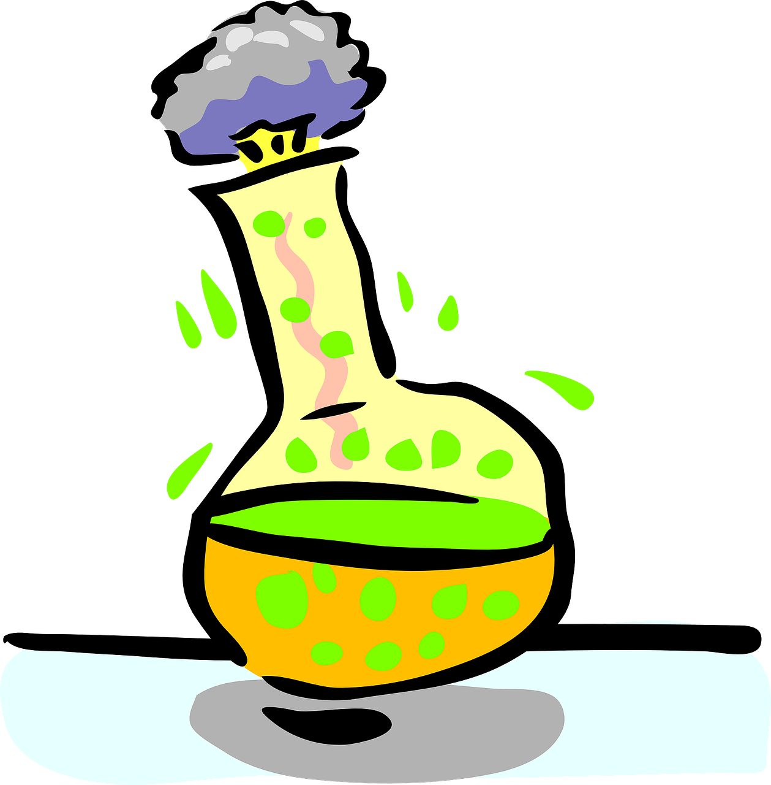
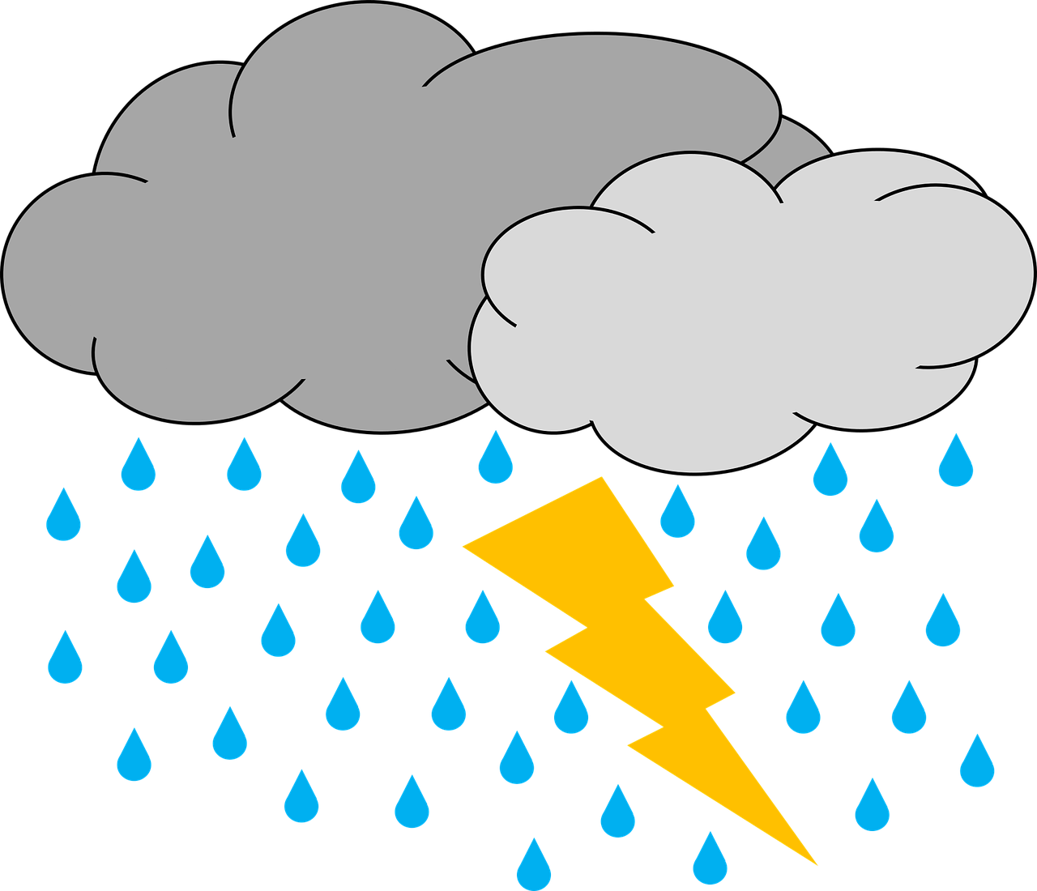
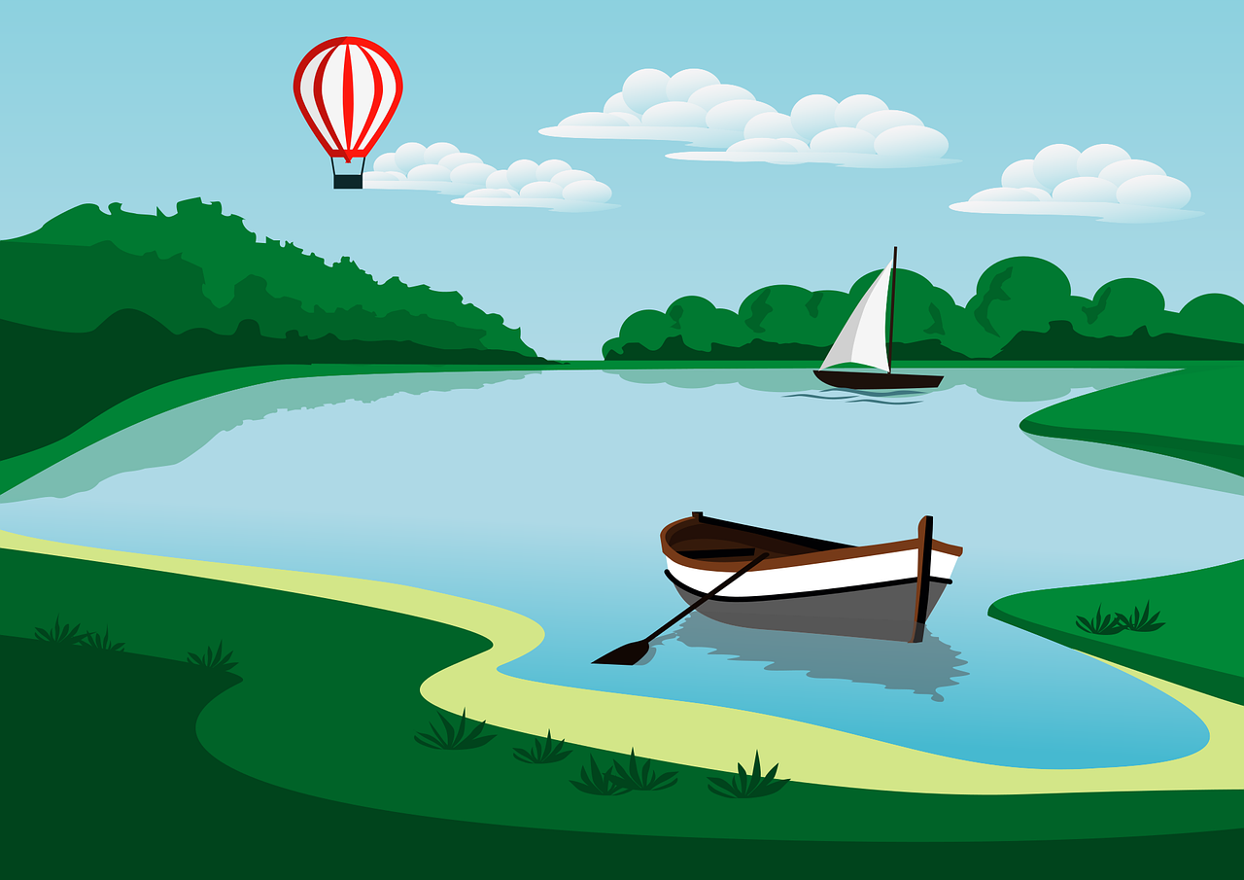
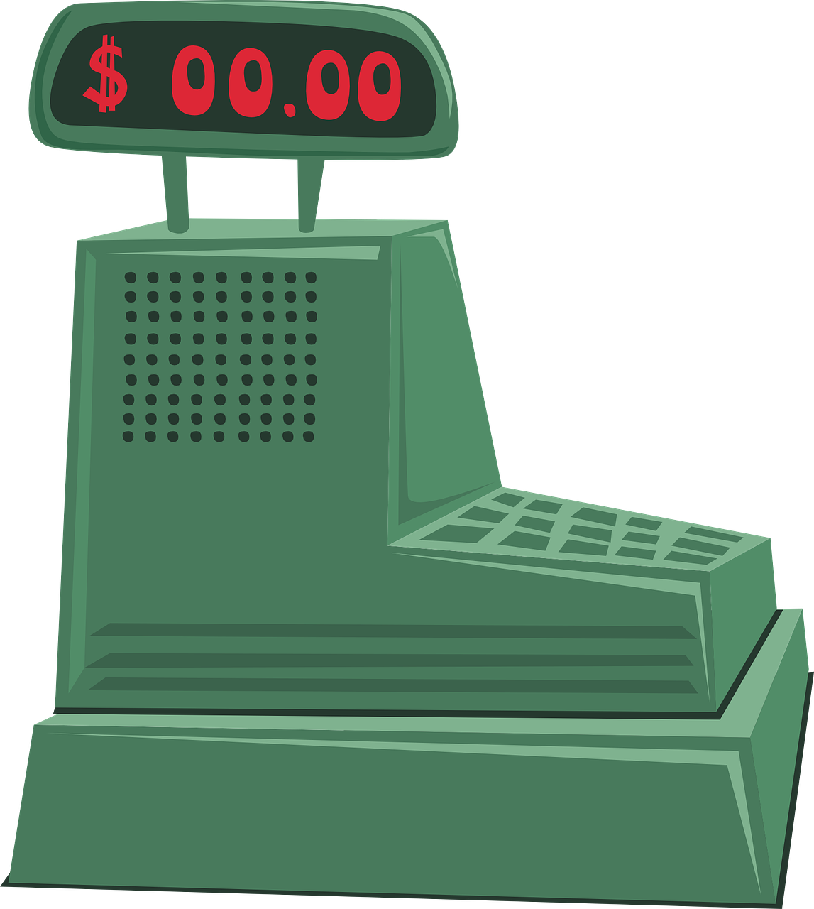
Phonics Revision
Schreib 1-10 und hör zu. Was ist richtig?
Write numbers 1-10. Listen and note down the missing sound in each word.
hören
1 | S t a d t | a oder ä?
2 | b ö s e | ö oder ü?
3 | F r eu d e | au oder eu?
4 | S e e | s oder z?
5 | K a ss e | s oder ss?
6 | S äu r e | au oder äu?
7 | K ü s t e | ü oder u?
8 | St u r m | st oder sp?
9 | Sch r e c k | sch oder sp?
10 | H o c h z e i t | s oder z?
?
?
?
?
?
?
?
?
?
?
Notes:
Timing: 5 minutes
Aim: to practise aural recognition and transcription of previously taught SSCs.
Procedure:
Explain that this week pupils will be revising all the sounds covered this term. They will hear 10 words and need to identify which of the two sounds suggested is the correct missing sound. For a greater challenge, some pupils might like to look away from the board and identify the sound independently.
Click audio button 1 to play the recording for item 1. Pupils need to write down the missing SSC: a or ä.
Elicit the answer and click to reveal the answer. Discuss meaning and click again for picture to appear.
Repeat for items 2-10. Now that pupils have learnt numbers, encourage them to follow the numbers as they listen to each item.
Transcript: 1. Stadt
2. böse
3. Freude
4. See
5. Kasse
6. Säure
7. Küste
8. Sturm
9. Schreck
10. Hochzeit
Word frequency of unknown words (1 is the most frequent word in German): böse [1229] Freude [1286] Hochzeit [3281] Kasse [2852] Küste [2628] Säure [2347] Schreck [2970] See [1317] Stadt [204] Sturm [2913] Source: Jones, R.L. & Tschirner, E. (2019). A frequency dictionary of German: core vocabulary for learners. Routledge

Slide 4
Vocabulary Revision
Wörter
Sag das Wort auf Deutsch. Schreib das auf Englisch.
Vokabeln
5. kein
3. der Fehler
8. benutzen
6. wer?
1. das Haus
10. machen
9. brauchen
2. das Papier
4. die Schülerin
7. total
house
not a; no
to do, make
paper
[female] pupil
mistake
who?
to use, using
totally
to need, needing
Notes:
Timing: 5 minutes Aim: to practise written comprehension and spoken pronunciation of vocabulary.
Procedure: 1. Students will use mini whiteboards to translate the German words which appear (or discuss in pairs if preferred).
2. Ask students to say the German word as it appears, and write down the English translation before the word has faded away (5 sec per word). As they now know numbers, encourage them to say the number too.
3. Click for English translation to be highlighted. 4. Repeat for all 10 items.
5. Check answers by eliciting the German from students, (i.e. so that they are translating back from their written English into spoken German).

Slide 5
lesen
Revising verb forms
Wer macht das?
You know that German verb endings often tell us who a statement is about.
E.g. Ich brauche= I need; du brauchst= you need; er/sie braucht= he/she needs.
Colour the bubbles red, yellow or blue to show who is doing each verb.
Farben
rot (I)
gelb (you)
blau (she/he)
braucht
braucht
spielst
spielst
versteht
versteht
benutze
Can you remember the verbs you have learnt that don’t follow this pattern?
benutze
machst
machst
bekommt
bekommt
spiele
spiele
haben = to have
I have = ich habe
You have = ?
He/she has = ?
sein = to be
I am = ich bin
You are = ?
He/she is = ?
schreibe
schreibe
macht
du bist
macht
du hast
er/sie hat
er/sie ist
Notes:
Timing: 5 minutes
Aim: To aid comprehension of 1st, 2nd and 3rd person singular weak verbs and haben.
Procedure:
1. Recap the rules about weak verb endings, using the example with brauchen.
Give pupils a copy of the handout. Pupils colour in the verbs in the bubbles according to the verb endings, using the key in the box.
Click on the outside edge of the bubbles (not the verbs) to show the correct colours.
Use the callouts to recall the irregular verbs haben and sein.
HANDOUT at end of presentation.

Slide 6
Revising verbs, definite and indefinite articles
Ronja’s phone signal is bad and she can only hear the middle of sentences.
What was the beginning and end of each sentence?
Hör zu. Was hörst du?
hören
ich | du
Katze | Brief
Remember: the masculine words for ‘a’ and ‘the’ change after most verbs:
ein→einen
der→den
B
1
er | du
Song | Spiel
2
sie | ich
Papier | Computer
du | sie
Baum | Haus
3
4
er | ich
Hilfe | Fahrrad
5
ich | du
Geschichte | Brief
ich | sie
Fehler | Spiel
6
Notes:
Timing: 5 minutes
Aim: to practise aural comprehension of definite and indefinite articles in the accusative (R2), and singular verb endings.
Procedure:
Explain the task. Ronja’s phone signal is bad, so pupils will only hear the middle of sentences. Discuss a) the different forms of einen, eine, ein and den, die, das depending on the gender of the noun that follows and b) the different verb endings they might hear.
Play the example (B). Pupils listen for the verb ending and decide which pronoun to use. Play the example again, this time pupils listen to the form of the indefinite or definite article to decide which noun would complete the sentence. Click to reveal answers.
Pupils write down numbers 1-6 (or use handout at end of presentation).
Play items 1-6 (pupils will need each item playing twice). Pupils write down/circle their choices for each item. Click to display answers.
Transcript:
B. [Ich] habe eine [Katze].
[Du] spielst ein [Spiel].
[Ich] benutze den [Computer].
[Sie] bekommt einen [Baum].
[Er] braucht das [Fahrrad].
[Du] schreibst die [Geschichte].
[Ich] mache einen [Fehler].

Slide 7
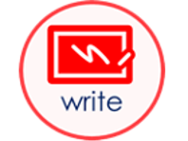
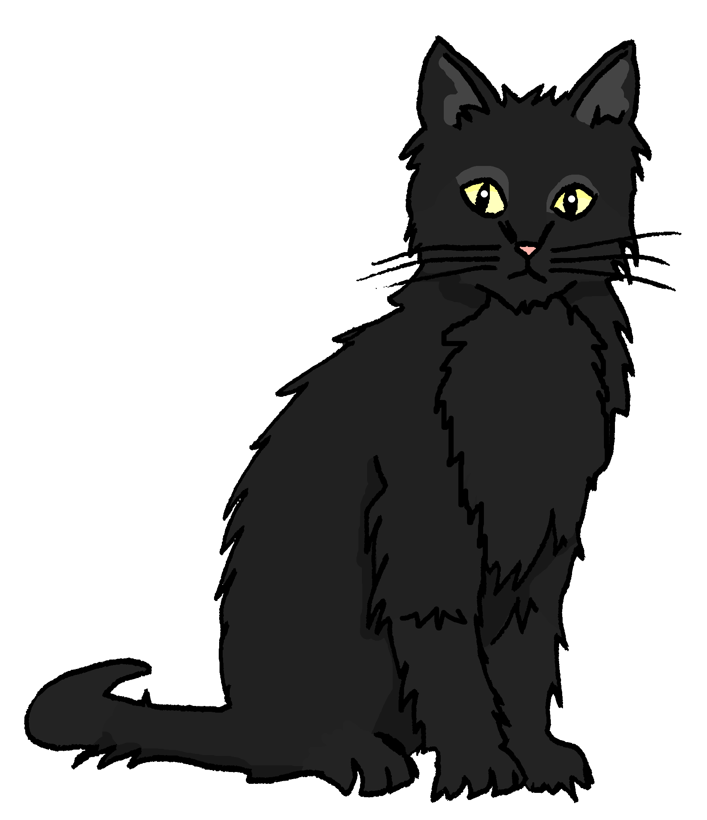
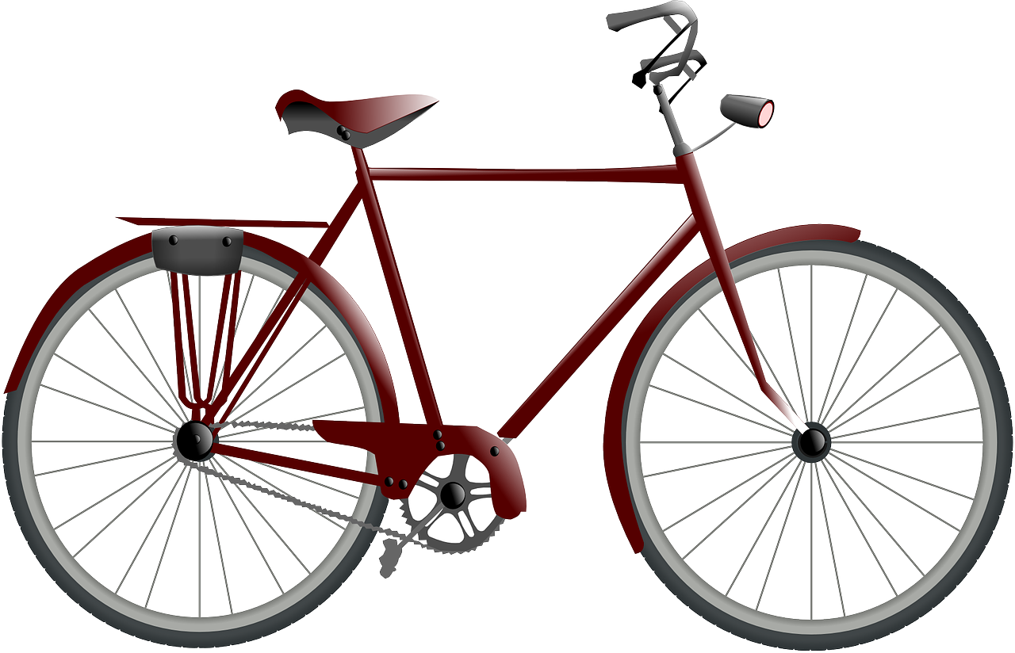
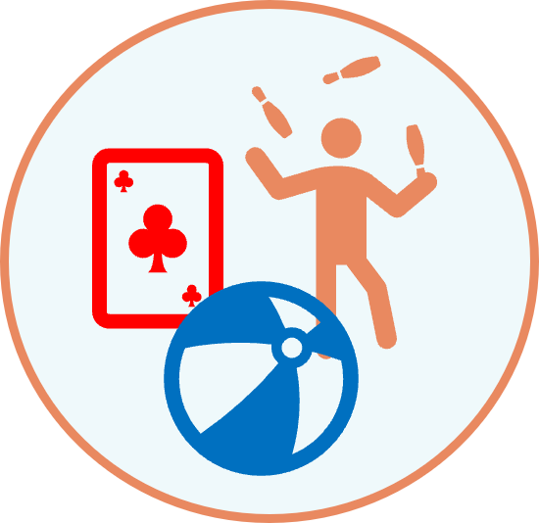
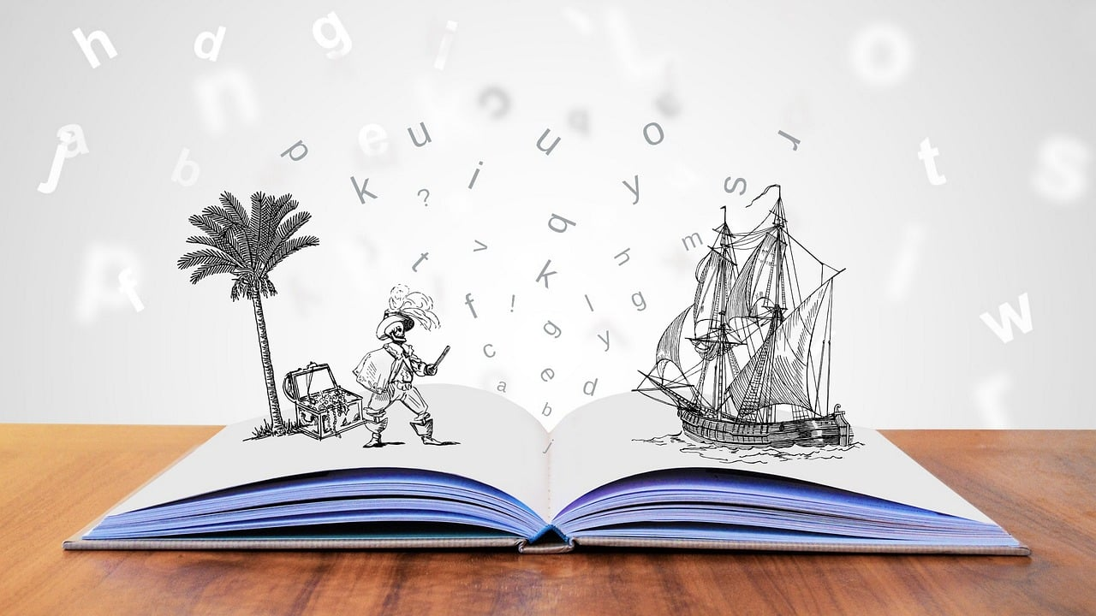
Wer bin ich?
Bist du Lias, Ronja, Mariem, Gabriel oder Leon?
sprechen
Lias
Ronja
Mariem
B: Ja, ich schreibe einen Brief.
A: Schreibst du einen Brief?
A: Hast du eine Katze?
B: Nein. Ich habe keine Katze.
Gabriel
Leon
A: Brauchst du Hilfe?
B: Ja, ich brauche Hilfe.
Bist du Mariem?
B: Richtig! Ich bin Mariem.
Notes:
Timing: 10 minutes
Aim: to practise oral production of questions and answers using the first and 2nd person forms of verbs met this term; to practise using definite and indefinite articles in the accusative (R2).
Procedure:
Tell pupils they are going to choose to be one of the characters but must not tell their partner/group who they have chosen.
Click through the speech bubbles to illustrate how the conversation might go. Person A asks ‘Do you + an activity on the board?’. Person B replies ‘ja’ or ‘nein’, pretending to be one of the characters. Person A can guess at any point saying ‘Bist du…?’
Pupils have their own dialogues, changing the questions in the speech bubbles depending on what they find out from their partner.
Repeat, with both pupils having at least 2 goes at each role.
Pupils should then say or write sentences in the 3rd person to describe the pictures e.g. Er (Lias) schreibt einen Brief, er benutzt den Computer, er bekommt ein Fahrrad und er hat eine Katze.
Note: It might be helpful/necessary to identify what each picture means before starting this activity. Additional task suggestions: 1. Pupils could join with another pair and report back on what their partner has in the 3rd person e.g. Er (Alex) macht Sport, er bekommt eine Geschichte, er spielt ein Spiel und er hat ein Fahrrad.

Slide 8
Tschüss!
gelb
Notes:
8

Slide 9
lesen
Revising verb forms
Wer macht das?
You know that German verb endings often tell us who a statement is about.
E.g. Ich brauche= I need; du brauchst= you need; er/sie braucht= he/she needs.
Colour the bubbles red, yellow or blue to show who is doing each verb.
braucht
spielst
versteht
Farben
rot (I)
gelb (you)
blau (she/he)
benutze
machst
bekommt
spiele
schreibe
macht
Notes:
HANDOUT

Slide 10
Revising verbs, definite and indefinite articles
Ronja’s phone signal is bad and she can only hear the middle of sentences.
What was the beginning and end of each sentence?
Hör zu. Was hörst du?
hören
B
ich | du
Katze | Brief
Remember: the masculine words for ‘a’ and ‘the’ change after most verbs:
ein→einen
der→den
1
er | du
Song | Spiel
2
sie | ich
Papier | Computer
3
du | sie
Baum | Haus
4
er | ich
Hilfe | Fahrrad
5
ich | du
Geschichte | Brief
6
ich | sie
Fehler | Spiel
Notes:
HANDOUT

