Slide 1
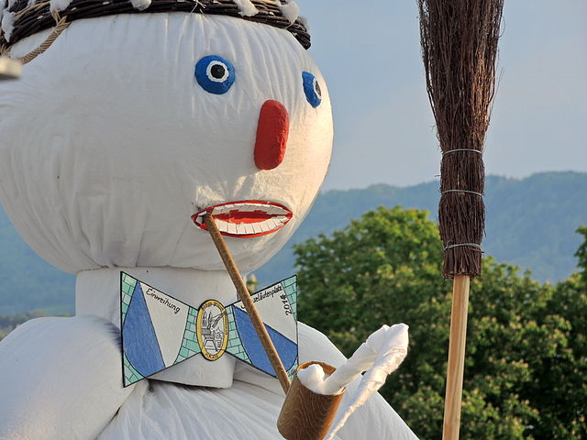
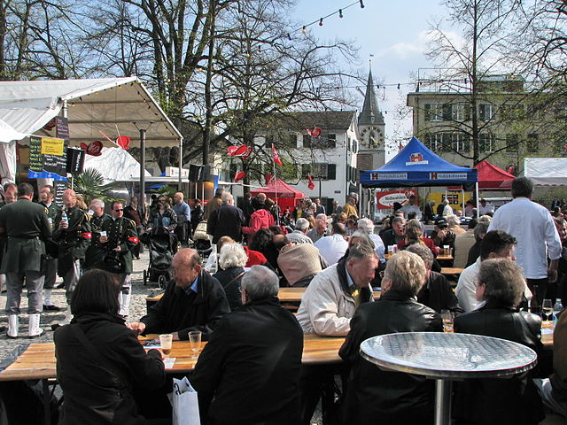
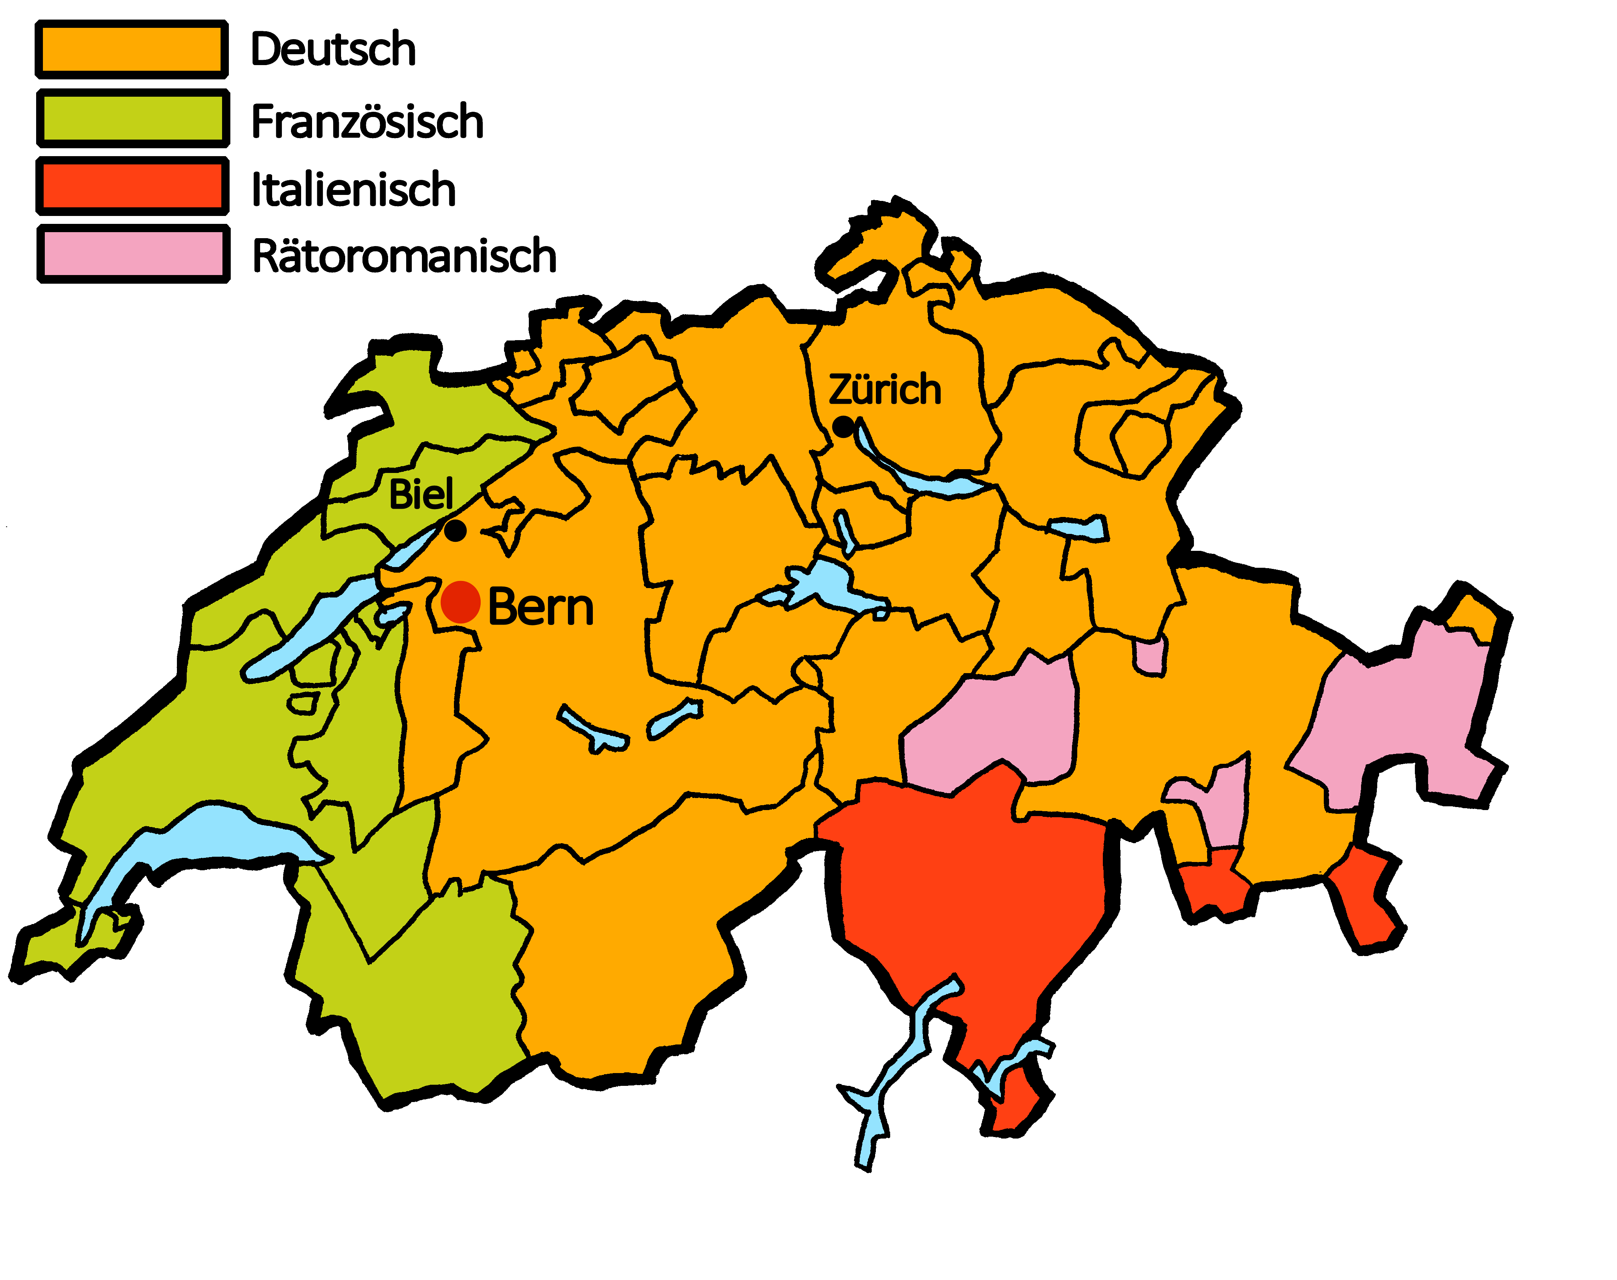
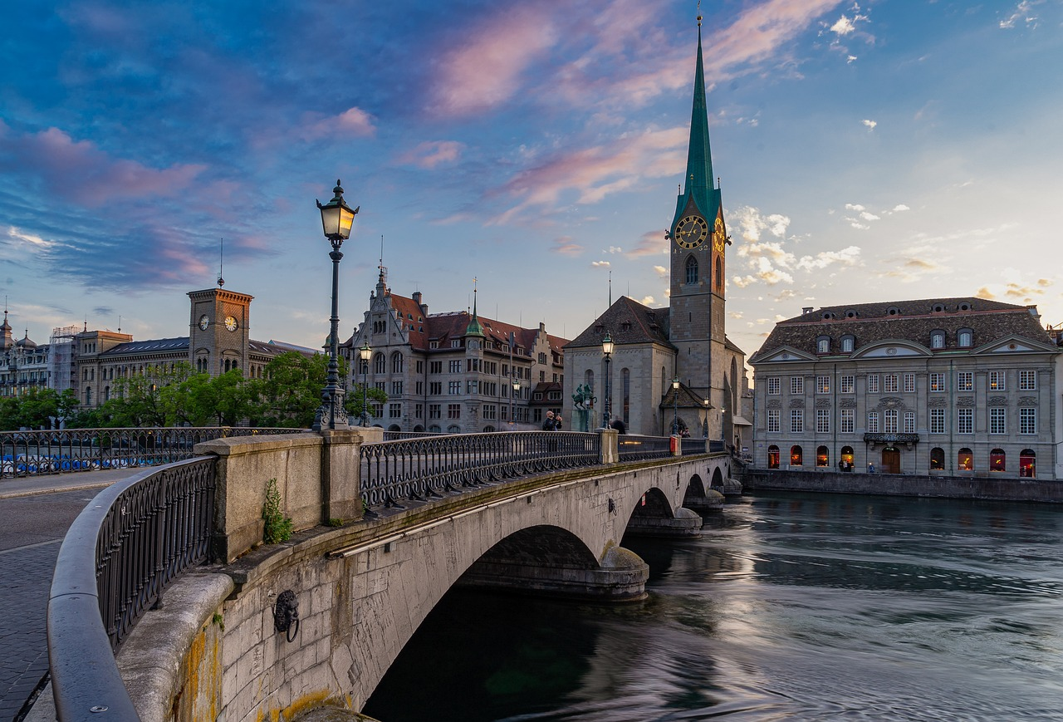
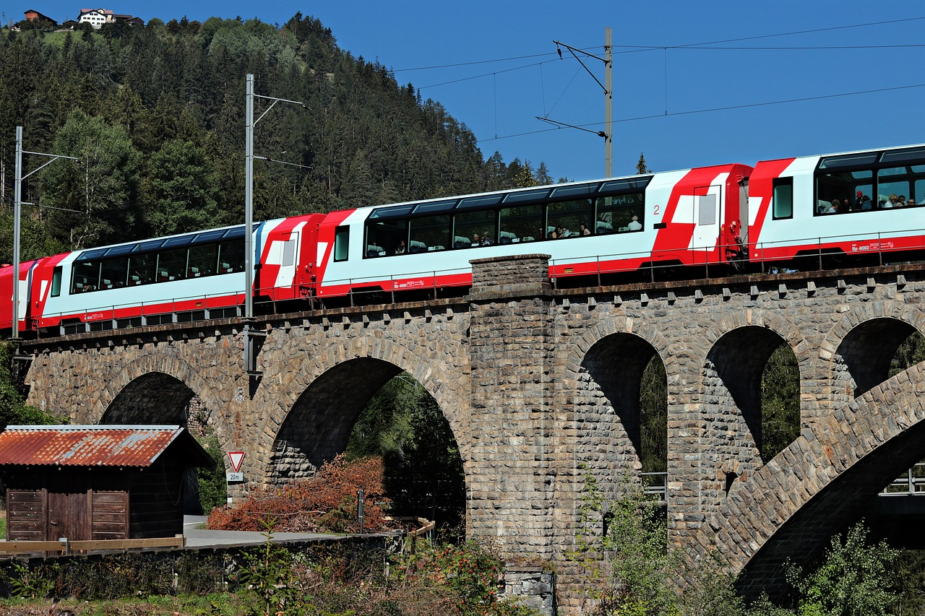
Talking about things and things to do
Montag
Freitag
Dienstag
Samstag
Mittwoch
Sonntag
Donnerstag
gelb
Follow ups 1-5
Term 3 Week 1
Notes:
Artwork by Steve Clarke. Pronoun pictures from NCELP (www.ncelp.org). All additional pictures selected from Pixabay and are available under a Creative Commons license, no attribution required.
Phonics: [v] vier [200] vergessen [584] Vater [232] positiv [516] viel [56]
Vocabulary: Montag [1044] Dienstag [1356] Mittwoch [1187] Donnerstag [1244] Freitag [981] Samstag [1112] Sonntag [804] Tag [111] Woche [219] heute [116] morgen [752]
Revisit 1: benutzen [1119] spielen [205] Sport [945] zu Hause [n/a]
Revisit 2: Frau [99] Herr [154] Mann [121] Schüler, Schülerin [556] Spieler, Spielerin [822] total [1021]
Jones, R.L & Tschirner, E. (2019). A frequency dictionary of German: Core vocabulary for learners. London: Routledge.
The frequency rankings for words that occur in this PowerPoint which have been previously introduced in these resources are given in the SOW and in the resources that first
introduced and formally re-visited those words.
For any other words that occur incidentally in this PowerPoint, frequency rankings will be provided in the notes field wherever possible.
Note that the first three lessons of the year teach language that can be continuously recycled as lesson routine every lesson in Y3/4.
The idea would be that the class teacher (whether or not s/he teaches the class German can re-use the language as part of the daily routine with the class.

Slide 2
aussprechen
[v]
…
The German [v] sounds very like the English [f] sound.
vier
Notes:
Timing: 1 minute
Aim: to introduce the SSC [v].
Procedure:
Introduce the SSC and present the source word ‘vier’ (with gesture, if using).
Click to bring on the picture and get pupils to repeat the word ‘vier’ (with gesture, if using).
Note:
a gesture for ‘vier’ might be to hold 4 fingers up.
2

Slide 3
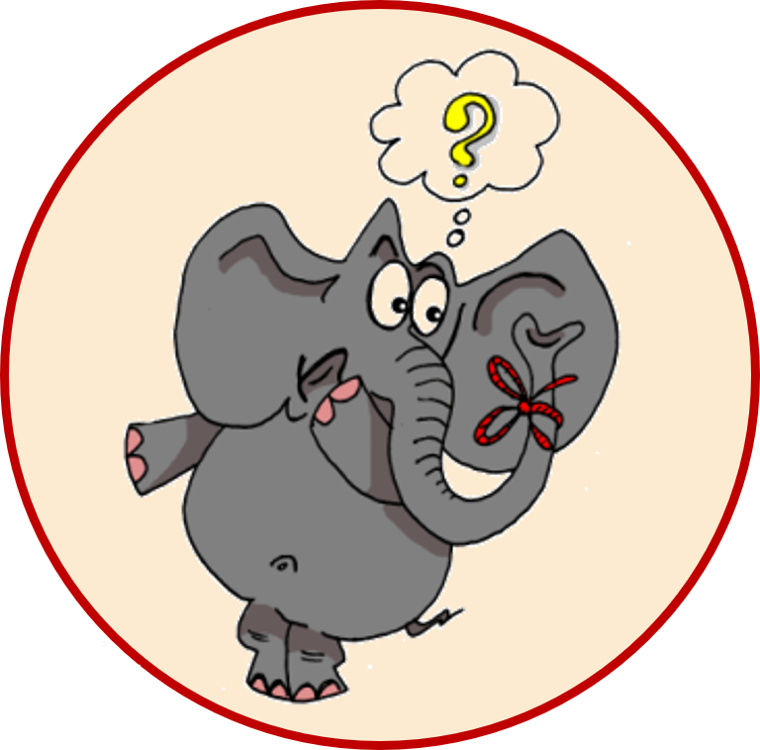
aussprechen
[v]
…
vergessen
Vater
vier
4
[to forget]
positiv
viel
[a lot, much]
Notes:
Timing: 1 minute
Aim: to consolidate the SSC [v].
Procedure:
Re-present the SSC and the source word ‘vier’ (with gesture, if using).
Click to bring on the picture and get pupils to repeat the word ‘vier’ (with gesture, if using).
Present the cluster words in the same way, bringing on the picture and getting pupils to pronounce the words.
Frequency:
vier [200] vergessen [584] Vater [232] positiv [516] viel [56]
Jones, R.L & Tschirner, E. (2019). A frequency dictionary of German: Core vocabulary for learners. London: Routledge.

Slide 4
aussprechen
[w]
Remember: A German [w] sounds like an English [v].
…
Wasser
Antwort
Welt
wahr
gewinnen
Notes:
Timing: 1 minute
Aim: to revise the SSC [W] before contrasting it with the new SSC [V]
Procedure:
Re-present the SSC and the source word ‘Welt’ (with gesture, if using).
Click to bring on the picture and get pupils to repeat the word ‘Welt’ (with gesture, if using).
Present the cluster words in the same way, bringing on the picture and getting pupils to pronounce the words.
Vocabulary: Antwort [522] gewinnen [372] wahr [737] Wasser [245] Welt [164]
Jones, R.L & Tschirner, E. (2019). A frequency dictionary of German: Core vocabulary for learners. London: Routledge.

Slide 5
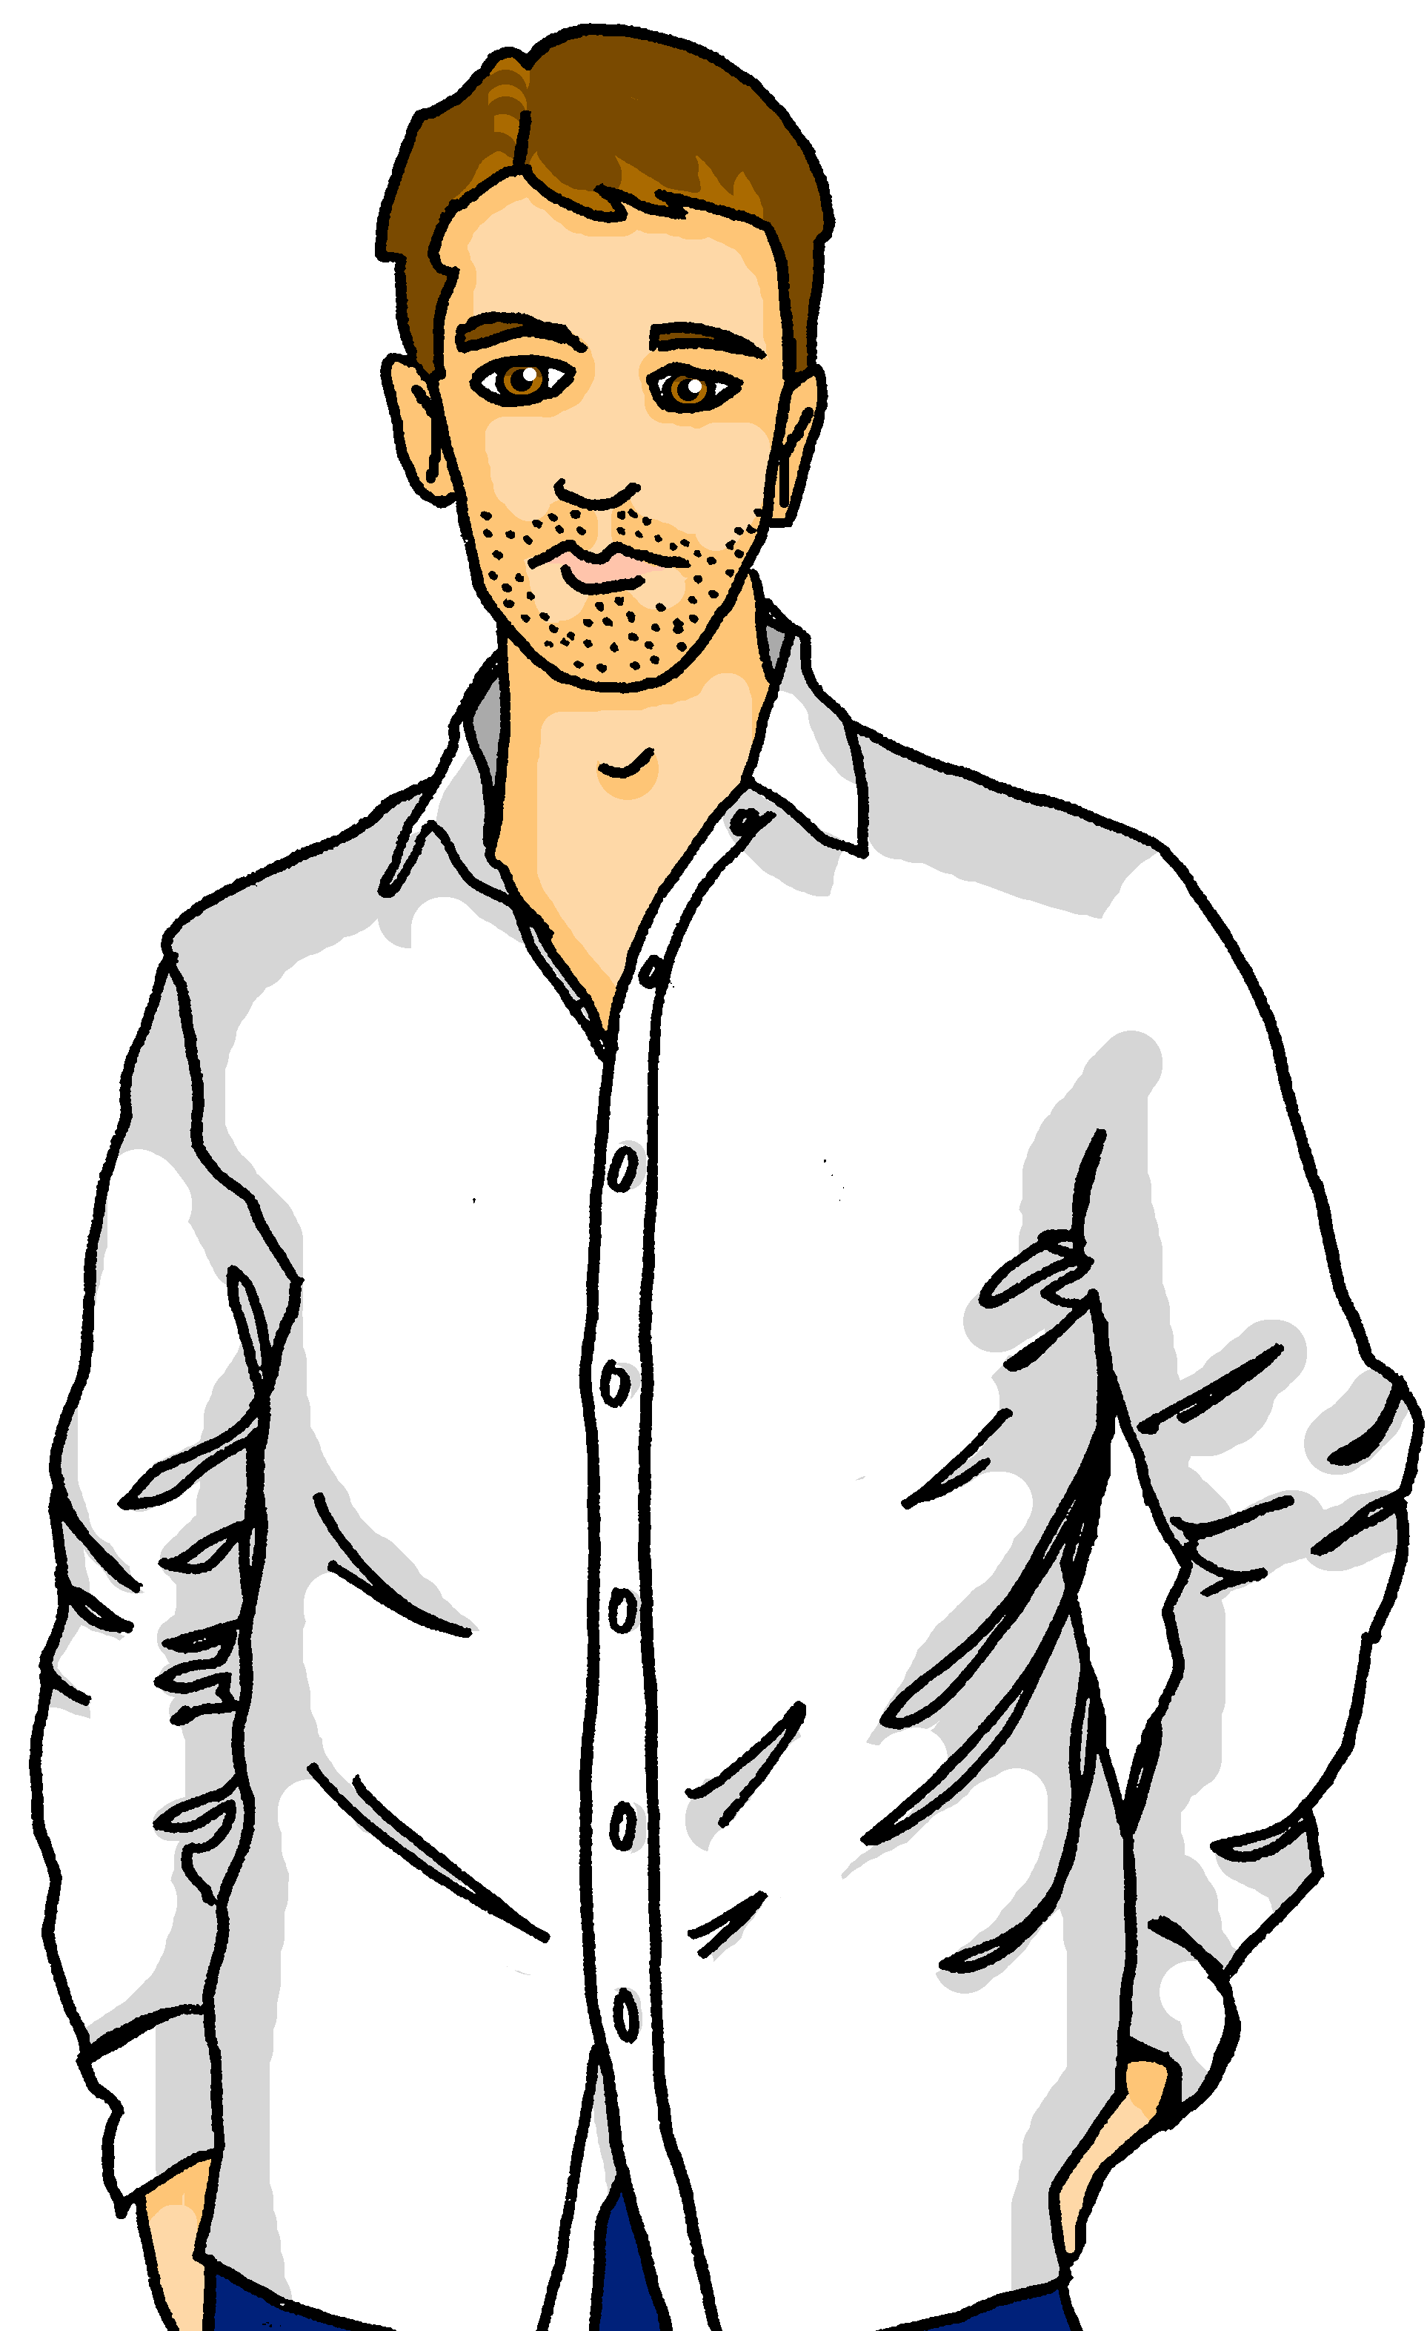
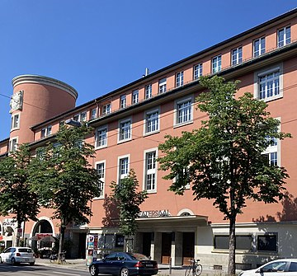
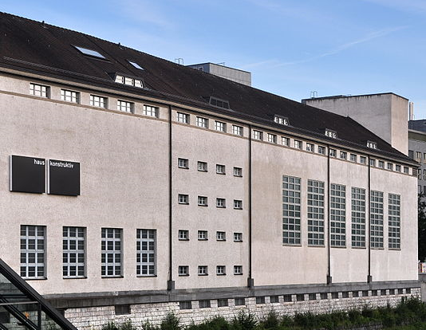
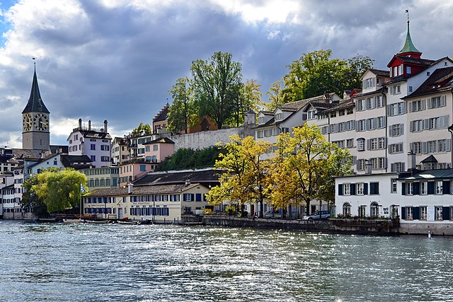
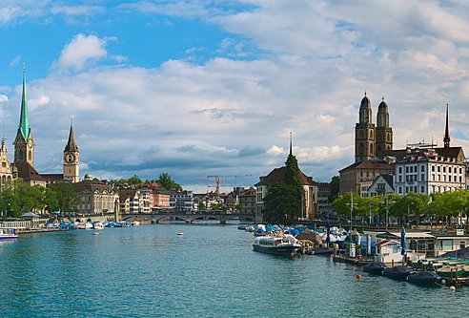
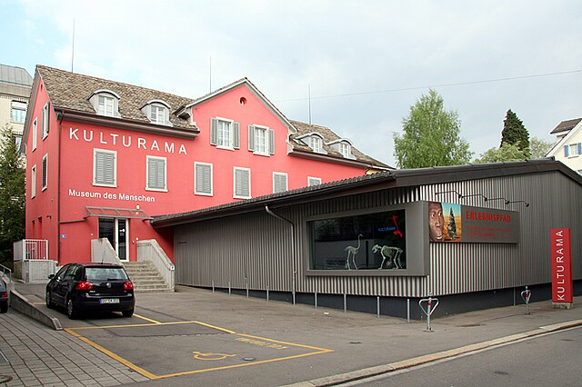
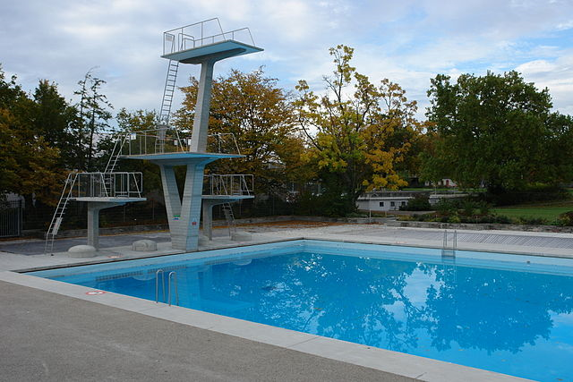
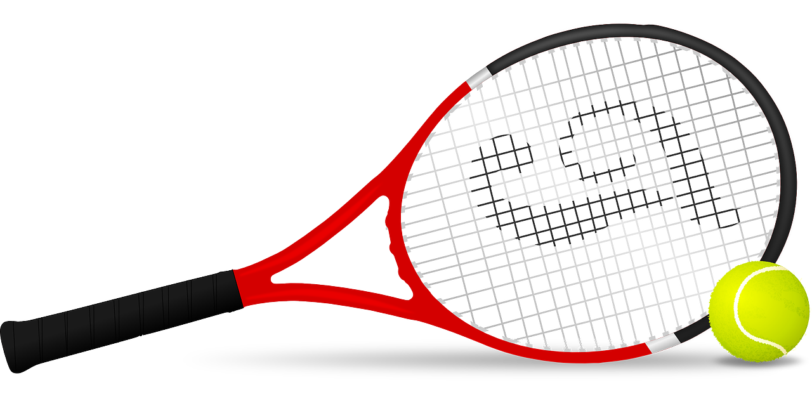
Follow up 1
Heute ist Samstag!
Lias, Ronja, and their parents are exploring Zurich. Where are they?
aussprechen
Verlag
Volkshaus
Konstruktiv
Lindenhof
Fluss
Englischviertel
Verein
Freibad
Notes:
Timing: 5 minutes
Aim: to consolidate the SSC [v] by reading out places in Zürich.
Procedure:
1. Pupils work in pairs reading out the places.
2. Change roles.
3. Click to make the family appear next to each of the places. Pupils chorally say where they are.
Word frequency:
Fluss [1687] Verein [899] Verlag [1699]
Image attribution:
Volkshaus Zürich Von Sarita98 - Eigenes Werk, CC BY-SA 4.0, https://commons.wikimedia.org/w/index.php?curid=107962534
Haus Konstruktiv By Roland zh - Own work, CC BY-SA 3.0, https://commons.wikimedia.org/w/index.php?curid=16090914
Die Lindenhof-Moräne Von © Roland Fischer, Zürich (Switzerland) – Mail notification to: roland_zh(at)hispeed(dot)ch / Wikimedia Commons, CC BY-SA 3.0, https://commons.wikimedia.org/w/index.php?curid=21842418
Limmat Von Daniel Kraft, CC BY-SA 3.0, https://commons.wikimedia.org/w/index.php?curid=91820342
Kulturama Von Martin Sauter - Eigenes Werk, CC BY-SA 3.0, https://commons.wikimedia.org/w/index.php?curid=6672899
Freibad Letzigraben Von Port(u*o)s - Eigenes Werk, CC BY-SA 3.0, https://commons.wikimedia.org/w/index.php?curid=10097336
https://commons.wikimedia.org/w/index.php?curid=123720245

Slide 6
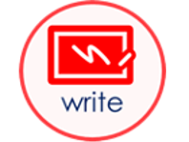
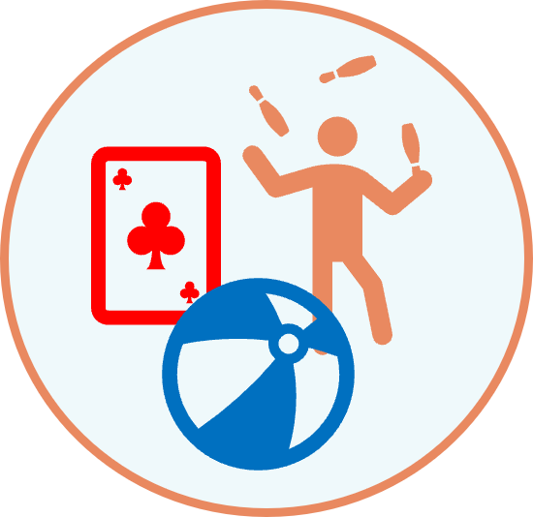
Follow up 2
Hör zu!
Meine Woche
Gabriel messages Lias about his week.
What does he do on each day?
1
2
3
4
5
6
7
totally
Here Gabriel said: ‘morgen ist Montag’ = tomorrow is Monday.
Notes:
Timing: 10 minutes
Aim: to practise aural recognition of the days of the week and new vocab (morgen, heute) and to revise some key verbs and vocabulary from previous weeks.
Procedure:
Explain the scenario. Gabriel is sending voice messages to Lias about his week.
Play audio 1-7 and ask pupils to draw lines on their handouts to match the correct day to the correct activity.
Click to show the answers on the board. Item 7 is tricky as pupils need to recognise the word ‘morgen’.
Transcript:
Es ist Donnerstag. Ich spiele zu Hause.
Heute ist Montag. Ich mache Sport.
Es ist Dienstag. Ich benutze den Computer.
Heute ist Samstag. Total wunderbar!
Es ist Freitag. Ich schreibe einen Brief.
Heute ist Mittwoch. Ich brauche Hilfe.
Morgen ist Montag! Heute bekomme ich einen Ball.

Slide 7
Follow up 3
Schreib auf Deutsch und auf Englisch.
A Write the missing days of the week.
lesen
C Translate the sentences into English.
 | heute | morgen
1 |  | Donnerstag
2 | Montag
3 |  | Samstag
4 | Sonntag
5 |  | Sonntag
1. | Heute ist Mittwoch.
2. | Morgen ist Dienstag.
3. | Mein Lieblingstag ist Samstag.
4. | Ist heute Donnerstag oder Freitag?
Mittwoch
Today is Wednesday.
Dienstag
Tomorrow is Tuesday.
Freitag
Montag
My favourite day is Saturday.
Samstag
Is today Thursday or Friday?
B
Write the days of the week in order.
Mittwoch
Donnerstag
Sonntag
Montag
Dienstag
Samstag
Freitag
Notes:
Timing: 5-10 minutes
Handout (optional) at end of presentation.
Aim: to consolidate written recognition and recall of the days of the week and other new vocab this week.
Procedure:
Recap meanings of heute (today) and morgen (tomorrow) and then ask pupils to fill in the missing days of the week in table A.
Click to bring up the answers.
Ask pupils to write the days of the week in order on the caterpillar. Pupils could turn away from the board to practise spelling from memory.
Click to bring up answers.
Ask pupils to translate the 4 sentences in C into English. Click to bring up translations.
Additional task suggestions: 1. Pupils could begin to write their own sentences in German using the days of the week and the example sentences here e.g. Mein Lieblingstag ist…/ Heute ist…
More able pupils could also add an activity they do e.g. Heute ist Mittwoch. Ich spiele zu Hause or someone else does e.g. Heute ist Donnerstag. Ellis macht Sport.

Slide 8
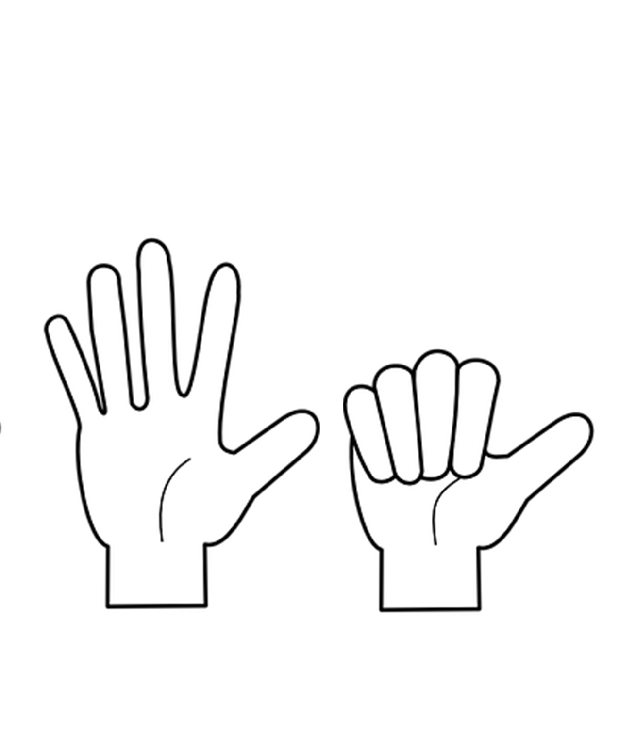
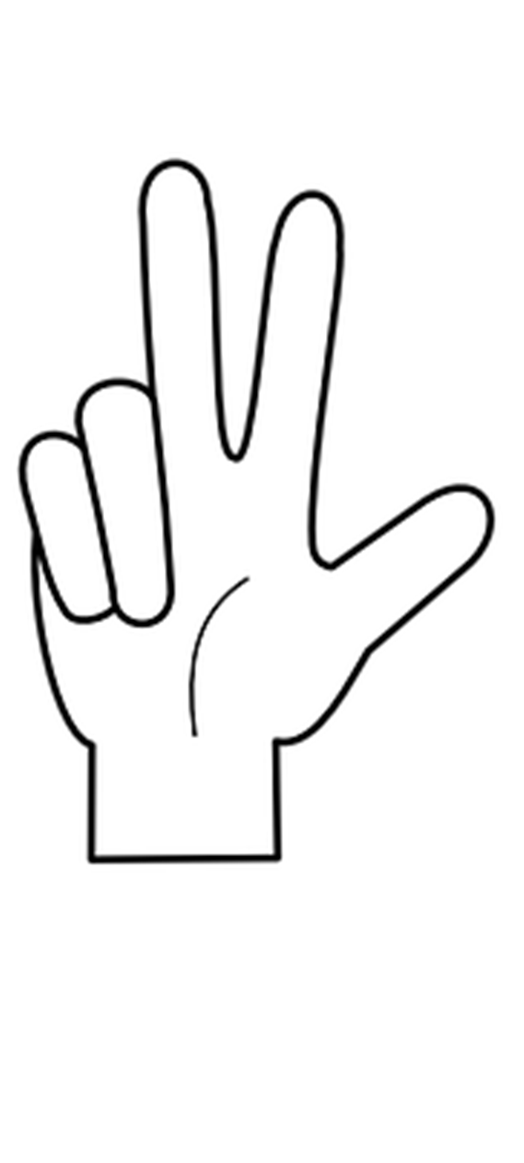
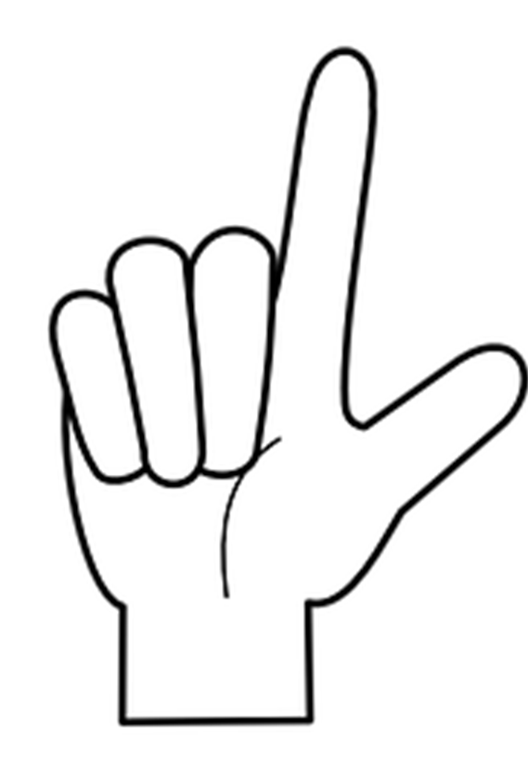
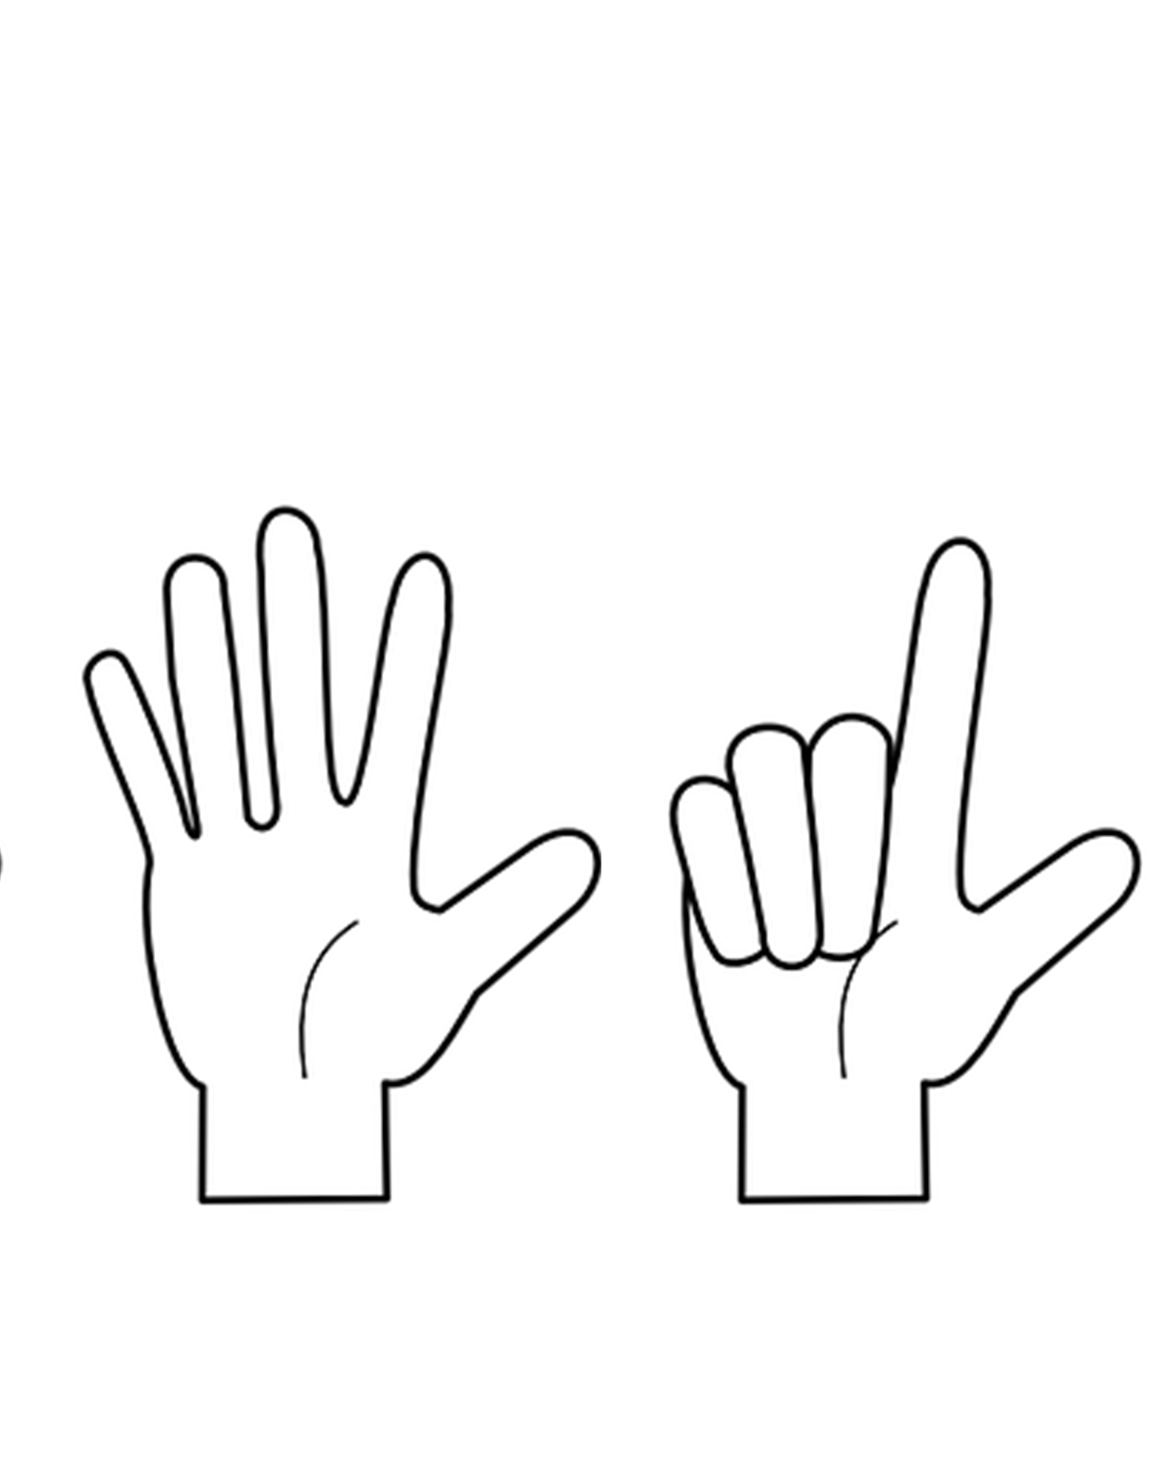
Follow up 4a Read the days aloud in the correct order.
…
Sag die Tage!
sprechen
60
Mittwoch
Samstag
Dienstag
S
Freitag
Montag
0
Sonntag
Donnerstag
START
Notes:
Timing: 2 minutes
Aim: to consolidate days of the week (in combination with hand gestures to embed meaning).
Procedure:
Read the instruction.
In pairs, ask pupils to read the days of the week in the correct order.
Click “Start” to trigger 30-second timer.
Go to next slide for answers.

Slide 9
Follow up 4a
…
Sag die Tage.
Dienstag
Freitag
sprechen
Samstag
Donnerstag
60
Montag
Mittwoch
Sonntag
S
Montag
Dienstag
Mittwoch
Donnerstag
0
Freitag
Samstag
START
Sonntag
Notes:
ANSWERS Procedure:
Click to make the days disappear in the correct order and click again to bring up the correct answer with image.
Click again to make all of the answers disappear and bring back the jumbled days.
Click “Start” to trigger 30-second timer. Pupils practise one more time saying all of the days in the correct order.

Slide 10
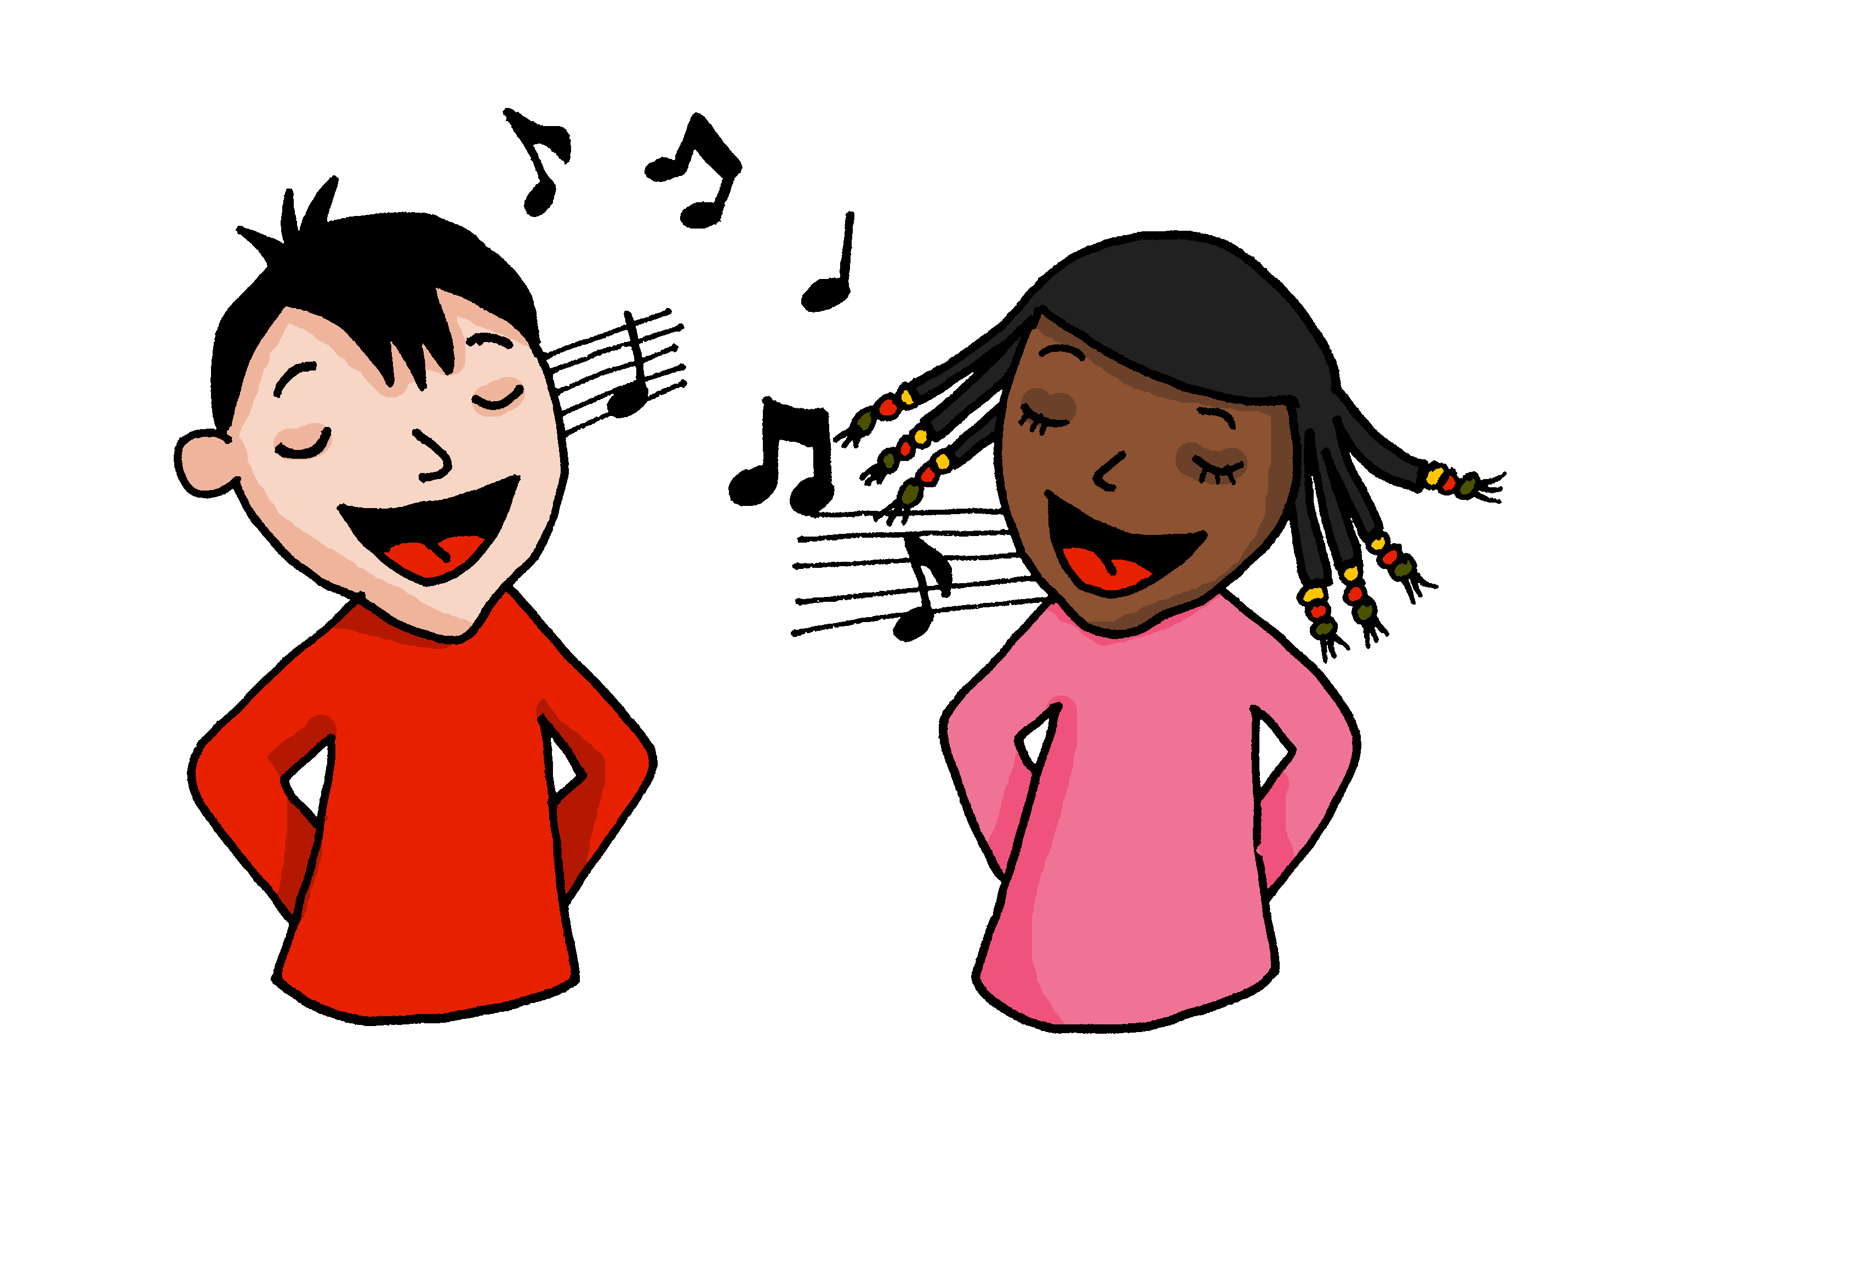
Follow up 4b:
Die Wochentage!
singen
Sing mit!
Notes:
OPTIONAL
Timing: 5 minutes
Aim: to practise oral production of the days of the week (in a song that constrains the time and helps to speed up production).
Procedure:
Click to play the song.
Encourage pupils to join in when they can.
Link to song:
https://www.youtube.com/watch?v=RjlfcpVBBNw
Notes: i) the song is just the days (repeated over and over) but the tune is catchy after a while and the harmonies make it not unpleasant to listen to, despite the minion-type voices!
ii) we recommend opening the link in a separate window just prior to the start of the lesson and playing through the adverts, leaving the song paused at the start ready to go, when needed.

Slide 11
Follow up 5:

Schreib auf Englisch.
Can you get at least 15 points?
Wörter
 | total | der Schüler | die Spielerin
 | Herr | der Mann | die Frau
 | benutzen | die Woche | spielen
 | der Tag | zu Hause | der Sport
 | Montag | Donnerstag | Sonntag
 | morgen | Mittwoch | Freitag
 | Dienstag | Samstag | heute
totally
(the) [male] pupil
(the) [female] player
Vokabeln
x3
Mr
(the) man
(the) woman, Mrs, Ms.
to use, using
(the) week
to play, playing
x2
(the) day
at home
(the) sport
Monday
Thursday
Sunday
tomorrow
Wednesday
Friday
x1
Tuesday
Saturday
today
Notes:
Timing: 5 minutes
Aim: to practise written comprehension of vocabulary from this and revisited weeks.
Procedure: 1. Give pupils a blank grid. They fill in the English meanings of any of the words they know, trying to reach 15 points in total.
Note: The most recently learnt and practised words are pink, words from the previous week are green and those from earlier weeks are blue, thus more points are awarded for them, to recognise that memories fade and more effort (heavy lifting!) is needed to retrieve them.

Slide 12
Follow up 5:

Schreib auf Deutsch.
Can you get at least 15 points?
Wörter
 | (the) [female] pupil | (the) Mann | totally
 | (the) woman, Mrs, Ms | Mr | (the) [male] player
 | (the) sport | to use, using | at home
 | to play, playing | (the) day | (the) week
 | Sunday | today | tomorrow
 | Thursday | Friday | Saturday
 | Monday | Tuesday | Wednesday
die Schülerin
der Mann
total
Vokabeln
x3
die Frau
Herr
der Spieler
der Sport
benutzen
zu Hause
x2
spielen
der Tag
die Woche
Sonntag
heute
morgen
Donnerstag
Freitag
Samstag
x1
Montag
Dienstag
Mittwoch
Notes:
Timing: 5 minutes
Aim: to practise written production of vocabulary from this and revisited weeks.
Procedure: 1. Give pupils a blank grid. They fill in the German meanings of any of the words they know, trying to reach 15 points in total.
Note: The most recently learnt and practised words are pink, words from the previous week are green and those from further back are blue, thus more points are awarded for them, to recognise that memories fade and more effort (heavy lifting!) is needed to retrieve them.

Slide 13
Tschüss!
gelb
Notes:
13

Slide 14
Follow up 2
Hör zu!
Meine Woche
Gabriel messages Lias about his week.
What does he do on each day?
totally
Notes:
HANDOUT

Slide 15
Follow up 3
Schreib auf Deutsch und auf Englisch.
A Write the missing days of the week.
C Translate the sentences into English.
 | heute | morgen
1 |  | Donnerstag
2 | Montag
3 |  | Samstag
4 | Sonntag
5 |  | Sonntag
1. | Heute ist Mittwoch.
2. | Morgen ist Dienstag.
3. | Mein Lieblingstag ist Samstag.
4. | Ist heute Donnerstag oder Freitag?
B
Write the days of the week in order.
Montag
Notes:
HANDOUT

Slide 16
Follow up 5:

Schreib auf Englisch.
Can you get at least 15 points?
Wörter
 | total | der Schüler | die Spielerin
 | Herr | der Mann | die Frau
 | benutzen | die Woche | spielen
 | der Tag | zu Hause | der Sport
 | Montag | Donnerstag | Sonntag
 | morgen | Mittwoch | Freitag
 | Dienstag | Samstag | heute
Vokabeln
x3
x2
x1
Notes:
HANDOUT

Slide 17
Follow up 5:

Schreib auf Deutsch.
Can you get at least 15 points?
Wörter
 | (the) [female] pupil | (the) Mann | totally
 | (the) woman, Mrs, Ms | Mr | (the) [male] player
 | (the) sport | to use, using | at home
 | to play, playing | (the) day | (the) week
 | Sunday | today | tomorrow
 | Thursday | Friday | Saturday
 | Monday | Tuesday | Wednesday
Vokabeln
x3
x2
x1
Notes:
HANDOUT

