Slide 1
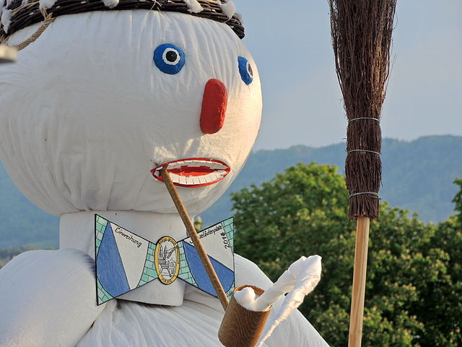
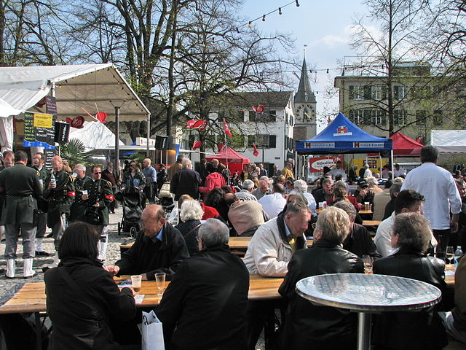
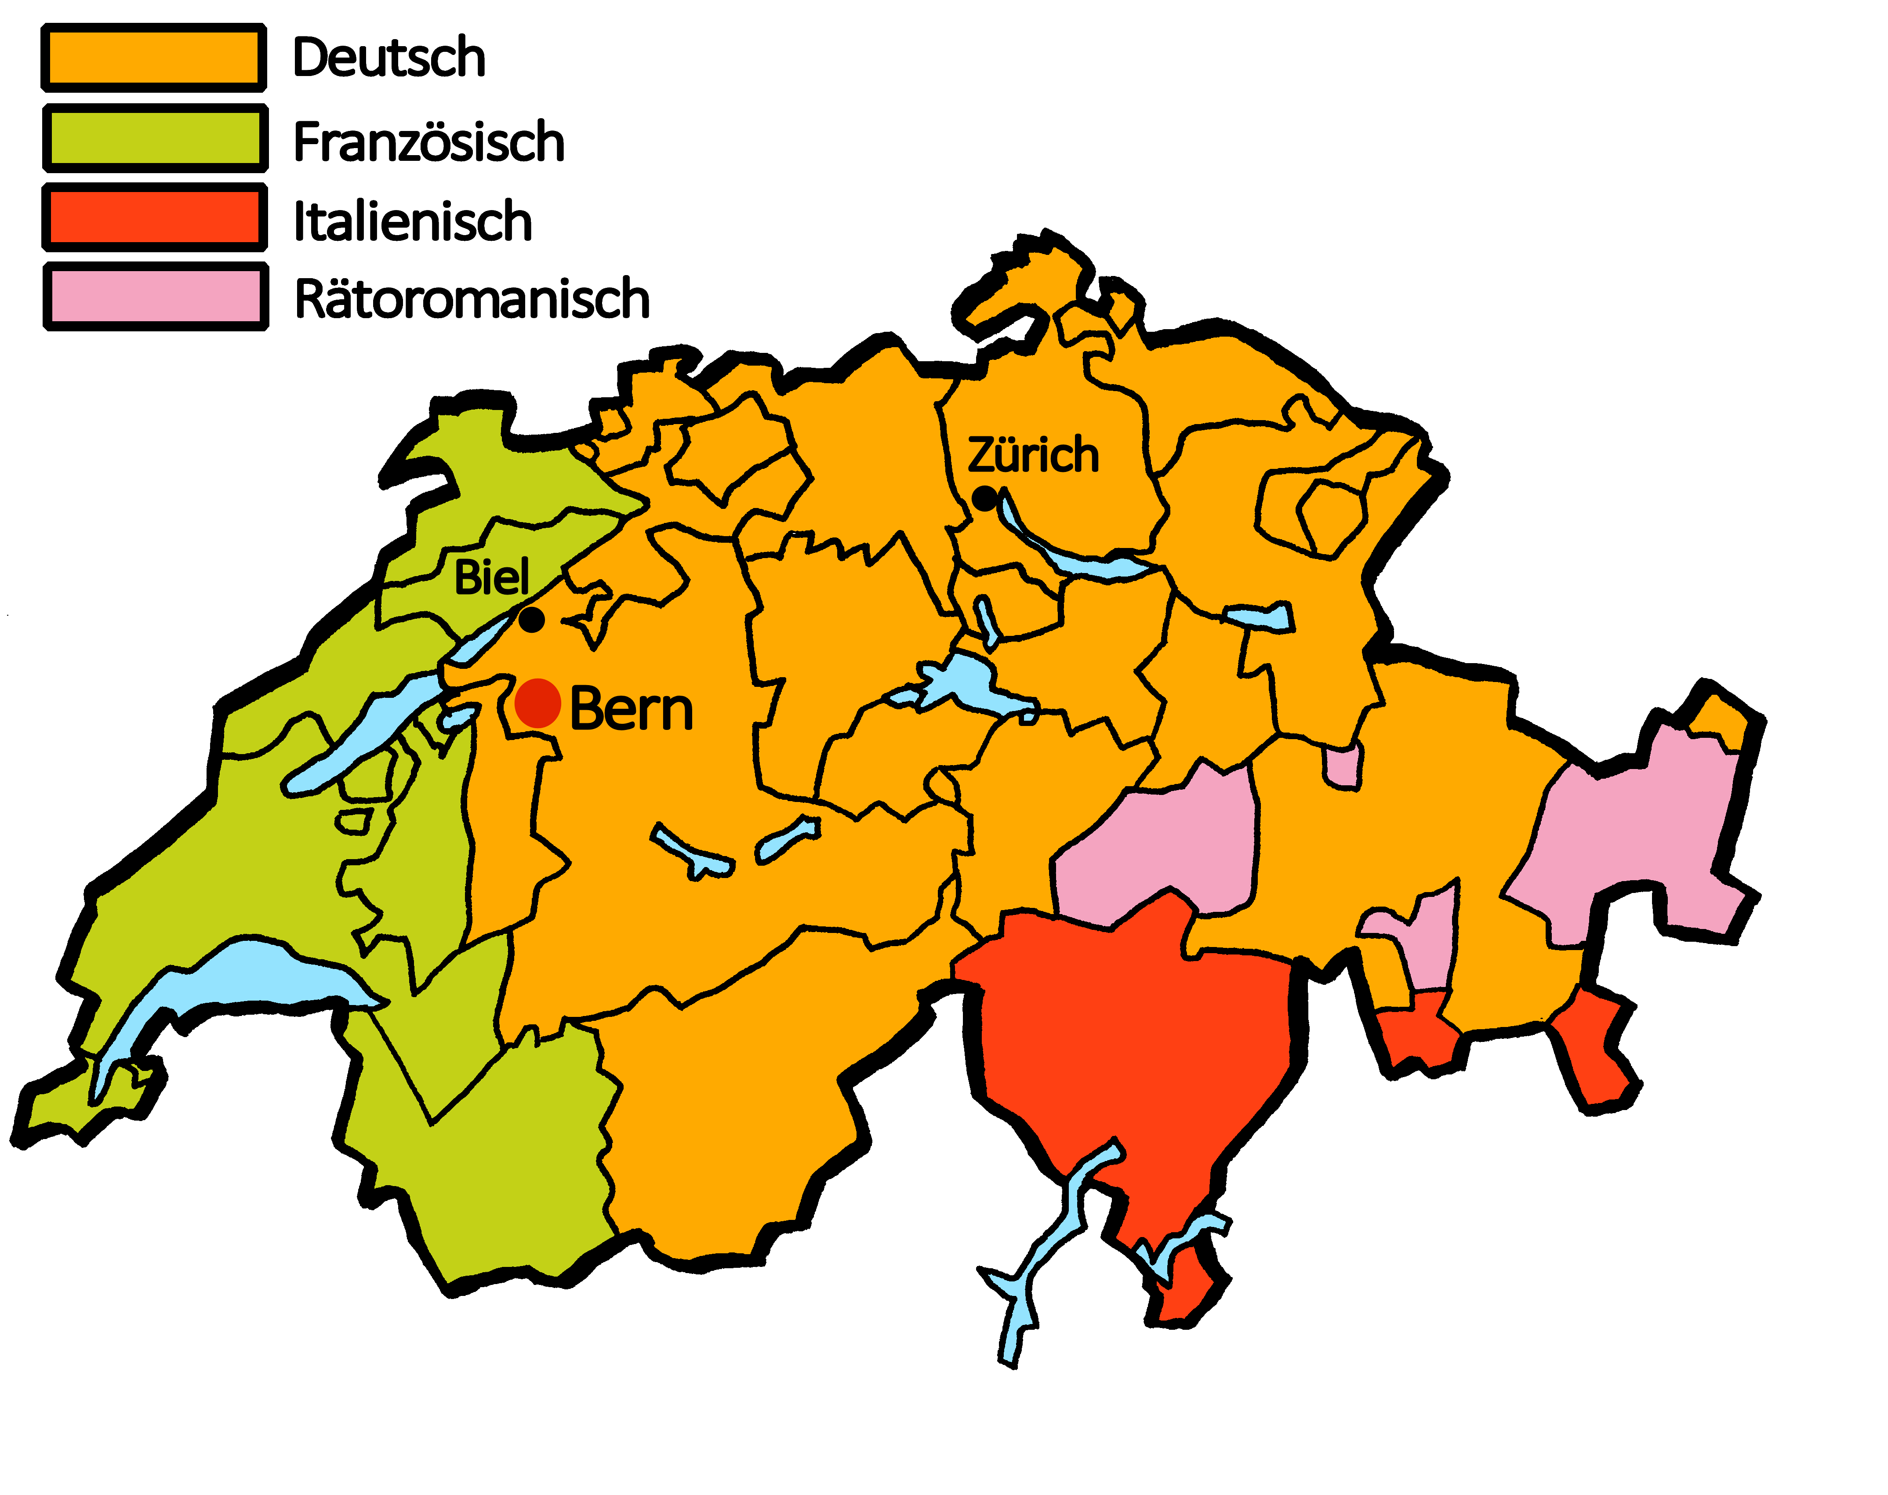
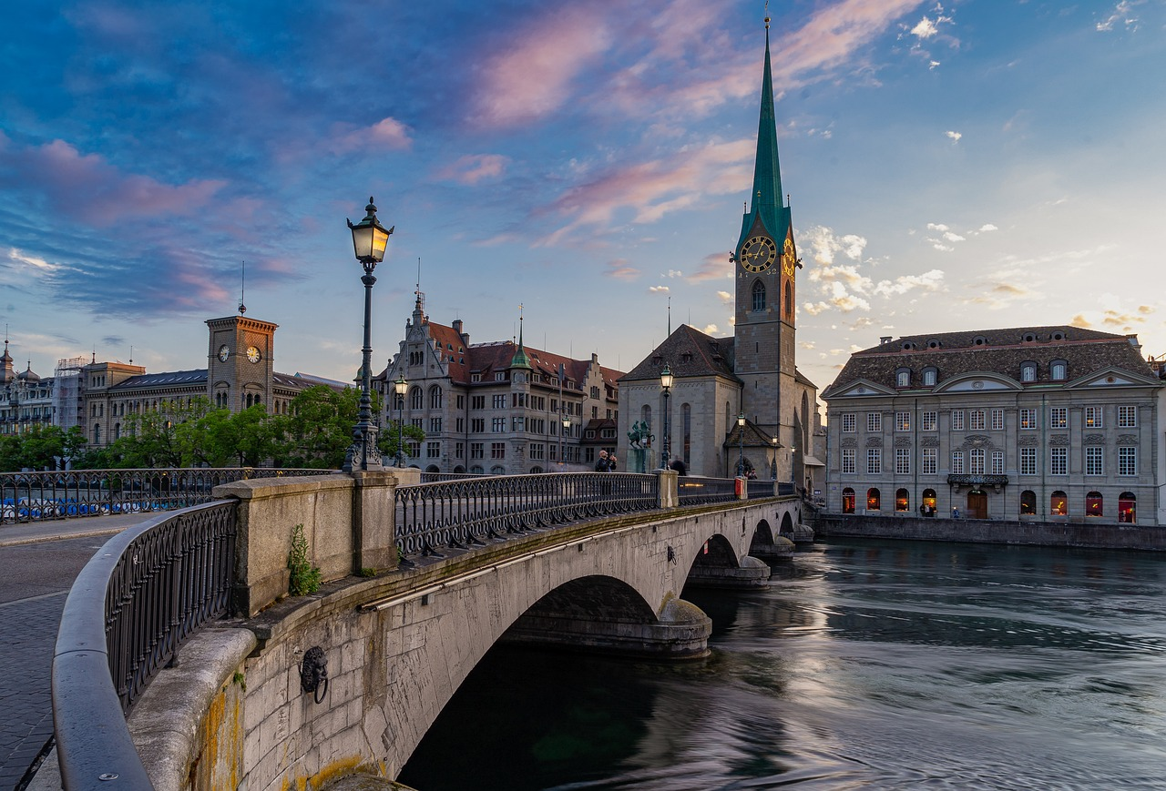
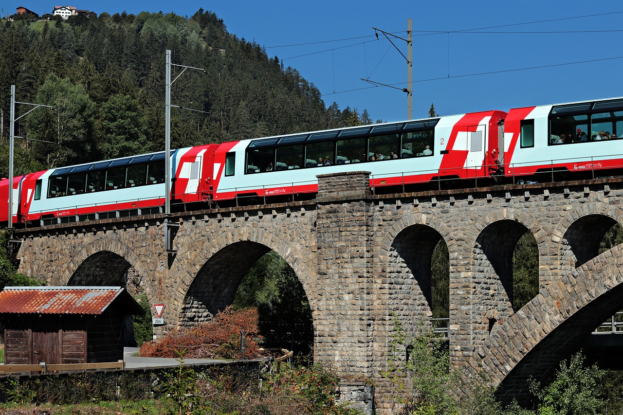
Talking about things and things to do
Montag
Freitag
Dienstag
Samstag
Mittwoch
Sonntag
Donnerstag
gelb
Days of the week
SSC [v]
Term 3 Week 1
Notes:
Artwork by Steve Clarke. Pronoun pictures from NCELP (www.ncelp.org). All additional pictures selected from Pixabay and are available under a Creative Commons license, no attribution required.
Phonics: [v] vier [200] vergessen [584] Vater [232] positiv [516] viel [56]
Vocabulary: Montag [1044] Dienstag [1356] Mittwoch [1187] Donnerstag [1244] Freitag [981] Samstag [1112] Sonntag [804] Tag [111] Woche [219] heute [116] morgen [752]
Revisit 1: benutzen [1119] spielen [205] Sport [945] zu Hause [n/a]
Revisit 2: Frau [99] Herr [154] Mann [121] Schüler, Schülerin [556] Spieler, Spielerin [822] total [1021]
Jones, R.L & Tschirner, E. (2019). A frequency dictionary of German: Core vocabulary for learners. London: Routledge.
The frequency rankings for words that occur in this PowerPoint which have been previously introduced in these resources are given in the SOW and in the resources that first
introduced and formally re-visited those words.
For any other words that occur incidentally in this PowerPoint, frequency rankings will be provided in the notes field wherever possible.
Note that the first three lessons of the year teach language that can be continuously recycled as lesson routine every lesson in Y3/4.
The idea would be that the class teacher (whether or not s/he teaches the class German can re-use the language as part of the daily routine with the class.
1

Slide 2
Guten Tag, die Klasse!
hören
sprechen
lesen
schreiben
Notes:
Timing: 1 minute
Aim: to revise four infinitive verbs as part of essential classroom language.
Procedure:
Say Guten Tag, die Klasse and prompt pupils to say the infintives and their English meaning.
Elicit pronunciation and word knowledge orally by prompting in English. (e.g. ‘Lesen’ – ‘to read, reading’. ‘Gut. Sprechen?...).

Slide 3
aussprechen
[v]
…
The German [v] sounds very like the English [f] sound.
vier
Notes:
Timing: 1 minute
Aim: to introduce the SSC [v].
Procedure:
Introduce the SSC and present the source word ‘vier’ (with gesture, if using).
Click to bring on the picture and get pupils to repeat the word ‘vier’ (with gesture, if using).
Note:
a gesture for ‘vier’ might be to hold 4 fingers up.
3

Slide 4
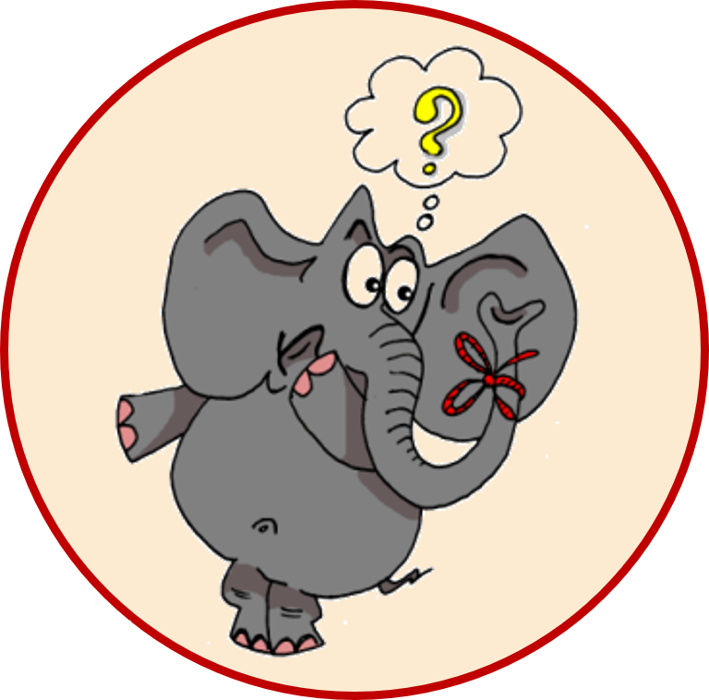
aussprechen
[v]
…
vergessen
Vater
vier
4
[to forget]
positiv
viel
[a lot, much]
Notes:
Timing: 1 minute
Aim: to consolidate the SSC [v].
Procedure:
Re-present the SSC and the source word ‘vier’ (with gesture, if using).
Click to bring on the picture and get pupils to repeat the word ‘vier’ (with gesture, if using).
Present the cluster words in the same way, bringing on the picture and getting pupils to pronounce the words.
Frequency:
vier [200] vergessen [584] Vater [232] positiv [516] viel [56]
Jones, R.L & Tschirner, E. (2019). A frequency dictionary of German: Core vocabulary for learners. London: Routledge.

Slide 5
aussprechen
[w]
Remember: A German [w] sounds like an English [v].
…
Wasser
Antwort
Welt
wahr
gewinnen
Notes:
Timing: 1 minute
Aim: to revise the SSC [W] before contrasting it with the new SSC [V]
Procedure:
Re-present the SSC and the source word ‘Welt’ (with gesture, if using).
Click to bring on the picture and get pupils to repeat the word ‘Welt’ (with gesture, if using).
Present the cluster words in the same way, bringing on the picture and getting pupils to pronounce the words.
Vocabulary: Antwort [522] gewinnen [372] wahr [737] Wasser [245] Welt [164]
Jones, R.L & Tschirner, E. (2019). A frequency dictionary of German: Core vocabulary for learners. London: Routledge.

Slide 6
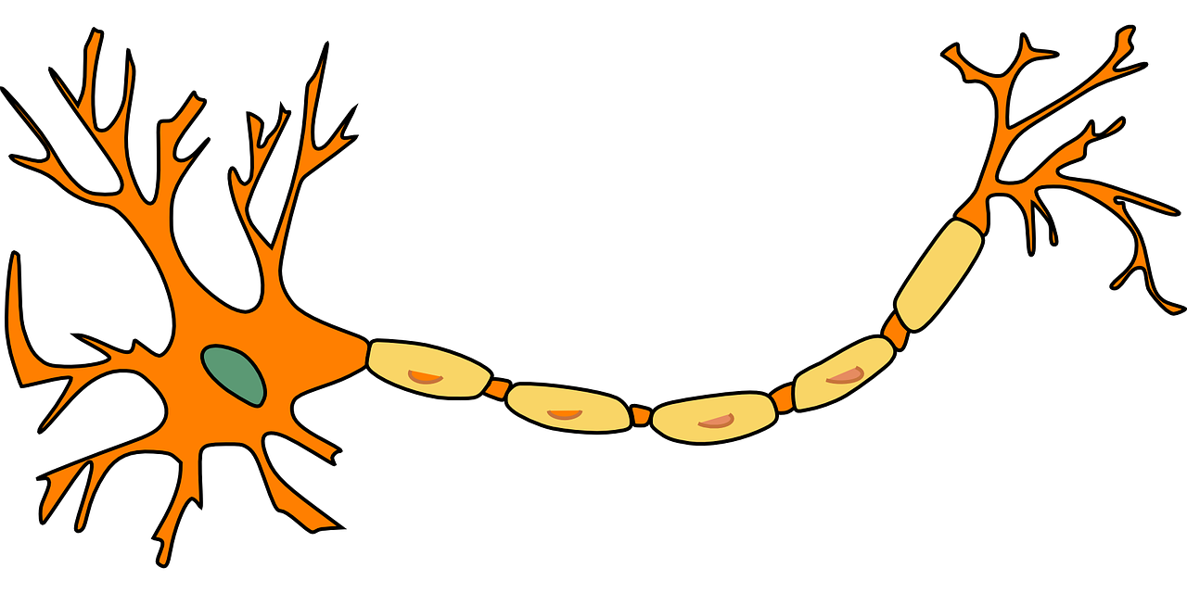
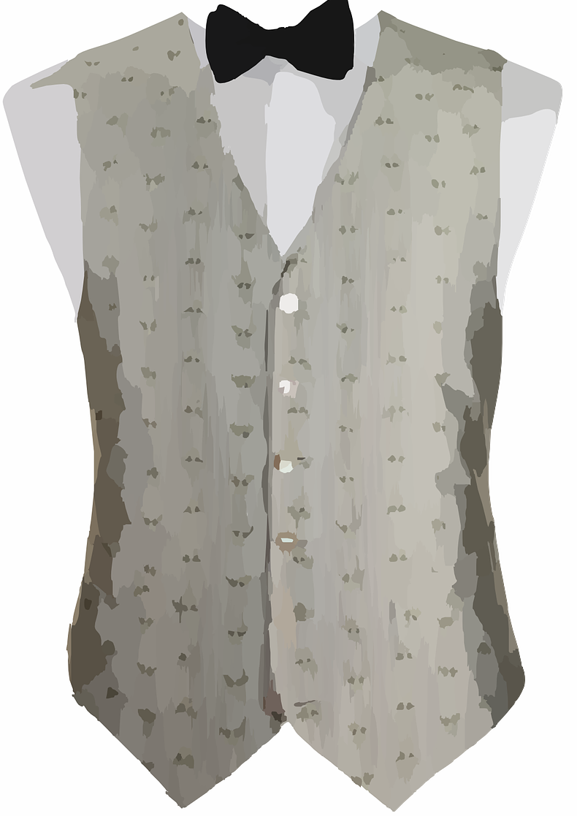
[v]
Comparing [v] and [w]
Hör zu. Ist das [v] oder [w]?
Write numbers 1-8. Listen and note down the missing sound in each word.
 | [v] oder [w]? | English?
1 | W i n t e r | [winter]
2 | m a s s i v | [massive]
3 | N e r v | [nerve]
4 | W e s t e | [vest, waistcoat]
5 | W i n d | [wind]
6 | v o l l | [full]
7 | p o s i t i v | [positive]
8 | V o l k s w a g e n | [‘people’s car’]
?
?
?
?
Notice that some words look very like the English but sound quite different!
?
?
?
?
?
Notes:
Timing: 5 minutes
Aim: to consolidate aural recognition of the SSC [v] by contrasting it with the SSC [w].
Procedure:
1. Pupils write down numbers 1-8 and will write [v] or [w] or both for each item.
2. Play the audio by pressing the buttons 1-8.
3. Elicit answers and click to reveal missing letter(s).
4. Discuss meanings of 8 words and click to reveal English definitions one by one. Draw attention to the fact many words look like the English but sound different. Encourage pupils to pronounce all of the words.
NOTE: Pupils may already have some idea how to pronounce Volkswagen, but encourage them to have a go with their new knowledge about pronunciation of [v] and [w].
Transcript:
Winter
massiv
Nerv
Weste
Wind
voll
positiv
Volkswagen
Word frequency:
massiv [1763] Nerv [2211] positiv [516] voll [388] Weste [>5000] Wind [1124] Winter [1206] Volkswagen [N/A]
Jones, R.L & Tschirner, E. (2019). A frequency dictionary of German: Core vocabulary for learners. London: Routledge.

Slide 7
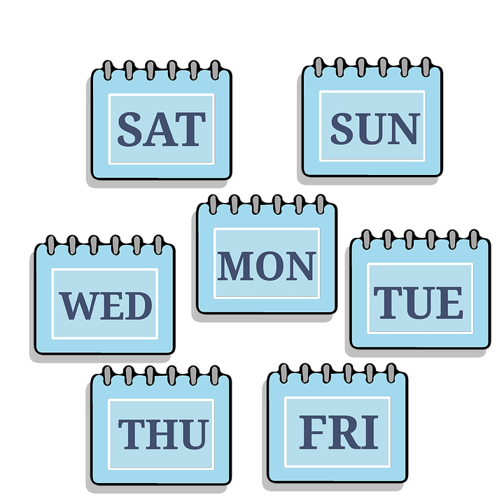
Vokabeln
Vokabeln lernen
Wörter
Sag die Wörter.
der Tag
heute
[day]
[today]
die Woche
morgen
[week]
Notes:
Timing: 2 minutes
Aim: to present and practise 4 new items of vocabulary for this week.
Procedure:
Click for each new word to appear, then again for the supporting picture and English to appear. Explain that today pupils will be learning days of the week, and they will see the words ‘Tag’ and ‘Woche’ appear in them.
Practise repeating the words as a whole class.
7

Slide 8
Vokabeln
Vokabeln lernen
Wörter
Was ist das auf Englisch? Und auf Deutsch?
der T_ _
day
_ eu _ _
_ _d _ y
der Tag
d _ _
heute
today
die W_ _ _e
die Woche
_ ee _
week
m_ _ _e_
tomorrow
morgen
t _ _ o _ _ o _
Notes:
Timing: 2 minutes
Aim: to consolidate understanding of 4 new items of vocabulary for this week.
Procedure:
Pupils try to recall the English orally (chorally), looking at the German and the gapped English.
Click to reveal the full English words one by one.
Next click to make the full German words disappear and the gapped versions to appear.
Pupils try to recall the German, looking at the English and the gapped German.
8

Slide 9
Vokabeln
Vokabeln lernen
Wörter
Sag die Wochentage.*
Montag
[Monday]
Both of these words end with the word ‘Tag’. Can you remember what that means?
This day is a little different. Can you work out the literal translation?
Dienstag
[Tuesday]
Mittwoch
Mitte= middle
Woche= week
*der Tag=day
die Woche=week
Wochentage=days of the week
[Wednesday]
Notes:
Timing: 2 minutes
Aim: to introduce the days of the week.
Procedure:
Click for each new day to appear, with its English translation.
Practise repeating the words as a whole class.
Click to bring up the call-outs relating to the words ‘Tag’ and ‘Woche’, and finally ‘Wochentage’.
9

Slide 10
Was sagt Herr Lehmann?
Heute ist…
lesen
Montag.
Dienstag.
Mittwoch.
Monday
Notes:
Timing: 2 minutes (3 slides)
Aim: to practise written comprehension and read aloud of the new vocabulary so far.
Procedure:
Teacher initiates the phrase: Heute ist…
Pupils respond orally with the correct word, based on the English clue.
Teacher clicks to confirm the answer.
Repeat for the next slides.
10

Slide 11
Was sagt Herr Lehmann?
Heute ist…
lesen
Montag.
Dienstag.
Mittwoch.
Wednesday
Notes:
[2/3]
11

Slide 12
Was sagt Herr Lehmann?
Heute ist…
lesen
Montag.
Dienstag.
Mittwoch.
Tuesday
Notes:
[2/3]
12

Slide 13
Vokabeln
Vokabeln lernen
Wörter
Sag die Wochentage.
Donnerstag
[Thursday]
Days of the week always have capital letters because they are nouns.
Freitag
All of these words end in the word ‘Tag’ too.
[Friday]
Samstag
[Saturday]
Sonntag
[Sunday]
Notes:
Timing: 2 minutes
Aim: to introduce the remaining days of the week.
Procedure:
Click for each new day to appear, with its English translation.
Practise repeating the words as a whole class.
Click to bring up the call-outs relating to the word ‘Tag’ and capital letters.
13

Slide 14
Vokabeln
Vokabeln lernen
Wörter
Sag die Wörter.
Dienstag
Freitag
[Tuesday]
[Friday]
Think carefully about how to pronounce these two days of the week.
This is the ie sound, as in the words Liebe, sie and Brief.
This is the ei sound, as in the words ein, sein and klein.
Notes:
Timing: 1 minute
Aim: to recap the SSC [ie] and [ei] in context of days of the week.
Procedure:
Click to bring up the callouts relating to pronunciation.
Practise repeating the words as a whole class.
14

Slide 15
Was sagt Herr Lehmann?
Heute ist…
lesen
Donnerstag.
Freitag.
Samstag.
Friday
Sonntag.
Notes:
Timing: 2 minutes (3 slides)
Aim: to practise written comprehension and read aloud of the new vocabulary so far.
Procedure:
Teacher initiates the phrase: Heute ist…
Pupils respond orally with the correct word, based on the English clue.
Teacher clicks to confirm the answer.
Repeat for the next slides.
15

Slide 16
Was sagt Herr Lehmann?
Heute ist…
lesen
Donnerstag.
Freitag.
Samstag.
Sunday
Sonntag.
Notes:
[2/3]
16

Slide 17
Was sagt Herr Lehmann?
Heute ist…
lesen
Donnerstag.
Freitag.
Samstag.
Thursday
Sonntag.
Notes:
[3/3]
17

Slide 18
Wochentage
Was ist das auf Englisch? Was ist das auf Deutsch?
Can you find the matching pairs?
Freitag
Saturday
Tuesday
Donnerstag
Sonntag
Sunday
Thursday
Montag
Monday
Friday
Samstag
Dienstag
Wednesday
Mittwoch
Notes:
Timing: 5 minutes
Aim: to consolidate pupils’ understanding of the days of the week.
Procedure:
Explain the task. This is a memory game to find matching pairs – a day of the week in German and its English translation.
Pupils suggest two “cards” to reveal. The teacher clicks on those cards. If the cards match, the teacher leaves them revealed. If the cards don’t match, the teacher clicks again to hide the days.
Pupils suggest another two cards, and try to remember what was behind the previous two cards!
Continue play until all matching pairs have been found.

Slide 19
Sechseläuten
In Zurich, on the third Monday in April, people celebrate the start of summer with the Sechseläuten festival.
Freitag
Every year, a different area of Switzerland is invited to come to Zurich and take part. On the Friday before Sechseläuten there is a funfair and the invited Canton brings food and music!
Monday is the highlight of the festival! There is another parade, and people set fire to the Böögg. The Böögg is a big snowman that represents winter. The faster the snowman burns, the better the summer weather is predicted to be!
Samstag
There aren’t any special events on Saturday.
On Sunday, people dress up and there is a parade.
Sonntag
Montag
Notes:
Timing: 3 minutes
Aim: to familiarise pupils with a Swiss cultural tradition and to further practise days of the weeks.
Procedure:
1. Click for information to appear for each day of the festival. Pupils might like to share their own experience or make contrasts with celebrations in other countries.
Image attribution:
Böögg By © Roland Fischer, Zürich (Switzerland) – Mail notification to: roland_zh(at)hispeed(dot)ch / Wikimedia Commons, CC BY-SA 3.0, https://commons.wikimedia.org/w/index.php?curid=32413108
Funfair at Lindenhof hill By Roland zh - Own work, CC BY-SA 3.0, https://commons.wikimedia.org/w/index.php?curid=10045936
Parade at Limmatquai By Roland zh - Own work, CC BY-SA 3.0, https://commons.wikimedia.org/w/index.php?curid=10064693

Slide 20
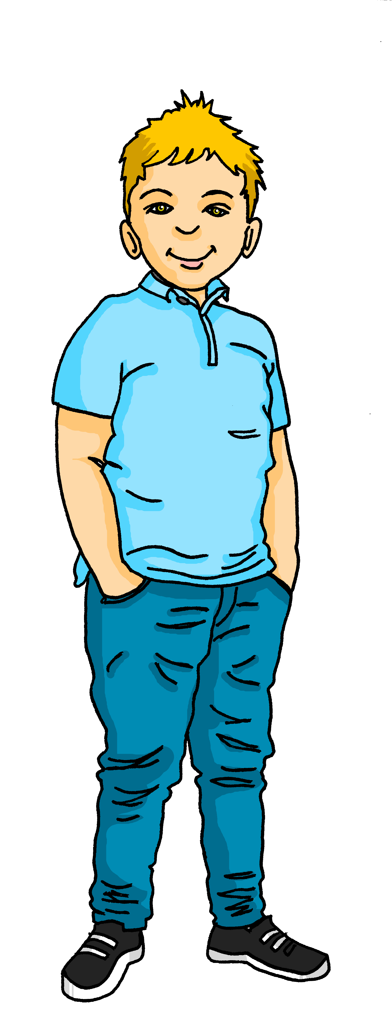
Lias Woche
Hör zu. Was sagt Lias?
Lias and Ronja are going to Zurich for Sechseläuten.
Lias messages Gabriel about his week.
hören
Heute ist Dienstag. Ich bin in Biel.
Morgen ist Donnerstag. Ich bin zu Hause.
Heute ist Freitag. Ich bin in Zurich! Hurra!
Heute ist Sonntag. Heute ist wunderbar.
Morgen ist Montag. Mein Lieblingstag!
__1__
__3__
__5__
__7__
__9__
__2__
__4__
__6__
__8__
__10__
Today is Tuesday. I am in Biel.
Tomorrow is Thursday. I am at home.
Today is Friday. I am in Zurich! Hurrah!
Today is Sunday. Today is wonderful.
Tomorrow is Monday. My favourite day!
Notes:
Timing: 5 minutes
Aim: to practise aural comprehension of days of the week, today and tomorrow.
Procedure:
Explain the task. Lias is sending Gabriel voice messages and photos from his week.
Pupils write 1-10 in their books.
Click on the first audio button to hear what Lias says. Pupils fill in the gaps based on what they hear. They transcribe the German word they have heard and then write the English translation for that word.
Click to reveal answers (first the German gaps appear, and then a full English translation).
Transcript:
[1] Heute ist Dienstag. Ich bin in Biel.
[2] Morgen ist Donnerstag. Ich bin zu Hause.
[3] Heute ist Freitag. Ich bin in Zurich. Hurra!
[4] Heute ist Sonntag. Heute ist wunderbar.
[5] Morgen ist Montag. Mein Lieblingstag!

Slide 21
Mach Sätze!
sprechen
Heute ist…
Morgen ist…
Montag
Dienstag
Mittwoch
Donnerstag
Freitag
Samstag
Sonntag
Mein Lieblingstag ist…
Notes:
Timing: 3 minutes
Aim: to use days of the week and the other new vocab from this week orally in full sentences.
Procedure:
Click to bring up the first sentence-starter: Heute ist…
Pupils complete the sentences orally with whatever day it is today!
Repeat for the next two sentence starters (tomorrow and favourite day of the week).
Repeat with pupils working in pairs to tell each other the day today, tomorrow and their own favourite day.
21

Slide 22
Montag
Notes:
Timing: 4 minutes (seven slides)
Aim: to practise reading aloud the days of the week once again, cuing pupils with hand gestures to represent the number of each day.
Procedure:
Use hand gesture and (1-7 for days of the week) in combination with oral production of day of the week & get pupils to repeat.

Slide 23
Dienstag
Notes:
[2/7]

Slide 24
Mittwoch
Notes:
[3/7]

Slide 25
Donnerstag
Notes:
[4/7]

Slide 26
Freitag
Notes:
[5/7]

Slide 27
Samstag
Notes:
[6/7]

Slide 28
Sonntag
Notes:
[7/7]

Slide 29
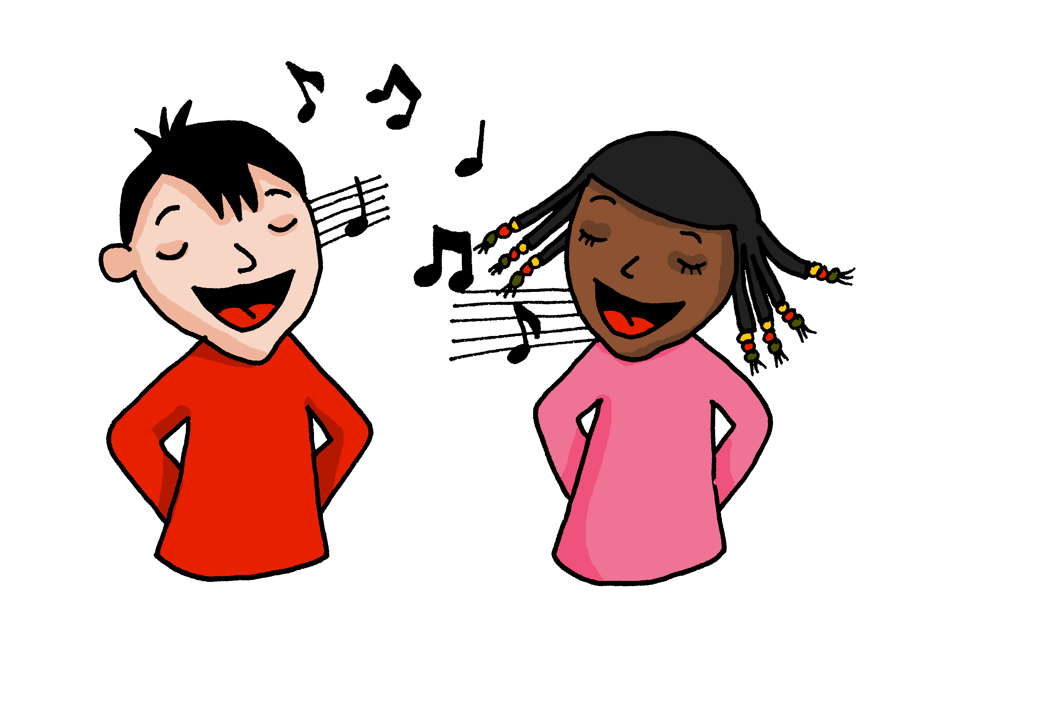
Die Wochentage!
singen
Sing mit!
Notes:
OPTIONAL
Timing: 5 minutes
Aim: to practise oral production of the days of the week (in a song that constrains the time and helps to speed up production).
Procedure:
Click to play the song.
Encourage pupils to join in when they can.
Link to song:
https://www.youtube.com/watch?v=RjlfcpVBBNw
Notes: i) the song is just the days (repeated over and over) but the tune is catchy after a while and the harmonies make it not unpleasant to listen to, despite the minion-type voices!
ii) we recommend opening the link in a separate window just prior to the start of the lesson and playing through the adverts, leaving the song paused at the start ready to go, when needed.

Slide 30
Auf Wiedersehen!
hören
sprechen
lesen
schreiben
Notes:
Timing: 1 minute
Aim: to recap four infinitive verbs as part of essential classroom language.
Procedure:
Remind pupils of the meanings and pronunciations of these four verbs.
Repeat them with the class.
Ask them to tell you which of these activities they have done this lesson.
Say Auf Wiedersehen, die Klasse! and explain the meaning of the words/phrase. Encourage pupils to respond and say ‘Auf Wiedersehen’ in response, perhaps with a ‘farewell wave’ gesture.

Slide 31
Tschüss!
gelb
Notes:
31

