Slide 1
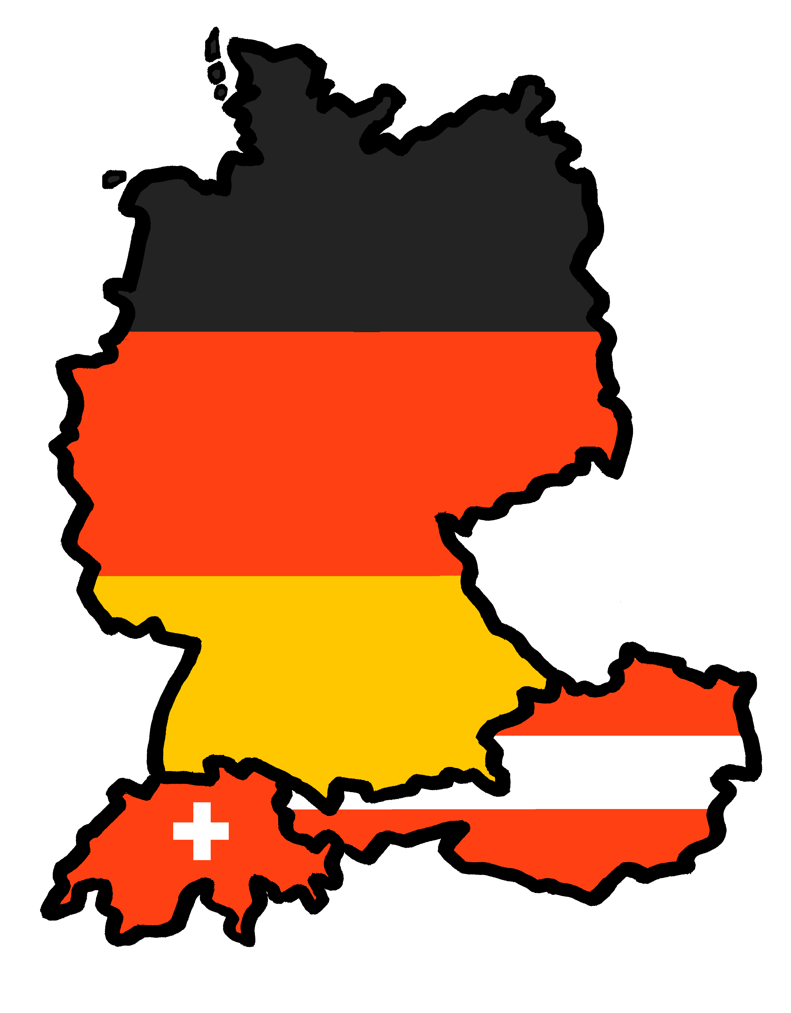
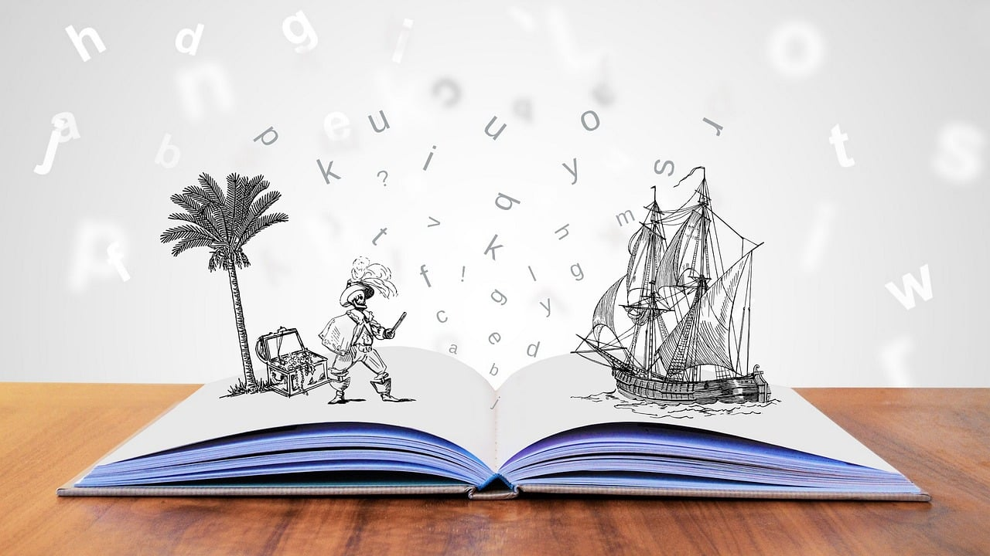
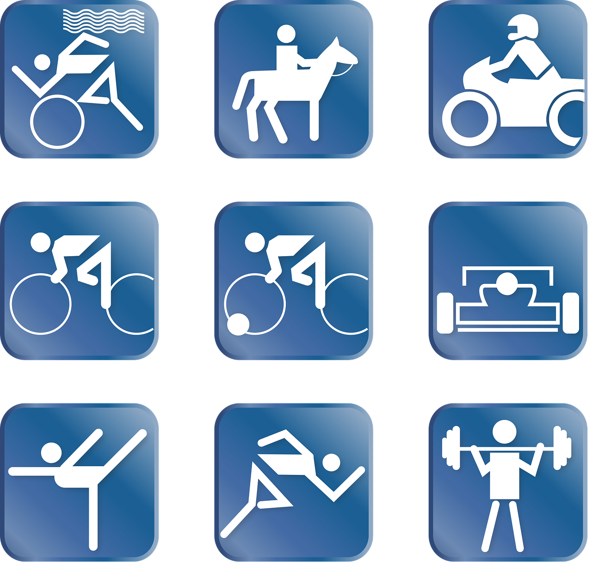
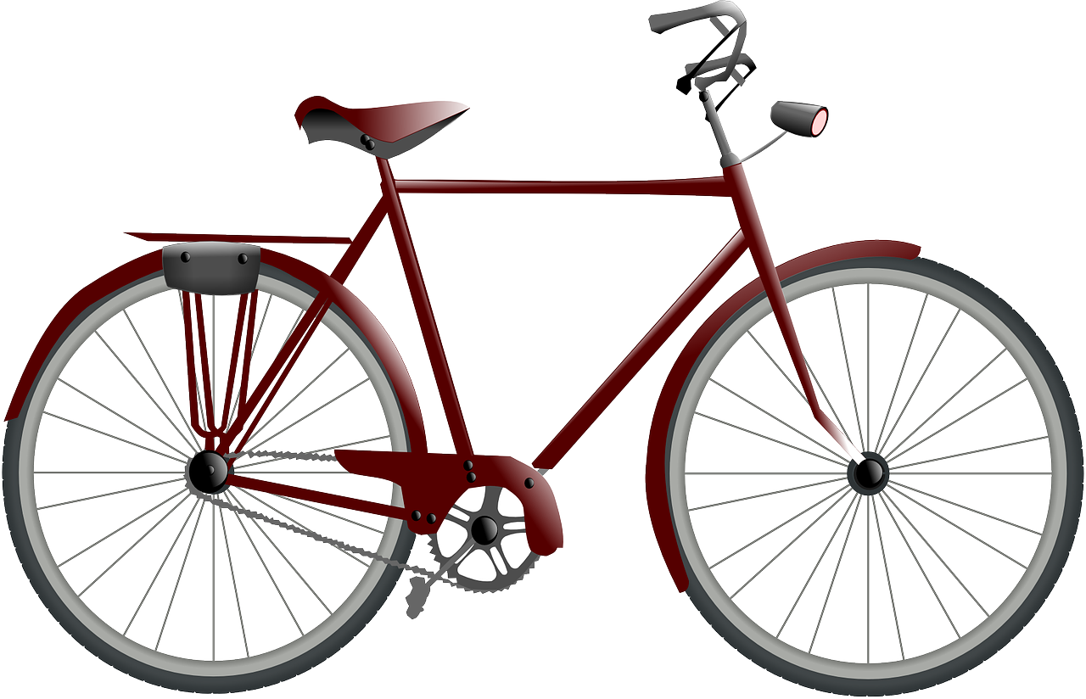
Talking about activities and events
Montag
Freitag
Dienstag
Samstag
Mittwoch
Sonntag
Donnerstag
gelb
Follow ups 1-5
Term 3 Week 2
Notes:
Artwork by Steve Clarke. Pronoun pictures from NCELP (www.ncelp.org). All additional pictures selected from Pixabay and are available under a Creative Commons license, no attribution required.
Phonics:
consonantal [r] rot [477] drei [106] rechts [829] Frage [157] warum? [192]
vocalic [r] Ort [341] Uhr [348] Tier [614] lernen [288] Farbe [1079]
Vocabulary: arbeiten [234] Grund [249] mit [13]
Revisit 1: Nummer [806] null [1680] eins [774] zwei [70] drei [106] vier [200] fünf [274] sechs [428] sieben [611] acht [645] neun [1053] zehn [333] elf [1507] zwölf [1080] es gibt [n/a]
Revisit 2: Wer? [149] haben, ich habe, er, sie, es hat [6] Baum [1013] Computer [1252] Fahrrad [2138] Papier [1163] Spiel [328]
Jones, R.L & Tschirner, E. (2019). A frequency dictionary of German: Core vocabulary for learners. London: Routledge.
The frequency rankings for words that occur in this PowerPoint which have been previously introduced in these resources are given in the SOW and in the resources that first
introduced and formally re-visited those words.
For any other words that occur incidentally in this PowerPoint, frequency rankings will be provided in the notes field wherever possible.
Note that the first three lessons of the year teach language that can be continuously recycled as lesson routine every lesson in Y3/4.
The idea would be that the class teacher (whether or not s/he teaches the class German can re-use the language as part of the daily routine with the class.

Slide 2
aussprechen
[r]
…
[r] before a vowel is a roll from the back of your throat. Open your mouth, tongue flat, lips still and growl ‘rrrr’.
Touch your throat and feel the vibration!
rot
Notes:
Timing: 1 minute
Aim: to introduce the SSC [r] before a vowel.
Procedure:
Introduce the SSC and present the source word ‘rot’ (with gesture, if using).
Click to bring on the picture and get pupils to repeat the word ‘rot’ (with gesture, if using).
Note:
a gesture for ‘rot’ might be to hold up some red classroom items e.g. a pen/book/flag/clothing.
2

Slide 3
aussprechen
[r]
…
3
Why?
warum?
drei
rot
?
Frage
rechts
[question]
Notes:
Timing: 1 minute
Aim: to consolidate the SSC [r] before a vowel.
Procedure:
Re-present the SSC and the source word ‘rot’ (with gesture, if using).
Click to bring on the picture and get pupils to repeat the word ‘rot’ (with gesture, if using).
Present the cluster words in the same way, bringing on the picture and getting pupils to pronounce the words.
Word frequency: rot [477] drei [106] rechts [829] Frage [157] warum? [192]
Jones, R.L & Tschirner, E. (2019). A frequency dictionary of German: Core vocabulary for learners. London: Routledge.
3

Slide 4
aussprechen
[r]
…
[r] after a vowel sounds like ‘uh’!
Ort
[place]
Notes:
Timing: 1 minute
Aim: to consolidate the SSC [r] after a vowel
Procedure:
Re-present the SSC and the source word ‘Ort’ (with gesture, if using).
Click to bring on the picture and get pupils to repeat the word ‘Ort’ (with gesture, if using).
Note:
a gesture for ‘Ort’ might be to point to a particular place on a map.

Slide 5
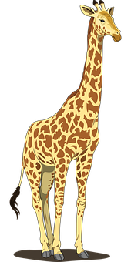
aussprechen
[r]
…
Farbe
lernen
Ort
[place]
When ‘h’ follows a vowel, it makes a long vowel sound.
Uhr
Tier
[clock, watch, o’clock]
Notes:
Timing: 1 minute
Aim: to consolidate the SSC [r] after a vowel
Procedure:
Re-present the SSC and the source word ‘Ort’ (with gesture, if using).
Click to bring on the picture and get pupils to repeat the word ‘Ort’ (with gesture, if using).
Present the cluster words in the same way, bringing on the picture and getting pupils to pronounce the words.
Note: ‘Uhr’ is a slight exception as the ‘r’ does not directly follow the vowel. However, ‘h’ following a vowel makes a long vowel sound, so the ‘r’ sound here is the same as after a vowel.
Word frequency: Ort [341] Uhr [348] Tier [614] lernen [288] Farbe [1079]
Jones, R.L & Tschirner, E. (2019). A frequency dictionary of German: Core vocabulary for learners. London: Routledge.

Slide 6
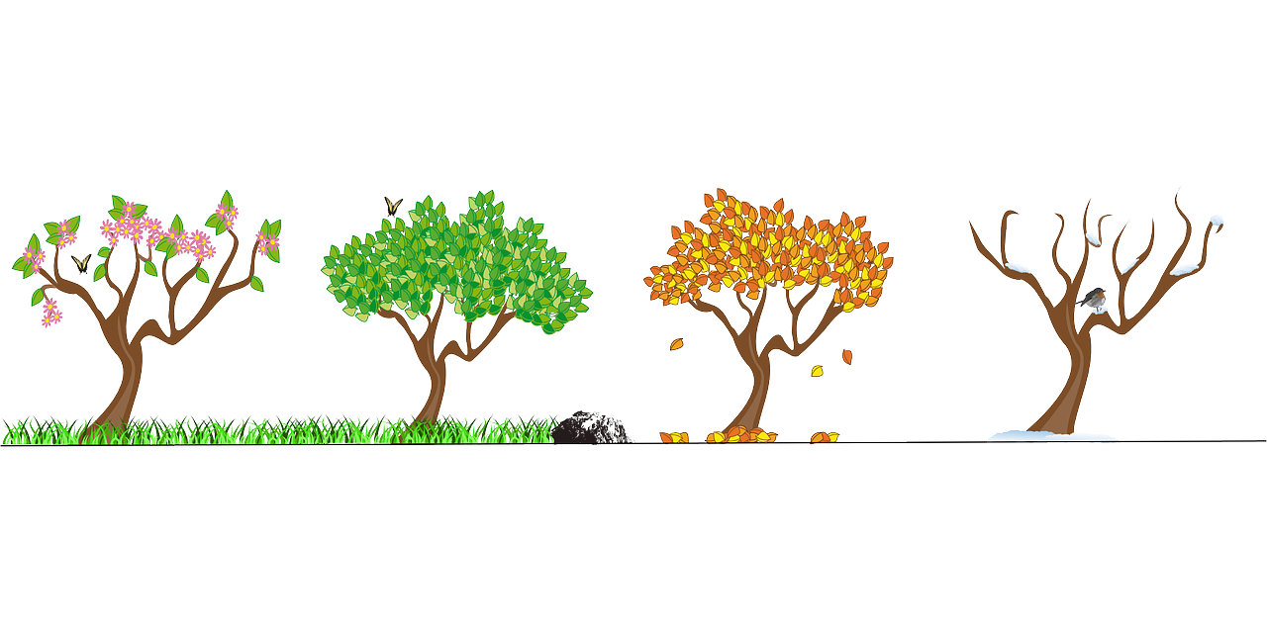
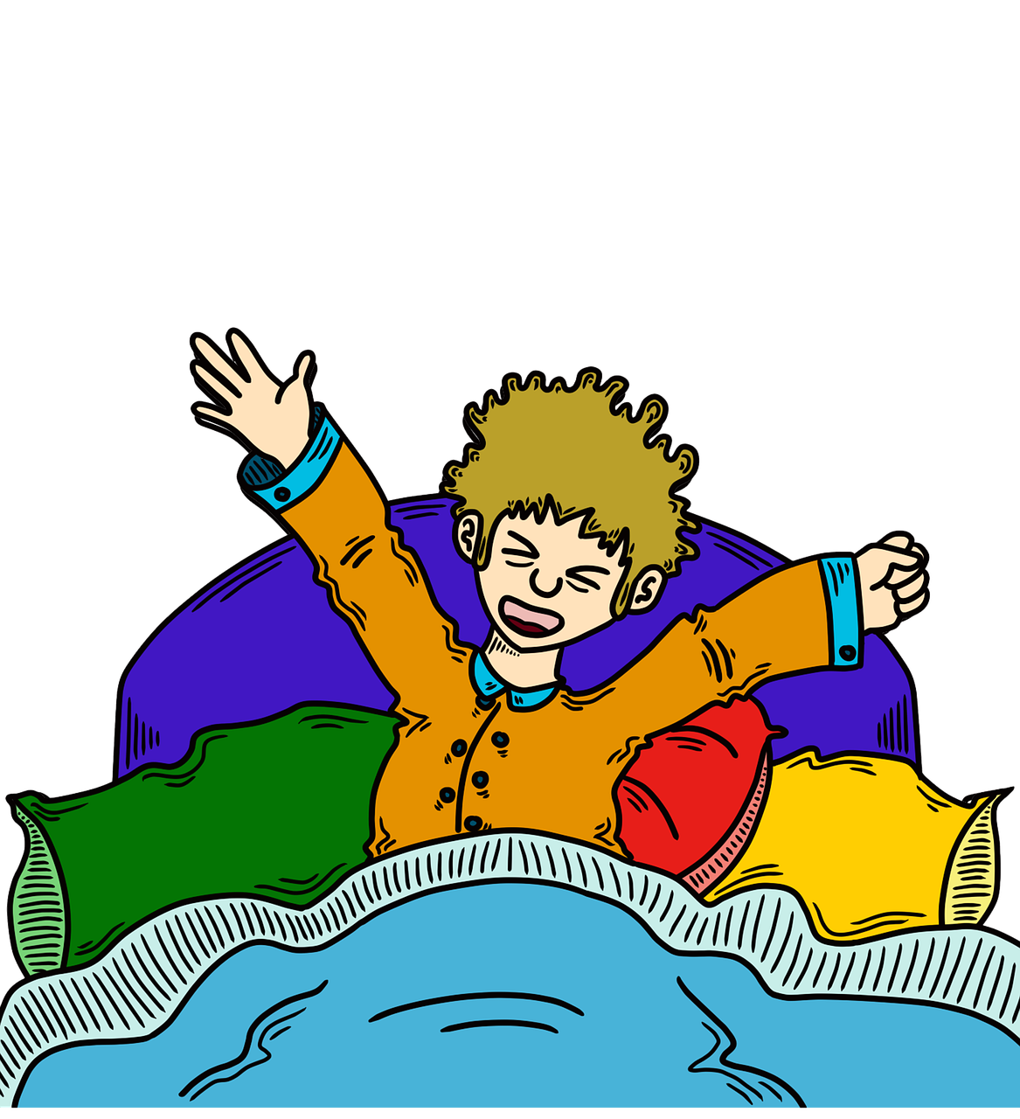
Follow up 1 [r] like ‘rot’ or [r] like ‘Ort’? Which word is the odd one out in each row?
aussprechen
1
1 | Frau | wahr | Freitag
2 | nur | morgen | April
3 | mehr | hören | rund
4 | Jahr | Frage | kurz
5 | klar | sprechen | Paar
6 | Prozent | früh | warten
60
2
3
[more]
S
4
5
6
0
START
Notes:
Timing: 5 minutes
Aim: to practise applying knowledge of [r] before and after a vowel.
Procedure: 1. Remind pupils about the two ways of pronouncing [r]: before and after a vowel.
2. Ask pupils to work in pairs to find the Odd One Out in each row, based on the pronunciation of the [r].
3. Click to bring up answers and discuss as a class. 4. Ask pupils to try and pronounce all 18 words against the 60 second timer.
5. Check pronunciation by pressing the blue numbers (optional).
Transcript:
Frau, wahr, Freitag
nur, morgen, April
mehr, hören, rund
Jahr, Frage, kurz
klar, sprechen, Paar
Prozent, früh, warten
Word frequency:
April [1004] Frage [157] früh [366] Jahr [53] kurz [176] mehr [52] nur [39] Paar [241] Prozent [172] warten [364]
Jones, R.L & Tschirner, E. (2019). A frequency dictionary of German: Core vocabulary for learners. London: Routledge.

Slide 7
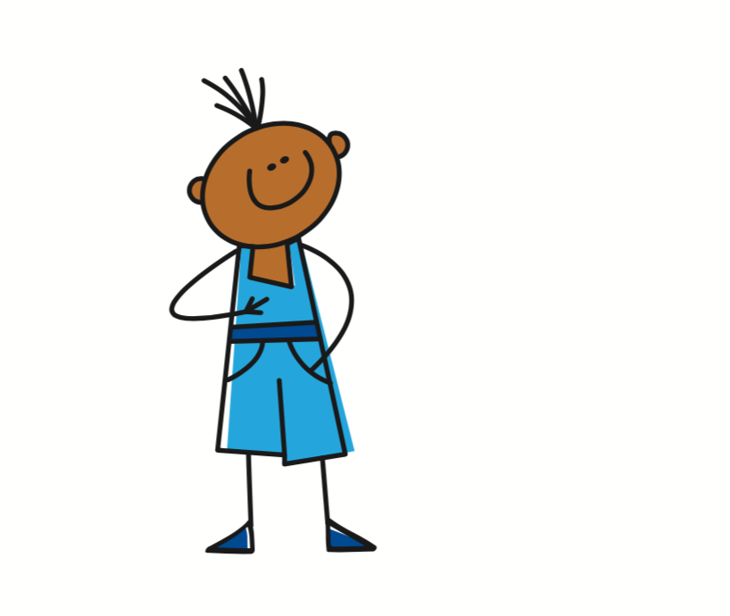
Time adverbs
Compare the word order:
Ich arbeite dienstags mit Lias.
I work with Lias on Tuesdays.
In German the time adverb often comes straight after the verb.
Du benutzt donnerstags das Fahrrad.
You use the bike on Thursdays.
In English the time adverb often comes at the end of the sentence.
Notes:
Timing: 2 minutes
Aim: to demonstrate the different relative positions of time adverbs in German and English.
Procedure:
Click through the animations to present the information.
Elicit English translation for the German examples provided.
7

Slide 8
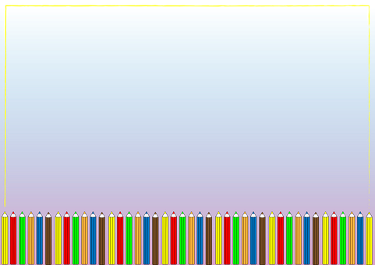
Follow up 2
Hör zu. Was macht Ronja?
Ronja is describing her after-school and weekend activities. Can you listen and fill in her weekly planner?
Can you work out what these abbreviations mean?
1
Ronjas Woche
MO. | DI. | MI. | DO. | FR. | SA. | SO.
Schule | Schule | Schule | Schule | Schule
2
3
4
5
Ich brauche mein Fahrrad.
Ich bekomme einen Brief
Ich benutze den Computer
Ich schreibe eine Geschichte
6
Ich arbeite mit Lias
Ich mache Sport
Ich spiele ein Spiel
7
Notes:
Optional handout at end of presentation
Timing: 5-10 minutes
Aim: to practise aural comprehension of a range of 1st person present tense verbs and time adverbs.
Procedure:
Draw attention to the abbreviated days of the week across the top of the timetable.
Pupils are going to listen and try to fill in Ronja’s activity planner, but the activities will not be given in order. They need to pay attention to the day of the week adverbs to identify when she does each activity.
Play audio number 1. On first listening, pupils should identify the day and draw a quick sketch or make a quick note of the activity in English in the correct box.
On second listening, pupils should try to transcribe the German.
Repeat for all 7 items.
NOTE: If no handout is used, pupils could either quickly copy down the days of the week and fill in their own version, or write numbers 1-7 and note down the day of the week each time as well as the activity.
Additional Activities:
1. Pupils could write sentences about Ronja in the 3rd person, using the information they have found out e.g. Sie macht donnerstags Sport.
Transcript:
Ich mache donnerstags Sport.
Ich arbeite montags mit Lias.
Ich benutze samstags den Computer. Samstag ist mein Lieblingstag!
Ich spiele dienstags ein Spiel.
Ich brauche mittwochs mein Fahrrad.
Ich schreibe sonntags eine Geschichte.
Ich bekomme freitags einen Brief.

Slide 9
Follow up 3
B Translate the
sentences into German.
I write on Saturdays.
2) I am receiving a tree today.
3) You have the number today.
4) She is using the paper today.
5) He does sport on Fridays.
Schreib auf Deutsch.
A Unjumble the German sentences.
She works at home on Mondays.
arbeitet zu Hause montags sie
2) You are playing with Ronja today.
spielst du heute Ronja mit
3) There is a reason today.
heute es gibt Grund einen
4) I need a bike on Wednesdays.
ein Fahrrad ich mittwochs brauche
Remember: the time adverb needs to be placed straight after the verb, so the word order will be different to the English.
schreiben
Remember: I am receiving is the same as I receive in German. Don’t try to translate the ‘am’!
Sie arbeitet montags zu Hause.
Ich schreibe samstags.
lesen
Ich bekomme heute einen Baum.
Du spielst heute mit Ronja.
Du hast heute die Nummer.
Es gibt heute einen Grund.
Sie benutzt heute das Papier.
Ich brauche mittwochs ein Fahrrad.
Er macht freitags Sport.
Notes:
Timing: 5-10 minutes
Aim: to practise forming sentences in the first, second and 3rd person singular present tense using time adverbs.
Procedure:
Explain Section A- pupils are given the English sentences and a jumbled up German sentence. They must rewrite the German correctly. Click to bring up the call-out to remind about position of the time adverb.
Discuss number 1 as a class and click for answer. Give pupils time independently to do numbers 2-4. Click to reveal answers.
Move on to full translation in Section B. Emphasise to pupils that the verb endings for ich/du/er/sie and the time adverbs are the most important considerations here (correct spellings of other words is a bonus).
Click to bring up answers one by one. Emphasise as you do so that despite the English simple present and present continuous looking and sounding quite different, German just has the one present tense. Most common mistake here would be for pupils to try and translate ‘am’ and ‘is’ in present continuous, which we want to try and eradicate now!
Note: In Years 5/6, pupils will learn that you can start sentences with the time adverbs and invert the verb and subject (Word Order 2), but for now we are sticking to straightforward word order. If you have native pupils (or someone who has learnt a lot of German) they may find it more natural to write e.g. ‘Montags arbeitet sie zu Hause’. Additional task suggestions: 1. Pupils make their own sentences about what they do/are doing and their friends do/are doing on different days.

Slide 10
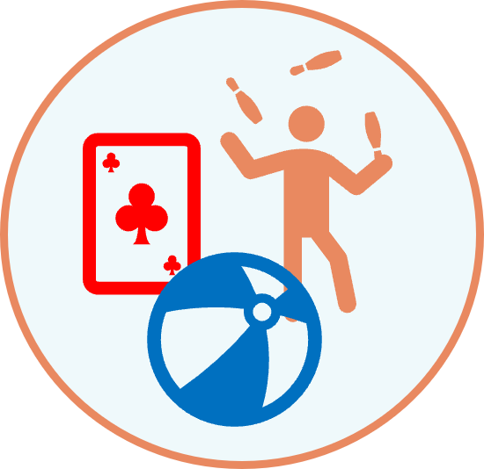
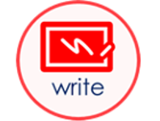
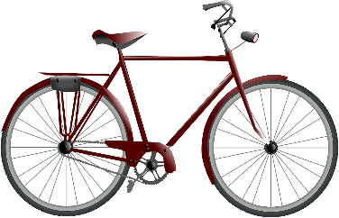
Follow up 4:
Wer bin ich?
Ronja
Jana
Mariem
Spielst du dienstags ein Spiel?
DI.
FR.
MI.
Ja!
DO.
DI.
heute
Arbeitest du freitags mit Ronja?
Lias
Leon
Gabriel
Nein!
MI.
heute
MO.
Du bist Ronja!
DO.
heute
heute
Notes:
Timing: 10 minutes
Aim: to practise oral production of second and first person weak verbs with time adverbs in the context of weekly activities.
Procedure:
Click through the model speech bubbles to explain the task.
Pupils work in pairs. Partner A secretly chooses one of the people on the board. Partner B asks questions to work out who they are.
Pupils swap roles
Depending on timing, pupils may like to repeat the task, choosing another person to be.
Additional Activities:
Pupils might like to have real conversations now about themselves using these and other verbs/activities of their choice. This could be done as a survey around the class: ‘Spielst du sonntags Spiele?’

Slide 11
Follow up 5:

Schreib auf Englisch.
Can you get at least 15 points?
Wörter
 | das Spiel | er, sie, es hat | wer?
 | haben | der Computer | der Baum
 | die Nummer | es gibt | null
 | sieben | drei | elf
 | eins | fünf | neun
 | zwölf | zwei | elf
 | arbeiten | der Grund | mit
(the) game
he, she, it has
who?
Vokabeln
x3
to have, having
(the) computer
(the) tree
(the) number
there is, there are
zero
x2
seven
three
eleven
one
five
nine
twelve
two
eleven
x1
to work, working
(the) reason
with
Notes:
Timing: 5 minutes
Aim: to practise written production of vocabulary from this and revisited weeks.
Procedure: 1. Give pupils a blank grid. They fill in the English meanings of any of the words they know, trying to reach 15 points in total.
Note: The most recently learnt and practised words are pink, words from the previous week are green and those from week 1 are blue, thus more points are awarded for them, to recognise that memories fade and more effort (heavy lifting!) is needed to retrieve them.

Slide 12
Follow up 5:

Schreib auf Deutsch.
Can you get at least 15 points?
Wörter
 | I have | (the) bicycle, bike | (the) game
 | who? | (the) tree | (the) paper
 | ten | twelve | there is, there are
 | three | one | five
 | (the) number | zero | two
 | with | (the) reason | four
 | six | to work, working | eight
ich habe
das Fahrrad
das Spiel
Vokabeln
x3
wer?
der Baum
das Papier
zehn
zwölf
es gibt
x2
drei
eins
fünf
die Nummer
null
zwei
mit
der Grund
vier
x1
sechs
arbeiten
acht
Notes:
Timing: 5 minutes
Aim: to practise written production of vocabulary from this and revisited weeks.
Procedure: 1. Give pupils a blank grid. They fill in the German meanings of any of the words they know, trying to reach 15 points in total.
Note: The most recently learnt and practised words are pink, words from the previous week are green and those from week 1 are blue, thus more points are awarded for them, to recognise that memories fade and more effort (heavy lifting!) is needed to retrieve them.

Slide 13
Tschüss!
gelb
Notes:
13

Slide 14
Follow up 2
Ronja is describing her after-school and weekend activities. Can you fill in her weekly planner?
Ronjas Woche
MO. | DI. | MI. | DO. | FR. | SA. | SO.
Schule | Schule | Schule | Schule | Schule
Notes:
HANDOUT

Slide 15
Follow up 5:

Schreib auf Englisch.
Can you get at least 15 points?
Wörter
 | das Spiel | er, sie, es hat | wer?
 | haben | der Computer | der Baum
 | die Nummer | es gibt | null
 | sieben | drei | elf
 | eins | fünf | neun
 | zwölf | zwei | elf
 | arbeiten | der Grund | mit
Vokabeln
x3
x2
x1
Notes:
Timing: 5 minutes
Aim: to practise written production of vocabulary from this and revisited weeks.
Procedure: 1. Give pupils a blank grid. They fill in the English meanings of any of the words they know, trying to reach 15 points in total.
Note: The most recently learnt and practised words are pink, words from the previous week are green and those from week 1 are blue, thus more points are awarded for them, to recognise that memories fade and more effort (heavy lifting!) is needed to retrieve them.

Slide 16
Follow up 5:

Schreib auf Deutsch.
Can you get at least 15 points?
Wörter
 | I have | (the) bicycle, bike | (the) game
 | who? | (the) tree | (the) paper
 | ten | twelve | there is, there are
 | three | one | five
 | (the) number | zero | two
 | with | (the) reason | four
 | six | to work, working | eight
Vokabeln
x3
x2
x1
Notes:
Timing: 5 minutes
Aim: to practise written production of vocabulary from this and revisited weeks.
Procedure: 1. Give pupils a blank grid. They fill in the German meanings of any of the words they know, trying to reach 15 points in total.
Note: The most recently learnt and practised words are pink, words from the previous week are green and those from week 1 are blue, thus more points are awarded for them, to recognise that memories fade and more effort (heavy lifting!) is needed to retrieve them.

