Slide 1
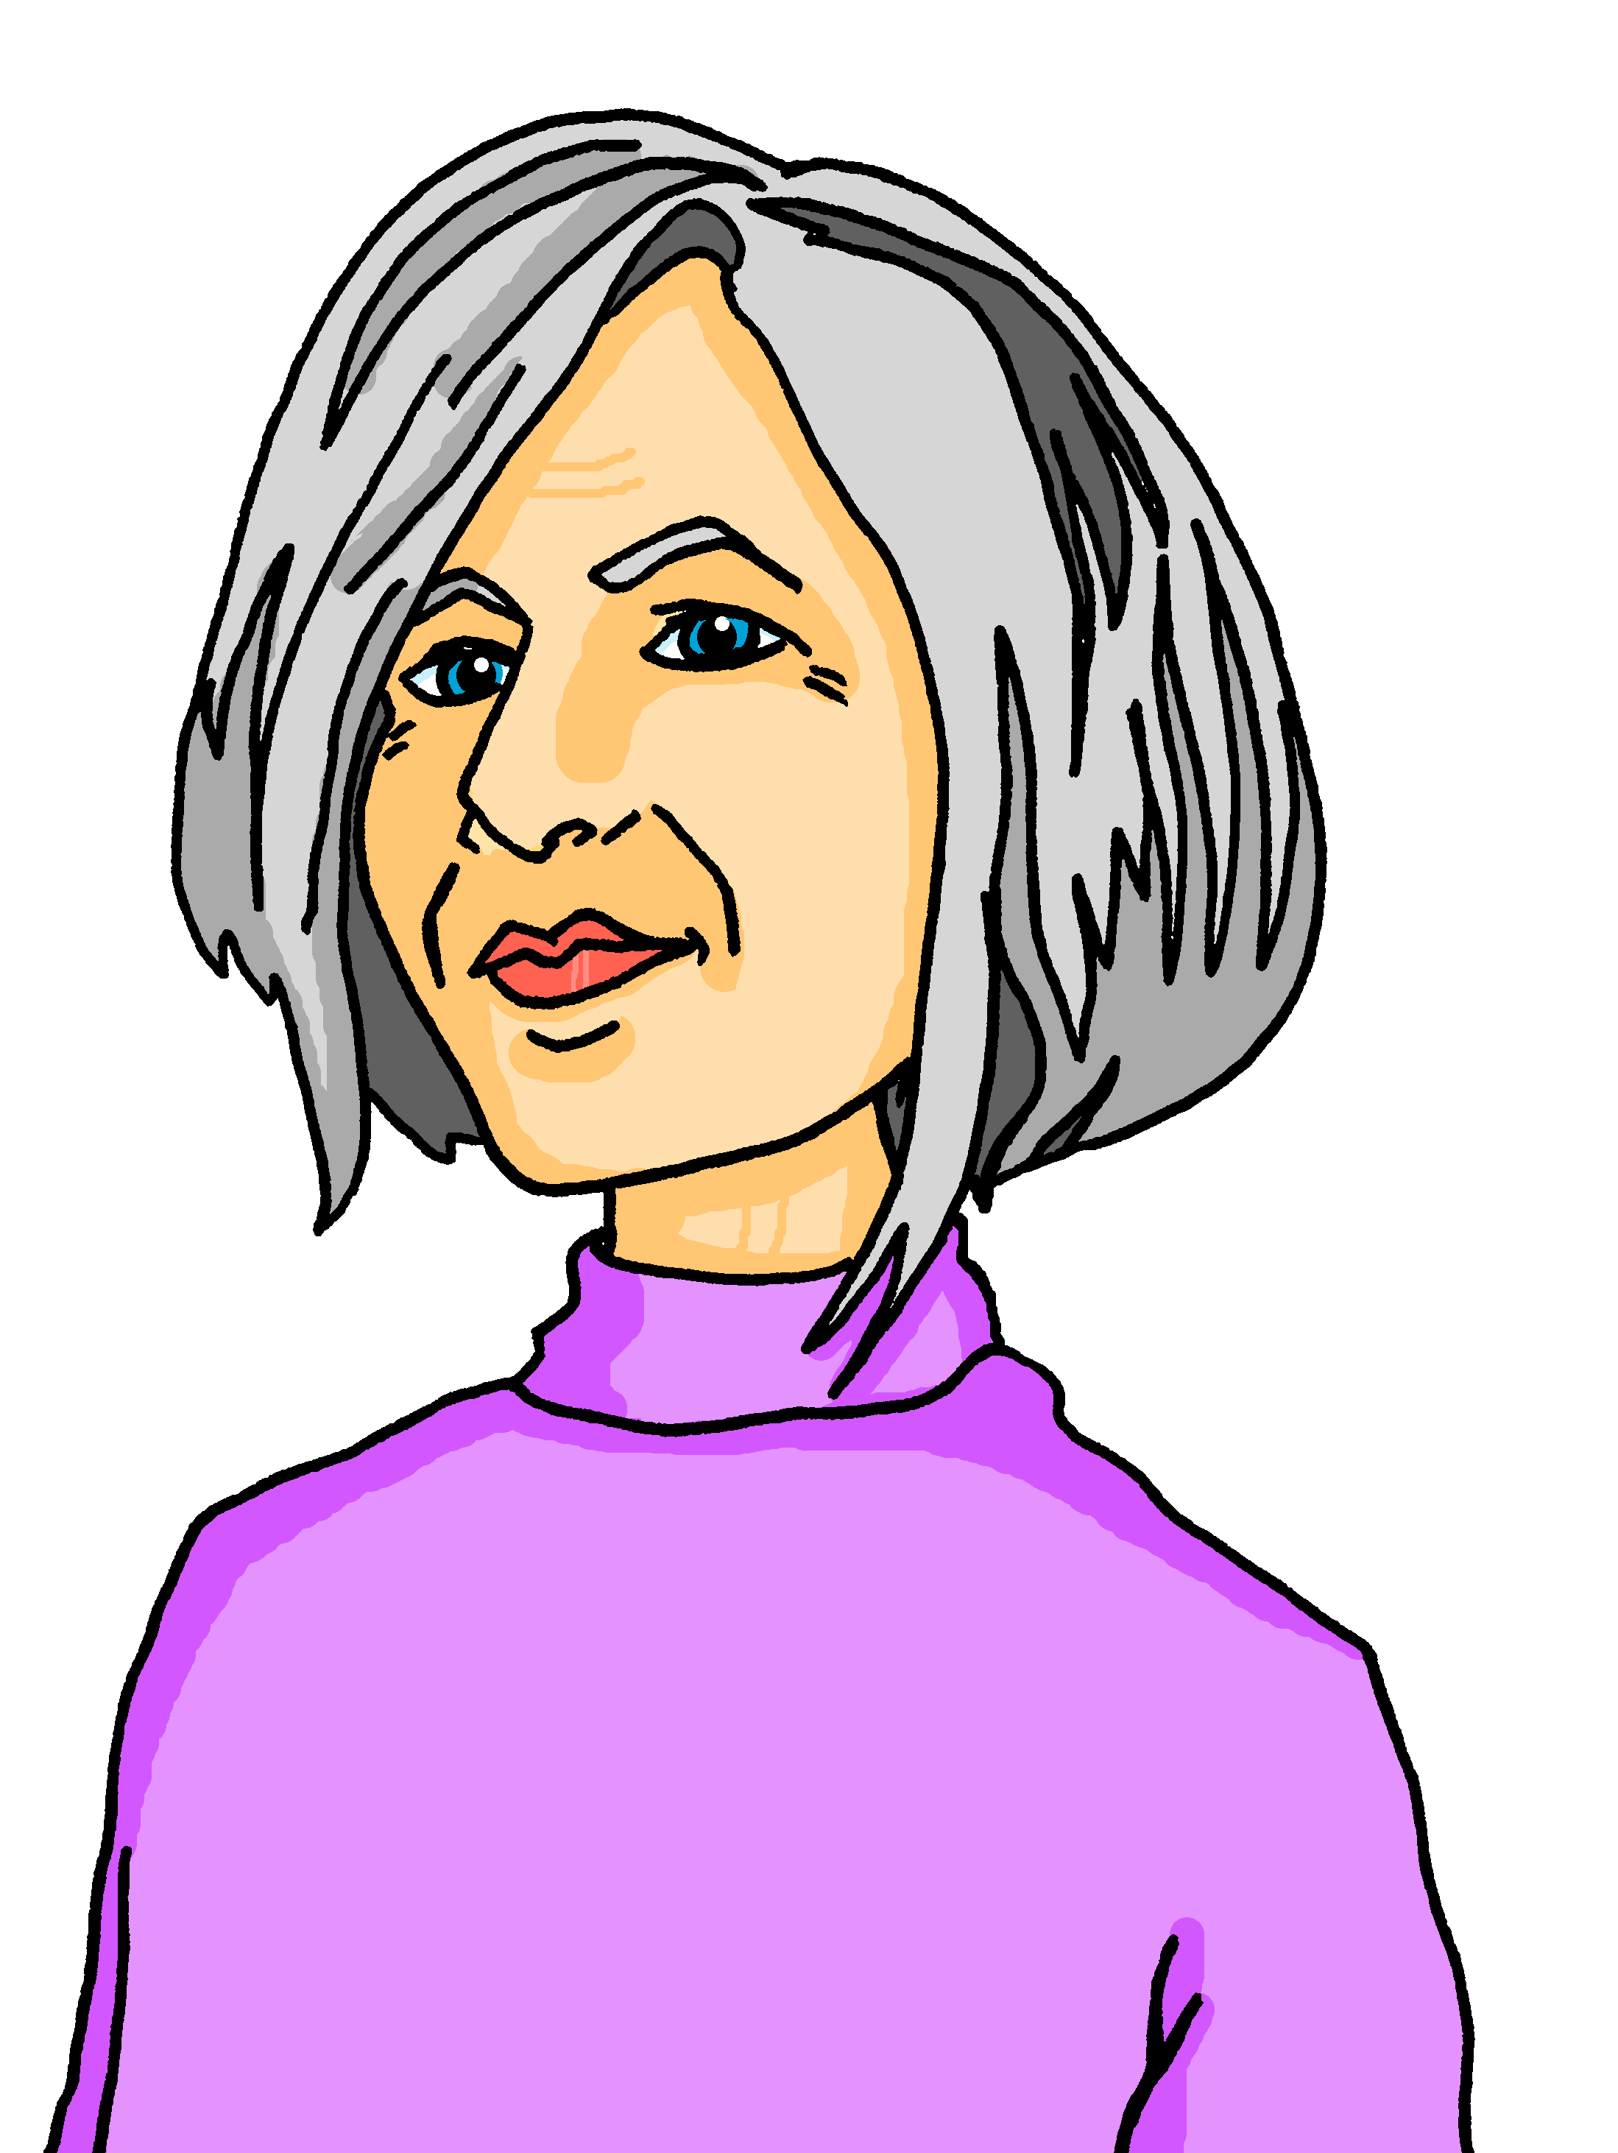
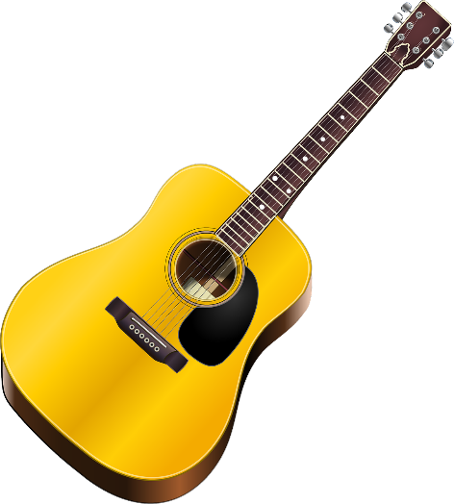
Talking about activities and events
gelb
Follow ups 1-5
Term 3 Week 3
Notes:
Artwork by Steve Clarke. Pronoun pictures from NCELP (www.ncelp.org). All additional pictures selected from Pixabay and are available under a Creative Commons license, no attribution required.
Phonics:
[er-] er [15] Konzert [2350] Person [357] schwer [256] wer? [173]
[-er] wieder [74] aber [31] oder [35] Oktober [1223] wunderbar [1603]
Vocabulary: besuchen [820] bleiben [113] Gitarre [n/a] Oma [2175]
Revisit 1: language from Term 2
Revisit 2: (du) hast [7]
Jones, R.L & Tschirner, E. (2019). A frequency dictionary of German: Core vocabulary for learners. London: Routledge.
The frequency rankings for words that occur in this PowerPoint which have been previously introduced in these resources are given in the SOW and in the resources that first introduced and formally re-visited those words.
For any other words that occur incidentally in this PowerPoint, frequency rankings will be provided in the notes field wherever possible.
Note that the first three lessons of the year teach language that can be continuously recycled as lesson routine every lesson in Y3/4.
The idea would be that the class teacher (whether or not s/he teaches the class German can re-use the language as part of the daily routine with the class.

Slide 2
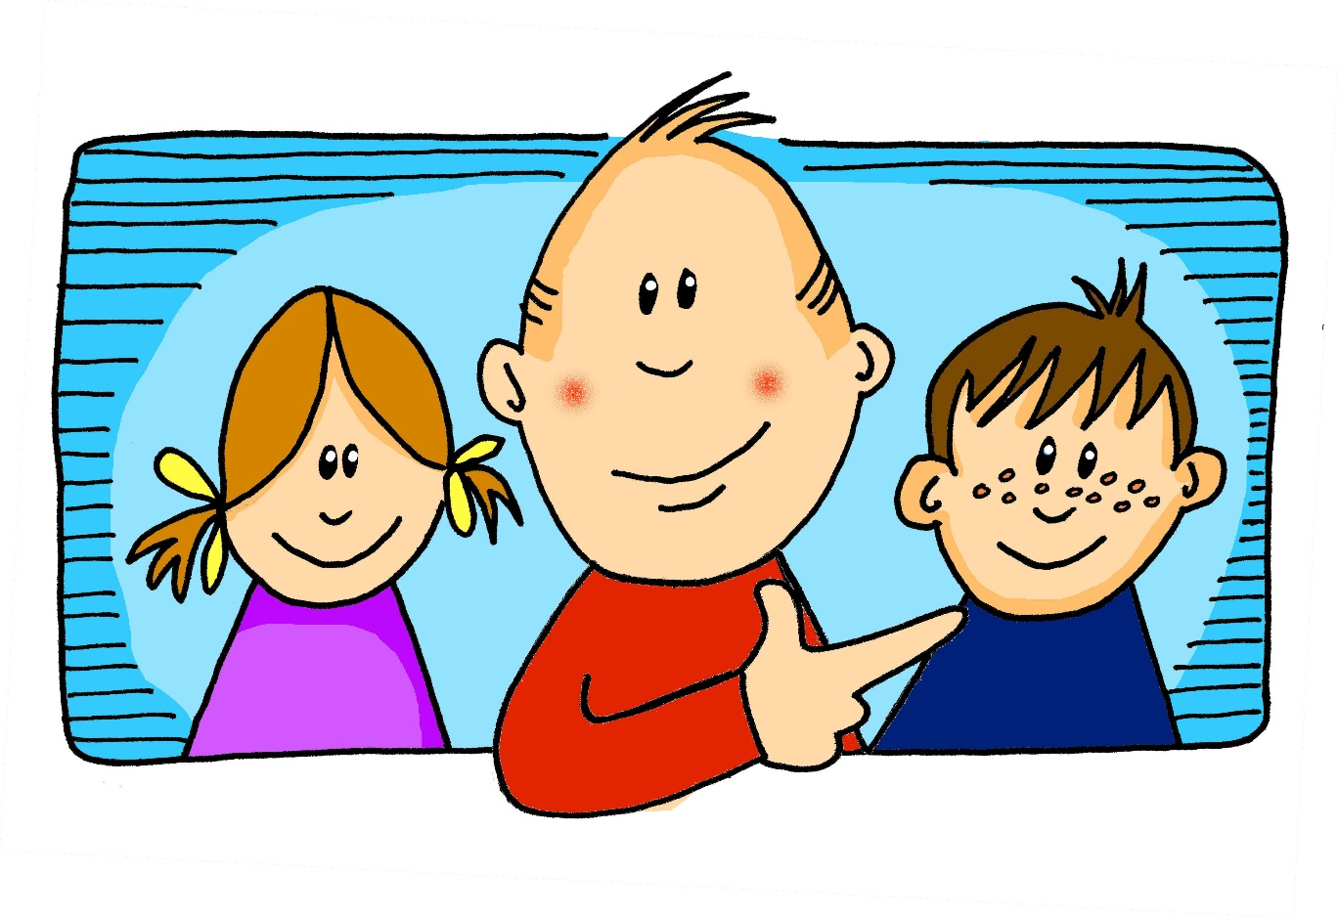
aussprechen
[er]
…
er
When the [er] is the stressed syllable, it usually sounds like two short syllables: e-uh
Remember, words are made up of different parts called syllables. A stressed syllable means the part of the word that is most emphasised when you say it aloud.
Notes:
Timing: 1 minute
Aim: to introduce/consolidate SSC [er]
Procedure: 1. Present the letter(s) and say the [er] sound first, on its own. Pupils repeat it with you. 2. Bring up the word ”er” on its own, say it, pupils repeat it, so that they have the opportunity to focus all of their attention on the connection between the written word and its sound.
3. A possible gesture for this would be to point to an imaginary ‘he’, using your index finger, thumb point upwards (to make the gesture more exaggerated), as per the image.
4. Roll back the animations and work through 1-3 again, but this time, dropping your voice completely to listen carefully to the pupils saying the [er] sound, pronouncing ”er” and, if using, doing the gesture. Word frequency (1 is the most frequent word in German): er [15] Source: Jones, R.L. & Tschirner, E. (2006). A frequency dictionary of German: core vocabulary for learners. Routledge
2

Slide 3
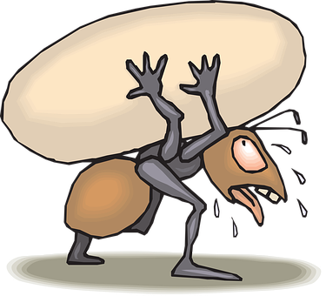
aussprechen
[er]
In all of these words, the [er] is part of the stressed syllable. This means it is emphasised or stronger than the other part of the word.
…
schwer
fertig
[heavy, difficult]
er
Konzert
wer?
Notes:
Timing: 2 minutes
Aim: to introduce/consolidate SSC [er]
Procedure:
Introduce and elicit the pronunciation of the individual SSC [er] and then the source word again ‘er’ (with gesture, if using).
Then present and elicit the pronunciation of the five cluster words.
The cluster words have been chosen for their high-frequency, from a range of word classes, with the SSC (where possible) positioned within a variety of syllables within the words (e.g. initial, 2nd, final etc.). Additionally, we have tried to use words that build cumulatively on previously taught SSCs (see the Phonics Teaching Sequence document) and do not include new SSCs. Where new SSCs are used, they are often consonants which have a similar symbol-sound correspondence in English.
Word frequency (1 is the most frequent word in German): er [15] fertig [n/a] Konzert [2350] schwer [256] wer? [173]
Source: Jones, R.L. & Tschirner, E. (2006). A frequency dictionary of German: core vocabulary for learners. Routledge

Slide 4
aussprechen
[er]
…
As you know [er] can also sound like ‘uh’. This is when the syllable is unstressed, most often at the end of the word.
wieder
[again]
Notes:
Timing: 1 minute
Aim: To introduce/consolidate SSC [er]
Procedure: 1. Present the letter(s) and say the [er] sound first, on its own. Pupils repeat it with you. 2. Bring up the word ”wieder” on its own, say it, pupils repeat it, so that they have the opportunity to focus all of their attention on the connection between the written word and its sound.
3. A possible gesture for this would be to roll your hands over in the air, clockwise. Your hands are in front of your body.
4. Roll back the animations and work through 1-3 again, but this time, dropping your voice completely to listen carefully to the pupils saying the [er] sound, pronouncing ”wieder” and, if using, doing the gesture. Word frequency (1 is the most frequent word in German): wieder [74] Source: Jones, R.L. & Tschirner, E. (2006). A frequency dictionary of German: core vocabulary for learners. Routledge
4

Slide 5
aussprechen
[er]
In all of these words, a different part of the word is the stressed syllable, not the [er] sound.
…
aber
Oktober
[but]
wieder
?
Wonderful!
[again]
oder
wunderbar
[or]
Notes:
Timing: 2 minutes
Aim: To introduce/consolidate SSC [er]
Procedure:
Introduce and elicit the pronunciation of the individual SSC [er] and then the source word again ‘wieder’ (with gesture, if using).
Then present and elicit the pronunciation of the four cluster words.
Word frequency (1 is the most frequent word in German): wieder [74] aber [31] oder [35] Oktober [1223] wunderbar [1603] Source: Jones, R.L. & Tschirner, E. (2006). A frequency dictionary of German: core vocabulary for learners. Routledge

Slide 6
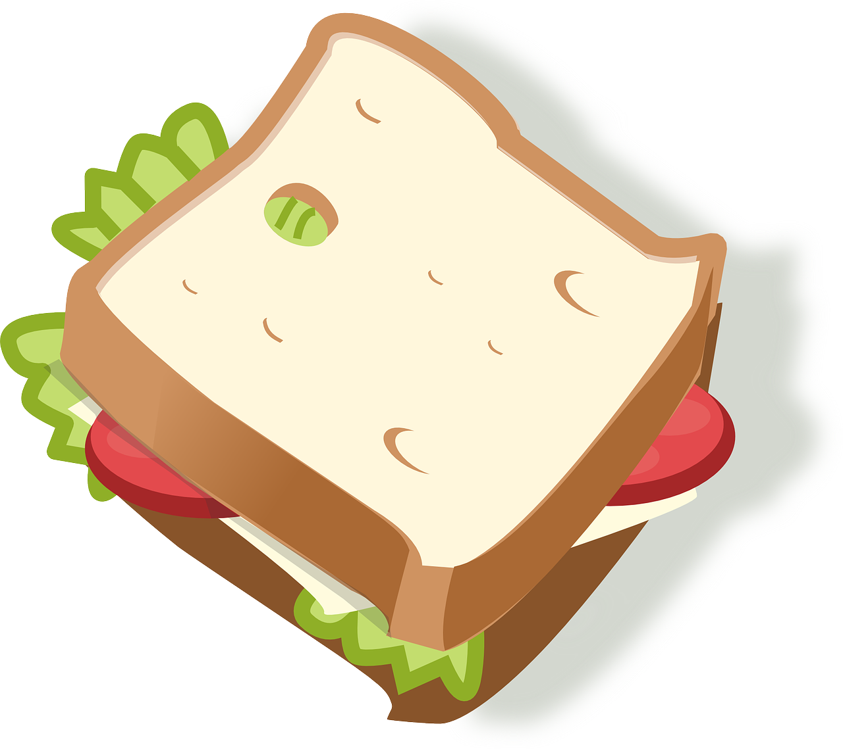
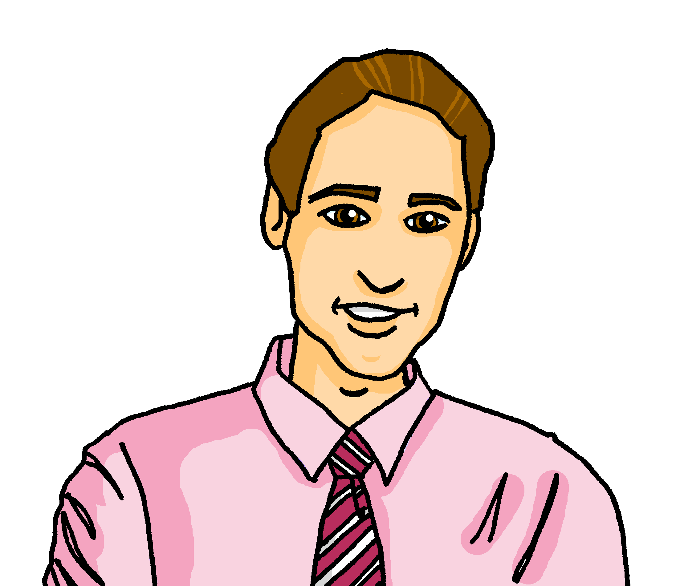
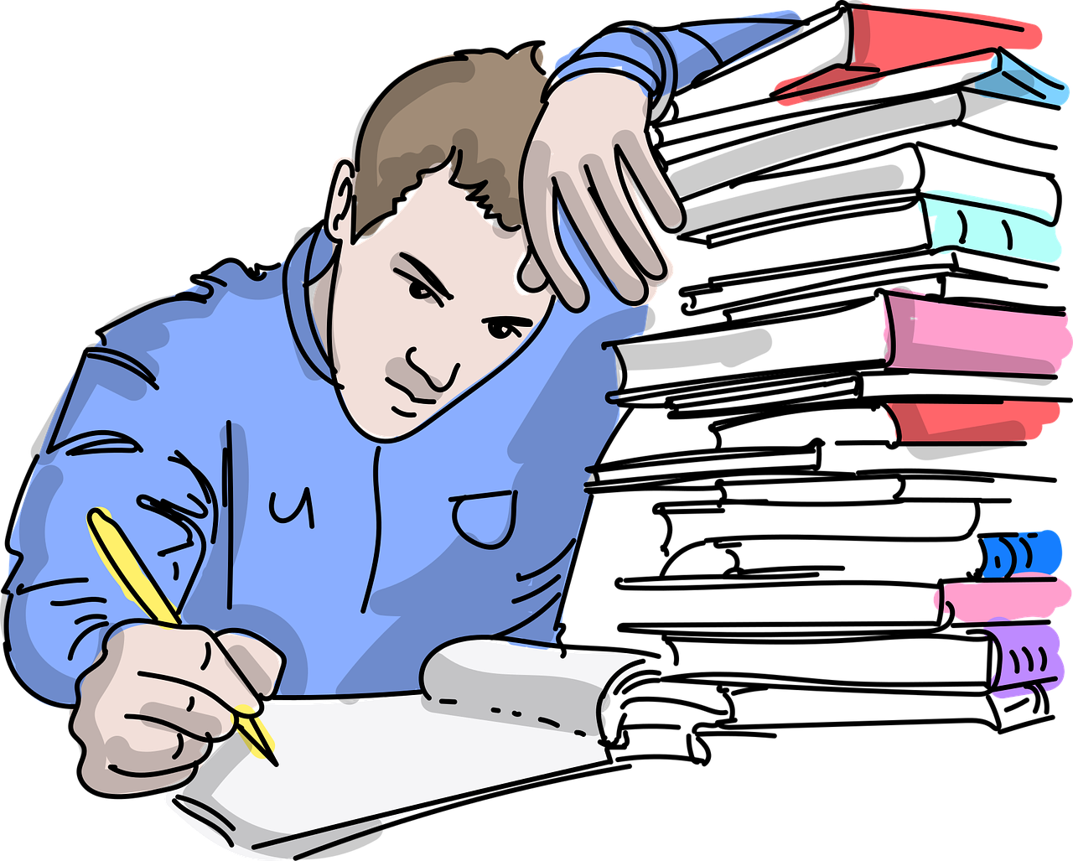
Follow up 1
Sag die Sätze und hör zu.
Oma is showing Lias and Ronja old photos of their parents.
aussprechen
1. Wer ist das? Das ist dein Vater. Er hat ein Butterbrot.
Who is that? That is your father. He has a sandwich.
2. Aber diese Person ist sein Bruder, Steffen. Er ist älter.
But this person is his brother, Steffen. He is older.
3. Das ist deine Mutter im Sommer. Sie klettert auf einen Berg.
That is your mother in summer. She is climbing a mountain.
4. Das ist dein Vater als Schüler. Er lernt nicht gern!
That is your father as a pupil. He doesn’t like learning!
5. Das ist sein erster Computer. Modern!
That is his first computer. Modern!
Notes:
Handout at end of presentation
Timing: 5 minutes
Aim: to practise applying knowledge of [er] in stressed and unstressed syllables.
Procedure: 1. Each pupil will need a copy of the handout at the end of the presentation to annotate.
2. Click to bring up the first sentence. As a class, identify and underline the stressed [er] syllables and circle the unstressed [er] syllables in the sentence. Listen to the sentence to check, then click to bring up the answers.
3. Click to bring up items 2-5. Ask pupils to read the sentences aloud in pairs and 1) underline the stressed [er] syllable and 2) circle the unstressed [er] in each sentence. You could encourage them to clap the syllables in the [er] words if you did this in the main lesson.
3. Listen to sentences 2-5 to allow pupils to check their answers. It is ok for them to change their mind now they have listened!
4. Click to bring up answers.
5. Discuss meanings and click to bring up English translations.
6. Encourage pupils to read aloud again now that they have the answers, clapping if appropriate.
NB: die Person is an unusual word in German. It almost has equal stress, (though ‘-son’ is stronger), so the ‘er’ in Per- is stressed ‘er’.
Transcript:
Wer ist das? Das ist dein Vater. Er hat ein Butterbrot.
Aber diese Person ist sein Bruder, Steffen. Er ist älter.
Das ist deine Mutter im Sommer. Sie klettert auf einen Berg.
Das ist dein Vater als Schüler. Er lernt nicht gern!
Das ist sein erster Computer. Modern!
Word frequency:
alt [138] auf [16] Berg [934] Bruder [730] dies [24] erste [95] gern [278] klettern [2601] lernen [288] modern [747] Mutter [218] sein [30] Sommer [771] Vater [232]

Slide 7
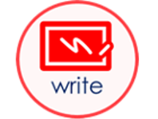
lesen
Follow up 2
Is Lias saying ‘not’ or don’t/doesn’t in each sentence?
Lies die Sätze.
 |  | don’t/ doesn’t | not
 | Das ist nicht grün.
 | Ich bin nicht Oma!
 | Er bleibt montags nicht.
 | Sie beuscht England nicht.
 | Das ist nicht meine Gitarre!
 | Heute ist nicht Dienstag.
 | Ich weiß es nicht.
 | Ich schreibe die Geschichte nicht.
1
That is not green.
2
I am not Grandma!
3
He doesn’t stay on Mondays.
4
She doesn’t visit England.
5
That is not my guitar.
6
Today is not Tuesday.
Tues.
7
I don’t know (it).
8
I don’t write the story.
Notes:
Timing: 5 minutes
Aim: to practise nicht (meaning both ‘don’t’ and ‘not’) and previously taught words in short sentences.
Procedure:
Pupils read the sentence and decide whether nicht would be translated as ‘don’t/doesn’t’ or ‘not’.
Click to bring up answer ticks.
Elicit full translations of sentences to recap both uses of nicht and vocabulary. Click to bring up answers in English.
NOTE: Pupils met ‘Ich weiß es nicht’ as an item of vocabulary in Term 2, but now can understand the translation of nicht as ‘don’t’.
Additional tasks:
1. Ask pupils to change one element of each sentence to make them their own. They could e.g. change one piece of vocabulary or they could change the person of the verb, or they could remove the nicht to make the sentence positive.
7

Slide 8
Follow up 3a
Hör zu.
Was macht Ronja (nicht)? Was macht Oma (nicht)?
Sie
hören
Ich
R
O
1
8
R + O
2
7
3
6
5
4
to visit
Notes:
Timing: 10 minutes [Slide 1/2]
Aim: to practise aural recognition of affirmative and negative sentences in the 1st and 3rd person.
Procedure:
Explain that Ronja is talking about herself (ich) and Oma (sie). Pupils must listen and decide which of the activities 1-8 just Ronja does, just Oma does, which both do, and which neither do.
Pupils jot down numbers 1-8 and will write down R, O, R+O, or neither for each activity.
Play each audio item.
Click for each picture to move to the correct part of the venn diagram to show answers.
Move on to the next slide to practise transcription of the same sentences.
Transcript:
Ich spiele Gitarre nicht. Sie spielt Gitarre.
Sie schreibt einen Brief nicht. Ich schreibe einen Brief.
Ich besuche die Schweiz nicht. Sie besucht die Schweiz.
Ich spiele das Spiel und sie spielt das Spiel!
Ich arbeite nicht und sie arbeitet nicht.
Ich mache Sport. Sie macht Sport nicht.
Sie braucht Hilfe und ich brauche Hilfe.
Sie bleibt in der Schweiz nicht. Ich bleibe in der Schweiz.

Slide 9
Follow up 3b
Hör zu und schreib auf Deutsch.
hören
 | I…..s………G………n…… | S….s……G………
 | I….s………..e……B…… | S….s………..e……B……n……
 | I…..b..……..d…….S……..n…… | S…..b………d…..S….….
 | I…..s………d….S..…..u….. | s…..s………..d…..S…..!
 | I…..a.……..n..…..u….. | s.…a………n…….
 | I…..m……..S…..… | S….m………S.…..n…….
 | i…b…..…H…… | S….b………H….…u…..
 | I….b……..i…d….S……... | S…. b……..i…d….S……...n…….
1
Ich spiele Gitarre nicht.
Sie spielt Gitarre.
2
Ich schreibe einen Brief.
Sie schreibt einen Brief nicht.
3
Ich besuche die Schweiz nicht.
Sie besucht die Schweiz.
4
Ich spiele das Spiel und…
…sie spielt das Spiel!
5
Ich arbeite nicht und…
… sie arbeitet nicht.
6
Ich mache Sport.
Sie macht Sport nicht.
7
…ich brauche Hilfe.
Sie braucht Hilfe und…
8
Ich bleibe in der Schweiz.
Sie bleibt in der Schweiz nicht.
Notes:
Timing: 10 minutes [Slide 2/2]
Aim: to practise aural recognition and transcription of affirmative and negative sentences in the 1st and 3rd person.
Procedure:
Explain that pupils will hear the same 8 items again.
Pupils jot down numbers 1-8 and will try to transcribe the German they hear. For a more challenging task, pupils should not face the board.
Play each audio item as many times as necessary.
Click for answers to appear. Draw attention to the position of nicht in each negative sentence.
Transcript
Ich spiele Gitarre nicht. Sie spielt Gitarre.
Sie schreibt einen Brief nicht. Ich schreibe einen Brief.
Ich besuche die Schweiz nicht. Sie besucht die Schweiz.
Ich spiele das Spiel und sie spielt das Spiel!
Ich arbeite nicht und sie arbeitet nicht.
Ich mache Sport. Sie macht Sport nicht.
Sie braucht Hilfe und ich brauche Hilfe.
Sie bleibt in der Schweiz nicht. Ich bleibe in der Schweiz.

Slide 10
Follow up 4:
Was sagt Oma? [1/5]
Oma is heading back to Germany. She sends Lothar messages to let him know how her journey is going.
I don’t visit Zürich.
Lothar
besuche
nicht
ich
Zürich
?
15
Sabine
Ich
besuche
Zürich
nicht
S
0
START
Notes:
Timing: 5 mins (six slides)
Aim: to practise scaffolded spoken production of nicht meaning don’t and not, and to contrast its position in sentences depending upon meaning.
Procedure:
Pupils read the English sentence.
Click to start the timer.
Pupils work in pairs to translate orally and say the sentence aloud in German within the fifteen-second time limit. They need to pay particular attention to the position of nicht.
Elicit answers from students (either chorally or from individuals).
Click on the blue speaker icon on the phone to bring up the answer.

Slide 11
Follow up 4:
Was sagt Oma? [1/5]
Oma is heading back to Germany. She sends Lothar messages to let him know how her journey is going.
That isn’t my computer!
Lothar
Computer
mein
das
nicht
ist
?
15
Sabine
Das
ist
nicht
mein
Computer
S
0
START
Notes:
[2/6]

Slide 12
Follow up 4:
Was sagt Oma? [1/5]
Oma is heading back to Germany. She sends Lothar messages to let him know how her journey is going.
I don’t write.
Lothar
nicht
ich
schreibe
?
15
Sabine
Ich
schreibe
nicht
S
0
START
Notes:
[3/6]

Slide 13
Follow up 4:
Was sagt Oma? [1/5]
Oma is heading back to Germany. She sends Lothar messages to let him know how her journey is going.
I don’t use the list.
Lothar
benutze
nicht
Liste
ich
die
?
15
Sabine
Ich
benutze
die
Liste
nicht
S
0
START
Notes:
[4/6]

Slide 14
Follow up 4:
Was sagt Oma? [1/5]
Oma is heading back to Germany. She sends Lothar messages to let him know how her journey is going.
The song is not old.
Lothar
nicht
der
alt
Song
ist
?
15
Sabine
Der
Song
ist
nicht
alt
S
0
START
Notes:
[5/6]

Slide 15
Follow up 4:
Was sagt Oma? [1/5]
Oma is heading back to Germany. She sends Lothar messages to let him know how her journey is going.
I don’t receive the sandwich.
Lothar
das
bekomme
nicht
ich
Butterbrot
?
15
Sabine
Ich
bekomme
das
Butterbrot
nicht
S
0
START
Notes:
[6/6]

Slide 16
Follow up 5:

Schreib auf Englisch.
Can you get at least 15 points?
Wörter
 | du hast | kein, keine,kein | Ich weiß es nicht
 | Wie sagt man? | haben | das Haus
 | der Baum | der Fehler | die Schule
 | die Hilfe | die Gruppe | es gibt
 | besuchen | bleiben | die Gitarre
 | die Oma | benutzen | brauchen
Vokabeln
you have
not a, no
I don’t know
x3
How do you say?
to have, having
(the) house
(the) tree
(the) mistake, error
(the) school
x2
(the) help
(the) group
there is, there are
to remain, stay, remaining, staying
to visit, visiting
(the) guitar
x1
(the) grandma
to use, using
to need, needing
Notes:
Timing: 5 minutes
Aim: to practise written comprehension of vocabulary from this and revisited weeks.
Procedure: 1. Give pupils a blank grid. They fill in the English meanings of any of the words they know, trying to reach 15 points in total.
Note: The most recently learnt and practised words are pink, words from the previous week are green and those from week 1 are blue, thus more points are awarded for them, to recognise that memories fade and more effort (heavy lifting!) is needed to retrieve them.

Slide 17
Follow up 5:

Schreib auf Deutsch.
Can you get at least 15 points?
Wörter
 | to have, having | you have | (the) house
 | not a, no | How do you say? | I don’t know
 | (the) school | (the) help | there is, there are
 | (the) group | (the) tree | (the) mistake, error
 | (the) guitar | (the) grandma | to use, using
 | to need, needing | to remain, stay, remaining, staying | to visit, visiting
Vokabeln
haben
du hast
das Haus
x3
kein, keine, kein
Wie sagt man?
Ich weiß es nicht
die Schule
die Hilfe
es gibt
x2
die Gruppe
der Baum
der Fehler
die Gitarre
die Oma
benutzen
x1
brauchen
bleiben
besuchen
Notes:
Timing: 5 minutes
Aim: to practise written comprehension of vocabulary from this and revisited weeks.
Procedure: 1. Give pupils a blank grid. They fill in the German translations of any of the words they know, trying to reach 15 points in total.
Note: The most recently learnt and practised words are pink, words from the previous week are green and those from week 1 are blue, thus more points are awarded for them, to recognise that memories fade and more effort (heavy lifting!) is needed to retrieve them.

Slide 18
Tschüss!
gelb
Notes:
18

Slide 19
Follow up 1
Follow up 1
Read each sentence aloud. Underline the stressed
[er] syllables and circle the unstressed [er] syllables.
Read each sentence aloud. Underline the stressed
[er] syllables and circle the unstressed [er] syllables.
1. Wer ist das? Das ist dein Vater. Er hat ein Butterbrot.
1. Wer ist das? Das ist dein Vater. Er hat ein Butterbrot.
2. Aber diese Person ist sein Bruder, Steffen. Er ist älter.
2. Aber diese Person ist sein Bruder, Steffen. Er ist älter.
3. Das ist deine Mutter im Sommer. Sie klettert auf einen Berg.
3. Das ist deine Mutter im Sommer. Sie klettert auf einen Berg.
4. Das ist dein Vater als Schüler. Er lernt nicht gern!
4. Das ist dein Vater als Schüler. Er lernt nicht gern!
5. Das ist sein erster Computer. Modern!
5. Das ist sein erster Computer. Modern!
Notes:
HANDOUT
There are 2 copies of the exercise per handout

Slide 20
Follow up 5:

Schreib auf Englisch.
Can you get at least 15 points?
Wörter
 | du hast | kein, keine,kein | Ich weiß es nicht
 | Wie sagt man? | haben | das Haus
 | der Baum | der Fehler | die Schule
 | die Hilfe | die Gruppe | es gibt
 | besuchen | bleiben | die Gitarre
 | die Oma | benutzen | brauchen
Vokabeln
x3
x2
x1
Notes:
HANDOUT

Slide 21
Follow up 5:

Schreib auf Deutsch.
Can you get at least 15 points?
Wörter
 | to have, having | you have | (the) house
 | not a, no | How do you say? | I don’t know
 | (the) school | (the) help | there is, there are
 | (the) group | (the) tree | (the) mistake, error
 | (the) guitar | (the) grandma | to use, using
 | to need, needing | to remain, stay, remaining, staying | to visit, visiting
Vokabeln
x3
x2
x1
Notes:
HANDOUT

