Slide 1
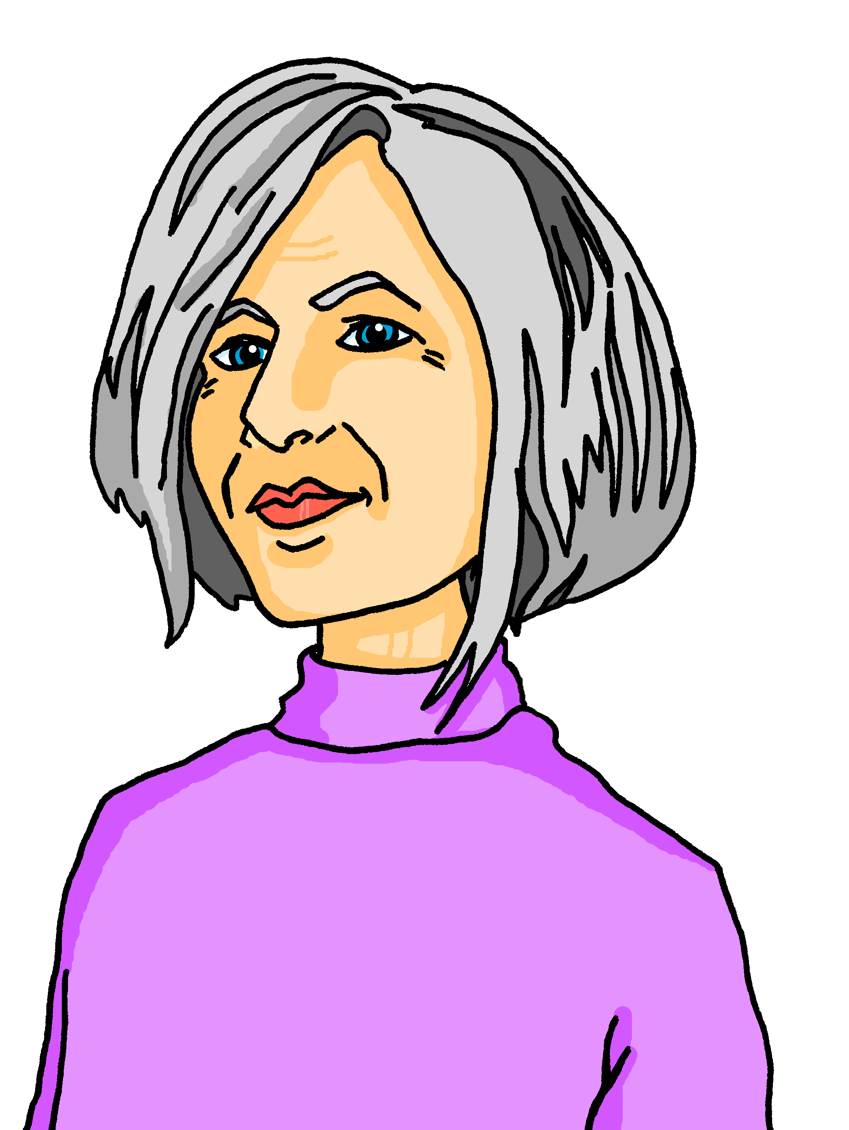
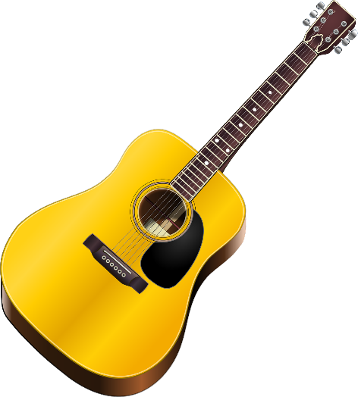
Talking about activities and events
gelb
Negation after verbs with nicht
SSC [er-] [-er]
Term 3 Week 3
Notes:
Artwork by Steve Clarke. Pronoun pictures from NCELP (www.ncelp.org). All additional pictures selected from Pixabay and are available under a Creative Commons license, no attribution required.
Phonics:
[er-] er [15] Konzert [2350] Person [357] schwer [256] wer? [173]
[-er] wieder [74] aber [31] oder [35] Oktober [1223] wunderbar [1603]
Vocabulary: besuchen [820] bleiben [113] Gitarre [n/a] Oma [2175]
Revisit 1: language from Term 2
Revisit 2: (du) hast [7]
Jones, R.L & Tschirner, E. (2019). A frequency dictionary of German: Core vocabulary for learners. London: Routledge.
The frequency rankings for words that occur in this PowerPoint which have been previously introduced in these resources are given in the SOW and in the resources that first
introduced and formally re-visited those words.
For any other words that occur incidentally in this PowerPoint, frequency rankings will be provided in the notes field wherever possible.
Note that the first three lessons of the year teach language that can be continuously recycled as lesson routine every lesson in Y3/4.
The idea would be that the class teacher (whether or not s/he teaches the class German can re-use the language as part of the daily routine with the class.
1

Slide 2
aussprechen
[er]
…
er
When the [er] is the stressed syllable, it usually sounds like two short syllables: e-uh
Remember, words are made up of different parts called syllables. A stressed syllable means the part of the word that is most emphasised when you say it aloud.
Notes:
Timing: 1 minute
Aim: to introduce/consolidate SSC [er]
Procedure: 1. Present the letter(s) and say the [er] sound first, on its own. Pupils repeat it with you. 2. Bring up the word ”er” on its own, say it, pupils repeat it, so that they have the opportunity to focus all of their attention on the connection between the written word and its sound.
3. A possible gesture for this would be to point to an imaginary ‘he’, using your index finger, thumb point upwards (to make the gesture more exaggerated), as per the image.
4. Roll back the animations and work through 1-3 again, but this time, dropping your voice completely to listen carefully to the pupils saying the [er] sound, pronouncing ”er” and, if using, doing the gesture. Word frequency (1 is the most frequent word in German): er [15] Source: Jones, R.L. & Tschirner, E. (2006). A frequency dictionary of German: core vocabulary for learners. Routledge
2

Slide 3
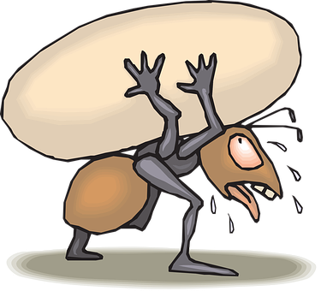
aussprechen
[er]
In all of these words, the [er] is part of the stressed syllable. This means it is emphasised or stronger than the other part of the word.
…
schwer
fertig
[heavy, difficult]
[ready, finished]
er
Konzert
wer?
Notes:
Timing: 2 minutes
Aim: to introduce/consolidate SSC [er]
Procedure:
Introduce and elicit the pronunciation of the individual SSC [er] and then the source word again ‘er’ (with gesture, if using).
Then present and elicit the pronunciation of the five cluster words.
The cluster words have been chosen for their high-frequency, from a range of word classes, with the SSC (where possible) positioned within a variety of syllables within the words (e.g. initial, 2nd, final etc.). Additionally, we have tried to use words that build cumulatively on previously taught SSCs (see the Phonics Teaching Sequence document) and do not include new SSCs. Where new SSCs are used, they are often consonants which have a similar symbol-sound correspondence in English.
Word frequency (1 is the most frequent word in German): er [15] fertig [n/a] Konzert [2350] schwer [256] wer? [173]
Source: Jones, R.L. & Tschirner, E. (2006). A frequency dictionary of German: core vocabulary for learners. Routledge

Slide 4
aussprechen
[er]
…
As you know [er] can also sound like ‘uh’. This is when the syllable is unstressed, most often at the end of the word.
wieder
[again]
Notes:
Timing: 1 minute
Aim: To introduce/consolidate SSC [er]
Procedure: 1. Present the letter(s) and say the [er] sound first, on its own. Pupils repeat it with you. 2. Bring up the word ”wieder” on its own, say it, pupils repeat it, so that they have the opportunity to focus all of their attention on the connection between the written word and its sound.
3. A possible gesture for this would be to roll your hands over in the air, clockwise. Your hands are in front of your body.
4. Roll back the animations and work through 1-3 again, but this time, dropping your voice completely to listen carefully to the pupils saying the [er] sound, pronouncing ”wieder” and, if using, doing the gesture. Word frequency (1 is the most frequent word in German): wieder [74] Source: Jones, R.L. & Tschirner, E. (2006). A frequency dictionary of German: core vocabulary for learners. Routledge
4

Slide 5
aussprechen
[er]
In all of these words, a different part of the word is the stressed syllable, not the [er] sound.
…
aber
Oktober
[but]
wieder
?
Wonderful!
[again]
oder
wunderbar
[or]
Notes:
Timing: 2 minutes
Aim: To introduce/consolidate SSC [er]
Procedure:
Introduce and elicit the pronunciation of the individual SSC [er] and then the source word again ‘wieder’ (with gesture, if using).
Then present and elicit the pronunciation of the four cluster words.
Word frequency (1 is the most frequent word in German): wieder [74] aber [31] oder [35] Oktober [1223] wunderbar [1603] Source: Jones, R.L. & Tschirner, E. (2006). A frequency dictionary of German: core vocabulary for learners. Routledge

Slide 6
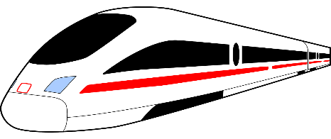
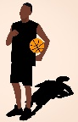
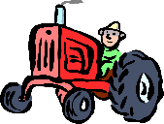
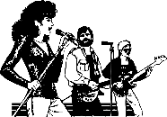
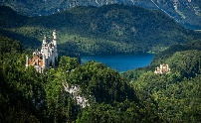
[er]
Oma is visiting Lias and Ronja! What can she see out of the train window?
Can you find the stressed syllable?
Is the [er] stressed or unstressed?
Hör zu.
 |  | stressed [er] | unstressed [er]
1 | Sportler
2 | Berg
3 | Energie
4 | Bauer
5 | Konzert
6 | Ferne
7 | Bayern
8 | Werkstatt
Can you clap the syllables in each word, clapping louder for the stressed syllables?
Notes:
Timing: 5 minutes
Aim: to consolidate the SSC [er] by identifying the stressed and unstressed syllables in known and unknown words.
Procedure:
1. Explain that pupils are going to hear words with [er]. On first listening they need to highlight/circle/jot down the syllable of the word they hear that is stressed/emphasised.
2. Play number one and click to show the syllable they should have highlighted. Then discuss as a class whether it is a stressed or unstressed [er].
3. Repeat for items 2-8.
4. Click to bring up the call-out and try clapping through the words together as a class, clapping louder for the stressed syllable in each word.
Transcript:
Sportler
Berg
Energie
Bauer
Konzert
Ferne
Bayern
Werkstatt
Word frequency:
Bauer [1548] Bayern [624] Berg [934] Energie [455] Ferne [3158] Konzert [2350] Sportler [2565] Werkstatt [3472]

Slide 7
Vokabeln
Vokabeln lernen
Wörter
Sag die Wörter.
to visit
besuchen
bleiben
die Gitarre
die Oma
Notes:
Timing: 5 minutes
Aim: to present and practise the new vocabulary for this week.
Procedure:
Click to bring up the verb ‘besuchen’ then the picture and repeat as a class. Repeat for the following 3 items.
Click for a picture to disappear. Pupils recall the English meaning. Repeat for the following 3 items.
Click for a German word to disappear. Pupils recall it. Repeat for the following 3 items.
7

Slide 8
Ich bin Oma!
Hallo! Ich bin Oma! Ich besuche heute Lias und Ronja in Biel. Ich bleibe eine Woche. Ich spiele Gitarre!
Notes:
Timing: 2 minutes
Aim: to introduce Oma, to recap this week’s new vocabulary, to revise the present tense with time adverbs.
Procedure:
1. Read the slide together as a class to meet Oma.
2. Discuss with pupils in English what we have learned about Oma.

Slide 9
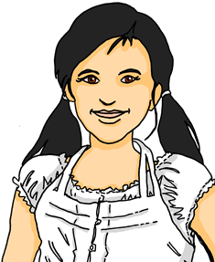
Nicht (not)
You already know how to use nicht (not):
Use nicht before an adjective or adverb to mean not:
Ich bin hier.
Ich bin nicht hier.
I am here.
I am not here.
Use nicht before ‘der, die, das’ and a noun to mean not the:
Das ist die Gitarre.
Das ist nicht die Gitarre.
That is the guitar.
That is not the guitar.
Use nicht before proper nouns to mean not:
Das ist Oma.
Das ist nicht Oma.
That is Grandma.
That is not Grandma.
Notes:
Timing: 2 minutes (two slides)
Aim: to revise the already known uses of nicht.
Procedure:
Click through the animations to recap uses of nicht information.
Elicit English translation for the German examples provided.
9

Slide 10
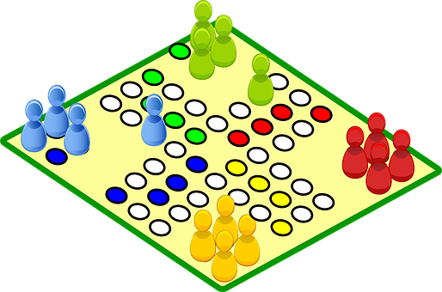
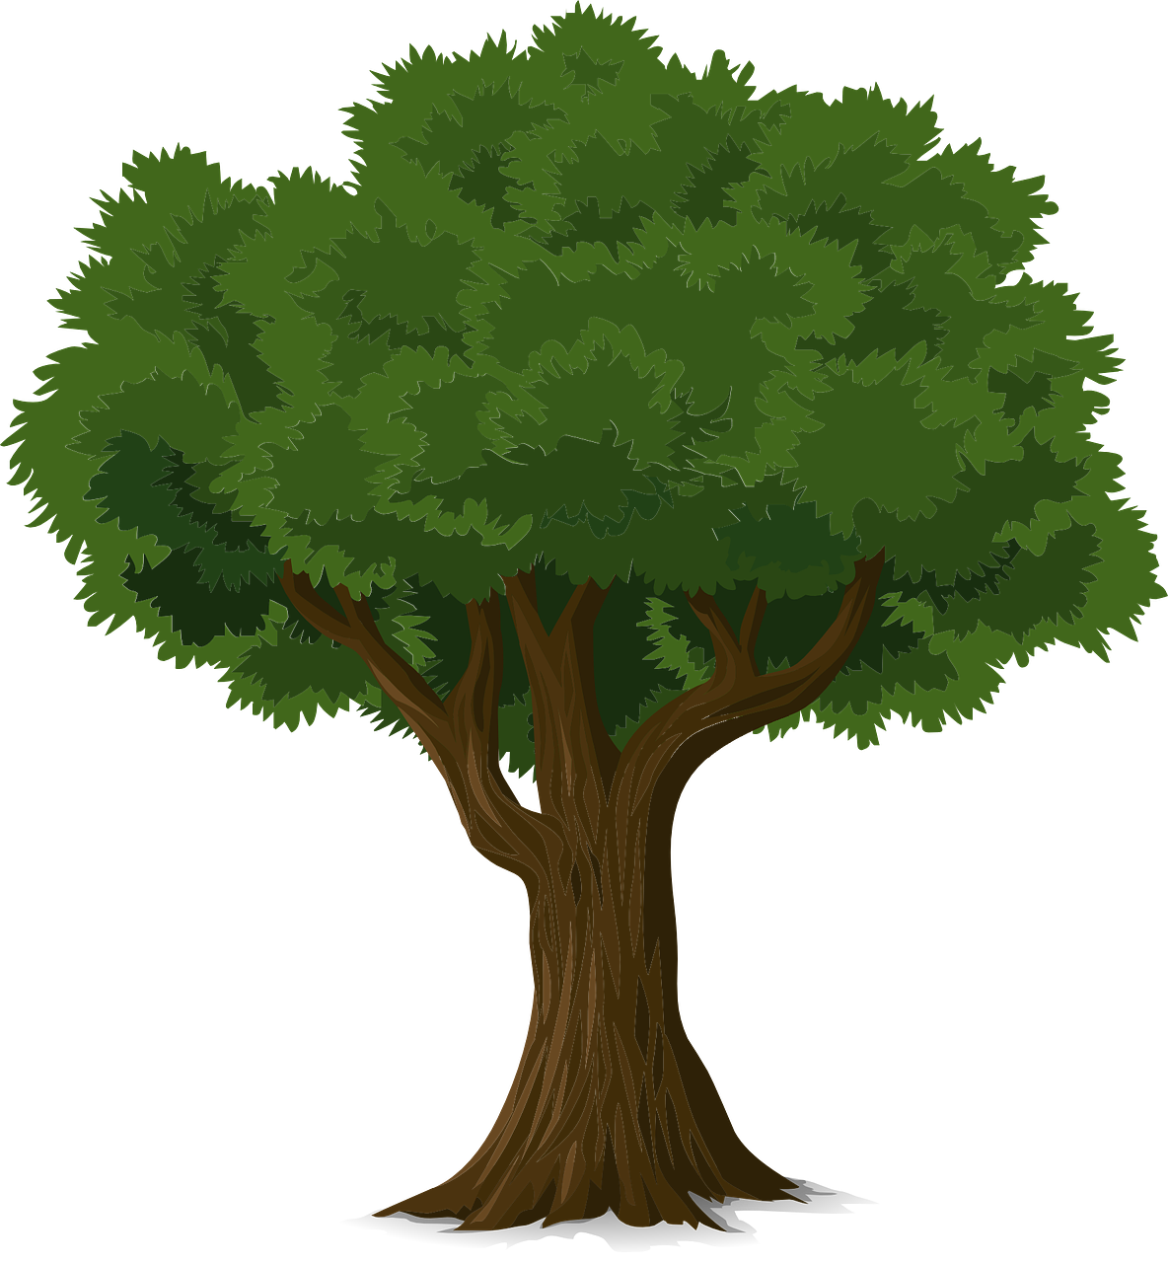
Nicht (not)
We also use nicht to mean not before ‘my’ and ‘your’:
Das ist mein Lieblingsspiel.
Das ist nicht mein Lieblingsspiel!
That is my favourite game.
That is not my favourite game!
Das ist dein Baum.
Das ist nicht dein Baum.
That is your tree.
That is not your tree.
Notes:
2/2
10

Slide 11
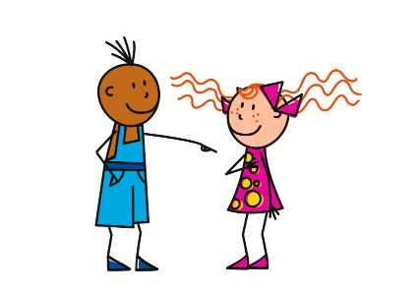
Nicht + Verb (don’t)
Note the word order difference between English and German!
We also use nicht after a verb to say what we don’t do:
Ich arbeite nicht.
I don’t work.
Du bleibst aber er bleibt nicht.
You stay but he doesn’t stay.
Notes:
Timing: 2 minutes
Aim: to introduce the use of ‘nicht’ with verbs to negate them.
Procedure:
Click through the animations to present the new information.
Elicit English translation for the German examples provided.
11

Slide 12
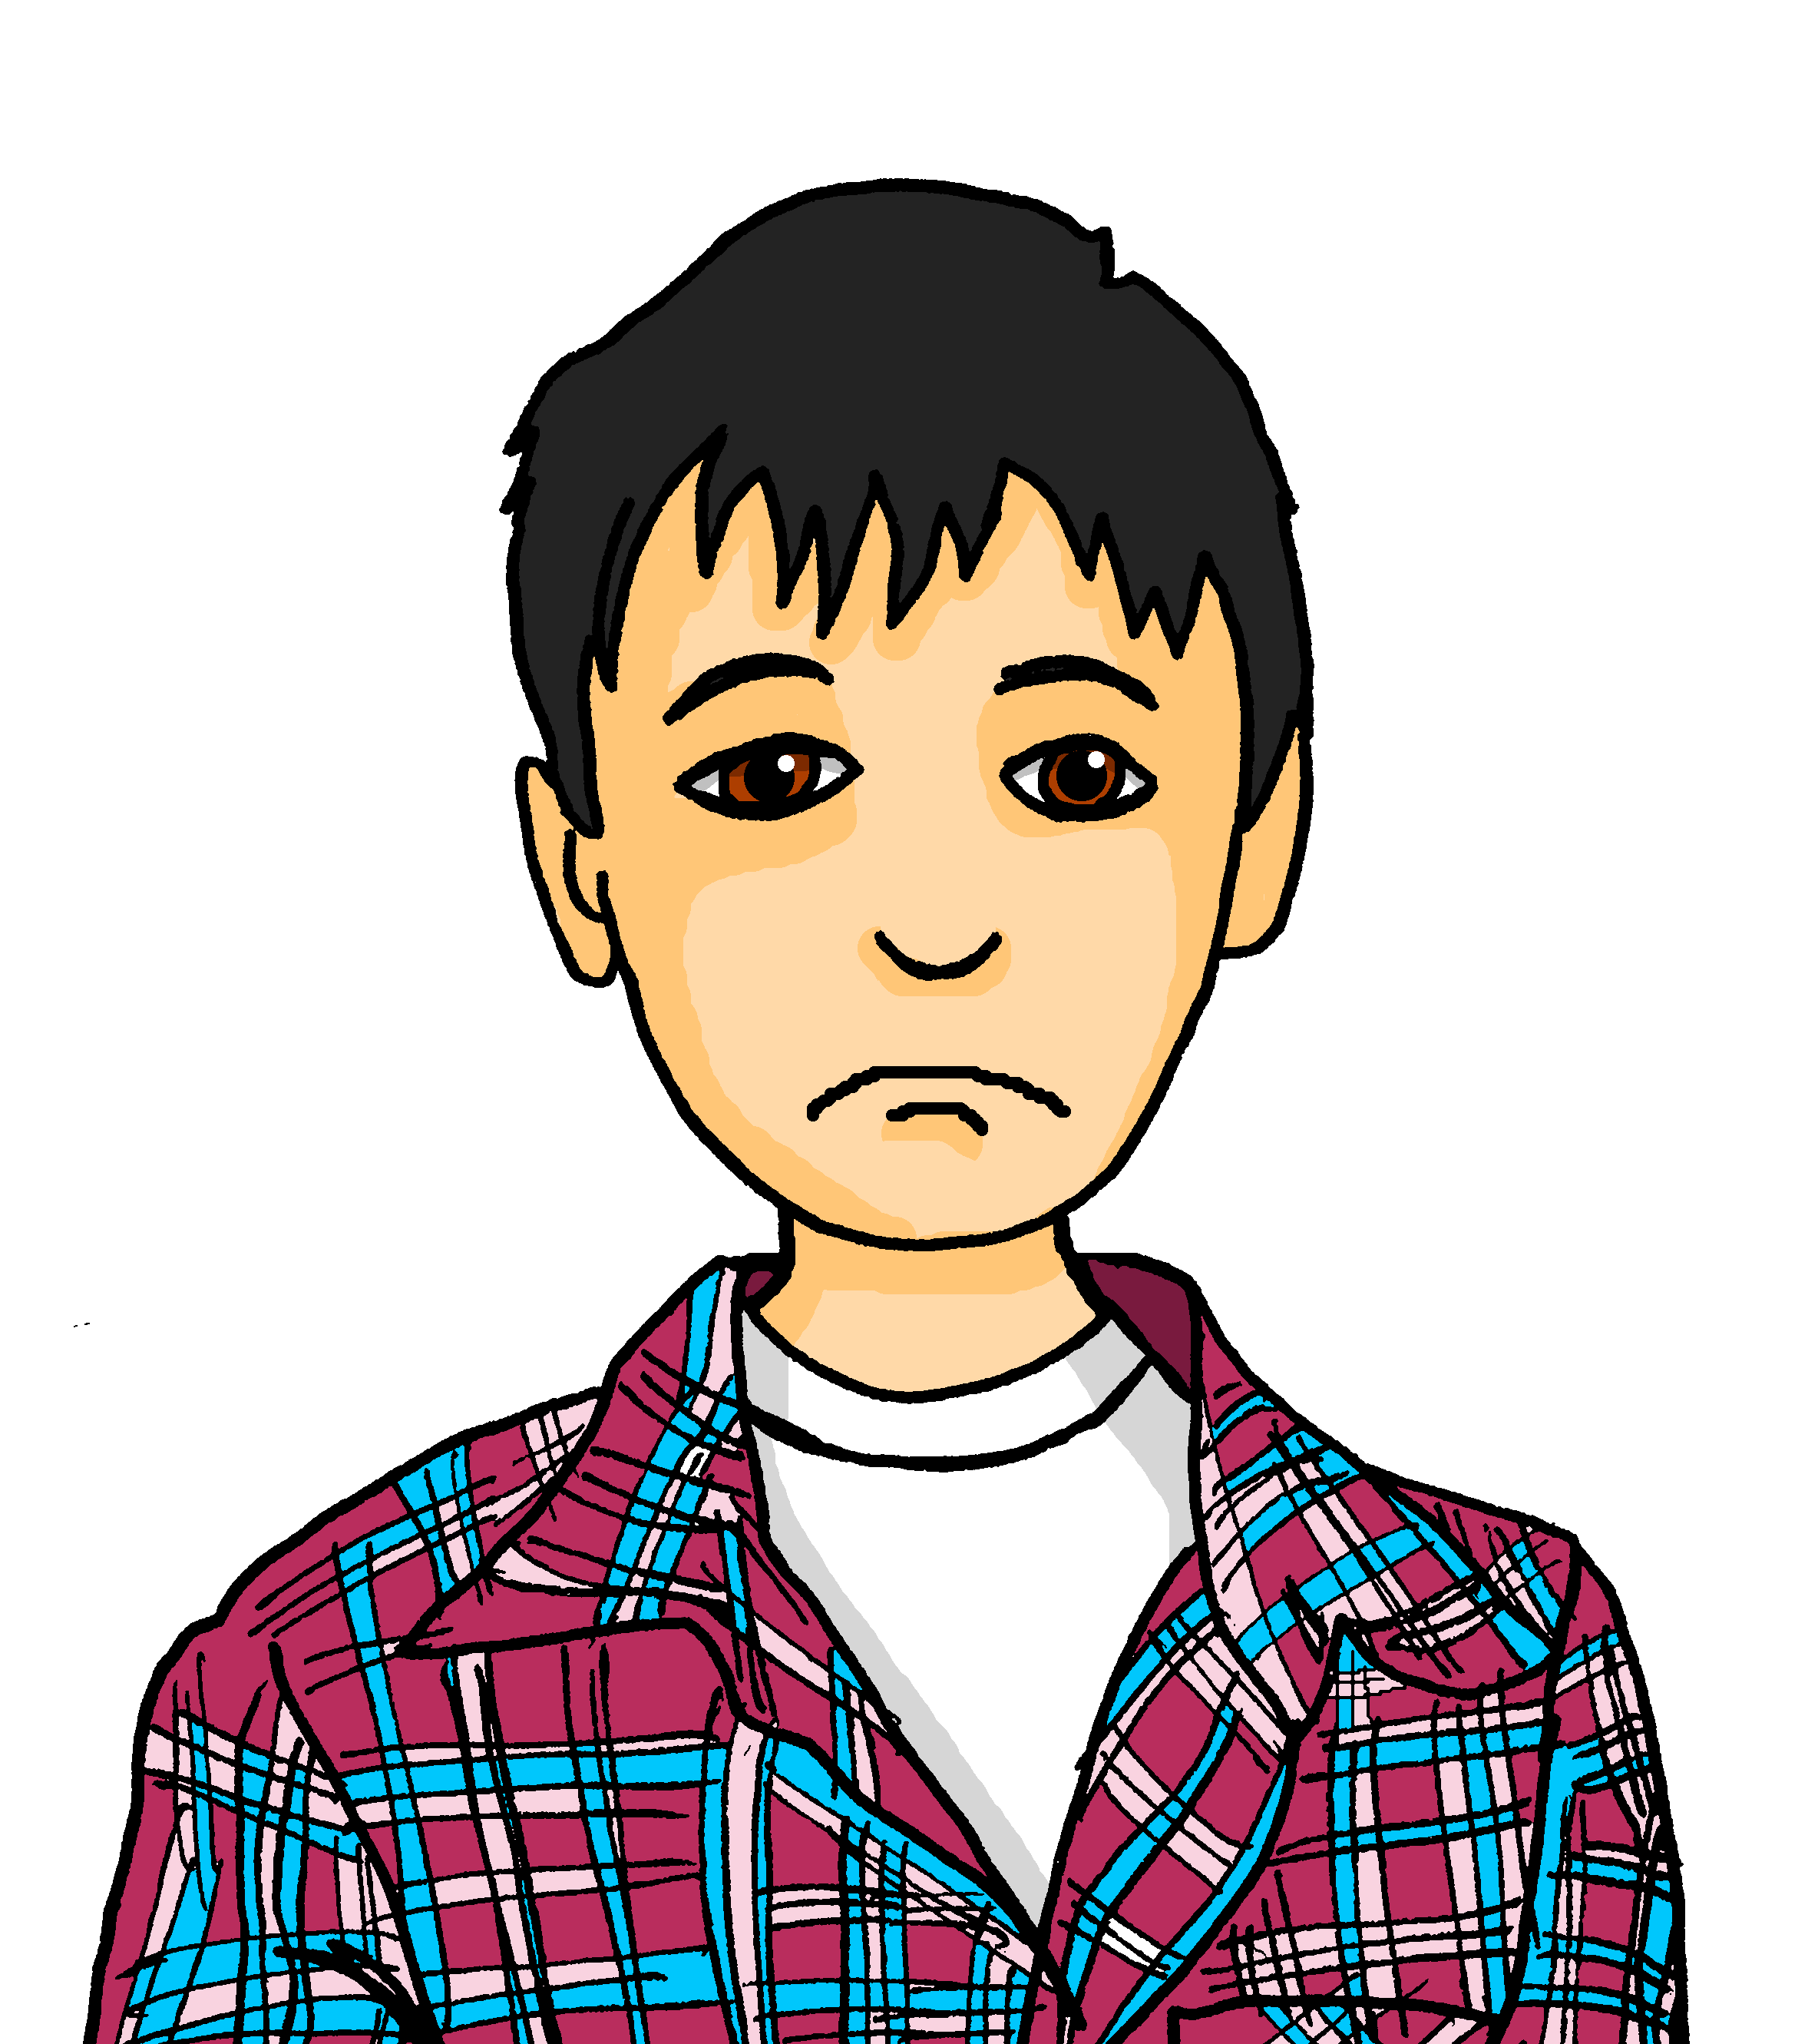
hören
Lias is hanging out with Oma. Is he talking about what he does/doesn’t do or what Oma does/doesn’t do?
Remember that the word order in English is different for the negative sentences.
Hör zu.
 |  | I | she
1
Grandma is visiting Switzerland.
2
She is staying a week.
3
She doesn’t work.
4
And I don’t work!
5
I play with Grandma.
6
I don’t win!
7
I don’t play! (I’m not playing!)
*gewinnen = to win
Notes:
Timing: 5 minutes
Aim: to practise aural comprehension of negative sentences with ‘nicht’ in the first and third person singular.
Procedure:
1. Explain that pupils are listening to Lias talking about himself and Grandma; what they do and what they don’t do.
2. Play audio 1. Pupils must tick if the sentence they hear is affirmative and cross if negative.
3. Repeat for items 2-7. Click for answers.
4. Now pupils are going to listen again and translate each sentence, identifying whether the sentence is in the ‘I’ or ‘She’ form. Use the call-out to remind about word order for the negative sentences.
5. Repeat for items 2-7. Click for answers.
Transcript:
Oma besucht die Schweiz.
Sie bleibt eine Woche.
Sie arbeitet nicht.
Und ich arbeite nicht!
Ich spiele mit Oma.
Ich gewinne nicht!.
Ich spiele nicht!
12

Slide 13
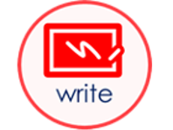
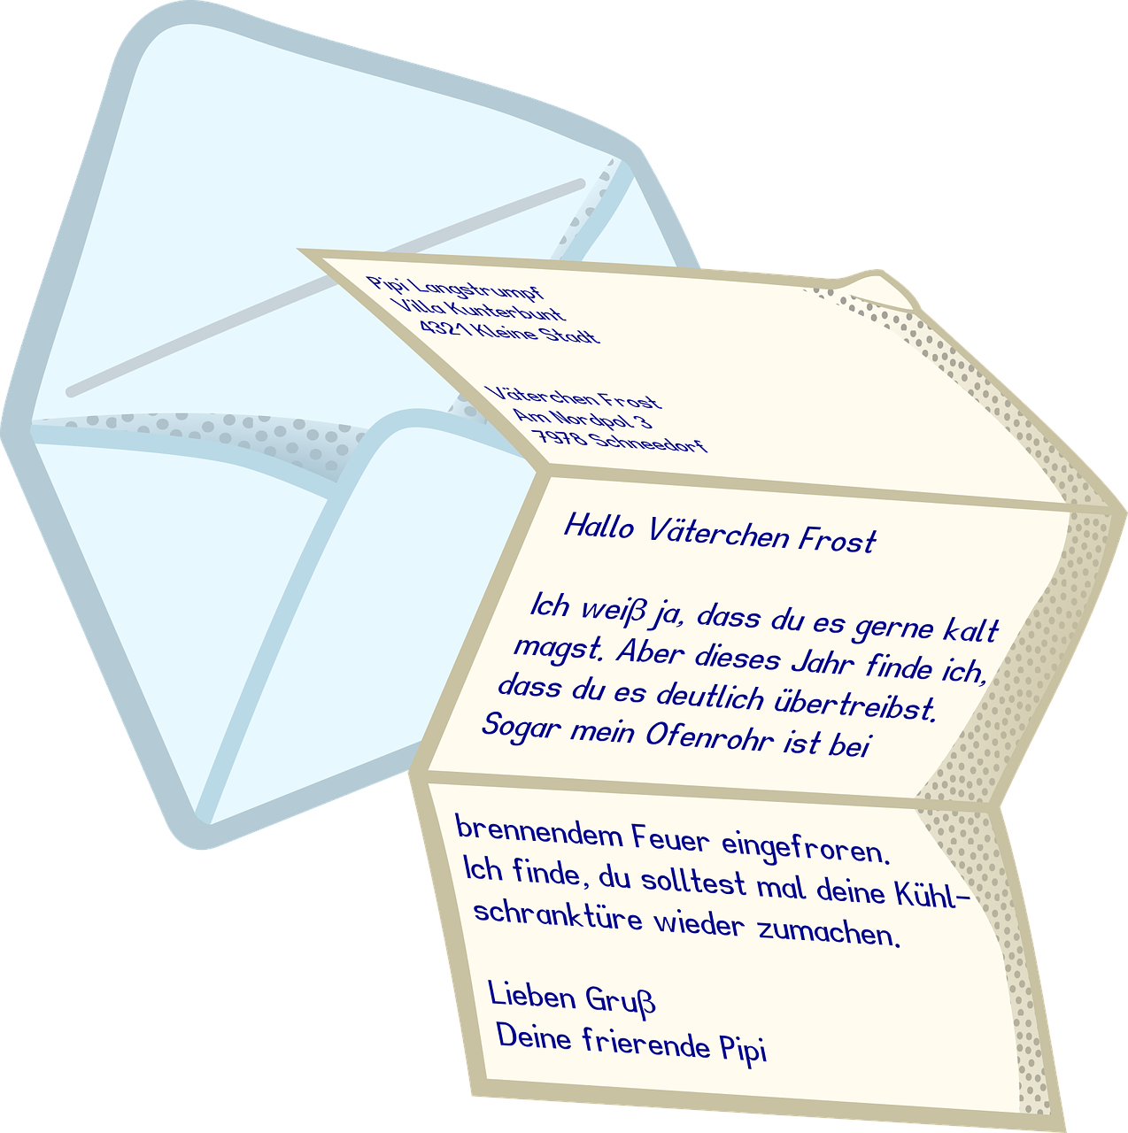
Nicht + Verb (don’t)
We know that we use nicht after a verb to mean ‘don’t’:
Ich schreibe nicht.
I don’t write.
However, when nicht negates a whole noun phrase, it goes to the end of the phrase:
Ich schreibe den Brief nicht.
I don’t write the letter.
Note again the word order difference between English and German!
Notes:
Timing: 2 minutes
Aim: to introduce the use of ‘nicht’ with noun phrases to negate them.
Procedure:
Click through the animations to present the new information.
Elicit English translation for the German examples provided.
13

Slide 14
Ronja is telling Oma what people don’t do. Is each sentence general (A) or specific (B)? Is there a noun hiding behind each ?
Schreib A oder B.
A | B
I don’t play. | I don’t play guitar.
You don’t work. | You don’t work with Lias.
She doesn’t write. | She doesn’t write the letter.
She doesn’t use. | She doesn’t use the paper.
I don’t do. | I don’t do sport.
He doesn’t visit. | He doesn’t visit Switzerland.
You don’t need. | You don’t need the bike.
1) Ich spiele Gitarre nicht.
2) Du arbeitest nicht .
3) Sie schreibt nicht .
4) Sie benutzt das Papier nicht.
5) Ich mache Sport nicht.
6) Er besucht nicht .
7) Du brauchst das Fahrrad nicht.
1
2
3
4
5
6
7
Notes:
Timing: 5 minutes
Aim: to practise written comprehension of nicht with a verb to mean ‘don’t’ with individual verbs and with whole noun phrases.
Procedure:
Explain that all of Ronja’s sentences are negative, but some are general e.g. I don’t play, whilst some are specific e.g. I don’t play guitar. Based on the position of nicht, pupils need to decide whether or not a noun is behind the red blobs.
Click to bring up the table with possible English translations.
Pupils write down 1-7 and A or B for each sentence.
Where they have chosen B, they could also try to translate the missing nouns into German.
Click to circle the correct answer A or B.
Elicit suggestions for the missing German nouns from pupils, then click to reveal if anything/what is behind the blobs.
Additional Tasks:
1. Pupils could rewrite numbers 2, 3 and 6, adding a noun and therefore moving nicht to the end of the sentence. E.g. Du arbeitest mit Lias nicht; Sie schreibt den Brief nicht; Er besucht die Schweiz nicht.
2. Pupils could alter the person (not) doing each verb e.g. 1) Er spielt Gitarre nicht, taking care to change their verb endings.

Slide 15
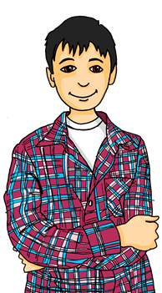
Kultur
Oma versteht* nicht!
*verstehen – to understand
sprechen – to speak
Grüezi, Oma!
Guten Tag, Lias!
Ich spreche* schweizerdeutsch zu Hause!
Aber ich spreche* hochdeutsch!
In Switzerland, people often speak Swiss German (schweizerdeutsch) at home. In Germany, people normally speak Standard German (hochdeutsch).
Swiss people can understand Standard German, though, because they use it for reading and writing.
Oma comes from Germany, not Switzerland. Lias and Ronja need to remember to speak in Standard German for Oma’s visit, or she won’t understand them!
Notes:
Timing: 5 minutes
Aim: to gain knowledge of differences between Swiss and Standard German.
Procedure:
Read through the explanation.
Click to reveal characters and speech bubbles. Note, Lias greets Oma by saying Grüezi, the Swiss German equivalent of Guten Tag – pupils are not expected to know this word!
If pupils are interested in hearing the differences between Swiss German and Standard German, this YouTube video covers some common greetings: https://www.youtube.com/watch?v=fI6r1mZfbZk
15

Slide 16
Tschüss!
gelb
Notes:
16

