Slide 1
What I can do
Ich kann das!
grün
Phonics, Vocabulary
and Grammar revision
Follow ups 1-5
Term 1 Week 12
Notes:
Artwork by Steve Clarke. Pronoun pictures from NCELP (www.ncelp.org). All additional pictures selected from Pixabay and are available under a Creative Commons license, no attribution required.
Phonics: revisit SSC long and short [a] [e] [i] [o] [u] (for these also write long or short); [ei] [ie] [w] [z] hard and soft [ch]
Vocabulary: revisit words from lessons 1 – 11
Revisit 1: geben [49] Blume [2463] Foto [633] Fahrrad [2138] Fußball [1277] Geschichte [262] Gitarre [n/a] Haus [147] Katze [2235] Papier [1163] Spiel [328] Tisch [529] Zug [675]
Revisit 2: dreizehn [4772] vierzehn [3950] fünfzehn [2858] sechzehn [4924] siebzehn [n/a] achtzehn [3741] neunzehn [n/a] zwanzig [1359] zweiundzwanzig [n/a] dreißig [2046] einunddreißig [n/a] an [19]
Jones, R.L & Tschirner, E. (2019). A frequency dictionary of German: Core vocabulary for learners. London: Routledge.
The frequency rankings for words that occur in this PowerPoint which have been previously introduced in these resources are given in the SOW and in the resources that first introduced and formally re-visited those words.
For any other words that occur incidentally in this PowerPoint, frequency rankings will be provided in the notes field wherever possible.
Note that the first three lessons of the year teach language that can be continuously recycled as lesson routine every lesson in Y3/4.
The idea would be that the class teacher (whether or not s/he teaches the class German can re-use the language as part of the daily routine with the class.
The frequency rankings for words that occur in this PowerPoint which have been previously introduced in these resources are given in the SOW and in the resources that first introduced and formally re-visited those words.
For any other words that occur incidentally in this PowerPoint, frequency rankings will be provided in the notes field wherever possible.
Remember that at the start of the course (first three lessons of Rot/Gelb) pupils learnt language (for greetings and register taking) that can still be part of the lesson routines in upper KS2 (Blau/Grün). They are not re-taught, as we anticipate that teachers have built these in from early in lower KS2.

Slide 2
aussprechen
Follow up 1
long [u]
short [u]
Fuß
Druck
[foot]
[pressure]
Notes:
Timing: 5 minutes (eight slides)
Aim: to practise read aloud of SSC learnt so far with unknown words.
Procedure:
Tell pupils that they are going to practise the sounds of German that they have learnt this year.
Click to bring up the first ‘flashcard’.
Elicit the SSC first. (To bring all pupils in together, teachers could use a silent 3-2-1 countdown gesture with their fingers).
Elicit the word, using the same countdown procedure.
Click to bring up the 2nd flashcard and repeat steps 3-4.
Word frequency (1 is the most frequent word in German):
Fuß [573] Druck 558]
Jones, R.L & Tschirner, E. (2019). A frequency dictionary of German: Core vocabulary for learners. London: Routledge.
2

Slide 3
aussprechen
long [a]
short [a]
Daten
aktuell
[data]
[current]
Notes:
[2/8]
Word frequency (1 is the most frequent word in German):
Daten [574] aktuell [568]
3

Slide 4
aussprechen
long [o]
short [o]
holen
Erfolg
[to fetch, fetching]
[ success)]
Notes:
3/8
Word frequency (1 is the most frequent word in German):
holen [547] Erfolg [564]
4

Slide 5
aussprechen
[ei]
[ie]
reich
anbieten
[to offer, offering, to be enough]
[rich]
Notes:
4/8
Word frequency (1 is the most frequent word in German):
reich [610] anbieten [627]
5

Slide 6
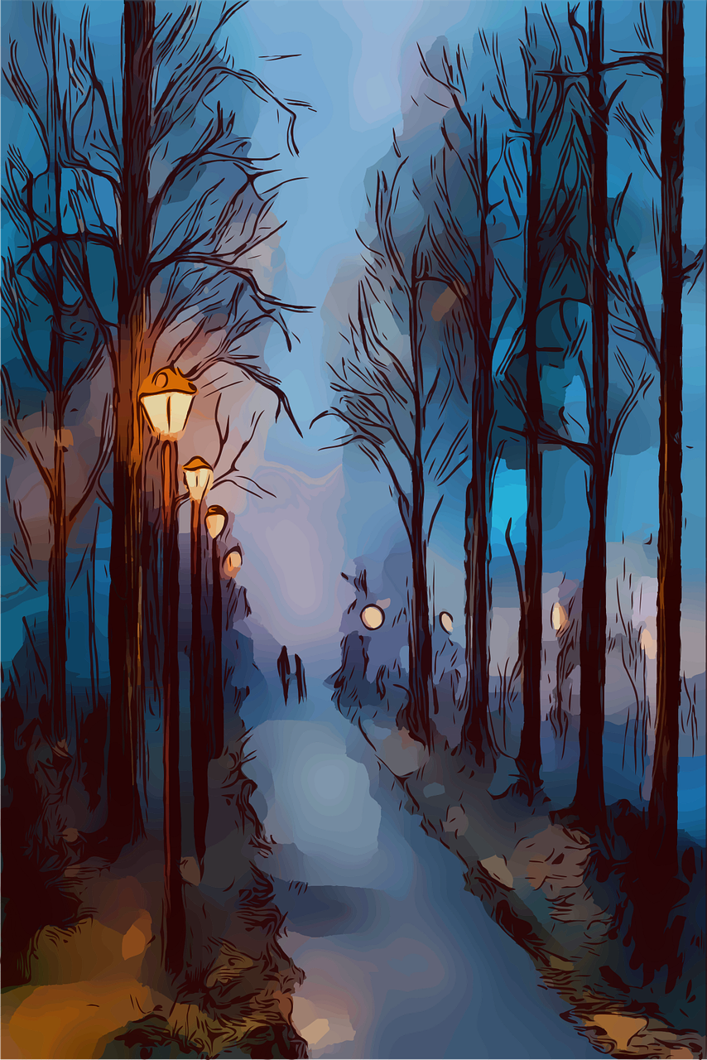
aussprechen
long [e]
short [e]
Weg
Welt
[path]
[world]
Notes:
5/8
Word frequency (1 is the most frequent word in German):
Weg [220] Welt [164]
6

Slide 7
aussprechen
long [i]
short [i]
relativ
drinnen
[relatively]
[inside]
Notes:
6/8
Word frequency (1 is the most frequent word in German):
relativ [571] drinnen [360]
7

Slide 8
aussprechen
[w]
[z]
verschwinden
Herz
[to disappear, disappearing]
[heart]
Notes:
7/8
Word frequency (1 is the most frequent word in German):
verschwinden [559] Herz [532]
8

Slide 9
ausprechen
soft [ch]
hard [ch]
berichten
suchen
[to report, reporting]
[to search, searching]
Notes:
8/8
Word frequency (1 is the most frequent word in German):
berichten [591] suchen [293]
9

Slide 10
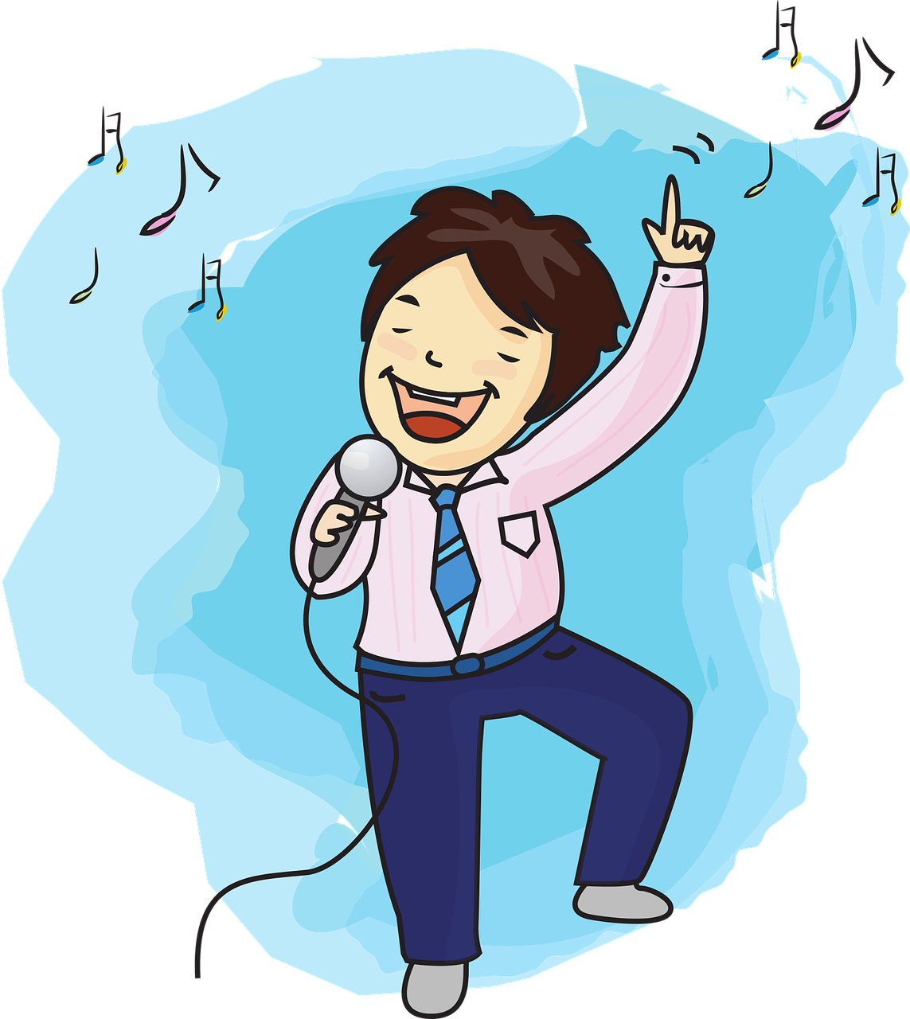
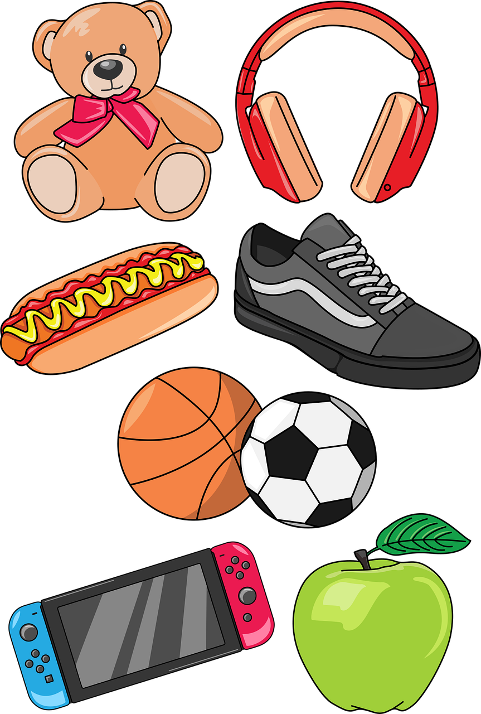
Follow up 2: Sag die Wörter.
aussprechen
morgen
gewinnen
Blick
Schule
60
[to win, winning]
[view]
S
Tafel
Flasche
Foto
Lied
Sachen
kennen
Recht
Bereich
0
[law]
[area]
START
Notes:
Timing: 5 minutes
Aim: to practise applying knowledge of previously learnt SSCs to known and unknown words.
Procedure: 1. Start the timer. Pupil A tries to read aloud all of the words taking care with their pronounciation of the highlighted SSC’s, within the 60 seconds allowed.
2. Pupil B listens. If Pupil A makes a slip, Pupil B can direct him/her to start again from the beginning. 3. They swap roles and repeat the task.
Word frequency for unknown words: (1 is the most frequent word in German):
Bereich [339] Blick [306] gewinnen [372] Recht [242]

Slide 11
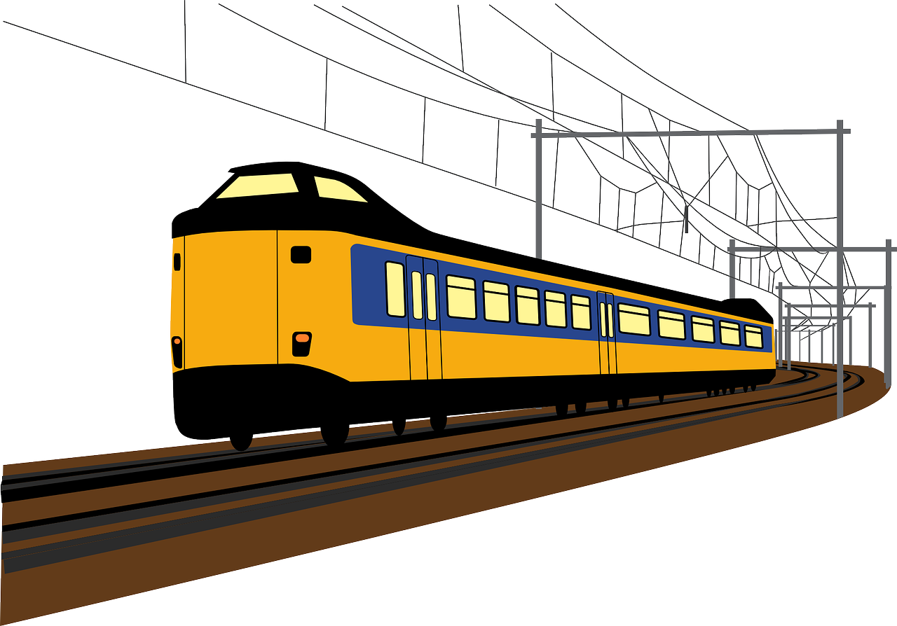
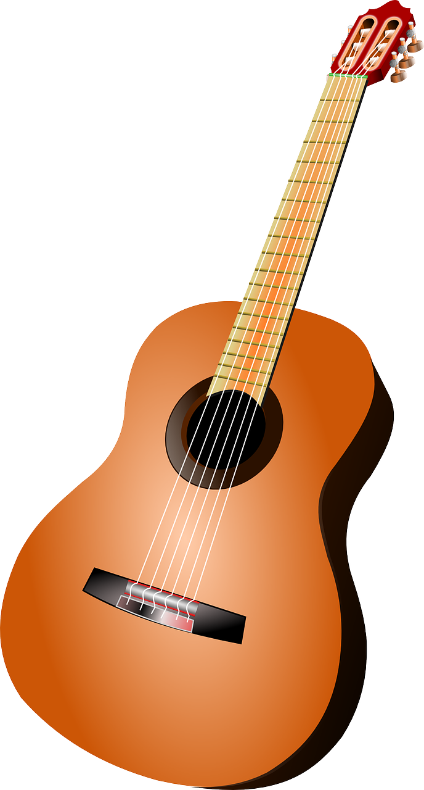
Follow up 3
Sag die Wörter.
sprechen
sprechen
story
der
das
die
die
Notes:
Timing: 5 minutes
Aim: to practise spoken production of a range of vocabulary and practise applying gendered articles
Procedure:
Click to bring up the image. Pupils say the word and say them aloud with the appropriate article.
Click again for the words to disappear into the appropriate ‘pacman’.
Continue for the rest of the items.
Items in order:
die Blume
die Gitarre
das Papier
das Fahrrad
der Tisch
die Katze
das Haus
das Foto
der Fußball
der Zug
das Spiel
die Geschichte

Slide 12
hören
Follow up 4
Das ist ein Quiz für dich, Robbie!
For each question, put a cross (x) under the type of word you hear. You will hear each German word twice. Choose one correct answer only.
This word is a good example of …
 | A | B | C | D
1. | a time span ☐ | a person ☐ | an animal ☐ | an object ☐
2. | an object ☐ | a description ☐ | a question word ☐ | a country ☐
3. | an animal ☐ | an object ☐ | a description ☐ | a question word ☐
4. | a description ☐ | a country ☐ | a question word ☐ | a greeting ☐
1
2
3
4
Notes:
Timing: 5 minutes
1/2
Procedure:
Pupils write 1-8 and write down A, B, C, or D for each word that they hear. Items 5-8 continue on the next slide.
Click to reveal answers 1-4 in turn.
Transcript:
Stunde
grün
freundlich
wann
12

Slide 13
hören
Follow up 4
This word is a good example of …
 | A | B | C | D
 | an object ☐ | a greeting ☐ | a person ☐ | a country ☐
 | a greeting ☐ | an object ☐ | an animal ☐ | a person ☐
 | a number ☐ | a country ☐ | a greeting ☐ | a question word ☐
 | an object ☐ | an animal ☐ | a person ☐ | a number ☐
5
6
7
8
Notes:
Answers
2/2
Transcript:
Bruder
Haustier
achtzehn
Geld
13

Slide 14
Follow up 5:

Schreib auf Deutsch.
Write any numbers as words! ☺

schreiben
1 _____________________________
Du hast am achten März Geburtstag.
You have on the eight of March (your) birthday.

Ich habe am dreißigsten Februar Geburtstag.
2 _____________________________
I have on 30 February (my) birthday .

3 _____________________________
Sie hat am siebzehnten Mai Geburtstag!
She has on 17 May (her) birthday!
Notes:
Timing: 5 minutes
Aim: to revise forms of the verb haben and dates.
Procedure:
Pupils translate the sentences from English into German.
Click for answers.

Slide 15
Tschüss!
grün
Notes:
15

