Slide 1
What I can do
Ich kann das!
grün
Phonics, Vocabulary
and Grammar revision
Term 1 Week 12
Notes:
Artwork by Steve Clarke. Pronoun pictures from NCELP (www.ncelp.org). All additional pictures selected from Pixabay and are available under a Creative Commons license, no attribution required.
Phonics: revisit SSC long and short [a] [e] [i] [o] [u] (for these also write long or short); [ei] [ie] [w] [z] hard and soft [ch]
Vocabulary: revisit words from lessons 1 – 11
Revisit 1: geben [49] Blume [2463] Foto [633] Fahrrad [2138] Fußball [1277] Geschichte [262] Gitarre [n/a] Haus [147] Katze [2235] Papier [1163] Spiel [328] Tisch [529] Zug [675]
Revisit 2: dreizehn [4772] vierzehn [3950] fünfzehn [2858] sechzehn [4924] siebzehn [n/a] achtzehn [3741] neunzehn [n/a] zwanzig [1359] zweiundzwanzig [n/a] dreißig [2046] einunddreißig [n/a] an [19]
Jones, R.L & Tschirner, E. (2019). A frequency dictionary of German: Core vocabulary for learners. London: Routledge.
The frequency rankings for words that occur in this PowerPoint which have been previously introduced in these resources are given in the SOW and in the resources that first introduced and formally re-visited those words.
For any other words that occur incidentally in this PowerPoint, frequency rankings will be provided in the notes field wherever possible.
Note that the first three lessons of the year teach language that can be continuously recycled as lesson routine every lesson in Y3/4.
The idea would be that the class teacher (whether or not s/he teaches the class German can re-use the language as part of the daily routine with the class.
The frequency rankings for words that occur in this PowerPoint which have been previously introduced in these resources are given in the SOW and in the resources that first introduced and formally re-visited those words.
For any other words that occur incidentally in this PowerPoint, frequency rankings will be provided in the notes field wherever possible.
Remember that at the start of the course (first three lessons of Rot/Gelb) pupils learnt language (for greetings and register taking) that can still be part of the lesson routines in upper KS2 (Blau/Grün). They are not re-taught, as we anticipate that teachers have built these in from early in lower KS2.
1

Slide 2
hören
Hör zu.
Final syllable vowels can be short or long before consonants so just listen out extra carefully!
Write 1-8 und the sound: [a], [e], [i] ,[o], [u] (and long or short); [ei], [ie], [w], [z], [ch] (for [ch] also hard or soft).
hören
1 | d e n k e n
2 | s o g a r
3 | j e d o ch
4 | r u n d
5 | a n d e r s
6 | j e m a n d
7 | r u f e n
8 | H e r z
?
?
short
short
?
?
long
long
?
?
to call
hard
long
?
round
?
short
Notes:
1/2
Timing: 5 minutes
Aim: to practise aural recognition and transcription of previously taught SSCs using unknown words.
Procedure:
Click for instructions to come up.
Click audio button 1 to play the recording for item 1. Pupils need to write down the SSC.
Elicit the answer.
Click to reveal the spelling of word 1.
Click to bring up callout to remind pupils of final syllable vowel length variation.
Elicit the meaning, based on the image.
Continue for items 2-8.
Transcript and word frequency: 1. denken [128] (short [e])
2. sogar [226] (long [o])
3. jedoch [228] (hard [ch])
4. rund [296] (short [u])
5. anders [303] (short [a])
6. jemand [330] [long [e])
7. rufen [530] (long [u])
8. Herz [532] ([z])
Source: Jones, R.L. & Tschirner, E. (2019). A frequency dictionary of German: core vocabulary for learners. Routledge

Slide 3
hören
Hör zu.
Write 1-8 und the sound: [a], [e], [i] ,[o], [u] (and long or short); [ei], [ie], [w], [z], [ch] (for [ch] also hard or soft).
hören
1 | r e l a t i v
2 | v ö l l i g
3 | p e r s ö n l i ch
4 | L a g e
5 | E r f o l g
6 | w ü n s c h e n
7 | n i e d r i g
8 | b r ei t
?
?
long
short
success
?
?
short
to wish
?
?
soft
low
?
?
long
wide
Notes:
2/2
Timing: 5 minutes
Transcript and word frequency: 1. relativ [572] (long [i])
2. völlig [515] (short [i])
3. persönlich [545] (soft [ch])
4. Lage [555] [long [a]]
5. Erfolg [541] (short [o])
6. wünschen [630] short [w]
7. niedrig [778] ([ie])
8. breit [847] ([ei])

Slide 4
Vokabeln
Meet the Primary Bee!
Wörter
Word knowledge not spelling
Open to Y5/6
Three stages (school, regional, national) each with 40 words
Notes:
OPTIONAL SLIDE (before practising the vocabulary)
Timing: 5 minutes
Aim: to present and practise new vocabulary for this week combined with an introduction to the Primary Bee.
Procedure:
Click through the animations and briefly explain the Primary Bee.
Notes taken from the Primary Bee Teachers’ Pack (2022): The aim of the Primary Bee is for students in Years 5 & 6 who have started learning a foreign language ab initio in KS2 to practise and improve their vocabulary, pronunciation and memory skills in the target language (French, Spanish and German). Native or bilingual students, as well as those who communicate in or are exposed to the language on a regular basis at home (speaking and/or listening), are not eligible to compete. It is the classroom teacher’s responsibility, with careful consideration of the ethos of the competition, to decide whether or not a student falls into this category.
Words and phrases have been selected according to the work of NCELP (National Centre for Excellence in Language Pedagogy) which highlights the importance of word frequency in informing vocabulary learning, particularly during the early stages of language development. The list includes many high-frequency words (e.g., some numbers, some colours, some verbs, days of the week, question words and a number of common verbs to help early learners to acquire a robust knowledge of verb vocabulary. These most common verbs are included in the infinitive and 3rd person singular forms; these two verb forms have been shown to provide a very useful linguistic core that can subsequently be further developed. For information we publish the word lists, indicating the word frequency.
4

Slide 5
Vokabeln
Was ist das auf Englisch?
Wörter
das Mädchen
erklären
alles
die Fahrräder
nichts
die Stadt
schön
vierzehn
lesen
everything
(the) girl
fourteen
(the) bicycles
nothing
to read, reading
lovely, beautiful
(the) town
to explain, explaining
Notes:
Timing: 6 minutes (two slides)
Aim: to practise written comprehension and read aloud of vocabulary from the Primary bee which overlaps with years 3/4 vocabulary.
Procedure: 1. Click for a German word. Elicit pronunciation from pupils.
2. Elicit the English meaning from pupils and click to confirm.
3. Continue with the remaining words.
4. Then move on to the next slide.
Transcript:
lesen
vierzehn
alles
nichts
schön
die Stadt
die Fahrräder
das Mädchen
erklären
5

Slide 6
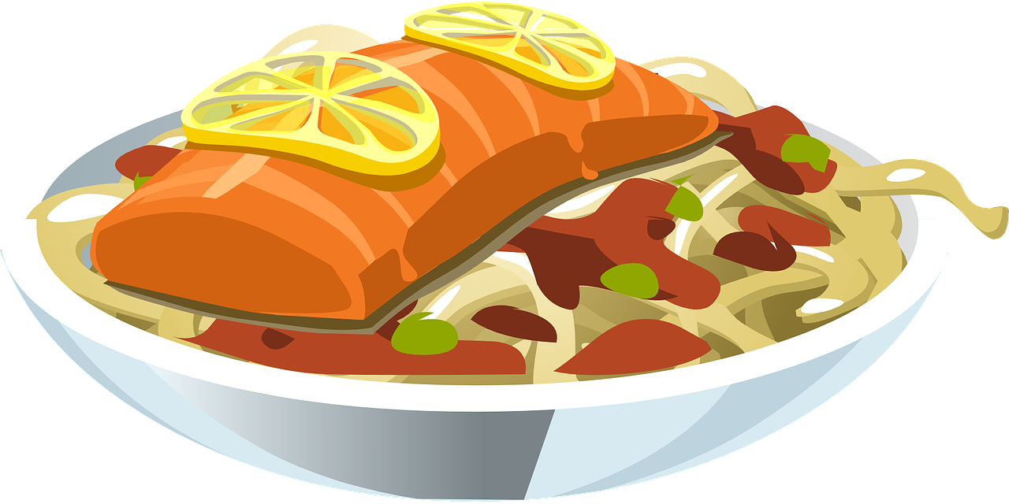
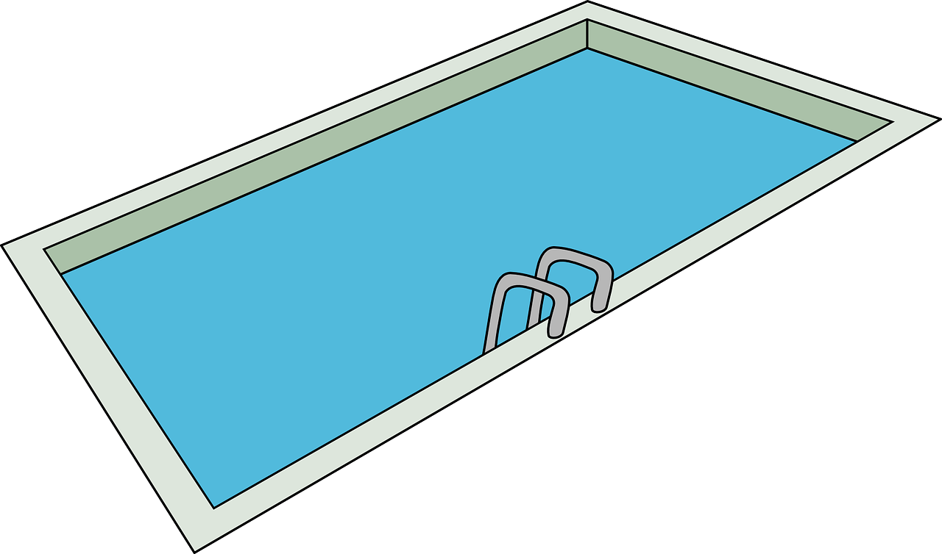
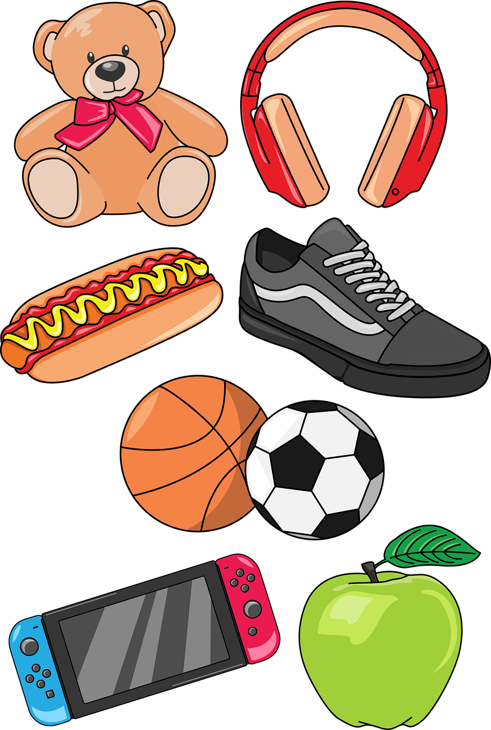
Vokabeln
Was ist das auf Deutsch?
Wörter
(the) things
(the) food, meal
(the) ice cream
Austria
(the) money
(the) country, countryside
(the) swimming pool
(the) cheese
(the) lake
das Schwimmbad
das Geld
das Essen
das Land
der Käse
die Sachen
das Eis
der See
Österreich
Notes:
Aim: to elicit oral production and accurate read-aloud of nouns from the Primary Bee (all previously taught from this SOW).
Procedure: 1. Click for an English word.
2. Elicit the German word from all pupils, chorally.
3. Click to provide the written answer.
4. If needed, click on the picture to hear the word pronounced.
Transcript:
das Land
das Schwimmbad
das Geld
die Sachen
der See
Österreich
der Käse
das Eis
das Essen
6

Slide 7
lesen
Robbie has forgotten some of his German. Can you help him?
 |  | A: mag | B: magst |  | C: 1 oder 2?
1 | du |  |  | keinen | ☐ Fotos (pl) ☐ Käse (m)
2 | er |  |  | kein | ☐ das Spiel (nt) ☐ Dorf (nt)
3 | ich |  |  | keine | ☐ Blumen (pl) ☐ Song (m)
4 | sie |  |  |  | ☐ den Ort (m) ☐ Aktivität (f)
5 | ich |  |  | kein | ☐ Farben (pl) ☐ Buch (nt)
6 | du |  |  |  | ☐ Fahrrad (nt) ☐ den Fußballspieler (m)
7 | es |  |  | keinen | ☐ Park (m) ☐ Sätze (pl)
8 | ich |  |  | keine | ☐ Spiele (pl) ☐ Haus (nt)
Remember!
Danke!
kein means no/not a, but in English it sometimes sounds better to say ‘any’ with a negative verb: Ich mag keinen Käse. I like no cheese → I don’t like any cheese.
1
2
3
4
5
6
7
8
Notes:
Timing: 8 minutes
Aim: to revise the singular forms of mögen and negation of plural nouns with keine.
Procedure:
Pupils write out 1-9, and write down A (mag), B (magst) and C1 or C2, depending on the form of kein or absence of kein before each noun. Note that the gender/number indicator has been provided to focus all of pupils’ attention on the connection between the form of kein and these aspects of each noun, or the absence of kein and the connection to the use of the definite article.
Click to bring up answer ticks in turn.
If time, elicit English translations for the full sentences.
Click on the number buttons to listen and check.
Note: the animations are set up for completion and correction of columns A/B first (the verb contrast) and then for Column C1/C2 (kein form/no kein noun contrast). Teachers can adapt this, as required.
Transcript: 1. Du magst keinen Käse.
2. Er mag kein Dorf. 3. Ich mag keine Blumen.
4. Sie mag den Ort. 5. Ich mag kein Buch. 6. Du magst den Fußballspieler. 7. Es mag keinen Park. 8. Ich mag keine Spiele.
7

Slide 8
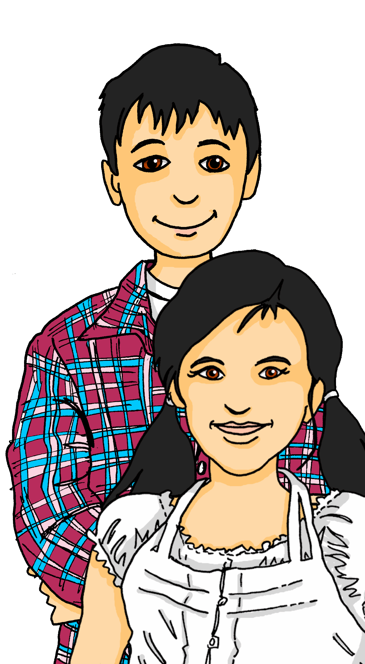
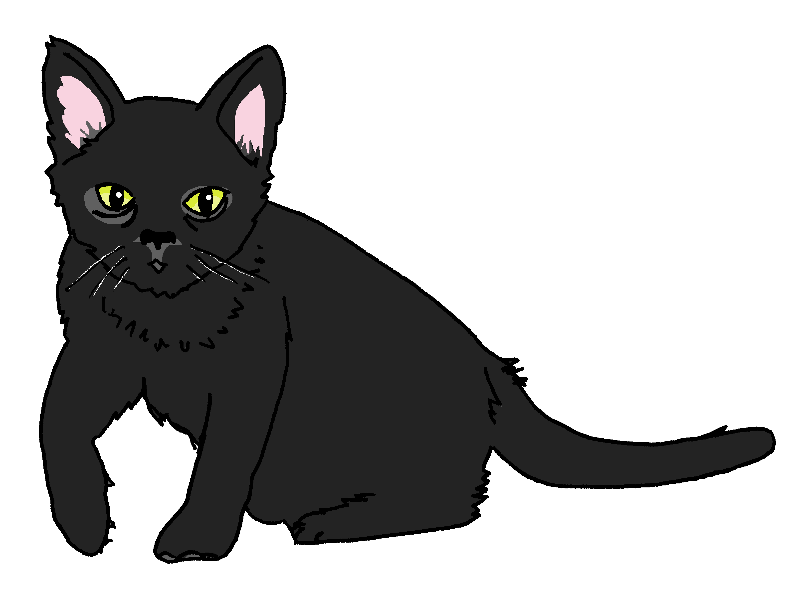
hören
Sie (Singular) oder sie (Plural)?
Ist das Leonie, oder sind das Lias und Ronja?
Leonie | Lias und Ronja
B.
1
2
3
4
5
6
Notes:
Timing: 5 minutes
Aim: to practise aural comprehension of sie (plural) vs sie (singular) based on singular or plural verb forms.
Procedure:
1. Click to play the audio for the example. Pupils choose their answer, based on the verb.
2. Click for answer tick. Click again to bring up Minze, Lias’ and Ronja’s cat, whom we haven’t seen for a while – if at all, if pupils are following Grün before Blau.
3. Continue for items 1-6.
Transcript:
Beispiel: Sie gibt Minze Wasser.
Sie geben Mariem einen Fußball.
Sie haben im März Geburtstag.
Sie ist im Park.
Sie sind in der Schweiz in der Schule.
Sie mag Käse.
Sie hat eine Schwester.
8

Slide 9
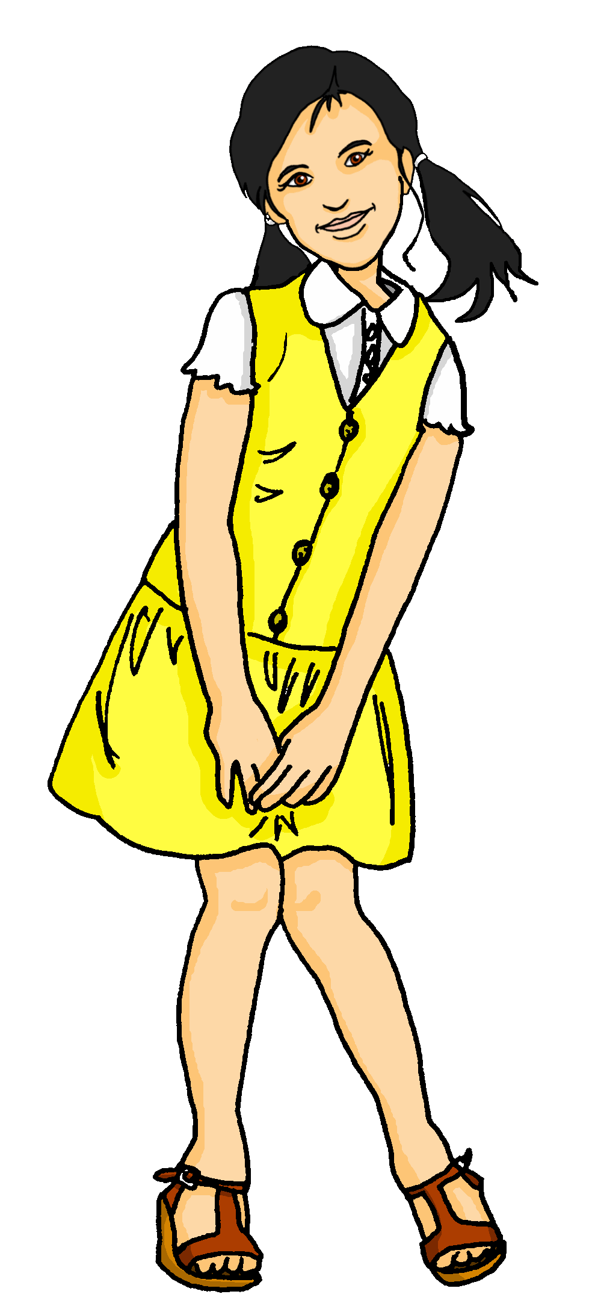
sprechen
Partnerarbeit
Ronja and Robbie take it in turns to say as many sentences as they can in one minute. You do the same with a partner!
60
 |  |  | Essen (nt)
 | gebe |  | Konzert (nt)
 | gibt | einen | Fahrrad (nt)
ich | gebt | eine | Feier (f)
er | habe | ein | Sachen (pl)
ihr | hat | keine | Blumen (pl)
 | habt |  | Katze (f)
 |  |  | Spiel (nt)
 |  |  | Bücher (pl)
Remember!
Positive plural statements need no article: → Er gibt Bilder (He gives pictures). Negative plural statements with nouns use keine: → Ich habe keine Flaschen. (I have no bottles / I don’t have any bottles.)
S
0
START
Notes:
1/2
Timing: 2 minutes (2 slides)
Aim: to practise spoken production of forms of geben and haben with forms of the indefinite article einen, eine, ein and keine for plural and/or feminine nouns.
Procedure:
Explain that pupils have to make as many sentences as they can and say them out loud in under one minute (use the timer).
First, the gender is indicated in brackets so that pupils can practise to get this right.
On the second slide, pupils do the task without the gender of the nouns being indicated in brackets.
If their partner notices a gender mistake, they swap over.
9

Slide 10
sprechen
Partnerarbeit
Ronja and Robbie take it in turns to say as many sentences as they can in one minute. You do the same with a partner!
60
Remember!
 |  |  | Essen
 | gebe |  | Konzert
 | gibt |  | Fahrrad
ich | gebt | einen | Feier
er | habe | eine | Sachen
ihr | hat | ein | Blumen
 | habt | keine | Katze
 |  |  | Spiel
 |  |  | Bücher
Positive plural statements need no article: → Er gibt Bilder (He gives pictures). Negative plural statements with nouns use keine: → Ich habe keine Flaschen. (I have no bottles / I don’t have any bottles.)
S
0
START
Notes:
2/2
Slide 2 without the gender of the nouns being indicated in brackets.
10

Slide 11
Can you help Robbie with his German?
Put a (X) next to the noun that completes each sentence.
lesen
1. | Diese | ☐ Partnerin (f) ☐ Mädchen (nt) | ist sehr nett.
2. | Dieser | ☐ See (m) ☐ Schwimmbad (nt) | ist klein.
3. | Dieses | ☐ Blume (f) ☐ Foto (nt) | ist schön.
4. | Hast du | einen | ☐ Song (m)? ☐ Katze(f)?
5. | Er hat | keine | ☐ Papier (nt). ☐ Idee(f).
Notes:
Timing: 5 minutes
Aim: to practise written understanding of dieser/diese/dieses and indefinite articles in the accusative/Row 2.
Note: the audio version of this resource has the audio attached to the answer cross (click on the green cross for each item, once it has appeared.
Procedure:
Pupils select the correct choice out of two for items 1-5.
Elicit answers.
Click for answers.
11

Slide 12
Tschüss!
grün
Notes:
12

