Slide 1
Interacting
Klassenfahrt
grün
Follow ups 1-5
Term 1 Week 1
Notes:
Artwork by Steve Clarke. Pronoun pictures from NCELP (www.ncelp.org). All additional pictures selected from Pixabay and are available under a Creative Commons license, no attribution required.
Phonics:
long [a] ja [45] da [239] Tag [111]
short [a] hallo [1077] danke [877] was? [38]
Vocabulary: wir sind, ihr seid [4] wir [26] ihr² [27] müde [2000] ruhig [991] schön [188] wunderbar [1603] da [48] hier [68] Österreich [707] Park [2141] Restaurant [1802]
Schweiz [763] Stadt [204] Zug [675] in [3] nicht wahr [n/a] ja [45] nein [148]
Revisit 1: Januar [1052] Februar [1093] März [987] April [1004] Mai [1048] Juni [1148] Juli [1544] August [1929] September [1035] Oktober [1223] November [1273] Dezember [1527]
Monat [316] wann [647]
Jones, R.L & Tschirner, E. (2019). A frequency dictionary of German: Core vocabulary for learners. London: Routledge.
The frequency rankings for words that occur in this PowerPoint which have been previously introduced in these resources are given in the SOW and in the resources that first
introduced and formally re-visited those words.
For any other words that occur incidentally in this PowerPoint, frequency rankings will be provided in the notes field wherever possible.

Slide 2
aussprechen
long [a]
…
ja
da
Tag
[yes]
[there]
[day]
Lina
Moritz
Notes:
Timing: 2 minutes
Aim: to consolidate the SSC long [a].
Procedure:
Re-present the SSC and the source word ‘da’ (with gesture, if using).
Click to bring on the picture and get pupils to repeat the word ‘da’ (with gesture, if using).
Present the cluster words in the same way, bringing on the picture and getting pupils to pronounce the words.
Note:
a gesture for ‘da’ might be to point at something away from you
2

Slide 3
aussprechen
short [a]
…
was?
hallo
danke
Notes:
Timing: 2 minutes
Aim: to consolidate the SSC short [a].
Procedure:
Re-present the SSC and the source word ‘hallo’ (with gesture, if using).
Click to bring on the picture and get pupils to repeat the word ‘hallo’ (with gesture, if using).
Present the cluster words in the same way, bringing on the picture and getting pupils to pronounce the words.

Slide 4
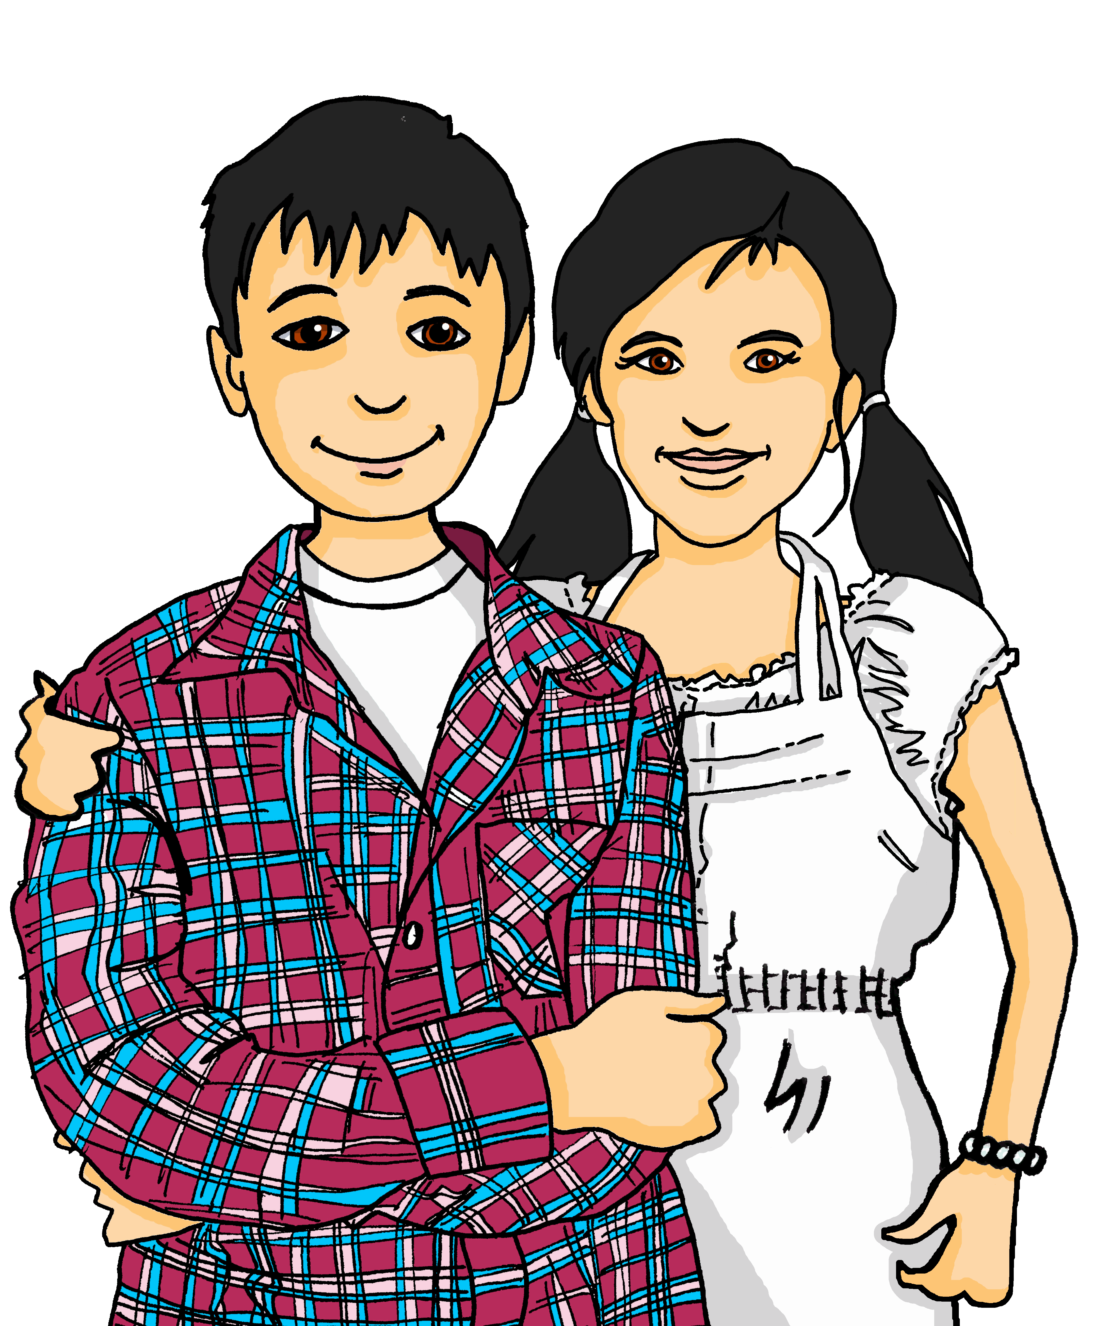
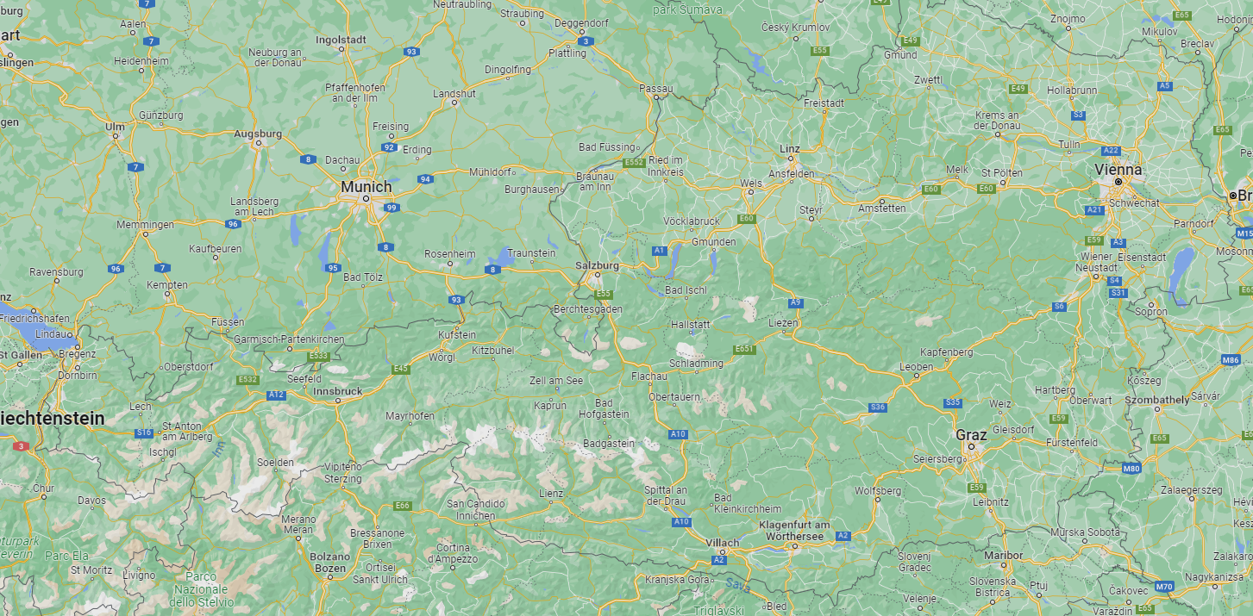
Follow up 1
Lias und Ronja finden Orte in Österreich bei* Google.
Wie heißt der Ort?
aussprechen
60
1. Passau
2. Amstetten
3. Salzburg
S
6. Kapfenberg
5. Kaprun
7. Oberwart
4. Sankt Anton am Arlberg
8. Bad Gastein
9. Graz
10. Spital an der Drau
11. Klagenfurth am Wörthersee
0
12. Villach
bei – here: on
START
Notes:
Timing: 3 minutes
Aim: to practise this week’s SSCs
Procedure:
Click to start the timer.
Pupils practise long and short [a] pronounciation reading out the 12 place names individually or in pairs.
Click on each place name to hear it pronounced, if desired.
Vocabulary: bei [29]
Jones, R.L & Tschirner, E. (2019). A frequency dictionary of German: Core vocabulary for learners. London: Routledge.

Slide 5
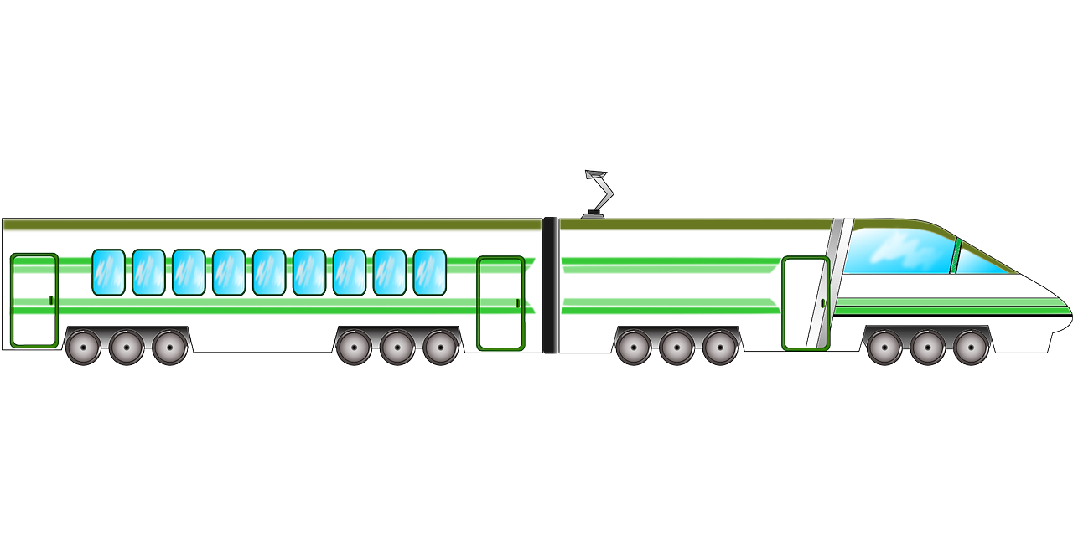
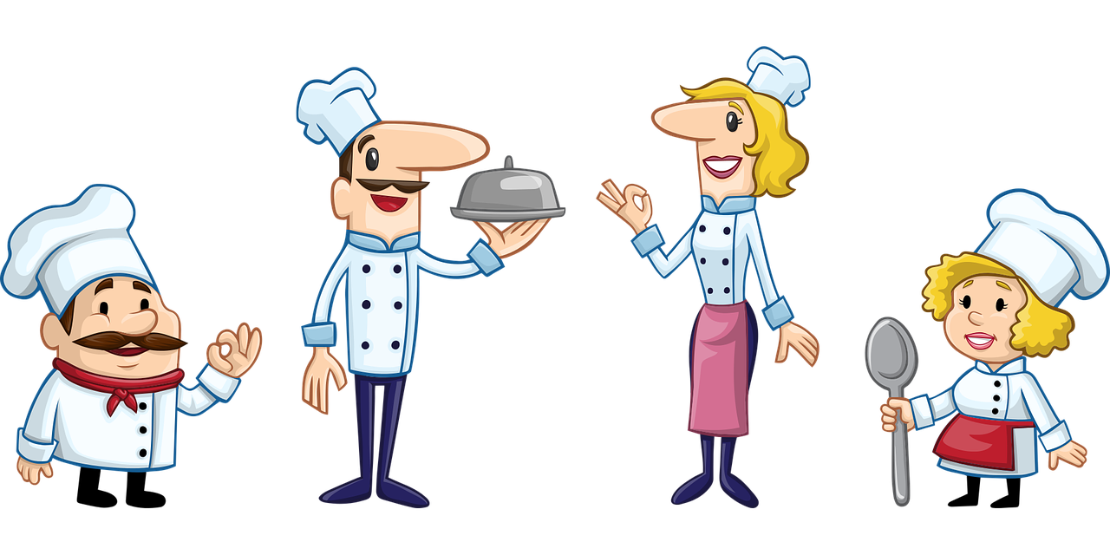
Follow up 2
Hör zu. Wer ist wo?
hören
 | ?
B
A
1
D
2
F
C
D
E
3
H
G
4
B
5
F
G
H
6
A
Notes:
Timing: 8 minutes
Aim: to practise im/ in der and also sind/seid/bist/bin in the listening modality.
Procedure:
Click to play the first recording. Pupils look at the pronoun+ image combinations A-H and select the correct one. NB: there are 8 pronoun/image combinations but only 6 items, so 2 items will be left over.
Elicit answer. Click for answer letter to appear.
Continue for times 2-6.
Click to bring up full sentences audio, which can be used to check answers.
Transcript:
1. Du bist in der [beep] (answer = Schweiz) 2. Ihr seid im [beep] (answer = Restaurant 3. Wir sind im [beep] (answer = Zug) 4. Ich bin in der [beep] (answer = Stadt) 5. Sind wir in der [beep]? (answer = Stadt) 6. Seid ihr in der [beep]? (answer = Schweiz)

Slide 6
Follow up 3
Wie finden Lias und Ronja das Land?
Ist das richtig? Ja? Dann schreib den Satz. Nein? Dann korrigiere* den Satz.
lesen
die Schweiz
 | Richtig oder falsch? | Schreib den Satz richtig!
1
2 | Wir finden Österreich im Dezember wunderbar . | Wir finden die Schweiz im Dezember wunderbar.
3 | Die Parks in der Schweiz sind schön, nicht wahr? | Die Parks in Österreich sind schön, nicht wahr?
4 | Nein, in Österreich im Januar sind wir nicht müde.
5 | Die Stadt Biel ist hier in der Schweiz, ja.
6 | In der Schweiz im Monat Mai, da ist es schön. | In Österreich im Monat Mai, da ist es schön.
wonderful in December
Wir finden die Schweiz im Juli ruhig.
Biel is here
quiet, calm in July
Österreich
beautiful in May
not tired here in January
beautiful parks
korregiere - correct
Notes:
Timing: 8 minutes
Aim: to practise written comprehension of this week’s and previously taught vocabulary in longer sentences with varied word order.
Procedure:
Explain the scenario. Pupils number 1-6, tick if the sentence is correct, or write out a corrected version of the sentence, if false, according to the English information given about both countries on the right.
Click to reveal the answers item by item.
Vocabulary: korrigieren [1326] Satz [432] finden [103]
Jones, R.L & Tschirner, E. (2019). A frequency dictionary of German: Core vocabulary for learners. London: Routledge.

Slide 7
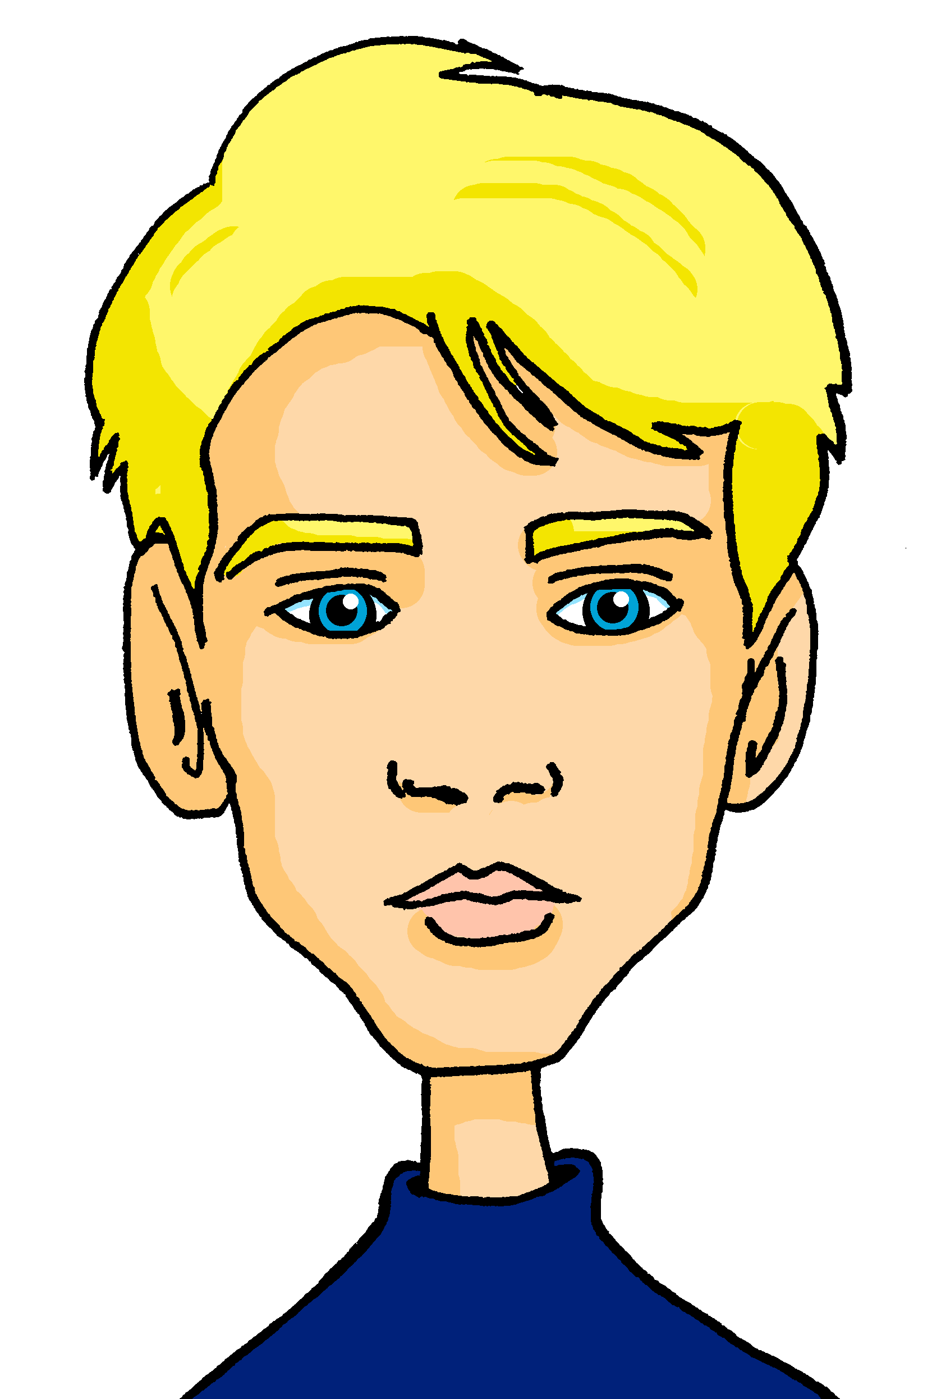
Follow up 4:

Schreib auf Deutsch. Du bist Ronja.
schreiben
Gabriel
Lias
Jana
Matteo
Ronja
im Garten
in der Schweiz
Mariem
in der Stadt
im Zug
im Restaurant
im Park
1. Wir sind im Restaurant.
1. We are in the restaurant.
2. You are in Switzerland.
3. You (all) are in the town.
4. You are on (in) the train.
5. We are in the park.
6. You are in the garden.
2. Du bist in der Schweiz.
3. Ihr seid in der Stadt.
4. Du bist im Zug.
5. Wir sind im Park.
6. Ihr seid im Garten.
Notes:
There are two versions of this slide. This is the more structured version, with sentences to translate and support provided with some of the language. The next slide has a more challenging version.
Timing: 10 minutes.
Aim: to practise the parts of sein in the written modality.
Procedure:
Explain that pupils are writing as Ronja. They have to translate the verb forms and pronouns for sentences 1-6.
Click for answers.

Slide 8
Follow up 4:

Schreib auf Deutsch. Du bist Ronja.
schreiben
Gabriel
Lias
Jana
Matteo
Ronja
in (the) Switzerland
in the garden
Mariem
in the restaurant
in the town
on (in) the train
in the park
1. Wir sind im Restaurant.
1. We are in the restaurant.
2. You are in Switzerland.
3. You (all) are in the town.
4. You are on (in) the train.
5. We are in the park.
6. You (all) are in the garden.
2. Du bist in der Schweiz.
3. Ihr seid in der Stadt.
4. Du bist im Zug.
5. Wir sind im Park.
6. Ihr seid im Garten.
Notes:
More challenging, this slide has full sentences to translate into German.
Timing: 10 minutes.
Aim: to practise the parts of sein in the written modality.
Procedure:
Explain that pupils are writing as Ronja. They have to translate the full sentences for 1-6.
Click for answers.

Slide 9
Follow up 4:

Schreib auf Deutsch. Du bist Ronja.
schreiben
Gabriel
Lias
Jana
Matteo
Ronja
in (the) Switzerland
in the garden
2
6
Mariem
3
in the town
on (in) the train
1
in the restaurant
4
5
in the park
1. Wir sind im Restaurant.
2. Du bist in der Schweiz.
3. Ihr seid in der Stadt.
4. Du bist im Zug.
5. Wir sind im Park.
6. Ihr seid im Garten.
Notes:
Most challenging, this version has prompts in English but no full sentences to translate.
Timing: 10 minutes.
Aim: to practise the parts of sein in the written modality.
Procedure:
Explain that pupils are writing as Ronja. They have to translate the full sentences for 1-6.
Click for answers.

Slide 10
Follow up 5

Schreib auf Englisch.
Can you get at least 12 points?
Wörter
 | Juni | August | der Monat
 | Mai | Oktober | Dezember
 | Juli | Februar | Januar
 | wann? | der Geburtstag | März
 | die Stadt | der Park | der Zug
 | ihr seid | schön | das Restaurant
 | wir | ihr | wir sind
June
August
(the) month
Vokabeln
May
October
December
x2
February
January
July
when?
(the) birthday
March
(the) town
(the) park
(the) train
you (all) are
lovely, beautiful
(the) restaurant
x1
we
you (all)
we are
Notes:
Timing: 5 minutes
Aim: to practise written comprehension of vocabulary from this and revisited weeks.
Procedure: 1. Give pupils a blank grid. They fill in the English meanings of any of the words they know, trying to reach 15 points in total. 2. Remind pupils that adjectives can refer to male or female persons and they should note this in their translations. E.g. pleased (f), short (m).
Note: The most recently learnt and practised words are pink, words from the previous week are green and those from week 1 are blue, thus more points are awarded for them, to recognise that memories fade and more effort (heavy lifting!) is needed to retrieve them.

Slide 11
Follow up 5

Schreib auf Deutsch.
Can you get at least 12 points?
Wörter
 | July | when? | March
 | January | December | February
 | (the) birthday | August | May
 | (the) month | October | June
 | we | we are | (the) restaurant
 | (the) town | (the)train | you (all) are
 | you (all) | (the) park | lovely, beautiful
Juli
wann?
März
Vokabeln
Januar
Dezember
Februar
x2
der Geburtstag
August
Mai
der Monat
Oktober
Juni
wir
wir sind
das Restaurant
die Stadt
der Zug
ihr seid
x1
ihr
der Park
schön
Notes:
Timing: 5 minutes
Aim: to practise written comprehension of vocabulary from this and revisited weeks.
Procedure: 1. Give pupils a blank grid. They fill in the German meanings of any of the words they know, trying to reach 15 points in total. 2. Remind pupils that adjectives can refer to male or female persons and they should note this in their translations. E.g. pleased (f), short (m).
Note: The most recently learnt and practised words are pink, words from the previous week are green and those from week 1 are blue, thus more points are awarded for them, to recognise that memories fade and more effort (heavy lifting!) is needed to retrieve them.

Slide 12
Tschüss!
grün
Notes:
12

Slide 13
Follow up 5

Schreib auf Englisch.
Can you get at least 12 points?
Wörter
 | Juni | August | der Monat
 | Mai | Oktober | Dezember
 | Juli | Februar | Januar
 | wann? | der Geburtstag | März
 | die Stadt | der Park | der Zug
 | ihr seid | schön | das Restaurant
 | wir | ihr | wir sind
Vokabeln
x2
x1
Notes:
Template

Slide 14
Follow up 5

Schreib auf Deutsch.
Can you get at least 12 points?
Wörter
 | July | when? | March
 | January | December | February
 | (the) birthday | August | May
 | (the) month | October | June
 | we | we are | (the) restaurant
 | (the) town | (the)train | you (all) are
 | you (all) | (the) park | lovely, beautiful
Vokabeln
x2
x1
Notes:
Template

