Slide 1
Interacting
eine Show sehen
grün
Follow ups 1-5
Term 1 Week 3
Notes:
Artwork by Steve Clarke. Pronoun pictures from NCELP (www.ncelp.org). All additional pictures selected from Pixabay and are available under a Creative Commons license, no
attribution required.
Phonics:
long [o] wo? [94] wohnen [380] Million [206]
short [o] Kopf [279] offen [382] kommen [61]
Vocabulary: mögen, ich mag, du magst, er/sie/es mag [168] Fahrräder [2138] Feier [n/a] Häuser [147] Länder [134] Mädchen [602] Musiker [2577] Sportler [2565]
Jones, R.L & Tschirner, E. (2019). A frequency dictionary of German: Core vocabulary for learners. London: Routledge.
The frequency rankings for words that occur in this PowerPoint which have been previously introduced in these resources are given in the SOW and in the resources that first
introduced and formally re-visited those words.
For any other words that occur incidentally in this PowerPoint, frequency rankings will be provided in the notes field wherever possible.
Remember that at the start of the course (first three lessons of Rot/Gelb) pupils learnt language (for greetings and register taking) that can still be part of the lesson routines in upper KS2 (Blau/Grün). They are not re-taught, as we anticipate that teachers have built these in from early in lower KS2.

Slide 2
aussprechen
long [o]
…
wohnen
wo
Million
Notes:
Timing: 1 minute
Aim: to consolidate the SSC long [o].
Procedure:
Re-present the SSC and the source word ‘wo’ (with gesture, if using).
Click to bring on the picture and get pupils to repeat the word ‘wo’ (with gesture, if using).
Present the cluster words in the same way, bringing on the picture and getting pupils to pronounce the words.
Word frequency (1 is the most frequent word in German): Million [206]] ohne [119] wo? [94] wohnen [380]
Jones, R.L & Tschirner, E. (2019). A frequency dictionary of German: Core vocabulary for learners. London: Routledge.

Slide 3
aussprechen
short [o]
…
kommen
Kopf
offen
kommen – to come
Notes:
Timing: 1 minute
Aim: to consolidate the SSC short [o].
Procedure:
Re-present the SSC and the source word ‘Kopf’ (with gesture, if using).
Click to bring on the picture and get pupils to repeat the word ‘Kopf’ (with gesture, if using).
Present the cluster words in the same way, bringing on the picture and getting pupils to pronounce the words.
Word frequency (1 is the most frequent word in German): kommen [61] Kopf [279] offen [382]
Jones, R.L & Tschirner, E. (2019). A frequency dictionary of German: Core vocabulary for learners. London: Routledge.
3

Slide 4
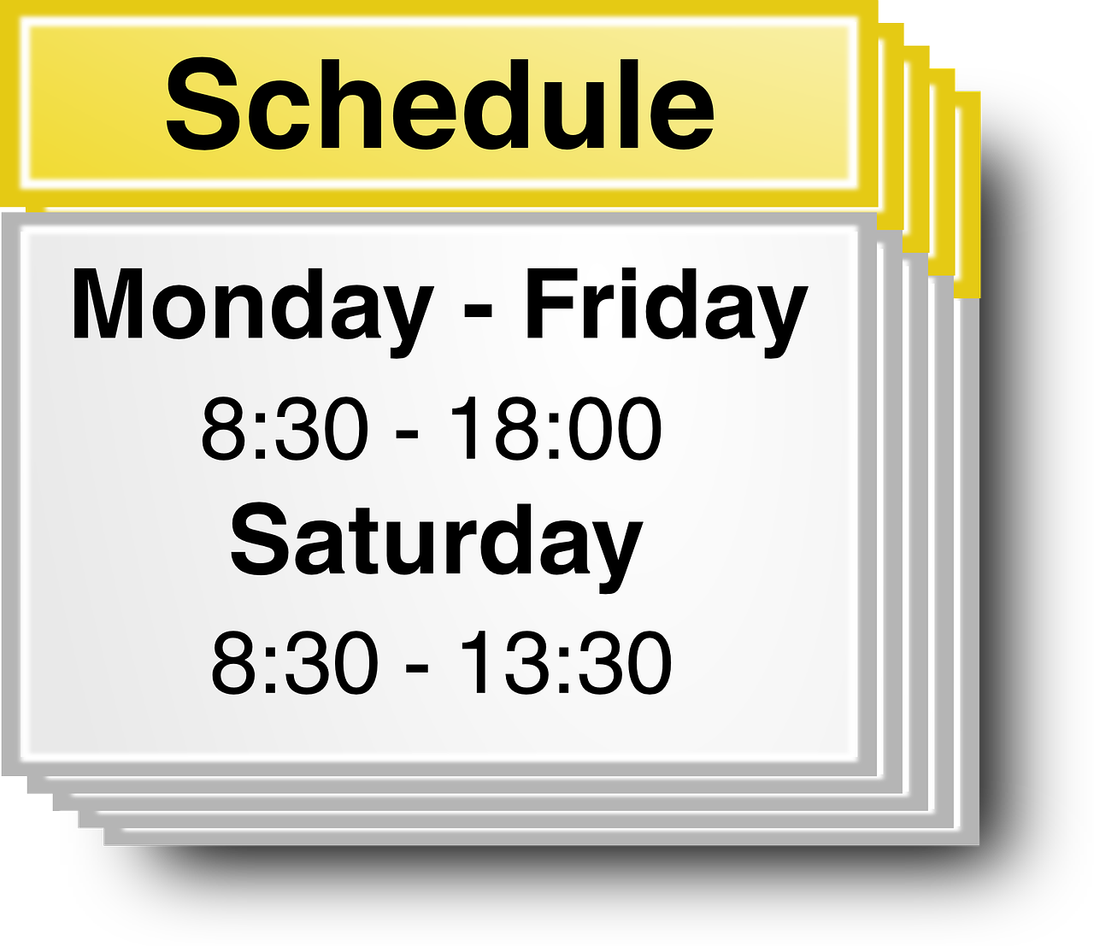
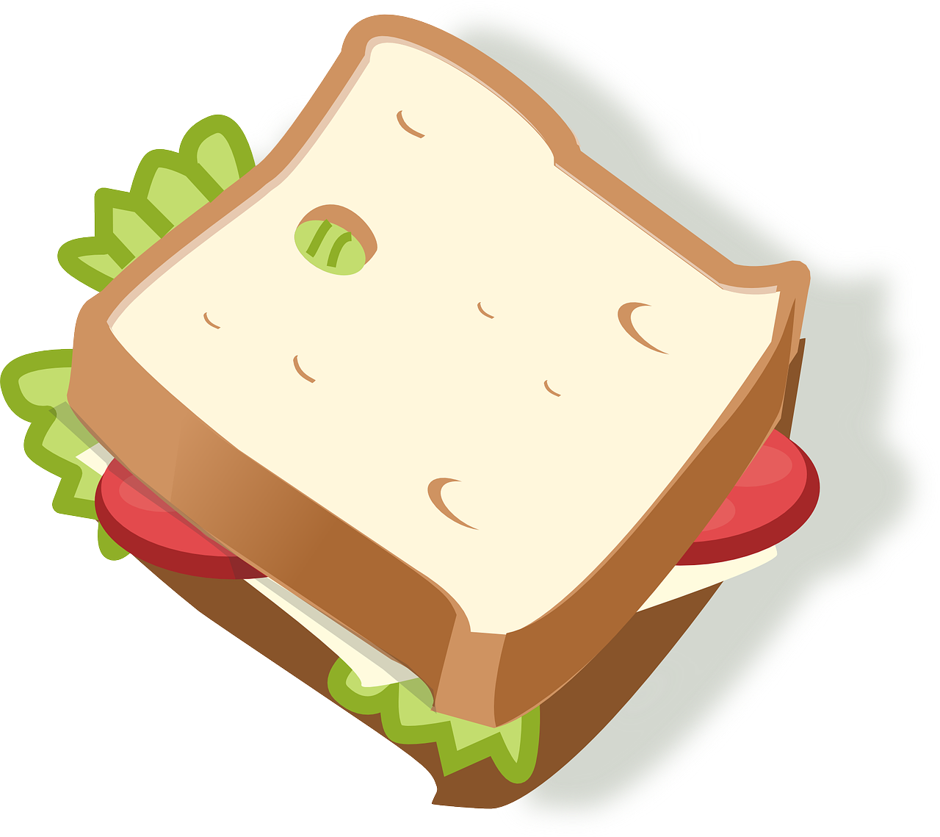
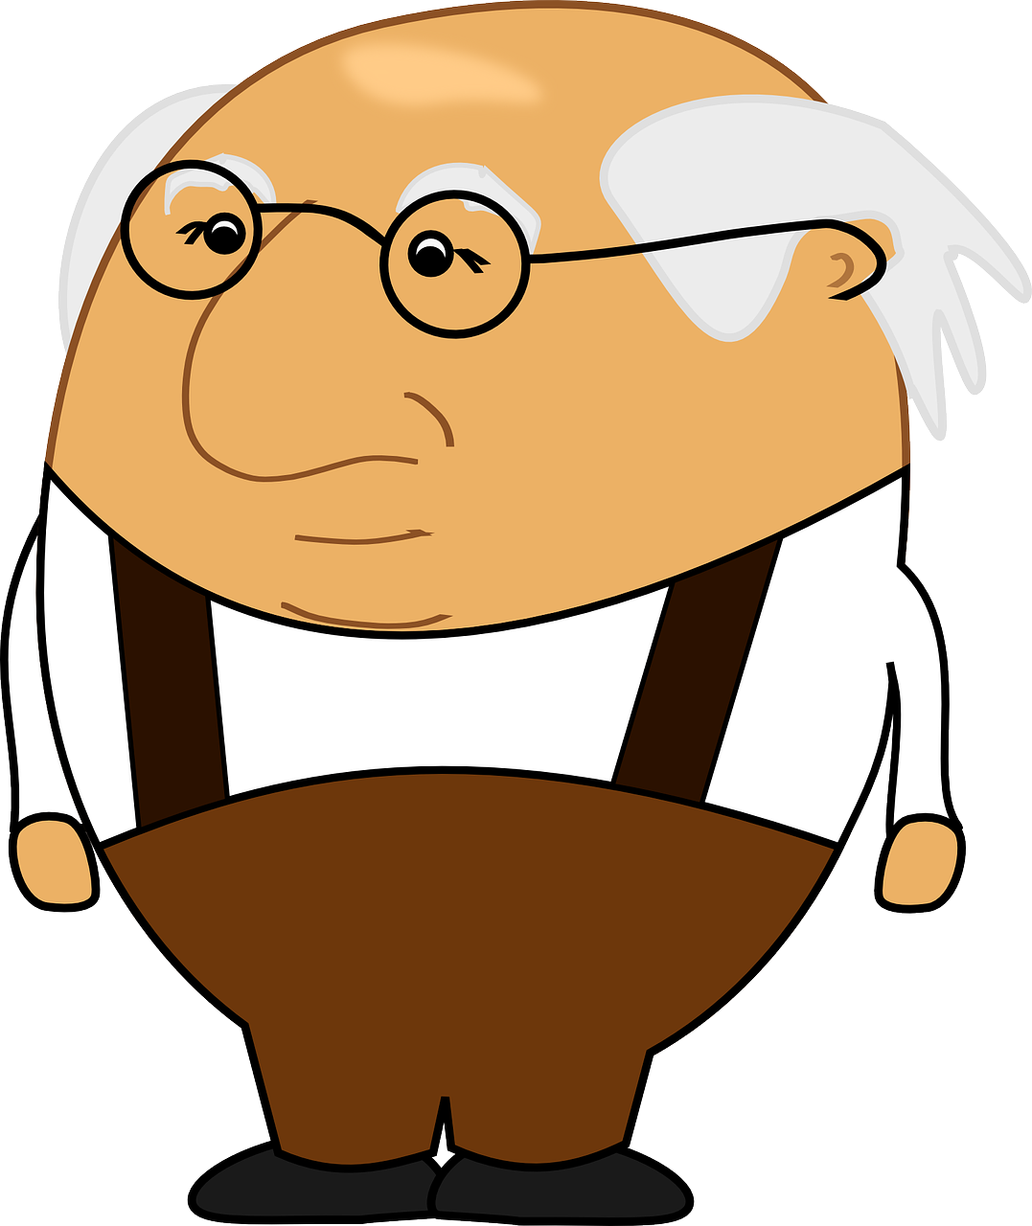
Follow up 1
long and short [o]
Hör zu. Langes oder kurzes [o]?
aussprechen
der Grand Prix
long [o] | short [o]
 | Osman
Ophelia
Moses
 | Oswin
Doro
Okatavio | Oktavio
Say these words one after the other as quickly as you can. Your partner will count and check.
1
2
Woche
Doktor
Rolle
Butterbrot
3
Monat
Kosten
oder
positiv
4
Nov
5
Kilometer
wiederholen
Computer
November
6
Okt
At the end of words in German, ‘o’ will always be long!
Polizei
Osten
Opa
Oktober
Notes:
Timing: 5 minutes
Aim: to practise aural recognition of this week’s SSC [o] and differentiate the long and short versions of the vowel.
Procedure:
Click to bring up the prompts.
Click on each audio symbol to listen to the name.
Pupils decide if they hear a long or short vowel [o].
Click for the answers. NB #6 has both a long AND a short [o].
Click to bring up task B.
Pupils apply their phonics knowledge to read aloud these words, a mixture of known words and unknown cognates. The listening partner can send his/her partner back to the start if s/he hears the [o] pronounced wrongly. NB that Doktor and Oktober have both a long and a short [o].
Teacher circulates to listen and support, as needed.
Pupils swap roles.
Transcript Part A: [1] Osman [2] Ophelia
[3] Moses
[4] Oswin
[5] Doro
[6] Oktavio
Frequency of unknown vocabulary and cognates: Doktor [240] Kosten [564] Osten [1208] Polizei [550] Rolle [385] positiv [516]
Jones, R.L & Tschirner, E. (2019). A frequency dictionary of German: Core vocabulary for learners. London: Routledge.

Slide 5
Follow up 2
Wie sagt man das ?
(the) musicians
(the) countries
I like
(the) houses
he/she/it likes
(the) celebration
(the) sportsperson
he/she/it would like
to like, liking
(the) girls
(the) bicycles
you like
sprechen
die Mädchen
m____
d__ M______
d__ S_______
mögen
der Sportler
du magst
d_ m____
d__ F____
die Feier
die Häuser
d__ H_____
i__ m__
die Fahrräder
ich mag
d__ F_________
d__ M______
die Musiker
e_/s__/e_ m__
er/sie/es möchte
er/sie/es mag
e_/s__/e_ m_____
d__ L_____
die Länder
Notes:
Timing: 5 minutes Aim: to practise spoken production of this week’s new vocabulary + er/sie/es möchte (revisited item) Procedure: 1. Click to bring up the English translations one by one.
2. For each English word, students identify the corresponding German from the first-letter clues provided and say the full word aloud.
3. Click on the mouse to reveal the answer and check.

Slide 6
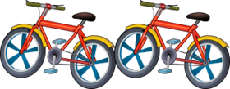
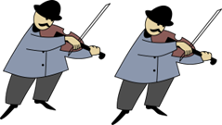
mögen + article ‘the’
You know how to say you like specific things:
Ich mag…
das Land.
I like the country.
Ich mag…
die Länder.
I like the countries.
To speak more generally we can leave out the article in English and German:
English and German use of ‘the’ is often the same so just leave out ‘the’ in German when you don’t use it in English.
Ich mag…
Fahrräder.
I like bicycles.
Häuser.
I like houses.
Musiker.
I like musicians.
Sportler.
I like sportspeople.
Notes:
Timing: 3 minutes Aim: To introduce the omission of articles before (usually) plural nouns in German and English.
Procedure: 1. Click through the animations to present the new information.
2. Elicit the English meanings of all the German examples.
6

Slide 7
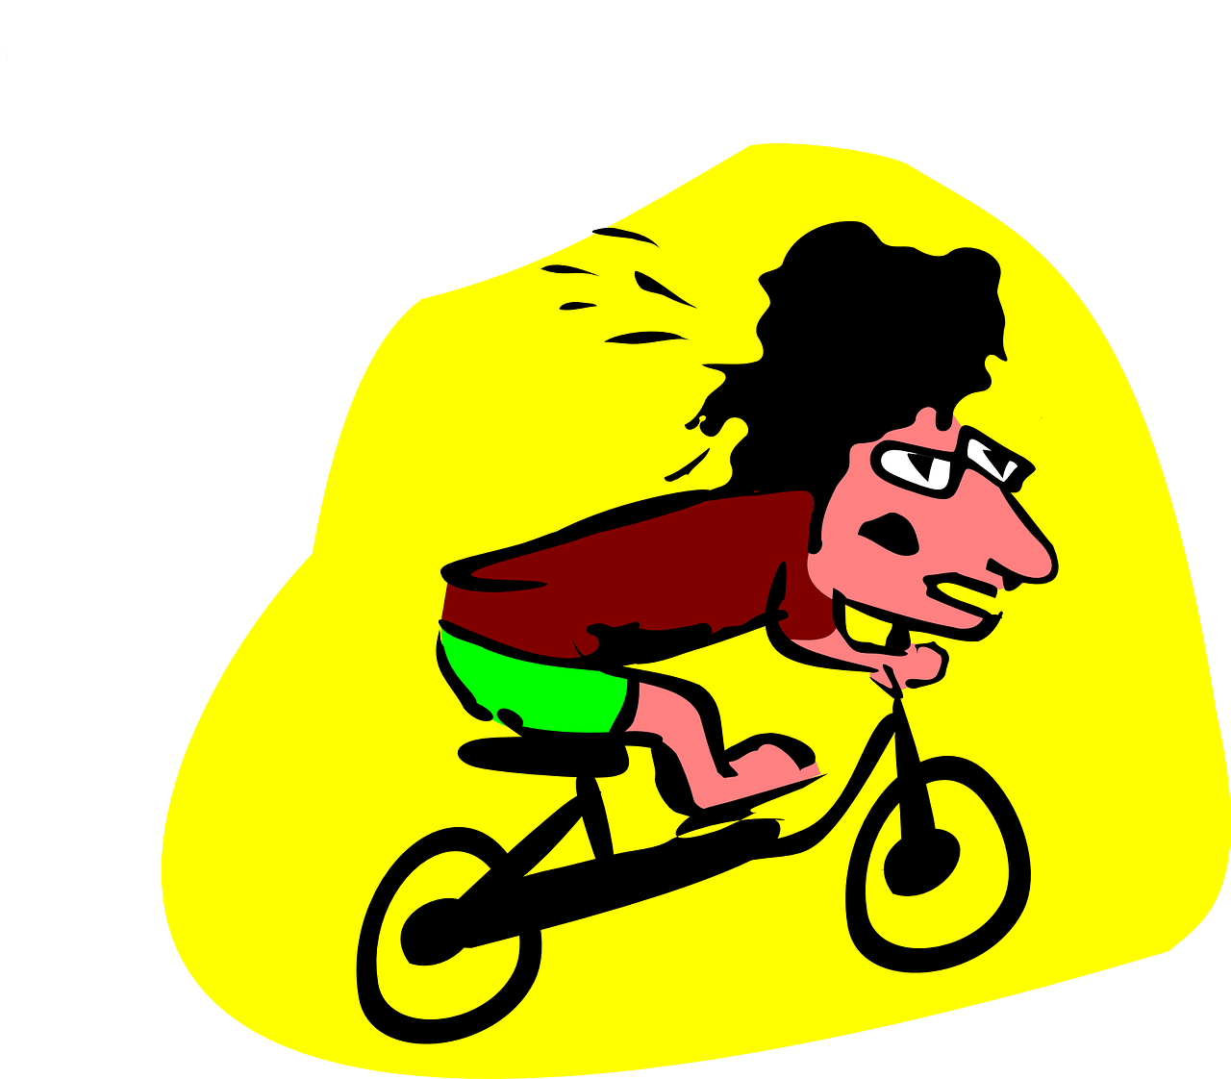
Follow up 3
Ronja und Mariem
Ronja introduces Mariem to her cousin, Johanna.
lesen
Welches Wort ist das? Du oder sie ?
_1_
Mariem, das ist meine Cousine*, Johanna. Sie mag Konzerte und Feiern. Du magst Lieder und Feiern, nicht wahr? Magst du auch Konzerte?
Du magst Sportler und Fahrräder. Sie mag Sportler und Fahrräder nicht. Sie mag Shows, wie ich.
Magst du Musiker? Du magst Rammstein, nicht wahr? Sie mag Rockmusik nicht. Sie mag Popmusik.
_2_
_3_
_4_
_5_
_6_
_7_
_8_
_9_
_10_
Cousine – cousin
Notes:
Timing: 5 minutes
Aim: To practise distinguishing between the second and third person forms of mögen (reading); to practise written comprehension of this week’s new and previously taught language.
Procedure:
1. Pupils decide whether du or sie should go in each gap in the text where the pronoun should be (based upon a consideration of the verb form).
2. Pupils check their answers by listening to the recording of the text, which plays in three parts, for manageability.
3. Once the audio for one section has finished playing, answers can be revealed individually on clicks. (Note, don’t click to reveal answers as the audio plays, as this will stop the audio.)
4. Pupils to volunteer information about what Ronja and Mariem have in common and any differing likes and dislikes. Do they think that they will get on. Why/Why not?

Slide 8
Follow up 4
Wer ist das?
sprechen
Olaf
Ole
Ottilie
I like bikes.
I like the houses.
I don’t like the celebration.
Dorothea
Oksana
Ophelia
I like the girls.
I like countries.
I don’t like the musicians.
Odine
Leonardo
Danilo
I like musicians.
I like the music.
I don’t like the sportspeople.
Klio
Konkordia
Oskar
I like the bike.
I don’t like the girls in the class.
I like the celebrations.
Notes:
Timing: 5 minutes Aim: to practise spoken production of this week’s new language. Procedure: 1. Pupils work in pairs. Pupil A chooses an identity and says the corresponding opinion in German. E.g., for Olaf ‘Ich mag Fahrräder’.
2. Pupil B works out the name and checks with Pupil. E.g. ‘Bist du Olaf?’ 3. They swap roles and repeat the task several times.
4. In the audio version, click on the names to hear the German sentences.
Note: an alternative or extension activity is to ask yes/no questions to work out the partner’s identity. E.g. Magst du Fahrräder? Nein. Magst du die Musik? Ja. Ah, du bist Leonardo. Ja!

Slide 9
Follow up 5:

Schreib auf Englisch.
Can you get at least 12 points?
Wörter
Vokabeln
 | er möchte | sie möchte | es möchte
 | wir sind | ihr seid | schön
 | er/sie mag | es mag | mögen
 | der Sportler | ich mag | du magst
 | die Länder | die Mädchen | der Musiker
 | die Feier | die Fahrräder | die Häuser
x3
he would like
she would like
it would like
x2
we are
you are
lovely, beautiful
he/she likes
it likes
to like
(the) sportsperson
I like
you like
(the) countries
(the) girls
(the) musician
x1
(the) celebration
(the) bicyles/bikes
(the) houses
Notes:
Timing: 5 minutes
Aim: to practise written comprehension of vocabulary from this and revisited weeks.
Procedure: 1. Give pupils a blank grid. They fill in the English meanings of any of the words they know, trying to reach 15 points in total.
2. Click to reveal answers (which will appear one by one from the bottom row upwards).
Note: The most recently learnt and practised words are pink, words from the previous week are green and those from week 1 are blue, thus more points are awarded for them, to recognise that memories fade and more effort (heavy lifting!) is needed to retrieve them.

Slide 10
Follow up 5:

Schreib auf Deusch.
Can you get at least 12 points?
Wörter
Vokabeln
 | it would like | he would like | she would like
 | lovely, beautiful | you are | we are
 | (the) countries | (the) celebration | (the) houses
 | (the) sportspeople | he/she likes | I like
 | you like | (the) bicycles/bikes | it likes
 | (the) girl | (the) musician | to like
x3
es möchte
er möchte
sie möchte
x2
schön
ihr seid
wir sind
die Länder
die Feier
die Häuser
die Sportler
er/sie mag
ich mag
du magst
die Fahrräder
es mag
x1
das Mädchen
der Musiker
mögen
Notes:
Timing: 5 minutes
Aim: to practise written comprehension of vocabulary from this and revisited weeks.
Procedure: 1. Give pupils a blank grid. They fill in the German meanings of any of the words they know, trying to reach 15 points in total.
2. Click to reveal answers (which will appear one by one from the bottom row upwards).
Note: The most recently learnt and practised words are pink, words from the previous week are green and those from week 1 are blue, thus more points are awarded for them, to recognise that memories fade and more effort (heavy lifting!) is needed to retrieve them.

Slide 11
Tschüss!
grün
Notes:
11

Slide 12
Follow up 5:

Schreib auf Englisch.
Can you get at least 12 points?
Wörter
Vokabeln
 | er möchte | sie möchte | es möchte
 | wir sind | ihr seid | schön
 | er/sie mag | es mag | mögen
 | der/die Sportler | ich mag | du magst
 | die Länder | das/die Mädchen | der/die Musiker
 | die Feier | die Fahrräder | die Häuser
x3
x2
x1
Notes:
Template

Slide 13
Follow up 5:

Schreib auf Deusch.
Can you get at least 12 points?
Wörter
Vokabeln
 | it would like | he would like | she would like
 | lovely, beautiful | you are | we are
 | (the) countries | (the) celebration | (the) houses
 | (the) sportsperson/ people | he/she likes | I like
 | you like | (the) bicycles/bikes | it likes
 | (the) girl(s) | (the) musician(s) | to like
x3
x2
es mag
x1
Notes:
Template

