Slide 1
Interacting
eine Show sehen
Plural noun patterns [3] and [4]
Modal verb mögen (to like)
this (diese(r, s)) and those (diese)
SSC: long and short [o]
grün
Term 1 Week 3
Notes:
Artwork by Steve Clarke. Pronoun pictures from NCELP (www.ncelp.org). All additional pictures selected from Pixabay and are available under a Creative Commons license, no
attribution required.
Phonics:
long [o] wo? [94] wohnen [380] Million [206]
short [o] Kopf [279] offen [382] kommen [61]
Vocabulary: mögen, ich mag, du magst, er/sie/es mag [168] Fahrräder [2138] Feier [n/a] Häuser [147] Länder [134] Mädchen [602] Musiker [2577] Sportler [2565]
Jones, R.L & Tschirner, E. (2019). A frequency dictionary of German: Core vocabulary for learners. London: Routledge.
The frequency rankings for words that occur in this PowerPoint which have been previously introduced in these resources are given in the SOW and in the resources that first
introduced and formally re-visited those words.
For any other words that occur incidentally in this PowerPoint, frequency rankings will be provided in the notes field wherever possible.
Remember that at the start of the course (first three lessons of Rot/Gelb) pupils learnt language (for greetings and register taking) that can still be part of the lesson routines in upper KS2 (Blau/Grün). They are not re-taught, as we anticipate that teachers have built these in from early in lower KS2.
1

Slide 2
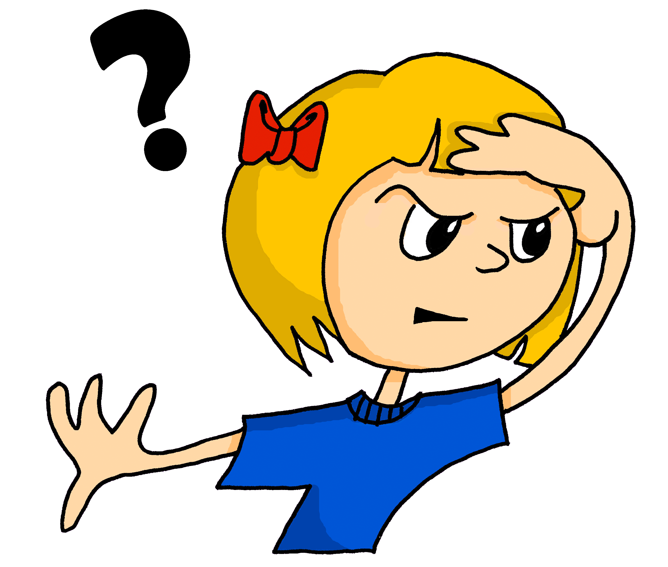
aussprechen
long [o]
…
wo
Notes:
Timing: 1 minute
Aim: to introduce the SSC long [o].
Procedure:
Introduce the SSC and present the source word ‘wo’ (with gesture, if using).
Click to bring on the picture and get pupils to repeat the word ‘wo’ (with gesture, if using).
Note:
a gesture for ‘wo’ might be to put your hand on your forehead and look into the distance as if to spot something on the horizon
Word frequency (1 is the most frequent word in German): wo? [94]
Jones, R.L & Tschirner, E. (2019). A frequency dictionary of German: Core vocabulary for learners. London: Routledge.
2

Slide 3
aussprechen
long [o]
…
wohnen
wo
Million
[to live]
Notes:
Timing: 1 minute
Aim: to consolidate the SSC long [o].
Procedure:
Re-present the SSC and the source word ‘wo’ (with gesture, if using).
Click to bring on the picture and get pupils to repeat the word ‘wo’ (with gesture, if using).
Present the cluster words in the same way, bringing on the picture and getting pupils to pronounce the words.
Word frequency (1 is the most frequent word in German): Million [206] ohne [119] wo? [94] wohnen [380]
Jones, R.L & Tschirner, E. (2019). A frequency dictionary of German: Core vocabulary for learners. London: Routledge.

Slide 4
aussprechen
short [o]
…
Kopf
Notes:
Timing: 1 minute
Aim: to introduce the SSC short [o].
Procedure:
Introduce the SSC and present the source word ‘Kopf’ (with gesture, if using).
Click to bring on the picture and get pupils to repeat the word ‘Kopf’ (with gesture, if using).
Note:
a gesture for ‘Kopf’ might be to point to your head.
Word frequency (1 is the most frequent word in German): Kopf [279]
Jones, R.L & Tschirner, E. (2019). A frequency dictionary of German: Core vocabulary for learners. London: Routledge.
4

Slide 5
aussprechen
short [o]
…
kommen
Kopf
offen
[to come]
Notes:
Timing: 1 minute
Aim: to consolidate the SSC short [o].
Procedure:
Re-present the SSC and the source word ‘Kopf’ (with gesture, if using).
Click to bring on the picture and get pupils to repeat the word ‘Kopf’ (with gesture, if using).
Present the cluster words in the same way, bringing on the picture and getting pupils to pronounce the words.
Word frequency (1 is the most frequent word in German): kommen [61] Kopf [279] offen [382]
Jones, R.L & Tschirner, E. (2019). A frequency dictionary of German: Core vocabulary for learners. London: Routledge.
5

Slide 6
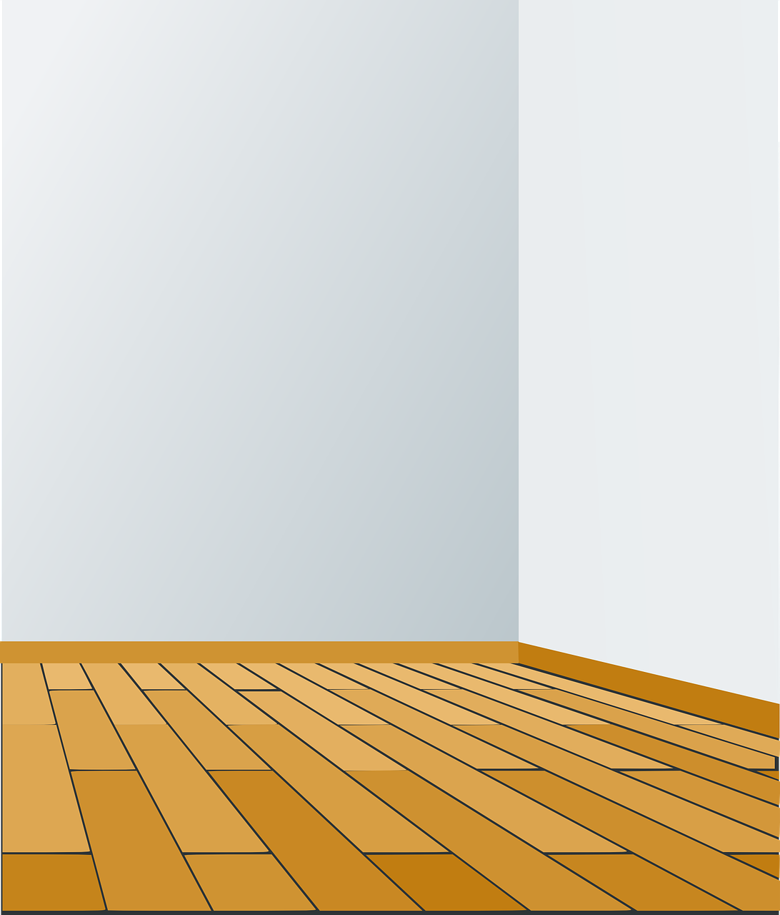
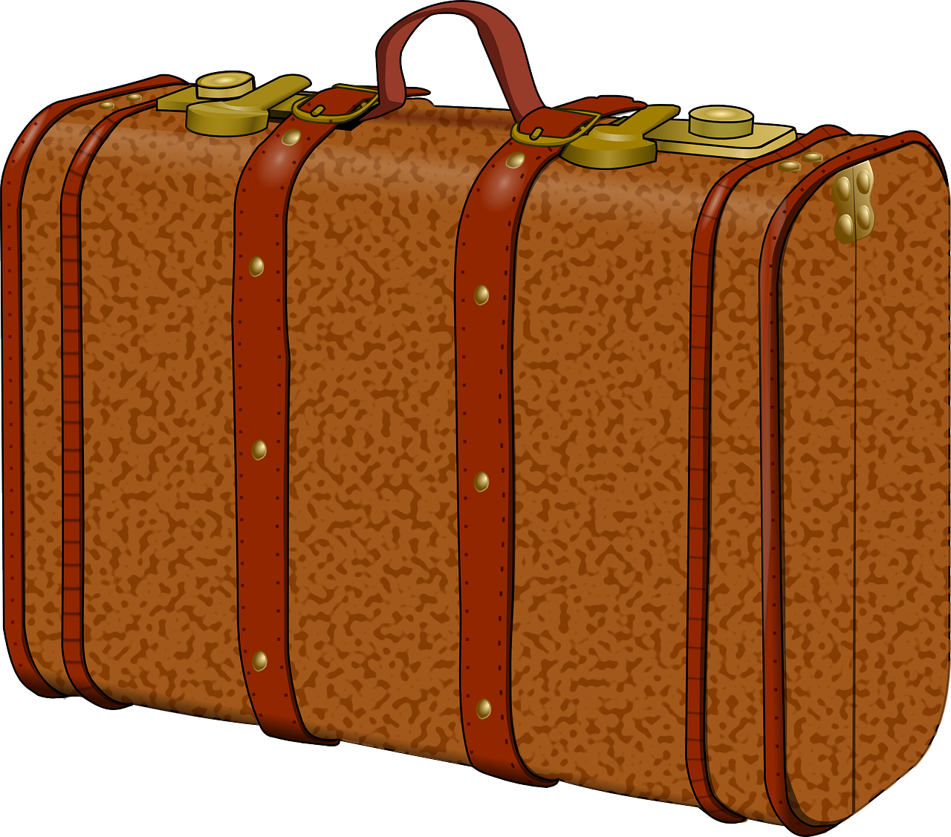
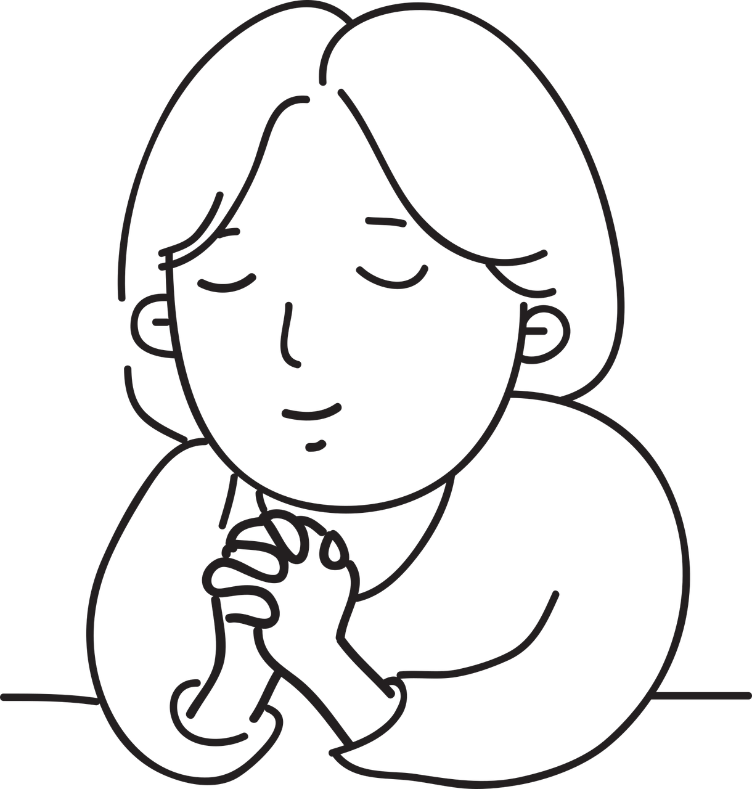
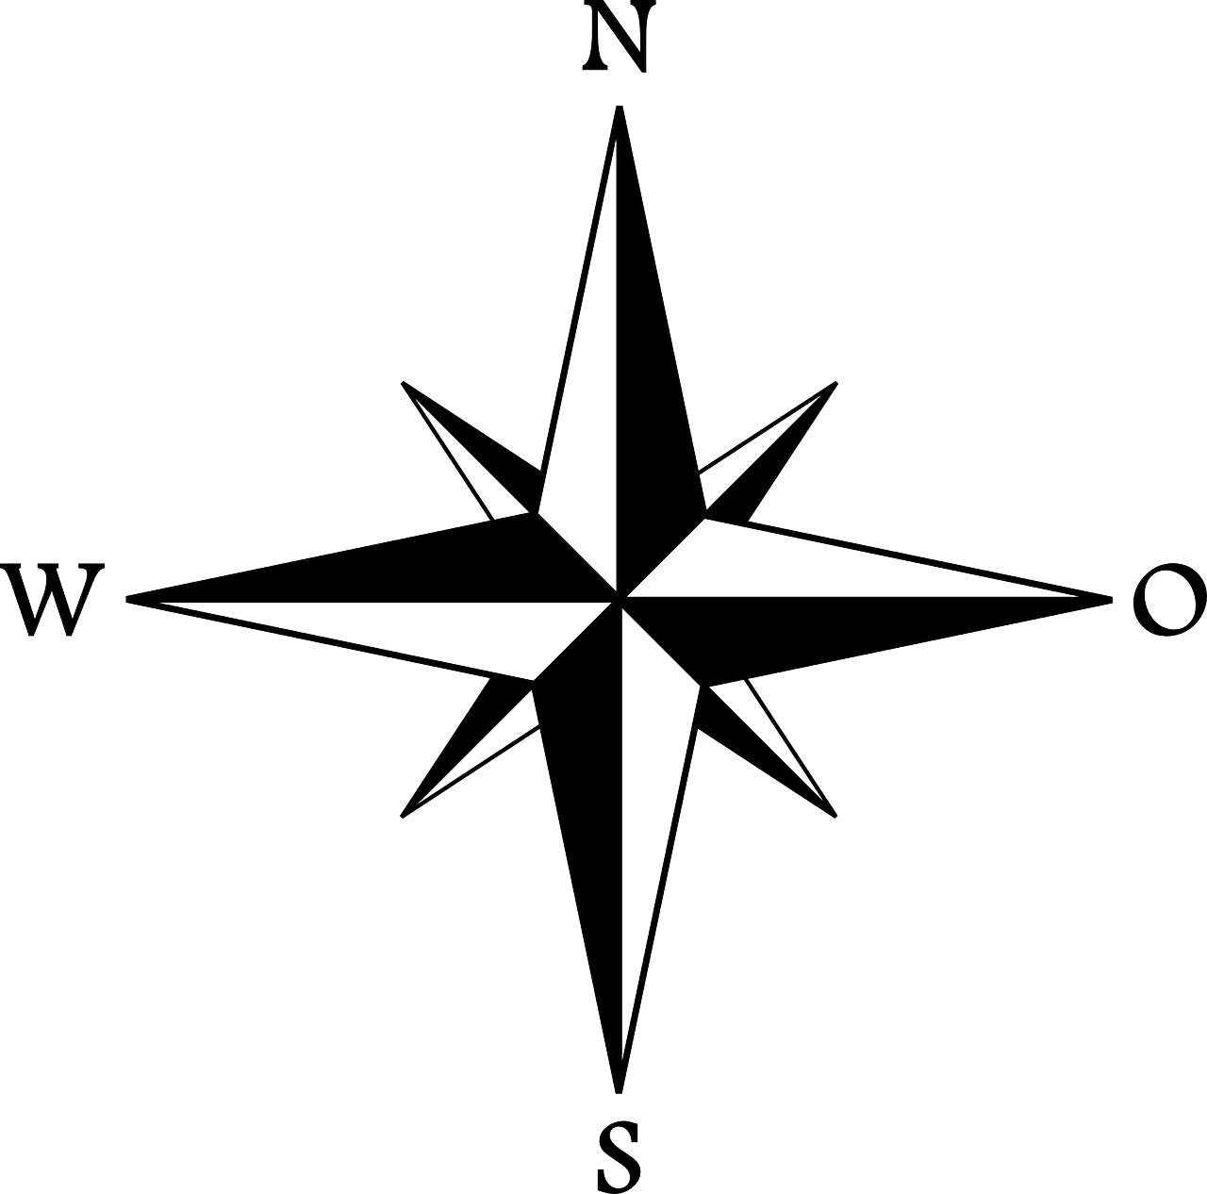
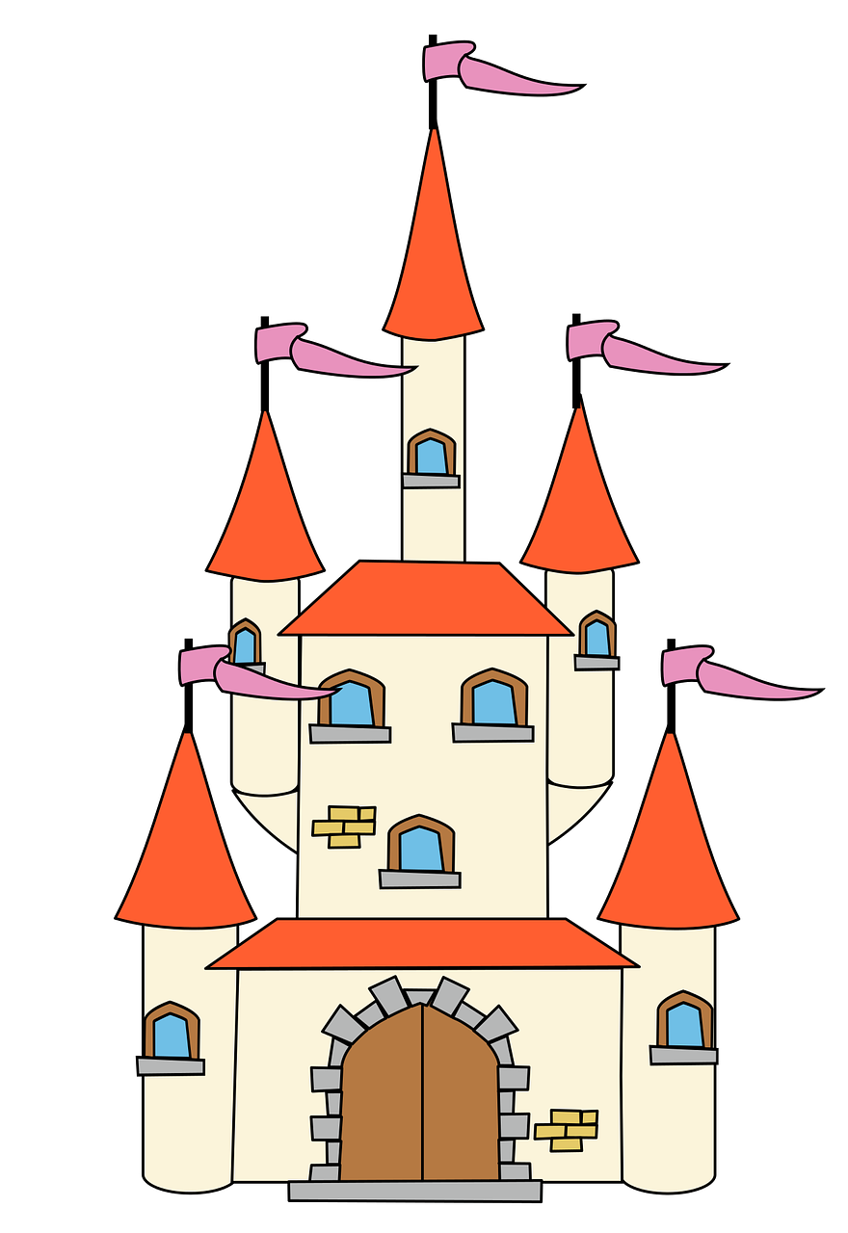
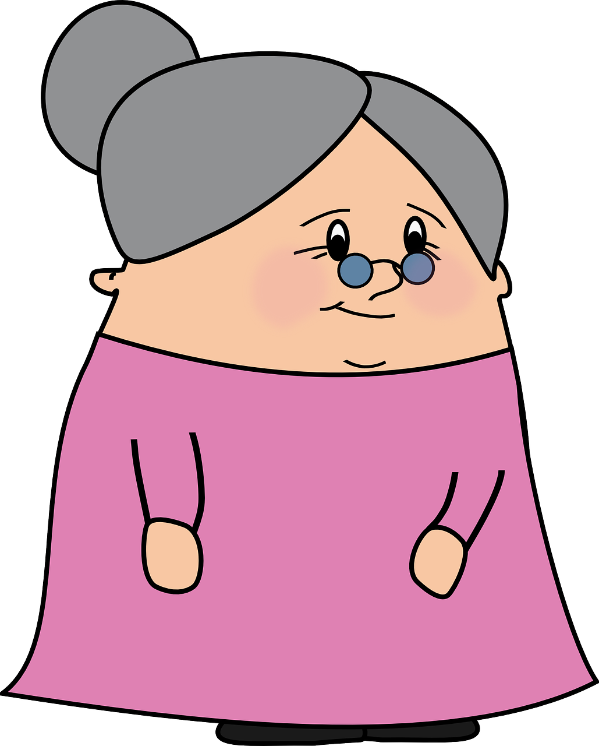
aussprechen
[o]
Kategorisiere die Wörter.
long [o]
short [o]
Koffer
Boden
hoffen
Europa
Ostern
froh
Oktober
Wochenende
Kino
holen
Schloss
Oma
Koffer | Boden | Oktober | hoffen | Europa | froh
Osten | Kino | holen | Wochenende | Oma | Schloss
Notes:
Timing: 5 minutes
Aim: to consolidate the SSC [o] by organising words with long and short [o] sounds.
Procedure:
1. Pupils work in pairs to decide which words contain long and short [o]. Teachers can encourage pupils to ‘sound out’ the words as part of this process.
2. To feed back, teachers elicit answers orally using the order of words from left to right, top to bottom, asking for example: Konzert, ist das langes [o] oder kurzes [o]?
3. On each mouse click, the word appears in the correct part of the Venn and disappears from the table.
Note: the majority of these words have not yet been taught, but they are words that will be learnt as part of the KS2 course.
Vocabulary: Koffer [2387] Boden [536] Oktober [1223] hoffen [689] Europa [294] froh [1424] Osten [1208] Kino [2020] holen [547] Wochenende [1243]Oma [2175]
Schloss [1907]
Jones, R.L & Tschirner, E. (2019). A frequency dictionary of German: Core vocabulary for learners. London: Routledge.

Slide 7
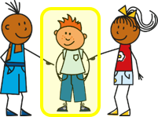
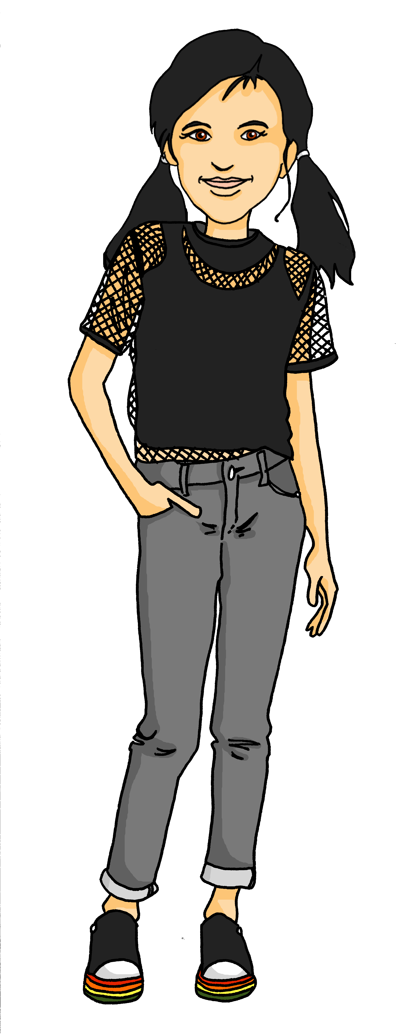
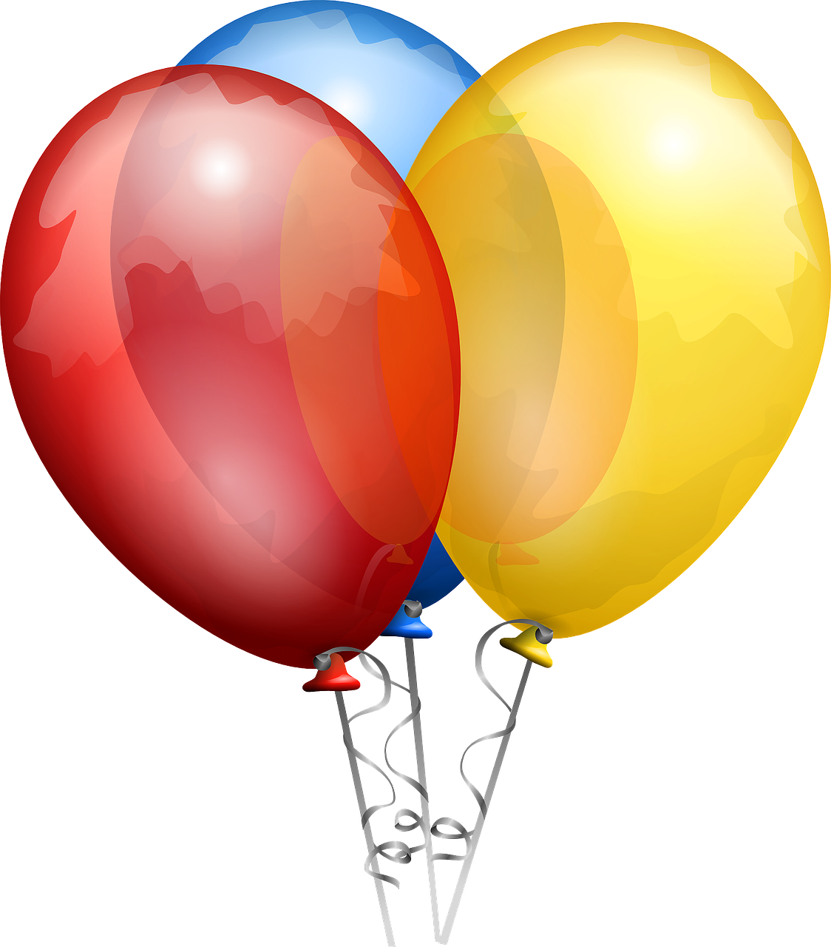
mögen – to like, liking
The er/sie/es form is the same as the ich form!
Mögen is an irregular verb. Use it to say what you like and don’t like.
ich mag
I like
du magst
you like
er/sie/es mag
s/he, it likes
Magst ___ die Feier, Lias?
____ mag die Feier. Magst du die Fahrräder?
du
Ich
Remember! To ask a yes/no question swap the verb and subject.
Nein, ____ mag die Fahrräder nicht!
ich
To say you don’t like something add nicht to the end of your statement.
Notes:
Timing: 2 minutes
Procedure:
Click through the animations to present the new information.
Elicit English translation for the German examples provided.
Elicit the German pronouns from the speech bubbles.
Note: Students may wonder why nicht is used as a negation here rather than kein, as they have learned to negate nouns with kein. If asked, teacher can explain that ich mag + kein can sometimes work too (i.e., in cases where nouns are used without articles e.g. Ich mag Musik (in general) vs Ich mag keine Musik (I don’t like music at all). Nicht is chosen here as this is the more frequently used option).
7

Slide 8
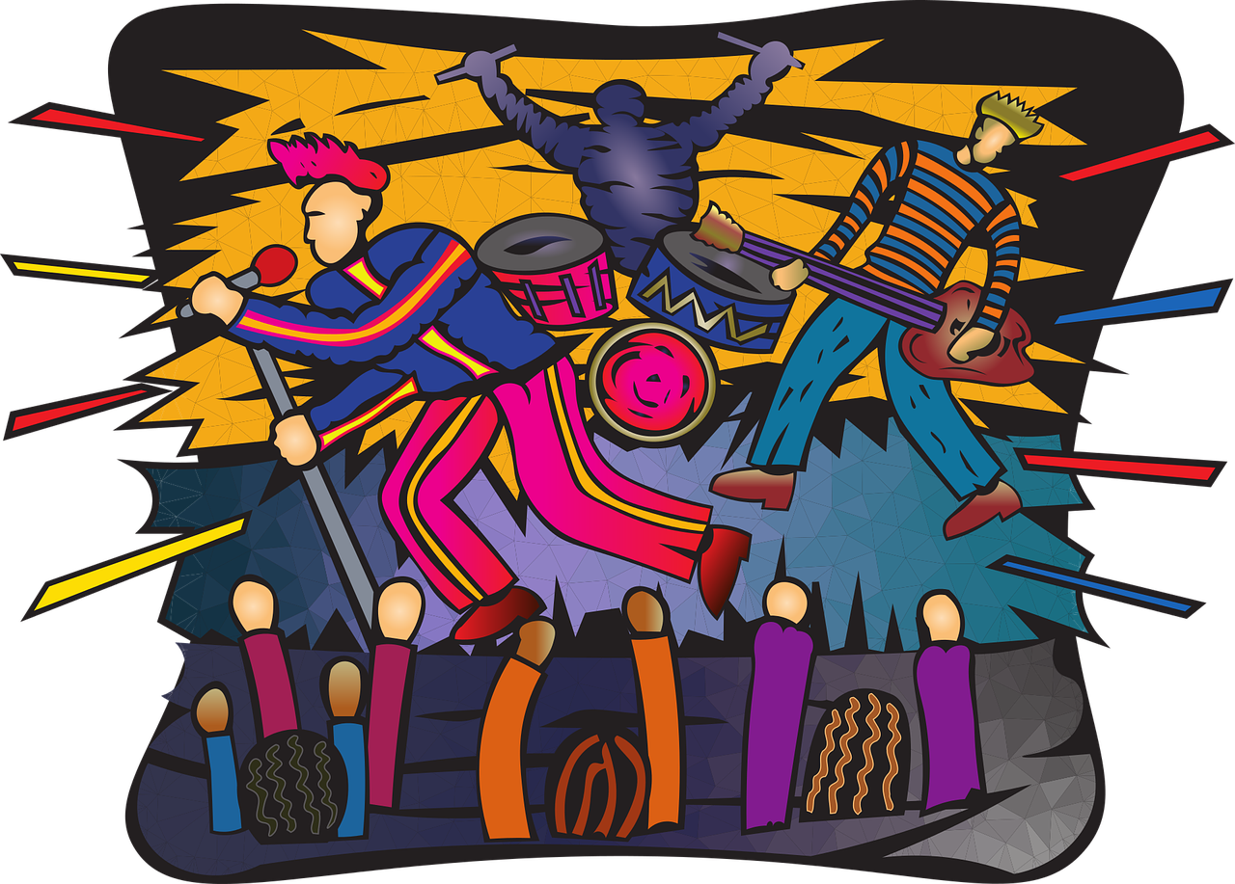
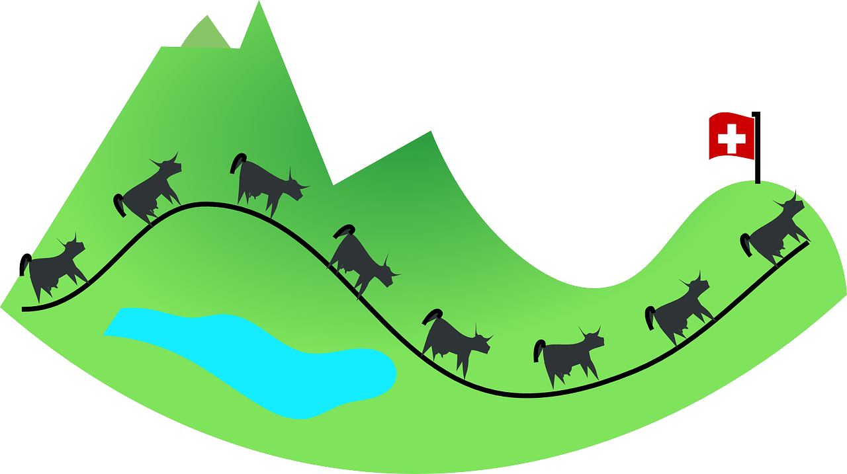
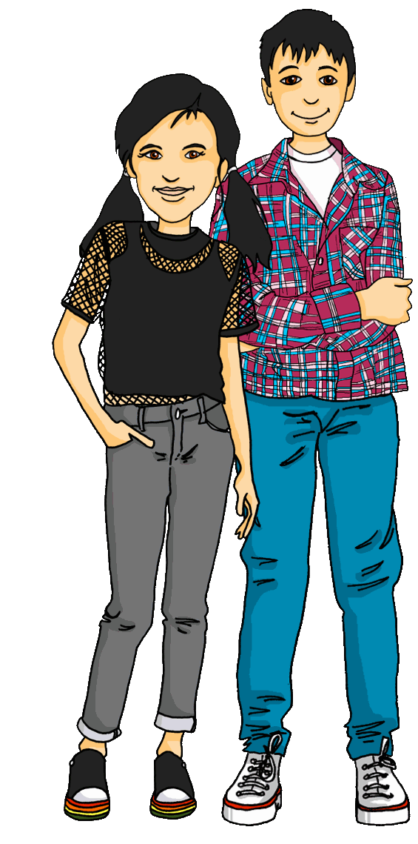
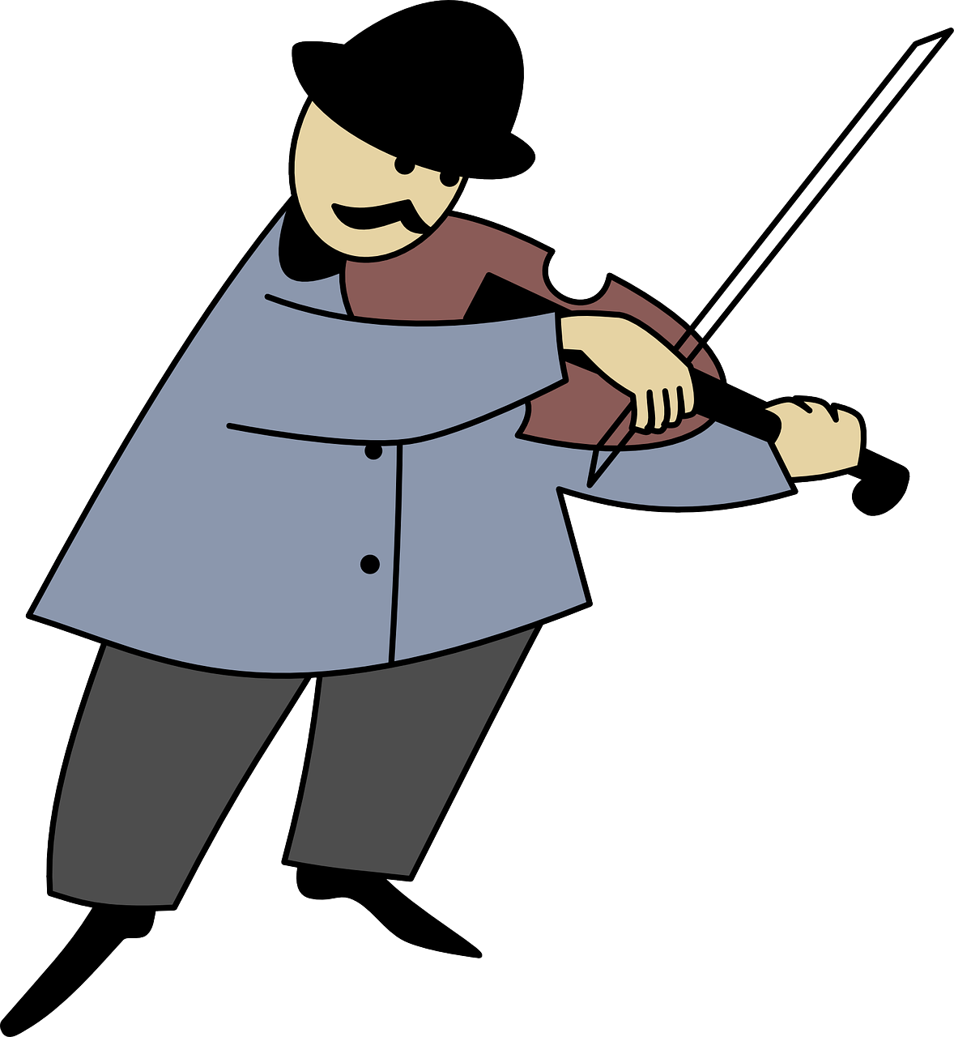
hören
Wer mag was?
Was sagt Ronja? Ist das ‘ich’ (Ronja) oder ‘du’ (Lias)?
ich
du
1
2
3
4
5
6
Notes:
Timing: 5 minutes
Aim: to practise connecting the first and second person singular forms of mögen with the meaning. Pupils also practise this week’s vocabulary, and revise use of nicht to make negative statements.
Procedure:
1. Click to play the audio (with pronouns obscured).
2. Pupils write ‘ich’ or ‘du’ for the person who likes each item represented by the symbols in the second column. Pupils decide based upon the verb form heard in each case.
3. Click to reveal the answers.
4. Click on symbols in second column to hear the complete sentences if you wish.
Transcript:
1. [Du] magst den Park, aber [ich] mag das Haus. 2. [Ich] mag die Show nicht, aber [du] magst die Show. 3. [Du] magst das Konzert, aber [ich] mag das Konzert nicht.
4. [Ich] mag die Stadt, aber [du] magst das Land.
5. [Du] magst die Feier. [Ich] mag auch die Feier.
6. [Ich] mag Musiker, aber [du] magst Sportler.
8

Slide 9
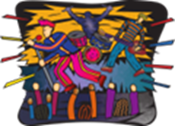
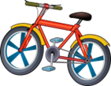
Plural patterns
More than 90% masculine and 75% neuter nouns work like this! ☺
You know this plural noun pattern:
der Ort
die Orte
das Konzert
die Konzerte
This is plural pattern 3.
Masculine or neuter words ending in –er or –en may not change:
der Musiker
die Musiker
das Mädchen
die Mädchen
This is plural pattern 4.
About 25% single syllable neuter nouns add –er, some with an umlaut:
das Haus
die Häuser
das Land
die Länder
das Fahrrad
die Fahrräder
Remember! The word for ‘the’ is ‘die’ for all plural nouns.
Notes:
Timing: 3 minutes Aim: To remind pupils of the plural ‘die’ of direct articles der, die das and to remind pupils of the plural pattern (-e) they have been introduced to already.
To introduce two new plural patterns: plural pattern 3 (no change for nouns ending in –er/-en) and plural pattern 4 (adding –er and sometimes an umlaut with neuter nouns).
Procedure: Click through the animations to present the information.
9

Slide 10
hören
Was mag Lias? [1/8]
Was sagt Ronja? Welches Bild ist das?
1
Notes:
Timing: 8 minutes (8 slides)
Aim: to practise distinguishing aurally between plural and singular forms of nouns.
Procedure:
1. Click the button to play audio.
2. Pupils use their knowledge of the singular nouns and plural patterns to match what they hear to the correct picture.
3. Elicit responses from pupils and click the mouse to reveal answers.
Transcript:
Er mag die Häuser.
Note: pupils already know the singular forms of most of these nouns. With some items, pupils can therefore benefit from two clues (article and word ending); however, it is only the article that helps them with the nouns ending in –en and –er.
10

Slide 11
hören
Was mag Lias? [2/8]
2
Notes:
[2/8]
Transcript:
Er mag die Fahrräder.
11

Slide 12
hören
Was mag Lias? [3/8]
Remember! More than 90% feminine nouns have the plural ending –(e)n. die Feier → die Feiern.
3
Notes:
[3/8]
Transcript:
Er mag die Feiern.
12

Slide 13
hören
Was mag Lias? [4/8]
4
Notes:
[4/8]
Transcript:
Er mag den Sportler.
13

Slide 14
hören
Was mag Lias? [5/8]
5
Notes:
[5/8]
Transcript:
Er mag das Land.
14

Slide 15
hören
Was mag Lias? [6/8]
6
Notes:
[6/8]
Transcript:
Er mag den Computer.
15

Slide 16
hören
Was mag Lias? [7/8]
7
Notes:
[7/8]
Transcript:
Er mag die Musiker.
16

Slide 17
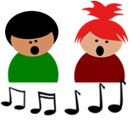
hören
Was mag Lias? [8/8]
8
Notes:
[8/8]
Transcript:
Er mag die Lieder.
17

Slide 18
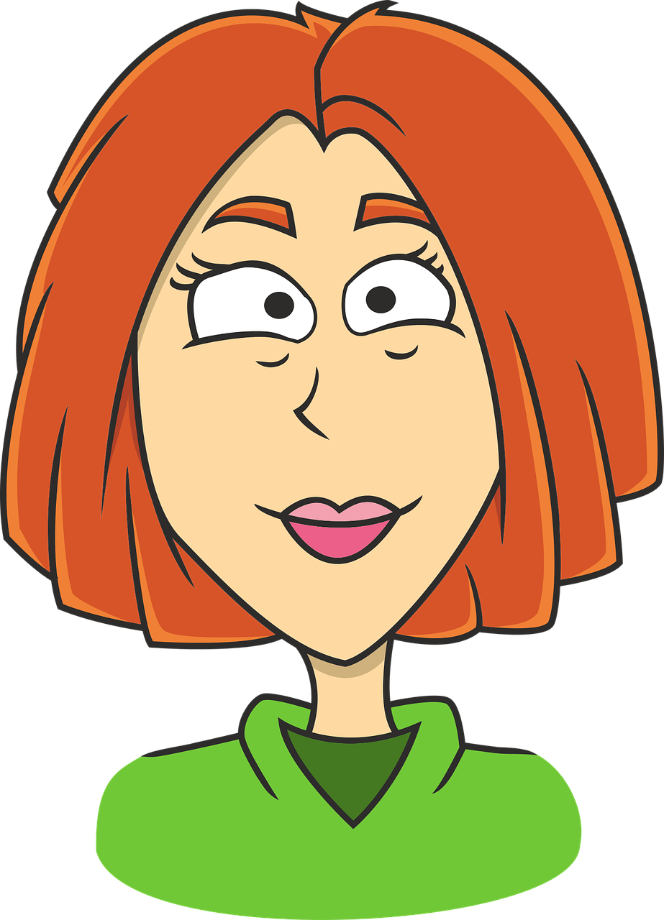
singen
Lias’ und Ronjas Klasse sagt „Tschüss“
Sing mit!
Tschüss, Tschüss, Tschüss, Tschüss,
Tschüss, Tschüss, Auf Wiedersehen!
Bis bald, bis bald, bis bald, bis bald.
Tschüss, Tschüss, Tschüss, Tschüss, Auf Wiedersehen!
Auf Wiedersehen, alle!
alle – all, everyone
Notes:
Timing: 1-2 minutes
Aim: to practise some previously learnt vocabulary in a simple song (to the tune of ‘Hi ho Hi ho it’s off to work we go’).
Note: This song was introduced in Rot T1 W7. Pupils have sung is many times since. This offers a further opportunity to revisit it.
Procedure: 1. Click to play the audio of the song.
2. Pupils join in.
3. If time allows, remove the words and sing the song through once or twice more.
18

Slide 19
Tschüss!
grün
Notes:
19

