Slide 1
Interacting
Wir planen ein Bücherfest!
grün
Follow ups 1-5
Term 1 Week 5
Notes:
Artwork by Steve Clarke. Pronoun pictures from NCELP (www.ncelp.org). All additional pictures selected from Pixabay and are available under a Creative Commons
license, no attribution required.
Phonics:
long [e] geben [49] Idee [451] mehr [52]
short [e] denken [128] Bett [659] helfen [338]
Vocabulary: bekommen [212] benutzen [1119] brauchen [179] erklären [238] kennen [216] lernen [288] lieben [701] schreiben [184] schwimmen [1863] singen [1063] spielen [205] dieser, diese, dieses [24]
Revisit 1: sie sind [4] Antwort [522] Bruder [730] Buch [300] Computer [1252] Film [505] Geschichte [262] Handy [1693] Hund [825] Instrument [1572] Katze [2235] Konzert [2350] Land [134] Lehrer, Lehrerin [695] Lied [1733] Musik [509] Ort [341] Partner, Partnerin [1172] Satz [432] Schwester [974] Show [3367] Stadt [204] welcher, welche, welches [122] die² [1]
Revisit 2: heißen [126] wohnen [560] Minute [324] Stunde [276] jung [199]
Jones, R.L & Tschirner, E. (2019). A frequency dictionary of German: Core vocabulary for learners. London: Routledge.
The frequency rankings for words that occur in this PowerPoint which have been previously introduced in these resources are given in the SOW and in the resources
that first introduced and formally re-visited those words.
For any other words that occur incidentally in this PowerPoint, frequency rankings will be provided in the notes field wherever possible.
Remember that at the start of the course (first three lessons of Rot/Gelb) pupils learnt language (for greetings and register taking) that can still be part of the lesson routines
in upper KS2 (Blau/Grün). They are not re-taught, as we anticipate that teachers have built these in from early in lower KS2.

Slide 2
aussprechen
long [e]
…
Notice that the 2nd ‘e’ sounds like the ‘a’ in ‘ago’.
to give
geben
Notes:
Timing: 1 minute
Aim: to introduce the SSC long [e].
Procedure:
Introduce the SSC and present the source word ‘geben’ (with gesture, if using).
Click to bring on the picture and get pupils to repeat the word ‘geben’ (with gesture, if using).
Note: a gesture for ‘geben’ might be to pretend to give someone on object.
geben [49]
2

Slide 3
aussprechen
long [e]
…
geben
to give
more
Idee
mehr
Notes:
Timing: 1 minute
Aim: to introduce the SSC long [e].
Procedure:
Re-present the SSC and the source word ‘geben’ (with gesture, if using).
Click to bring on the picture and get pupils to repeat the word ‘geben’ (with gesture, if using).
Present the cluster words in the same way, bringing on the picture and getting pupils to pronounce the words.
Idee [451] mehr [52]
3

Slide 4
aussprechen
short [e]
…
Notice that the 2nd ‘e’ sounds like the ‘a’ in ‘ago’.
to think
denken
Notes:
Timing: 1 minute
Aim: to consolidate the SSC short [e].
Procedure:
Introduce the SSC and present the source word ‘denken’ (with gesture, if using).
Click to bring on the picture and get pupils to repeat the word ‘denken’ (with gesture, if using).
Note: a gesture for ‘denken’ might be to pretend to to put your finger to your temple as though you are pondering something.
denken [128]

Slide 5
aussprechen
short [e]
…
denken
to think
to help
Bett
helfen
Notes:
Timing: 1 minute
Aim: to consolidate the SSC short [e].
Procedure:
Re-present the SSC and the source word ‘denken’ (with gesture, if using).
Click to bring on the picture and get pupils to repeat the word ‘denken’ (with gesture, if using).
Present the cluster words in the same way, bringing on the picture and getting pupils to pronounce the words.
Note: a gesture for ‘denken’ might be to pretend to to put your finger to your mouth and as if you’re concentrating and thinking about something.
Bett [659] helfen [338]

Slide 6
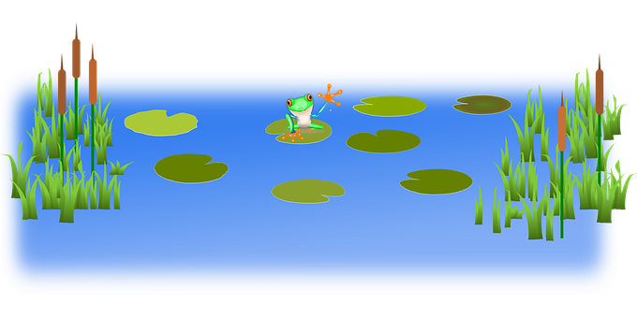
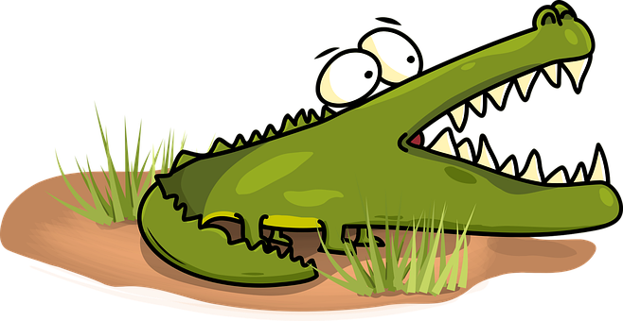
Follow up 1:
Sag die Wörter.
Runde 1: Person A
Runde 2: Person B
Achtung! Krokodil!
Can you pronounce all of the words below correctly in 1 minute?
Can you make a safe path across the water by pronouncing ONLY the words with a long [e]?
aussprechen
Geld
Instrument
zehn
Geschenk
Lehrer
Schwester
neben
welche
kennen
verstehen
Fehler
sehen
Notes:
Timing: 5 minutes
Aim: to practise knowledge of long and short [e] in known words.
Procedure:
Click to bring up the instructions.
Pupils work in pairs to practise pronunciation of long and short [e]. For their first go, they can choose where to start and have one minute to pronounce all the words correctly to avoid being eaten by the crocodile. For their second go, students must ONLY pronounce the words with a long [e] to find a safe path across from left to right. If they accidentally say the words with a short [e] they fall into the water.
In their pairs, one student is Person A and one person is Person B. Click to indicate it’s Person A’s turn. Click again to bring up Person B’s turn.

Slide 7
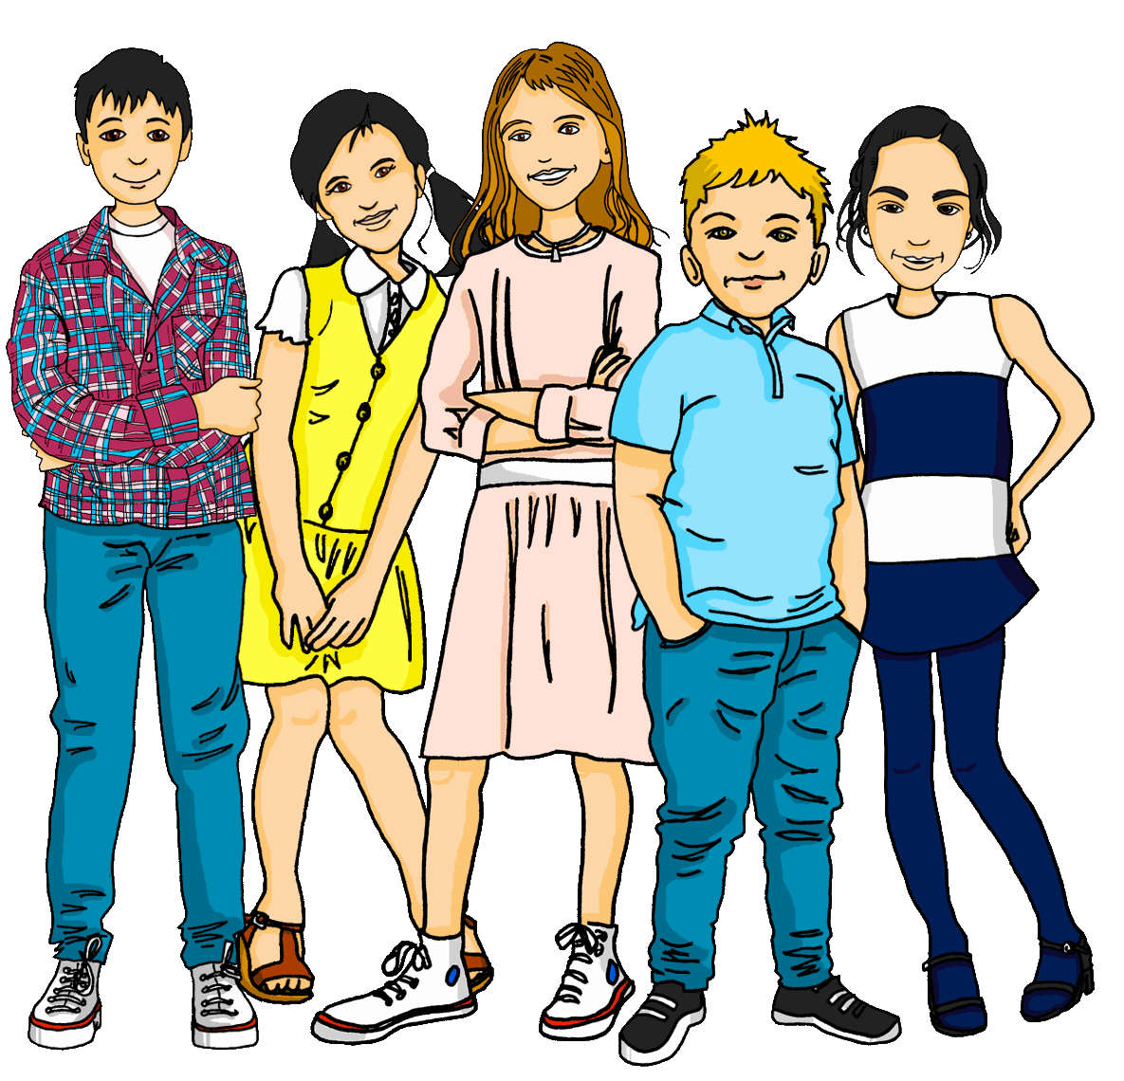
Follow up 2
Hör zu. Wer macht das? Ronja (she) oder die Schüler (they)? Was machen sie?
hören
 | she or they? | activity?
1
they
plan/are planning a book festival
2
they
sell/are selling books
3
she
plays/is playing music
4
they
use/are using the library
5
she
sings/is singing a song
6
she
knows this story
Notes:
Timing: 10 minutes
Aim: to practise aural identification of singular and plural 3rd person verb endings with the pronoun ‘sie’ (she or they).
Procedure:
Click to play the first recording. Pupils decide whether the verb is in the 3rd person singular (-t ending) or the 3rd person plural (-en ending) and write down ‘she’ or ‘they’. They also try to note the activity mentioned in English.
Click to reveal answers.
Repeat for numbers 2-6.
Extra: Can students recreate the original German sentences?
Transcript:
Sie planen ein Bücherfest
Sie verkaufen Bücher
Sie spielt Musik
Sie benutzen die Bibliothek
Sie singt ein Lied
Sie kennt diese Geschichte

Slide 8
Follow up 3
Hör zu.
C Take turns to say the following German words out loud. Your partner will give you a point each time you remember the English translation as well.
Partner A
bekommen
brauchen
lernen
diese
schreiben
singen
dieses
A Listen. Write the word that is mentioned.
B.
the dogs swim | the cat swims | the dog swims
hören
The letter ‘B’ here stands for ‘Beispiel’ (example)
Partner B
benutzen
kennen
dieser
lieben
schwimmen
spielen
erklären
1
they sing | she is | she sings
…
2
they love | she loves | we love
sprechen
3
they explain | she explains | she knows
4
my sister knows | my brother knows | they know
5
this (nt) | this (pl) | this (f)
B Write the number of the matching answer.
D Ping Pong translation in pairs
Round 1: Challenge each other by testing whether you can translate the German words into English.
Round 2: Now challenge your partner by asking for the German words.
4
3
mein Bruder kennt ____ 4. sie erklärt ____
sie singen ____ 5. diese Show ____
der Hund schwimmt ____ 6. wir lieben ____
1
5
B
2
Notes:
Timing: 10 minutes
Aim: to practise aural and oral comprehension and oral production of this week’s new grammar point and vocabulary.
Procedure:
Section A: Click to bring up callout to explain that the ‘B.’ for the first time stands for ‘Beispiel’ – example. Click again for callout to disappear again, then click to listen. Pupils write the correct English word(s) or they can use numbers 1,2,3 to represent the 3 options. Click for answers. Some of these require understanding of singular and plural verb forms; others require recognition of vocabulary.
Section B: Pupils refer to the listening table in Section A, and write the corresponding numbers to match the vocabulary/verb forms. Click for answers.
Sections C & D: Oral work in pairs to focus on pronunciation, translation and recall of vocabulary.
Transcript: B. Der Hund schwimmt. 1. Sie singen ein Lied. 2. Wir lieben diese Stadt.
3. Sie erklärt den Satz.
4. Mein Bruder kennt das Buch.
5. Meine Partnerin findet diese Show toll!

Slide 9
Follow up 4:

Schreib auf Deutsch.
Beschreib die Aktivitäten. Schreib 5 Sätze.
schreiben
[the song]
[the library]
B: Ich singe das Lied.
Notes:
Timing: 6-8 minutes Aim: to practise more independent written production of first & third person singular and plural sentences, drawing on a variety of previously taught vocabulary.
Procedure:
Pupils write sentences using the I, he, we forms of regular present tense verbs to describe (with 5 sentences) any of the activities that Herr Weber and Lias do for the book festival.
The Venn diagram shows what Herr Weber and Lias do together, and what each does on his own. Herr Weber is ‘talking’ so his sentences use the ‘I’ form. Elicit that the activities in Herr Weber’s section will be the ‘I’ form, in the middle section will be the ‘we’ form and in Lias’s sections will be 3rd person singular (Lias or ‘he’).
The example demonstrates the correct verb form for one of Herr Weber’s activities.
Note: Teachers can add a list of verb phrases to the slide to help pupils, if needed. E.g. Geschichte erklären; Computer brauchen; Bücher bekommen; Bibliothek lieben; Lied singen; Handy benutzen.
Extra: ask pupils if they can change ‘the’ to ‘this/these’ e.g. Herr Weber needs this computer.

Slide 10
Follow up 5:

Schreib auf Englisch.
Can you get at least 15 points?
Wörter
 | die Stunde | sie sind | die Minute
 | wohnen | jung | heißen
 | die Antwort | der Hund | das Konzert
 | die Stadt | der Ort | das Land
 | kennen | erklären | brauchen
 | lieben | dieser | bekommen
(the) hour
they are
(the) minute
Vokabeln
x3
to live, living
young
to be called
(the) answer
(the) dog
(the) concert
x2
(the) town
(the) place
(the) country
to know, knowing
to explain, explaining
to need, needing
x1
to love, loving
this, that (m)
to receive, receiving
Notes:
Timing: 5 minutes
Aim: to practise written comprehension of vocabulary from this and revisited weeks.
Procedure: 1. Give pupils a blank grid. They fill in the English meanings of any of the words they know, trying to reach 15 points in total. 2. Remind pupils to try and specify gender (m/f/nt) for welch- and dies- words.
Note: The most recently learnt and practised words are pink, words from the previous week are green and those from week 1 are blue, thus more points are awarded for them, to recognise that memories fade and more effort (heavy lifting!) is needed to retrieve them.

Slide 11
Follow up 5:

Schreib auf Deutsch.
Can you get at least 15 points?
Wörter
 | young | to live, living | to be called
 | (the) minute | (the) hour | they are
 | (the) concert | (the) answer | (the) town
 | (the) dog | (the) country | (the) place
 | to need, needing | this, that (m) | to receive, receiving
 | to love, loving | to explain, explaining | to know, knowing
jung
wohnen
heißen
Vokabeln
x3
die Minute
die Stunde
sie sind
das Konzert
die Antwort
die Stadt
x2
der Hund
das Land
der Ort
brauchen
dieser
bekommen
x1
lieben
erklären
kennen
Notes:
Timing: 5 minutes
Aim: to practise written production of vocabulary from this and revisited weeks.
Procedure: 1. Give pupils a blank grid. They fill in the German translations of any of the words they know, trying to reach 15 points in total. 2. Remind pupils to think about m/f/nt/plural forms of ‘which’ and ‘this’ words and to think about singular and plural nouns.
Note: The most recently learnt and practised words are pink, words from the previous week are green and those from week 1 are blue, thus more points are awarded for them, to recognise that memories fade and more effort (heavy lifting!) is needed to retrieve them.

Slide 12
Tschüss!
grün
Notes:
12

Slide 13
Follow up 5:

Schreib auf Englisch.
Can you get at least 15 points?
Wörter
 | die Stunde | sie sind | die Minute
 | wohnen | jung | heißen
 | die Antwort | der Hund | das Konzert
 | die Stadt | der Ort | das Land
 | kennen | erklären | brauchen
 | lieben | dieser | bekommen
Vokabeln
x3
x2
x1
Notes:
HANDOUT

Slide 14
Follow up 5:

Schreib auf Deutsch.
Can you get at least 15 points?
Wörter
 | young | to live, living | to be called
 | (the) minute | (the) hour | they are
 | (the) concert | (the) answer | (the) town
 | (the) dog | (the) country | (the) place
 | to need, needing | this, that (m) | to receive, receiving
 | to love, loving | to explain, explaining | to know, knowing
Vokabeln
x3
x2
x1
Notes:
HANDOUT

