Slide 1
Interacting
Wir planen ein Bücherfest!
grün
Present tense – wir (we), they (sie)
diese(r, s) this/these
SSC long and short [e]
Term 1 Week 5
Notes:
Artwork by Steve Clarke. Pronoun pictures from NCELP (www.ncelp.org). All additional pictures selected from Pixabay and are available under a Creative Commons
license, no attribution required.
Phonics:
long [e] geben [49] Idee [451] mehr [52]
short [e] denken [128] Bett [659] helfen [338]
Vocabulary: bekommen [212] benutzen [1119] brauchen [179] erklären [238] kennen [216] lernen [288] lieben [701] schreiben [184] schwimmen [1863] singen [1063] spielen [205] dieser, diese, dieses [24]
Revisit 1: sie sind [4] Antwort [522] Bruder [730] Buch [300] Computer [1252] Film [505] Geschichte [262] Handy [1693] Hund [825] Instrument [1572] Katze [2235] Konzert [2350] Land [134] Lehrer, Lehrerin [695] Lied [1733] Musik [509] Ort [341] Partner, Partnerin [1172] Satz [432] Schwester [974] Show [3367] Stadt [204] welcher, welche, welches [122] die² [1]
Revisit 2: heißen [126] wohnen [560] Minute [324] Stunde [276] jung [199]
Jones, R.L & Tschirner, E. (2019). A frequency dictionary of German: Core vocabulary for learners. London: Routledge.
The frequency rankings for words that occur in this PowerPoint which have been previously introduced in these resources are given in the SOW and in the resources that first introduced and formally re-visited those words.
For any other words that occur incidentally in this PowerPoint, frequency rankings will be provided in the notes field wherever possible.
Remember that at the start of the course (first three lessons of Rot/Gelb) pupils learnt language (for greetings and register taking) that can still be part of the lesson routines in upper KS2 (Blau/Grün). They are not re-taught, as we anticipate that teachers have built these in from early in lower KS2.
1

Slide 2
aussprechen
long [e]
…
Notice that the 2nd ‘e’ sounds like the ‘a’ in ‘ago’.
to give
geben
Notes:
Timing: 1 minute
Aim: to introduce the SSC long [e].
Procedure:
Introduce the SSC and present the source word ‘geben’ (with gesture, if using).
Click to bring on the picture and get pupils to repeat the word ‘geben’ (with gesture, if using).
Note: a gesture for ‘geben’ might be to pretend to give someone on object.
geben [49]
2

Slide 3
aussprechen
long [e]
…
geben
to give
more
Idee
mehr
Notes:
Timing: 1 minute
Aim: to introduce the SSC long [e].
Procedure:
Re-present the SSC and the source word ‘geben’ (with gesture, if using).
Click to bring on the picture and get pupils to repeat the word ‘geben’ (with gesture, if using).
Present the cluster words in the same way, bringing on the picture and getting pupils to pronounce the words.
Idee [451] mehr [52]
3

Slide 4
aussprechen
short [e]
…
Notice that the 2nd ‘e’ sounds like the ‘a’ in ‘ago’.
to think
denken
Notes:
Timing: 1 minute
Aim: to consolidate the SSC short [e].
Procedure:
Introduce the SSC and present the source word ‘denken’ (with gesture, if using).
Click to bring on the picture and get pupils to repeat the word ‘denken’ (with gesture, if using).
Note: a gesture for ‘denken’ might be to pretend to to put your finger to your temple as though you are pondering something.
denken [128]

Slide 5
aussprechen
short [e]
…
denken
to think
to help
Bett
helfen
Notes:
Timing: 1 minute
Aim: to consolidate the SSC short [e].
Procedure:
Re-present the SSC and the source word ‘denken’ (with gesture, if using).
Click to bring on the picture and get pupils to repeat the word ‘denken’ (with gesture, if using).
Present the cluster words in the same way, bringing on the picture and getting pupils to pronounce the words.
Note: a gesture for ‘denken’ might be to pretend to to put your finger to your mouth and as if you’re concentrating and thinking about something.
Bett [659] helfen [338]

Slide 6
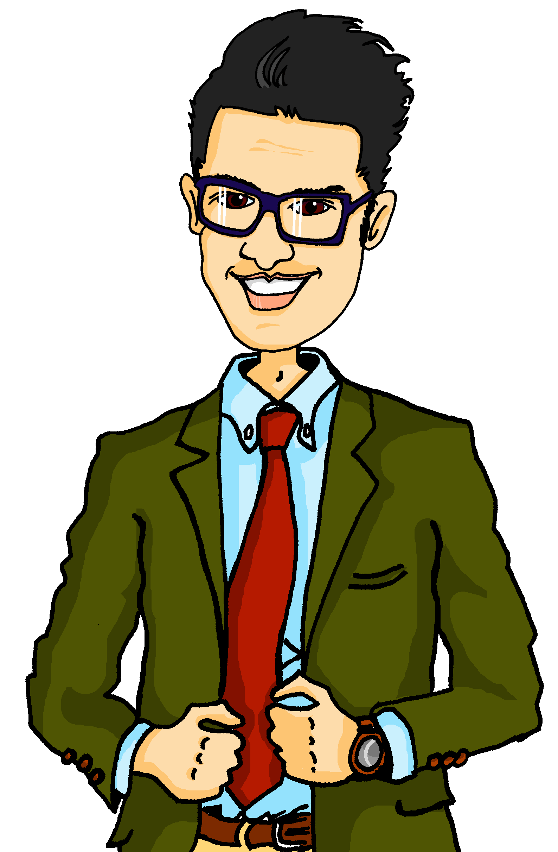
lesen
Eine neue Bibliothek
Hör zu und lies den Text. Warum braucht die Schule Geld?
hören
Herr Weber: Im November bekommen wir eine neue Bibliothek! Toll, nicht wahr? Ich liebe Bücher!
Aber wir brauchen mehr Geld* denn ich möchte neue Bücher kaufen. Wie können wir helfen?
Lias: Ich habe eine Idee! Ein Bücherfest! Wir können ein Bücherfest organisieren*!
Herr Weber: Ein Bücherfest? Was ist das? Kannst du es erklären*, bitte?
das Geld - money
organisieren – to organise
erklären – to explain
Notes:
Timing: 5 minutes
Aim: to practise comprehension of previously taught vocabulary and structures in a longer text; to introduce the context for this week’s lesson.
Procedure:
1. Click to listen to the text. Pupils follow along reading. Pause the recording a few times and ask pupils to say the next word.
2. Play the audio again and ask pupils to read the text aloud along with the recording.
3. Ask pupils what the school needs money for: ‘Warum braucht die Schule Geld?’ (für Bücher / für die Bibliothek)
Note: ask pupils to guess what ‘Bücherfest’ might mean. Encourage them to notice the two halves of the word, ‘Buch’ (book) and ‘Fest’ (festival) as they have come across both these words before.
Further questions:
Was mag der Lehrer? (Bücher)
Magst du Bücher? (pupils’ own opinions)
Ist ein Bücherfest eine gute Idee? (pupils’ own opinions)
6

Slide 7
Vokabeln
Vokabeln lernen
Wörter
[to explain, explaining]
[to know, knowing]
[to love, loving]
[to receive, receiving]
[to use, using]
erklären
kennen
lieben
bekommen
benutzen
[to need, needing]
[to learn, learning]
[to write, writing]
[to swim, swimming]
[to sing, singing]
[to play, playing]
brauchen
lernen
schreiben
schwimmen
singen
spielen
Notes:
Timing: 3 minutes
Aim: to present the new & revisited vocabulary for this week.
Procedure: 1. Click for a German word. Elicit pronunciation from pupils.
2. Click for the English meaning and picture prompt. Elicit the German word again.
3. Present all 11 words like this, in order.
4. Click for one English meaning to disappear. Elicit the English meaning from pupils. Continue with the remaining items.
5. Click for the German word to disappear. Elicit the German from pupils. Continue with the remaining items.
7

Slide 8
Present tense: wir (we)
As you know, regular verbs have endings which match the subject pronoun.
Ich bekomme Geld.
I get/receive money.
Sie verkauft Bücher.
She sells/is selling books.
To say wir (we) + regular verb:
Wir bekommen Geld.
We get/receive money.
Wir verkaufen Bücher.
We sell/are selling books.
The wir form of the verb is the same as the infinitive form in the dictionary.
Notes:
Timing: 2 minutes
Aim: to present the 1st person plural form of regular present tense.
Procedure:
Click through the animations to present the new information.
Elicit English translation for the German examples provided.
8

Slide 9
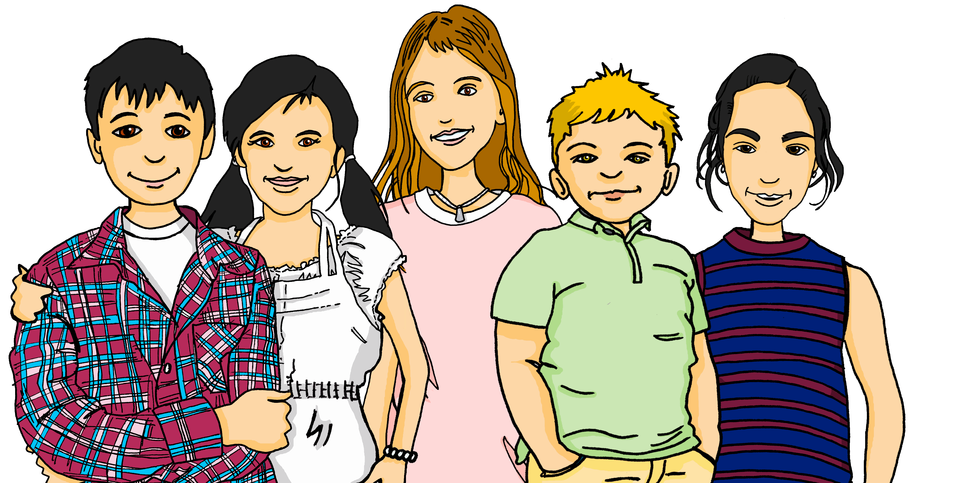
lesen
Lias und Freunde in der Schule
Was schreibt Lias? Wer macht was? Ist das Lias (ich) oder die Schüler (wir)?
Schreib 1 – 6 und ich oder wir.
1
Ich
organisiere ein Bücherfest!
4
Ich
tragen Kleidung von Figuren aus Büchern.
Wir
Wir
2
Ich
5
Ich
schreibe ein Lied über eine Geschichte.
habe viele Ideen!
Wir
Wir
3
Ich
6
Ich
bekommen Geld für die Bibliothek.
verkaufen Bücher.
Wir
Wir
die Figur - character
Notes:
Timing: 6 minutes
Aim: to practise written comprehension of 1st persons singular and plural of verbs in the present tense.
Procedure:
Read the instructions with pupils and clarify the context. It is the next day at school and Gabriel was absent yesterday when Lias suggested organising a book festival. Lias is excited tell him and his other classmates about it and is passing notes to them about his plans in class. As they’re passed along bits get torn and messages get a bit jumbled.
Pupils read the text fragments and work out whether the activity is something Lias is doing (I) or the pupils are doing together (we).
Elicit each answer from pupils and click to remove the incorrect pronouns.
Elicit orally what pupils understand about the book festival plans so far.
9

Slide 10
Present tense: sie (they)
You know sie means ‘she’:
Sie erklärt die Idee.
She explains/is explaining the idea.
But sie also means ‘they’:
Sie erklären die Idee.
They explain/are explaining the idea.
And it is the same verb form as wir and the infinitive:
Wir erklären die Idee.
We explain/are explaining the idea.
Notes:
Timing: 2 minutes
Aim: to present the 3rd person plural form of regular present tense and the new meaning of the pronoun sie (they).
Procedure:
Click through the animations to present the new information.
Elicit English translations for the German examples provided.
10

Slide 11
diese, dieser, dieses (this), diese (these)
You already know how to ask ‘which?’:
Welcher Film?
Welche Geschichte?
Welches Buch?
Welche Filme/Geschichten/Bücher?
To reply saying ‘this’ use:
dieser Film
diese Geschichte
dieses Buch
this film
this story
this book
diese, meaning ‘these’, is used for all plural nouns:
diese Filme/Geschichten/Bücher
Notes:
Timing: 3 minutes
Aim: To introduce dieser/diese/dieses (this/these) and to revisit welcher/welche/welches? (which?)
Procedure:
Click through the animations to present the new grammar.
Elicit English translation for the German examples provided.
11

Slide 12
lesen
Lias plant. Er textet mit Gabriel. Ist es ‘sie’ (Ronja) oder ‘sie’ (die Schüler?)
Schreib 1 – 5 und she oder they. Dann schreib Lias Ideen auf Englisch.
1
Sie singen dieses Lied/Musik.
she
.
they
2
4
she
they
Sie kennt dieses Geschichte/Buch.
Sie erklärt diese Film/Geschichte.
she
they
3
5
she
they
Sie benutzen diese Bibliothek/Handy.
Sie spielen diese Musik/Instrument.
.
.
they
she
Notes:
Timing: 5 minutes
Aim: to practise written comprehension of 3rd persons singular and plural of regular present tense verbs, as well as dies-.
Procedure:
Explain the context that Lias is texting his friend Gabriel and is excited to tell him about what his sister and his classmates are going to do for the book festival.
Do number one together as an example, encouraging pupils to notice both the plural verb ending and the ‘dieses’.
Pupils write down ‘they’ or ‘she’. They also note down the correct noun: ‘Lied’ or ‘Musik’. Click to reveal answers.
Pupils complete items 2-5.
Elicit pupil responses and click to reveal answers 2-5.
Pupils then write Lias’ ideas down in English. Alternatively, teachers can elicit these orally from the class.
12

Slide 13
Tschüss!
grün
Notes:
13

