Slide 1
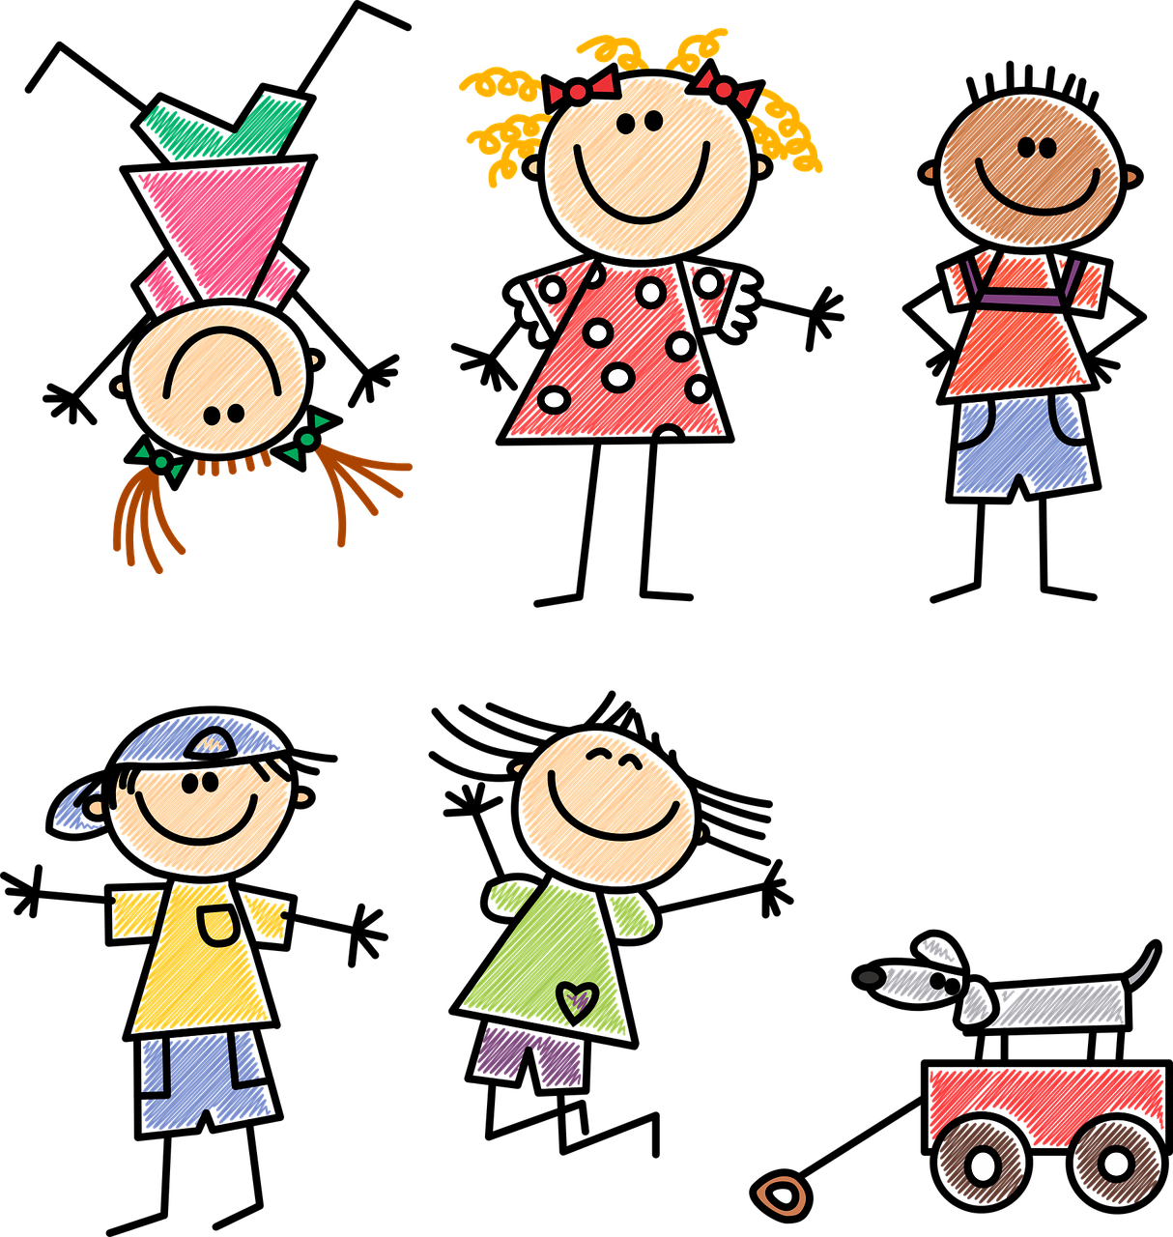
Interacting
Helping younger children
Kann ich helfen?
Negation with keine (plural)
Plural noun patterns 1-4
SSC [ie]
grün
Term 1 Week 7
Notes:
Artwork by Steve Clarke. Pronoun pictures from NCELP (www.ncelp.org). All additional pictures selected from Pixabay and are available under a Creative Commons license, no
attribution required.
Phonics:
[ei]
frei [318] ein [5] klein [114] sein [3] allein [258]
Vocabulary: Antwort [522] Baum [1013] Dorf [959] Fahrrad [2138] Farbe [1079] Form [307] Fußballspieler [n/a] Haus [147] Idee [451] Karte [1474] Land [134] Mädchen [602] Musiker [2577] Ort [341] Papier [1163] Partner [1172] Punkt [248] Satz [432] Schwimmbad, Schwimmbäder [n/a] Sportler [2565] keine² [46]
Revisit 1: dreizehn [4772] vierzehn [3950] fünfzehn [2858] sechzehn [4924] siebzehn [n/a] achtzehn [3741] neunzehn [n/a] zwanzig [1359] zweiundzwanzig [n/a] dreißig [2046] einunddreißig [n/a] an [19]
Jones, R.L & Tschirner, E. (2019). A frequency dictionary of German: Core vocabulary for learners. London: Routledge.
The frequency rankings for words that occur in this PowerPoint which have been previously introduced in these resources are given in the SOW and in the resources that first
introduced and formally re-visited those words.
For any other words that occur incidentally in this PowerPoint, frequency rankings will be provided in the notes field wherever possible.
1

Slide 2
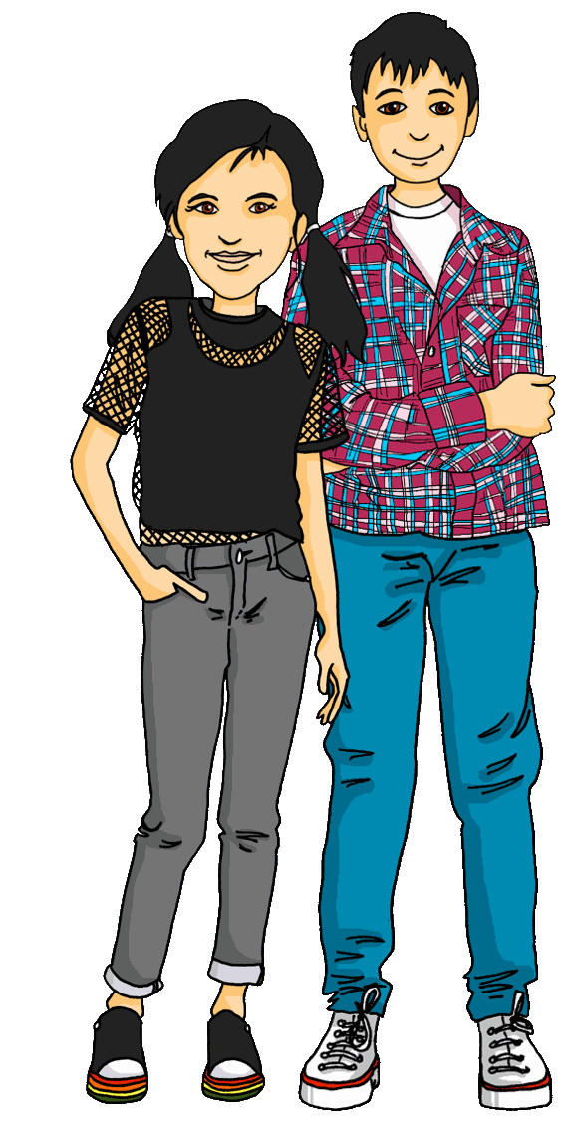
Lias und Ronja singen das Lied noch einmal.*
Sing mit!
noch einmal – again
Hallo! Hallo! Guten Tag! Hallo! Hallo! Guten Tag!
Hallo! Wir sind hier,
Hallo! Ihr seid da, Wie schön, nicht wahr? Wunderbar!
Notes:
Timing: 2 minutes
Aim: to practise some previously learnt vocabulary in a simple song (to the tune of ‘If you’re happy and you know it’).
Procedure: 1. Click to play the audio of the song.
2. Pupils join in immediately as they are familiar with the song and recap it every few weeks.

Slide 3
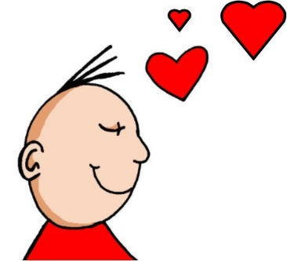
aussprechen
[ie]
…
Liebe
Notes:
Timing: 1 minute
Aim: to introduce the SSC [ie].
Procedure:
Introduce the SSC and present the source word ‘Liebe’ (with gesture, if using).
Click to bring on the picture and get pupils to repeat the word ‘Liebe’ (with gesture, if using).
Note:
A gesture for ‘Liebe’ might be to make a ‘heart’ shape with both hands approximately where your heart is in your body.
Liebe [844]
Jones, R.L & Tschirner, E. (2019). A frequency dictionary of German: Core vocabulary for learners. London: Routledge.
3

Slide 4
aussprechen
[ie]
…
sie
Liebe
Brief
Notes:
Timing: 1 minute
Aim: to introduce the SSC [ie].
Procedure:
Re-present the SSC and present the source word ‘Liebe’ (with gesture, if using).
Click to bring on the picture and get pupils to repeat the word ‘Liebe’ (with gesture, if using).
Present the cluster words in the same way, bringing on the picture and getting pupils to pronounce the words.
sie [7] Brief [838]
Jones, R.L & Tschirner, E. (2019). A frequency dictionary of German: Core vocabulary for learners. London: Routledge.
4

Slide 5
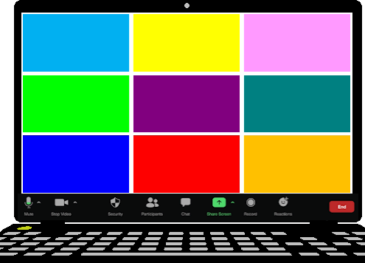
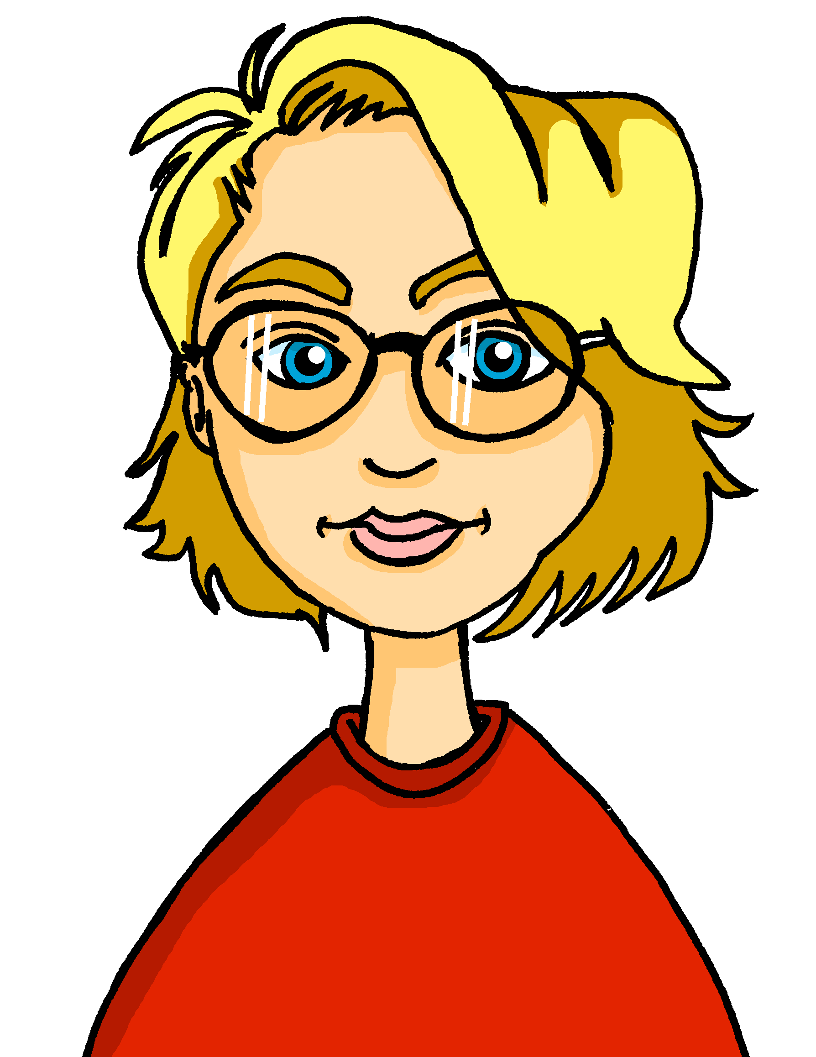
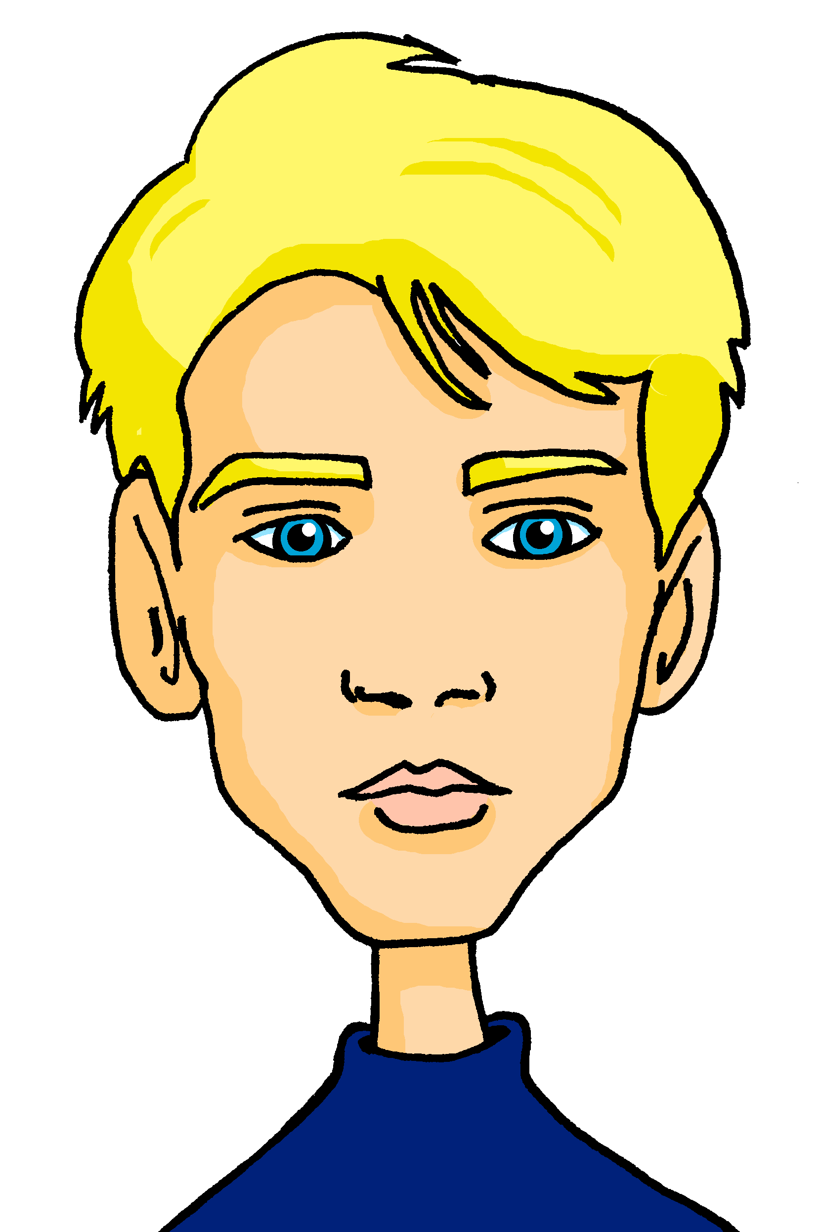
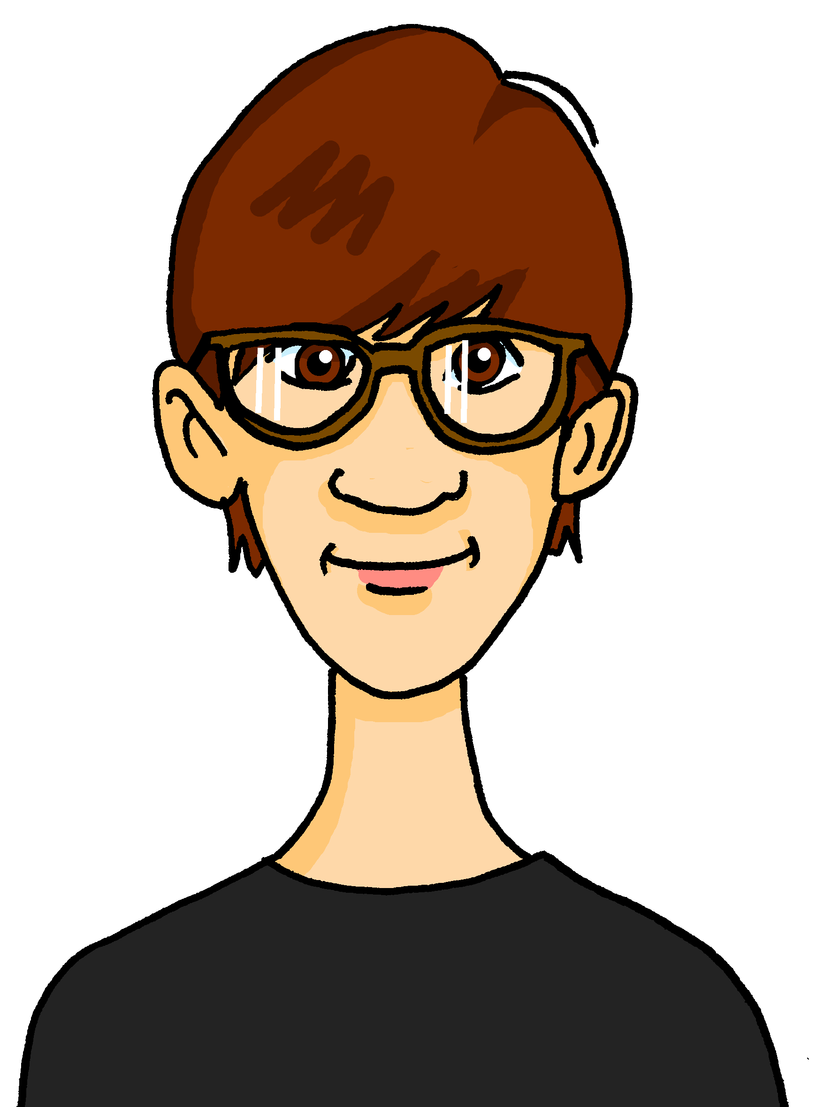
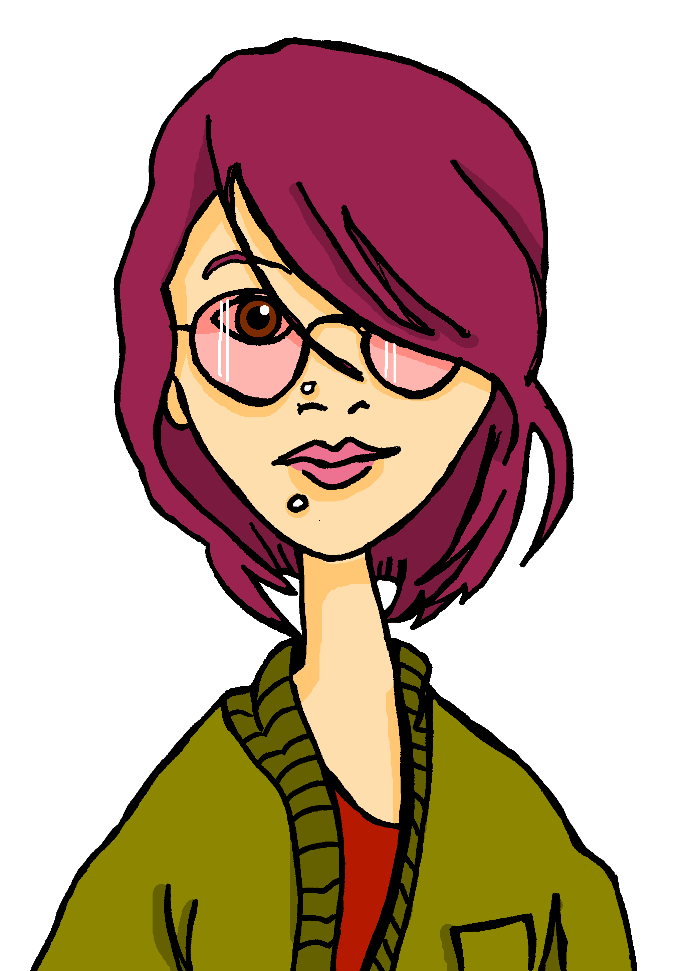
hören
Lias und Ronja üben* mit der Klasse.
üben – to practise
Hör zu. Schreib das Wort mit der SSC [ie].
 | Wort mit SSC [ie]
1 | dieser
2 | sieben
3 | Auf Wiedersehen
4 | Spiel
5 | Lieblings-
6 | siebenundzwanzig
Gabriel
Mariem
Barbara
Lias
Matteo
Emil
Jana
Clara
Ronja
Notes:
Timing: 5 minutes
Aim: to practise transcription of previously taught words, distinguishing [ie] from two other SSC, [ei] and [i].
Procedure:
1. Click to listen to three items.
2. Pupils write down the word that contains the SSC [ie].
3. They may need to listen several times to each item.
4. Additionally, they may write the English.
5. Elicit responses and click to reveal the correct words.
Transcript:
Bleistift | ich | dieser
ist | sieben | Beispiel
eine | Auf Wiedersehen | nicht
Freundin | mein | Spiel
Lieblings- | Musik | weiß
gewinnen | siebenundzwanzig | dreizehn
5

Slide 6
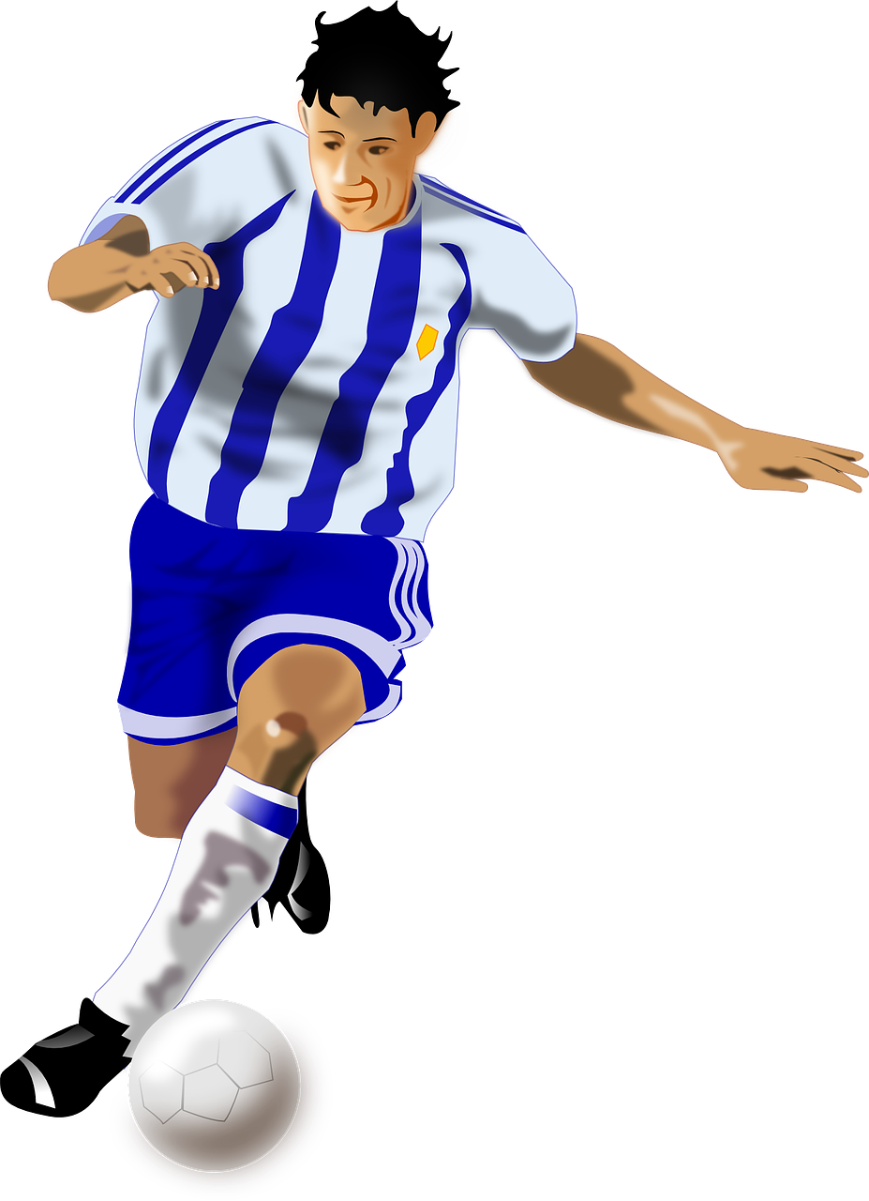
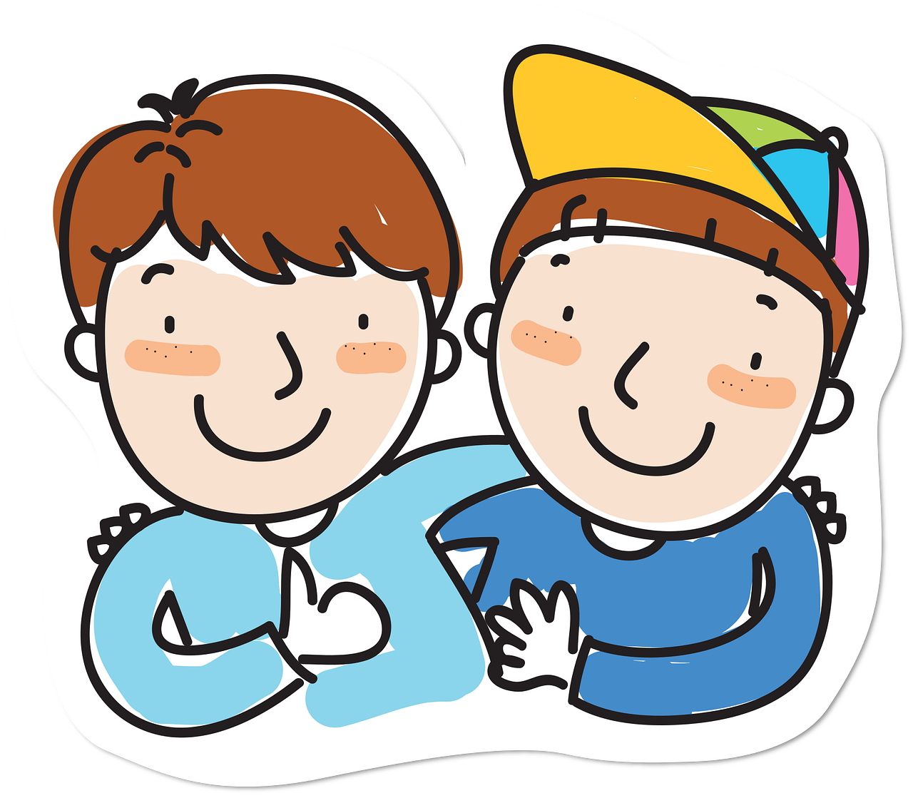
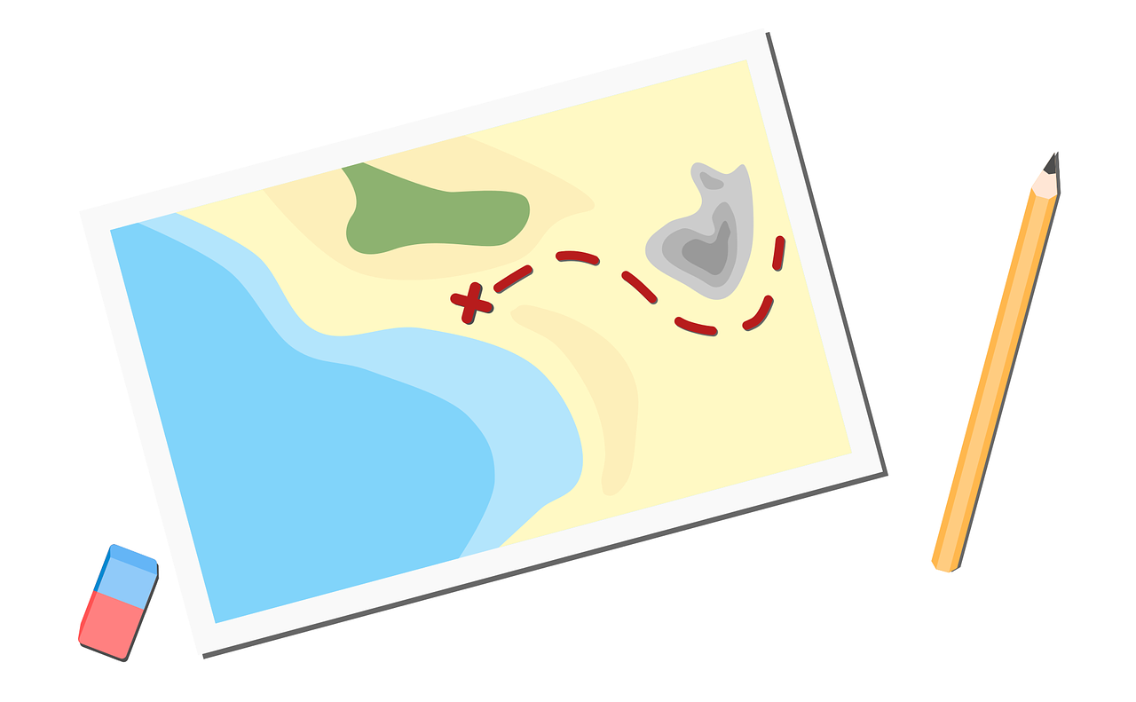
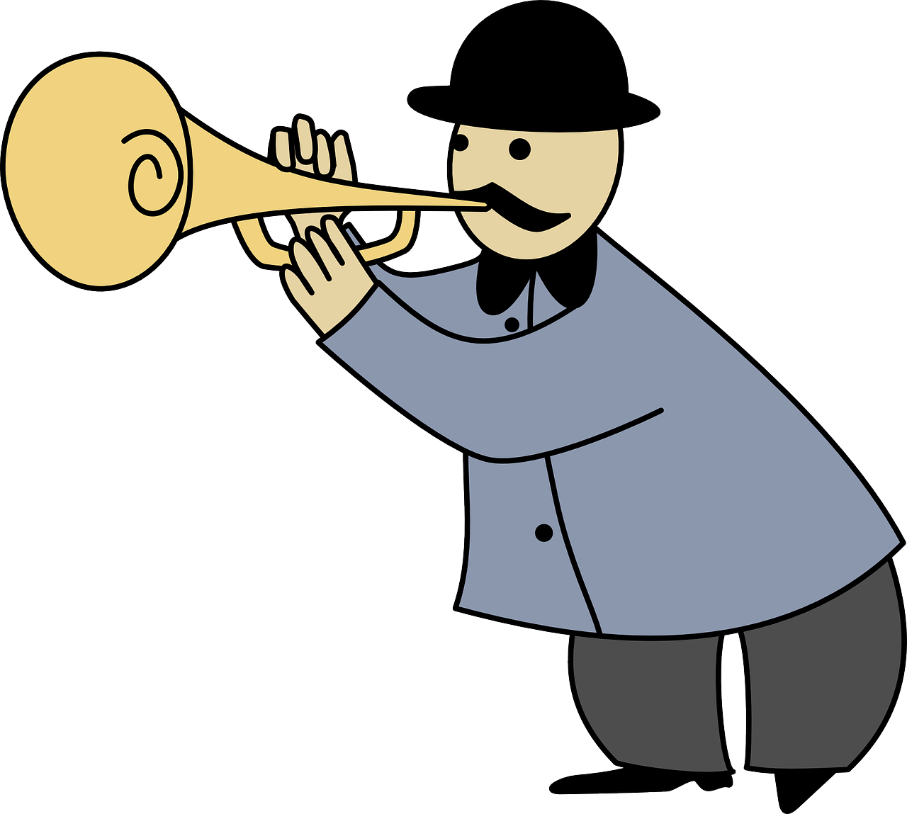
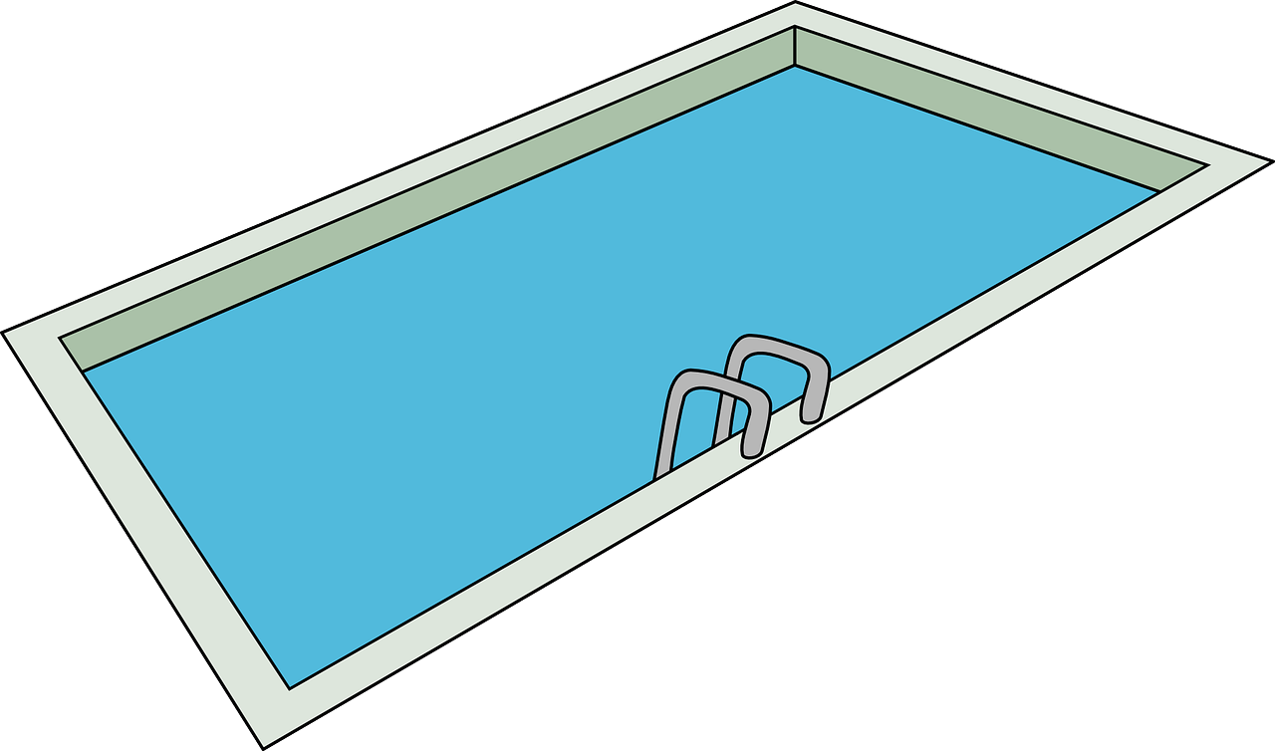
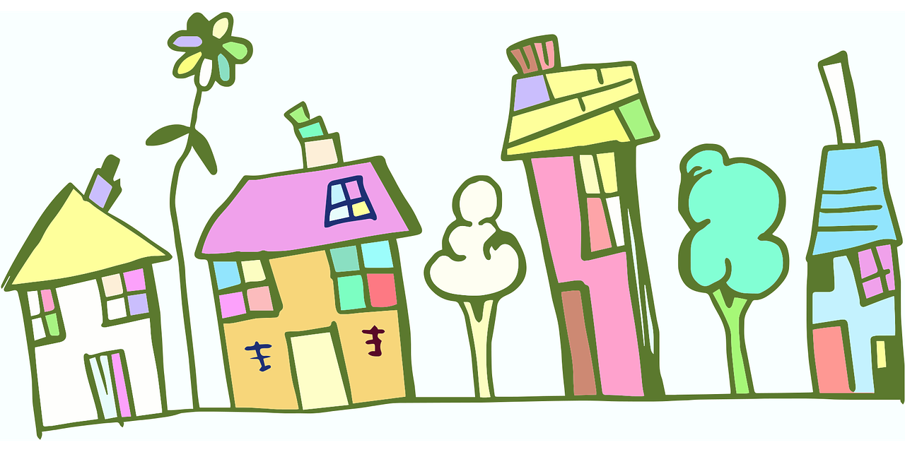
Vokabeln
Wie heißt das auf Deutsch?
Wörter
Sag das Wort und den Artikel auf Deutsch.
der
die
das
Fußball-spieler
Schwimmbad
Dorf
Musiker
Farbe
Haus
Ort
Idee
Fahrrad
Partner
Antwort
Land
Punkt
Karte
Mädchen
Notes:
Timing: 5 minutes
Aim: to recap previously taught vocabulary and connect with the correct gender article.
Procedure:
Click for a picture prompt.
Pupils name the item with definite article in German.
Click again – the picture disappears and the written German word appears in the correct gender ‘bucket’.
Complete for all 15 items.
6

Slide 7
Plural patterns 1- 4
This is plural pattern 2. More than 90% feminine nouns add (e)n for the plural.
You know four plural noun patterns:
This is plural pattern 1.
der Punkt
die Punkte
die Antwort
die Antworten
This is plural pattern 3.
Masculine or neuter words ending in –er or –en may not change:
der Fußballspieler
die Fußballspieler
das Mädchen
die Mädchen
This is plural pattern 4.
About 25% single syllable neuter nouns add –er, some with an umlaut:
das Fahrrad
die Fahrräder
das Schwimmbad
das Haus
die Häuser
die Schwimmbäder
Remember! The word for ‘the’ is ‘die’ for all plural nouns.
Notes:
Timing: 3 minutes Aim: to revisit the four plural noun patterns that pupils have practised previously.
Procedure: 1. Click through the animations to present the information.
2. Elicit the English meanings for the German.
7

Slide 8
hören
Lias und Ronja machen ein Quiz für die Klasse.
Hör zu. Ist das Wort im Singular oder im Plural?
Singular | Plural | Wort | Englisch
 |  | Karte | map
 |  | Orte | places
 |  | Schwimmbäder | swimming pools
 |  | Antworten | answers
 |  | Idee | idea
 |  | Bäume | trees
 |  | Partner | partner(s)
B
1
2
3
4
5
6
Notes:
Timing: 5 minutes
Aim: to practise aural comprehension of plural and singular nouns.
Procedure:
1. Click to hear the example word.
2. Pupils decide whether the word is singular or plural, then write the word in German and its meaning in English.
3. Elicit responses orally and click to reveal the answer. Ask pupils to say what they would have heard if the example had been plural. (i.e., Karten).
4. Repeat steps 1-3 with items 1 – 6.
Prompt pupils to note that number 6 could be either because it is an example of plural pattern 3 – no change.
Transcript:
Beispiel: Karte
Orte
Schwimmbäder
Antworten
Idee
Bäume
Partner
8

Slide 9
Negation with keine
Remember that after most verbs, kein → keinen for masculine nouns: e.g., Ich habe keinen Preis.
Remember! To say ‘not a/no’ with nouns, use kein:
Das ist kein Schwimmbad.
That is not a/no swimming pool.
‘kein’ works like ‘ein’ and matches the gender of the noun.
Das ist keine Antwort.
That is not an/no answer.
Das ist kein Fahrrad.
That is not a/no bike.
Use ‘keine’ for all plural nouns.
To say ‘not (any)/no’ with plural nouns, use keine:
Das sind keine Schwimmbäder.
Those are not/no swimming pools.
Das sind keine Antworten.
Those are not/no answers.
Das sind keine Fahrräder.
Those are not/no bikes.
Notes:
Timing: 2 minutes
Aim: to revisit knowledge of singular noun negation with kein; to introduce the plural form keine.
Procedure:
Click through the animations to present the new information.
Elicit English translation for the German examples provided.
9

Slide 10
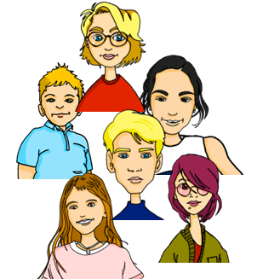
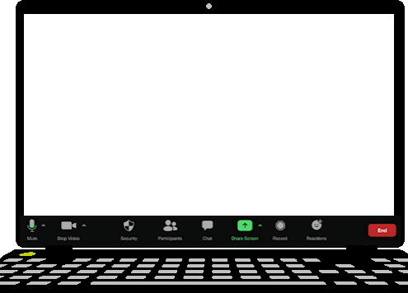
hören
Ronja gibt Beispiele.
Hör zu. Welches Bild ist richtig?
A
B
1
2
3
4
Ich bin in der Klasse.
Der Ort ist schön.
5
6
7
8
Notes:
Timing: 5 minutes
Aim: to practise aural comprehension and distinction of kein/keine/keinen with plural and singular nouns.
Procedure:
1. Do number 1 with pupils to model the task. Tell pupils that when the plural and singular forms of the noun are the same, they will only get the answer from the form of ‘kein’ they hear. Otherwise they will get two clues, one from kein and one from the noun itself.
2. Pupils decide whether the word is singular or plural, and write A or B.
3. Elicit responses (A/B) orally and click to reveal the answer tick. Elicit the German sentence from pupils for additional practice/stretch and challenge.
4. Repeat steps 1-3 with items 2-8.
Transcript:
Ich habe keinen Punkt.
Ich habe keine Idee.
In der Klasse habe ich keine Mädchen.
Ich habe keine Farben.
Ich habe keine Sätze.
Ich habe kein Fahrrad.
Ich habe keine Form.
Ich habe keine Partner.
10

Slide 11
Tschüss!
grün
Notes:
11

