Slide 1
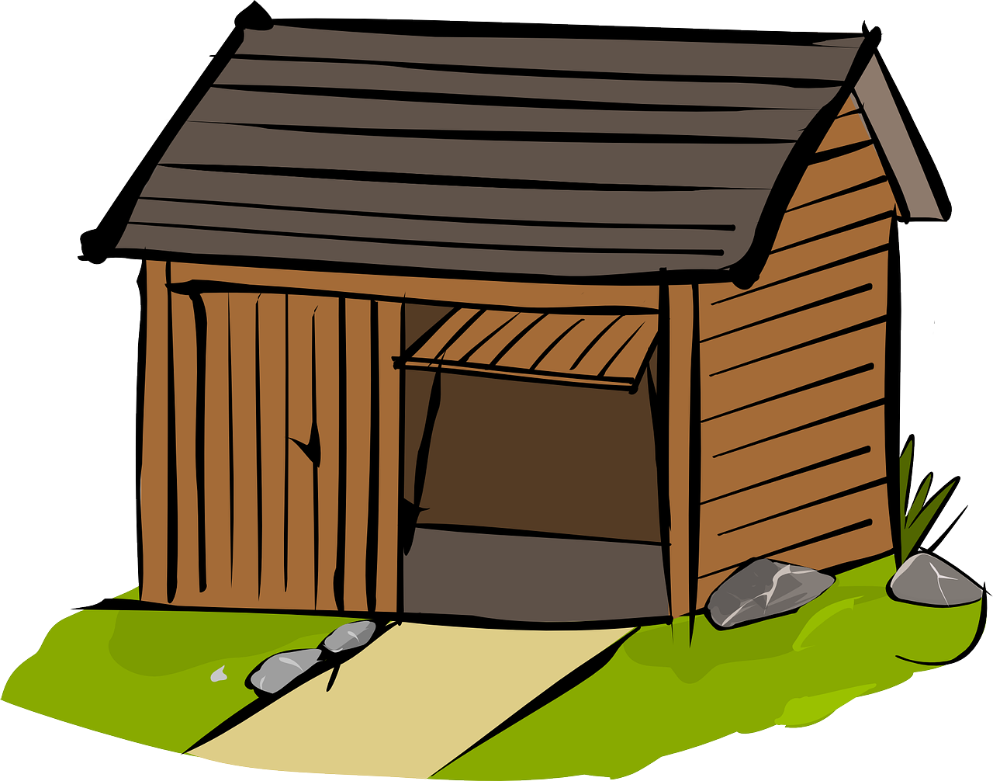
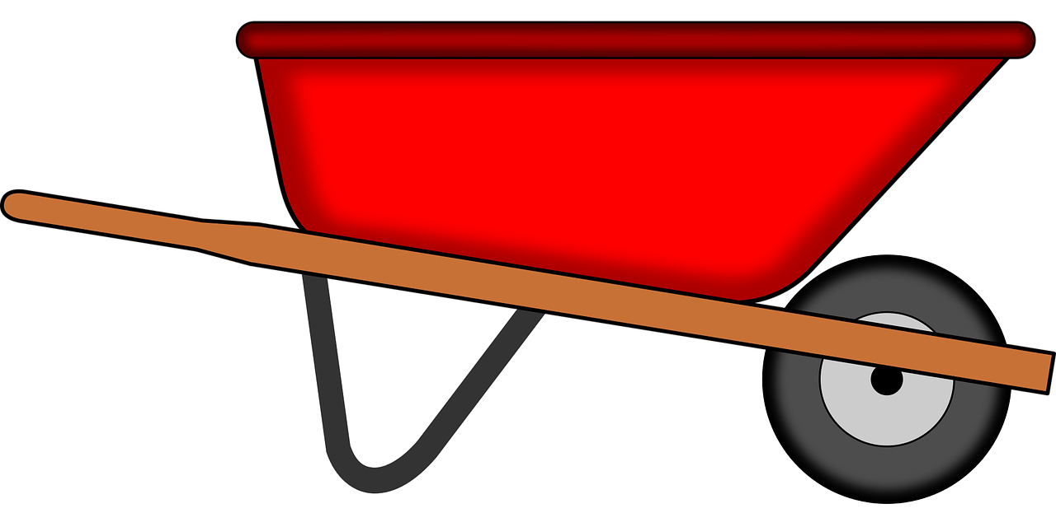
Interacting
grün
Follow ups 1-5
Term 1 Week 9
Notes:
Artwork by Steve Clarke. Pronoun pictures from NCELP (www.ncelp.org). All additional pictures selected from Pixabay and are available under a Creative Commons license, no attribution required.
Phonics: [w] Welt [164] Wasser [245] Antwort [522] wahr [737] gewinnen [372]
Vocabulary:
geben [49] Blume [2463] Foto [633] Fahrrad [2138] Fußball [1277] Geschichte [262] Gitarre [n/a] Haus [147] Katze [2235] Papier [1163] Spiel [328] Tisch [529] Zug [675]
Revisit 1: holen [547] sitzen [231] stehen [85] Dorf, Dörfer [959] fertig [n/a] durch [55]
(plus language from week 5)
Revisit 2: wir sind, ihr seid [4] wir [26] ihr2 [27] müde [2000] ruhig [991] schön [188] wunderbar [1603] da [48] hier [68] Österreich [707] Park [2141] Restaurant [1802] Schweiz [763] Stadt [204] Zug [675] in [3] nicht wahr [n/a] ja [45] nein [148]
Jones, R.L & Tschirner, E. (2019).
A frequency dictionary of German: Core vocabulary for learners. London: Routledge.
The frequency rankings for words that occur in this PowerPoint which have been previously introduced in these resources are given in the SOW and in the resources that first
introduced and formally re-visited those words.
For any other words that occur incidentally in this PowerPoint, frequency rankings will be provided in the notes field wherever possible.
Remember that at the start of the course (first three lessons of Rot/Gelb) pupils learnt language (for greetings and register taking) that can still be part of the lesson routines in upper KS2 (Blau/Grün). They are not re-taught, as we anticipate that teachers have built these in from early in lower KS2.

Slide 2
aussprechen
[w]
…
Welt
Notes:
Timing: 1 minute
Aim: to introduce the SSC [w].
Procedure:
Introduce the SSC and present the source word ‘Welt’ (with gesture, if using).
Click to bring on the picture and get pupils to repeat the word ‘Welt’ (with gesture, if using).
Note:
a gesture for ‘Welt’ might be to mime a big sphere with your hands.
Vocabulary: Welt [164]
Jones, R.L & Tschirner, E. (2019). A frequency dictionary of German: Core vocabulary for learners. London: Routledge.
2

Slide 3
aussprechen
[w]
…
Wasser
Antwort
Welt
wahr
gewinnen
Notes:
Timing: 1 minute
Aim: to consolidate the SSC [w].
Procedure:
Re-present the SSC and the source word ‘Welt’ (with gesture, if using).
Click to bring on the picture and get pupils to repeat the word ‘Welt’ (with gesture, if using).
Present the cluster words in the same way, bringing on the picture and getting pupils to pronounce the words.
Vocabulary: Antwort [522] gewinnen [372] wahr [737] Wasser [245] Welt [164]
Jones, R.L & Tschirner, E. (2019). A frequency dictionary of German: Core vocabulary for learners. London: Routledge.

Slide 4
aussprechen
[v]
…
Vater
Notes:
Timing: 1 minute
Aim: to recap the SSC [v] before meeting [w] and [v] together on next slide.
Procedure:
Present the SSC and the source word ‘Vater’
Click to bring on the picture and get pupils to repeat the word ‘Vater’, with gesture if using.
Note:
a gesture for ‘Vater’ might be to use the BSL gesture, found here: https://www.signbsl.com/sign/father. Although the gesture is not evocative of father, it does tap out the two syllables and the words father/Vater share the same origin, and are very similar, so this does work for the German word, too. Teachers may prefer other alternatives, or not to have a gesture at all.
Vocabulary: Vater [232]
Jones, R.L & Tschirner, E. (2019). A frequency dictionary of German: Core vocabulary for learners. London: Routledge.

Slide 5
aussprechen
[v]
…
Vater
vier
viel
4
[a lot, much]
verstehen
Notes:
Timing: 1 minute
Aim: to consolidate the SSC [v]
Procedure:
Present the SSC and the source word ‘Vater’
Click to bring on the picture and get pupils to repeat the word ‘Vater’
Present the cluster words in the same way, bringing on the picture and getting pupils to pronounce the words.
Vocabulary: Vater [232] vier [200] verstehen [211] viel [56]
Jones, R.L & Tschirner, E. (2019). A frequency dictionary of German: Core vocabulary for learners. London: Routledge.

Slide 6
Follow up 1
[w]
[v]
Hör zu. Welches Wort ist das? Schreib die Nummer.
aussprechen
A
B
C
D
E
F
7
1
11
3
8
2
hören
1. Woll-
2. wir
3. Veilchen
4. Wetter
[wool]
[we]
[violet]
[weather]
6. voll
7. Vetter
5. werden
8. Verden
[to become]
[full
[male cousin]
[town in Germany]
9. Vieh
10. vier
11. wie?
12. Weilchen
[four) 4
[cattle]
[how?]
[a little while]
Notes:
Timing: 5 minutes
Aim: to practise aural recognition of words containing SSC [w] or [v]; the [v] words act as significant distractors given that English [v] = German [w].
Procedure: 1. Pupils write down letters A-F. They are going to hear six words. They need to write down the number of the word they hear.
2. Click on audio buttons A-F to listen to each word.
2. Pupils note down the numbers of the word they hear, next to each letter A-F.
3. Elicit answers by asking pupils to say the word in German and give its number.
4. Answers revealed on clicks. English translation of words appears too.
5. After each answer the ‘distractor’ partner word for the answer is highlighted to elicit pupils’ pronunciation, so that they can compare and contrast the two words.
5. Pupils then work in pairs to pronounce all of the words 1-12 as accurately as they can.
NB: Verden is the name of a real town in Saxony, Germany. https://en.wikipedia.org/wiki/Verden_an_der_Aller
Transcript:
Vetter
Woll
wie Veilchen Verden wir
Frequency:
voll [388] Wolle [N/A] wissen [78]
Jones, R.L & Tschirner, E. (2019). A frequency dictionary of German: Core vocabulary for learners. London: Routledge.

Slide 7
Negation with kein
As you know, kein means ‘not a/no’ with nouns, and matches the gender of the noun:
Das ist kein Fußball.
That is not a/no ball.
Das ist keine Blume.
That is not a/no flower.
Das ist kein Foto.
That is not a/no photo.
After most other verbs kein becomes keinen for masculine nouns:
Es gibt keinen Fußball.
There is not a/no football.
It is still ‘keine’ for feminine and ‘kein’ for neuter nouns.
Es gibt keine Blume.
There is not a/no flower.
Es gibt kein Foto.
There is not a/no photo.
Es gibt keine Fußbälle.
Use ‘keine’ for all plural nouns.
There are not any/no footballs.
Notes:
Timing: 2 minutes
Aim: to revisit knowledge of singular noun negation with kein; to introduce the accusative form keinen for masculine nouns after most verbs.
Procedure:
Click through the animations to present the new information.
Elicit English translation for the German examples provided.
7

Slide 8
Follow up 2
Johanna and Moritz’s mum Maike tells their dad Steffen about the garage tidy but it’s hard to hear.
Hör zu. Ist das Verb ‘ist’ oder nicht?
hören
 | ist? | other verb?
1
1
Hör noch mal zu. Was sagt Maike?
2
That is not a film.
2
3
Moritz has no/doesn’t have a computer.
3
Moritz is not looking for a letter.
4
4
A cat is not a prize!
5
5
Johanna is not fetching a football.
6
6
That is not a table.
Notes:
Timing: 5 minutes Aim: to practise comprehension of indefinite negative article kein – and distinction between nominative R1 and accusative R2 forms with masculine nouns - in the listening modality.
Procedure: 1. Click on the audio buttons to play the sentences which are missing the verb.
2. Pupils tick the column of the missing verb in each case (by listening to the form of ‘kein’ which follows).
3. Click to bring up the answers. 4. Play the full sentences. Teachers elicit English meanings. It is not straightforward to translate ‘kein’ so well worth practising its English meaning in these different sentences.
Transcript:
Das [ist] kein Film.
Moritz [hat] keinen Computer.
Er [sucht] keinen Brief.
Eine Katze [ist] kein Preis!
Johanna [holt] keinen Fußball.
Das [ist] kein Tisch.

Slide 9
Follow up 3
Was
Lies die Sätze. Was geben Johanna und Moritz?
Moritz macht eine Liste.
Johanna schreibt die Liste. Ist das richtig oder falsch?
lesen
Er gibt ein Fahrrad.
Er gibt eine Gitarre.
Er gibt keine Fußbälle.
Er gibt kein Spiel.
Er gibt eine Blume.
Er gibt keinen Tisch.
kein
viele
einen
Notes:
Timing: 5 minutes
Aim: to practise recognition of positive and negative statements using ‘ein’ and ‘kein’ words in written form.
Procedure:
Explain the scenario: Johanna asks Moritz to make a list of everything he is donating and everything he is not ready to give up for the sale. He draws the items and ticks/crosses to show whether he will give them away. Johanna writes the list out in full… but has she got it right?
Pupils write down numbers 1-6. Looking at Moritz’s picture list on the left, they decide whether Johanna’s sentences on the right are true or false, and draw a tick or a cross.
Pupils should also be encouraged to try and correct the false sentences by writing the correct word or whole sentence in German.
Click to reveal true/false answers and corrected sentences.
Additional Task suggestions:
Pupils could quickly draw their own version of a picture list (using vocab from this or previous lessons). Their partner should then say/write sentences in the 3rd person about the list e.g. Alex gibt ein Bild; er gibt keinen Baum.

Slide 10
Follow up 4

Schreib die Wörter auf Deutsch und auf Englisch.
Es gibt _______ Fahrräder.
Er _______ ________ Fußall.
Gebt ___ genug ________?
____ _____ keine Katze!
Diese _______ ist ______!
schreiben
__________lots of ___________ .
______gives no _________.
___ you (all)_______ ________ games?
That is _________ _____________!
____ flower ___ beautiful!
In English we are more likely to say: He isn’t giving a football.
bikes
1
viele
There are
2
gibt
keinen
He
football
This could also mean: Do you give enough games
Are
giving
enough
3
ihr
Spiele
4
Das
ist
not a/no
cat
5
Blume
schön
This
is
Notes:
Timing: 5-10 minutes
Aim: to practise written production and comprehension of this week’s new verb forms (gibt/gebt), kein, new and revisited vocabulary.
This is a jigsaw translation task.
Procedure:
Pupils write the missing words in both German and English to complete the sentences.
Teacher clicks to provide the written answers and/or clicks the audio buttons to hear the full German sentences.
Pupil HANDOUT at end of this presentation
Differentiation: 1. For a different challenge (i.e. to practise spelling rather than full written recall of the missing German words), the task could be completed as a transcription task initially, by listening to the full sentences and writing the words.
2. Then pupils could complete the English part of the jigsaw.

Slide 11
Follow up 5:

Schreib auf Englisch.
Can you get at least 15 points?
Wörter
 | Österreich | you (all) are | schön
 | da | die Stadt | ihr seid
 | hier | müde | die Schweiz
 | fertig | sitzen | stehen
 | durch | das Dorf | holen
 | geben | die Geschichte | die Gitarre
 | der Zug | die Katze | das Papier
Austria
ihr seid
beautiful, nice
Vokabeln
x3
there
(the) town
you (all) are
here
tired
Switzerland
x2
ready, finished
to sit, sitting
to stand
through
(the) village
to fetch, fetching
to give, giving
(the) story
(the) guitar
x1
(the) train
(the) cat
(the) paper
Notes:
Timing: 5 minutes
Aim: to practise written production of vocabulary from this and revisited weeks.
Procedure: 1. Give pupils a blank grid. They fill in the English meanings of any of the words they know, trying to reach 15 points in total. 2. Click to reveal answers from the bottom of the grid up.
Note: The most recently learnt and practised words are pink, words from the previous week are green and those from week 1 are blue, thus more points are awarded for them, to recognise that memories fade and more effort (heavy lifting!) is needed to retrieve them.

Slide 12
Follow up 5:

Schreib auf Deutsch.
Can you get at least 15 points?
Wörter
 | tired | there | here
 | Austria | Switzerland | (the) town
 | we are | you (all) are | beautiful, nice
 | (the) village | ready, finished | through
 | to fetch, fetching | to stand, standing | to sit, sitting
 | (the) paper | (the) cat | (the) train
 | to give, giving | (the) story | (the) guitar
müde
da
hier
Vokabeln
x3
Österreich
die Schweiz
die Stadt
wir sind
ihr seid
schön
x2
das Dorf
fertig
durch
stehen
holen
sitzen
das Papier
die Katze
der Zug
x1
geben
die Geschichte
die Gitarre
Notes:
Timing: 5 minutes
Aim: to practise written production of vocabulary from this and revisited weeks.
Procedure: 1. Give pupils a blank grid. They fill in the German meanings of any of the words they know, trying to reach 15 points in total. 2. Click to reveal answers from the bottom of the grid up.
Note: The most recently learnt and practised words are pink, words from the previous week are green and those from week 1 are blue, thus more points are awarded for them, to recognise that memories fade and more effort (heavy lifting!) is needed to retrieve them.

Slide 13
Tschüss!
grün
Notes:
13

Slide 14
Follow up 4

Schreib die Wörter auf Deutsch und auf Englisch.
Es gibt _______ Fahrräder.
Er _______ ________ Fußall.
Gebt ___ genug ________?
____ _____ keine Katze!
Diese _______ ist ______!
schreiben
__________lots of ___________ .
______gives no _________.
___ you (all)_______ ________ games?
That is _________ _____________!
____ flower ___ beautiful!
1
2
3
4
5
Notes:
HANDOUT

Slide 15
Follow up 5:

Schreib auf Englisch.
Can you get at least 15 points?
Wörter
 | Österreich | you (all) are | schön
 | da | die Stadt | ihr seid
 | hier | müde | die Schweiz
 | fertig | sitzen | stehen
 | durch | das Dorf | holen
 | geben | die Geschichte | die Gitarre
 | der Zug | die Katze | das Papier
Vokabeln
x3
x2
x1
Notes:
HANDOUT

Slide 16
Follow up 5:

Schreib auf Deutsch.
Can you get at least 15 points?
Wörter
 | tired | there | here
 | Austria | Switzerland | (the) town
 | we are | you (all) are | beautiful, nice
 | (the) village | ready, finished | through
 | to fetch, fetching | to stand, standing | to sit, sitting
 | (the) paper | (the) cat | (the) train
 | to give, giving | (the) story | (the) guitar
Vokabeln
x3
x2
x1
Notes:
HANDOUT

