Slide 1
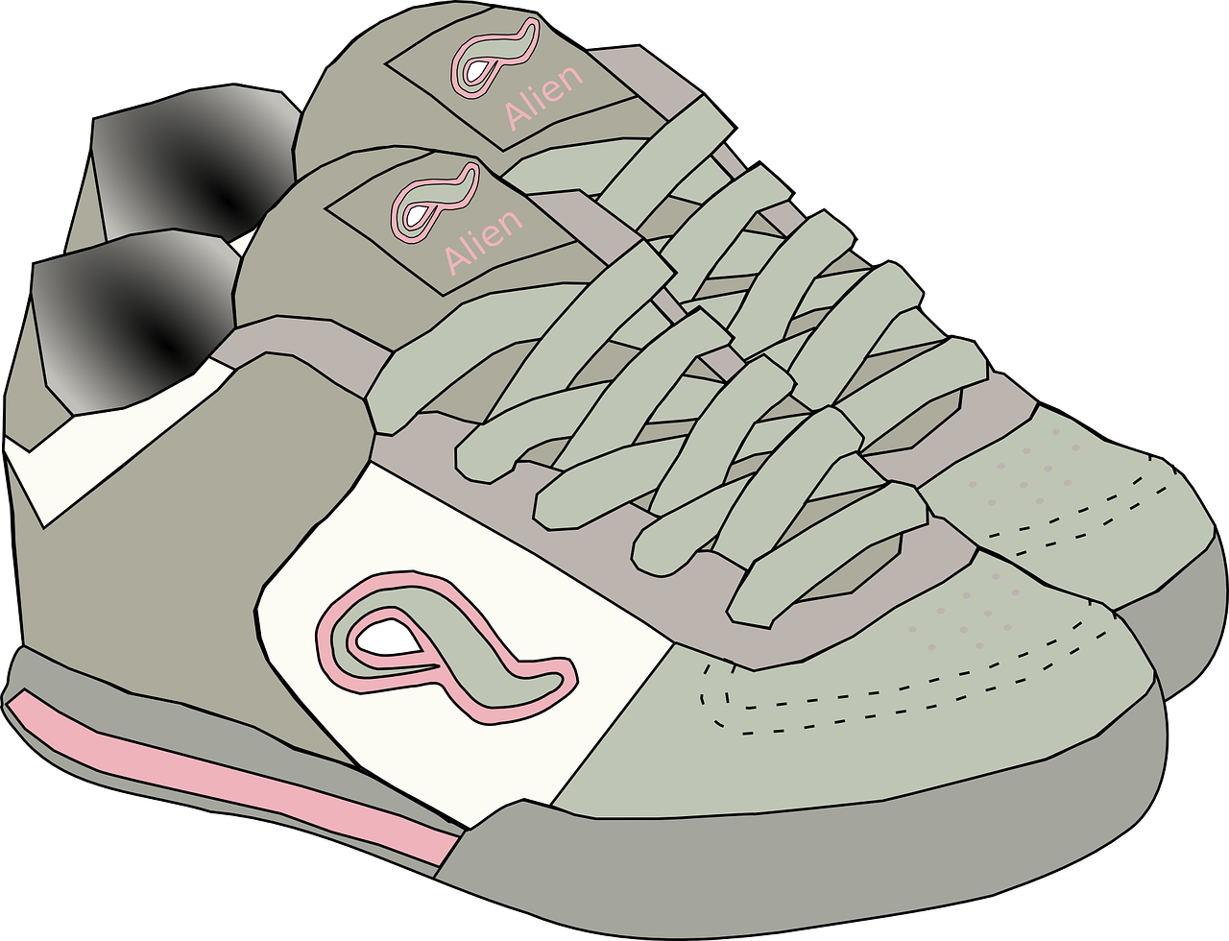
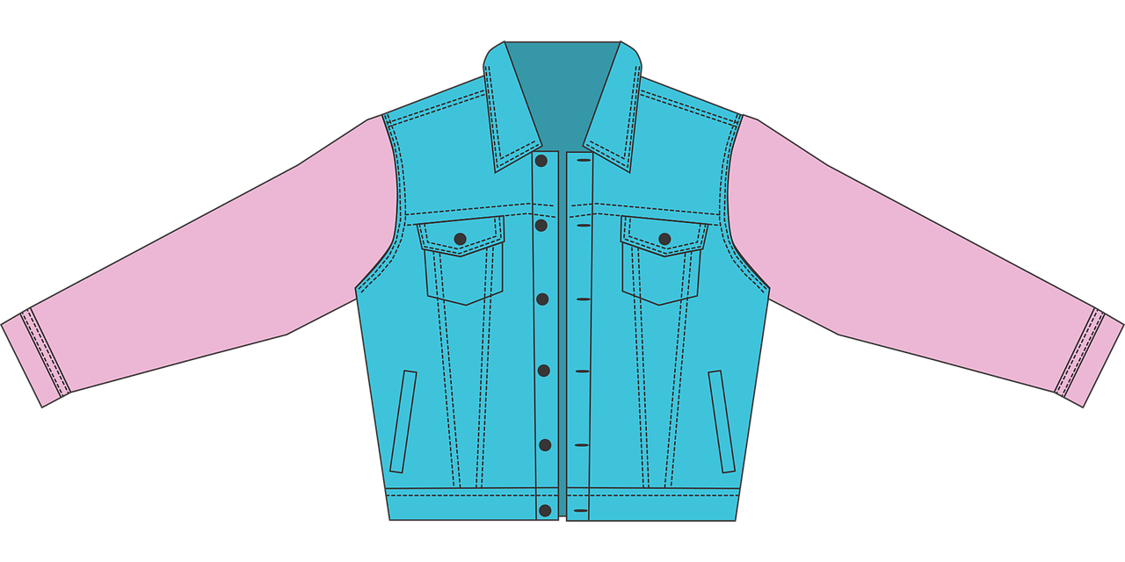
Interacting
grün
Negation with kein (R2-acc.)
Es gibt vs. geben
SSC [w]
Term 1 Week 9
Notes:
Artwork by Steve Clarke. Pronoun pictures from NCELP (www.ncelp.org). All additional pictures selected from Pixabay and are available under a Creative Commons license, no
attribution required.
Phonics: [w] Welt [164] Wasser [245] Antwort [522] wahr [737] gewinnen [372]
Vocabulary:
geben [49] Blume [2463] Foto [633] Fahrrad [2138] Fußball [1277] Geschichte [262] Gitarre [n/a] Haus [147] Katze [2235] Papier [1163] Spiel [328] Tisch [529] Zug [675]
Revisit 1: holen [547] sitzen [231] stehen [85] Dorf, Dörfer [959] fertig [n/a] durch [55]
(plus language from week 5)
Revisit 2: wir sind, ihr seid [4] wir [26] ihr2 [27] müde [2000] ruhig [991] schön [188] wunderbar [1603] da [48] hier [68] Österreich [707] Park [2141] Restaurant [1802] Schweiz [763] Stadt [204] Zug [675] in [3] nicht wahr [n/a] ja [45] nein [148]
Jones, R.L & Tschirner, E. (2019). A frequency dictionary of German: Core vocabulary for learners. London: Routledge.
The frequency rankings for words that occur in this PowerPoint which have been previously introduced in these resources are given in the SOW and in the resources that first
introduced and formally re-visited those words.
For any other words that occur incidentally in this PowerPoint, frequency rankings will be provided in the notes field wherever possible.
Remember that at the start of the course (first three lessons of Rot/Gelb) pupils learnt language (for greetings and register taking) that can still be part of the lesson routines in upper KS2 (Blau/Grün). They are not re-taught, as we anticipate that teachers have built these in from early in lower KS2.
1

Slide 2
aussprechen
[w]
…
Welt
Notes:
Timing: 1 minute
Aim: to introduce the SSC [w].
Procedure:
Introduce the SSC and present the source word ‘Welt’ (with gesture, if using).
Click to bring on the picture and get pupils to repeat the word ‘Welt’ (with gesture, if using).
Note:
a gesture for ‘Welt’ might be to mime a big sphere with your hands.
Vocabulary: Welt [164]
Jones, R.L & Tschirner, E. (2019). A frequency dictionary of German: Core vocabulary for learners. London: Routledge.
2

Slide 3
aussprechen
[w]
…
Wasser
Antwort
Welt
wahr
gewinnen
Notes:
Timing: 1 minute
Aim: to consolidate the SSC [w].
Procedure:
Re-present the SSC and the source word ‘Welt’ (with gesture, if using).
Click to bring on the picture and get pupils to repeat the word ‘Welt’ (with gesture, if using).
Present the cluster words in the same way, bringing on the picture and getting pupils to pronounce the words.
Vocabulary: Antwort [522] gewinnen [372] wahr [737] Wasser [245] Welt [164]
Jones, R.L & Tschirner, E. (2019). A frequency dictionary of German: Core vocabulary for learners. London: Routledge.

Slide 4
aussprechen
[v]
…
Vater
Notes:
Timing: 1 minute
Aim: to recap the SSC [v] before meeting [w] and [v] together on next slide.
Procedure:
Present the SSC and the source word ‘Vater’
Click to bring on the picture and get pupils to repeat the word ‘Vater’, with gesture if using.
Note:
a gesture for ‘Vater’ might be to use the BSL gesture, found here: https://www.signbsl.com/sign/father. Although the gesture is not evocative of father, it does tap out the two syllables and the words father/Vater share the same origin, and are very similar, so this does work for the German word, too. Teachers may prefer other alternatives, or not to have a gesture at all.
Vocabulary: Vater [232]
Jones, R.L & Tschirner, E. (2019). A frequency dictionary of German: Core vocabulary for learners. London: Routledge.

Slide 5
aussprechen
[v]
…
Vater
vier
viel
4
[a lot, much]
verstehen
Notes:
Timing: 1 minute
Aim: to consolidate the SSC [v]
Procedure:
Present the SSC and the source word ‘Vater’
Click to bring on the picture and get pupils to repeat the word ‘Vater’
Present the cluster words in the same way, bringing on the picture and getting pupils to pronounce the words.
Vocabulary: Vater [232] vier [200] verstehen [211] viel [56]
Jones, R.L & Tschirner, E. (2019). A frequency dictionary of German: Core vocabulary for learners. London: Routledge.

Slide 6
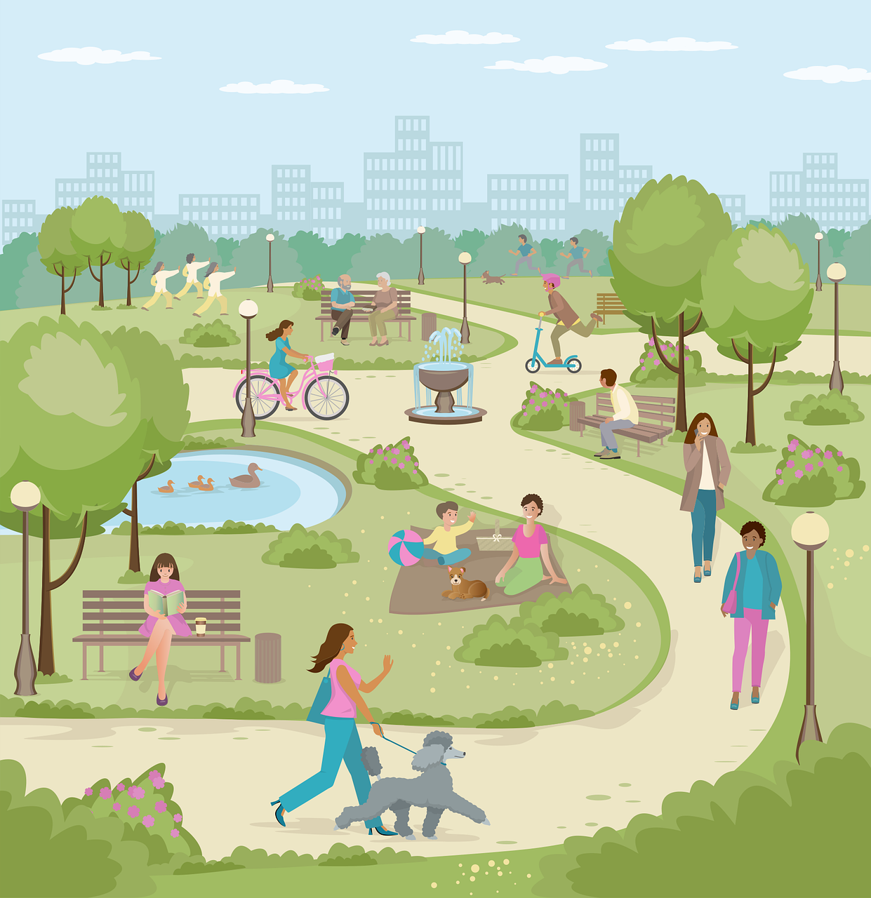
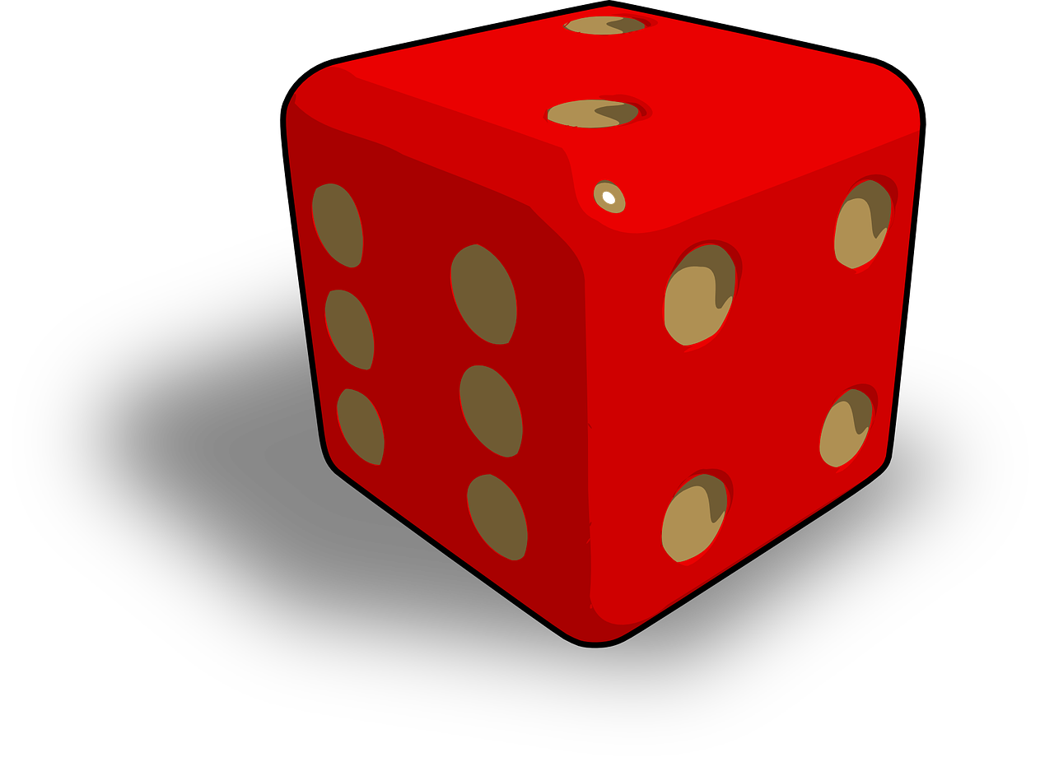
aussprechen
[w] oder [v]?
Hör zu. Schreib [w] oder [v].
1 |  | 5
2 |  | 6
3 |  | 7
4 |  | 8
verstehen
W ert
[value]
hören
Weg
v erlieren
[way, path]
[to lose]
w eit
V erbindung
[far]
[connection]
Vater
w achsen
[to grow]
Notes:
Timing: 5 minutes
Aim: to consolidate the SSC [w] by listening and transcribing the missing letters. [w] is contrasted with [v] because in English we pronounce [v] like [w] in German.
Procedure:
1. Explain the task.
2. Pupils listen to each word and write either [w] or [v]. Note: if pupils want to challenge themselves they can turn away from the board to write each whole word.
3. Elicit the full word pronunciation from pupils.
4. Click to reveal the answer and click again for a picture to support meaning.
Transcript:
verstehen
Weg
weit
Vater
Wert
verlieren
Verbindung
wachsen
Vocabulary:
Vater [232] Verbindung [434] verlieren [313] verstehen [211] wachsen [470] Weg [2020] weit [230] Wert [290]

Slide 7
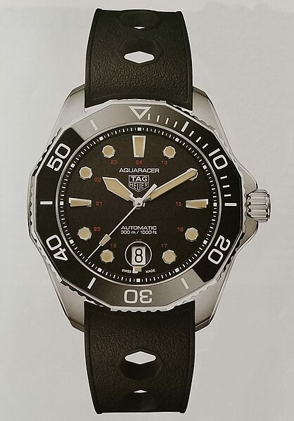
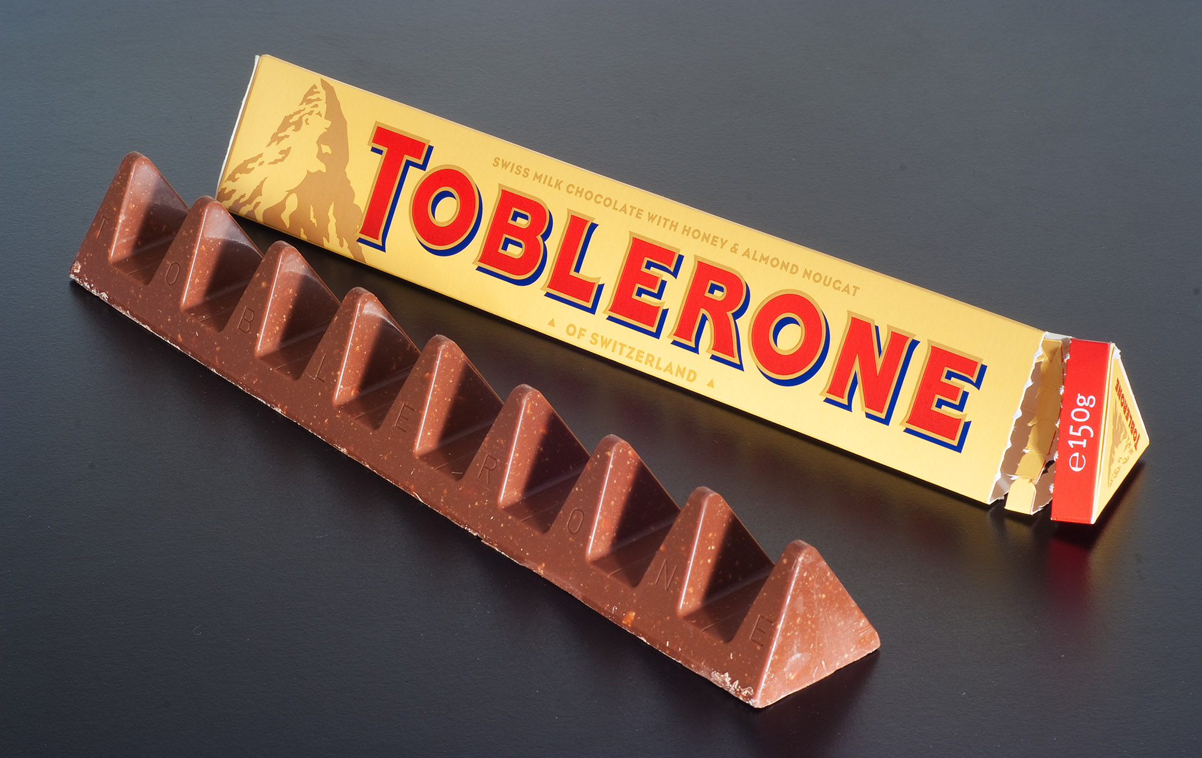
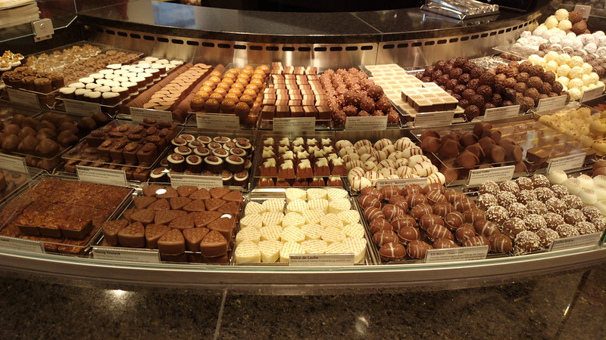
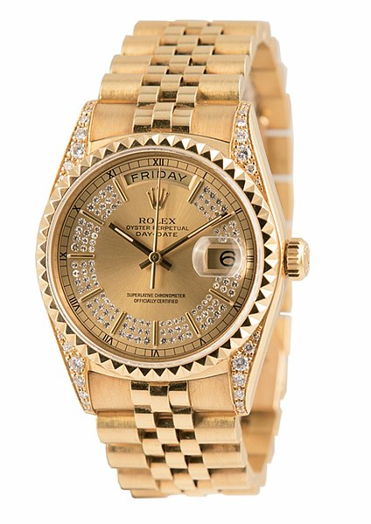
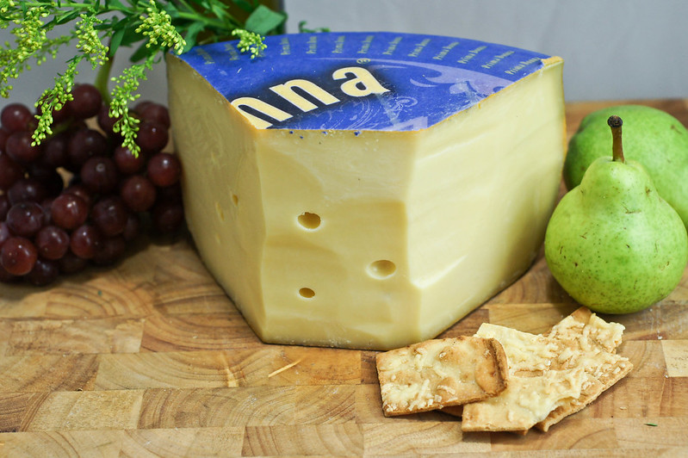
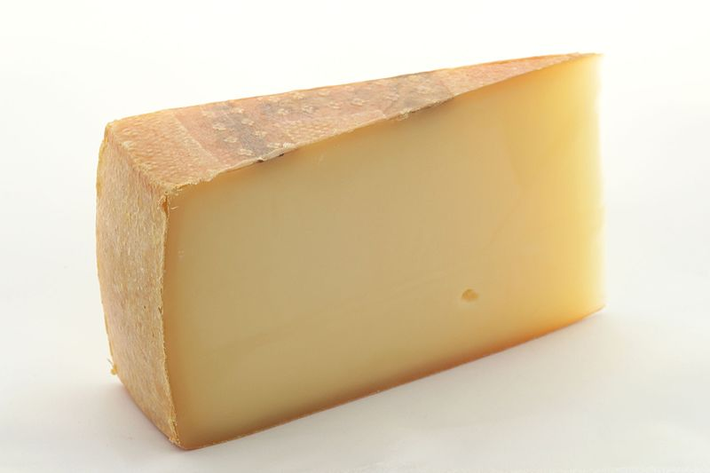
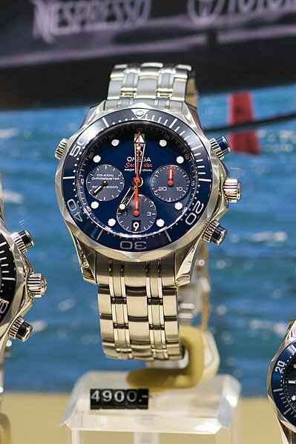
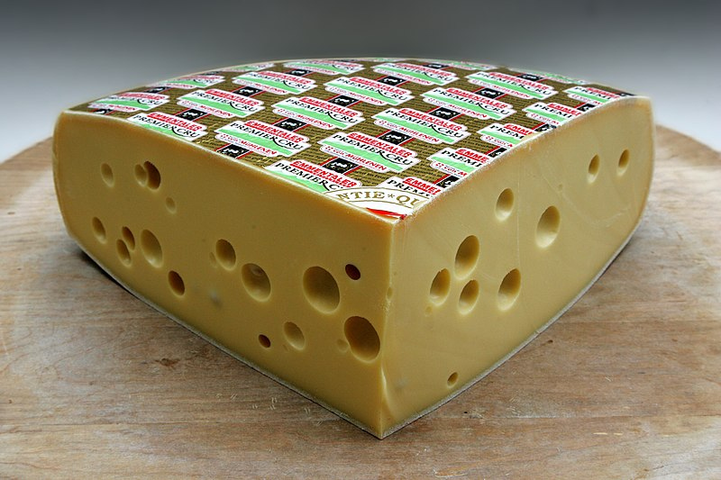
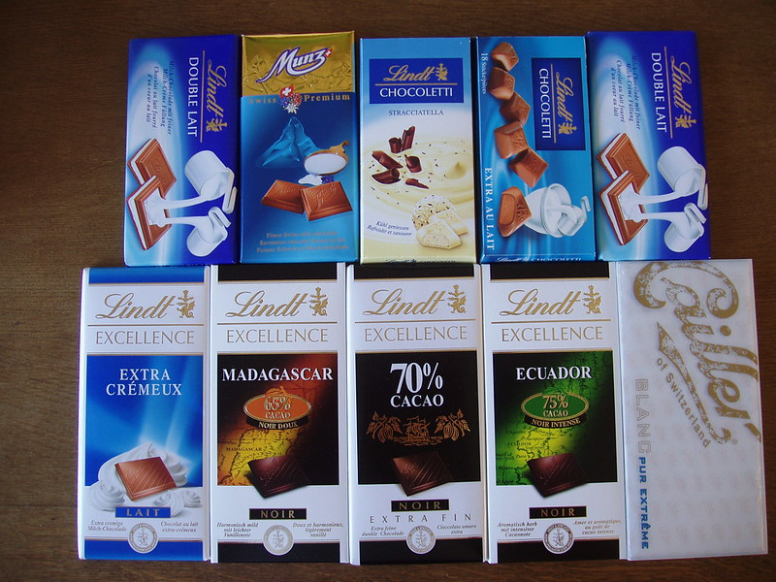
Kultur
Sachen* aus* der Schweiz
Switzerland is known for some famous brands for watches, chocolate and cheese!
Was möchtest du aus der Schweiz? Eine Uhr, Käse, oder Schokolade?
eine Uhr
Schokolade
Toblerone
Schokolade
Tagheuer
Ich möchte…
eine Uhr! Rolex!
eine Uhr
Käse
…a watch! Rolex!
Läderach
Rolex
Prima Donna
eine Uhr
Käse
Käse
Schokolade
Appenzeller
*Sachen-things
aus-from
Emmentaler
Lindt
Omega
Notes:
Timing: 2 minutes
Aim: to raise awareness of some famous Swiss brands and to practise read-aloud decoding by categorising brand names
Procedure:
Read the title and cultural information on famous watch, chocolate and cheese brands. Explain that pupils will ask each other what they would like from Switzerland, using the category (Uhr, Käse, Schokolade) and the brand name.
Click to bring up the question ‘Was möchtest du aus der Schweiz?’ and click again for the answer ‘Ich möchte…’ plus the English “ a watch! Rolex!”.
Elicit the German for “ a watch! Rolex!” Click to bring up the answer.
Pupils continue asking each other what they would like and answering, taking turns until they’ve talked through all the images.
Toblerone – ist das eine Uhr, Schokolade oder Käse? Elicit the answer. Click to bring the answer.
Continue for all images.
Ask what other Swiss brands pupils may know?
Image credits:
Toblerone chocolate: By Ashley Pomeroy - Own work, CC BY 3.0, https://commons.wikimedia.org/w/index.php?curid=53119702
Lindt chocolate: By Hendrik Sijens – Own work, CC BY-NC-SA 2.0, https://flic.kr/p/CtNip
Läderach chocolate: By hugovk, CC BY-NC-SA 2.0, https://flic.kr/p/FMhqVa
Rolex watch: WALLI1912, CC BY-SA 3.0, http://creativecommons.org/licenses/by-sa/3.0/
Tagheuer watch: Clyde94, CC BY-SA 4.0 Clyde94, https://upload.wikimedia.org/wikipedia/commons/4/42/TAG_Heuer_Aquaracer_tribute_to_ref._844.jpg
Omega watch: By Thomas Quine, CC BY 2.0 https://upload.wikimedia.org/wikipedia/commons/f/f8/Omega_watch_%2825263509997%29.jpg
Emmentaler cheese: Manuel2, CC BY-SA 2.0 DE https://upload.wikimedia.org/wikipedia/commons/3/38/Emmentaler_Premier_Cru.jpg
Appenzeller cheese: Manuel2, CC BY-SA 2.0 DE https://upload.wikimedia.org/wikipedia/commons/8/8c/Appenzeller_classic2_%283_mois%29.jpg
Prima Donna cheese: By Artizone, CC BY-NC-ND 2.0, https://flic.kr/p/8yawDk
Vocabulary:
aus [37] Sache [318] [Schokolade [4532]
7

Slide 8
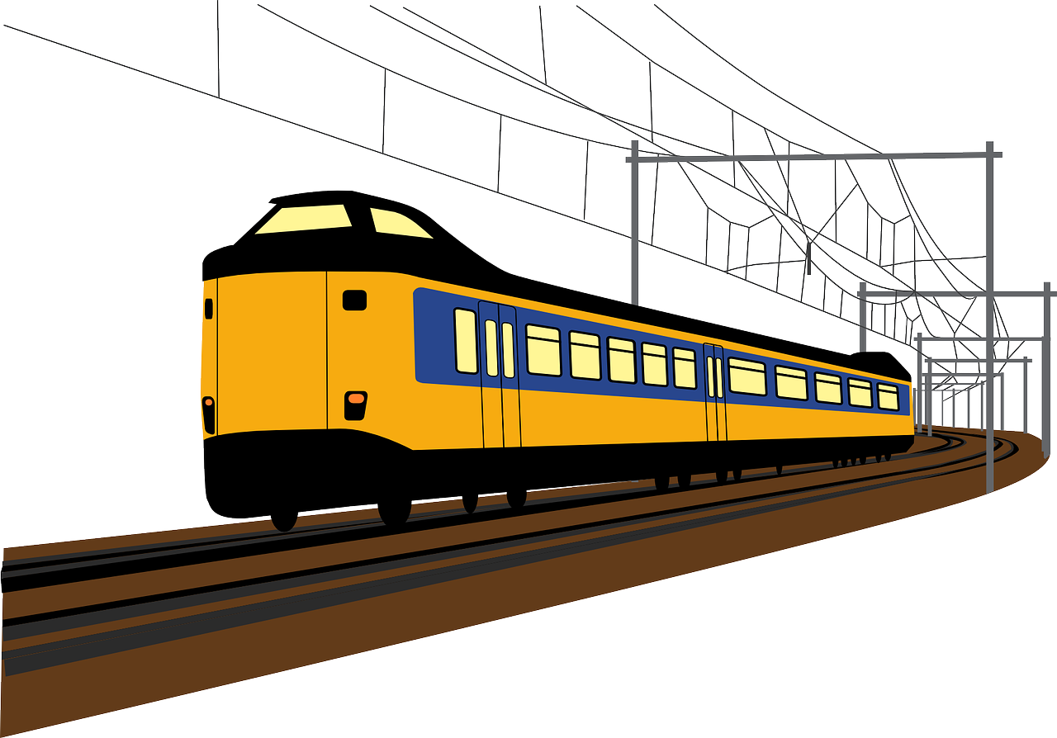
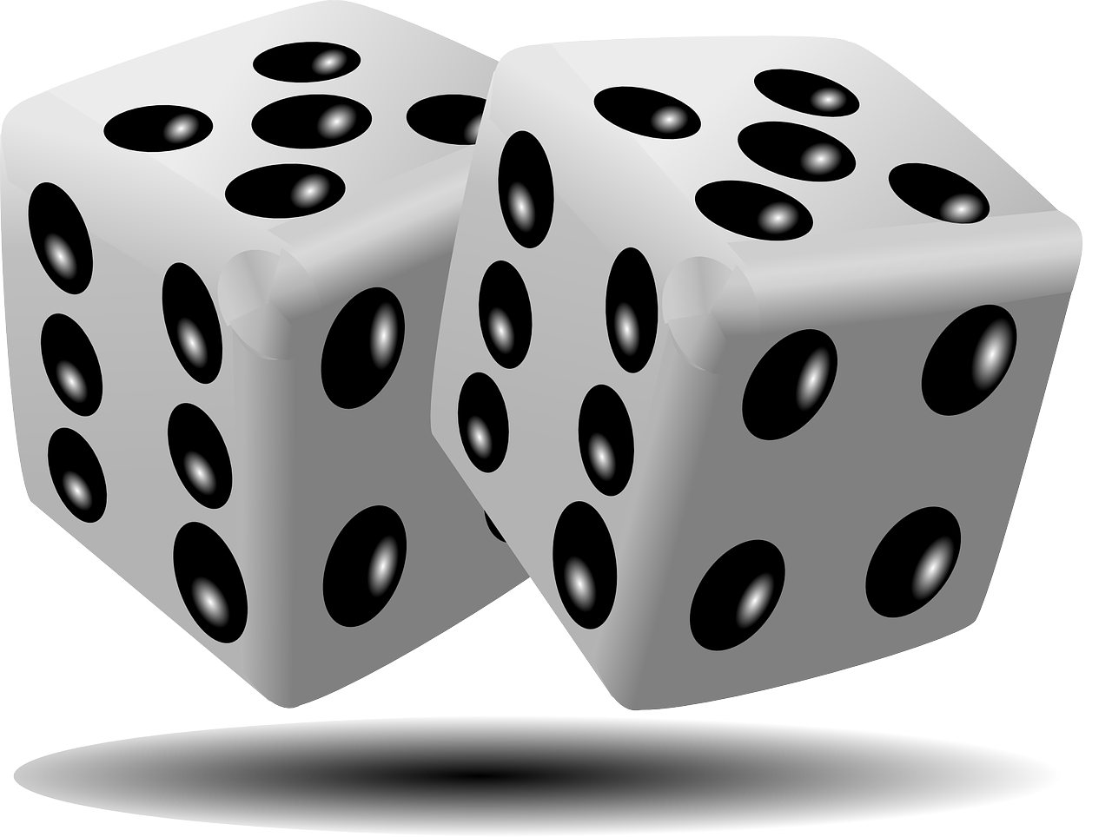
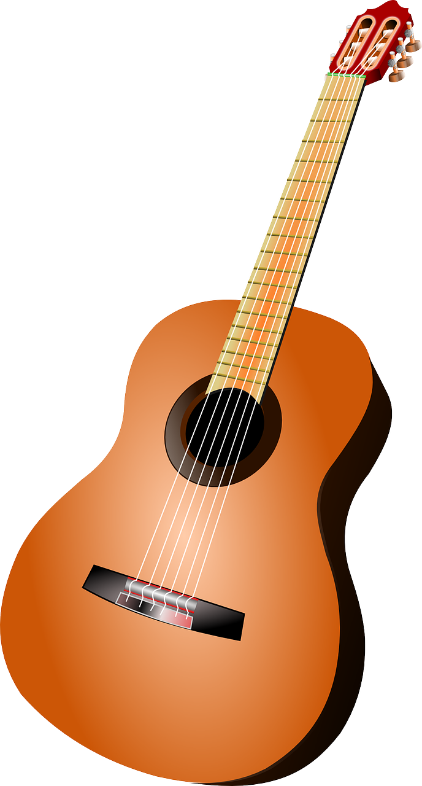
Vokabeln
Was ist das auf Deutsch?
Wörter
to give, giving
(the) table
(the) cat
(the) paper
(the) bicycle, bike
(the) train
(the) photo
(the) game
(the) house
(the) story
(the) football
(the) flower
there is, there are
(the) book
(the) guitar
der Fußball
die Blume
das Foto
das Papier
geben
der Zug
das Buch
das Spiel
die Gitarre
es gibt
there is,
there are
die Geschichte
die Katze
das Haus
das Fahrrad
der Tisch
Notes:
Timing: 3 minutes
Aim: to elicit oral production and translation of revisited vocabulary and 2 new items.
Procedure:
1. Click for an English word.
2. Elicit the German word from all pupils, chorally. The only new word is geben (to give, giving), which appears last.
3. With pictures now covered up, pupils work in pairs to a) pronounce the German words b) translate the German words back into English.
4. Click for all pictures to reappear for pupils to check meanings.
4. If needed, click on the pictures to hear the words pronounced.
8

Slide 9
geben | es gibt
The verb geben means to give. It changes ‘e’ to ‘i’ in the er/sie/es form:
ich gebe
er gibt
I give/I am giving
he gives/he is giving
sie gibt
Remember! After most verbs ein (m) changes to einen. But eine (f) and ein (nt) stay the same.
she gives/she is giving
Remember that ‘es gibt’ (it gives) usually means ‘there is’ or ‘there are’:
Es gibt einen Fußball.
There is a football.
Notes:
Timing: 2 minutes
Aim: to highlight the vowel change in 3rd person singular of the verb ‘geben’ & to remind pupils of the commonly used phrase ‘es gibt’ (there is/are).
Procedure:
Click through the animations to present the new information.
Elicit English translation for the German examples provided.
9

Slide 10
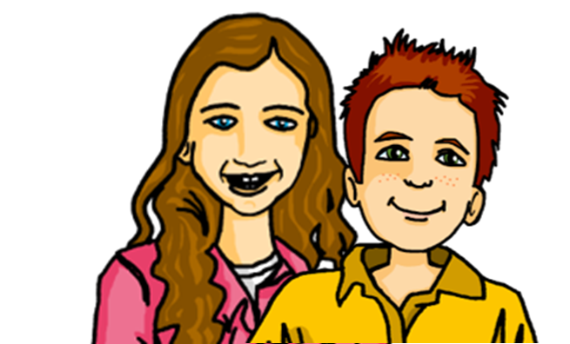
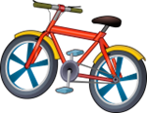
hören
Lias and Ronja’s cousins, Johanna and Moritz are tidying up their garage. Which items are they giving away?
Hör zu. Was gibt es und was gibt Johanna oder Moritz?
s/he is giving | there is/are
What?
B
a bicycle
1
a table
2
a photo
3
a football
4
a guitar
5
a game
6
a train
Notes:
Timing: 5 minutes
Aim: to practise aural comprehension of the 3rd person singular of geben and its two different meanings: er/sie gibt (he/she gives) versus es gibt (there is/are)
Procedure:
1. Introduce the context of Johanna and Moritz giving away some of their belongings for a sale. Johanna and Moritz are the cousins of twins Lias and Ronja. They live in Germany.
2. Click to hear example. Pupils decide whether the sentence is telling us that Johanna or Moritz (he/she) is giving something away (er/sie gibt) or whether it is telling us what there is (es gibt). They also note down what the item is in English. Click for answers
3. Repeat for items 1-6.
Transcript:
Beispiel: Sie gibt ein Fahrrad.
Es gibt einen Tisch.
Es gibt ein Foto.
Er gibt einen Fußball.
Sie gibt eine Gitarre.
Es gibt ein Spiel.
Er gibt einen Zug.
10

Slide 11
geben
The verb geben keeps the ‘e’ in plural forms:
wir geben
we give / we are giving
ihr gebt
you (all) give / you (all) are giving.
sie geben
they give / they are giving
Notes:
Timing: 2 minutes
Aim: to highlight the return to ‘e’ for plural forms of ‘geben’, in contrast to the vowel change seen earlier in the 3rd person singular.
Procedure:
Click through the animations to present the new information.
Elicit English translation for the German examples provided.
11

Slide 12
lesen
Johanna in Deutschland und Ronja in der Schweiz texten. Schreiben sie über Moritz oder Johanna und Moritz?
Schreib 1-6 und ‘he’ oder ‘you (all)’.
1
4
1. Er gibt einen Fußball…meinen Lieblingsfußball!
__
4. Ihr gebt kein Fahrrad!
__
 | he or you (all/both) | What given away?
1
2
3
4
5
6
5
he
my (favourite)
football
2
2.Gibt er viel Papier?
5. Gibt er viele Fotos?
__
__
ihr means ‘you’ (more than one person). Sometimes we translate this as ‘you both’, ‘you two’, ‘you all’ or even just ‘you’. Which do you think works best here when referring to Johanna and Moritz?
he
lots of paper
you (all)
games
you (all)
no bicycles
3
6
he
lots of photos
6. Gebt ihr eine Katze? Nicht Mieze?!
3. Gebt ihr Spiele?
__
__
you (all)
a cat
Notes:
Timing: 5 minutes
Aim: to practise written comprehension of er gibt and ihr gebt and nouns new and previously taught.
Procedure:
Pupils write 1-6 and the correct English pronoun from the two options, he or you (all/both), and also the item that is being given away.
Click to reveal answers.
In audio version, click on the numbered buttons to hear the full sentences, if desired.
12

Slide 13
Tschüss!
grün
Notes:
13

