Slide 1
Exploring
Wie ist die Schweiz?
grün
Follow ups 1-5
Term 2 Week 1
Notes:
Artwork by Steve Clarke. Pronoun pictures from NCELP (www.ncelp.org). All additional pictures selected from Pixabay and are available under a Creative Commons license, no attribution required.
Phonics: [ä] vs. [a]
long [a] ja [45] da [239] Tag [111]
short [a] hallo [1077] danke [877] was? [38]
Vocabulary: liegen [107] Berg [934] Dorf [959] Europa [294] Haus [147] Leute [224] Meer [854] See [1317] Wetter [1881] kalt [887] dort [139]
Revisit 1: helfen [338] mitnehmen [1459] nehmen [142] sehen [79] Bus [1562] Film [505] Freund [273] Geld [235] Hausaufgabe [n/a] Sachen [318] Zug [675] normalerweise [2062]
Revisit 2: bekommen [212] benutzen [1119] brauchen [179] erklären [238] kennen [216] lernen [288] lieben [701] schreiben [184] schwimmen [1863] singen [1063] spielen [205] Geld [235] dieser, diese, dieses [24]
Jones, R.L & Tschirner, E. (2019). A frequency dictionary of German: Core vocabulary for learners. London: Routledge.
The frequency rankings for words that occur in this PowerPoint which have been previously introduced in these resources are given in the SOW and in the resources that first introduced and formally re-visited those words.
For any other words that occur incidentally in this PowerPoint, frequency rankings will be provided in the notes field wherever possible.
Remember that at the start of the course (first three lessons of Rot/Gelb) pupils learnt language (for greetings and register taking) that can still be part of the lesson routines in upper KS2 (Blau/Grün). They are not re-taught, as we anticipate that teachers have built these in from early in lower KS2.

Slide 2
Follow up 1:
Unten im Meer
Arielle ist eine Meerjungfrau. Arielles Freund singt ein Lied.
Was ist das auf Deutsch? Hör zu und sing mit!
Unten im Meer, unten im Meer
Bei jedem Wetter
ist es viel netter und bietet
mehr
Als dieses Land, das oben sitzt
Wo jeder schuftet und nur schwitzt
Wir schwimmen besser hier im Gewässer
Unten im Meer
Under the sea, under the sea
In every weather, everything’s nicer and offers more
Than this land, that sits above
Where everyone just works too hard and sweats
We swim better here in the water
Under the sea
Notes:
Timing: 5 minutes
Aim: to practise some recently-learnt vocabulary in a German version of a well-known song.
Procedure: 1. Explain that many Disney films have been translated in German, including the songs! It can be a lot of fun singing along to the German versions of songs you know in English and a good way to practise your German. Ask pupils to guess what ‘Arielle ist eine Meerjungfrau’ means (Ariel is a mermaid, literally: sea young woman (Meer-jung-Frau)).
2. On the left is the German version of the chorus of ‘Under the Sea’ from ‘The Little Mermaid.’ On the right is the English translation. Can they guess what the words in bold are in German? Click to reveal.
3. Now click on the picture of The Little Mermaid to play the video of the chorus. (https://youtu.be/egxUrfYxnu8?feature=shared&t=30 – starts at 30 seconds, ends at 50 seconds) 4. Play the clip again from 30 seconds in and ask pupils to sing along. Repeat a couple of times more, perhaps adding some actions for some of the words like unten (under), Meer (sea), Wetter (weather), besser (better), mehr (more), oben (above), schuftet (works too hard), schwitzt (sweats), schwimmen (swim), hier (here)
5. If time, play the whole song and ask pupils if they noticed any other words they knew.

Slide 3
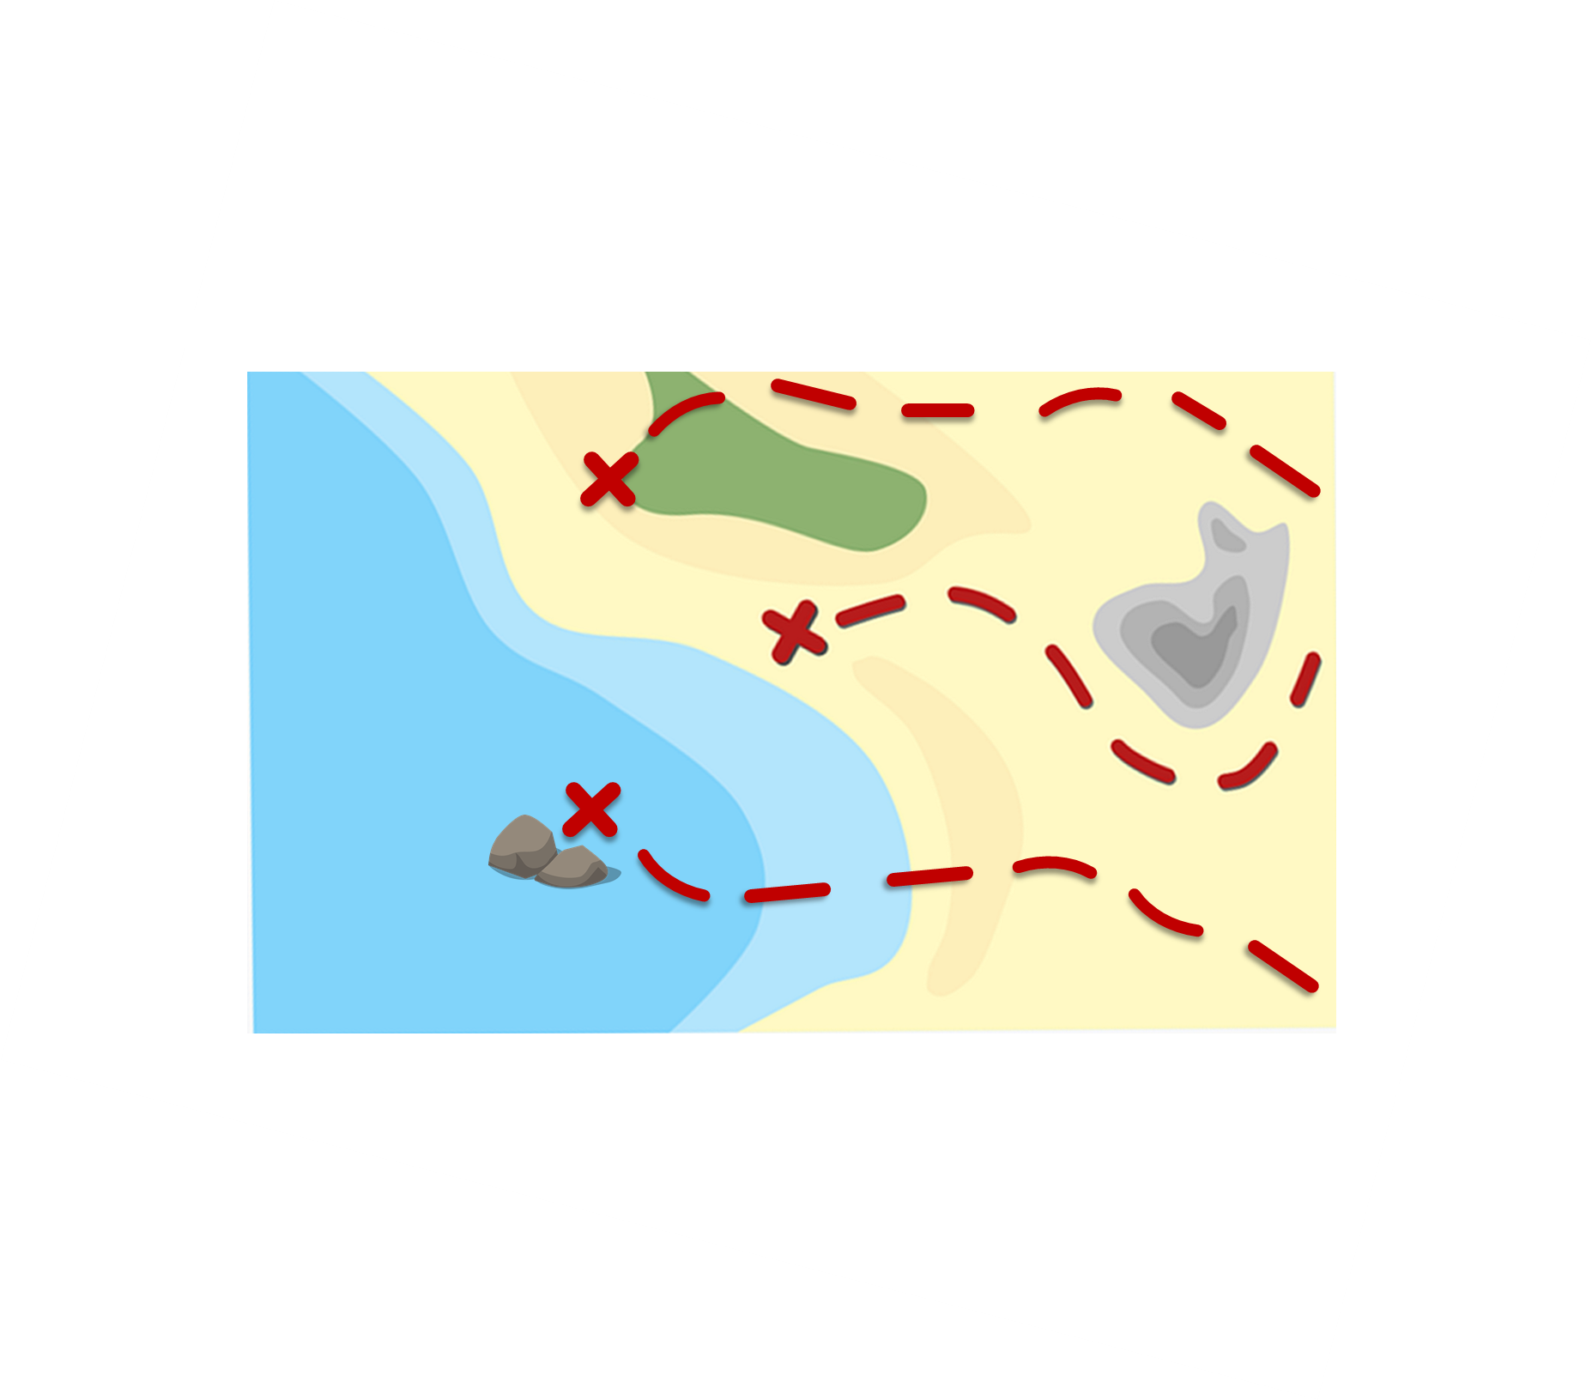
Follow up 2:
sammeln - collect
Sag die Wörter und sammle* das Geld.
Katzen
aussprechen
60
Antworten
Schwimmbäder
Gläser
Sätze
S
Farben
Äpfel
Hände
Städte
0
Sachen
Fahrräder
Länder
START
Notes:
Timing: 5 minutes [2 rounds]
Aim: To practise the pronunciation of German words with the SSC [ä].
Procedure:
Pupils work in pairs to practise pronunciation. They can choose where to start and have one minute to collect as many coins as possible.
Divide the class in A & B and click to indicate it’s ‘Person A’’s turn.
Pupil A starts from either ‘Gläser’ ‘Sätze’ or ‘Länder’, and follows the path to pronounce the words and collect the corresponding coins. S/he tries to do all of the routes. Pupil B listens and notes down the number of coins for his/her partner.
Click to bring up Person B’s turn.
Click on each word to hear it pronounced, as required.
Frequency of unknown words:
sammeln [1219]
Jones, R.L & Tschirner, E. (2019). A frequency dictionary of German: Core vocabulary for learners. London: Routledge.

Slide 4
Order of words in a sentence
Remember in + der/das → in dem → im for locations.
You know this common order of words in a German sentence:
der Berg
ist
dort.
Word order
1
SUBJECT
VERB
PLACE ADVERB
The mountain
is
there.
Sometimes, we want to start the sentence with the adverb to emphasise it.
When we do this, the adverb and subject swap places.
Dort
ist
der Berg.
Word order
2
PLACE ADVERB
VERB
SUBJECT
English hardly ever changes word order like this, and only in phrases like: “And so say all of us!”
The verb position does not change.
Notes:
Timing: 3 minutes
Aim: to explain the order of words in a German sentence, and how this is affected by an initial adverb of place/location.
Procedure:
Click to present the new information.
Elicit the English meaning of the words in the sentence.
Ensure that pupils understand that this change is for emphasis – the essential meaning of the sentence remains the same. It’s also important to point out (with the callout) that we hardly ever do this in English, just in phrases like ‘And so say all of us’!
4

Slide 5
Follow up 3
Hör zu. Schreib auf Englisch.
1
Switzerland is (located - lies) in Europe.
hören
Die Schweiz liegt in Europa.
2
There are lots of lakes and mountains there.
Dort gibt es viele Berge und Seen.
3
There you see no sea / you won’t see the sea.
Dort siehst du kein Meer.
4
They travel by train (‘with the train’) through Switzerland.
Sie fahren mit dem Zug durch die Schweiz.
5
Here are my things.
Hier sind meine Sachen.
6
She is taking a jacket with her. The weather is cold!
Sie nimmt eine Jacke mit. Das Wetter ist kalt!
Notes:
Timing: 5 minutes
Aim: to practise aural comprehension of this week’s new language in sentences with word order 1 and 2.
Procedure:
Click to listen to each sentence.
Write the English meanings.
Click to reveal answers.
Transcript
Die Schweiz liegt in Europa.
Dort gibt es viele Berge und Seen.
Dort siehst du kein Meer.
Sie fahren mit dem Zug durch die Schweiz.
Hier sind meine Sachen.
Sie nimmt eine Jacke mit. Das Wetter ist kalt!

Slide 6
Follow up 4

*in jedes Kästchen – into each square
Schreib ein Wort auf Deutsch in jedes Kästchen*.
schreiben
people | village
to help | to use
this (n) | to explain
sea/ocean | to take
lake | to lie/be located in
cold | Europe
Notes:
Timing: 5 minutes
Aim: to practise written production of this week’s new language.
Procedure: 1. Pupils choose any 9 of the words from the English table and write them into their grid in German.
2. Teacher then calls out the German for any of the 9 words in the table in whichever order.
3. Pupils call Bingo when they have any three in a row (vertical, horizontal, or diagonal) and then again for the first full house.
4. Click on the blue buttons to hear the German translations if needed to support the activity.
Translation:
Leute
helfen
dieses
Meer
See
kalt
Dorf
benutzen
erklären
nehmen
liegen
Europa

Slide 7
Follow up 5:

Schreib auf Englisch.
Can you get at least 15 points?
Wörter
 | bekommen | kennen | lernen
 | dieser | spielen | singen
 | helfen | die Hausaufgabe | das Geld
 | normalerweise | mitnehmen | der Bus
 | die Leute | liegen | das Meer
 | das Dorf | dort | der Berg
 | kalt | das Wetter | Europa
to receive
to know
to learn
Vokabeln
x3
this (m)
to play
to sing
to help
(the) homework
(the) money
x2
normally
to take/bring with
(the) bus
(the) people
to lie / be located in
(the) sea/ocean
(the) village
there (far away)
(the) hill/mountain
x1
cold
(the) weather
Europe
Notes:
Timing: 5 minutes
Aim: to practise written comprehension of vocabulary from this and revisited weeks.
Procedure: 1. Give pupils a blank grid. They fill in the English meanings of any of the words they know, trying to reach 15 points in total.
Note: The most recently learnt and practised words are pink, words from the previous week are green and those from week 1 are blue, thus more points are awarded for them, to recognise that memories fade and more effort (heavy lifting!) is needed to retrieve them.

Slide 8
Follow up 5:

Schreib auf Deutsch.
Can you get at least 15 points?
Wörter
 | to learn | this (m) | to sing
 | to know | to receive | to play
 | (the) money | (the) homework | to take/bring with
 | (the) bus | to help | normally
 | (the) sea/ocean | (the) weather | (the) hill/mountain
 | there (far away) | to lie / be located in | the village
 | (the) people | Europe | cold
lernen
dieser
singen
Vokabeln
x3
kennen
bekommen
spielen
das Geld
die Hausaufgabe
mitnehmen
x2
der Bus
helfen
normalerweise
das Meer
das Wetter
der Berg
dort
liegen
das Dorf
x1
die Leute
Europa
kalt
Notes:
Timing: 5 minutes
Aim: to practise written production of vocabulary from this and revisited weeks.
Procedure: 1. Give pupils a blank grid. They fill in the German meanings of any of the words they know, trying to reach 15 points in total.
Note: The most recently learnt and practised words are pink, words from the previous week are green and those from week 1 are blue, thus more points are awarded for them, to recognise that memories fade and more effort (heavy lifting!) is needed to retrieve them.

Slide 9
Tschüss!
grün
Notes:
9

Slide 10
Follow up 5:

Schreib auf Englisch.
Can you get at least 15 points?
Wörter
 | bekommen | kennen | lernen
 | dieser | spielen | singen
 | helfen | die Hausaufgabe | das Geld
 | normalerweise | mitnehmen | der Bus
 | die Leute | liegen | das Meer
 | das Dorf | dort | der Berg
 | kalt | das Wetter | Europa
Vokabeln
x3
x2
x1
Notes:
Template for photocopying

Slide 11
Follow up 5:

Schreib auf Deutsch.
Can you get at least 15 points?
Wörter
 | to learn | this (m) | to sing
 | to know | to receive | to play
 | (the) money | (the) homework | to take/bring with
 | (the) bus | to help | normally
 | (the) sea/ocean | (the) weather | (the) hill/mountain
 | there (far away) | to lie / be located in | the village
 | (the) people | Europe | cold
Vokabeln
x3
x2
x1
Notes:
Template for photocopying

