Slide 1
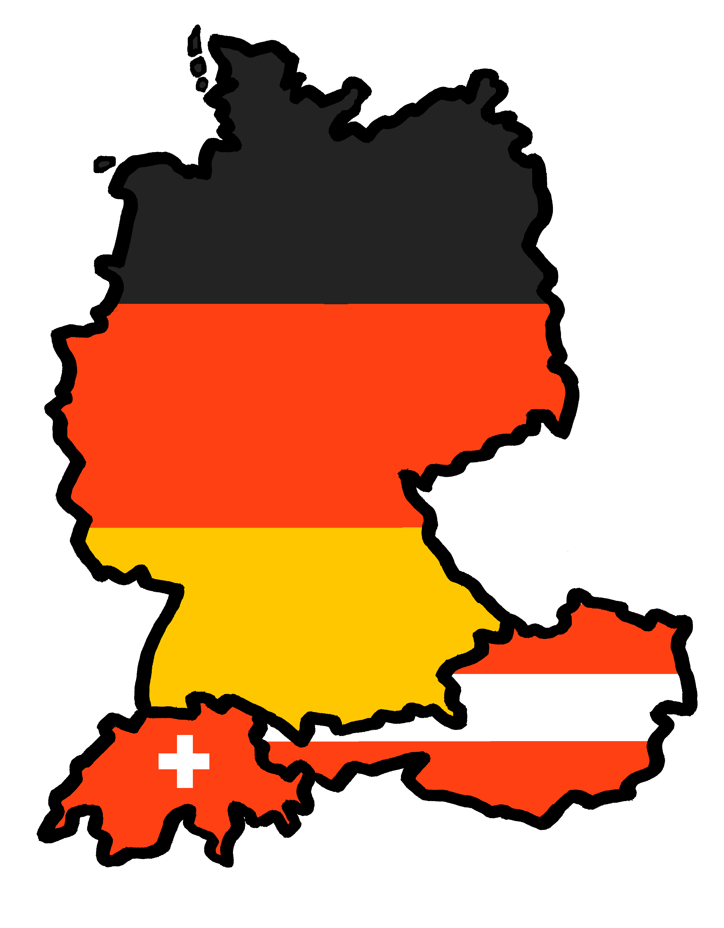
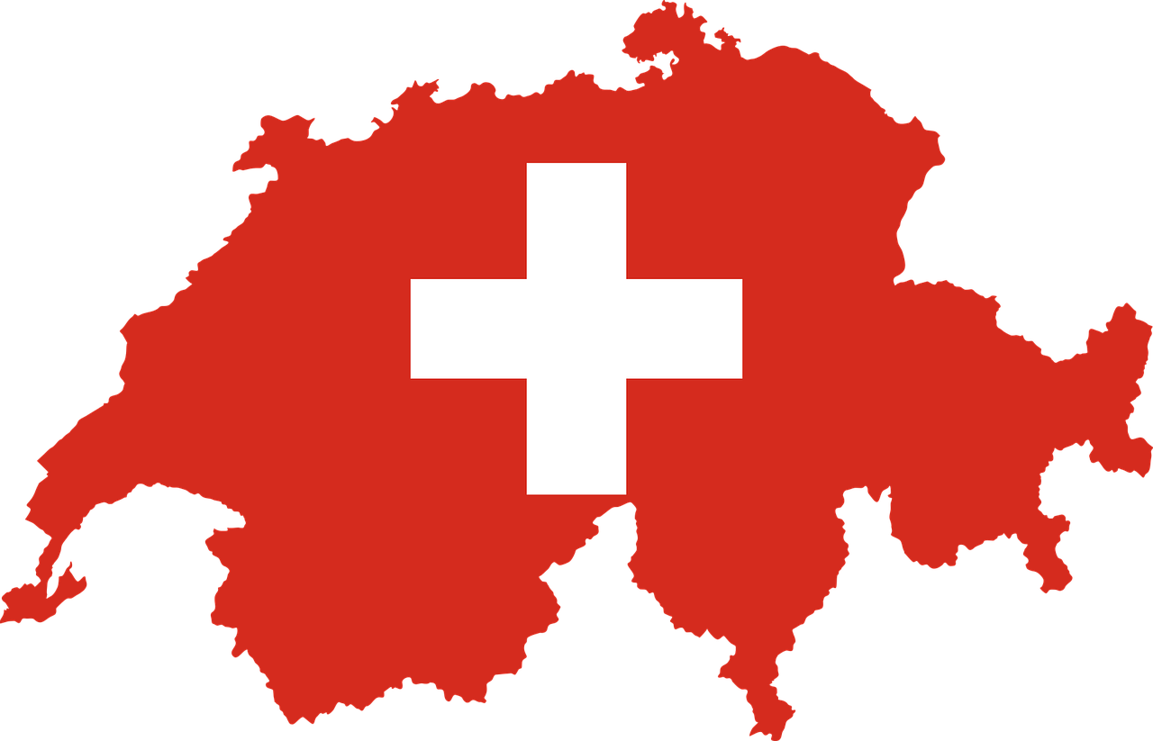
Exploring
Wie ist die Schweiz?
grün
WO2 after adverbs of place
SSC [ä] v. [a]
Term 2 Week 1
Notes:
Artwork by Steve Clarke. Pronoun pictures from NCELP (www.ncelp.org). All additional pictures selected from Pixabay and are available under a Creative Commons license, no
attribution required.
Phonics: [ä] vs. [a]
long [a] ja [45] da [239] Tag [111]
short [a] hallo [1077] danke [877] was? [38]
Vocabulary: liegen [107] Berg [934] Dorf [959] Europa [294] Haus [147] Leute [224] Meer [854] See [1317] Wetter [1881] kalt [887] dort [139]
Revisit 1: helfen [338] mitnehmen [1459] nehmen [142] sehen [79] Bus [1562] Film [505] Freund [273] Geld [235] Hausaufgabe [n/a] Sachen [318] Zug [675] normalerweise [2062]
Revisit 2: bekommen [212] benutzen [1119] brauchen [179] erklären [238] kennen [216] lernen [288] lieben [701] schreiben [184] schwimmen [1863] singen [1063] spielen [205] Geld [235] dieser, diese, dieses [24]
Jones, R.L & Tschirner, E. (2019). A frequency dictionary of German: Core vocabulary for learners. London: Routledge.
The frequency rankings for words that occur in this PowerPoint which have been previously introduced in these resources are given in the SOW and in the resources that first
introduced and formally re-visited those words.
For any other words that occur incidentally in this PowerPoint, frequency rankings will be provided in the notes field wherever possible.
Remember that at the start of the course (first three lessons of Rot/Gelb) pupils learnt language (for greetings and register taking) that can still be part of the lesson routines in upper KS2 (Blau/Grün). They are not re-taught, as we anticipate that teachers have built these in from early in lower KS2.
1

Slide 2
aussprechen
long [a]
…
ja
da
Tag
[yes]
[there]
[day]
Lina
Moritz
Notes:
Timing: 2 minutes
Aim: to consolidate the SSC long [a].
Procedure:
Re-present the SSC and the source word ‘da’ (with gesture, if using).
Click to bring on the picture and get pupils to repeat the word ‘da’ (with gesture, if using).
Present the cluster words in the same way, bringing on the picture and getting pupils to pronounce the words.
Note:
a gesture for ‘da’ might be to point at something away from you
2

Slide 3
aussprechen
short [a]
…
was?
hallo
danke
Notes:
Timing: 2 minutes
Aim: to consolidate the SSC short [a].
Procedure:
Re-present the SSC and the source word ‘hallo’ (with gesture, if using).
Click to bring on the picture and get pupils to repeat the word ‘hallo’ (with gesture, if using).
Present the cluster words in the same way, bringing on the picture and getting pupils to pronounce the words.

Slide 4
aussprechen
long [ä]
…
1, 2, 3, …100
spät
wählen
zählen
[to count]
[to choose]
Notes:
Timing: 1 minute
Aim: to introduce the SSC [ä].
Procedure:
Re-present the SSC and the source word ‘spät’ (with gesture, if using).
Click to bring on the picture and get pupils to repeat the word ‘spät’ (with gesture, if using).
Present the cluster words in the same way, bringing on the picture and getting pupils to pronounce the words.
spät [171] zählen [680] wählen [64]
Jones, R.L & Tschirner, E. (2019). A frequency dictionary of German: Core vocabulary for learners. London: Routledge.
4

Slide 5
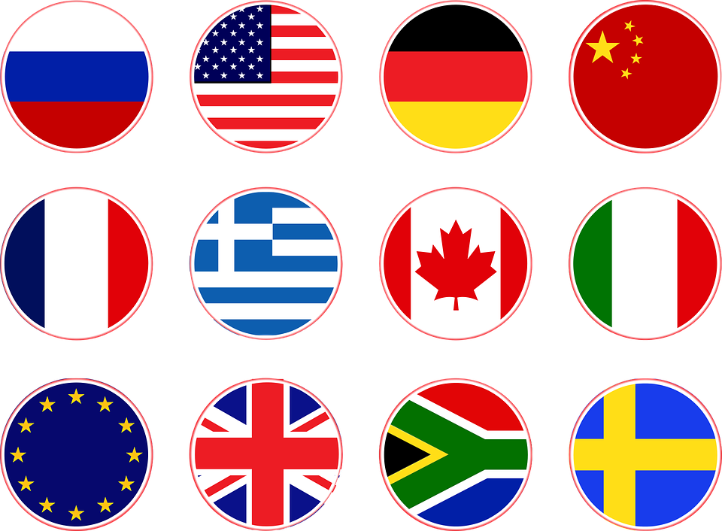
aussprechen
short [ä]
All vowels in German can be long or short, and [ä] is no exception. [ä] is short when followed by two consonants.
…
Blätter²
Hände
Länder
[leaves]
You already know Blatt means sheet. It also means leaf!
Notes:
Timing: 1 minute
Aim: to introduce the SSC short [ä].
Procedure:
Present the SSC and the source word ‘Hände’ (with gesture, if using).
Click to bring on the picture and get pupils to repeat the word ‘Hände’(with gesture, if using).
Present the cluster words in the same way, bringing on the picture and getting pupils to pronounce the words.
Gesture: pupils put up both their hands in front of them, palms facing away from them.
Blatt [1270] Hand [180] Land [134]
Jones, R.L & Tschirner, E. (2019). A frequency dictionary of German: Core vocabulary for learners. London: Routledge.
5

Slide 6
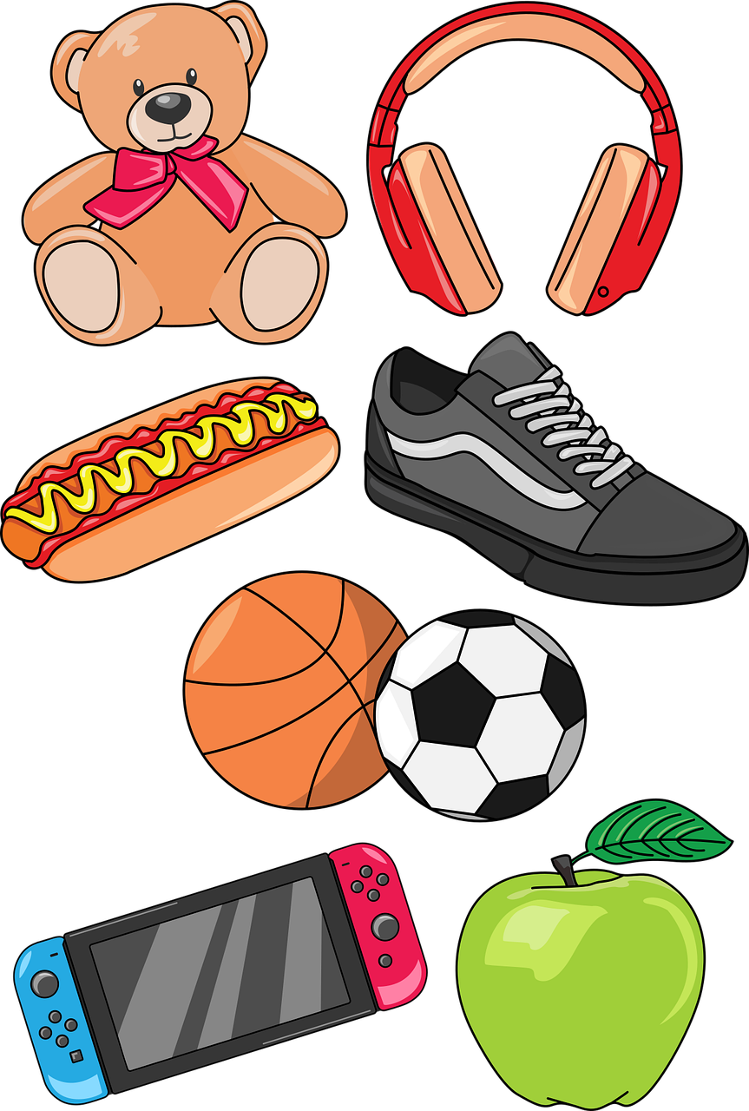
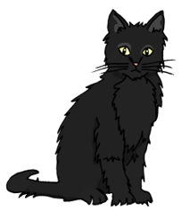
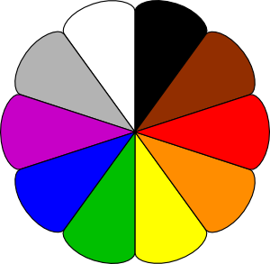
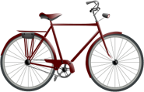
aussprechen
[a] oder [ ä]?
Schreib den Buchstaben*
…
der Buchstabe – letter
Gl ä ser
S a chen
F a rben
F a hrr ä der
S ä tze
St ä dte
K a tzen
A ntworten
L ä nder
Schwimmb ä der
1
6
2
7
3
8
4
9
The cat sat on the mat.
The cat sat on the mat.
10
5
Notes:
Timing: 1 minute
Aim: to consolidate the SSC [ä] and differentiate it from [a] in a Phonics listening task using plurals of known words with and without [ä].
Procedure:
Play the first recording by clicking on the number button. Pupils listen and decide whether they hear [a] or [ä].
Click to reveal the missing vowel.
Elicit the English meaning.
Continue for items 2-10.
Vocabulary: Buchstabe [2905]
Jones, R.L & Tschirner, E. (2019). A frequency dictionary of German: Core vocabulary for learners. London: Routledge.
6

Slide 7
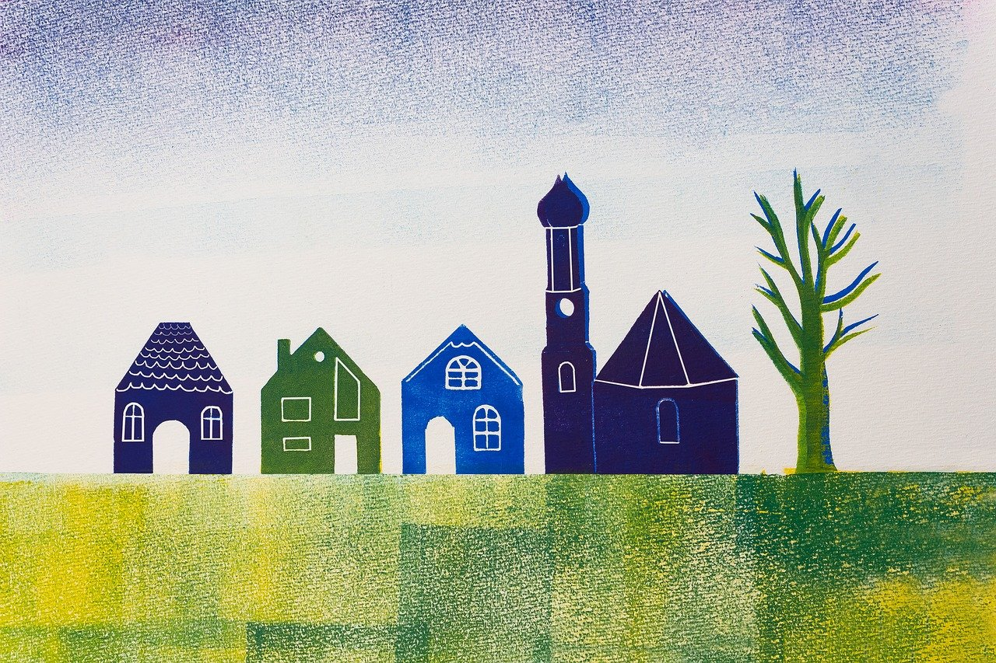
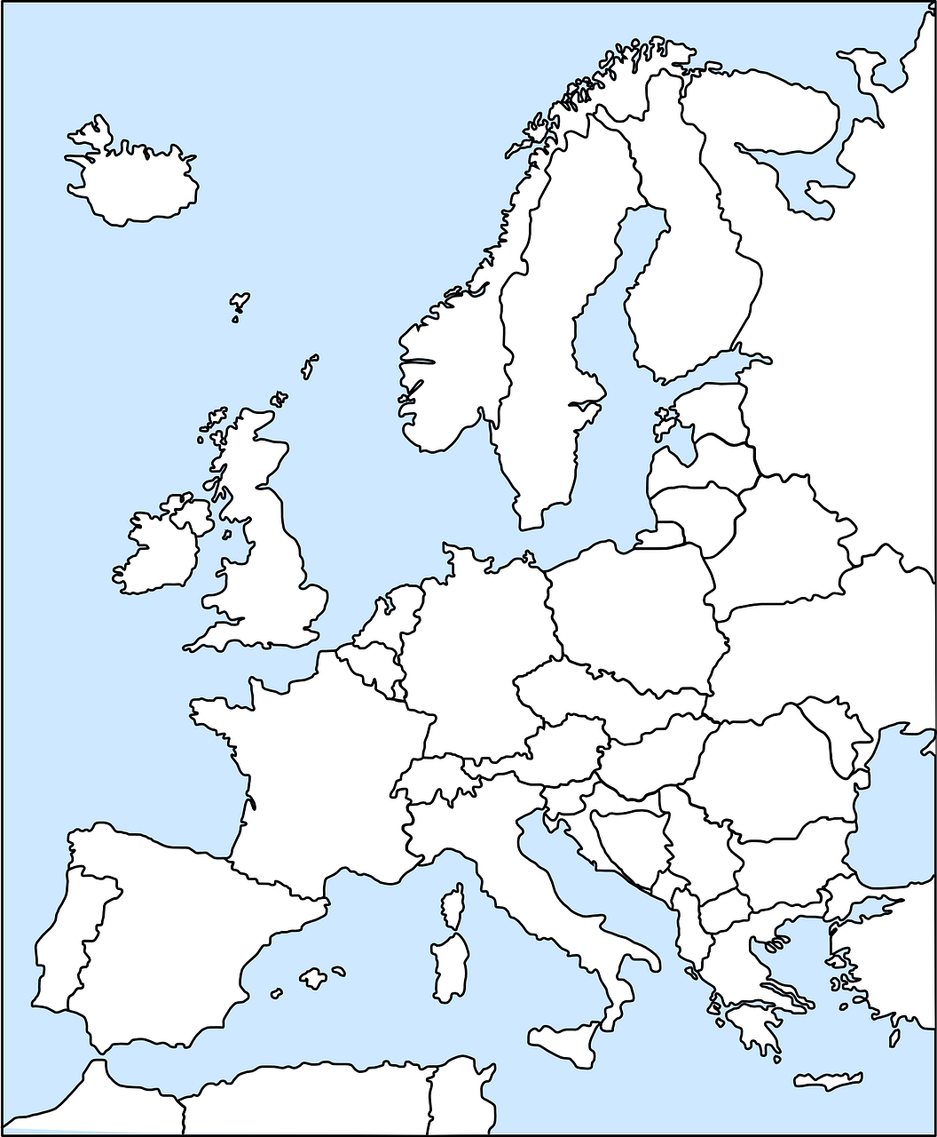
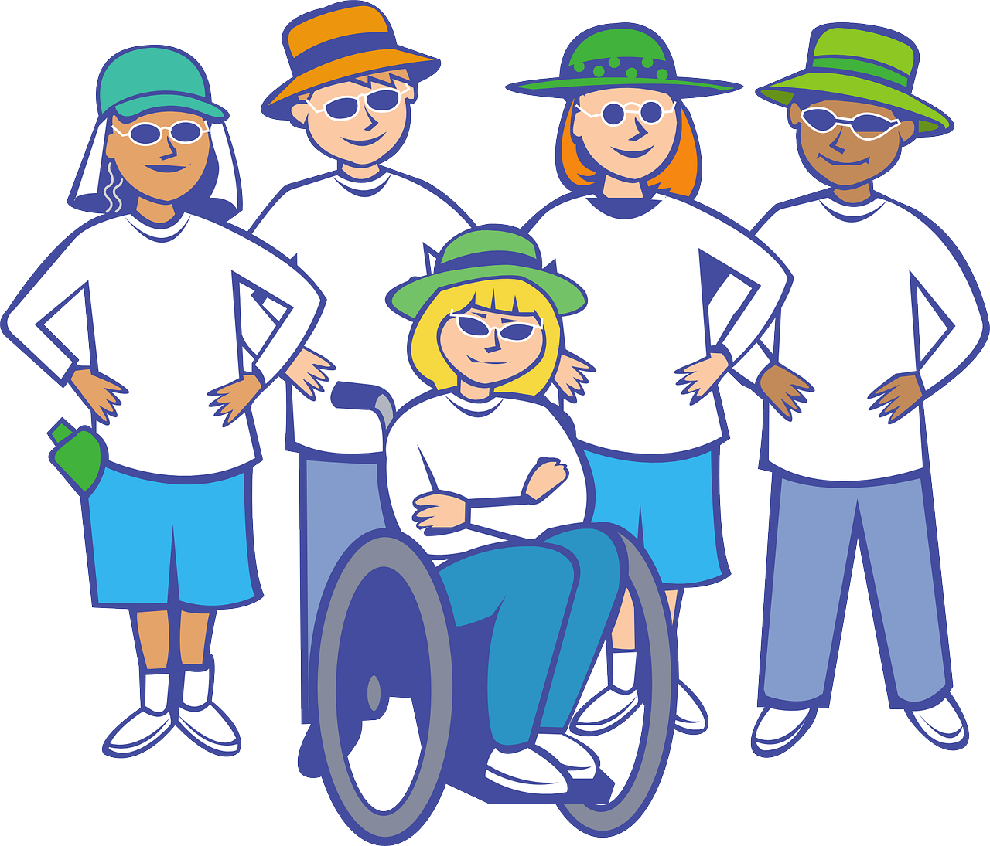
Vokabeln
‘liegen’ has many meanings, e.g.
1. lie (as in lie in bed)
2. lie (as in to be located somewhere, to describe where something is)
Hör zu und sag das Wort.
Wörter
liegen
der Berg
das Dorf
[to lie, to be lying]
[(the) village]
[(the) hill, mountain]
Can you remember what the plural of these are?
das Dorf
das Haus
die Leute
das Haus
That’s right!
die Dörfer
die Häuser
Europa
[(the) people]
[(the) house]
[Europe]
Notes:
Timing: 5 minutes (two slides)
Aim: to present and practise written comprehension and read aloud of the new vocabulary for this week.
Procedure: 1. Click for a German word. Elicit pronunciation from pupils.
2. Click for the English meaning and picture prompt. Elicit the German word again.
3. Present all nine words like this, in order.
4. Click for one English meaning to disappear in random order. Elicit the English meaning from pupils. Click for meaning to reappear. Continue with the remaining items.
5. Click for the German word to disappear. Elicit the German from pupils. Click for word to reappear. Continue with the remaining items.
6. Move to slide 2 and repeat steps 1-5.
7

Slide 8
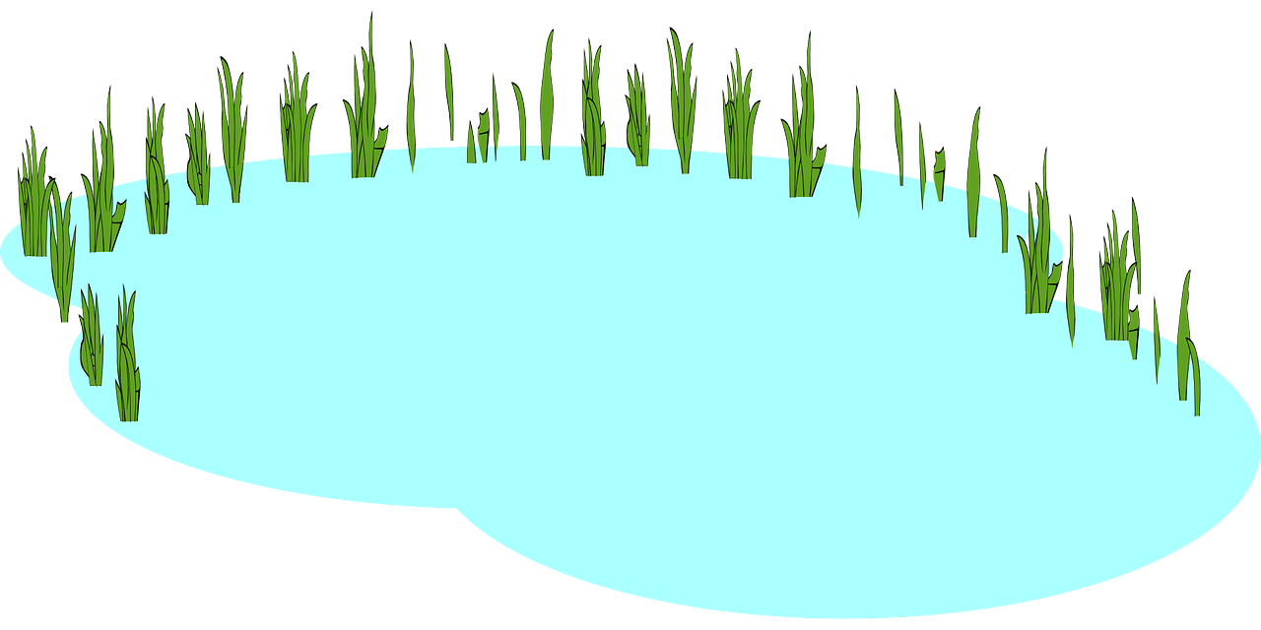
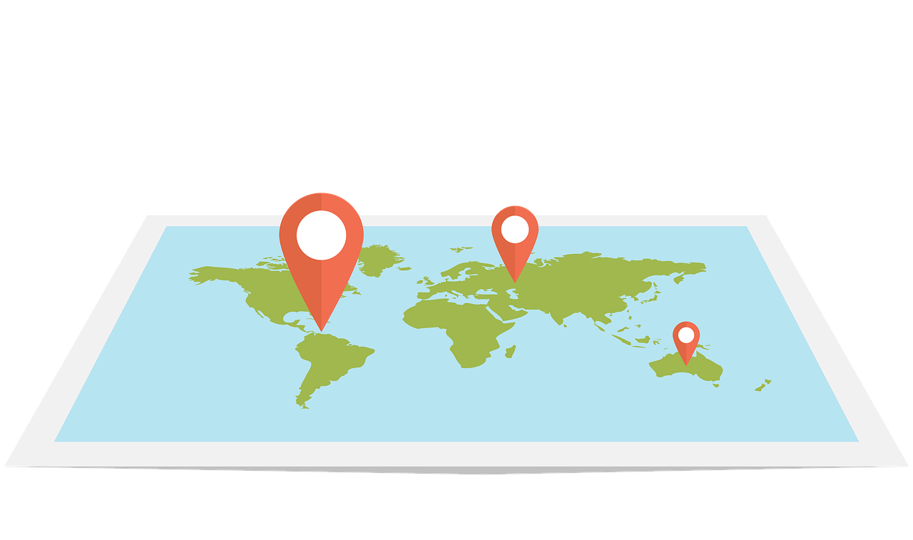
Vokabeln
Hör zu und sag das Wort.
Can you remember the plural of der See?
Wörter
That’s right!
die Seen
das Meer
der See
[(the) sea, ocean]
[(the) lake]
kalt
dort
das Wetter
[cold]
[there]
[(the) weather]
Notes:
[2/2]
8

Slide 9
Vokabeln
Wo liegt mein Handy?
Wörter
Hör zu und sag das Wort.
oben
[up, above]
links
da and dort both mean ‘there’. We usually use dort for things that are further away that we can’t see, e.g. in a different country. We usually use da for things that are closer and we can see, e.g. in the same room.
rechts
hier
[left, on the left]
[here]
[right, on the right]
unten
[down, below]
da
dort
[there]
[there]
Notes:
Timing: 3 minutes
Aim: to revise adverbs of place in preparation for the grammar point this week.
Procedure: 1. Click for a German word. Elicit pronunciation from pupils.
2. Click for the English meaning and picture prompt. Elicit the German word again.
3. Present all nine words like this, in order.
9

Slide 10
Order of words in a sentence
Remember in + der/das → in dem → im for locations.
You know this common order of words in a German sentence:
der Berg
ist
dort.
Word order
1
SUBJECT
VERB
PLACE ADVERB
The mountain
is
there.
Sometimes, we want to start the sentence with the adverb to emphasise it.
When we do this, the adverb and subject swap places.
Dort
ist
der Berg.
Word order
2
PLACE ADVERB
VERB
SUBJECT
English hardly ever changes word order like this, and only in phrases like: “And so say all of us!”
The verb position does not change.
Notes:
Timing: 3 minutes
Aim: to explain the order of words in a German sentence, and how this is affected by an initial adverb of place/location.
Procedure:
Click to present the new information.
Elicit the English meaning of the words in the sentence.
Ensure that pupils understand that this change is for emphasis – the essential meaning of the sentence remains the same. It’s also important to point out (with the callout) that we hardly ever do this in English, just in phrases like ‘And so say all of us’!
10

Slide 11
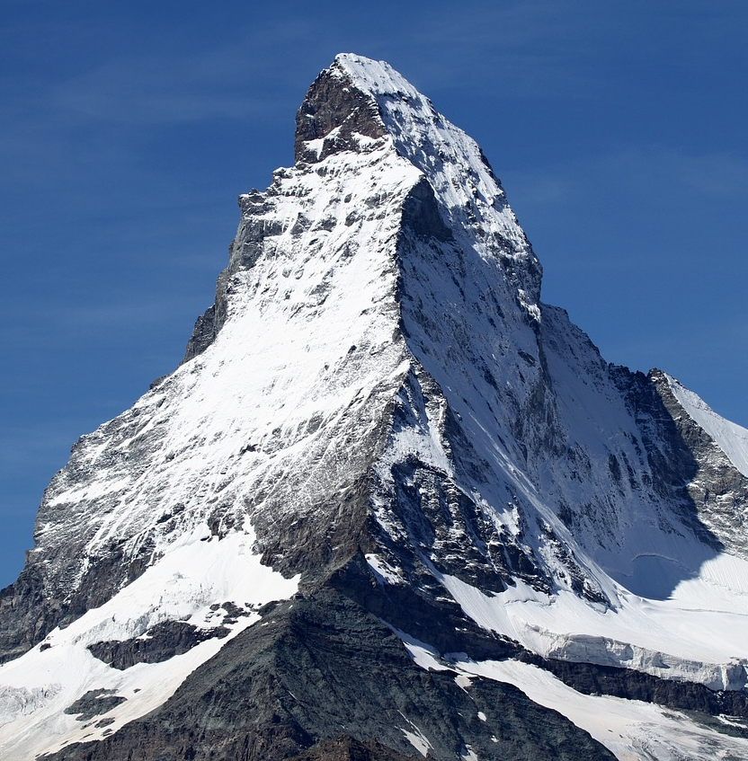
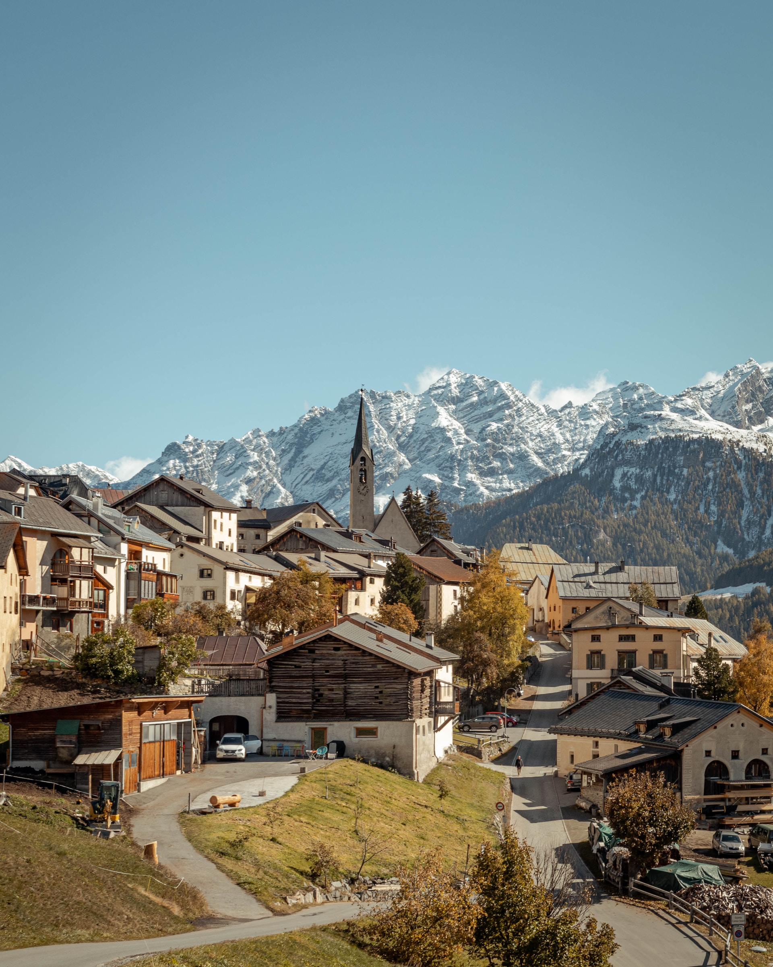
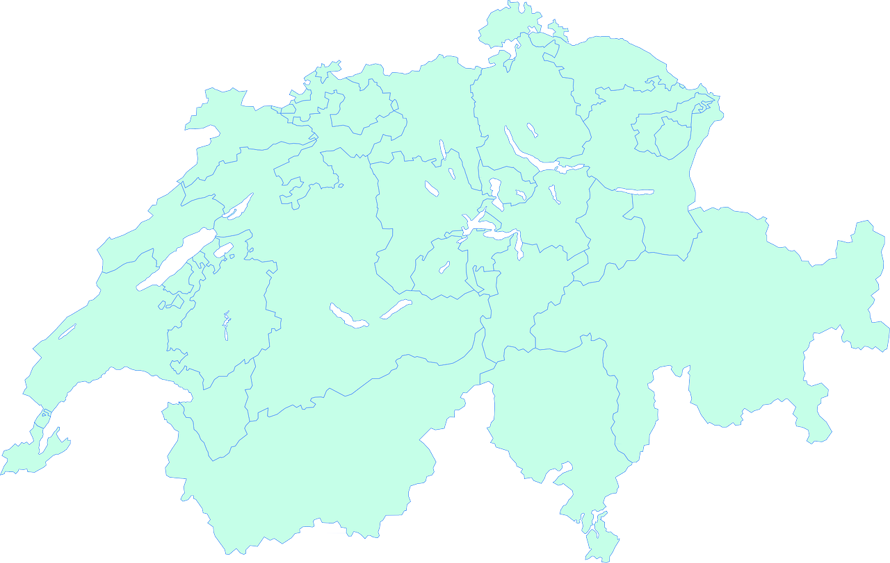
lesen
Mein Lieblingsort*
Lias und Ronja schreiben über ihre Lieblingsorte.
Was schreiben Lias und Ronja?
1
Hier
ist ein kleines Dorf. Es heißt Guarda.
-
2
Dort
es liegt neben Österreich.
-
3
Dort
es gibt viele schöne Häuser.
-
Hier
4
gibt es einen Berg. Er heißt Matterhorn.
-
Dort
5
gibt es oft viele Leute.
-
6
Dort
das Wetter ist normalerweise kalt.
-
der Lieblingsort – favourite place
Notes:
https://www.youtube.com/watch?v=VSiX15flm_0
Timing: 8 minutes
Aim: to practise this week’s and previous vocabulary in the context of describing cultural aspects of Switzerland’s geography.
Procedure:
Explain the scenario. Lias and Ronja are looking at a map of Switzerland and thinking about where they want to go on a family holiday. Lias wants to go Guarda but Ronja wants to go to the Matterhorn. They point to different places on the map and make notes about these places which they will later use to convince their parents that the family should go there on holiday!
Pupils identify the correct choice for item one, based on the syntax of the second part of the sentence.
Click for the incorrect choice to disappear and only the correct choice visible. The first three answers are about Guarda, after which a picture of the village will appear. The next three answers are about the Matterhorn, after which a picture of the mountain will appear.
Elicit oral translations of each message.
Photo of Guarda by Nolan Di Meo on Unsplash
11

Slide 12
Was gibt es wo in der Schweiz? Lothar redet mit Lias und Ronja.
5
4
Oben ist Zürich. Die Stadt ist groß und es gibt dort viele Leute. Dort gibt es auch das Lindt Schokoladenmuseum*!
Hier sind wir in Biel! Diese Stadt ist die beste Stadt in der Schweiz, nicht wahr?! Nein, in Europa! Hier ist es wunderbar!
Und wo ist das Meer? Ich liebe das Meer!
Genf is the German name for Geneva. On Swiss maps you might see it written in French: Genève.
3
4
Rechts ist St. (Sankt) Moritz. Dort brauchst du viel Geld! Es gibt viele tolle Hotels und Restaurants. Die Stadt liegt in den Bergen. Leute machen dort Wintersport.
Which country do you think ‘Italien’ is?
5
1
Links ist Genf. Dort gibt es einen großen See. Er heißt Genfer See. Viele Leute machen dort Wassersport.
Das Meer?! Es gibt kein Meer in der Schweiz!!
3
What do you think Genfer See is in English?
Yes, it’s Italy.
2
1
2
Unten ist Locarno. Die Stadt liegt neben Italien und es gibt dort Berge und Seen. Im August gibt es ein großes Filmfest. Dort sehen viele Leute Filme.
It’s Lake Geneva!
der Wintersport – winter sports
das Schokoladenmuseum – chocolate museum
Notes:
Timing: 5 minutes
Aim: to present some cultural information and to practise new vocabulary and grammar for this week in the reading modality.
Procedure:
Explain the context. Lias and Ronja have told their dad, Lothar about their ideas for places to go on holiday. Lothar has some other ideas. He points out different places on the map.
Click for the information to appear for each location 1-6.
Elicit the English translations of the texts (included below).
Click to reveal Lias’ question and Lothar’s answer and elicit the meaning in English (Lias: And where is the sea/ocean? I love the sea/ocean!; Lothar: The sea/ocean?! There is no sea/ocean in Switzerland!)
Extra: Ask pupils which place pupils like the most from the descriptions.
Frequency of unknown words:
Winter [1206]; Schokolade [4532]; Museum [1078]
Jones, R.L & Tschirner, E. (2019). A frequency dictionary of German: Core vocabulary for learners. London: Routledge.
English translations of texts:
On the left is Geneva. There is a big lake there. It is called Lake Geneva. Lots of people do water sports there.
Below is Locarno. The town/city is located/is next to Italy and there are mountains and lakes. In August there is a big film festival. Lots of people see films there.
On the right is St Moritz. You need lots of money there! There are lots of great hotels and restaurants. The town/city is located/is in the mountains. People do winter sports there.
Above is Zurich. The town/city is big and there are lots of people there. There’s also the Lindt chocolate museum!
Here we are in Biel! This town/city is the best town/city in Switzerland, isn’t it?! No, in Europe! It’s wonderful here!
12

Slide 13
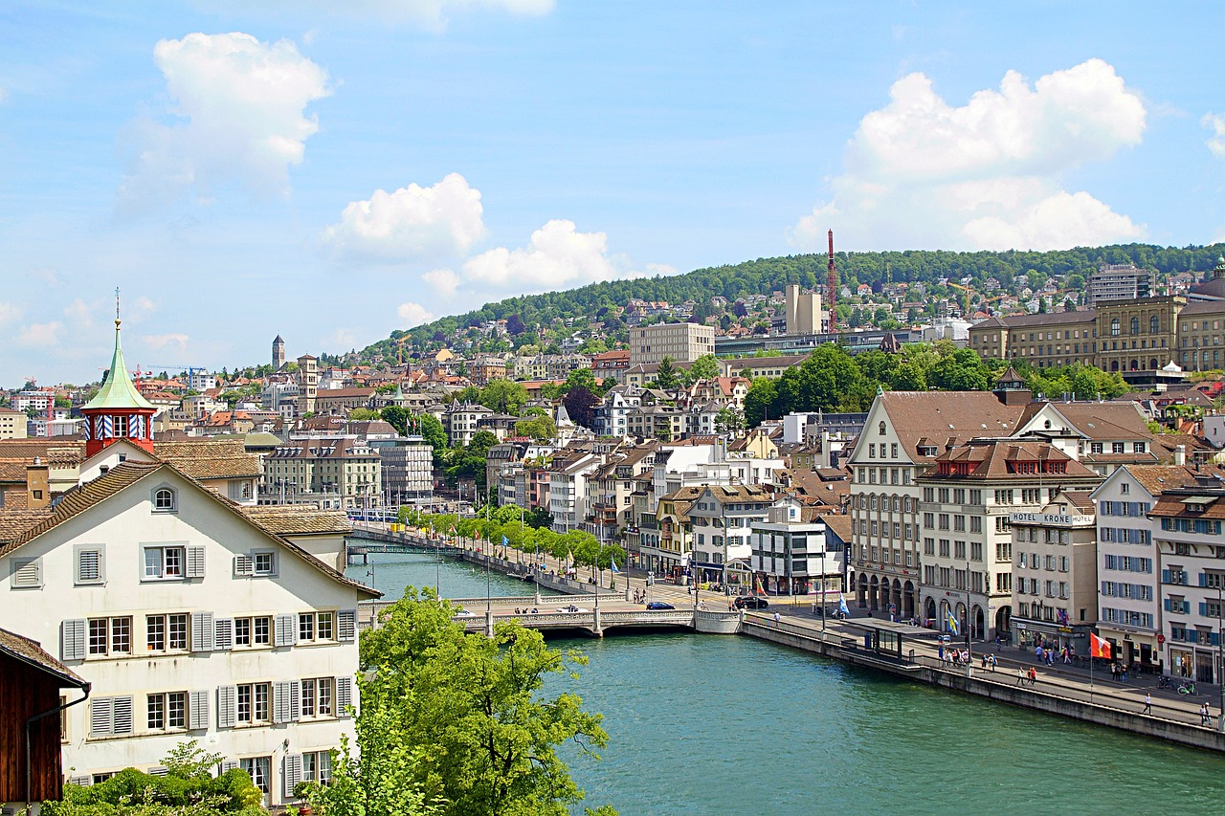
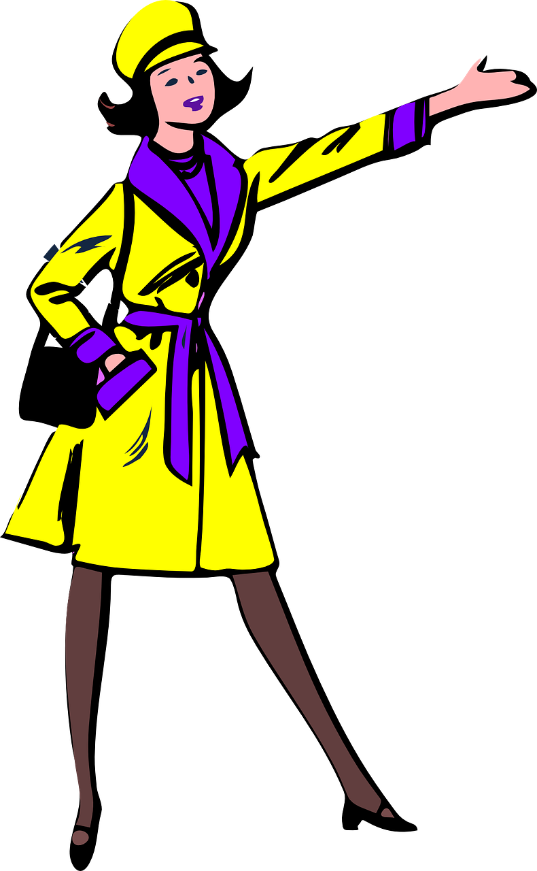
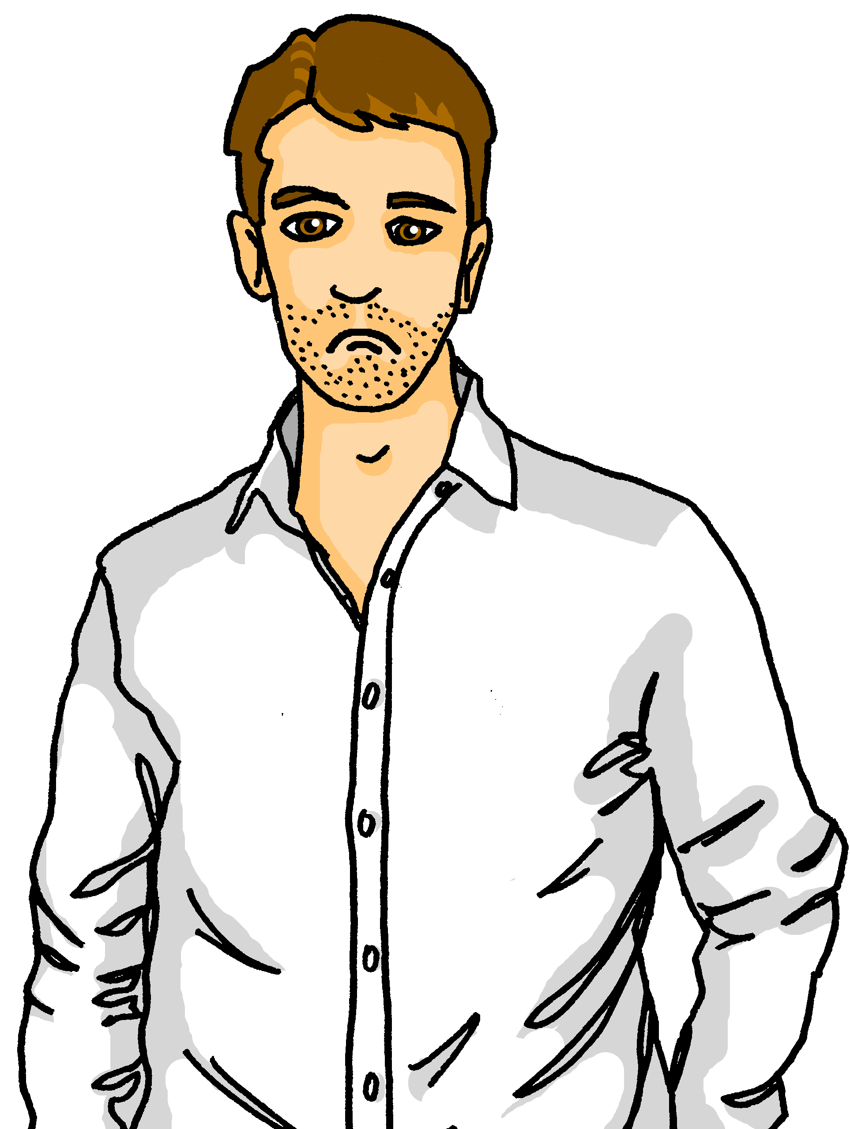
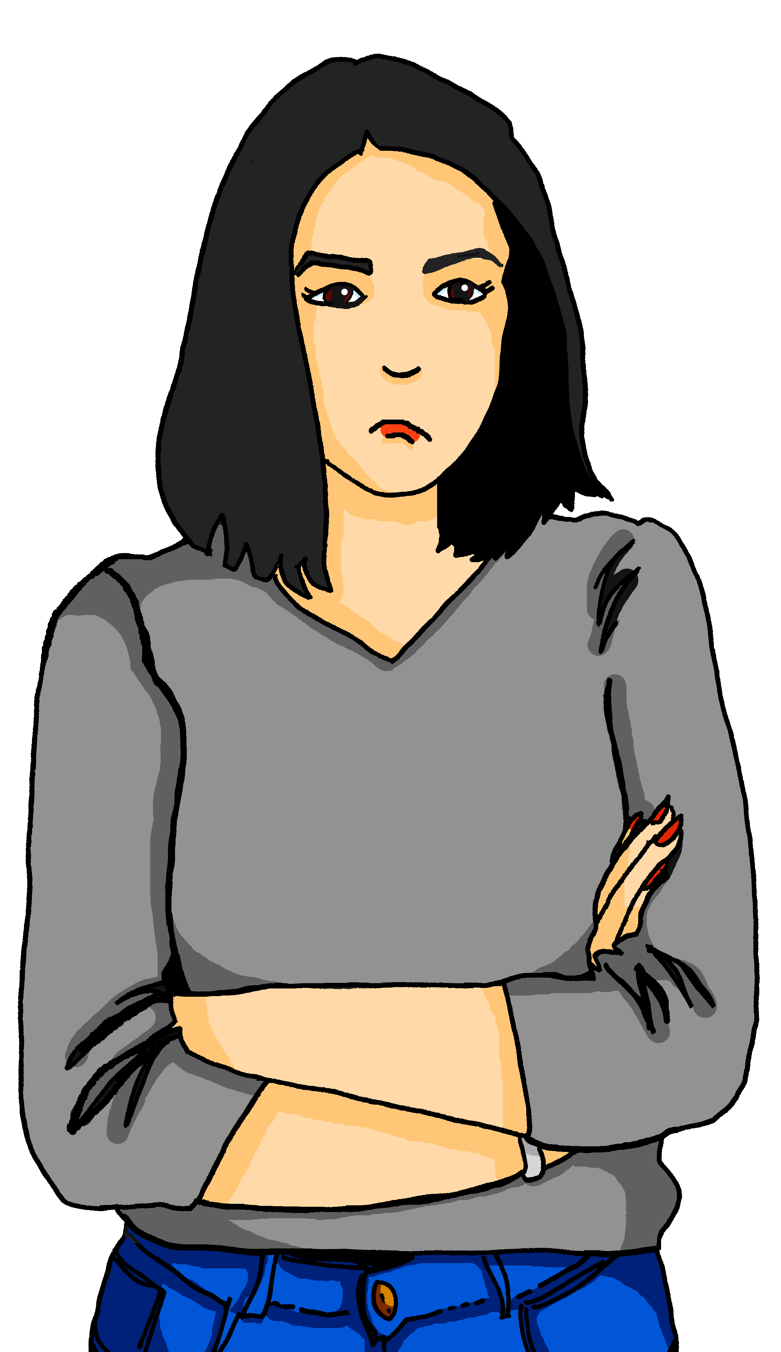
hören
Die Familie fährt nach Zürich. Sie machen dort eine Tour aber es ist zu laut*. Sie hören nicht alles.
Hör zu. Was sagt die Reiseleiterin*?
A | B
Hier | _
_ | Dort
Da | -
- | Rechts
- | Oben
Unten | -
1
2
3
4
5
6
zu laut - too loud
die Reiseleiterin – the tour guide (f)
von - from
Notes:
Timing: 5 minutes
Aim: to practise aural distinction between WO1 and WO2
Procedure:
Explain the context. The family has decided to go to Zurich. They are doing a walking tour but it’s really loud outside and they don’t hear everything the tour guide is saying.
Click to listen to sentences with the beginnings obscured by the noise of the city.
Pupils select the correct beginning – A or B.
3. Click to elicit and confirm answers.
Transcript:
[Hier] ist der See. Er heißt Zürichsee.
[-] Es gibt viele Schwimmbäder am See.
[Da] ist ein sehr altes Haus.
[Rechts] seht ihr ein Berg. Er heißt Zürichberg.
[-] Es gibt viele tolle Restaurants. In den Restaurants seht ihr die Stadt und den See von oben.
[-] Es gibt einen Bus zum Berg.
Frequency of unknown words:
zu [21]; laut [773]; Reise [734]; Leiter [1622]; von [9]
Jones, R.L & Tschirner, E. (2019). A frequency dictionary of German: Core vocabulary for learners. London: Routledge.
13

Slide 14
Tschüss!
grün
Notes:
14

