Slide 1
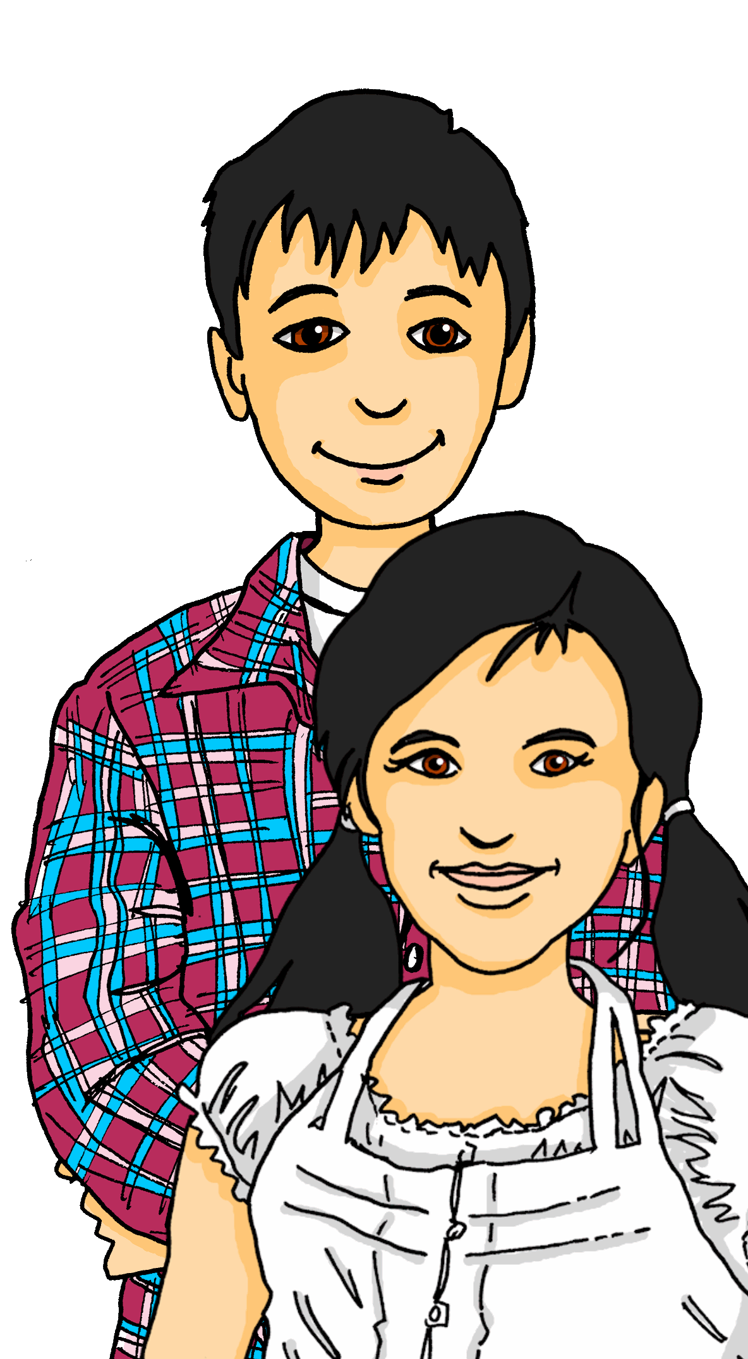
Exploring
Talking to cousins in Germany
grün
Follow ups 1-5
Term 2 Week 2
Notes:
Artwork by Steve Clarke. Pronoun pictures from NCELP (www.ncelp.org). All additional pictures selected from Pixabay and are available under a Creative Commons license, no
attribution required.
Phonics: [ö] vs. [o]
long [ö] König [1087] Österreich [707] Wörter [194]
short [ö] Köpfe [279] öffnen [508] zwölf [1080]
long [o] wo? [94] wohnen [380] Million [206]
short [o] Kopf [279] offen [382] kommen [61]
Vocabulary: benutzen [1119] lernen [288] machen [58] singen [1063] spielen [205] Computer [1252] Fußball [1277] Opa [2776] Song [3373] normalerweise [2062] zu Hause [n/a]
Revisit am + days of the week (am Montag) and adverbs (montags)
Jones, R.L & Tschirner, E. (2019). A frequency dictionary of German: Core vocabulary for learners. London: Routledge.
The frequency rankings for words that occur in this PowerPoint which have been previously introduced in these resources are given in the SOW and in the resources that first
introduced and formally re-visited those words.
For any other words that occur incidentally in this PowerPoint, frequency rankings will be provided in the notes field wherever possible.
Remember that at the start of the course (first three lessons of Rot/Gelb) pupils learnt language (for greetings and register taking) that can still be part of the lesson routines in upper KS2 (Blau/Grün). They are not re-taught, as we anticipate that teachers have built these in from early in lower KS2.

Slide 2
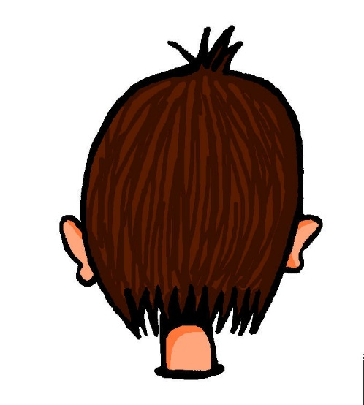
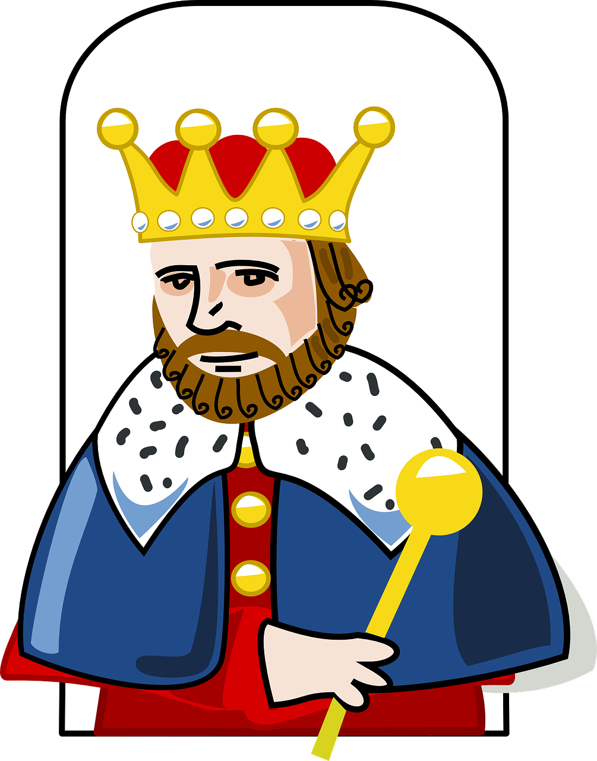
aussprechen
…
long [o] short [o] long [ö] short [ö]
Kopf
wo
König
Köpfe
Notes:
Timing: 1 minute
Aim: to revisit the SSC long [o], short [o], long [ö], short [ö]!
Procedure:
Re-present the SSC and the first of the four source words ‘wo’ (with gesture, if using).
Click to bring on the picture and get pupils to repeat the word.
Present the other three source words in the same way, bringing on first the picture and getting pupils to pronounce the words.
long [ö] König [1087]
short [ö] Köpfe [279]
long [o] wo? [94]
short [o] Kopf [279]
Jones, R.L & Tschirner, E. (2019). A frequency dictionary of German: Core vocabulary for learners. London: Routledge.

Slide 3
aussprechen
Follow up 1:
Lies die Städtenamen*. Ist das [o] oder [ö]?
…
xxxxxxxxxxxxxxxxxxxxxxxx
Eckernförde
Städtenamen – town names
Norderstett
aussprechen
Schönefeld
30
Hannover
Nordhorn
Königs Wüsterhausen
Cottbus
Boxberg
Bonn
Göttingen
Wernberg Köblitz
Rothenburg
ob der Tauber
Hollabrunn
Monte Rosa isn’t a town, but Swizerland’s highest mountain range! The highest point (called the Dufourspitze) is 4,634 metres high!
Mössingen
Schönberg-Lachtal
Adelboden
Deutsch Goritz
0
Monte Rosa
Vöcklabruck
START
Notes:
Timing: 3 minutes
Aim: to practise the SSCs [o] and [ö].
Procedure:
Before you start, point out that all arrows point to towns in Germany, Austria and Switzerland, but one of them is the odd one out. Which one and why? (Monte Rosa – a mountain range, not a town). Click to bring out a callout explaining /confirming this. Then:
Pairwork: One pupil selects 5 town names in their head.
The other pupil reads out town names, trying to ‘guess’ which ones their partner has chosen within the 30 seconds on the timer.
Click the timer to start the game.
Pupils swap roles.
3

Slide 4
Follow up 2
Hör zu.
Remember! Hausaufgaben is Haus (house, home) plus Aufgabe (task, job) → homework!
A Schreib das Verb auf Englisch.
hören
B Schreib die Details auf Englisch.
B.
you do | you use | you read
 | wann? | was? / wo?
B. | normally | computer
1 | today | English
2 | Mondays | money
3 | on Sunday | at home
4 | on Wednesday | football
5 | Fridays | English (at school)
1
you learn | you eat | you play
2
you play | you bring | you are using
3
you sing | you learn | are play
4
do you play | do you use | do you speak
5
you are doing | you are speaking | are you speaking
Notes:
Timing: 5 minutes
Aim: to practise aural comprehension of this week’s new vocabulary.
Procedure:
Click to listen. Pupils circle the correct answer (if they have the sheet printed). If not, they can use numbers 1,2.3. Click for answers.
Bring up Section B instruction. Pupils listen again and write the corresponding details into the table in Section B.
Click to reveal answers. After the Beispiel, click to bring up a reminder about Hausaufgaben meaning.
Transcript: B. Ihr benutzt normalerweise den Computer. [you use]
1. Ihr lernt heute zu Hause Englisch. [you learn]
2. Montags bringt ihr Geld mit. [you bring (with)]
3. Am Sonntag singt ihr mit Opa zu Hause. [you sing]
4. Spielt ihr am Mittwoch Fußball? [do you play]
5. Ihr redet freitags Englisch in der Schule. [you speak]

Slide 5
Follow up 3
Schatzsuche*
Schatzsuche – treasure hunt
Such den Schatz!
Reminder: the du form of sehen ist siehst!
sprechen
Fußball
zu Hause
Geld
Dörfer
mit Opa
am Computer
spielen
lernen
mitbringen
sehen
singen
sitzen
Du
Du siehst Dörfer.
Ihr
Ihr singt mit Opa.
Ihr ?
Lernt ihr zu Hause?
Notes:
slide 1 of 2 – example and instruction slide.
Timing: 8 minutes for two slides.
Aim: to practice this week’s vocabulary and the second persons singular and plural verbs.
Procedure:
Pupils use the table to make sentence.
Pupils choose a square. If they say the sentence correctly, click on the relevant square. There may or may not be a treasure (Schatz) underneath.
Black square: Du siehst Dörfer. (NB callout re the ‘ e→ ie’ in the du form). Red square: Ihr singt mit Opa. Yellow square: Lernt ihr zu Hause?
When the task is clear, click for the next slide to do the task with the complete table. The noun phrases are the same, but the treasures are in different places.
Note: noun phrases:
Fußball spielen, zu Hause lernen, Geld mitbringen, Dörfer sehen, mit Opa singen, am Computer sitzen, Additional task suggestions: 1. Elicit English translations.
Vocabulary:
Schatz [2649] Suche [1508]
Jones, R.L & Tschirner, E. (2019). A frequency dictionary of German: Core vocabulary for learners. London: Routledge.

Slide 6
Follow up 3
Schatzsuche*
Schatzsuche – treasure hunt
Such den Schatz!
Reminder: the du form of sehen ist siehst!
sprechen
spielen
lernen
mitbringen
sehen
singen
sitzen
Du
Ihr
Ihr ?
Notes:
slide 2 of 2 – task slide. Procedure on previous slide.

Slide 7
Follow up 4:

Schreib auf Englisch.
Can you get at least 15 points?
Wörter
 | fertig | durch | das Dorf
 | holen | sitzen | stehen
 | Deutsch | essen | Englisch
 | bringen | reden | nichts
 | am Montag | dienstags | machen
 | benutzen | normalerweise | zu Hause
ready, finished
through
(the) village
Vokabeln
x3
to fetch, fetching
to sit, sitting
to stand, standing
German
to eat, eating
English
x2
to bring, bringing
to talk, talking
nothing
on Monday
Tuesdays
to do, to make, doing, making
x1
to use, using
normally
at home
Notes:
Timing: 5 minutes
Aim: to practise written production of vocabulary from this and revisited weeks.
Procedure: 1. Give pupils a blank grid. They fill in the English meanings of any of the words they know, trying to reach 15 points in total. 2. Remind pupils that adjectives can refer to male or female persons and they should note this in their translations. E.g. pleased (f), short (m).
Note: The most recently learnt and practised words are pink, words from the previous week are green and those from week 1 are blue, thus more points are awarded for them, to recognise that memories fade and more effort (heavy lifting!) is needed to retrieve them.

Slide 8
Follow up 4:

Schreib auf Deutsch.
Can you get at least 15 points?
Wörter
 | to fetch, fetching | to stand, standing | ready, finished
 | to sit, sitting | through | (the) village
 | English | to bring, bringing | nothing
 | to talk, talking | German | to eat, eating
 | at home | normally | on Monday
 | Tuesdays | to use, using | to do, make
holen
stehen
fertig
Vokabeln
x3
sitzen
durch
das Dorf
Englisch
bringen
nichts
x2
reden
Deutsch
essen
zu Hause
normalerweise
am Montag
x1
dienstags
benutzen
machen
Notes:
Timing: 5 minutes
Aim: to practise written production of vocabulary from this and revisited weeks.
Procedure: 1. Give pupils a blank grid. They fill in the German meanings of any of the words they know, trying to reach 15 points in total. 2. Remind pupils that adjectives can refer to male or female persons and they should note this in their translations. E.g. pleased (f), short (m).
Note: The most recently learnt and practised words are pink, words from the previous week are green and those from week 1 are blue, thus more points are awarded for them, to recognise that memories fade and more effort (heavy lifting!) is needed to retrieve them.

Slide 9
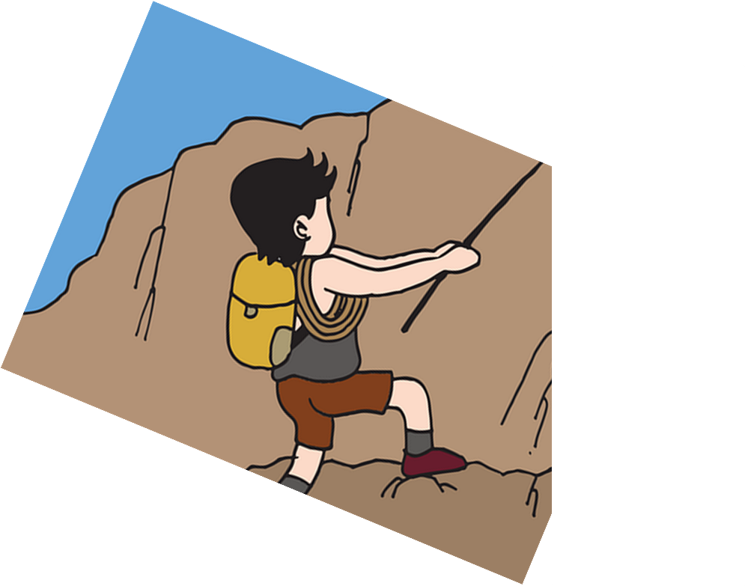
Follow up 5:
Sag den Satz auf Deutsch.
Are you singing a song on Friday?
sprechen
freitags
am Samstag
am Freitag
5
einen Text
einen Song
einen Fußball
eine Geschichte
4
3
singt
ihr
du
singst
2
Singst
Du
Ihr
Singt
1
Notes:
Timing: 5 minutes [5 slides, 5 items] Slide 1/5
Aim: to practise spoken production of sentences using this week’s vocabulary and target structures.
Procedure:
Tell students they need to use the words, starting from the bottom, to climb up the mountain (so that they translate the sentence!).
Ask students to work in pairs to practise first.
Click to trigger the timer (15 seconds per sentence).
Ask a volunteer from a pair to say the German sentence out loud.
Move to the next slide to see the answers.
Repeat with the next 4 sentences (there are 5 in total).

Slide 10
Follow up 5:
Sag den Satz auf Deutsch.
Are you singing a song on Friday?
sprechen
freitags
am Samstag
am Freitag
einen Text
einen Song
einen Fußball
eine Geschichte
singt
ihr
du
singst
Singst
Du
Ihr
Singt
Notes:
Timing: ANSWER [1/5]
Singst du einen Song am Freitag?
Procedure:
Click on the English version of the sentence to hear the German sentence audio.

Slide 11
Follow up 5:
Sag den Satz auf Deutsch.
You all normally eat on Sundays.
sprechen
am Sonntag
sonntags
samstags
5
oft
normaler-weise
4
wunder-bar
heute
3
esst
ihr
du
isst
2
Esst
Du
Ihr
Isst
1
Notes:
Slide 2/5

Slide 12
Follow up 5:
Sag den Satz auf Deutsch.
You all normally eat on Sundays.
sprechen
am Sonntag
sonntags
samstags
oft
normaler-weise
wunder-bar
heute
esst
ihr
du
isst
Esst
Du
Ihr
Isst
Notes:
Answer Slide 2/5
Ihr esst normalerweise sonntags.

Slide 13
Follow up 5:
Sag den Satz auf Deutsch.
Are you all bringing things on Thursday?
sprechen
Sachen mit
Dörfer mit
Computer mit
5
diens-tags
donners-tags
am Dienstag
am Donnerstag
4
3
bringt
ihr
du
bringst
2
Bringt
Du
Ihr
Bringst
1
Notes:
Slide 3/5

Slide 14
Follow up 5:
Sag den Satz auf Deutsch.
Are you all bringing things on Thursday?
sprechen
Sachen mit
Dörfer mit
Computer mit
diens-tags
donners-tags
am Dienstag
am Donnerstag
bringt
ihr
du
bringst
Bringt
Du
Ihr
Bringst
Notes:
Answer Slide 3/5
Bringt ihr am Donnerstag Sachen mit?

Slide 15
Follow up 5:
Sag den Satz auf Deutsch.
You all are playing football on Wednesdays.
sprechen
am Mittwoch
mittwochs
dienstags
5
4
Spiele
Ball
Fußball
3
spielt
ihr
du
spielst
2
Spielst
Du
Ihr
Spielt
1
Notes:
Slide 4/5

Slide 16
Follow up 5:
Sag den Satz auf Deutsch.
You all are playing football on Wednesday.
sprechen
am Mittwoch
mittwochs
dienstags
Spiele
Ball
Fußball
spielt
ihr
du
spielst
Spielst
Du
Ihr
Spielt
Notes:
Answer Slide 4/5
Ihr spielt Fußball am Mittwoch.

Slide 17
Follow up 5:
Sag den Satz auf Deutsch.
Are you fetching Opa on Sundays?
sprechen
freitags
sonntags
am Sonntag
5
Opa
eine Freundin
4
Oma
einen Freund
3
holt
ihr
du
holst
2
Holst
Du
Ihr
Holt
1
Notes:
Slide 5/5

Slide 18
Follow up 5:
Sag den Satz auf Deutsch.
Are you fetching Opa on Sundays?
sprechen
freitags
sonntags
am Sonntag
Opa
Oma
einen Freund
eine Freundin
holt
ihr
du
holst
Holst
Du
Ihr
Holt
Notes:
Answer Slide 5/5
Holst du Opa sonntags?

Slide 19
Tschüss!
grün
Notes:
19

Slide 20
Follow up 4:

Schreib auf Englisch.
Can you get at least 15 points?
Wörter
 | fertig | durch | das Dorf
 | holen | sitzen | stehen
 | Deutsch | essen | Englisch
 | bringen | reden | nichts
 | am Montag | dienstags | machen
 | benutzen | normalerweise | zu Hause
Vokabeln
x3
x2
x1
Notes:
HANDOUT

Slide 21
Follow up 4:

Schreib auf Deutsch.
Can you get at least 15 points?
Wörter
 | to fetch, fetching | to stand, standing | ready, finished
 | to sit, sitting | through | (the) village
 | English | to bring, bringing | nothing
 | to talk, talking | German | to eat, eating
 | at home | normally | on Monday
 | Tuesdays | to use, using | to do, to make, doing, making
Vokabeln
x3
x2
x1
Notes:
HANDOUT

