Slide 1
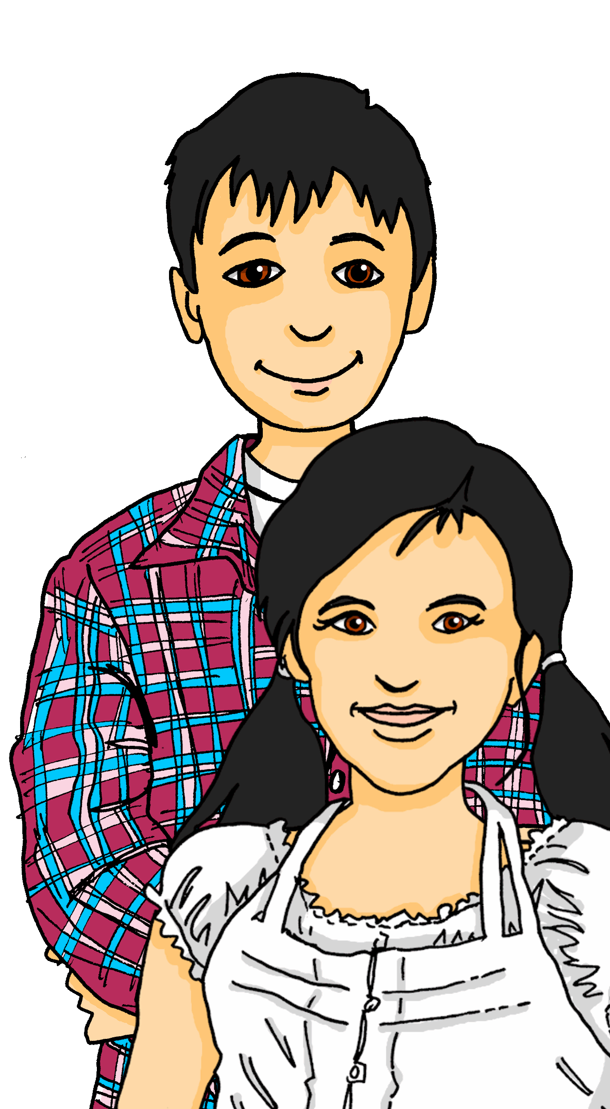
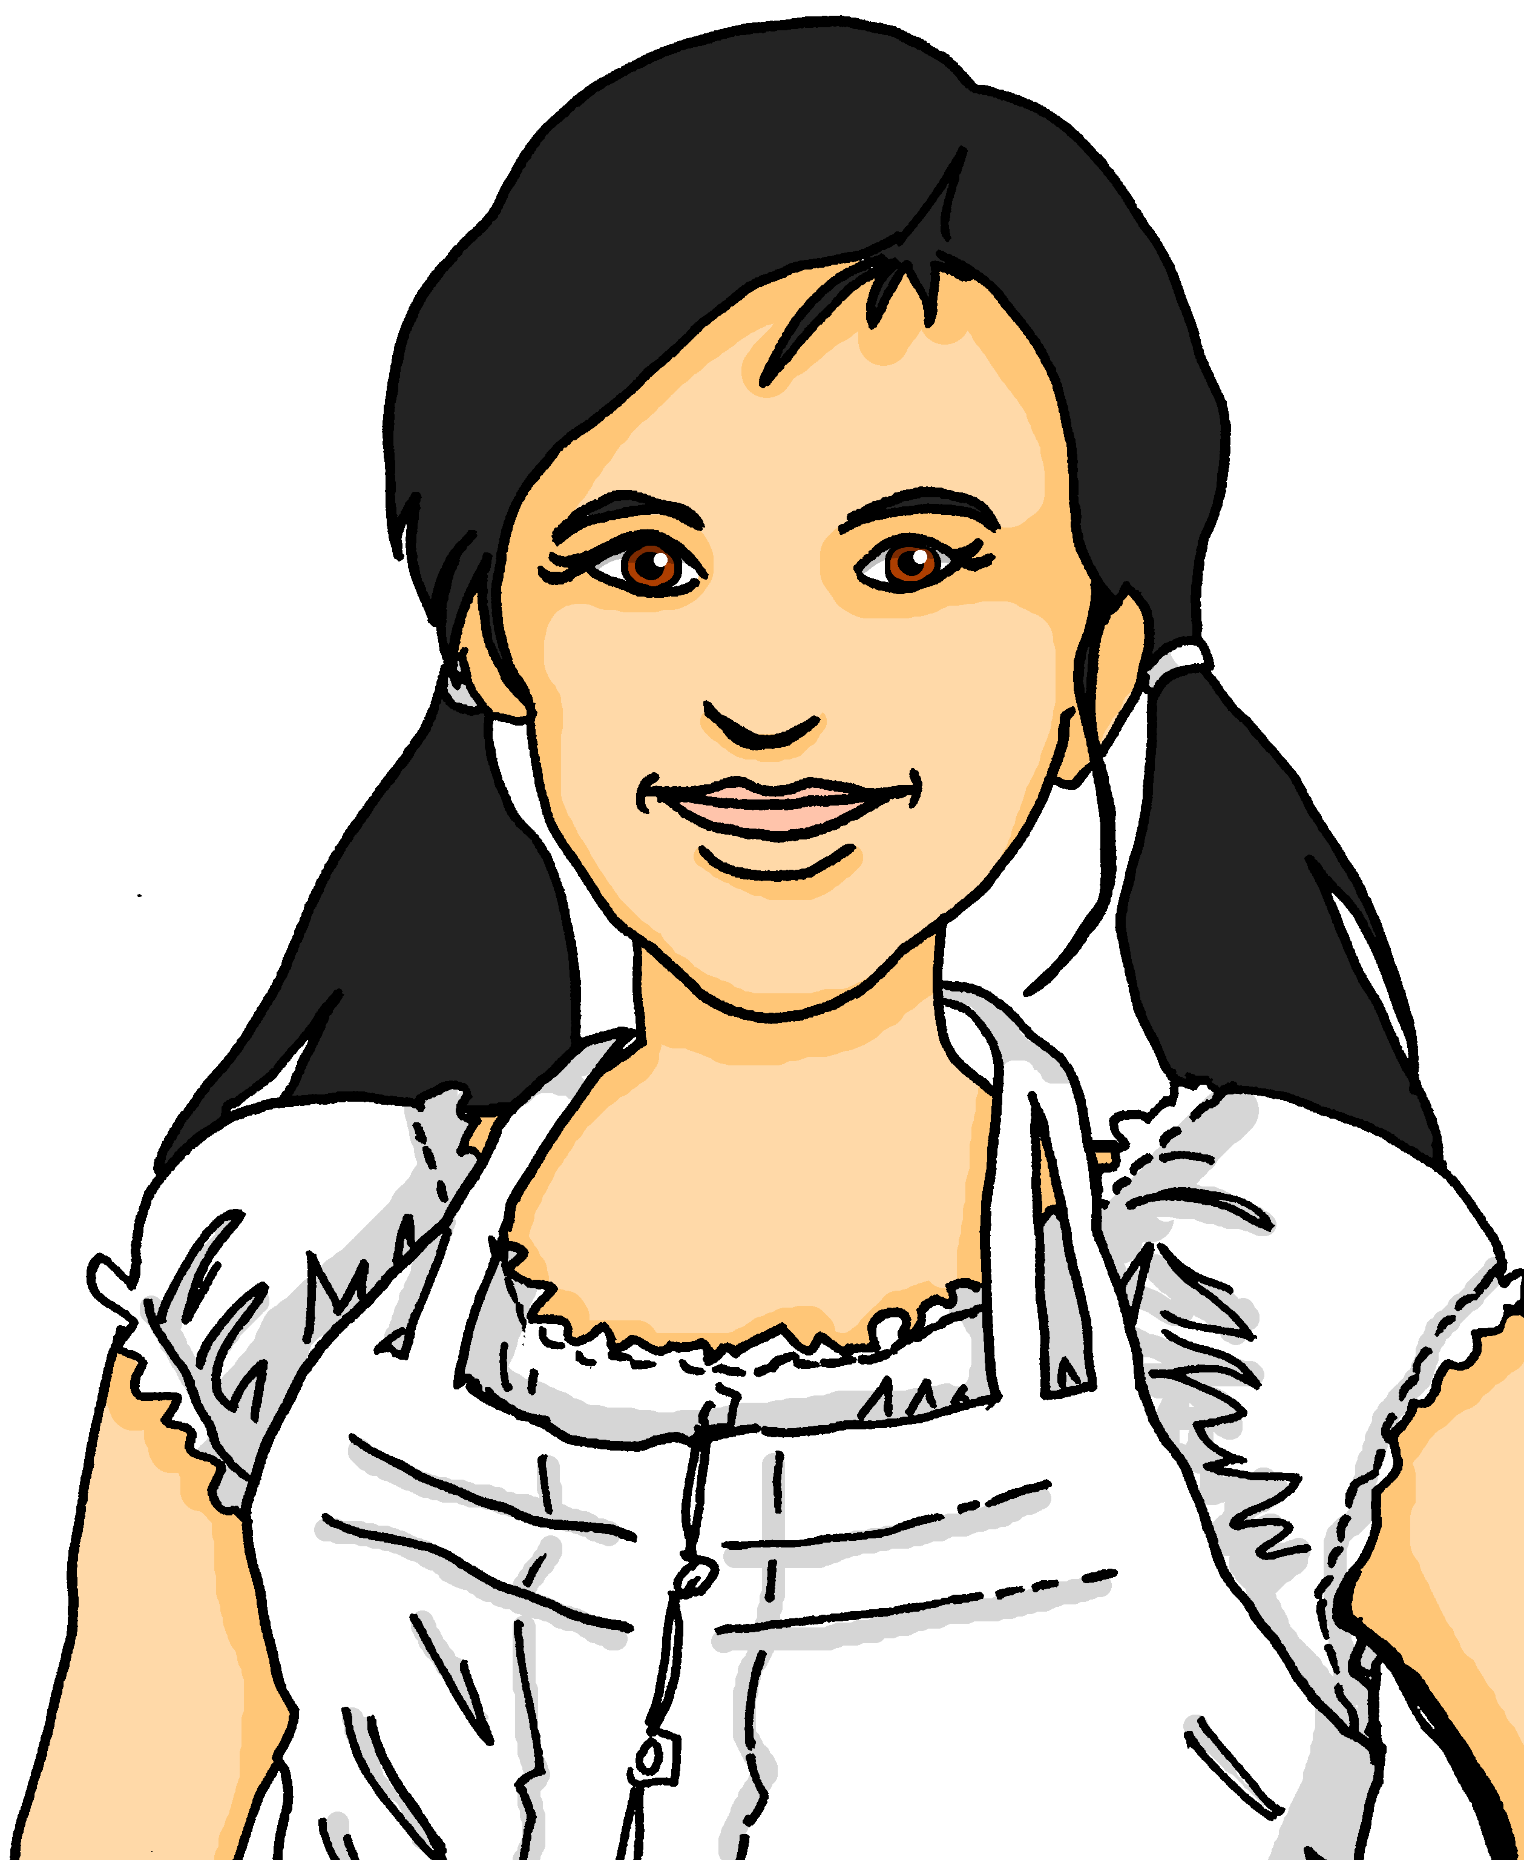
Exploring
Reporting back
grün
Follow ups 1-5
Term 2 Week 3
Notes:
Phonics: [ü] vs. [u]
long [ü] Tür [375] grün [682] müde [2000]
short [ü] fünf [274] Glück [641] wünschen [630]
long [u] du [54] gut [76] super [1772]
short [u] Punkt [248] Nummer [806] dunkel [706]
Vocabulary: no new vocabulary. Instead revisit new vocabulary from T1 & the previous week: benutzen [1119] lernen [288] machen [58] singen [1063] spielen [205] Computer [1252] Fußball [1277] Opa [2776] Song [3373] normalerweise [2062] zu Hause [n/a] Revisit am + days of the week (am Montag) and adverbs (montags)
Revisit 1: Revisit language from Term 1
Revisit 2: Antwort [522] Baum [1013] Dorf [959] Fahrrad [2138] Farbe [1079] Form [307] Fußballspieler [n/a] Haus [147] Idee [451] Karte [1474] Land [134] Mädchen [602] Musiker [2577] Ort [341] Papier [1163] Partner [1172] Punkt [248] Satz [432] Schwimmbad, Schwimmbäder [n/a] Sportler [2565] keine² [46]Jones, R.L & Tschirner, E. (2019). A frequency dictionary of German: Core vocabulary for learners. London: Routledge.
The frequency rankings for words that occur in this PowerPoint which have been previously introduced in these resources are given in the SOW and in the resources that first introduced and formally re-visited those words.
For any other words that occur incidentally in this PowerPoint, frequency rankings will be provided in the notes field wherever possible.
Note that the first three lessons of the year teach language that can be continuously recycled as lesson routine every lesson in Y5/6.
The idea would be that the class teacher (whether or not s/he teaches the class German can re-use the language as part of the daily routine with the class.

Slide 2
aussprechen
…
long [u] short [u] long [ü] short [ü]
du
Punkt
Tür
fünf
[you]
[dot, full stop]
[door]
Ruth
Lukas
Notes:
Timing: 1 minute
Aim: to revisit the SSC long [u], short [u], long [ü], short [ü]!
Procedure:
Re-present the SSC and the first of the four source words ‘du’ (with gesture, if using).
Click to bring on the picture and get pupils to repeat the word.
Present the other three source words in the same way, bringing on first the word then the picture and getting pupils to pronounce the words.
long [u] du [54]
short [u] Punkt [248]
long [ü] Tür
short [ü] fünf
Jones, R.L & Tschirner, E. (2019). A frequency dictionary of German: Core vocabulary for learners. London: Routledge.

Slide 3
aussprechen
Follow up 1:
Lies die Städtenamen*. Ist das [u] oder [ü]?
…
xxxxxxxxxxxxxxxxxxxxxxxx
Flensburg
Büsum
Lübeck
aussprechen
Buxtehude
30
Münster
Städtenamen – town names
Cottbus
Düren
Nürnberg
Ulm
Gmünd
München
Purbach
am Neusiedlersee
Zürich
0
Fürstenfeld
Chur
START
Innsbruck
Notes:
Timing: 3 minutes
Aim: to practise the SSCs [u] and [ü].
NB the geography is approximate, the focus here is on the pronounciation of the place names.
Procedure:
Pair work: One pupil selects 5 town names in their head.
The other pupil reads out town names, trying to ‘guess’ which ones their partner has chosen within the 30 seconds on the timer.
Click the timer to start the game.
Pupils swap roles.
3

Slide 4
Follow up 2
Hör zu.
A Was ist richtig?
hören
B Schreib die Details auf Englisch.
B.
she is giving | they are giving | Is she giving?
 | wann? | was? / wo?
B. | today | giving an answer
1 | on Sundays | like cake
2 | Wednesdays | use computers
3 | normally | sing songs
4 | Fridays | go to the pool
5 | on Monday | eating cheese
1
does she like? | does she have? | do they like?
2
does she use? | they use | do they use?
3
they listen to | they sing | she sings
4
does she go? | she goes | they go
5
she is eating | is she eating? | they are eating
Notes:
Timing: 5 minutes
Aim: to practise aural distinction between sie (she) and sie (they), and between statement and question word order.
Procedure:
Explain the task.
Click to listen. Pupils circle the correct answer (if they have the sheet printed). If not, they can use numbers 1,2.3. Click for answers.
Bring up Section B instruction. Pupils listen again and write the corresponding details into the table in Section B.
Click to reveal answers.
Transcript: Beispiel. Sie gibt heute eine Antwort.
1. Mag sie sonntags Kuchen?
2. Benutzen sie mittwochs Computer?
3. Sie singen normalerweise Songs.
4. Sie geht freitags ins Schwimmbad.
5. Am Montag isst sie Käse.

Slide 5
Follow up 3
Schatzsuche*
die Schatzsuche – treasure hunt
Such den Schatz!
sprechen
ins Schwimm-bad gehen
Ideen haben
Blumen mit-bringen
am Meer sitzen
Konzerte besuchen
Farben mögen
Sie hat Ideen.
sie (she)
Sie bringen Blumen mit.
sie (they)
Besucht sie Konzerte?
sie (she)?
Notes:
slide 1 of 2 – example and instruction slide.
Timing: 8 minutes for two slides.
Aim: to practice distinguishing between sie (she) and sie (they), and between statement and question word order.
Procedure:
Pupils use the table to make a sentence or a question e.g. first column: Sie spielt Fußball, Sie spielen Fußball, Spielt sie Fußball?
Pupils choose a square. If they say the sentence correctly, click on the relevant square. There may or may not be a treasure (Schatz) underneath.
When the task is clear, click for the next slide to do the task with the complete table. The noun phrases are the same, but the treasures are in different places.
Note: noun phrases:
new noun phrases for Gruen:
ins Schwimmbad gehen
Ideen haben
Blumen mitbringen
am Meer sitzen
Konzerte besuchen
Farben mögen
Additional task suggestions: 1. Elicit English translations.
Vocabulary:
Schatz [2649] Suche [1508]
Jones, R.L & Tschirner, E. (2019). A frequency dictionary of German: Core vocabulary for learners. London: Routledge.

Slide 6
Follow up 3
Schatzsuche*
Schatzsuche – treasure hunt
Such den Schatz!
sprechen
ins Schwimm-bad gehen
Ideen haben
Blumen mit-bringen
am Meer sitzen
Konzerte besuchen
Farben mögen
sie (she)
sie (they)
sie (she)?
Notes:
slide 2 of 2 – task slide. Procedure on previous slide.

Slide 7
Follow up 4:

Schreib auf Englisch.
Can you get at least 15 points?
Wörter
Vokabeln
 | das Schwimmbad | der Satz | erklären
 | die Kultur | viele | der Käse
 | benutzen | lernen | machen
 | normalerweise | spielen | brauchen
 | der Baum | das Mädchen | das Papier
 | die Karte | der Ort | die Antwort
(the) swimming pool
(the) sentence
to explain, explaining
x3
(the) culture
many
(the) cheese
to do, make, doing, making
to use, using
to learn, learning
x2
normally
to play, playing
to need, needing
(the) tree
(the) girl
(the) paper
x1
(the) card, ticket, menu
(the) place
(the) answer
Notes:
Timing: 5 minutes
Aim: to practise written production of vocabulary from this and revisited weeks.
Procedure: 1. Give pupils a blank grid. They fill in the English meanings of any of the words they know, trying to reach 15 points in total. 2. Remind pupils that adjectives can refer to male or female persons and they should note this in their translations. E.g. pleased (f), short (m).
Note: The most recently learnt and practised words are pink, words from the previous week are green and those from week 1 are blue, thus more points are awarded for them, to recognise that memories fade and more effort (heavy lifting!) is needed to retrieve them.

Slide 8
Follow up 4:

Schreib auf Deutsch
Can you get at least 15 points?
Wörter
Vokabeln
 | many | (the) culture | (the) swimming pool
 | to explain, explaining | (the) cheese | (the) sentence
 | to play, playing | to use, using | to learn, learning
 | to need, needing | normally | to do, make, doing, making
 | (the) card, ticket, menu | (the) paper | (the) place
 | (the) answer | (the) tree | (the) girl
viele
die Kultur
das Schwimmbad
x3
erklären
der Käse
der Satz
spielen
benutzen
lernen
x2
brauchen
normalerweise
machen
die Karte
das Papier
der Ort
x1
die Antwort
der Baum
das Mädchen
Notes:
Timing: 5 minutes
Aim: to practise written production of vocabulary from this and revisited weeks.
Procedure: 1. Give pupils a blank grid. They fill in the German meanings of any of the words they know, trying to reach 15 points in total. 2. Remind pupils that adjectives can refer to male or female persons and they should note this in their translations. E.g. pleased (f), short (m).
Note: The most recently learnt and practised words are pink, words from the previous week are green and those from week 1 are blue, thus more points are awarded for them, to recognise that memories fade and more effort (heavy lifting!) is needed to retrieve them.

Slide 9
Follow up 5:
Partnerarbeit: wir sprechen!
…
Person A spricht.
sprechen
Person B findet das richtige Bild. Ist das eine Frage oder ein Satz?
Person A
Are they learning English?
Person B
1) _____________________
[A] [B] ?
Lernen sie Englisch?
Are they learning English?
B
A
Notes:
Timing: 5-10 minutes
Aim: to practise receptive and productive knowledge of 3rd person singular feminine (sie) and 3rd person plural (also sie) verbs and yes/no questions.
Procedure: 1. Use this slide to model the task.
2. Pupil A produces the statement or question in German. Discuss with class how a statement and question will be different (word order).
3. Pupil B identifies the correct picture – A or B (she or they?), writes the English down, and identifies whether or not it is a question.
4. Complete items 1-5 for partner A.
5. Then pupils swap roles and repeat the task. 6. See next slides for answers and handouts at the end of the presentation.
Note: pupils have learnt that the German present tense translates into present simple and present continuous in English. Here, as there are no adverbs many of the sentences/questions could be either present simple or continuous, so if pupils have given a different formulation in their answer, they can be reassured about this.

Slide 10
Round 1
…
Person A
1) She is playing football.
……………………………….
2) Are they giving many flowers?
……………………………….
3) They see the bus.
……………………………….
4) Is she explaining the story?
……………………………….
5 Do they love culture?
………………………………..
Person B
sprechen
[A] [B] ?
She is playing football.
Sie spielt Fußball.
Are they giving many flowers?
Geben sie viele Blumen?
They see the bus.
Sie sehen den Bus.
Is she explaining the story?
Erklärt sie die Geschichte?
Do they love culture?
Lieben sie Kultur?
Notes:
ANSWERS ROUND 1

Slide 11
Round 2
…
Person B
1) They are fetching the sister.
……………………………….
2) Are they bringing the card?
……………………………….
3)She is using her mobile phone.
……………………………….
4)Is she singing a song?
……………………………….
5) She has a partner, hasn’t she?
………………………………..
Person A
sprechen
[A] [B] ?
Sie holen die Schwester.
They are fetching the sister.
Bringen sie die Karte mit?
Are they bringing the card?
Sie benutzt ihr Handy.
She is using her mobile phone.
Singt sie ein Lied?
Is she singing a song?
Sie hat einen Partner, nicht wahr?
She has a partner, hasn’t she?
Notes:
ANSWERS ROUND 2

Slide 12
Tschüss!
grün
Notes:
12

Slide 13
Follow up 4:

Schreib auf Englisch.
Can you get at least 15 points?
Wörter
Vokabeln
 | das Schwimmbad | der Satz | erklären
 | die Kultur | viele | der Käse
 | benutzen | lernen | machen
 | normalerweise | spielen | brauchen
 | der Baum | das Mädchen | das Papier
 | die Karte | der Ort | die Antwort
x3
x2
x1
Notes:
HANDOUT

Slide 14
Follow up 4:

Schreib auf Deutsch
Can you get at least 15 points?
Wörter
Vokabeln
 | many | (the) culture | (the) swimming pool
 | to explain, explaining | (the) cheese | (the) sentence
 | to play, playing | to use, using | to learn, learning
 | to need, needing | normally | to do, make, doing, making
 | (the) card, ticket, menu | (the) paper | (the) place
 | (the) answer | (the) tree | (the) girl
x3
x2
x1
Notes:
HANDOUT

Slide 15
Round 1
Person A
…
Round 2
Person A
Person A
1) She is playing football.
……………………………….
2) Are they giving many flowers?
……………………………….
3) They see the bus.
……………………………….
4) Is she explaining the story?
……………………………….
5 Do they love culture?
………………………………..
sprechen
[A] [B] ?
Notes:
HANDOUT PERSON A

Slide 16
Round 1
Person B
…
Round 2
sprechen
Person B
1) They are fetching the sister.
……………………………….
2) Are they bringing the card?
……………………………….
3)She is using her mobile phone.
……………………………….
4)Is she singing a song?
……………………………….
5) She has a partner, hasn’t she?
………………………………..
[A] [B] ?
Notes:
HANDOUT PERSON B

