Slide 1
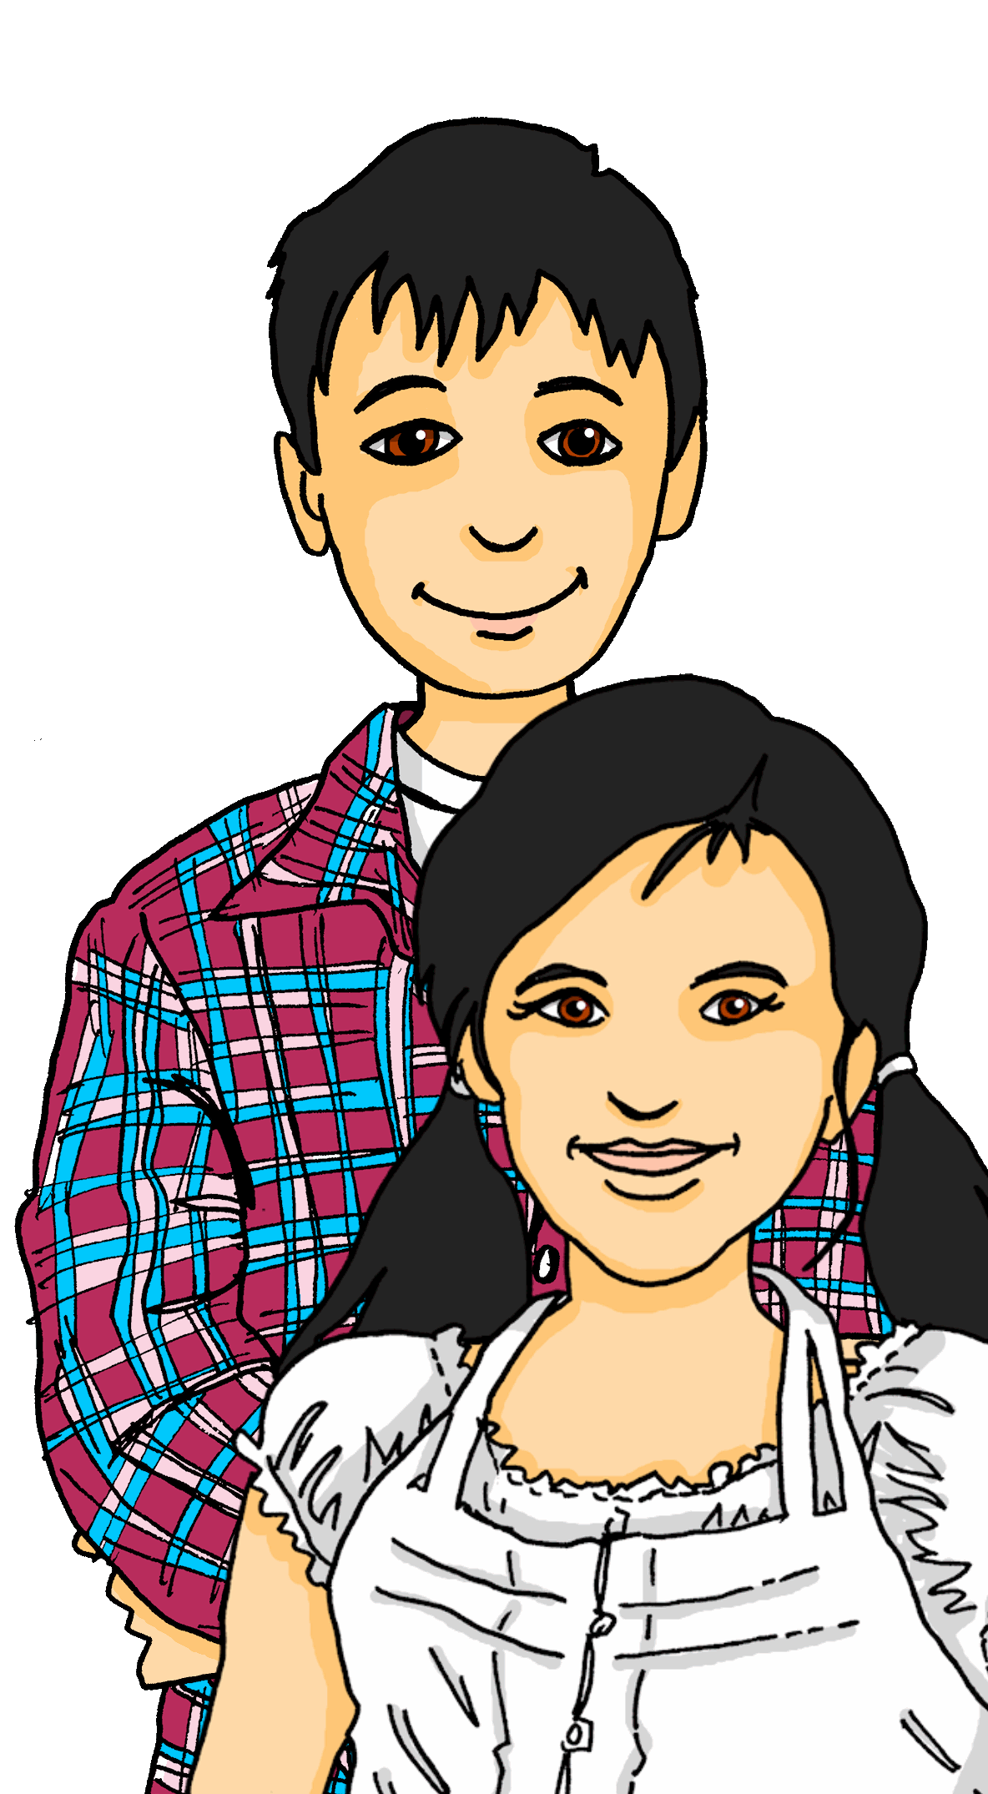
Exploring
Reporting back
grün
Present tense – sie (they) vs sie (she)
WO2 after time adverbs
(am+ noun, adv –s)
SSC [ü] v. [u]
Term 2 Week 3
Notes:
Phonics: [ü] vs. [u]
long [ü] Tür [375] grün [682] müde [2000]
short [ü] fünf [274] Glück [641] wünschen [630]
long [u] du [54] gut [76] super [1772]
short [u] Punkt [248] Nummer [806] dunkel [706]
Vocabulary: no new vocabulary. Instead revisit new vocabulary from T1 & the previous week: benutzen [1119] lernen [288] machen [58] singen [1063] spielen [205] Computer [1252] Fußball [1277] Opa [2776] Song [3373] normalerweise [2062] zu Hause [n/a] Revisit am + days of the week (am Montag) and adverbs (montags)
Revisit 1: Revisit language from Term 1
Revisit 2: Antwort [522] Baum [1013] Dorf [959] Fahrrad [2138] Farbe [1079] Form [307] Fußballspieler [n/a] Haus [147] Idee [451] Karte [1474] Land [134] Mädchen [602] Musiker [2577] Ort [341] Papier [1163] Partner [1172] Punkt [248] Satz [432] Schwimmbad, Schwimmbäder [n/a] Sportler [2565] keine² [46]Jones, R.L & Tschirner, E. (2019). A frequency dictionary of German: Core vocabulary for learners. London: Routledge.
The frequency rankings for words that occur in this PowerPoint which have been previously introduced in these resources are given in the SOW and in the resources that first introduced and formally re-visited those words.
For any other words that occur incidentally in this PowerPoint, frequency rankings will be provided in the notes field wherever possible.
Note that the first three lessons of the year teach language that can be continuously recycled as lesson routine every lesson in Y5/6.
The idea would be that the class teacher (whether or not s/he teaches the class German can re-use the language as part of the daily routine with the class.
1

Slide 2
aussprechen
long[u]
…
gut
du
super
[good]
[you]
Ruth
Lukas
Notes:
Timing: 2 minutes
Aim: to consolidate the SSC long [u].
Procedure:
Re-present the SSC and the source word ‘du’ (with gesture, if using).
Click to bring on the picture and get pupils to repeat the word ‘du’ (with gesture, if using).
Present the cluster words in the same way, bringing on the picture and getting pupils to pronounce the words.
Note:
a gesture for ‘du’ might be to point at someone else.
2

Slide 3
aussprechen
long [ü]
…
grün
Tür
müde
[green]
[door]
[tired]
Notes:
Timing: 1 minute
Aim: to intorduce the SSC long [ü].
Procedure:
Present the SSC and the source word ‘Tür’ (with gesture, if using).
Click to bring on the picture and get pupils to repeat the word ‘Tür’ (with gesture, if using).
Present the cluster words in the same way, bringing on the picture and getting pupils to pronounce the words.
Gesture: a gesture for ‘Tür’ might be to pretend pushing down a door handle and opening a door.
long [ü] Tür [375] grün [682] müde [2000]
Jones, R.L & Tschirner, E. (2019). A frequency dictionary of German: Core vocabulary for learners. London: Routledge.
3

Slide 4
aussprechen
short [u]
…
Nummer
Punkt
dunkel
[number]
[dot, full stop]
[dark]
Notes:
Timing: 2 minutes
Aim: to consolidate the SSC short [u].
Procedure:
Re-present the SSC and the source word ‘Punkt’ (with gesture, if using).
Click to bring on the picture and get pupils to repeat the word ‘Punkt’ (with gesture, if using).
Present the cluster words in the same way, bringing on the picture and getting pupils to pronounce the words.
short [u] Punkt [248] Nummer [806] dunkel [706]
Jones, R.L & Tschirner, E. (2019). A frequency dictionary of German: Core vocabulary for learners. London: Routledge.

Slide 5
aussprechen
short [ü]
All vowels in German can be long or short, including [ü]. [ü] is usually short when followed by two consonants.
…
Glück
fünf
wünschen
[luck|happiness]
[to wish, wishing]
Notes:
Timing: 1 minute
Aim: to introduce the SSC short [ü].
Procedure:
First click for callout explaining about long and short vowels and [ü]. Click again for callout to disappear.
Present the SSC and the source word ‘fünf’ (with gesture, if using).
Click to bring on the picture and get pupils to repeat the word ‘fünf ’(with gesture, if using).
Present the cluster words in the same way, bringing on the picture and getting pupils to pronounce the words.
Gesture: hold out your open hand showing all five fingers
fünf [274] Glück [641] wünschen [630]
Jones, R.L & Tschirner, E. (2019). A frequency dictionary of German: Core vocabulary for learners. London: Routledge.
5

Slide 6
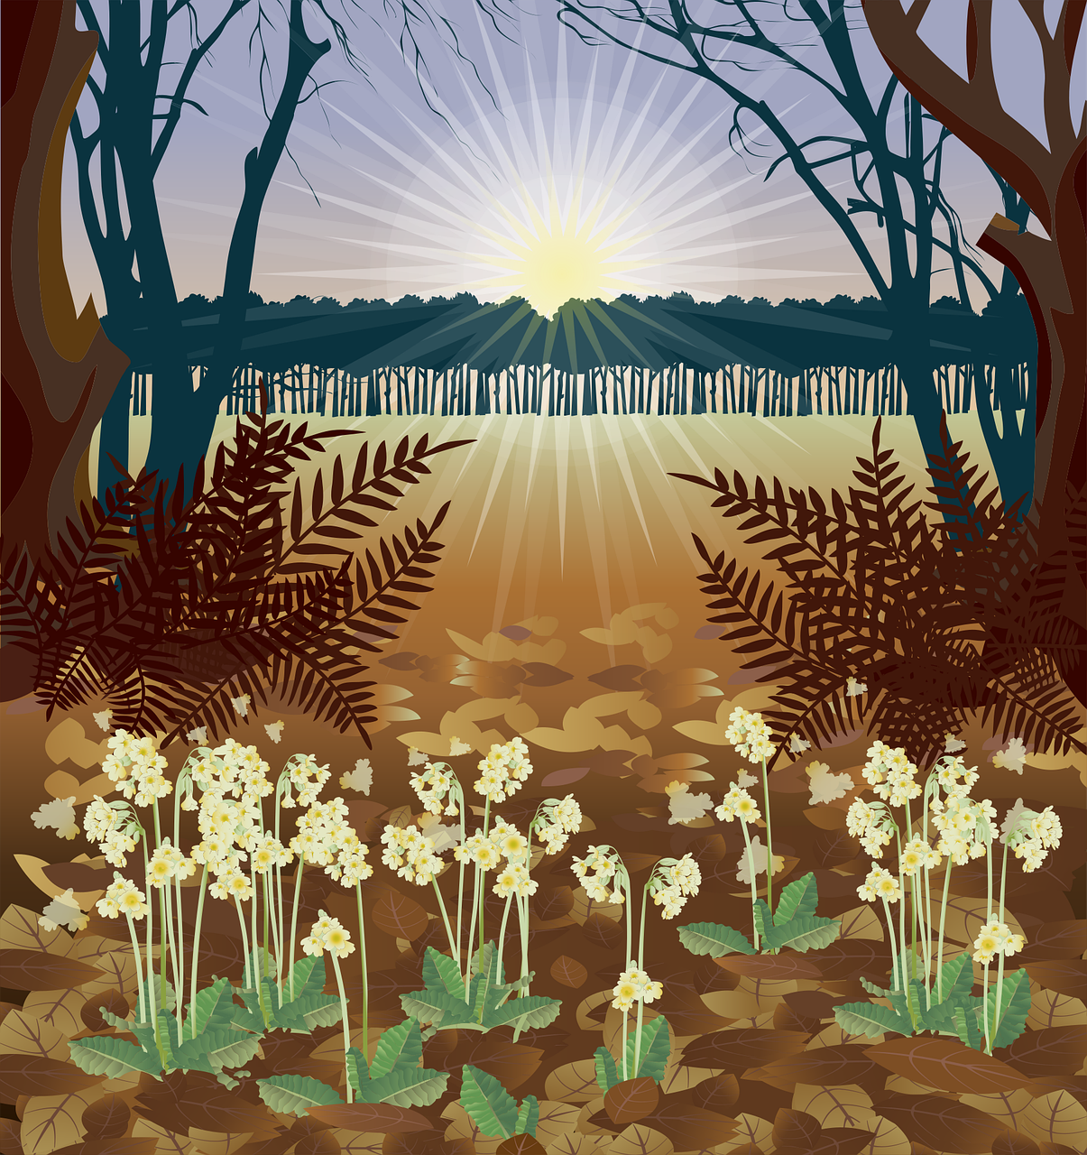
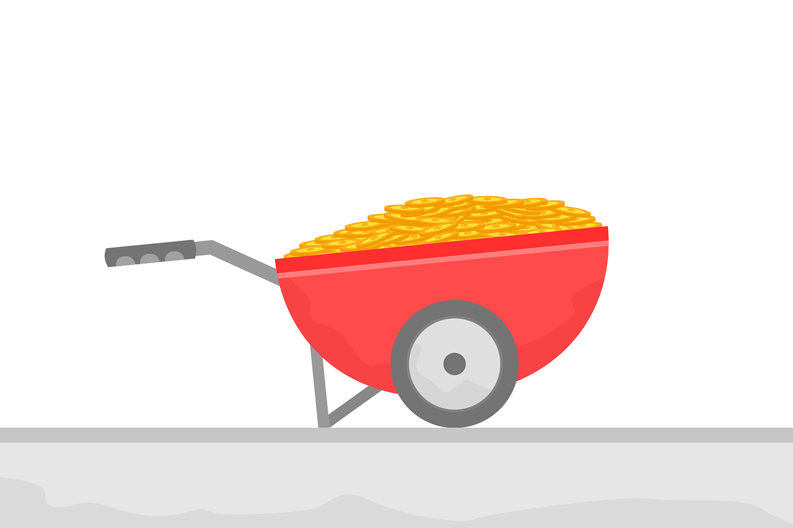
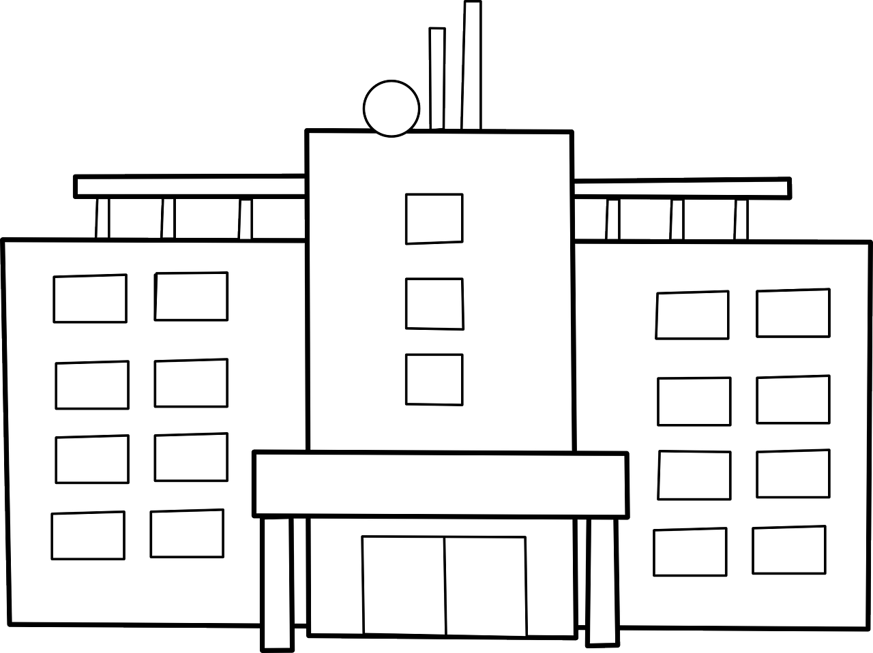
hören
[ü] oder [u]?
Hör zu. Ist es [ü] oder [u]?
m u s s
f r ü h
f ü h l e n
1
_
2
_
3
_
[have to, must]
[early]
[to feel, feeling]
V e r –
b i n d u n g
F u n k t i o n
5
6
4
_
g e g e n –
ü b e r
_
_
[function]
[connection]
[opposite]
W o h n –
u n g
8
9
S t ü c k
7
g e n u g
_
_
_
[flat]
[enough]
[piece]
Notes:
Timing: 5 minutes
Aim: to consolidate the SSC [ü] by aurally differentiating between [ü and [u].
Procedure:
1. Click to listen to the first item. Pupils decide whether they hear [ü] or [u].
2. Click to reveal the answer.
3. Continue with items 2-9 and click to reveal answers.
Transcript:
muss
früh
fühlen
Funktion
Verbindung
gegenüber
Wohnung
genug
Stück
Word frequency (1 is the most frequent word in German):
fühlen [394] früh [366] gegenüber [439] genug [498] müssen [43] Stück [511] Verbindung [434] Wohnung [501] Source: Jones, R.L. & Tschirner, E. (2019). A frequency dictionary of German: core vocabulary for learners. Routledge

Slide 7
Vokabeln
Hör zu und sag das Wort.
Wörter
das Schwimm-bad
zu Hause
die Idee
(the) swimming pool
at home
(the) idea
der Käse
(the) cheese
das Dorf
der Satz
(die) Sachen
(the) village
(the) sentence
(the) country(side)
(the) things
das Land
normaler-weise
(the) girl
(the) dot,
point, full stop
die Schwimm-bäder
normally
das Mädchen
der Punkt
(the) swimming pools
wir sind
keine
we are
not any, no (pl),
not a, no (f)
fertig
holen
finished, ready
to fetch, fetching
Notes:
Timing: 5 minutes
Aim: to practise oral recall of vocabulary.
Procedure:
1. Pupils sketch a 4x4 grid.
2. Working in pairs, they take turns to choose a word to translate orally into English.
3. Pupils should work as quickly as they can without repeating a word the other has already said. If their partner agrees the given translation is correct, the speaking pupil ‘claims’ the relevant square on the grid by putting their initials in it. If they cannot translate a word, or translate it incorrectly, they do not claim a square and the game moves on. NB for ‘keine’, saying ONE of the possible translations is enough.
4. Click to reveal translations one by one.
5. Pupils count up the number of squares they have claimed. The pupil with the most squares wins.
7

Slide 8
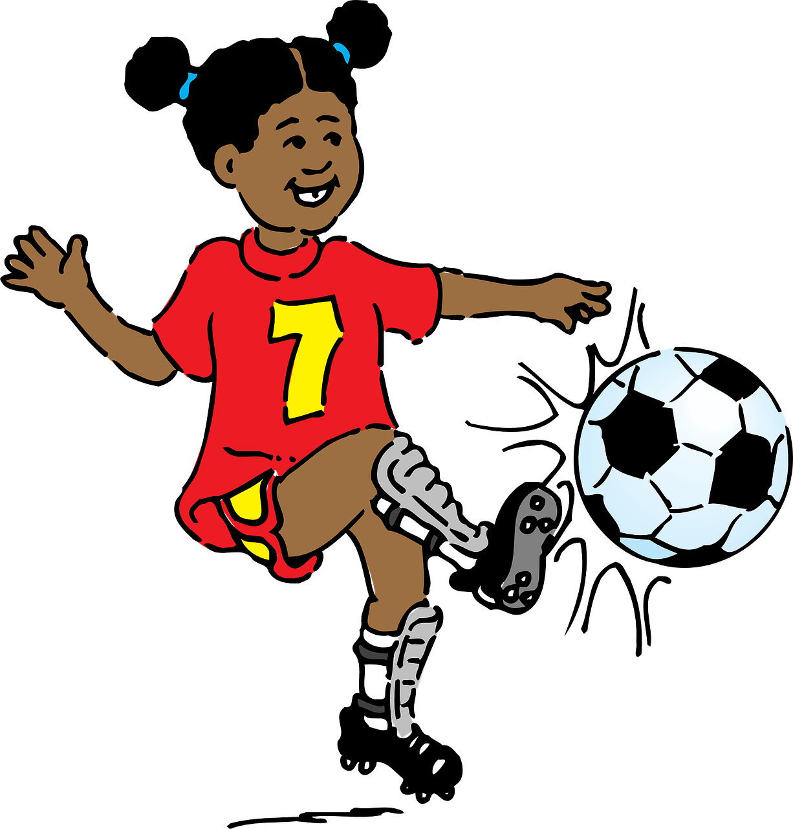
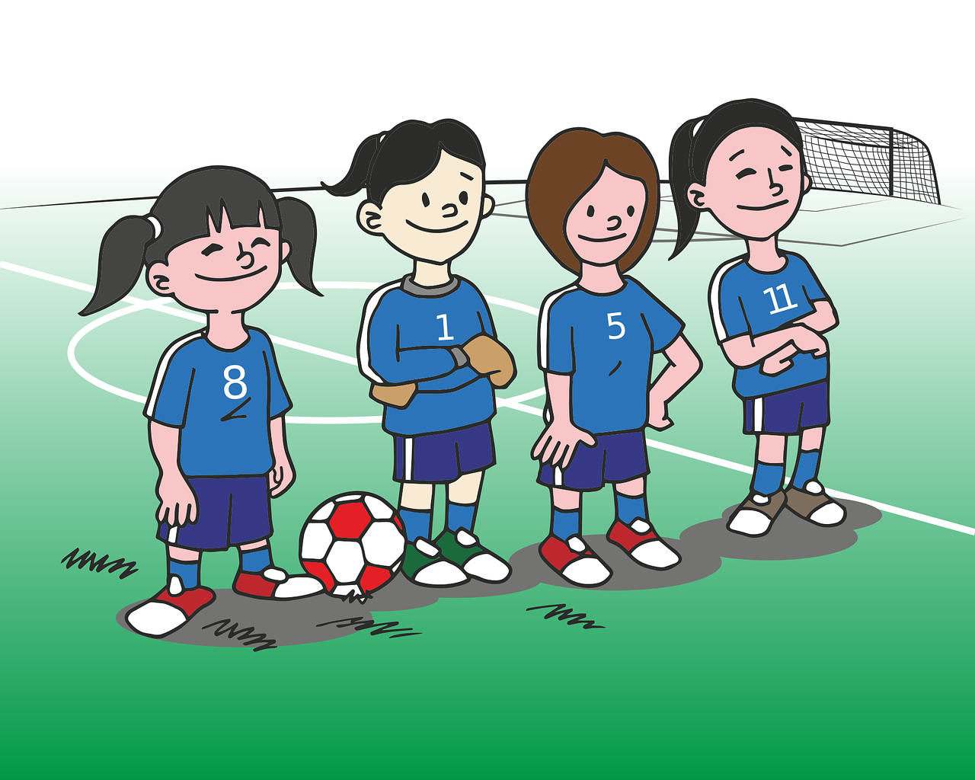
Present tense: er, sie, es| sie (they)
Note: geben (to give) → gibt
Remember! To mean ‘she’ use sie with ‘t’ verb ending:
Remember! English has two present tenses, but German only has one!
Sie spielt Fußball.
Sie gibt Blumen.
She plays | is playing football.
She gives | is giving flowers.
Note: no spelling change in ‘they’ form.
To mean ‘they’ use sie with ‘en’ verb ending:
Sie spielen Fußball.
Sie geben Blumen.
They play | are playing football.
They give| are giving flowers.
Notes:
Timing: 2 minutes
Aim: to recap the 3rd person singular (s/he, it) and plural form (they) of regular (weak) and strong present tense.
Procedure:
Click through the animations to present the information.
Elicit English translation for the German examples provided.
8

Slide 9
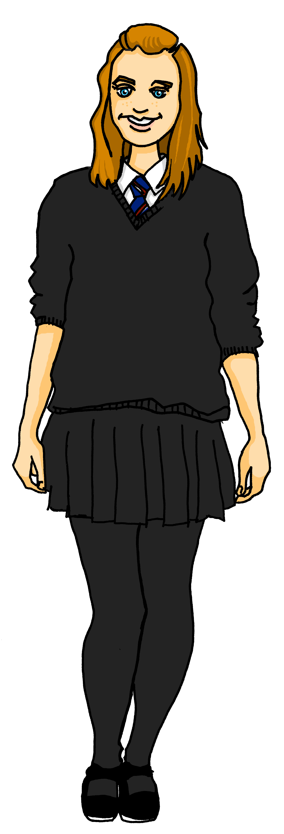
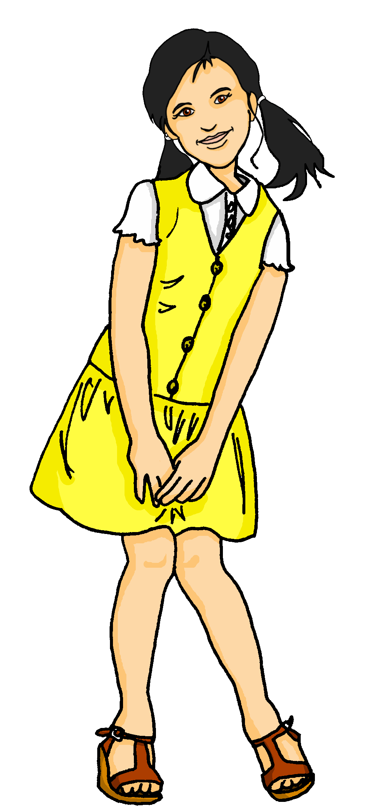
hören
Olivia fragt* Ronja.
Hör zu. Was sagt Olivia? Ist es ‘sie’ (she) oder ‘sie’ (they)?
sie (she) | sie (they) | was?
 |  | normally uses the computer
 |  | speak English on Wednesdays
 |  | sings/is singing a song
 |  | is bringing money on Monday.
 |  | love the villages in Switzerland
 |  | likes concerts
 |  | are in Germany on Saturday
B.
1
2
3
4
5
6
fragen – to ask
Notes:
Timing: 5 minutes
Aim: to practise aural distinction between 3rd person singular and 3rd person plural in the present tense.
Procedure:
Olivia asks Ronja some questions about her and Lias. She reports back. Is she talking about something Ronja and Lias do (they?), or something only Ronja does (she)?
Play the example with the pronoun bleeped out. Pupils select the correct pronoun.
Click to elicit and confirm the answer.
Elicit the English meaning of the question.
Click to elicit and confirm the answer.
Continue for items 1-6.
Transcript:
Beispiel: Sie benutzt normalerweise den Computer.
1. Sie reden mittwochs Englisch.
2. Sie singt einen Song.
3. Sie bringt am Montag Geld mit.
4. Sie lieben die Dörfer in der Schweiz.
5. Sie mag Konzerte.
6. Sie sind am Samstag in Deutschland.
9

Slide 10
Order of words in a sentence
You know we can start a German sentence with the place adverb to emphasize it.
When we do this, the adverb and subject swap places.
This works with time adverbs too.
Montags
benutzen sie
Computer.
Word order
2
TIME ADVERB
VERB + SUBJECT
OBJECT
On Mondays
they use
computers.
The verb position stays the same – just the adverb and subject swap around!
Notes:
Timing: 3 minutes
Aim: to recap the order of words in a German sentence, and how this is affected by an initial adverb of time.
Procedure:
Click to present the information.
Elicit the English meaning of the words in the sentence.
Ensure that pupils understand that this change is for emphasis – the essential meaning of the sentence remains the same.
10

Slide 11
lesen
Olivia schreibt ihre* Antworten.
ihr(e) – her
Wo ist ‘sie’? Ist es 1 oder 2? Was ist das auf Englisch?
Deutsch
Englisch
B
Normalerweise benutzt sie den Computer.
1
Normally she uses the computer.
Oops! Olivia spills
hot chocolate!
2
Sie reden mittwochs Englisch.
They speak English on Wednesdays.
1
1
2
 | WO1 | WO2
B.
1
2
3
4
5
6
2
Sie singt einen Song.
She sings/ is singing a song.
1
2
3
Am Montag bringen
sie Geld mit.
On Monday they are bringing money.
1
2
4
Sie lieben die Dörfer in der Schweiz.
They love the villages in Switzerland.
1
2
Sie mag Konzerte.
5
1
2
She likes concerts.
2
On Saturday they are in Germany.
Am Samstag sind sie in Deutschland.
1
6
Notes:
Timing: 8 minutes
Aim: to distinguish between Word Order 1 or 2, 3rd persons singular and plural, and to practise comprehension of recently learnt vocabulary.
Procedure:
Explain the scenario: Olivia is writing up her survey answers but spills hot chocolate on them.
Pupils identify the correct choice for item one, Word order 1 or Word order 2.
Click for the numbered spillages to be removed and to bring up the answer ticks in the table. If desired, click the numbered buttons to hear full, correct sentences.
Then give pupils times to translate the example into English and elicit responses from pupils.
Click to correct, ensuring that they note the difference between –t/-en verb endings.
Continue with items 1-6.
Click to correct all items.
11

Slide 12
Tschüss!
grün
Notes:
12

