Slide 1
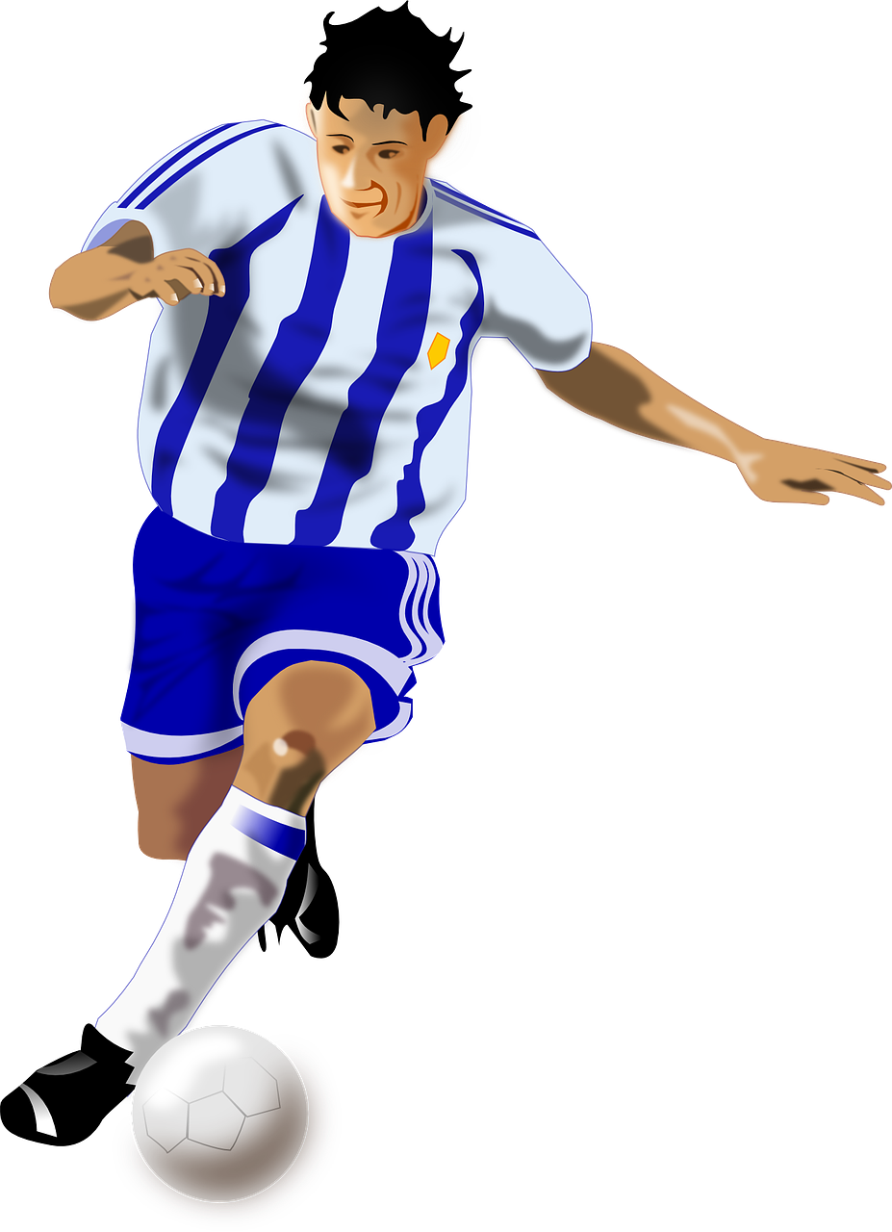
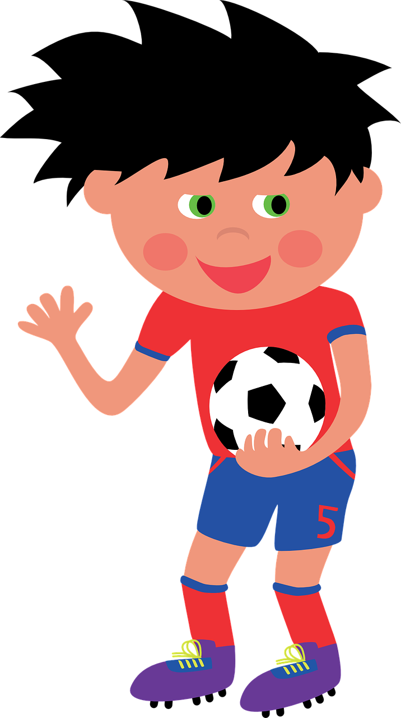
Exploring
Besucher* in der Schule
grün
Follow ups 1-5
die Besucher - visitors
Term 2 Week 4
Notes:
Artwork by Steve Clarke. Pronoun pictures from NCELP (www.ncelp.org). All additional pictures selected from Pixabay and are available under a Creative Commons license, no attribution required.
Phonics:
[au] Haus [147] blau [948] laufen [252]
[eu] Deutschland [140] Freund [273] heute [116]
Vocabulary: finden [103] Sie [7] Kunst [554] Müll [4506] Projekt [720]
Revisit 1: liegen [107] Berg [934] Dorf [959] Europa [294] Haus [147] Leute [224] Meer [854] See [1317] Wetter [1881] kalt [887] dort [139]
Revisit 2: alles [36] alle [36] viele [56] Baum [1013] Blume [2463] Buch [300] Essen1 [323] Fußballspieler [n/a] Haus [147] Käse [4094] Kultur [594] Land2 [134] Satz [432] Schule [359] See [1317] Seen [1317] Song [3373] Sport [945]
Jones, R.L & Tschirner, E. (2019). A frequency dictionary of German: Core vocabulary for learners. London: Routledge.
The frequency rankings for words that occur in this PowerPoint which have been previously introduced in these resources are given in the SOW and in the resources that first introduced and formally re-visited those words.
For any other words that occur incidentally in this PowerPoint, frequency rankings will be provided in the notes field wherever possible.
Remember that at the start of the course (first three lessons of Rot/Gelb) pupils learnt language (for greetings and register taking) that can still be part of the lesson routines in upper KS2 (Blau/Grün). They are not re-taught, as we anticipate that teachers have built these in from early in lower KS2.

Slide 2
aussprechen
[au]
…
Haus
Notes:
Timing: 1 minute
Aim: to introduce the SSC [au].
Procedure:
Introduce the SSC and present the source word ‘Haus’ (with gesture, if using).
Click to bring on the picture and get pupils to repeat the word ‘Haus’ (with gesture, if using).
Note:
a gesture for ‘Haus’ might be to make a roof above your head with two hands.
2

Slide 3
aussprechen
[eu]
…
Deutschland
Notes:
Timing: 1 minute
Aim: to introduce the SSC [eu].
Procedure:
Re-present the SSC and the source word ‘Deutschland’
Click to bring on the picture and get pupils to repeat the word ’Deutschland’

Slide 4
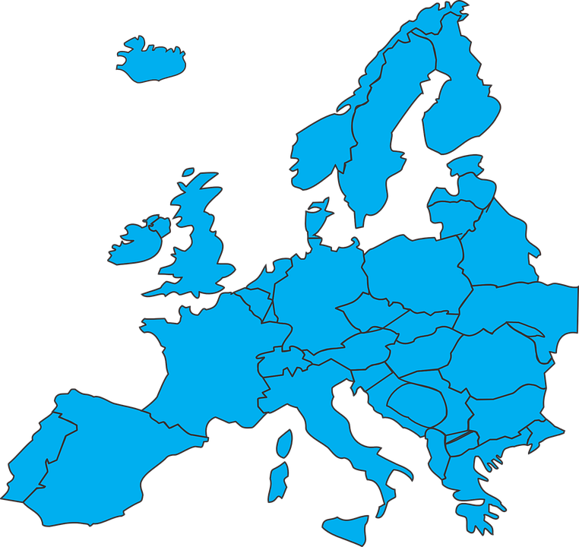
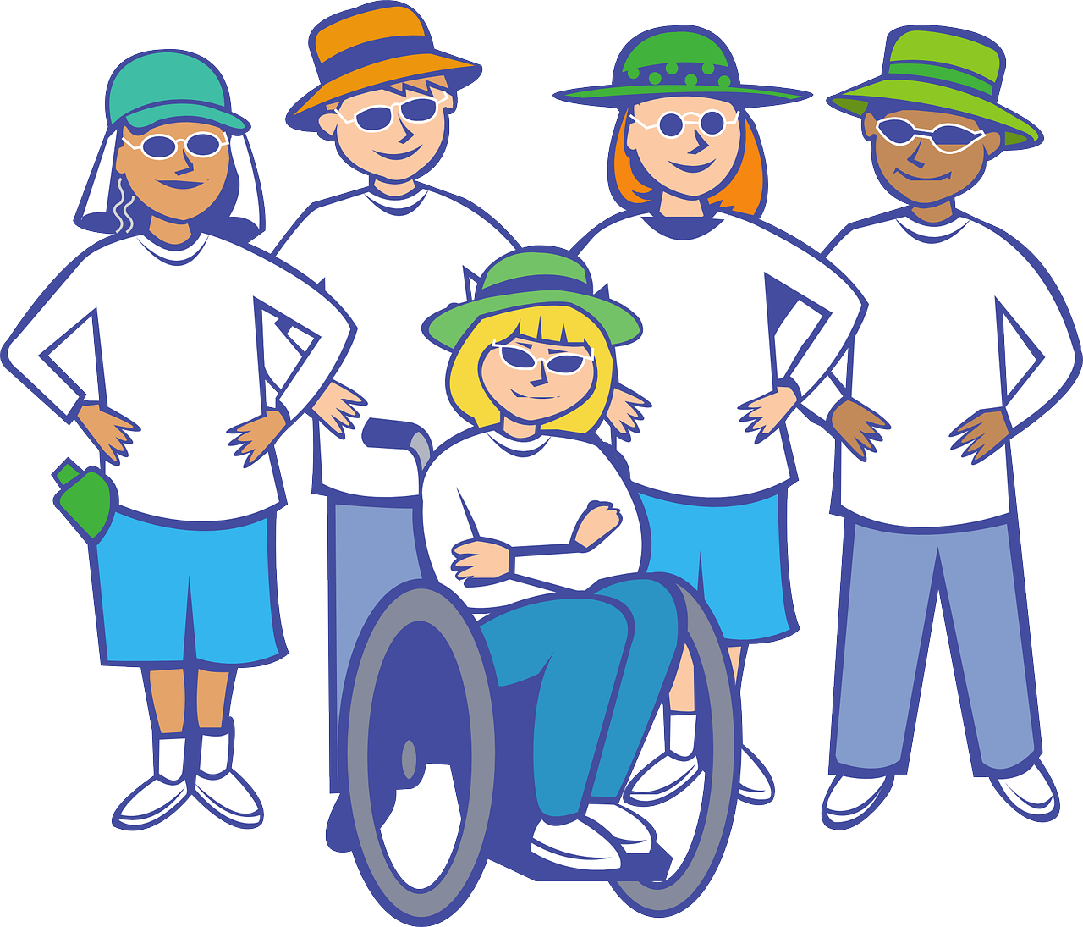
Follow up 1
[au|eu]
Ist das [au] oder [eu]?
A. Hör zu.
Which order are the SSCs in?
der Grand Prix
A: [au]
B: [eu]
aussprechen
Laute | Leute
auch | euch
fauchten | feuchten
Mauten | Meuten
Haut | heut'
schauen | scheuen
rauen | reuen
B. Say these words one after the other as quickly as you can. Your partner will count and check.
1
B-A
2
A-B
3
B-A
Europa
Baum
Leute
braun
4
B-A
90
[expensive]
[clean]
5
A-B
teuer
Haus
neunzig
sauber
6
B-A
[joy]
[to dive]
[your (pl)]
euer
traurig
Freude
tauchen
7
A-B
Flugzeug
bauen
Feuer
Mauer
Notes:
Timing: 5 minutes
Aim: to practise aural recognition and pronounciation of this week’s SSC [au/eu]
Procedure:
Click to play the audio of the paired words. In task A, pupils write down the order in which they hear the SSCs – e.g. 1. Leute (B) is said first followed by Laute (A) so the answer would be B – A.
Click to reveal the answer.
Click to bring up task B.
Pupils apply their phonics knowledge to read aloud these words alternating between [au] and [eu].The listening partner can send his/her partner back to the start if s/he hears the [au/eu] pronounced with English pronunciation.
Teacher circulates to listen and support, as needed.
Pupils swap roles.
Transcript
Leute, Laute (people, lute)
auch, euch (also, you (all))
feuchten, fauchten (to wet, to hiss – past tense form)
Meuten, Mauten (mobs, tolls)
Haut, heut- (skin, today – (heut' is sometimes used in dialect and proverbs as a shortening of heute))
scheuen, schauen (to dread, to look)
rauen, reuen (to roughen, to regret)
Grand Prix translations
Europa – Europe; Baum – tree; Leute – people; braun – brown
teuer – expensive; Haus – house; neunzig – 90; sauber – clean
euer – your (pl); traurig – sad; Freude – joy; tauchen – to dive
Flugzeug – aeroplane; bauen – to build; Feuer – fire; Mauer - wall
Vocabulary:
Laute [N/A] Leute [224] auch [18] euch [495] fauchten [N/A] feuchten [N/A] Maut [N/A] Meute [N/A] Haut [1149] Heute [116] schauen [510] scheuen [N/A] rauen [N/A] reuen [N/A]
braun [2320] teuer [950] neunzig [3028] sauber [2026] euer [1309] traurig [1752] Freude [1286] tauchen [1581] Flugzeug [1776] bauen [667] Feuer [1576] Mauer [1659]
Jones, R.L & Tschirner, E. (2019). A frequency dictionary of German: Core vocabulary for learners. London: Routledge.

Slide 5
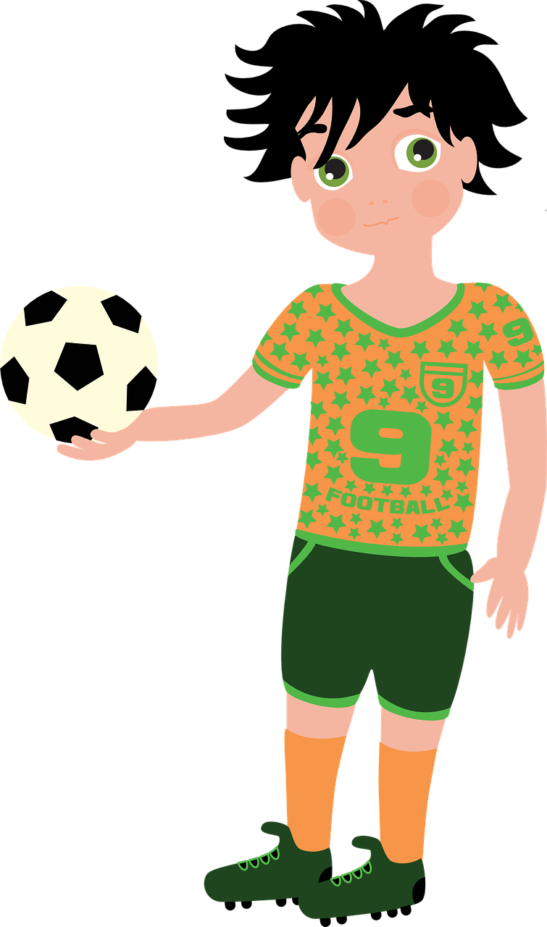
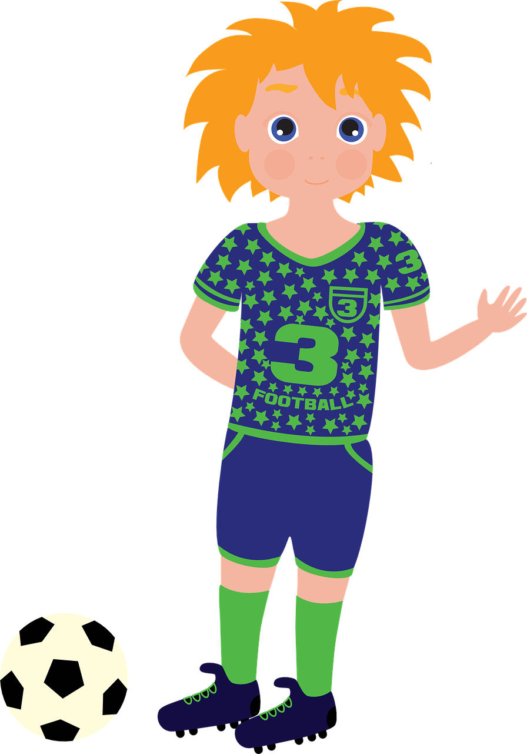
Follow up 2
Help them sort out the questions for the footballer (you formal) from the questions about the students at the football academy (they).
Lies die Fragen.
Die Schüler haben ein Problem!
B
Spielen sie jeden Tag* Fußball?
lesen
jeden Tag – every day
B. Do they play football every day?
1
2
Spielen Sie in vielen Ländern Fußball?
Machen Sie viel Sport?
3. Do they sing football songs?
6. Do they also play in cold weather?
3
4
Singen sie Fußballsongs?
Finden Sie alle Schüler freundlich?
1. Do you play football in many countries?
2. Do you do a lot of sport?
5
6
4. Do you find all the students friendly?
Mögen Sie das Essen in der Schule?
Spielen sie auch bei* kaltem Wetter?
bei - in
5. Do you like the food in the school?
Notes:
Timing: 5 minutes
Aim: to practise written distinction between Sie (you formal) and sie (they) in present tense questions.
Procedure:
Click to bring up the instructions.
Pupils read the questions on the post-it notes and decide whether the question is for the teacher (you formal) or about the students at the football academy (they).
Elicit who each question is for.
Click to bring up the answer.
Continue for items 1-6.
Vocabulary:
jeden Tag [N/A] bei [29]
Jones, R.L & Tschirner, E. (2019). A frequency dictionary of German: Core vocabulary for learners. London: Routledge.

Slide 6
Follow up 3
Hör zu. Ist die Frage für den Schüler (du) oder für den Fußballspieler (Sie)?
hören
Wie heißt die Frage auf Englisch?
B
Do you visit many schools?
1
Do you like this school?
2
Do you live in Biel?
3
Do you love books?
4
Do you take a football with you to school?
How do you find/What do you think of the art project?
5
6
Do you do lots of projects?
Notes:
Timing: 5 minutes
Aim: to practise distinguishing between du and Sie, and to practise previously learnt vocabulary in a sentence translation task.
Procedure:
Explain that the scenario from the lesson continues – the students have more questions! They decide to ask either the student from the football academy (du) or the footballer (Sie). Pupils decide which one they hear.
Click to hear the example.
Elicit answer, click for answer tick.
Elicit English translation, click to reveal written form.
Continue for items 1-6.
Transcript:
Beispiel. Besuchst du viele Schulen?
1. Magst du diese Schule?
2. Wohnen Sie in Biel?
3. Lieben Sie Bücher?
4. Nimmst du einen Fußball mit in die Schule?
5. Wie finden Sie das Kunstprojekt?
6. Machst du viele Projekte?

Slide 7
Follow up 4:

Can you get at least 15 points?
Schreib auf Englisch
Wörter
 | der Satz | alles | der Käse
 | die Blume | die Kultur | der See, die Seen
 | dort | das Dorf | liegen
 | das Meer | das Wetter | der Berg
 | finden | Sie | die Kunst
 | der Müll | das Projekt
(the) sentence
everything
(the) cheese
Vokabeln
x3
(the) flower
(the) culture
(the) lake, (the) lakes
there
(the) village
to lie, to be located
x2
(the) sea
(the) weather
(the) hill, mountain
to find, finding
you (formal)
(the) art
x1
(the) rubbish
(the) project
Notes:
Timing: 5 minutes
Aim: to practise written production of vocabulary from this and revisited weeks.
Procedure: 1. Give pupils a blank grid. They fill in the English meanings of any of the words they know, trying to reach 15 points in total. 2. Remind pupils that adjectives can refer to male or female persons and they should note this in their translations. E.g. pleased (f), short (m).
Note: The most recently learnt and practised words are pink, words from the previous week are green and those from week 1 are blue, thus more points are awarded for them, to recognise that memories fade and more effort (heavy lifting!) is needed to retrieve them.

Slide 8
Follow up 4:

Can you get at least 15 points?
Schreib auf Deutsch.
Wörter
 | (the) cheese | (the) culture | (the) lake, (the) lakes
 | everything | (the) flower | (the) sentence
 | (the) village | (the) sea | (the) hill, mountain
 | (the) weather | there | to lie, to be located
 | you (formal) | (the) project | to find, finding
 | (the) art | (the) rubbish
der Käse
die Kultur
der See, die Seen
Vokabeln
x3
alles
die Blume
der Satz
das Dorf
das Meer
der Berg
x2
das Wetter
dort
liegen
Sie
das Projekt
finden
x1
die Kunst
der Müll
Notes:
Timing: 5 minutes
Aim: to practise written production of vocabulary from this and revisited weeks.
Procedure: 1. Give pupils a blank grid. They fill in the German meanings of any of the words they know, trying to reach 15 points in total. 2. Remind pupils that adjectives can refer to male or female persons and they should note this in their translations. E.g. pleased (f), short (m).
Note: The most recently learnt and practised words are pink, words from the previous week are green and those from week 1 are blue, thus more points are awarded for them, to recognise that memories fade and more effort (heavy lifting!) is needed to retrieve them.

Slide 9
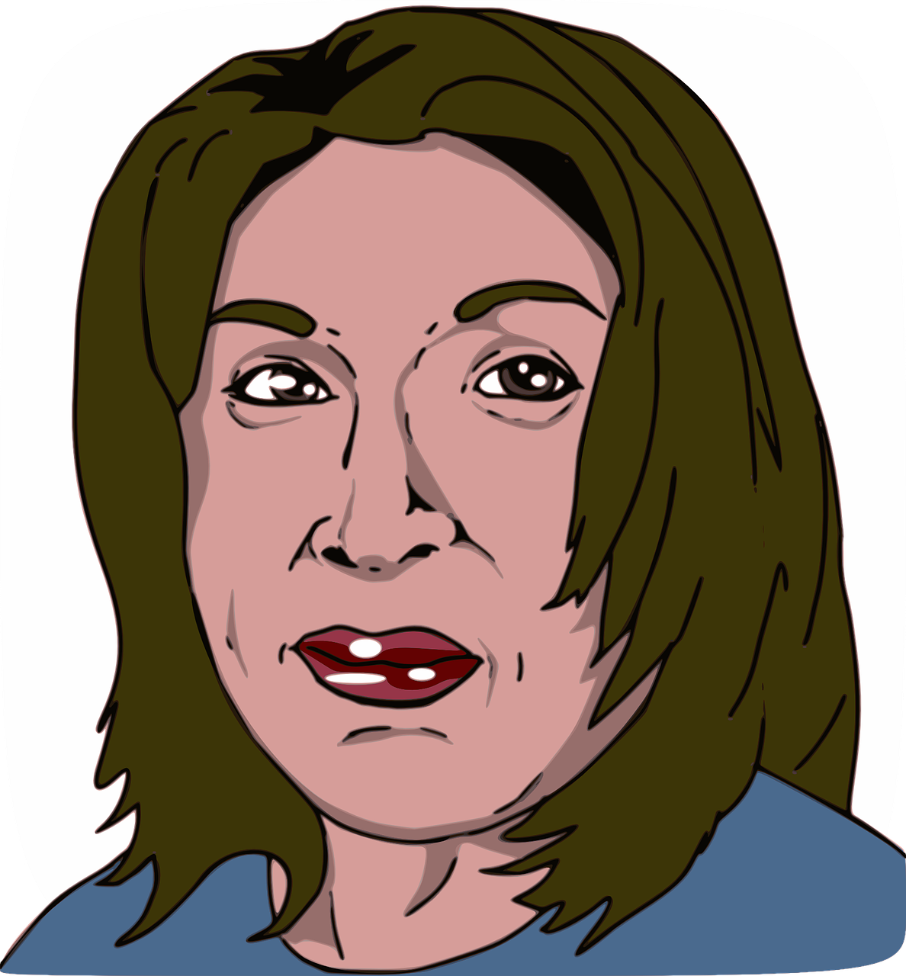
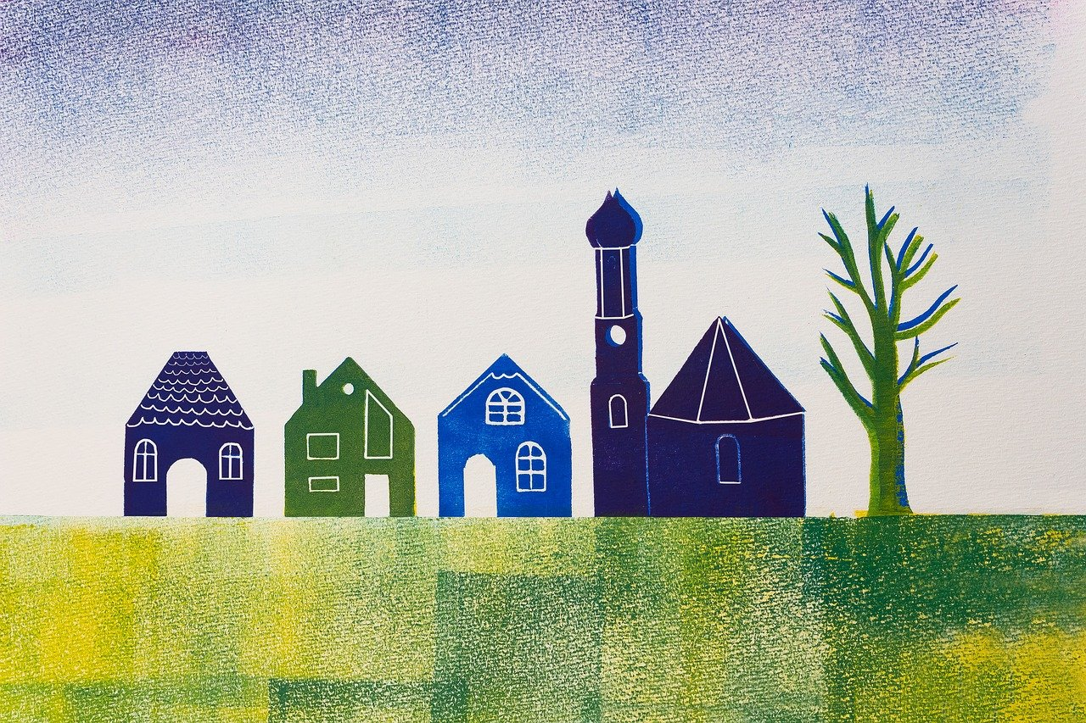
Follow up 5
Rede mit deinem Partner/deiner Partnerin.
Ba
Bb
Person A: Finden Sie das Projekt toll?
sprechen
Person B: Das ist eine Frage für den Fußballspieler.
Person A: Ja, richtig!
der Fußball-
spieler
der Schüler
[(the) project]
1a
1b
2a
2b
3a
3b
Ronja
Herr Weber
Lias
Herr Neumann
Frau Braun
Gabriel
[art]
[cheese]
[(the) sea]
4a
4b
5a
5b
6a
6b
Jana
[(the) lake]
Doktor Bauer
[(the) weather]
Frau Kraus
Olivia
Mariem
Frau Baumann
[(the) village]
Notes:
1/2
Timing: 6 minutes
Aim: to practise using and identifying du and Sie as appropriate in a speaking task.
Procedure:
Click to bring up the instructions.
Talk pupils through the example. Person A picks either a or b from the example and asks a question. Person B has to identify who the question is for by deciding is it formal (Sie) or informal (du). Note that the characters in 2b, 3a, 4b, 5b and 6a all have names containing ‘au’ or ‘eu’.
When pupils have worked through items 1-6, they will swap roles for a second slide.
Note:
To keep the cognitive load manageable, given that pupils are asking from memory, we would expect that most pupils would use ‘finden’ throughout – just adapting each question for the person (du/Sie) and the noun each time. They could additionally vary the adjective if they want to (e.g., changing ‘toll’ for another appropriate adjective – interessant, gut, schlecht, klein, kalt, etc..)

Slide 10
Follow up 5
Rede mit deinem Partner/deiner Partnerin.
Ba
Bb
Person A: Findest du das Projekt toll?
sprechen
Person B: Das ist eine Frage für den Schüler.
Person A: Ja, richtig!
der Fußball-
spieler
der Schüler
[(the) project]
1a
1b
2a
2b
3a
3b
Ronja
Herr Weber
Lias
Herr Neumann
Frau Braun
Gabriel
[art]
[cheese]
[(the) sea]
4a
4b
5a
5b
6a
6b
Jana
[(the) lake]
Doktor Bauer
[(the) weather]
Frau Kraus
Olivia
Mariem
Frau Baumann
[(the) village]
Notes:
2/2 Pupils swap roles.
NB the example is the only difference between the two slides.

Slide 11
Tschüss!
grün
Notes:
11

Slide 12
Follow up 4:

Schreib auf Englisch.
Can you get at least 15 points?
Wörter
 | der Satz | alles | der Käse
 | die Blume | die Kultur | der See, die Seen
 | dort | das Dorf | liegen
 | das Meer | das Wetter | der Berg
 | finden | Sie | die Kunst
 | der Müll | das Projekt
Vokabeln
Notes:
PRINTOUT

Slide 13
Follow up 4:

Schreib auf Deutsch.
Can you get at least 15 points?
Wörter
 | (the) cheese | (the) culture | (the) lake, (the) lakes
 | everything | (the) flower | (the) sentence
 | (the) village | (the) sea | (the) hill, mountain
 | (the) weather | there | to lie, to be located
 | you (formal) | (the) project | to find, finding
 | (the) art | (the) rubbish
Vokabeln
x3
x2
x1
Notes:
PRINTOUT

