Slide 1
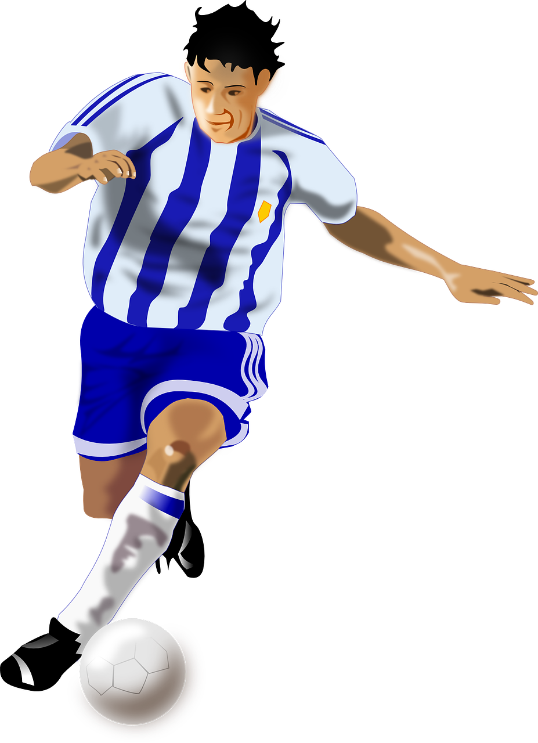
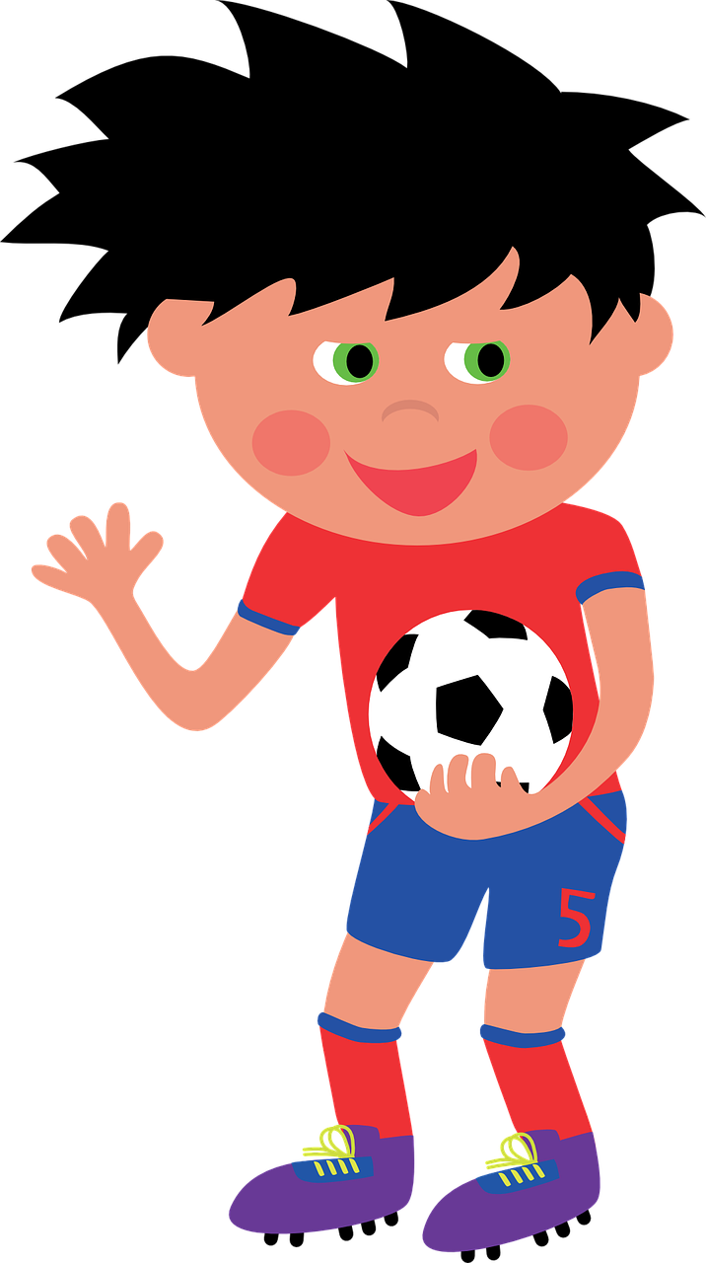
Exploring
Besucher* in der Schule
grün
Using formal ‘you’ (Sie)
Yes/no questions
SSC [au] and [eu]
die Besucher - visitors
Term 2 Week 4
Notes:
Artwork by Steve Clarke. Pronoun pictures from NCELP (www.ncelp.org). All additional pictures selected from Pixabay and are available under a Creative Commons license, no attribution required.
Phonics:
[au] Haus [147] blau [948] laufen [252]
[eu] Deutschland [140] Freund [273] heute [116]
Vocabulary: finden [103] Sie [7] Kunst [554] Müll [4506] Projekt [720]
Revisit 1: liegen [107] Berg [934] Dorf [959] Europa [294] Haus [147] Leute [224] Meer [854] See [1317] Wetter [1881] kalt [887] dort [139]
Revisit 2: alles [36] alle [36] viele [56] Baum [1013] Blume [2463] Buch [300] Essen1 [323] Fußballspieler [n/a] Haus [147] Käse [4094] Kultur [594] Land2 [134] Satz [432] Schule [359] See [1317] Seen [1317] Song [3373] Sport [945]
Jones, R.L & Tschirner, E. (2019). A frequency dictionary of German: Core vocabulary for learners. London: Routledge.
The frequency rankings for words that occur in this PowerPoint which have been previously introduced in these resources are given in the SOW and in the resources that first introduced and formally re-visited those words.
For any other words that occur incidentally in this PowerPoint, frequency rankings will be provided in the notes field wherever possible.
Remember that at the start of the course (first three lessons of Rot/Gelb) pupils learnt language (for greetings and register taking) that can still be part of the lesson routines in upper KS2 (Blau/Grün). They are not re-taught, as we anticipate that teachers have built these in from early in lower KS2.
1

Slide 2
aussprechen
[au]
…
Haus
Notes:
Timing: 1 minute
Aim: to introduce the SSC [au].
Procedure:
Introduce the SSC and present the source word ‘Haus’ (with gesture, if using).
Click to bring on the picture and get pupils to repeat the word ‘Haus’ (with gesture, if using).
Note:
a gesture for ‘Haus’ might be to make a roof above your head with two hands.
2

Slide 3
aussprechen
[au]
…
Haus
[to run, running]
blau
laufen
Notes:
Timing: 1 minute
Aim: to consolidate the SSC [au].
Procedure:
Re-present the SSC and the source word ‘Haus’ (with gesture, if using).
Click to bring on the picture and get pupils to repeat the word ‘Haus’ (with gesture, if using).
Present the cluster words in the same way, bringing on the picture and getting pupils to pronounce the words.
3

Slide 4
aussprechen
[eu]
…
Deutschland
Notes:
Timing: 1 minute
Aim: to introduce the SSC [eu].
Procedure:
Re-present the SSC and the source word ‘Deutschland’
Click to bring on the picture and get pupils to repeat the word ’Deutschland’

Slide 5
aussprechen
[eu]
…
[today]
[friend]
Freund
heute
Deutschland
Notes:
Timing: 1 minute
Aim: to consolidate the SSC [eu].
Procedure:
Re-present the SSC and the source word ‘Deutschland’
Click to bring on the picture and get pupils to repeat the word ’Deutschland’
Present the cluster words in the same way, bringing on the picture and getting pupils to pronounce the words.

Slide 6
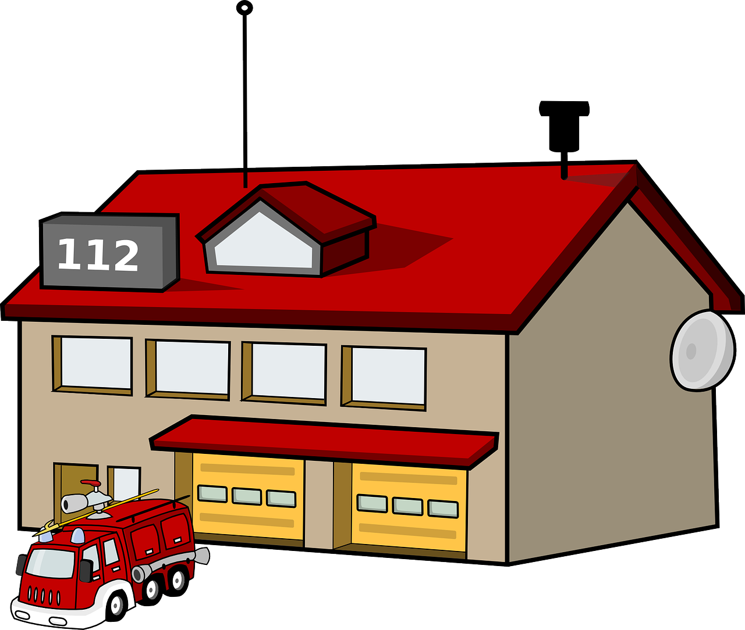
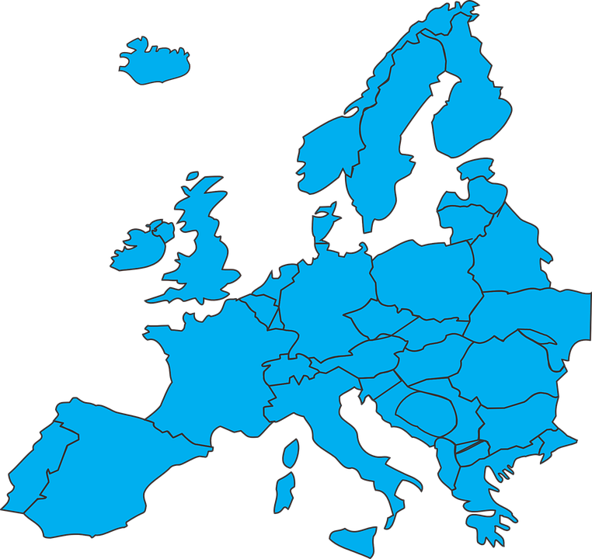
das Feuerwehrhaus – fire station
haustierfreundlich – pet friendly
Hör zu.
Schreib 1-8 und das Wort. Ist es mit [au], [eu] oder [au] und [eu]?
1. L_ _ te
grau
Leute
6. _ _fgabe
2. gr_ _
Freundin
brauchen
9
Feurwehrhaus*
7. n_ _n
eu
au
3. br_ _ chen
haustierfreundlich*
8. _ _ ropa
9
Frau
neun
4. Fr_ _ ndin
9. Fr_ _
Aufgabe
Europa
5. F_ _erwehrh_ _ s
10. h_ _stierfr_ _ ndlich
Notes:
Timing: 5 minutes
Aim: to practise recognising aurally the SSCs [au] and [eu].
Procedure:
Click to bring up instructions. Pupils write down 1-8 and will write the full word with [eu] or [au], based on what they hear.
Click the audio button for item 1 to hear the first word, elicit the answer from pupils and click to display answer.
Repeat for items 2-10.
Note: encourage pupils to notice the words that make up haustierfreundlich (pet friendly): Haus (house), Tier (animal) / Haustier (pet), freundlich (friendly)
Transcript:
Leute
grau
brauchen
Freundin
Feurwehrhaus
Aufgabe
neun
Europa
Frau
haustierfreundlich
Word frequency (1 is the most frequent word in German): Leute [224] grau [1560] brauchen [179] Frau [99] Feuerwehrhaus – Feuerwehr [3778] & Haus [147] Aufgabe [256] neun [1053] Europa [294] Freundin - Freund [273] haustierfreundlich – Haus [147] & Tier [614] & freundlich [1566]
Source: Jones, R.L. & Tschirner, E. (2019). A frequency dictionary of German: core vocabulary for learners. Routledge

Slide 7
Vokabeln
Sag die Wörter auf Deutsch. Was ist das auf Englisch?
Wörter
die Kunst
sie with small ‘s’ can mean ‘she’ or ‘they’. Sie with capital ‘s’ means ‘you’ to an adult you don’t know well.
[(the) art]
finden
der Müll
[to find, finding]
[(the) rubbish]
Sie
[you (formal)]
das Projekt
[(the) project]
Notes:
[1/3]
Timing: 3 minutes
Aim: to introduce new vocabulary.
Procedure 1. Pupils either work by themselves or in pairs, reading out the words and recapping their English meaning (1 minute). When you come to the last item, Sie, click to bring up callout to explain the difference between sie (she/they) and Sie (you formal). Explain that the handshaking image signifies formality by shaking hands. 2. Then, on the next slide, students try to recall the English orally (chorally), looking at the German (1 minute). 3. Then, on the following slide, they to recall the German meanings orally (again, chorally), looking at the English (1 minute).
Notes:
Note that images/words won’t disappear and appear in this activity as in previous resources.
7

Slide 8
Vokabeln
Sag die Wörter auf Deutsch. Was ist das auf Englisch?
Wörter
(the) art
(the) a _ _
die Kunst
t_ f_ _ _ , f_ _ _ _ _ _
to find, finding
finden
(the) r _ _ _ _ _ _
(the) rubbish
der Müll
y_ _
(formal)
you (formal)
Sie
(the) p _ _ _ _ _ _
(the) project
das Projekt
Notes:
[2/3]
Procedure: 1. Students try to recall the English orally (chorally), looking at the German (1 minute). 2. Elicit answers and click to reveal
3. Then, in the following slide, they to recall the German meanings orally (again, chorally), looking at the English (1 minute).
8

Slide 9
Vokabeln
Sag die Wörter auf Deutsch. Was ist das auf Englisch?
Wörter
(the) art
die Kunst
d_ _ K_ _ _ _
to find, finding
finden
f _ _ _ _ _
(the) rubbish
d_ _ M_ _ _
der Müll
you (formal)
S_ _
Sie
(the) project
d_ _ P_ _ _ _ _ _
das Projekt
Notes:
[3/3]
Procedure: 1. Students recall the German meanings orally (again, chorally), looking at the English (1 minute)
2. Click to reveal the answers.
9

Slide 10
Using Sie to mean ‘you’
You already know du and ihr mean you:
In English, we usually say ‘Do you think that the art is great?’
Kultur
e
Findest du die Kunst toll?
Do you _{[one person]} find the art great?
Add ‘e’ to make these parts of finden easier to say: du findest er, sie, es findet ihr findet
e
Findet ihr das Projekt schwer?
Do you _{[all|both]} find the project difficult?
Use Sie to mean you to any adult or adults you don’t know well:
Finden Sie oft Müll in der Schule?
With Sie, the verb form is the same as the infinitive.
Do you _{[formal]} often find rubbish in the school?
Notes:
Timing: 2 minutes
Procedure:
Click through the animations to present the new information.
Elicit English translation for the German examples provided.
10

Slide 11
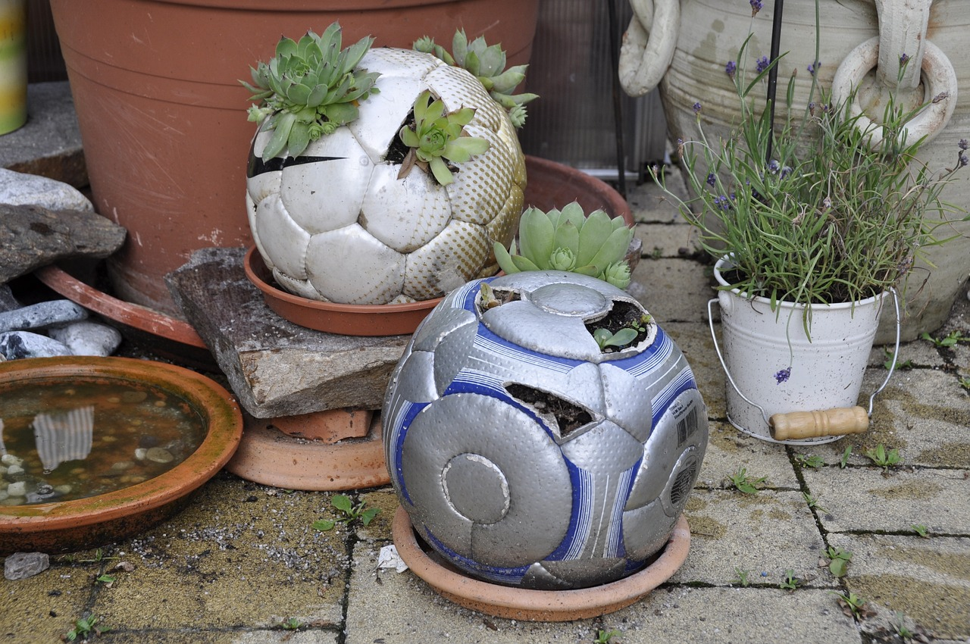
lesen
Ein Fußballspieler und ein Schüler von der Fußballschule besuchen die Klasse.
Das ist mein Kunstprojekt. Ich benutze den Müll in der Fußballschule!
Notes:
Timing: 1 minute
Aim: to introduce the context for the next activity.
Procedure:
Explain the context: a footballer and a student from a football academy have come to visit the class to talk about their interesting project – upcycling football-related rubbish, e.g. footballs and using them to create art and useful objects such as flower pots and bags.
Elicit the meaning of what the student is saying (This is my art project. I use the rubbish in the football school).
11

Slide 12
lesen
Kunst aus* Müll - das Kunstprojekt
aus - from
Ist die Frage für den Fußballspieler oder den Schüler?
B.
Wie finden Sie das Projekt?
1. Do you get lots of ideas?
1
Bekommst du viele Ideen?
2. Do you think that football academy/school is great?
2
Findest du die Fußballschule toll?
4. Do you find lots of old footballs?
3
Wo finden Sie den Müll?
B. How do you find the project?
4
Findest du viele alte Fußbälle?
3. Where do you find the rubbish?
5
Lieben Sie Kunst?
5. Do you love art?
6
Verkaufen Sie die Sachen?
6. Do you sell the things?
Notes:
Timing: 8 minutes
Aim: to practise written comprehension of du and Sie questions, connecting form and meaning.
Procedure:
Read through the scenario and instruction. As the students in the class were watching the presentation by the footballer and the football academy student, they write down questions to ask. Are the questions for the footballer or the student?
Read the example with pupils. Teachers asks: Ist die Frage für den Fußballspieler (Sie) oder für den Schüler (du)? They say ‘Fußballspieler ’ or ‘Schüler’.
Click to bring up the person’s icon next to the question.
Teacher asks: Wie heißt die Frage auf Englisch? and elicits pupils’ response.
Click to reveal the question’s English meaning in the correct person’s box on the right hand side of the slide.
12

Slide 13
hören
Der Fußballspieler und der Schüler stellen Fragen.
Remember! The verb ending for ihr (you all) is –(e)t.
Hör zu. Ist die Frage für die Klasse oder für Herrn Weber?
Schreib die Frage auf Englisch.
die Webseite von – the website of / _’s website
B
Do you also make art out of rubbish?
1
Do you have a lot of rubbish?
2
Do you need ideas for an art project?
3
Do you know the football academy’s website?
4
Do you play football?
5
When do you visit/are you visiting the football academy?
6
Do you get money for the art project?
When do you organise/are you organising the project?
7
Notes:
Timing: 5 minutes
Aim: to practise aural comprehension of ihr and Sie questions, connecting form and meaning.
Procedure:
Explain the scenario. The football player and the student decide to ask either Herr Weber or all the pupils in the class, so they need the ihr form or the Sie form.
Click to bring up callout to remind pupils of the meaning of ‘ihr’. Click to disappear callout.
Click to hear the example.
Elicit answer, click for answer tick.
Elicit German meaning, click to reveal written form.
Continue for items 1-7.
Transcript:
B. Macht [ihr] auch Kunst aus Müll?
Haben [Sie] viel Müll?
Braucht [ihr] Ideen für ein Kunstprojekt?
Kennen [Sie] die Webseite von* der Fußballschule?
Spielt [ihr] oft Fußball?
Wann besucht [ihr] die Fußballschule?
Bekommen [Sie] Geld für das Kunstprojekt?
Wann organisieren [Sie] das Projekt?
13

Slide 14
Tschüss!
Tschüss!
Don’t forget this more formal way to say Goodbye!
Auf Wiedersehen!
grün
Notes:
14

