Slide 1
Exploring
Sportfest!
grün
Follow ups 1-5
Term 2 Week 5
Notes:
Artwork by Steve Clarke. Pronoun pictures from NCELP (www.ncelp.org). All additional pictures selected from Pixabay and are available under a Creative Commons license, no
attribution required.
Phonics:
[äu] Häuser [Haus-147] Mäuse [Maus-3463] träumen [1793] vs. [au] and [eu]
Vocabulary: kaufen [506] laufen [252] machen [58] Rad fahren [n/a] tragen [271] (Sport)Kleidung [2820]
Jones, R.L & Tschirner, E. (2019). A frequency dictionary of German: Core vocabulary for learners. London: Routledge.
Revisit1: benutzen [1119] brauchen [179] lernen [288] machen [58] singen [1063] spielen [205] Computer [1252] Fußball [1277] Opa [2776] Song [3373] normalerweise [2062] zu Hause [n/a]
Revisit am + days of the week (am Montag) and adverbs (montags)
Revisit2: geben [49] Blume [2463] Foto [633] Fahrrad [2138] Fußball [1277] Geschichte [262] Gitarre [n/a] Haus [147] Katze [2235] Papier [1163] Spiel [328] Tisch [529] Zug [675]
The frequency rankings for words that occur in this PowerPoint which have been previously introduced in these resources are given in the SOW and in the resources that first
introduced and formally re-visited those words.
For any other words that occur incidentally in this PowerPoint, frequency rankings will be provided in the notes field wherever possible.
Remember that at the start of the course (first three lessons of Rot/Gelb) pupils learnt language (for greetings and register taking) that can still be part of the lesson routines in upper KS2 (Blau/Grün). They are not re-taught, as we anticipate that teachers have built these in from early in lower KS2.

Slide 2
aussprechen
[au]
…
Haus
Notes:
Timing: 1 minute
Aim: to introduce the SSC [au].
Procedure:
Introduce the SSC and present the source word ‘Haus’ (with gesture, if using).
Click to bring on the picture and get pupils to repeat the word ‘Haus’ (with gesture, if using).
Note:
a gesture for ‘Haus’ might be to make a roof above your head with two hands.
Frequency: Haus [147] Jones, R.L & Tschirner, E. (2019). A frequency dictionary of German: Core vocabulary for learners. London: Routledge.
2

Slide 3
aussprechen
[äu]
…
Häuser
Notes:
Timing: 1 minute
Aim: to introduce the SSC [äu].
Procedure:
Introduce the SSC. Click to bring up callout to explain that it is the same sound as [eu], which they already know (e.g. Deutschland).
Present the source word ‘Häuser’ (with gesture, if using). A callout to explain that it is the plural of Haus comes up at the same time.
Click to bring on the picture and get pupils to repeat the word ‘Häuser’ (with gesture, if using).
Note:
a gesture for ‘Haus’ might be to make a roof above your head with two hands, and then do it again to indicate plural.
Frequency:
Häuser [Haus-147]
Jones, R.L & Tschirner, E. (2019). A frequency dictionary of German: Core vocabulary for learners. London: Routledge.
3

Slide 4
Follow up 1
Partnerarbeit! Partner A turns away, Partner B reads out sentences 1-4. A translates, B corrects. Then swap roles for 5-8.
Hör zu und schreib das Verb auf Deutsch.
hören
Du t r ä g s t Sportkleidung am Sportfest.
1
_ _ _ _ _ _
You wear sports clothes for sports day.
t r ä g s t
2
Du s p r i c h s t Deutsch in der Schule.
Geben and sprechen change e → i
_ _ _ _ _ _ _ _
Geben and sprechen change e → i.
s p r i c h s t
You speak German in school.
_ _ _ _ _
He sells old clothes.
3
Er k a u f t neue Sportkleidung
k a u f t
4
Sie b r i n g t Spiele für das Sportfest.
She brings games for sports day.
_ _ _ _ _ _
b r i n g t
_ _ _ _ _
I carry bags for the teachers on sports day.
5
Ich t r a g e am Sportfest Taschen für die Lehrer.
t r a g e
No stem change for kaufen/verkaufen!
No stem change for kaufen!
6
_ _ _ _ _ _
k a u f s t
Du k a u f s t Blumen für das Sportfest.
You buy flowers for sports day.
_ _ _ _ _
She cycles in the group.
Sie f ä h r t Rad in der Gruppe.
7
f ä h r t
8
Er m a c h t immer Fotos am Sportfest .
He always takes (“makes”)photos on sports day.
_ _ _ _ _
m a c h t
Notes:
Timing: 8 minutes
Aim: to practise this week’s vocabulary and grammar focus in a verb transcription, read-aloud and comprehension task.
Procedure:
Click on the first audio button to play the recording of the verb from. Pupils transcribe the verb form.
Continue for items 2-8.
Click for next instructions. Partner A turns away from the board and partner B reads out the German sentences 1-4. Partner A translates the German sentence. B corrects if necessary.
Then swap roles. Once Partner B has turned away from the board, click for sentences 5-8.
Note: in the audio version, click on the German sentences to hear them pronounced, as required.
Transcript 1. trägst
2. sprichst
3. kauft
4. bringt
5. trage
6. kaufst
7. fährt
8. macht

Slide 5
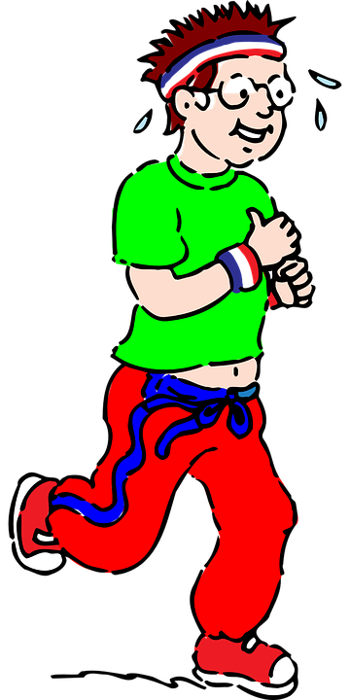
Present tense: strong verbs a→ ä
In German, strong verbs change the stem vowel in the er/sie/es form and also the du form:
Ich laufe.
I run/am running.
Du läufst.
You run/are running.
Sie läuft.
She runs/is running.
All plural forms (you all, we, they) keep the original vowel, like ich:
Ihr lauft.
You (all) run/are running.
Notes:
Timing: 3 minutes
Aim: to introduce that the ihr-form (second person plural) for strong verbs which change a→ä in the second person singular always keep the original vowel ‘a’.
Procedure:
Click through the animations to present the information.
Elicit English translation for the German examples provided.
5

Slide 6
Follow up 2
Is Moritz asking about Ronja (she-sie) or asking Lias about him and Ronja (you both (ihr)?
Lies die Fragen.
Moritz wants to know more from Lias about sports day.
B
Esst ihr Eis am Sportfest?
sie (she)
lesen
3. What does she give as prizes? Flowers or cakes?
1
2
Sprecht ihr Englisch oder Deutsch für den Tag?
Tragt ihr immer Sportkleidung?
4. Is she running for two hours?
6. Is she also wearing sports clothes for the concert?
3
4
ihr (you both)
Was gibt sie für Preise? Blumen oder Kuchen?
Läuft sie zwei Stunden lang?
B. Do you both eat ice cream on sports day?
1. Are you both speaking English or German for the day?
5
6
2. Do you both always wear sports clothes?
Gebt ihr ein Konzert am Sportfest?
Trägt sie auch Sportkleidung für das Konzert?
5. Are you both giving a concert on sports day?
Gewinner - winner
Notes:
Timing: 5 minutes
Aim: to identify the distinction between strong verb verbs a→ ä and e → i in the 3rd person singular (she) and 2nd person plural (ihr).
Procedure:
Click to bring up the instructions.
Pupils decide, based on the verb form, whether Moritz is asking Lias about sie (Ronja) or ihr (Lias and Ronja).
Click in turn to bring up the translation in the correct box.

Slide 7
Follow up 3:

Schreib auf Englisch.
Can you get at least 15 points?
Wörter
 | das Fahrrad | die Katze | die Gitarre
 | der Zug | das Spiel | das Papier
 | am Montag | dienstags | lernen
 | benutzen | brauchen | spielen
 | kaufen | laufen | machen
 | Rad fahren | tragen | Sportkleidung
Vokabeln
(the) bicycle, bike
(the) cat
(the) guitar
x3
(the) train
(the) game
(the) paper
on Monday
Tuesdays
to learn, learning
x2
to use, using
to need, needing
to play, playing
to do, make, doing, making
to buy, buying
to run, running
to wear, carry,
wearing, carrying
x1
to cycle, cyling
sports clothes
Notes:
Timing: 5 minutes
Aim: to practise written comprehension of vocabulary from this and revisited weeks.
Procedure: 1. Give pupils a blank grid. They fill in the English meanings of any of the words they know, trying to reach 15 points in total.
Note: The most recently learnt and practised words are pink, words from the previous week are green and those from week 1 are blue, thus more points are awarded for them, to recognise that memories fade and more effort (heavy lifting!) is needed to retrieve them.

Slide 8
Follow up 3:

Schreib auf Deutsch
Can you get at least 15 points?
Wörter
 | (the) cat | (the) paper | (the) train
 | (the) game | (the) guitar | (the) bicycle, bike
 | to learn, learning | to use, using | to need, needing
 | Tuesdays | to play, playing | on Monday
 | sports clothes | cycle, cycling | to wear, carry, wearing, carrying
 | to run, running | to do, make, doing, making | to buy, buying
Vokabeln
die Katze
das Papier
der Zug
x3
das Spiel
die Gitarre
das Fahrrad
lernen
benutzen
brauchen
x2
dienstags
spielen
am Montag
tragen
Sportkleidung
Rad fahren
x1
laufen
machen
kaufen
Notes:
Timing: 5 minutes
Aim: to practise written comprehension of vocabulary from this and revisited weeks.
Procedure: 1. Give pupils a blank grid. They fill in the German meanings of any of the words they know, trying to reach 15 points in total.
Note: The most recently learnt and practised words are pink, words from the previous week are green and those from week 1 are blue, thus more points are awarded for them, to recognise that memories fade and more effort (heavy lifting!) is needed to retrieve them.

Slide 9
Follow up 4

Verb and subject stay together in German.
After time adverb swap verb and subject!
Schreib die Wörter auf Deutsch und auf Englisch.
Am Sportfest _________ ___ Fotos.
___ _____ ______________ Blumen für Preise.
Meine Freundin ____ ___ ______ ________ auf dem Kopf.
Mein Freund fährt ______ Rad für eine Stunde.
Sie tragen _____________ auch für das _________ .
schreiben
________________ I am taking (making) ________.
I normally give ________ for _________.
___ _______ is running with a football __ _________ ______.
My friend always _______ ___ ____ ____.
____ ____ ________ sports clothes ______ for the concert.
On sports day
mache ich
photos
Ich gebe normalerweise
flowers
prizes
läuft mit einem
My friend
Fußball
on the (her) head
immer
cycles
for one hour
Sportkleidung
They are wearing
Konzert
also
Notes:
Timing: 5-10 minutes
Aim: to practise written production of this week’s new vocabulary and written comprehension of other new and revisited vocabulary.
This is a jigsaw translation task.
Procedure:
Click to remind pupils about Word Order 2 and that the verb and subject always stay together in German (compare with English where we often split them around the adverb – I sometimes give).
Pupils write the missing words in both German and English to complete the sentences.
Teacher clicks to provide the written answers and/or clicks the audio buttons to hear the full German sentences.
Differentiation: 1. For a different challenge (i.e. to practise spelling rather than full written recall of the missing German words), the task could be completed as a transcription task initially, by listening to the full sentences and writing the words.
2. Then pupils could complete the English part of the jigsaw.

Slide 10
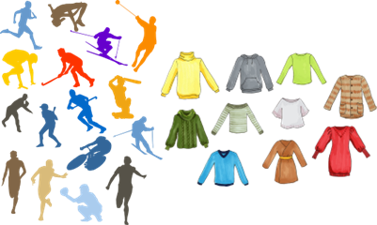
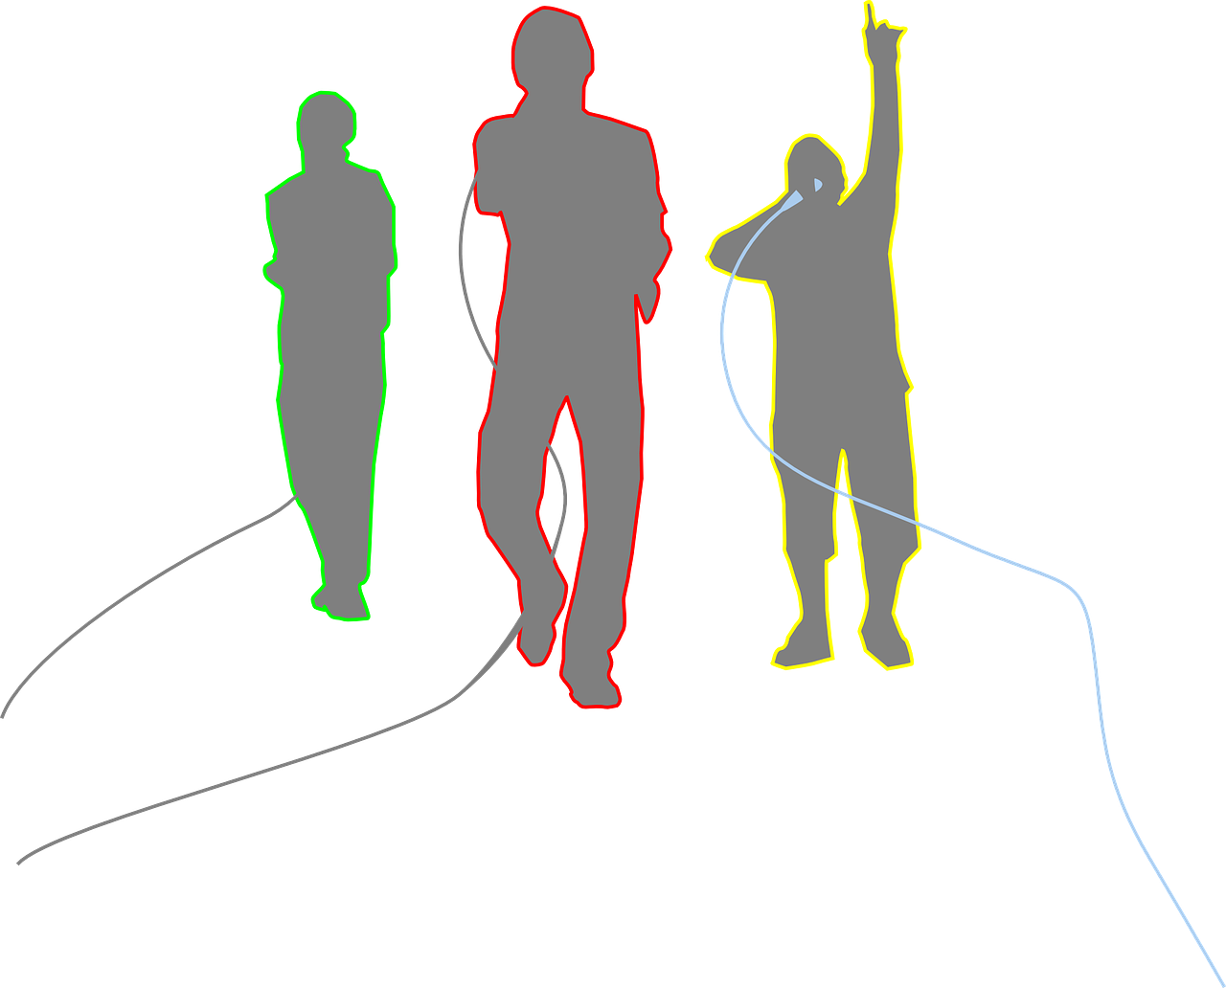
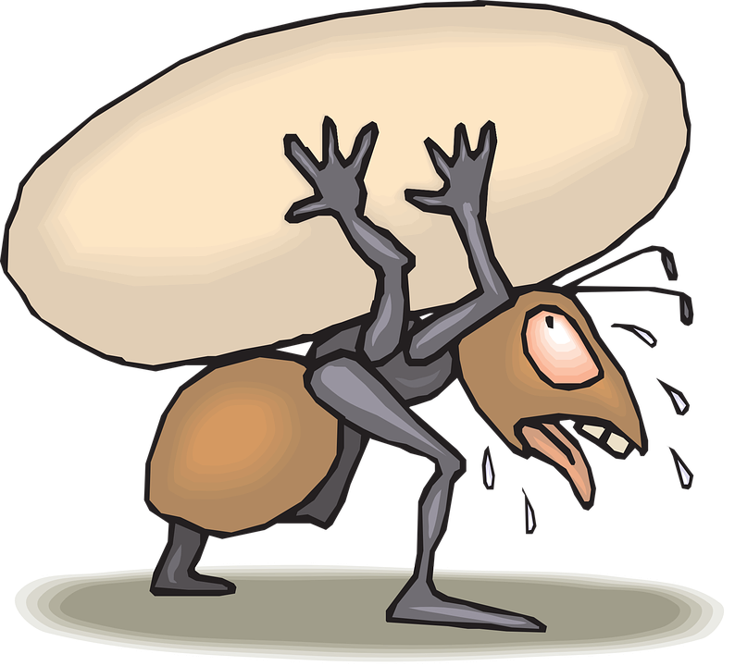
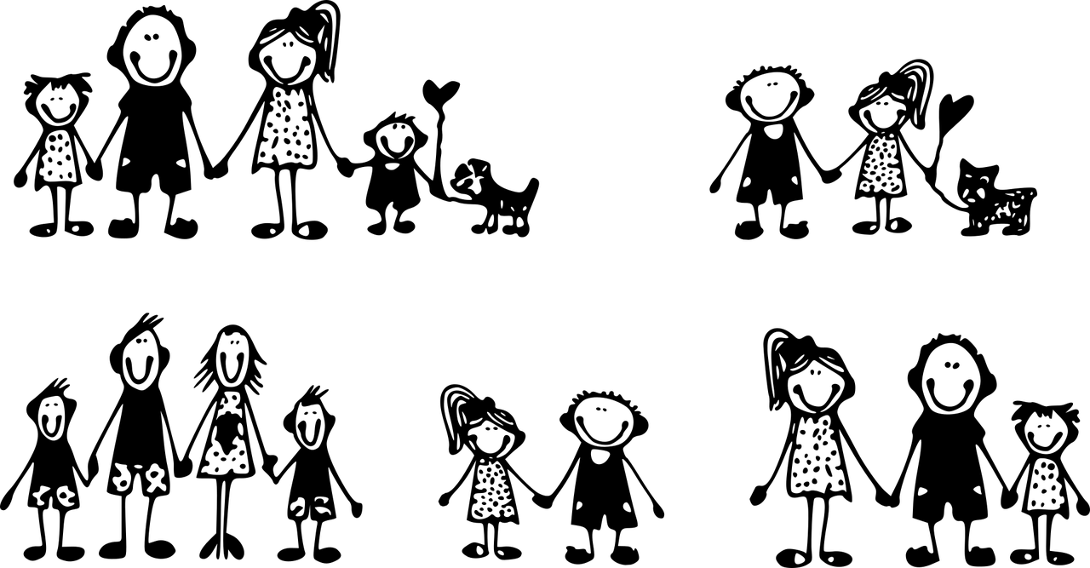
Follow up 5:

Schreib auf Deutsch. Dann sprich auf Deutsch.
Choose three images. Write a sentence choosing either er or sie to describe each one.
Say your sentences. Your partner will try to draw the images. Swap roles.
schreiben
1
2
3
sprechen
3
4
5
6
5KM
Beispiel: Sie trägt Sportkleidung in der Schule.
8
9
7
Notes:
Timing: 5-10 minutes
Aim: to practise oral production of sentences with strong verbs in the 3rd person singular.
Procedure:
The idea here is to describe what normally happens on sports day.
Pupils have approximately three minutes to choose three images from the screen and plan one sentence to describe each. They must keep their choices and sentences hidden from their partners. Note: explain that the gender symbol means they choose either er or sie – trying to get away from the ideal that short hair = boy, longer hair = girl.
Click for the Beispiel sentence – number 3. If needed, give some more examples (you can use the example sentences below).
Once the preparation time is over, click to cover the pictures on the screen.
Pupils then take it in turns to read their sentences to their partner, who attempts to draw the images being described. When the partner draws ‘he’ or ‘she’ they could use the correct gender symbol or annotate their picture with ‘she’ or ‘he’.
Click to reveal the images on screen again for pupils to compare their drawings.
Example sentences: 1. Er/Sie kauft Kuchen. 2. Er/Sie bringt Blumen für Preise.
3. Er/Sie trägt Sportkleidung in der Schule. 4. Er/Sie gibt ein Konzert.
5. Er/Sie trägt Taschen für die Lehrer. 6. Er/Sie läuft fünf Kilometer.
7. Er/sie läuft mit einem Fußball auf dem Kopf. 8. Er/Sie fährt Rad in der Gruppe.
9. Er/Sie macht Fotos für die Eltern.

Slide 11
Tschüss!
Tschüss!
Don’t forget this more formal way to say Goodbye!
Auf Wiedersehen!
grün
Notes:
11

Slide 12
Follow up 3:

Schreib auf Englisch.
Can you get at least 15 points?
Wörter
 | das Fahrrad | die Katze | die Gitarre
 | der Zug | das Spiel | das Papier
 | am Montag | dienstags | lernen
 | benutzen | brauchen | spielen
 | kaufen | laufen | machen
 | Rad fahren | tragen | Sportkleidung
Vokabeln
x3
x2
x1
Notes:
PRINTOUT

Slide 13
Follow up 3:

Schreib auf Deutsch
Can you get at least 15 points?
Wörter
 | (the) cat | (the) paper | (the) train
 | (the) game | (the) guitar | (the) bicycle, bike
 | to learn, learning | to use, using | to need, needing
 | Tuesdays | to play, playing | on Monday
 | sports clothes | cycle, cycling | to wear, carry, wearing, carrying
 | to run, running | to do, make, doing, making | to buy, buying
x3
x2
x1
Notes:
PRINTOUT

