Slide 1
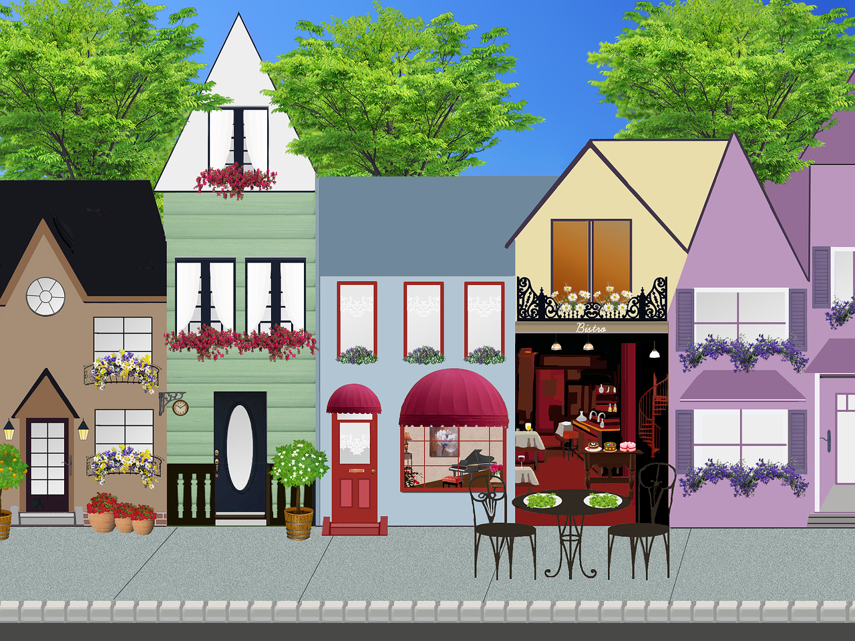
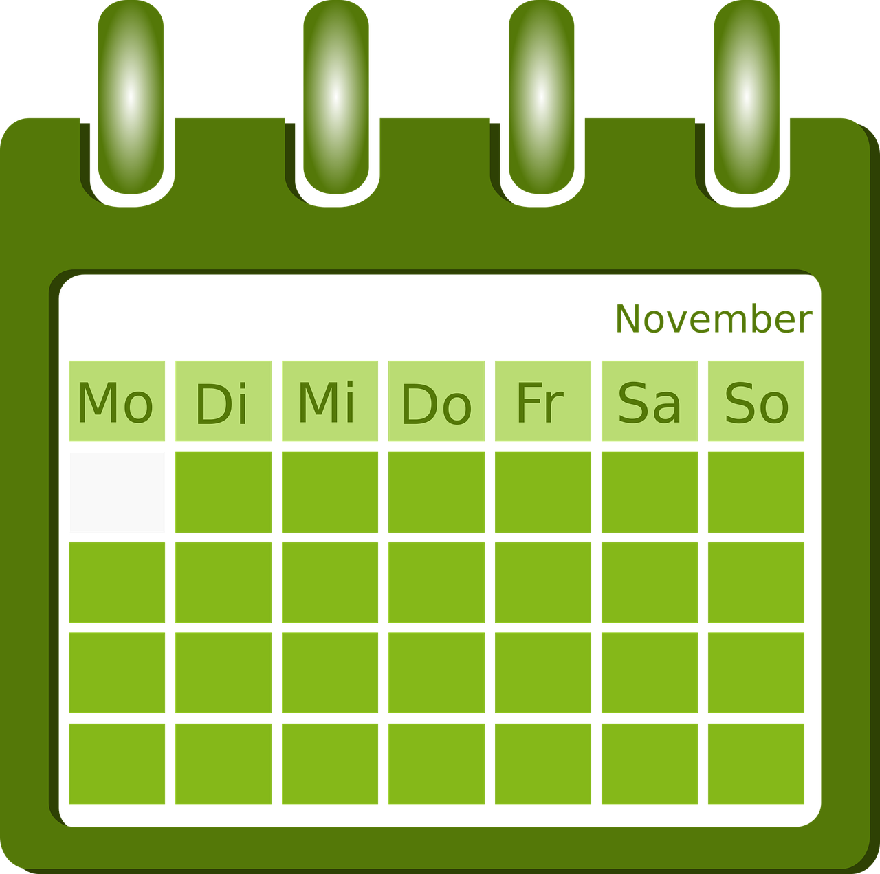
Exploring
Am Wochenende*
grün
Follow ups 1 - 5
am Wochenende – at the weekend
Term 2 Week 7
Notes:
Artwork by Steve Clarke. Pronoun pictures from NCELP (www.ncelp.org). All additional pictures selected from Pixabay and are available under a Creative Commons license, no attribution required.
Phonics:
[s-] [-s-] singen [1063] Person [357] langsam [526] sehr [81] besuchen [820]
[z] Zug [675] sitzen [231] Platz [326] Zimmer [665] zehn [333]
Vocabulary: gehen [66] sein [3] Laden [1675] Museum [1078] Park [2141] Restaurant [1802] Schwimmbad [n/a] Schule [359] Stadt [204] Wohin? [1811]
Revisit 1: kaufen [506] laufen [252] machen [58] Rad fahren [n/a] tragen [271] (Sport)Kleidung [2820]
Revisit 2: bringen [163] essen [323] mitbringen [1828] reden [368] nichts [109] Deutsch [112] Englisch [662]
Jones, R.L & Tschirner, E. (2019). A frequency dictionary of German: Core vocabulary for learners. London: Routledge.
The frequency rankings for words that occur in this PowerPoint which have been previously introduced in these resources are given in the SOW and in the resources that first
introduced and formally re-visited those words.
For any other words that occur incidentally in this PowerPoint, frequency rankings will be provided in the notes field wherever possible.
Remember that at the start of the course (first three lessons of Rot/Gelb) pupils learnt language (for greetings and register taking) that can still be part of the lesson routines in upper KS2 (Blau/Grün). They are not re-taught, as we anticipate that teachers have built these in from early in lower KS2.
1

Slide 2
aussprechen
[s]
Before a vowel, German 's' sounds like English ‘z’.
…
singen
[slow]
langsam
besuchen
Person
sehr
other words: Person langsam sehr
besuchen
(we then have all the vowels represented)
Notes:
Timing: 1 minute
Aim: to consolidate the SSC [s] before a vowel.
Procedure:
Re-present the SSC and the source word ‘singen’ (with gesture, if using).
Click to bring on the picture and get pupils to repeat the word ‘singen’ (with gesture, if using).
Present the cluster words in the same way, bringing on the picture and getting pupils to pronounce the words.

Slide 3
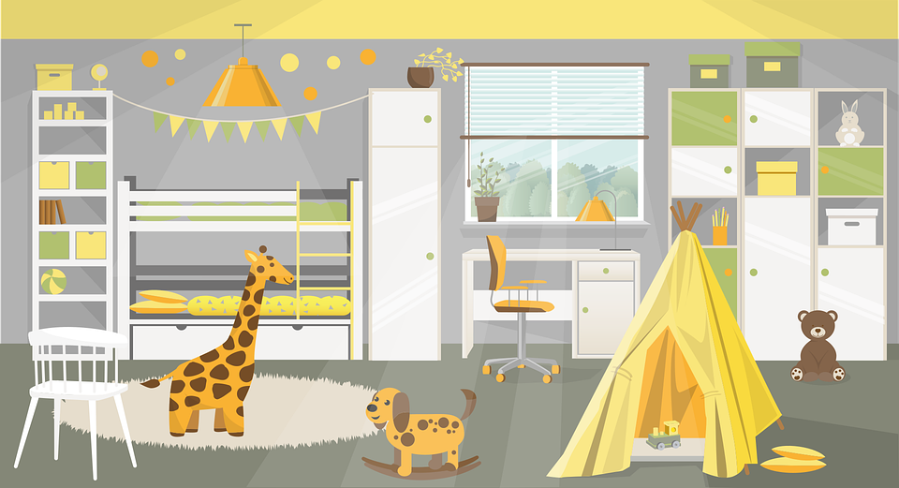
aussprechen
[z]
Which words are nouns? How do you know?
…
Zug
sitzen
Platz
Zimmer
zehn
Notes:
Timing: 1 minute
Aim: to consolidate the SSC [z].
Procedure:
Re-present the SSC and the source word ‘Zug’ (with gesture, if using).
Click to bring on the picture and get pupils to repeat the word ‘Zug’ (with gesture, if using).
Present the cluster words in the same way, bringing on the picture and getting pupils to pronounce the words.
Click to bring up call-out explaining the pronounciation of ‘z’.
Click to bring up the prompt to identify the nouns (the ones with capital letters). This is still very new knowledge for pupils, so it’s good to revisit this as often as we can. Plus, it gives an additional opportunity to pronounce the words.
Click to highlight the 3 x nouns.
Vocabulary:
sitzen [231] Platz [326] Zimmer [665] zehn [333]
Jones, R.L & Tschirner, E. (2019). A frequency dictionary of German: Core vocabulary for learners. London: Routledge.

Slide 4
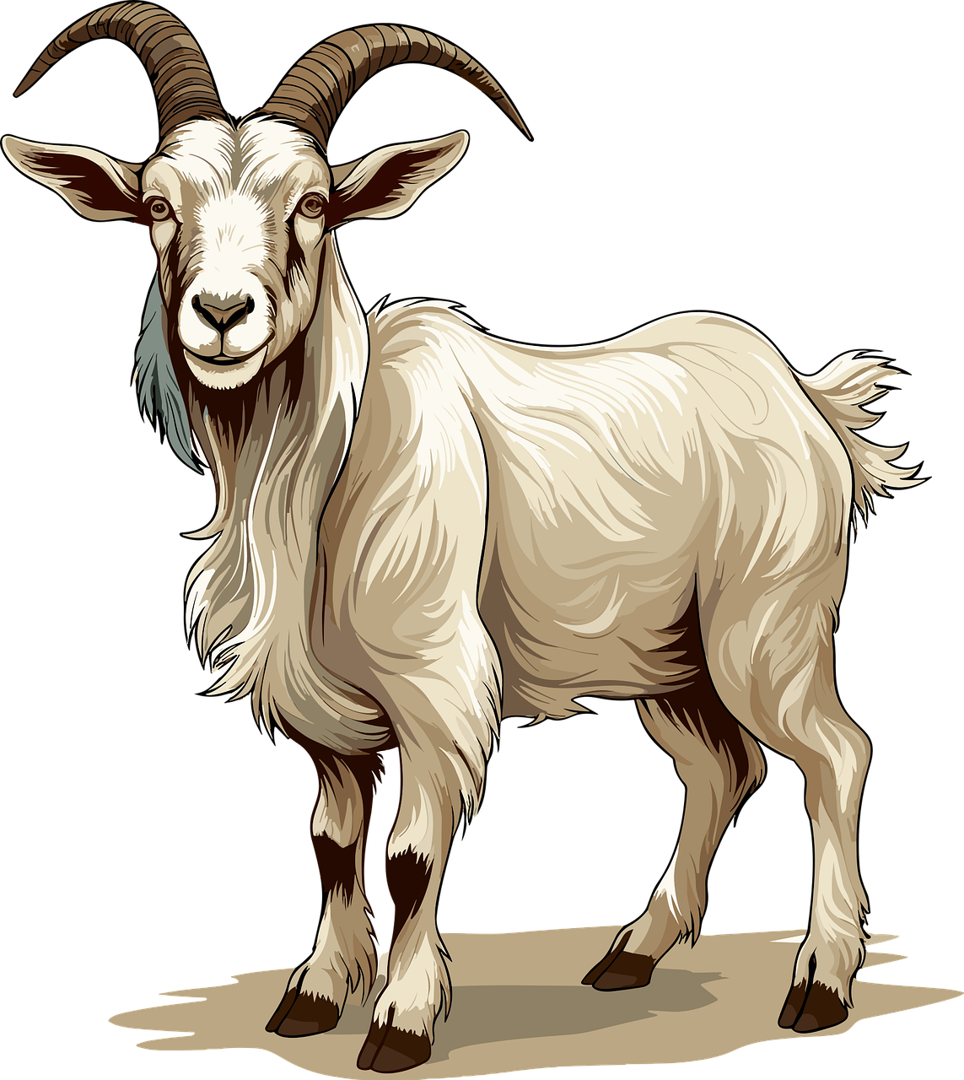
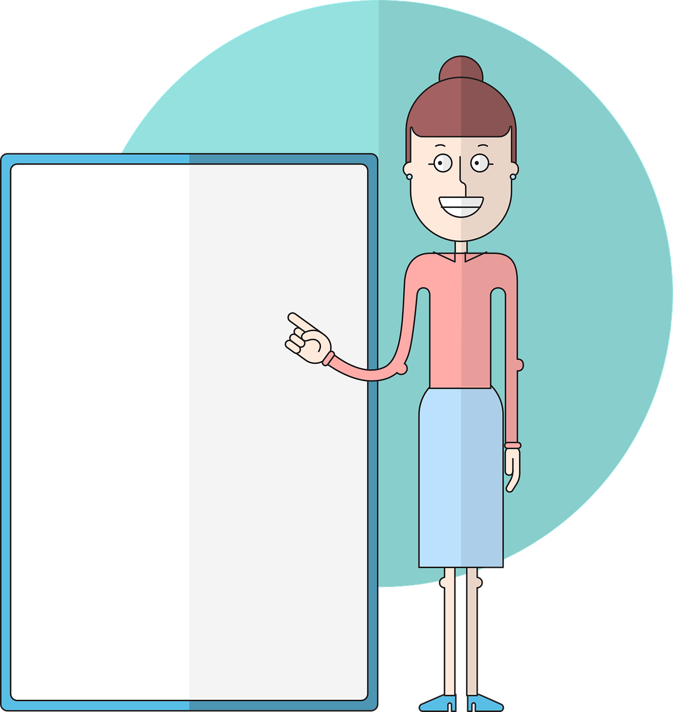
Follow up 1:
Sag die Wörter.
März
Sonntag
sehen
sehr
aussprechen
very
60
Salat
Seite
zwölf
Zeit
12
S
Dezember
Ziege
zeigen
sitzen
0
START
Notes:
Timing: 5 minutes
Aim: to practise applying knowledge of [s] and [z] to known and unknown words.
Procedure: 1. Start the timer. Pupil A tries to read aloud all of the words paying attention to [s] and [z], within the 60 seconds allowed.
2. Pupil B listens. If Pupil A makes a mistake, Pupil B can direct him/her to start again from the beginning. 3. They swap roles and repeat the task.
Vocabulary:
Salat [N/A] Seite [197] Zeit [96] Ziege [N/A] zeigen [136]
Jones, R.L & Tschirner, E. (2019). A frequency dictionary of German: Core vocabulary for learners. London: Routledge.

Slide 5
Follow up 2
Hör zu.
 | Person? | be | go ? | Where? | Where to?
hören
1
we
are
in the sports shop
you
go/ are going
into the town
2
3
I
am
in the film museum
4
you (all)
go/are going
into the school
5
she
is
in the park
6
you (all)
are
in the swimming pool
7
she
goes/ is going
into the restaurant
8
they
go/are going
into the music shop
Notes:
Aim: to identify all the person verb forms of sein and gehen, and to translate their meaning into English.
Procedure:
Play the recordings by clicking on the audio buttons.
Answers are revealed by consecutive mouse clicks.
Transcript: 1. Wir sind im Sportladen.
2. Du gehst in die Stadt.
3. Ich bin im Filmmuseum.
4. Ihr geht in die Schule.
5. Sie ist im Park.
6. Ihr seid im Schwimmbad.
7. Sie geht ins Restaurant.
8. Sie gehen in den Musikladen.

Slide 6
Follow up 3
Rede mit deinem Partner/deiner Partnerin.
Person A spricht.
sprechen
Person B antwortet.
Person A schreibt.
Person A sagt:
I go/am going ....................
1)
in den Park
im Laden
into the park
Ich gehe in den Park.
Ich gehe…
A
B
Notes:
1/2: Model slide
Timing: 5-10 minutes
Aim: to practise productive knowledge of ‘ich gehe’ and ‘ich bin’ and receptive knowledge of R2 and R3 articles following verbs of location / movement.
Procedure:
Print handouts for Pupils A and B (slides 12 and 13).
Use this slide to model the task.
Pupil A looks at no. 1 on their sheet to see if they have ’I go’/am going (‘Ich gehe’) or ‘I am’ (‘Ich bin’). They say this in German to pupil B.
Pupil B looks at their sheet and identifies the correct ending to the sentence. In the example, ‘Ich gehe’ can be followed by ‘in den Park’ but not ‘im Laden’.
B completes the spoken sentence with the correct option.
A writes person B’s response on their sheet in English.
Complete items 1-5.
Then swap to complete roles.

Slide 7
Follow up 3
Runde 1
Runde 2
sprechen
Person A sagt:
1) I am ....................................................................
2) I go/am going ..................................................
3) I am ....................................................................
4) I am ....................................................................
5) I go/am going ..................................................
Person B sagt:
1) I go/am going ..................................................
2) I go/am going ..................................................
3) I am ....................................................................
4) I go/am going ..................................................
5) I am ....................................................................
in the museum
into the museum
into the school
into the park
in the town
in the school
in the restaurant
into the shop
into the shop
in the swimming pool
B
Notes:
4/4
Answers for both rounds

Slide 8
Follow up 4:
Wo seid ihr? Wohin geht ihr?

Schreib auf Deutsch.
schreiben
Olivia is telling Ronja what she is doing with her sister in town.
Schreib vier SMS: “Wir sind... Wir gehen…”
Notes:
Timing: 5 minutes
Aim: to practise written production of sentences using R2 and R3 articles correctly, following in + sein (location) and gehen (movement).
Procedure:
Read the title and instructions with pupils and ensure that the task is clear.
Pupils write four messages, using the pictures.
Extra: Challenge pupils to add to their sentences with a verb they know. You could elicit these from pupils by pointing to a picture and asking ‘Was machst du im Laden/Schwimmbad...’. Verbs could include kaufen, spielen, laufen, essen, schwimmen, sehen.
Note: The sentences won’t be identical as students can choose which combination of places to talk about in each sentence.
Pupils can be encouraged to share their texts with each other. They can orally translate these into English, and peer check answers for meaning.
Teachers can circulate as students are writing to check accuracy of Row 2/Row 3 articles.

Slide 9
Follow up 5:

Schreib auf Englisch.
Can you get at least 15 points?
Wörter
 | bringen | Englisch | reden
 | mitbringen | Deutsch | nichts
 | kaufen | laufen | die Kleidung
 | tragen | machen | Rad fahren
 | gehen | wohin? | der Laden
 | die Stadt | das Museum | das Schwimmbad
to bring
English
to talk
Vokabeln
x3
to bring with
German
nothing
to buy
to run
(the) clothing
x2
to wear, to carry
to do, make
to cycle
to go
where (to)?
(the) shop
x1
(the) town
(the) museum
(the) swimming pool
Notes:
Timing: 5 minutes
Aim: to practise written comprehension of vocabulary from this and revisited weeks.
Procedure: 1. Give pupils a blank grid. They fill in the English meanings of any of the words they know, trying to reach 15 points in total.
Note: The most recently learnt and practised words are pink, words from the previous week are green and those from week 1 are blue, thus more points are awarded for them, to recognise that memories fade and more effort (heavy lifting!) is needed to retrieve them.

Slide 10
Follow up 5:

Schreib auf Deutsch.
Can you get at least 15 points?
Wörter
 | German | to talk | English
 | nothing | to bring | to bring with
 | (the) clothing | to buy | to cycle
 | to run | to wear, to carry | to do, to make
 | where (to)? | (the) shop | (the) swimming pool
 | (the) town | to go | (the) museum
Vokabeln
Deutsch
reden
Englisch
x3
nichts
bringen
mitbringen
die Kleidung
kaufen
Rad fahren
x2
laufen
tragen
machen
wohin?
der Laden
das Schwimmbad
x1
die Stadt
gehen
das Museum
Notes:
Timing: 5 minutes
Aim: to practise written production of vocabulary from this and revisited weeks.
Procedure: 1. Give pupils a blank grid. They fill in the German meanings of any of the words they know, trying to reach 15 points in total.
Note: The most recently learnt and practised words are pink, words from the previous week are green and those from week 1 are blue, thus more points are awarded for them, to recognise that memories fade and more effort (heavy lifting!) is needed to retrieve them.

Slide 11
Tschüss!
grün
Notes:
11

Slide 12
Follow up 3
Person A Runde 1
Person A Runde 2
Person A sagt:
1) I am ....................................................................
2) I go/am going ..................................................
3) I am ....................................................................
4) I am ....................................................................
5) I go/am going...................................................
1)
2)
3)
4)
5)
sprechen
ins Museum
im Schwimmbad
im Restaurant
in den Park
in der Schule
ins Museum
in den Laden
im Park
in die Stadt
im Schwimmbad
B
Notes:
Handout A

Slide 13
Follow up 3
Person B Runde 1
Person B Runde 2
1)
2)
3)
4)
5)
Person B sagt:
1) I go/am going ..................................................
2) I go/am going ..................................................
3) I am ....................................................................
4) I go/am going ..................................................
5) I am ....................................................................
sprechen
in den Park
im Museum
im Park
in die Schule
in der Stadt
in die Schule
ins Schwimmbad
im Restaurant
in der Schule
in den Laden
B
Notes:
Handout B

Slide 14
Follow up 5:

Schreib auf Englisch.
Can you get at least 15 points?
 | bringen | Englisch | reden
 | mitbringen | Deutsch | nichts
 | kaufen | laufen | die Kleidung
 | tragen | machen | Rad fahren
 | gehen | wohin? | der Laden
 | die Stadt | das Museum | das Schwimmbad
x3
x2
x1
Notes:
Template

Slide 15
Follow up 5:

Schreib auf Deutsch.
Can you get at least 15 points?
 | German | to talk | English
 | nothing | to bring | to bring with
 | (the) clothing | to buy | to cycle
 | to run | to wear, to carry | to do, to make
 | where (to)? | (the) shop | (the) swimming pool
 | (the) town | to go | (the) museum
Notes:
Template

