Slide 1
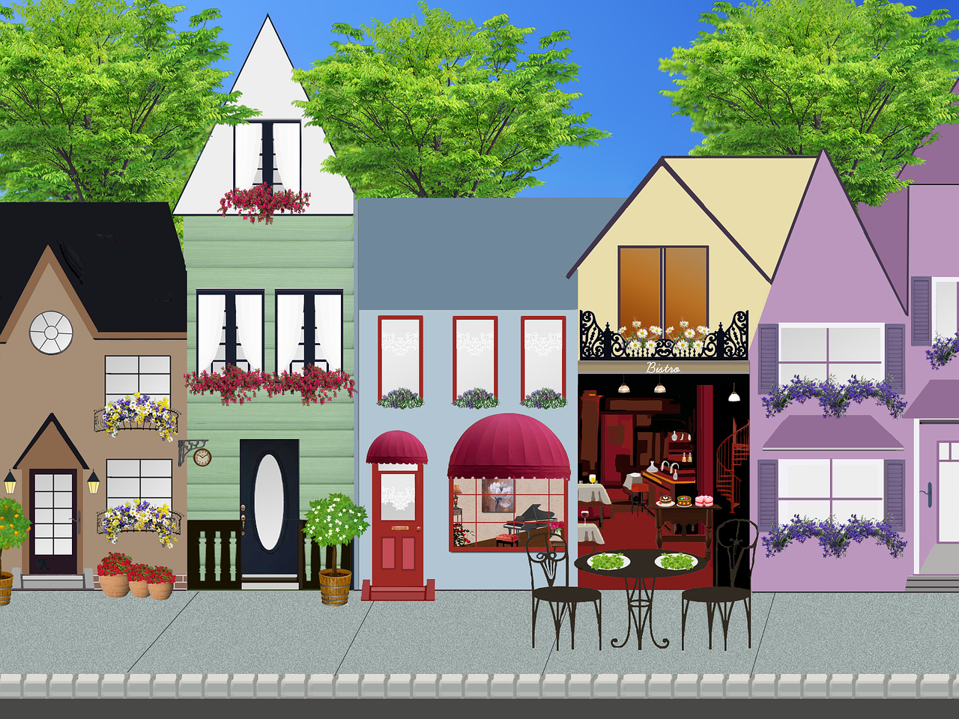
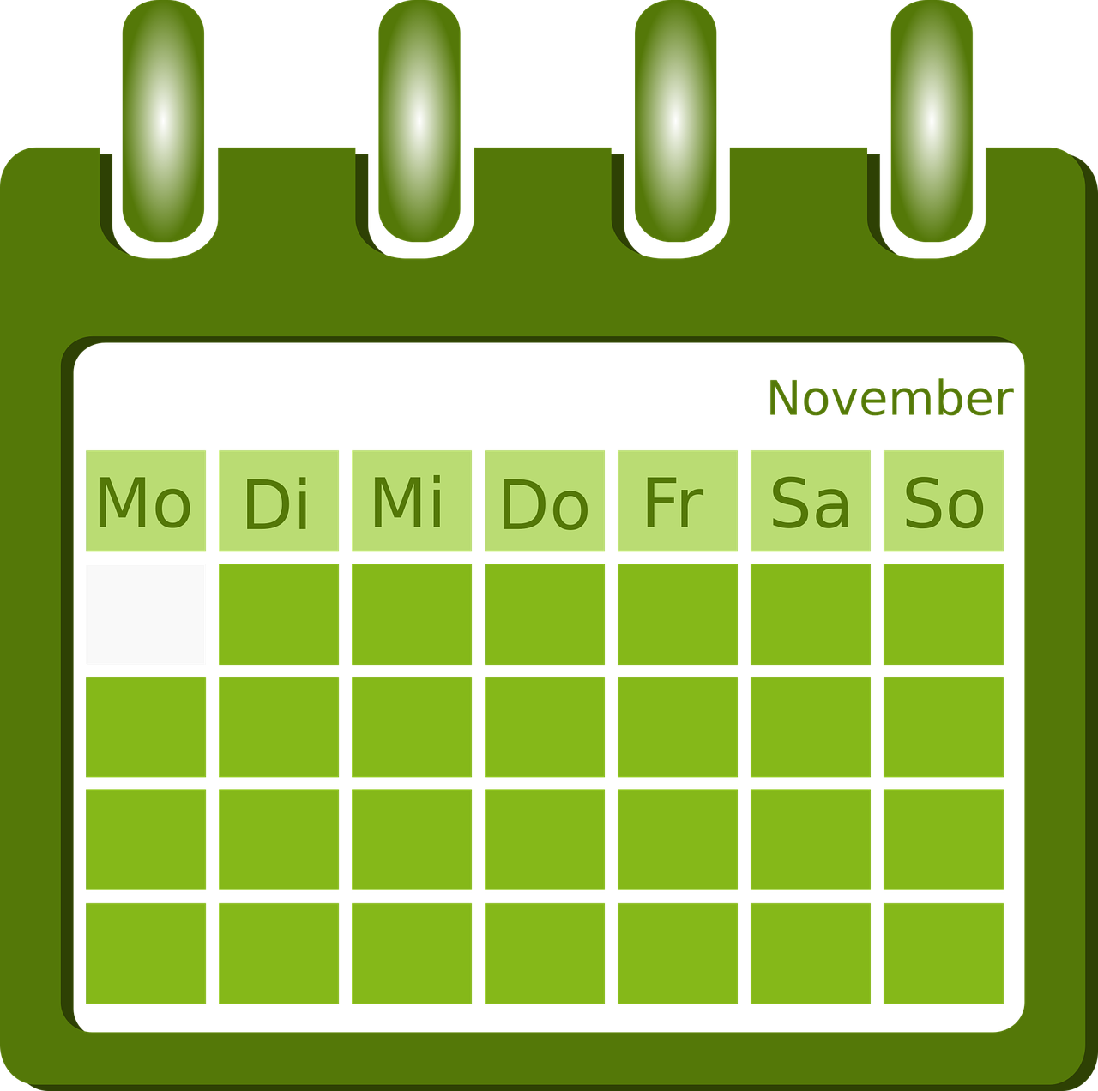
Exploring
Am Wochenende*
grün
in (R3) location and in (R2) movement
present tense
SSC [s-|-s-] vs [z]
am Wochenende – at the weekend
Term 2 Week 7
Notes:
Artwork by Steve Clarke. Pronoun pictures from NCELP (www.ncelp.org). All additional pictures selected from Pixabay and are available under a Creative Commons license, no attribution required.
Phonics:
[s-] [-s-] singen [1063] Person [357] langsam [526] sehr [81] besuchen [820]
[z] Zug [675] sitzen [231] Platz [326] Zimmer [665] zehn [333]
Vocabulary: gehen [66] sein [3] Laden [1675] Museum [1078] Park [2141] Restaurant [1802] Schwimmbad [n/a] Schule [359] Stadt [204] Wohin? [1811]
Revisit 1: kaufen [506] laufen [252] machen [58] Rad fahren [n/a] tragen [271] (Sport)Kleidung [2820]
Revisit 2: bringen [163] essen [323] mitbringen [1828] reden [368] nichts [109] Deutsch [112] Englisch [662] Jones, R.L & Tschirner, E. (2019). A frequency dictionary of German: Core vocabulary for learners. London: Routledge.
The frequency rankings for words that occur in this PowerPoint which have been previously introduced in these resources are given in the SOW and in the resources that first
introduced and formally re-visited those words.
For any other words that occur incidentally in this PowerPoint, frequency rankings will be provided in the notes field wherever possible.
Remember that at the start of the course (first three lessons of Rot/Gelb) pupils learnt language (for greetings and register taking) that can still be part of the lesson routines in upper KS2 (Blau/Grün). They are not re-taught, as we anticipate that teachers have built these in from early in lower KS2.
1

Slide 2
aussprechen
[s]
Before a vowel, German 's' sounds like English ‘z’.
…
singen
Notes:
Timing: 1 minute
Aim: to present the SSC [s] before a vowel.
Procedure:
Present the SSC and the source word ‘singen’ (with gesture, if using).
Click to bring on the picture and get pupils to repeat the word ‘singen’ (with gesture (a gesture might be to sing ‘lalala’) if using).

Slide 3
aussprechen
[s]
Before a vowel, German 's' sounds like English ‘z’.
…
singen
[slow]
langsam
besuchen
Person
sehr
other words: Person langsam sehr
besuchen
(we then have all the vowels represented)
Notes:
Timing: 1 minute
Aim: to consolidate the SSC [s] before a vowel.
Procedure:
Re-present the SSC and the source word ‘singen’ (with gesture, if using).
Click to bring on the picture and get pupils to repeat the word ‘singen’ (with gesture, if using).
Present the cluster words in the same way, bringing on the picture and getting pupils to pronounce the words.

Slide 4
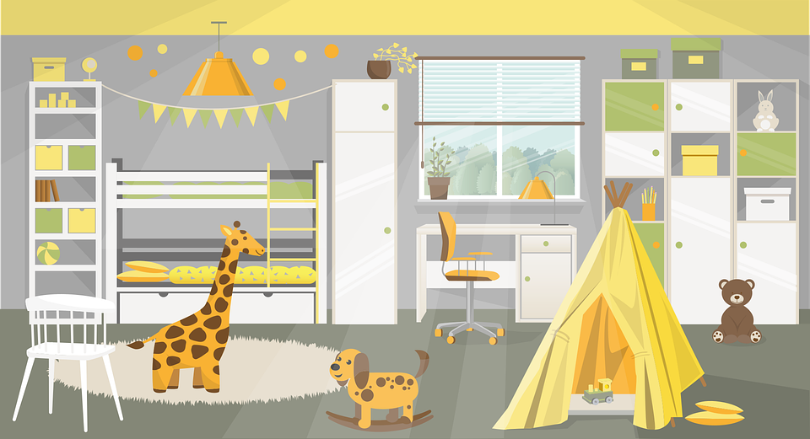
aussprechen
[z]
Which words are nouns? How do you know?
…
Zug
sitzen
Platz
Zimmer
zehn
Notes:
Timing: 1 minute
Aim: to consolidate the SSC [z].
Procedure:
Re-present the SSC and the source word ‘Zug’ (with gesture, if using).
Click to bring on the picture and get pupils to repeat the word ‘Zug’ (with gesture, if using).
Present the cluster words in the same way, bringing on the picture and getting pupils to pronounce the words.
Click to bring up call-out explaining the pronounciation of ‘z’.
Click to bring up the prompt to identify the nouns (the ones with capital letters). This is still very new knowledge for pupils, so it’s good to revisit this as often as we can. Plus, it gives an additional opportunity to pronounce the words.
Click to highlight the 3 x nouns.
Vocabulary:
sitzen [231] Platz [326] Zimmer [665] zehn [333]
Jones, R.L & Tschirner, E. (2019). A frequency dictionary of German: Core vocabulary for learners. London: Routledge.

Slide 5
aussprechen
Sag die Wörter.
Runde 1: Person A spricht. 🗣
Person B macht Notizen📝✅
Sachen
sehen
sein
Sie
Katze
singen
zusammen
zu Hause
Zug
Notes:
1/3
Timing: 5-6 minutes [3 slides]
Aim: To practise the pronunciation of German words with the SSC [s] and [z].
Procedure:
Pupils work in pairs to practise and recognise correct pronunciation.
Divide the class in A & B before explaining the task.
Click to bring up the instruction in German. Click again to start the fish going across the screen (it will come across the screen three times, revealing three words at a time)
Pupil A reads the words aloud and pupil B checks their pronunciation. There are 9 words in total.
Vocabulary:
Sie [7] Katze [2235] singen [1063] zu Hause [n/a] zusammen [533]
Jones, R.L & Tschirner, E. (2019). A frequency dictionary of German: Core vocabulary for learners. London: Routledge.

Slide 6
aussprechen
Sag die Wörter.
Runde 2: Person B spricht. 🗣
Person A macht Notizen📝✅
See
Käse
Satz
zweiundzwanzig
dieser
siebzehn
Konzert
Schweiz
Häuser
Notes:
2/3
Procedure:
Pupils swap roles and repeat the activity.
Vocabulary:
See [1317] Konzert [2350] Käse [4094] Schweiz [763] dieser [24] Satz [432] zweiundzwanzig [n/a] siebzehn [n/a] Häuser [147]
Jones, R.L & Tschirner, E. (2019). A frequency dictionary of German: Core vocabulary for learners. London: Routledge.
.

Slide 7
aussprechen
How much are your words worth?
Runde 1
Runde 2
Sachen 💰
Sie 💰💰
zusammen 💰
sehen 💰
Katze 💰💰
zu Hause 💰💰
sein 💰
singen 💰💰
Zug 💰
See 💰
Konzert 💰
Schweiz 💰
Käse 💰💰
dieser 💰💰
zweiundzwanzig 💰
Satz 💰💰
siebzehn 💰
Häuser 💰💰
Notes:
3/3
Procedure:
Pupils can view their results and another round can be played with the same words or swapping A/B.
All words are previously taught words so for an extra point pupils can translate the words.

Slide 8
Vokabeln
Sag die Wörter. Was heißt das auf Deutsch?
Wörter
(the) shop
to go, walk
(the) park
Wohin?
die Schule
der Laden
der Park
das Museum
gehen
Where to?
(the) school
(the) museum
Notes:
Timing: 5 minutes
Aim: to present and practise written comprehension and read aloud of two previously taught words and the new vocabulary for this week (four words).
Procedure: 1. Click for a German word and icon. Elicit English translation from pupils.
2. Continue until the final word (Wohin?) has been introduced. 3. Elicit translation of all words again, clicking to provide an emphasis animation.
8

Slide 9
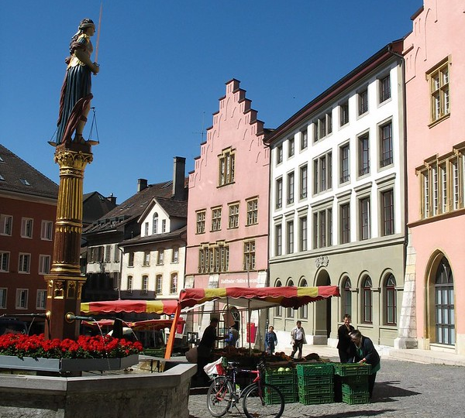
Kultur
The French name for Biel is Bienne
Biel
Lies den Text.
Lias und Ronja wohnen in Biel.
Biel ist eine Stadt in der Schweiz. Sie liegt im „Drei-Seen-Land“. Dort gibt es drei Seen, natürlich*!
Die Altstadt ist sehr schön. Neben der Altstadt ist das „NMB Neues Museum“. Dort findest du viel Geschichte*, Kunst und tolle alte Sachen.
Geschichte means story, but also history.
natürlich – of course, naturally
Notes:
Timing: 5 minutes
Aim: to present and practise new vocabulary for this week
Procedure:
Click to bring up short reading text about Biel/Bienne.
Click to bring up callout to say that Biel is called Bienne in French.
Discuss the text and ensure that the meaning is clear. Encourage students to work out what ‘Altstadt’ means (old town).
Translation: Lias and Ronja live in Biel. Biel is a town/city in Switzerland. It is located in the ‘Drei-Seen-Land’ (Three-Lake-Country – in English we sometimes call the area Seeland). There are three lakes there, of course! The old town is very beautiful. Next to the old town is the NMB Neues Museum (NMB New Museum). There you find lots of history, art and great old things.
Vocabulary:
natürlich [137]
Jones, R.L & Tschirner, E. (2019). A frequency dictionary of German: Core vocabulary for learners. London: Routledge.
“Gerechtigkeitsbrunnen (Fountain of Justice) & Farmers Market on the Burgplatz, Biel / Bienne, Switzerland” by nikoretro is licensed under CC BY-SA 2.0.
9

Slide 10
The preposition ‘in’ for location
Remember that ‘in’ is the same word in English and German:
We shorten ‘in dem‘ to ‘im’.
Wir sind in Biel.
We are in Biel.
You know that to say ‘in the’, the words for ‘the’ (der, die, das) change.
der Park:
in dem Park
im Park
in the park
die Stadt:
in der Stadt
in the town/city
‘Stadt’ still has feminine gender. Just the article spelling has changed.
das Museum:
in dem Museum
im Museum
in the museum
Notes:
Timing: 2 minutes
Aim: to recap the preposition ‘in’ for location.
Procedure:
Click through the animations to present the grammar of ‘in’.
10

Slide 11
The preposition ‘in’ for movement.
We shorten ‘in das‘ to ‘ins’.
Also use ‘in’ in German to mean moving into.
In this case, the words for ‘the’ (der, die, das) are:
masculine
feminine
neuter
Ich gehe…
in den Park
in die Stadt
in das Museum
I go/am going…
into the park
into the town
into the museum
For ‘in’ a place (location), compare:
‘in dem’ → im
‘in dem’ → im
Ich bin…
in dem Park
in der Stadt
in dem Museum
I am…
in the park
in the town
in the museum
Notes:
Timing: 2 minutes
Aim: to introduce the preposition ‘in’.
Procedure:
Click through the animations to present the grammar of ‘in’.
11

Slide 12
Olivia sendet Ronja eine SMS.
lesen
Olivia
Ronja
Hallo, Olivia! Ich mache dieses Wochenende ganz* viel!
Hallo, Ronja! Was machst du am Wochenende? Wohin gehst du?
ganz - quite
Notes:
Timing: 1 minute
Aim: to set up the context for the next activity.
Procedure:
Explain the scenario. Olivia is texting Ronja.
Elicit the translations for the messages. Olivia’s message: Hello Ronja! What are you doing at the weekend? Where are you going? (This could also be translated as ‘What do you do at the weekend? Where do you go?) Ronja’s message: Hello Olivia! I’m doing quite a lot this weekend!
Vocabulary:
Wochenende [1243]
Jones, R.L & Tschirner, E. (2019). A frequency dictionary of German: Core vocabulary for learners. London: Routledge.
12

Slide 13
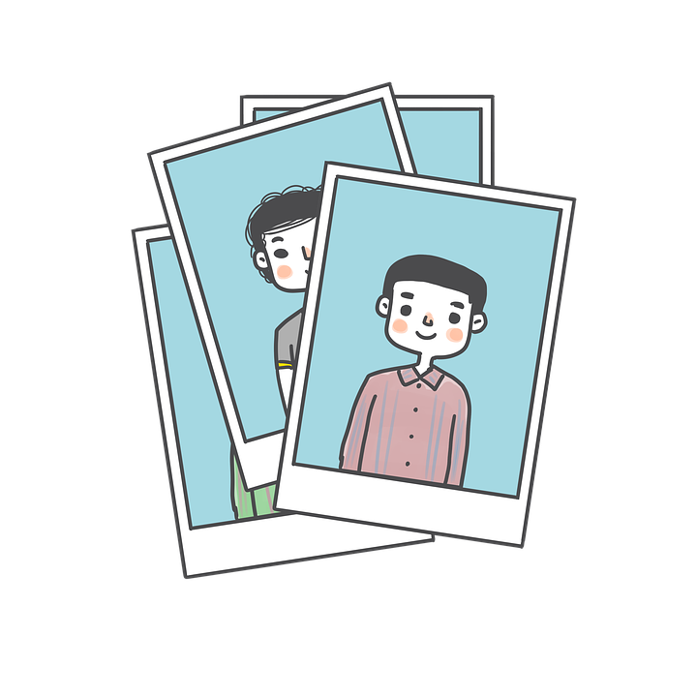
lesen
Ronja sendet Olivia Fotos von Biel, aber es gibt ein Problem: keine Fotos!
Was schreibt Ronja? Ist es ‘ich gehe’ oder ‘ich bin’?
An: Olivia
Ich gehe | bin im Schwimmbad.
An: Olivia
Ich gehe | bin in der Stadt.
4
1
An: Olivia
Ich gehe | bin im Restaurant.
An: Olivia
Ich gehe | bin in den Laden.
5
2
An: Olivia
Ich gehe | bin ins Museum.
An: Olivia
Ich gehe | bin nicht in die Schule. Heute ist Samstag!
3
6
Notes:
Timing: 8 minutes
Aim: to practise identifying movement /no-movement with ‘in’ based on the article case(R2 or R3).
Procedure:
Explain the scenario. Ronja is sending her pictures of what she is doing on the weekend in Biel.
Pupils identify the correct choice of verb for item one.
Click to block out the incorrect choice and only the correct choice visible.
Elicit oral translations of each message.
13

Slide 14
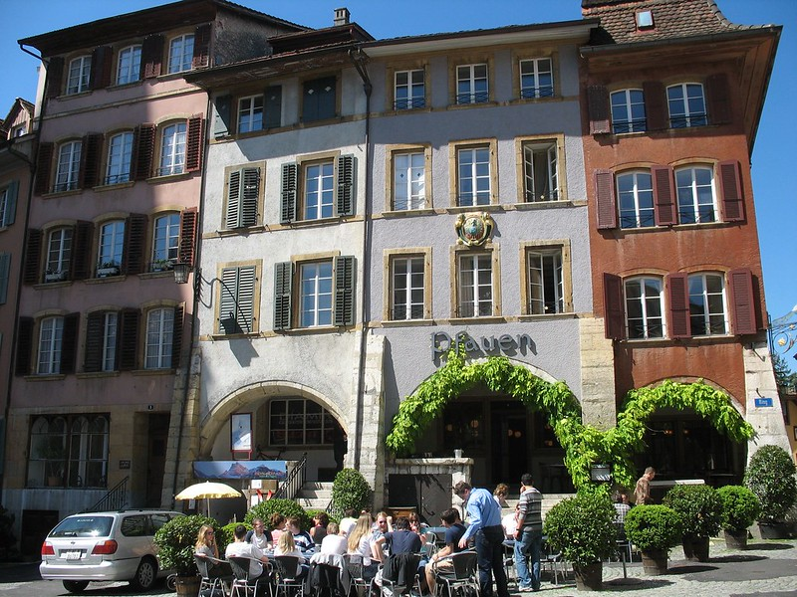
hören
Lias ist auch in der Stadt aber er findet Ronja nicht!
Er sendet Ronja Sprachnachrichten*
Wo ist er, oder wohin geht er?
 |  | bin
 |  | bin
 | gehe
 |  | bin
 | gehe
 | gehe
 | gehe
 |  | bin
Ich gehe…
Ich bin…
1
2
3
4
5
6
7
8
die Sprachnachricht – voice mail
sogar - even
Notes:
Timing: 5 minutes
Aim: to practise aural comprehension of R2 and R3 articles, which in turn helps them to identify the correct verb – location (I am) or movement towards (I’m going).
Procedure:
Make sure the context is clear – Lias is looking for Ronja but can’t find her. He goes to lots of places in the town searching for her (and doing some other things while he’s at particular places) and leaves her voice messages to say where he is/is going.
Pupils need only write 1-8 and either gehe or bin.
They listen and decide if Lias is somewhere or going somewhere.
The answers are animated and appear upon successive clicks of the mouse.
Transcript
Ich [bin] in der Stadt.
Ich [bin] im Laden. Ich kaufe hier Sportkleidung.
Ich [gehe] ins Schwimmbad.
Ich [bin] im Museum. Die Sachen hier sind toll.
Ich [gehe] ins Restaurant. Dort essen wir oft Fondue.
Ich [gehe] in den Park. Dort rede ich mit Gabriel.
Ich [gehe] sogar in die Schule aber du bist nicht da!
Ich [bin] im Bus und gehe nach Hause. Wo bist du, Ronja?!
Vocabulary:
sogar [226] Nachricht [1218]
Jones, R.L & Tschirner, E. (2019). A frequency dictionary of German: Core vocabulary for learners. London: Routledge.
“Biel/Bienne, Switzerland” by nikoretro is licenced under CC BY-SA 2.0
14

Slide 15
Tschüss!
grün
Notes:
15

