Slide 1
Talking about things and things to do
gelb
Vocabulary & Grammar quiz
Easter activities
Term 2 Week 10
Notes:
Word frequency (1 is the most frequent word in German):
Jones, R.L & Tschirner, E. (2019). A frequency dictionary of German: Core vocabulary for learners. London: Routledge.
The frequency rankings for words that occur in this PowerPoint which have been previously introduced in these resources are given in the SOW and in the resources that first introduced and formally re-visited those words. For any other words that occur incidentally in this PowerPoint, frequency rankings will be provided in the notes field wherever possible.
1

Slide 2
Vocabulary
A For each question, put a cross (x) under the English meaning that matches what you hear. You will hear each German word twice. Choose one correct answer only. (4 marks on this slide)
hören
A | B | C | D
 | ball | clothing | partner | cat
 | ☐ | ☐ | ☐ | ☐
 | I | you | she | he
 | ☐ | ☐ | ☐ | ☐
 | to need | to play | to receive | to have
 | ☐ | ☐ | ☐ | ☐
 | watch | jacket | task | tree
 | ☐ | ☐ | ☐ | ☐
1
2
3
4
Notes:
1/2.
Timing: 20-25 minutes (all assessment slides)
Aim: to practise aural comprehension of vocabulary taught in terms 1 and 2 of the course.
Procedure:
1. Click the audio buttons to play each item. (The words are recorded twice with a pause to allow pupils to process the information).
2. Pupils can either write 1C, etc.. or if they have the assessment on a print out they can put a X in the correct box.
3. After items 1-4, continue to the next slide to complete the remainder of the task.
Transcript:
Kleidung
ich
bekommen
Uhr
2

Slide 3
Vocabulary
A For each question, put a cross (x) under the English meaning that matches what you hear. You will hear each German word twice. Choose one correct answer only. (4 marks on this slide)
hören
A | B | C | D
 | wrong | difficult | white | bad
 | ☐ | ☐ | ☐ | ☐
 | how ? | clear | good | easy
 | ☐ | ☐ | ☐ | ☐
 | pupil | Mr | woman | man
 | ☐ | ☐ | ☐ | ☐
 | one | six | zero | four
 | ☐ | ☐ | ☐ | ☐
5
6
7
8
Notes:
2/2
Transcript
5. schwer
6. klar
7. Mann
8. null
3

Slide 4
Vocabulary
B For each question, put a cross (x) under the type of word you hear. You will hear each German word twice. Choose one correct answer only. (4 marks)
hören
This word is a good example of …
 | A | B | C | D
 | a number | a place | an activity | a person
 | ☐ | ☐ | ☐ | ☐
 | a colour | an animal | a question | a building
 | ☐ | ☐ | ☐ | ☐
 | a person | a question | a food | a place
 | ☐ | ☐ | ☐ | ☐
 | an activity | a number | a colour | an animal
 | ☐ | ☐ | ☐ | ☐
1
2
3
4
Notes:
1/1
Aim: to practise aural comprehension of vocabulary taught in terms 1 and 2 of the course.
Procedure:
1. Click the audio buttons to play each item. (The words are recorded twice with a pause to allow pupils to process the information).
2. Pupils can either write 1C, etc.. or if they have the assessment on a print out they can put a X in the correct box.
Transcript:
acht
Schule
wie geht’s?
Sport
4

Slide 5
Vocabulary
C Translate the underlined German word to complete each English sentence. (12 marks)
lesen
1. Ich weiß (es) nicht, Herr Lehmann. | _______________________, Mr Lehmann. | (3)
2. Wo ist England? | ________________ is England? | (1)
3. Was ist dein Lieblingssong? | What is your _________________________________? | (1)
4. Die Farbe ist grün, nicht wahr?. | The colour is green,___________________________? | (2)
5. Meine Aufgabe ist total einfach. | My task is _________________ easy. | (1)
6. Schwarz oder grau?. | Black _________________ grey? | (1)
7. Ich brauche ein Blatt. | I _________________ a sheet. | (1)
8. Guten Morgen, Frau Müller! | _____________________________ Mrs Müller! | (2)
Notes:
1/1
Aim: to practise written recall of previously taught vocabulary.
Procedure:
Ensure that the task is clear.
Pupils could write 1 – 8 and the individual English word meanings (or they could fill in if they have printed assessment sheets).
If necessary, explain that ‘Lehmann’ and ‘Müller’ are common German surnames.
5

Slide 6
Vocabulary
D For each question, put a cross (x) under the word that best fits each category. Choose one correct answer only. (5 marks)
lesen
This word is a good example of …
 | A | B | C | D
1. a number | lang ☐ | sieben ☐ | neu ☐ | tschüss ☐
2. a person | Partner ☐ | Text ☐ | Hausaufgabe ☐ | Liste ☐
3. a country | Ort ☐ | Ding ☐ | Butterbrot ☐ | die Schweiz ☐
4. an activity | haben ☐ | schreiben ☐ | es hat ☐ | sein ☐
5. a description | aber ☐ | auch ☐ | rund ☐ | und ☐
Notes:
1/1
Aim: to practise written recall of previously taught vocabulary.
Procedure:
Ensure that the task is clear.
Pupils can either write 1C, etc.. or if they have the assessment on a print out they can put a X in the correct box.
6

Slide 7
Vocabulary
E Translate the underlined English words to complete the German sentence. (15 marks)
schreiben
1. No, you are there. | ________, du ________ da. | (write two words)
2. Here is the mistake. | Hier ist der ___________. | (write one words)
3. There is a prize. | ___________ ___________ einen Preis. | (write two words)
4. Mia writes. | Mia ___________. | (write one word)
5. Luca has five stories. | Luca hat ___________ Geschichten. | (write one word)
6. What is the problem? | Was ist das ___________ ? | (write one word)
7. I make that. | Ich ___________ das. | (write one word)
8. Yes, that is right. | Ja, das ist ___________. | (write one word)
9. Who is the person? | ___________ ist die Person? | (write one word)
10. She has the letter. | Sie hat den ___________. | (write one word)
Notes:
1/1
Aim: to practise written recall of previously taught vocabulary.
Procedure:
Ensure that the task is clear.
Pupils could write 1 – 10 and the individual English word meanings (or they could fill in if they have printed assessment sheets).
7

Slide 8
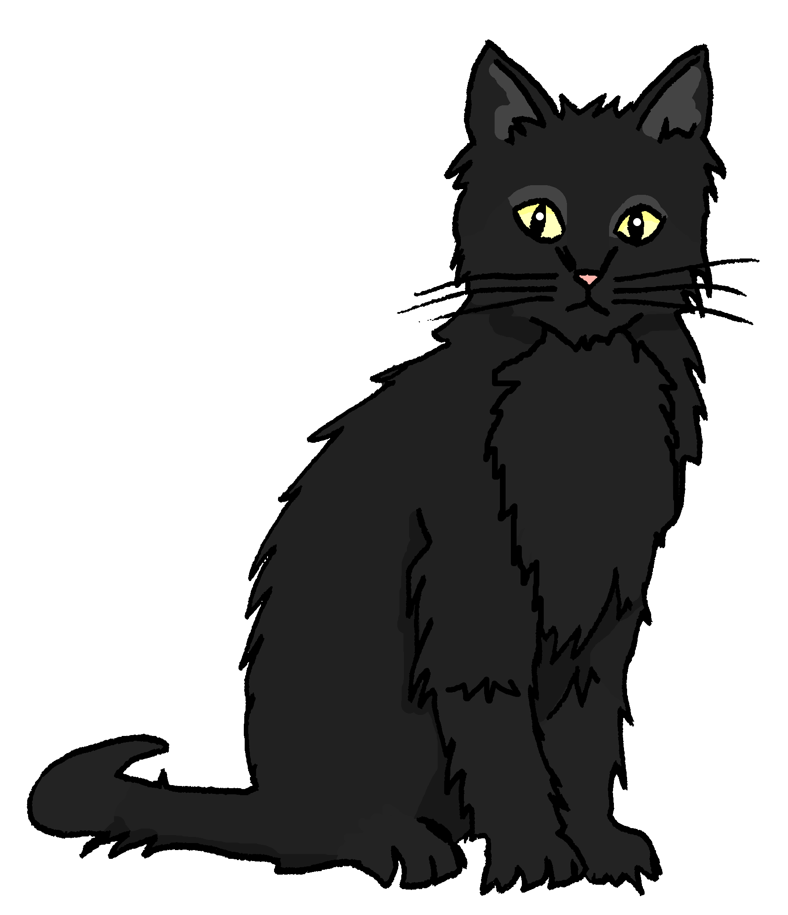
Grammar
A Put a (X) next to the person the sentence is about. (5 marks)
lesen
1 | ☐ I ☐ you _{[singular]} ☐ she/he | … hast eine Katze.
2 | ☐ I ☐ you _{[singular]} ☐ she/he | … benutze das Papier.
3 | ☐ I ☐ you _{[singular]} ☐ she/he | … ist wunderbar.
4 | ☐ I ☐ you _{[singular]} ☐ she/he | … brauchst Hilfe.
5 | ☐ I ☐ you _{[singular]} ☐ she/he | … bin in der Schweiz.
Notes:
1/1
Aim: to practise written understanding of previously taught grammar features (verb endings for 1st, 2nd, 3rd person with familiar verbs).
Procedure:
Ensure that the task is clear.
Pupils could write 1 – 5 and the correct English pronoun (or they could fill in if they have printed assessment sheets).
8

Slide 9
Grammar
B Add a full stop (.) or a question mark (?) next to each sentence to show whether it is a statement or a question. (2 marks)
lesen
 | Bekommst du eine Karte
 | Er spielt zu Hause
1
2
Notes:
1/1
Aim: to practise written understanding of previously taught grammar features (word order).
Procedure:
Ensure that the task is clear.
Pupils could write 1 – 2 and the correct punctuation (or they could fill in if they have printed assessment sheets).
9

Slide 10
Grammar
C Put a (X) next to the English meaning of the German sentence. (3 marks)
lesen
1 | Das ist nicht das Haus. | ☐ That is the house. ☐ That is not the house.
2 | Ich habe keine Farbe. | ☐ I have a colour. ☐ I don’t have a colour.
3 | Das ist eine Nummer. | ☐ That is a number. ☐ That is not a number.
Notes:
1/1
Aim: to practise written understanding of previously taught grammar features (negation)
Procedure:
Ensure that the task is clear.
Pupils could write 1 – 3 and 1 (top) or 2 (bottom) for each answer (or they could fill in if they have printed assessment sheets).
10

Slide 11
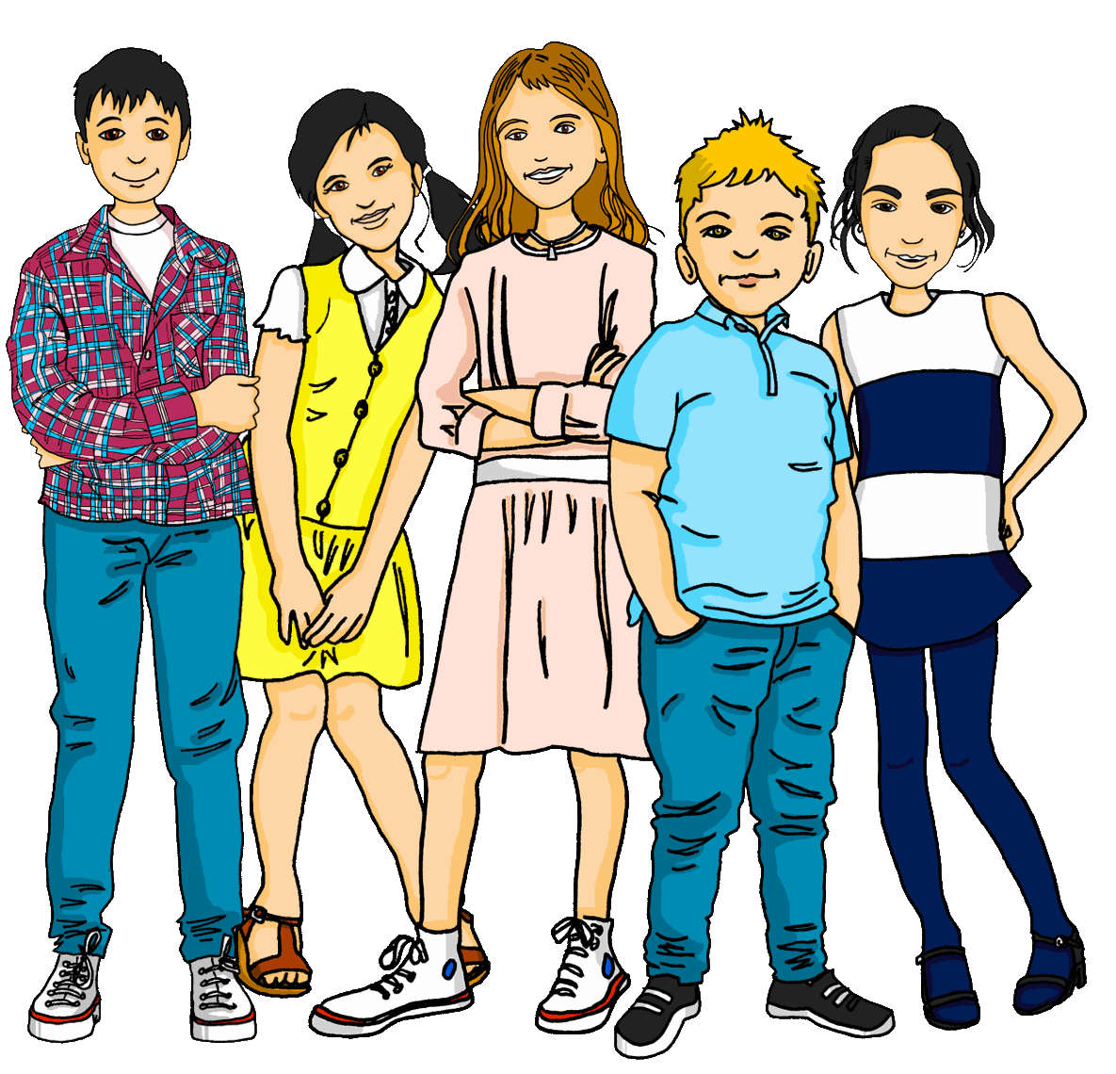
Grammar
D Write the German word for ‘a’ in the gap. (2 marks)
schreiben
1 | ___________ Spiel (n)
2 | Er hat ___________ Apfel. (m)
E Write the German word for ‘the’ in the gap (2 marks)
1 | ___________ Gruppe (f)
2 | Du hast ___________ Computer. (m)
Notes:
1/1
Aim: to practise written recall of previously taught grammar features (articles).
Procedure:
Ensure that the task is clear.
Pupils could write 1 – 2 and the target word (or they could fill in if they have printed assessment sheets).
11

Slide 12
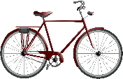
Grammar
F Write the German word for ‘your’ in the gap. (2 marks)
schreiben
1 | Das ist ___________ Fahrrad. (n)
2 | Das ist ___________ Idee. (f)
Notes:
1/1
Aim: to practise written recall of previously taught grammar features (articles).
Procedure:
Ensure that the task is clear.
Pupils could write 1 – 2 and the target word (or they could fill in if they have printed assessment sheets).
12

Slide 13
Grammar
G Look at these male nouns.
Write the female version of each noun in the table below. (2 marks)
schreiben
1 | der Schüler | die ___________________
2 | the (male) pupil | the (female) pupil
2 | der Spieler | die ___________________
4 | the (male) player | the (female) player
Notes:
1/1
Aim: to practise written recall of previously taught grammar features (articles).
Procedure:
Ensure that the task is clear.
Pupils could write 1 – 2 and the target word (or they could fill in if they have printed assessment sheets).
13

Slide 14
Grammar
H Write the plural version of each noun in the table below. (2 marks)
schreiben
1 | ein Baum | zwei _______________
2 | one (a) tree | two trees
2 | eine Jacke | drei _______________
4 | one (a) jacket | three jackets
Notes:
1/1
Aim: to practise written recall of previously taught grammar features (articles).
Procedure:
Ensure that the task is clear.
Pupils could write 1 – 2 and the target word (or they could fill in if they have printed assessment sheets).
14

Slide 15
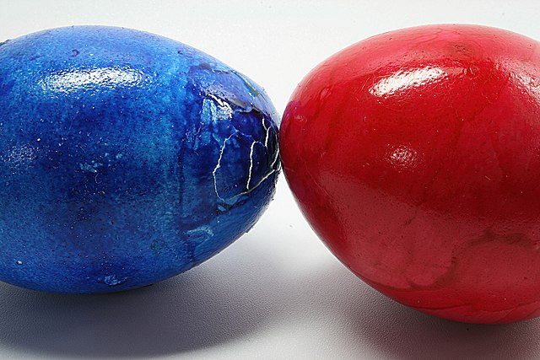
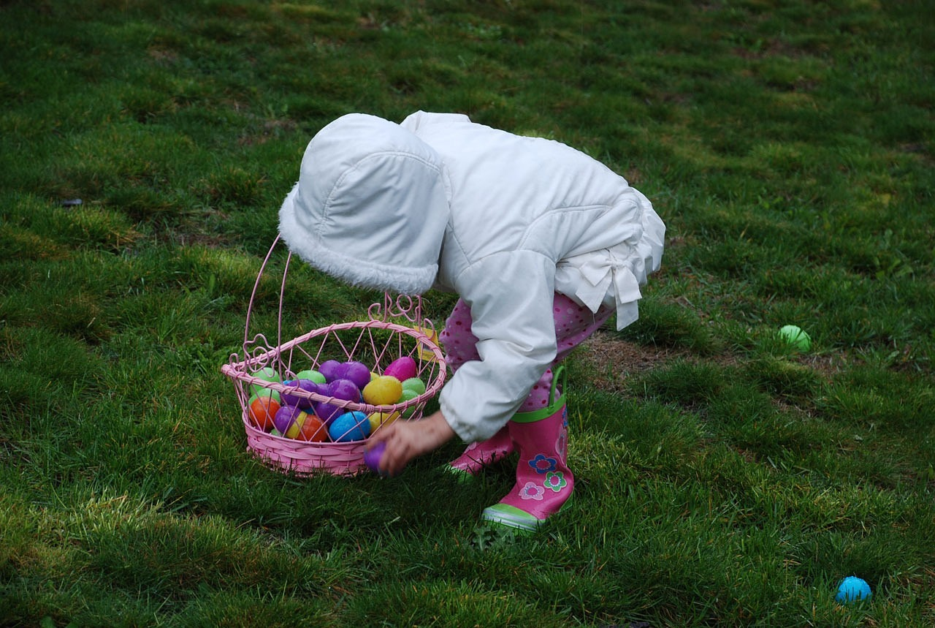
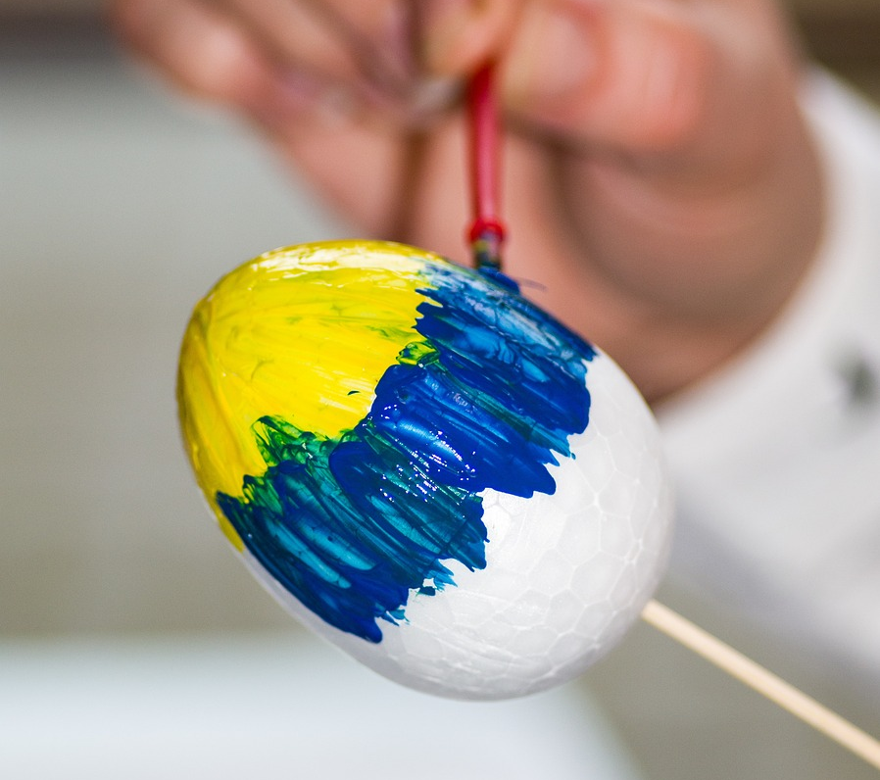
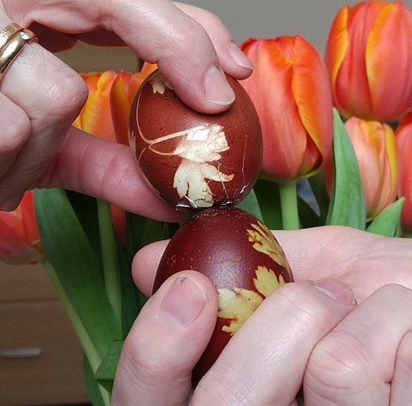
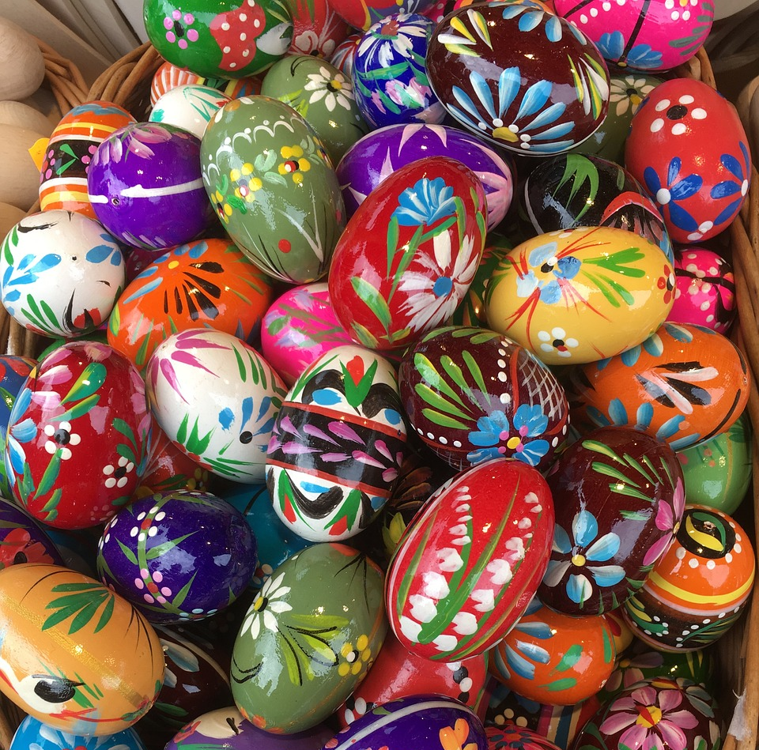
How to people celebrate Easter in Switzerland?
Ostern in der Schweiz
What is she doing?
What is he doing?
What is he playing?
Was macht sie?
Was macht er?
Was spielt er?
Using the pictures, and the words in the blue boxes, can you work out what “Eier” means?
Eiertütschen is a bit like playing conkers! The goal is to break the shell of your opponent’s egg while keeping your egg intact.
Easter egg hunts are popular in Switzerland!
People decorate eggs by dying or painting them.
Now can you work out what “Ostereier” means?
Eiertütschen
Ostereier suchen
Ostereier bemalen
Notes:
Timing: 5-10 mins (whole class)
Aim: To familiarise pupils with a few Swiss Easter traditions and to encourage them to compare with their own experiences/traditions; to encourage recognition of compound nouns; to revise questions with weak verbs in the present tense; to practise pronunciation of unknown words using SSCs previously met.
Procedure:
Introduce the word ‘Ostern’ (Easter).
Pupils read the first question in German and chorally translate into English. Click to reveal the English translation. Click again to bring up the Swiss tradition.
Pupils should have a go at using their phonics knowledge to pronounce these Easter traditions. Use ‘hook’ words they know to help e.g. ei= frei = Eier. Click directly on the words to check pronunciation.
Click to bring up the explanation of the tradition. Pupils could share their own experiences of these or similar traditions.
Repeat for the next two items.
Click to bring up a callout encouraging pupils to work out what “Eier” means, and to then use their knowledge of compound nouns to work out what “Ostereier” means.
Word frequency (1 is the most frequent word in German): bemalen [>5000] Ei [1999] Ostern [N/A] suchen [293]
Source: Jones, R.L. & Tschirner, E. (2019). A frequency dictionary of German: core vocabulary for learners. Routledge
Image attribution:
Eiertütschen Von L.Kenzel - Eigenes Werk, CC0, https://commons.wikimedia.org/w/index.php?curid=67936899
Eiertütschen Von Superbass - Eigenes Werk, CC BY-SA 3.0, https://commons.wikimedia.org/w/index.php?curid=3767798
Egg painting by Henryk Niestrój, Pixabay

Slide 16
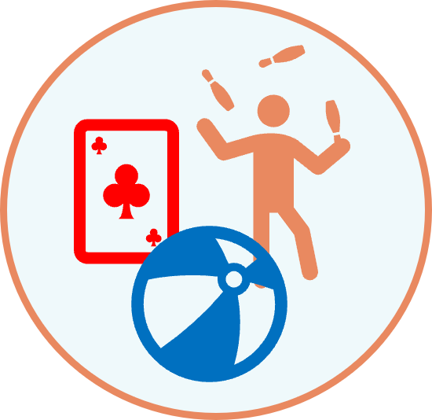
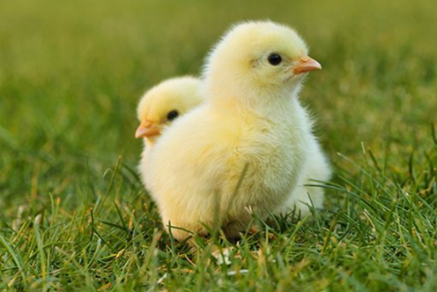
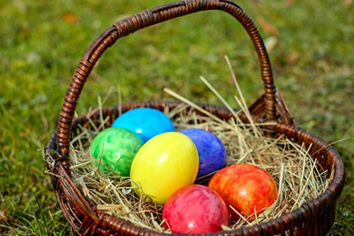
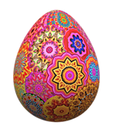
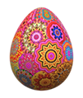
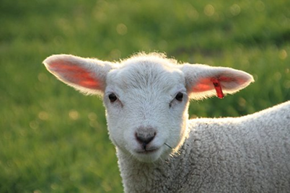
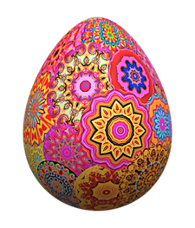
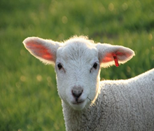
Ostereisuche*!
Make sentences to find all the hidden Easter eggs!
sprechen
?
?
?
Ich
Du
Er
Ostereisuche- Easter egg hunt
Notes:
Timing: 5-10 minutes (whole class)
Aim: to practise oral production of statements and questions using singular verb forms and a range of regular verbs.
Procedure:
Explain that as a class pupils need to find all the Easter eggs by saying correct sentences to reveal the squares. In total there are 17 eggs to collect. Allocate 1 pupil to keep track of the eggs as they collect them.
A pupil selects a pronoun from the vertical axis and a verb from the horizontal axis and makes a sentence or a question e.g. ich spiele ein Spiel; du bekommst ein Fahrrad; sie macht Sport. If there is a ?, they need to make a question instead e.g. brauchst du Hilfe?
Hover over the chosen square and click to reveal what is beneath.
Repeat with different pupils selecting different squares until they have found all the Easter eggs.

Slide 17
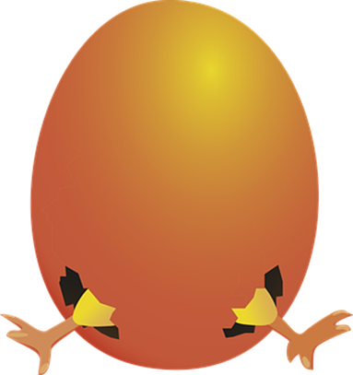
Tschüss!
gelb
Notes:
17

Slide 18
Vocabulary (ANSWERS)
A For each question, put a cross (x) under the English meaning that matches what you hear. You will hear each German word twice. Choose one correct answer only. (4 marks on this slide)
hören
A | B | C | D
 | ball | clothing | partner | cat
 | ☐ | X | ☐ | ☐
 | I | you | she | he
 | X | ☐ | ☐ | ☐
 | to need | to play | to receive | to have
 | ☐ | ☐ | X | ☐
 | watch | jacket | task | tree
 | X | ☐ | ☐ | ☐
1
2
3
4
Notes:
1/2.
ANSWERS
18

Slide 19
Vocabulary (ANSWERS)
A For each question, put a cross (x) under the English meaning that matches what you hear. You will hear each German word twice. Choose one correct answer only. (4 marks on this slide)
hören
A | B | C | D
 | wrong | difficult | white | bad
 | ☐ | X | ☐ | ☐
 | how ? | clear | good | easy
 | ☐ | X | ☐ | ☐
 | pupil | Mr | woman | man
 | ☐ | ☐ | ☐ | X
 | one | six | zero | four
 | ☐ | ☐ | X | ☐
5
6
7
8
Notes:
2/2
ANSWERS
19

Slide 20
Vocabulary (ANSWERS)
B For each question, put a cross (x) under the type of word you hear. You will hear each German word twice. Choose one correct answer only. (4 marks)
hören
This word is a good example of …
 | A | B | C | D
 | a number | a place | an activity | a person
 | X | ☐ | ☐ | ☐
 | a colour | an animal | a question | a building
 | ☐ | ☐ | ☐ | X
 | a person | a question | a food | a place
 | ☐ | X | ☐ | ☐
 | an activity | a number | a colour | an animal
 | X | ☐ | ☐ | ☐
1
2
3
4
Notes:
1/1
ANSWERS
20

Slide 21
Vocabulary
C Translate the underlined German word to complete each English sentence. (12 marks)
lesen
1. Ich weiß (es) nicht, Herr Lehmann. | I don‘t know Mr Lehmann. | (3)
2. Wo ist England? | Where is England? | (1)
3. Was ist dein Lieblingssong? | What is your favourite song? | (1)
4. Die Farbe ist grün, nicht wahr?. | The colour is green, isn‘t it? | (2)
5. Meine Aufgabe ist total einfach. | My task is totally easy. | (1)
6. Schwarz oder grau?. | Black or grey? | (1)
7. Ich brauche ein Blatt. | I need a sheet. | (1)
8. Guten Morgen, Frau Müller! | Good Morning, Mrs Müller! | (2)
Notes:
1/1
ANSWERS
21

Slide 22
Vocabulary
D For each question, put a cross (x) under the word that best fits each category. Choose one correct answer only. (5 marks)
lesen
This word is a good example of …
 | A | B | C | D
1. a number | lang ☐ | sieben X | neu ☐ | tschüss ☐
2. a person | Partner ☐ | Text ☐ | Hausaufgabe ☐ | Liste ☐
3. a country | Ort ☐ | Ding ☐ | Butterbrot ☐ | die Schweiz X
4. an activity | haben ☐ | schreiben X | es hat ☐ | sein ☐
5. a description | aber ☐ | auch ☐ | rund X | und ☐
Notes:
1/1
ANSWERS
22

Slide 23
Vocabulary
E Translate the underlined English words to complete the German sentence. (15 marks)
schreiben
1. No, you are there. | Nein du bist da. | (write two words)
2. Here is the mistake. | Hier ist der Fehler. | (write one words)
3. There is a prize. | Es gibt einen Preis. | (write two words)
4. Mia writes. | Mia schreibt. | (write one word)
5. Luca has five stories. | Luca hat fünf Geschichten. | (write one word)
6. What is the problem? | Was ist das Problem ? | (write one word)
7. I make that. | Ich mache das. | (write one word)
8. Yes, that is right. | Ja, das ist richtig. | (write one word)
9. Who is the person? | Wer ist die Person? | (write one word)
10. She has the letter. | Sie hat den Brief. | (write one word)
Notes:
1/1
ANSWERS
23

Slide 24
Grammar
A Put a (X) next to the person the sentence is about. (5 marks)
lesen
1 | ☐ I ☒ you _{[singular]} ☐ she/he | … hast eine Katze.
2 | ☒ I ☐ you _{[singular]} ☐ she/he | … benutze das Papier.
3 | ☐ I ☐ you _{[singular]} ☒ she/he | … ist wunderbar.
4 | ☐ I ☒ you _{[singular]} ☐ she/he | … brauchst Hilfe.
5 | ☒ I ☐ you _{[singular]} ☐ she/he | … bin in der Schweiz.
Notes:
1/1
ANSWERS
24

Slide 25
Grammar
B Add a full stop (.) or a question mark (?) next to each sentence to show whether it is a statement or a question. (2 marks)
lesen
 | Bekommst du eine Karte
 | Er spielt zu Hause
1
?
2
.
Notes:
1/1
ANSWERS
25

Slide 26
Grammar
C Put a (X) next to the English meaning of the German sentence. (3 marks)
lesen
1 | Das ist nicht das Haus. | ☐ That is the house. ☒ That is not the house.
2 | Ich habe keine Farbe. | ☐ I have a colour. ☒ I don’t have a colour.
3 | Das ist eine Nummer. | ☒ That is a number. ☐ That is not a number.
Notes:
1/1
ANSWERS
26

Slide 27
Grammar
D Write the German word for ‘a’ in the gap. (2 marks)
schreiben
1 | ein Spiel (n)
2 | Er hat einen Apfel. (m)
E Write the German word for ‘the’ in the gap (2 marks)
1 | die Gruppe (f)
2 | Du hast den Computer. (m)
Notes:
1/1
ANSWERS
27

Slide 28
Grammar
F Write the German word for ‘your’ in the gap. (2 marks)
schreiben
1 | Das ist dein Fahrrad. (n)
2 | Das ist deine Idee. (f)
Notes:
1/1
ANSWERS
28

Slide 29
Grammar
G Look at these male nouns.
Write the female version of each noun in the table below. (2 marks)
schreiben
1 | der Schüler | die Schülerin
2 | the (male) pupil | the (female) pupil
2 | der Spieler | die Spielerin
4 | the (male) player | the (female) player
Notes:
1/1
ANSWERS
29

Slide 30
Grammar
H Write the plural version of each noun in the table below. (2 marks)
schreiben
1 | ein Baum | zwei Bäume
2 | one (a) tree | two trees
2 | eine Jacke | drei Jacken
4 | one (a) jacket | three jackets
Notes:
1/1
ANSWERS
30

