Slide 1







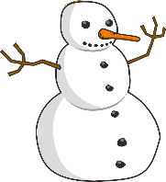
Talking about activities and events
gelb
Follow ups 1-5
Term 3 Week 4
Notes:
Artwork by Steve Clarke. Pronoun pictures from NCELP (www.ncelp.org). All additional pictures selected from Pixabay and are available under a Creative Commons license, no attribution required.
Phonics:
[-ig] richtig [177] dreißig [2046] fertig [n/a] ruhig [911] wichtig [144]
Vocabulary: Januar [1052] Februar [1093] März [987] April [1004] Mai [1048] Juni [1148] Juli [1544] August [1929] September [1035] Oktober [1223] November [1273] Dezember [1527] Monat [316] Plan [954] wann [657]
Revisit 1: Montag [1044] Dienstag [1356] Mittwoch [1187] Donnerstag [1244] Freitag [981] Samstag [1112] Sonntag [804] Tag [111] Woche [219] heute [116] morgen [752]
Revisit 2: Gruppe [369] Lieblings - [n/a] Song [3373]
Jones, R.L & Tschirner, E. (2019). A frequency dictionary of German: Core vocabulary for learners. London: Routledge.
The frequency rankings for words that occur in this PowerPoint which have been previously introduced in these resources are given in the SOW and in the resources that first introduced and formally re-visited those words.
For any other words that occur incidentally in this PowerPoint, frequency rankings will be provided in the notes field wherever possible.
Note that the first three lessons of the year teach language that can be continuously recycled as lesson routine every lesson in Y3/4.
The idea would be that the class teacher (whether or not s/he teaches the class German can re-use the language as part of the daily routine with the class.

Slide 2


aussprechen
[-ig]
…
The [-ig] sound is mostly found at the end of words.
richtig
Notes:
Timing: 1 minute
Aim: To introduce/consolidate SSC [-ig]
Procedure:
1. Present the letter(s) and say the [-ig] sound first, on its own. Pupils repeat it with you.
2. Bring up the word ”richtig” on its own, say it, pupils repeat it, so that they have the opportunity to focus all of their attention on the connection between the written word and its sound.
3. A possible gesture for this would be to mime ‘correct’ by tracing a tick in the air with the index finger on your right hand.
4. Roll back the animations and work through 1-3 again, but this time, dropping your voice completely to listen carefully to the pupils saying the [-ig] sound, pronouncing ”richtig” and, if using, doing the gesture.
Word frequency (1 is the most frequent word in German):
richtig [177]
Source: Jones, R.L. & Tschirner, E. (2019). A frequency dictionary of German: core vocabulary for learners. Routledge
2

Slide 3



aussprechen
[-ig]
…
30
fertig
dreißig
richtig
[ready, finished]
ruhig
wichtig
[quiet, calm]
[important]
Notes:
Timing: 2 minutes
Aim: To introduce/consolidate SSC [-ig]
Procedure:
Introduce and elicit the pronunciation of the individual SSC [-ig] and then the source word again ‘richtig’ (with gesture, if using).
Then present and elicit the pronunciation of the four cluster words.
The cluster words have been chosen for their high-frequency, from a range of word classes, with the SSC (where possible) positioned within a variety of syllables within the words (e.g. initial, 2nd, final etc.). Additionally, we have tried to use words that build cumulatively on previously taught SSCs (see the Phonics Teaching Sequence document) and do not include new SSCs. Where new SSCs are used, they are often consonants which have a similar symbol-sound correspondence in English.
Word frequency (1 is the most frequent word in German):
richtig [177] dreißig [2046] fertig [n/a] ruhig [911] wichtig [144]
Source: Jones, R.L. & Tschirner, E. (2019). A frequency dictionary of German: core vocabulary for learners. Routledge

Slide 4


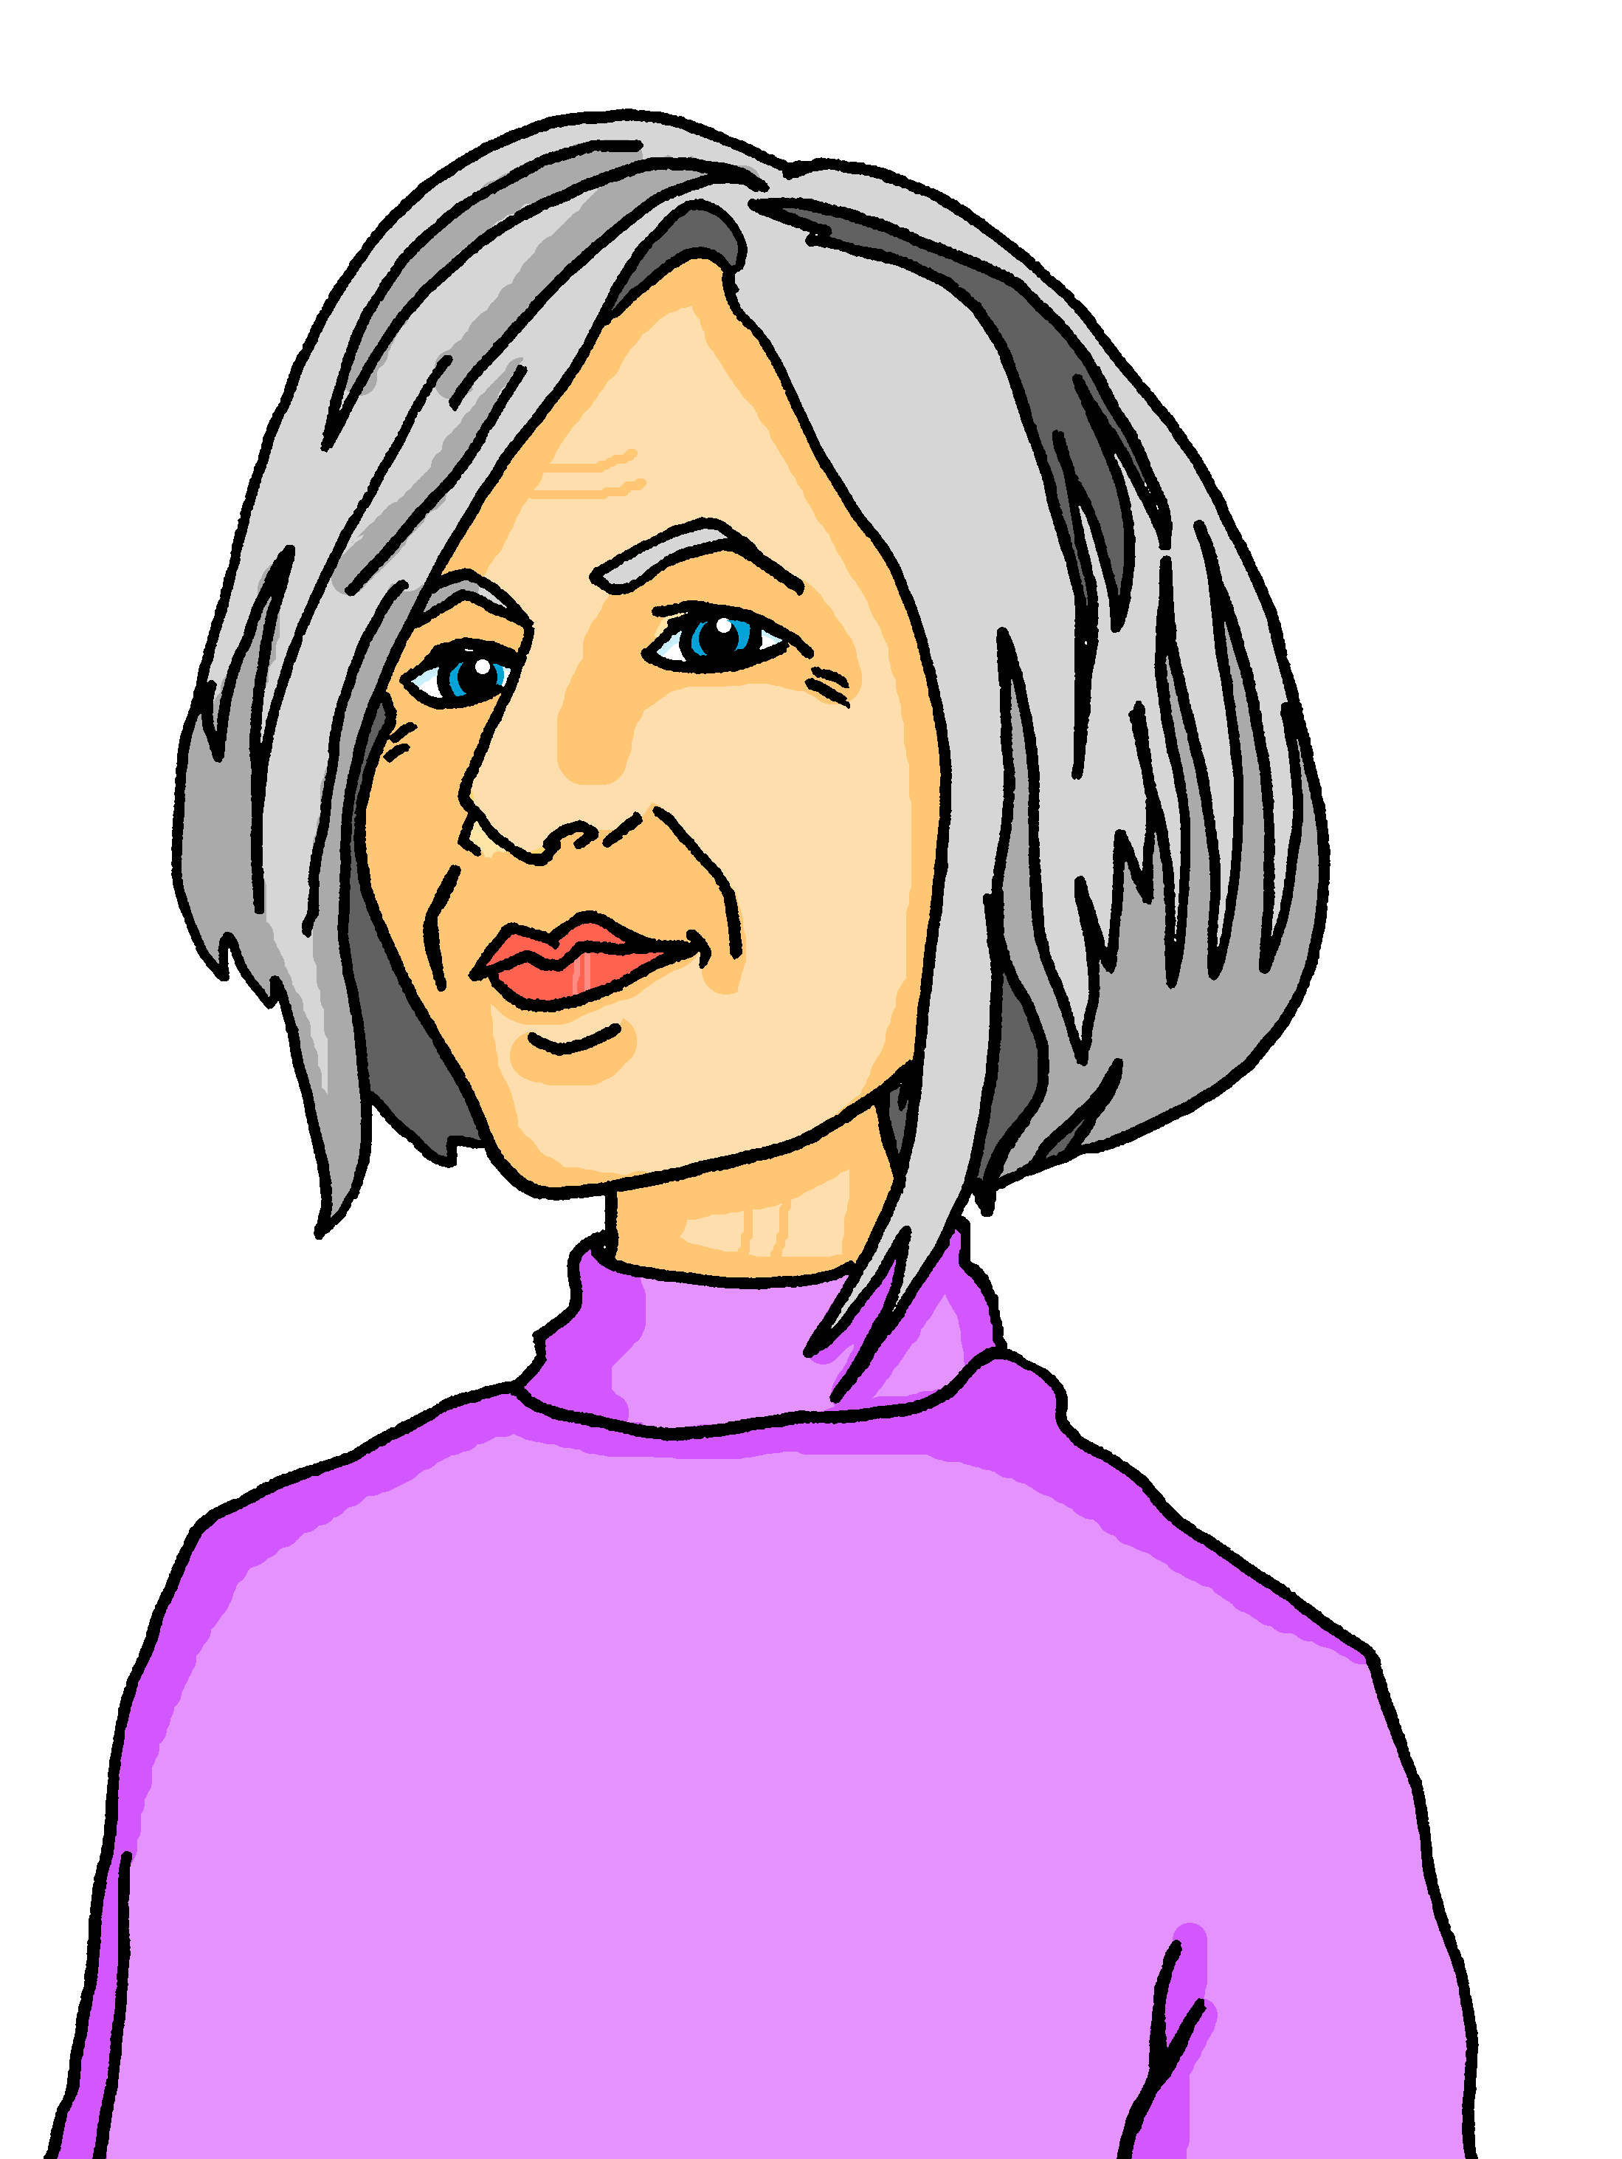

Sag die Wörter. Was ist das auf Englisch?
Follow up 1
…
The German [-ig] is the equivalent of the English [-y] at the end of adjectives.
Can you pronounce these [-ig] words like Oma, and then like Lias?
What do you think these words could mean? Remember they are all adjectives ending in –y in English!
aussprechen
[ik]
60
[ich]
butterig
cremig
eisig
[buttery]
[creamy]
fettig
fischig
[icy]
jazzig
feurig
[fishy]
[fatty]
[fiery]
[jazzy]
krustig
orangig
kurvig
[crusty]
[orangey]
[curvy]
fruchtig
glasig
hungrig
0
[fruity]
[hungry]
START
[glassy]
Notes:
Timing: 5 minutes
Aim: to practise pronouncing unknown words with the SSC [-ig] and to make the link between German [-ig] and English [-y] in adjectives.
Procedure:
Explain that all of these words end in –ig, and can be translated by English adjectives endings in –y.
Pupils work in pairs and each try to pronounce all of the words within the 60 second time limit. They should have one go pronouncing the –ig the Northern German way [-ich], like Oma from Germany, and then another go pronouncing it [-ik], like Lias from Switzerland. Click Start to start the timer.
If needed, click on the yellow audio buttons to check the [-ich] pronunciation and the white audio buttons to check the [-ik] pronunciation.
Click to bring up the text box asking pupils to think about meanings and give them 1 minute to discuss.
Click for English translations to appear. Give pupils time to notice the many cognates and the –y replacing the –ig.
Word frequency:
butterig [N/A] cremig [N/A] eisig [N/A] fettig [N/A] feurig [N/A] fischig [N/A] fruchtig [N/A] glasig [N/A] hungrig [2124] jazzig [N/A] krustig [N/A] kurvig [N/A] orangig [N/A]
Source: Jones, R.L. & Tschirner, E. (2019). A frequency dictionary of German: core vocabulary for learners. Routledge

Slide 5

Follow up 2
Hör zu. Ist A, B oder C richtig?
A
B
C
hören
1
I do sport in February. | I do sport in November. | I make games in February.
2
He visits Switzerland in April. | He visits England in April. | He visits England in August.
3
She works at home in June. | She works at home in July. | He works at home in July.
4
You write a song in April. | You write a song in March. | You write a song in May.
5
She receives a letter in November. | She receives a cat in November. | She receives a cat in December.
6
I play a game in July. | I play a game in January. | I play a game in June.
Notes:
Timing: 5 minutes
Aim: to practise aural comprehension of this week’s new vocabulary combined with activities using indefinite articles in the accusative in preparation for a speaking exercise.
Procedure:
Click on the first audio button to hear a question. Pupils listen carefully and decide whether option A, B or C contains the correct answer.
Repeat for questions 2-6.
Click to reveal the answers.
Transcript:
1. Ich mache im Februar Sport.
2. Er besucht im April England.
3. Sie arbeitet im Juni zu Hause.
4. Du schreibst im Mai einen Song.
5. Sie bekommt im November eine Katze.
6. Ich spiele im Juli ein Spiel.

Slide 6

Follow up 3
Schreib auf Deutsch.
A
1
Januar
Februar
März
B
Mai
Juni
Juli
Er hat
Du hast
2
Ich habe
Sie hat
Oktober
November
Dezember
3
im Februar
im April
im Juni
im Dezember
4
April
Mai
Juni
Pläne.
5
Juli
August
September
Beispiel:
Sie hat im April Pläne.
= She has plans in April.
Februar
März
April
6
Notes:
Timing: 5 minutes
Aim: to practise written production of the months of the year and full sentences with haben.
Procedure:
For activity A, pupils write down the missing month(s) in each sequence.
Click to display answers.
Click to bring up activity B. Here pupils must write their own sentences using one of each colour components in the circle, and translate into English. Click again to bring up the example (Beispiel).
Additional tasks:
1. Pupils could continue to write their own sentences e.g. Ich habe im Oktober Pläne. Susie hat im April Pläne.

Slide 7
Follow up 4a
Wann hast du Pläne?
eine Gruppe
einen Song
eine Gitarre
Sport
zu Hause
einen Brief
eine Geschichte
einen Baum
einen Computer
ein Fahrrad
die Schweiz
ein Spiel
im Januar
im Februar
im März im April im Mai im Juni im Juli im August im September im Oktober im November im Dezember
besuche
bleibe
arbeite
benutze
spiele
brauche
bekomme
mache
schreibe
Remember, masculine ein becomes einen after haben and most other verbs. Feminine eine and neuter ein stay the same.
Ich
Notes:
Timing: 2 minutes
Aim: to provide written practice of the months of the year and of indefinite articles in the accusative.
Procedure:
Read the callout reminding pupils about indefinite articles in the accusative.
Pupils use one item from each column to write a sentence about their plans. Each pupil only needs to write one sentence which will be used in the following speaking activity.

Slide 8

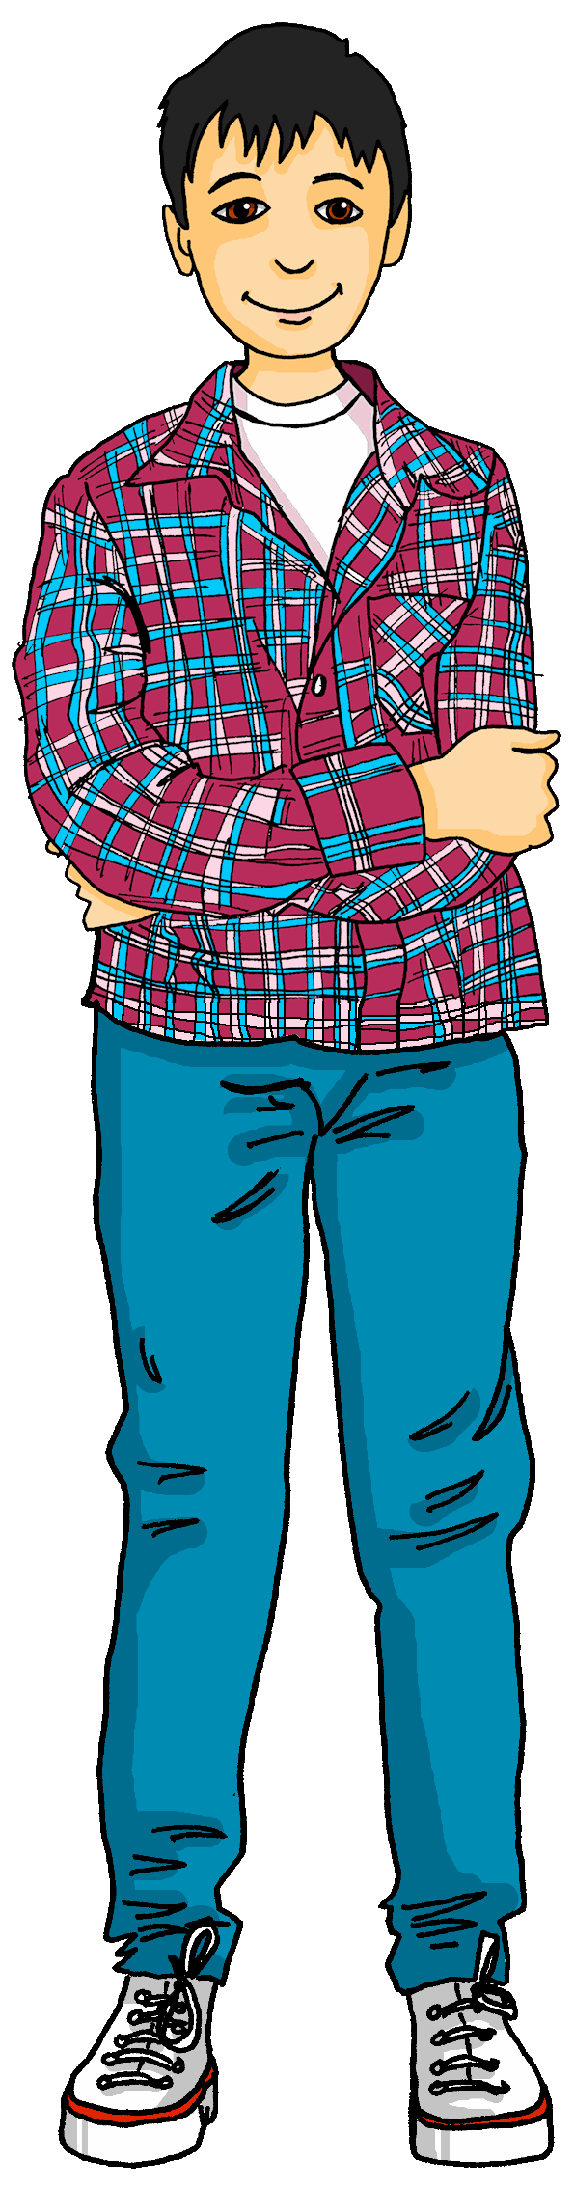
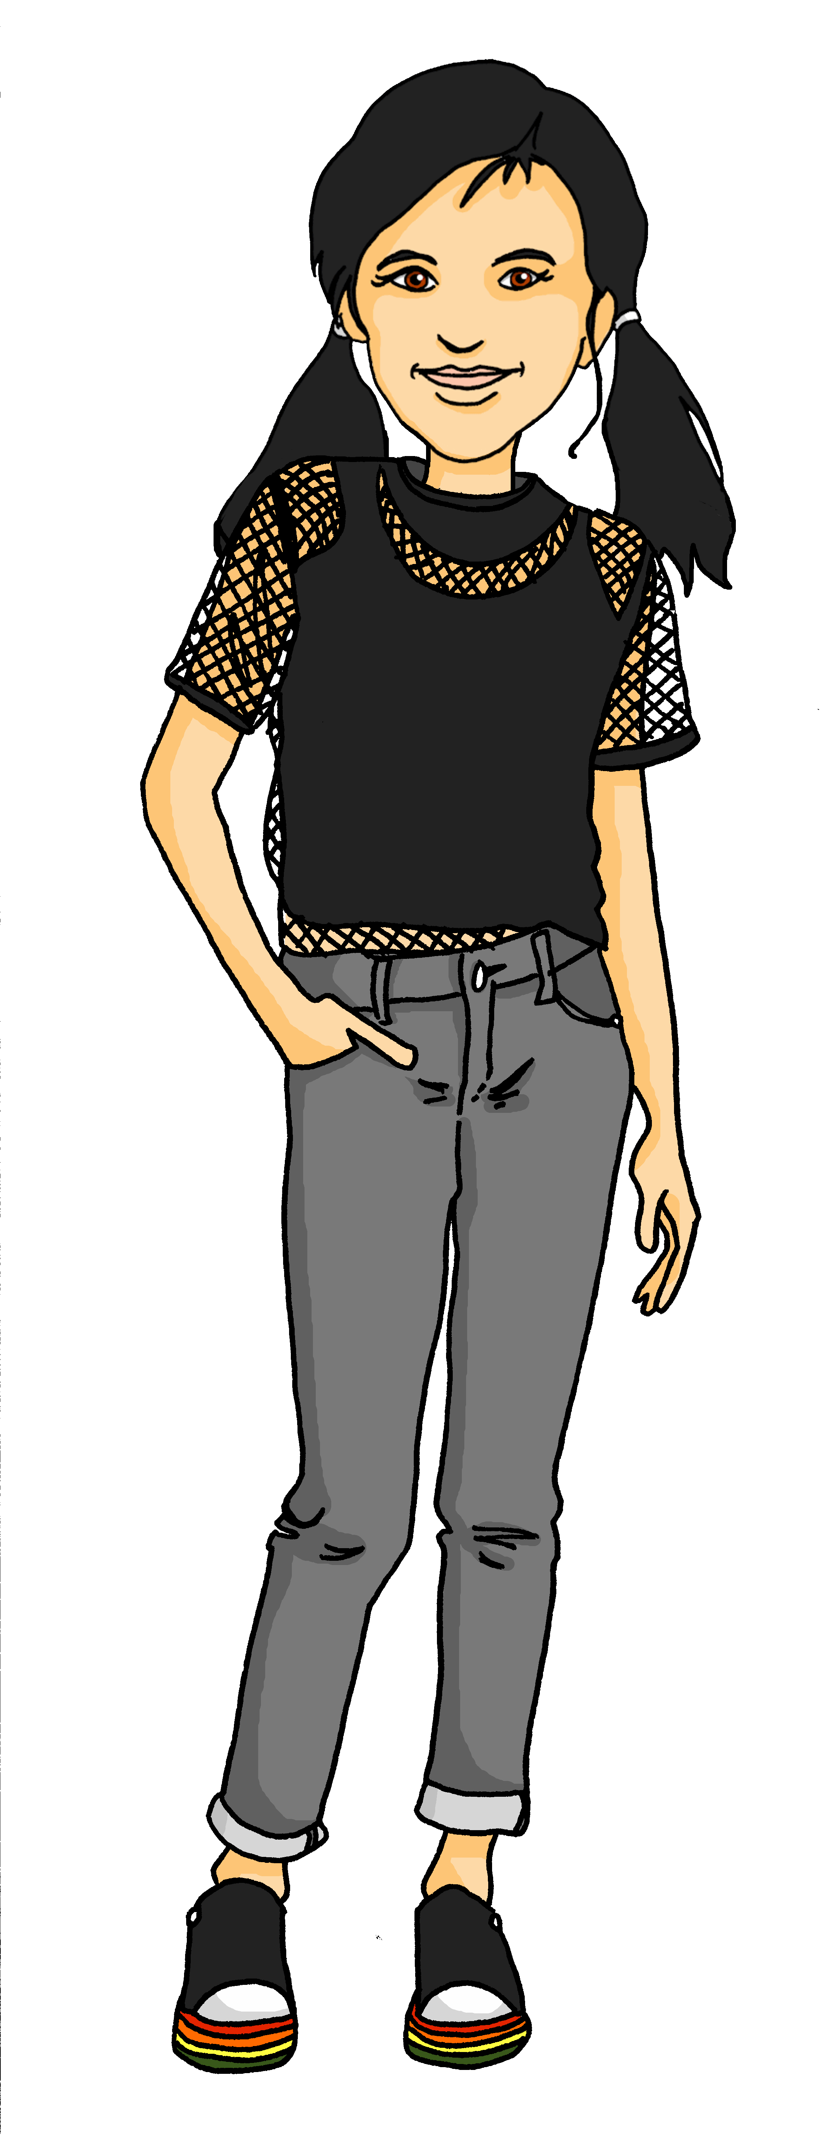
Follow up 4b
Wann hast du Pläne?
Wann hast du Pläne?
Januar | Februar | März | April
Mai | Juni | Juli | August
September | Oktober | November | Dezember
sprechen
Ronja (plays guitar)
Ich habe im April Pläne.
Was machst du?
Ich spiele im April Gitarre.
Notes:
Timing: 5 minutes
Aim: to provide oral practice of the months of the year and of indefinite articles in the accusative.
Procedure:
Model the conversations that pupils will have with Lias and Ronja.
Pupils will use the sentence they wrote down in follow up 4a to provide their answer.
Using the handout at the end of the presentation, pupils will circulate, asking each other when they have plans. They will note the pupil’s name in the appropriate month, and for an extra challenge, they could write the pupil’s plans in English.
The goal is for pupils to find somebody with a plan for each month of the year. The first pupil with a full calendar wins!

Slide 9


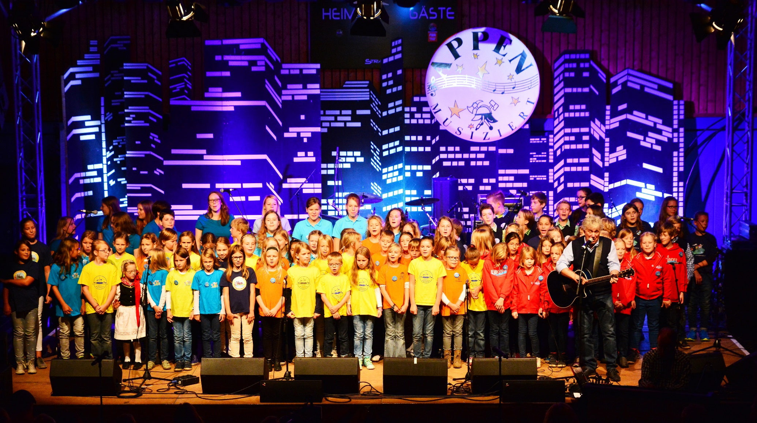

Hör zu und sing mit!
Rolf Zuckowski is a German musician. German children grow up knowing his catchy songs.
See if you can join in with the months of the year in this song!
Jahr- year
Uhr- clock, watch
Notes:
Timing: Optional 5 mins
Aim: to practise oral production of the months of the year in a memorable way.
Procedure:
1. Discuss the title of the song and read the sentences on the right about Rolf Zuckowski.
2. Play the video and invite pupils to sing along with the months. It is very repetitive and catchy.
Note:
The ideas in the compound noun ‘Jahresuhr’ may be understood from the two separate words, but finding an English equivalent can be tricky (yearly clock, calendar year; year’s clock?)
Word frequency of unknown words (1 is the most frequent word in German):
Jahr [53] stehen 85] niemals [1402] still [1301] wecken [2578] uns [75] Lebenslust [N/A] anfangen [497] ganz [69] von [9] vorne [N/A]
Source: Jones, R.L. & Tschirner, E. (2019). A frequency dictionary of German: core vocabulary for learners. Routledge
Photo attribution: Frank Schwichtenberg, CC BY-SA 3.0 <https://creativecommons.org/licenses/by-sa/3.0>, via Wikimedia Commons
Video link: https://www.youtube.com/watch?v=WJ0uJo5kJ04

Slide 10



Follow up 5:

Schreib auf Englisch.
Can you get at least 15 points?
Wörter
 | der Song | die Gruppe | heute
 | Lieblings | Freitag | die Woche
 | Samstag | der Tag | morgen
 | Dienstag | Mittwoch | Donnerstag
 | der Plan | der Monat | Wann?
 | August | Oktober | Dezember
 | Februar | April | Juni
(the) song
(the) group
today
Vokabeln
x3
favourite
Friday
(the) week
Saturday
(the) day
tomorrow
x2
Tuesday
Wednesday
Thursday
(the) plan
(the) month
When?
August
October
December
x1
February
April
June
Notes:
Timing: 5 minutes
Aim: to practise written comprehension of vocabulary from this and revisited weeks.
Procedure:
1. Give pupils a blank grid. They fill in the English meanings of any of the words they know, trying to reach 15 points in total.
Note:
The most recently learnt and practised words are pink, words from the previous week are green and those from week 1 are blue, thus more points are awarded for them, to recognise that memories fade and more effort (heavy lifting!) is needed to retrieve them.

Slide 11
Follow up 5:

Schreib auf Deutsch.
Can you get at least 15 points?
Wörter
 | Tuesday | (the) day | tomorrow
 | (the) group | favourite | (the) song
 | Sunday | today | (the) week
 | Monday | Wednesday | Friday
 | When? | (the) plan | (the) month
 | July | September | November
 | January | March | May
Dienstag
der Tag
morgen
Vokabeln
x3
die Gruppe
Lieblings
der Song
Sonntag
heute
die Woche
x2
Montag
Mittwoch
Freitag
Wann?
der Plan
der Monat
x1
Juli
September
November
Januar
März
Mai
Notes:
Timing: 5 minutes
Aim: to practise written production of vocabulary from this and revisited weeks.
Procedure:
1. Give pupils a blank grid. They fill in the German meanings of any of the words they know, trying to reach 15 points in total.
Note:
The most recently learnt and practised words are pink, words from the previous week are green and those from week 1 are blue, thus more points are awarded for them, to recognise that memories fade and more effort (heavy lifting!) is needed to retrieve them.

Slide 12
Tschüss!
gelb
Notes:
12

Slide 13
Follow up 4
Wann hast du Pläne?
sprechen
Januar | Februar | März | April
Mai | Juni | Juli | August
September | Oktober | November | Dezember
Notes:
HANDOUT

Slide 14
Follow up 5:

Schreib auf Englisch.
Can you get at least 15 points?
Wörter
 | der Song | die Gruppe | heute
 | Lieblings | Freitag | die Woche
 | Samstag | der Tag | morgen
 | Dienstag | Mittwoch | Donnerstag
 | der Plan | der Monat | Wann?
 | August | Oktober | Dezember
 | Februar | April | Juni
Vokabeln
x3
x2
x1
Notes:
HANDOUT

Slide 15
Follow up 5:

Schreib auf Deutsch.
Can you get at least 15 points?
Wörter
 | Tuesday | (the) day | tomorrow
 | (the) group | favourite | (the) song
 | Sunday | today | (the) week
 | Monday | Wednesday | Friday
 | When? | (the) plan | (the) month
 | July | September | November
 | January | March | May
Vokabeln
x3
x2
x1
Notes:
HANDOUT

