Slide 1
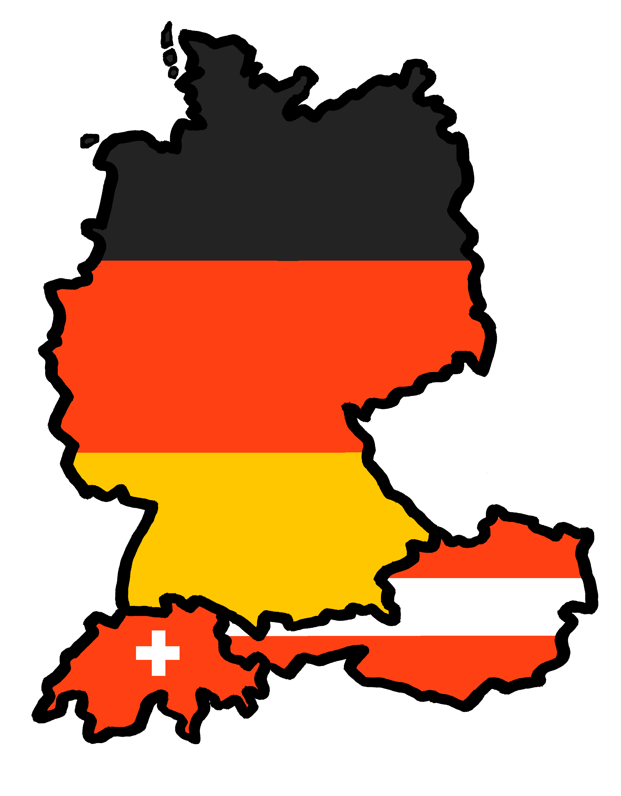
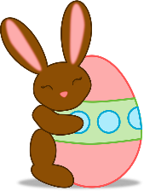
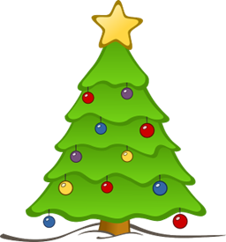
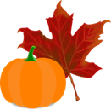
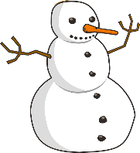
Talking about activities and events
gelb
die Monate
haben – I, you, s/he, it
SSC [-ig]
Term 3 Week 4
Notes:
Artwork by Steve Clarke. Pronoun pictures from NCELP (www.ncelp.org). All additional pictures selected from Pixabay and are available under a Creative Commons license, no attribution required.
Phonics:
[-ig] richtig [177] dreißig [2046] fertig [n/a] ruhig [911] wichtig [144]
Vocabulary: Januar [1052] Februar [1093] März [987] April [1004] Mai [1048] Juni [1148] Juli [1544] August [1929] September [1035] Oktober [1223] November [1273] Dezember [1527] Monat [316] wann [657]
Revisit 1: Montag [1044] Dienstag [1356] Mittwoch [1187] Donnerstag [1244] Freitag [981] Samstag [1112] Sonntag [804] Tag [111] Woche [219] heute [116] morgen [752]
Revisit 2: Gruppe [369] Lieblings - [n/a] Song [3373]
Jones, R.L & Tschirner, E. (2019). A frequency dictionary of German: Core vocabulary for learners. London: Routledge.
The frequency rankings for words that occur in this PowerPoint which have been previously introduced in these resources are given in the SOW and in the resources that first introduced and formally re-visited those words.
For any other words that occur incidentally in this PowerPoint, frequency rankings will be provided in the notes field wherever possible.
Note that the first three lessons of the year teach language that can be continuously recycled as lesson routine every lesson in Y3/4.
The idea would be that the class teacher (whether or not s/he teaches the class German can re-use the language as part of the daily routine with the class.
1

Slide 2
aussprechen
[-ig]
…
The [-ig] sound is mostly found at the end of words.
richtig
Notes:
Timing: 1 minute
Aim: To introduce/consolidate SSC [-ig]
Procedure: 1. Present the letter(s) and say the [-ig] sound first, on its own. Pupils repeat it with you. 2. Bring up the word ”richtig” on its own, say it, pupils repeat it, so that they have the opportunity to focus all of their attention on the connection between the written word and its sound.
3. A possible gesture for this would be to mime ‘correct’ by tracing a tick in the air with the index finger on your right hand.
4. Roll back the animations and work through 1-3 again, but this time, dropping your voice completely to listen carefully to the pupils saying the [-ig] sound, pronouncing ”richtig” and, if using, doing the gesture. Word frequency (1 is the most frequent word in German): richtig [177]
Source: Jones, R.L. & Tschirner, E. (2019). A frequency dictionary of German: core vocabulary for learners. Routledge
2

Slide 3
aussprechen
[-ig]
…
30
fertig
dreißig
richtig
[ready, finished]
ruhig
wichtig
[quiet, calm]
[important]
Notes:
Timing: 2 minutes
Aim: To introduce/consolidate SSC [-ig]
Procedure:
Introduce and elicit the pronunciation of the individual SSC [-ig] and then the source word again ‘richtig’ (with gesture, if using).
Then present and elicit the pronunciation of the four cluster words.
The cluster words have been chosen for their high-frequency, from a range of word classes, with the SSC (where possible) positioned within a variety of syllables within the words (e.g. initial, 2nd, final etc.). Additionally, we have tried to use words that build cumulatively on previously taught SSCs (see the Phonics Teaching Sequence document) and do not include new SSCs. Where new SSCs are used, they are often consonants which have a similar symbol-sound correspondence in English.
Word frequency (1 is the most frequent word in German): richtig [177] dreißig [2046] fertig [n/a] ruhig [911] wichtig [144] Source: Jones, R.L. & Tschirner, E. (2019). A frequency dictionary of German: core vocabulary for learners. Routledge

Slide 4
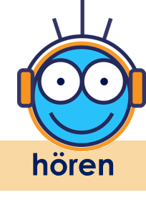
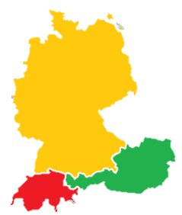
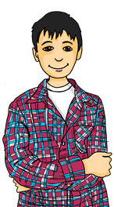
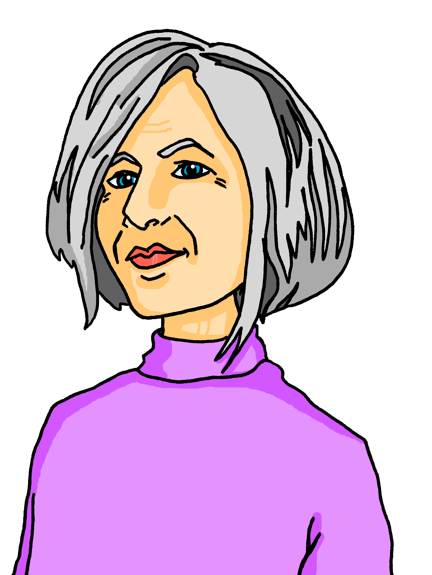
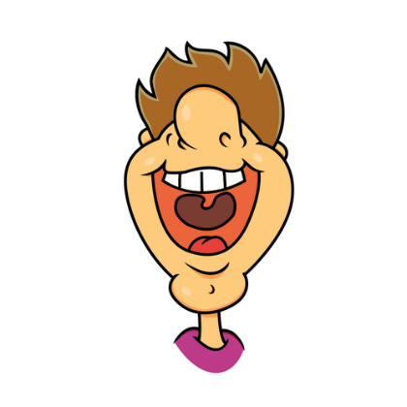
[ig]
Hör zu und wiederhole.
In Germany, Austria and Switzerland, there are lots of dialects.
In Northern Germany, where I live, [-ig] is pronounced like [-ich].
In Southern Germany, Austria and Switzerland, where I live, [-ig] is pronounced like [-ik].
richtig wenig einzig künftig nötig riesig
1
richtig wenig einzig künftig nötig riesig
1
Deutschland
2
2
3
3
Remember that German [-ig] usually occurs at the end of a word. Whether you pronounce it with [ich] as in North Germany or [ik] as in Switzerland, you don’t use your vocal chords.
4
4
Österreich
5
Schweiz
5
6
6
Notes:
Timing: 5 minutes
Aim: to consolidate the SSC [ig] and to introduce pupils to the idea of regional variation in pronunciation.
Procedure:
Click to bring up Oma and speech bubble, then Lias and speech bubble, to introduce the idea of regional variation.
Click to bring up the two sets of the 6 words.
Click each number to hear the two versions of each word. Pupils listen and repeat. Which do they prefer?
Click to bring up the call-out to point out that we don’t use our vocal chords for either pronunciation of [ig].
Transcript:
richtig
wenig
einzig
künftig
nötig
riesig
Word frequency:
einzig [343] künftig [890] nötig [1038] riesig [1075] wenig [102] Source: Jones, R.L. & Tschirner, E. (2019). A frequency dictionary of German: core vocabulary for learners. Routledge

Slide 5
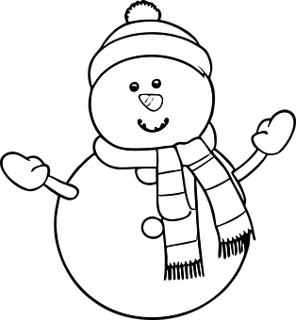
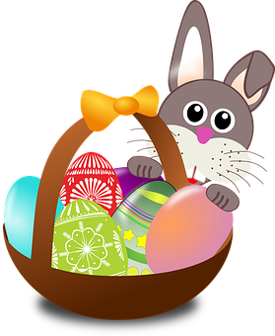
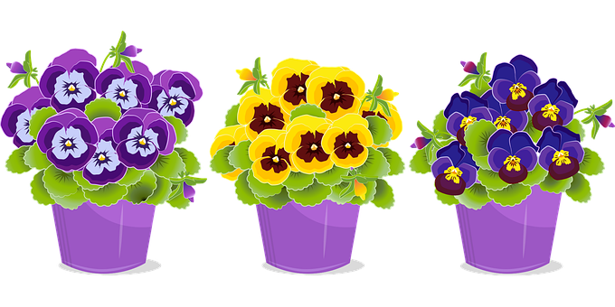
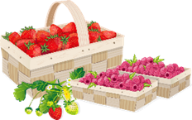
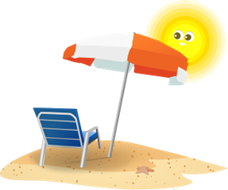
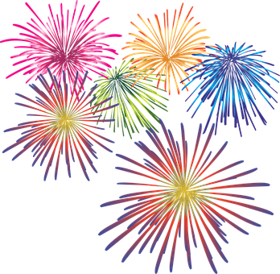
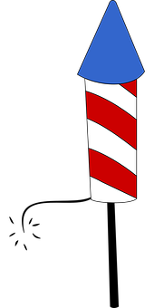
Vokabeln
Vokabeln lernen
Which of the months are cognates? Be careful with your pronunciation, as some of them look like the English but sound quite different!
Wörter
Hör zu und wiederhole.
Januar
Februar
März
April
Mai
Juni
Juli
August
September
Oktober
November
Dezember
Notes:
Timing: 3 minutes
Aim: to present and practise the months of the year.
Procedure:
Click to bring up the month of January and then again for the picture.
Repeat for all 12 months.
Click to bring up call-out about cognates.
5

Slide 6
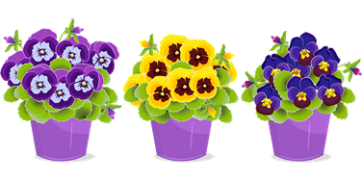
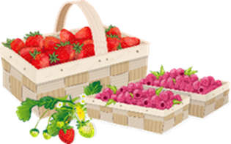
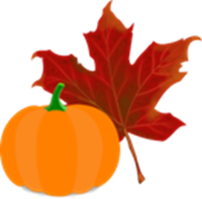
Vokabeln
Vokabeln
Wörter
Wie sagt man das auf Deutsch?
Februar
April
November
Mai
Juni
Oktober
September
February
June
May
April
March
January
December
November
August
October
July
März
Januar
Juli
August
September
Dezember
Notes:
Timing: 3 minutes
Aim: to practise written recognition and read aloud of the months of the year.
Procedure: 1. Click for an English word to appear in the middle. Elicit the German translation from pupils. Emphasis here is on good pronunciation as well as finding the correct word.
2. Continue until all months have been introduced. 3. Elicit choral pronunciation of all months again, clicking to provide an emphasis animation. Encourage pupils to focus on pronunciation and avoid anglicism of the cognates.
6

Slide 7
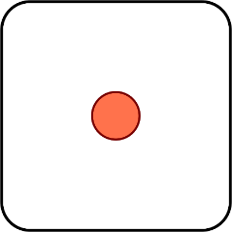
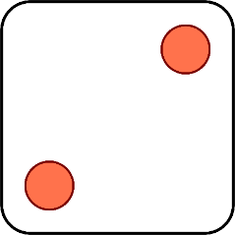
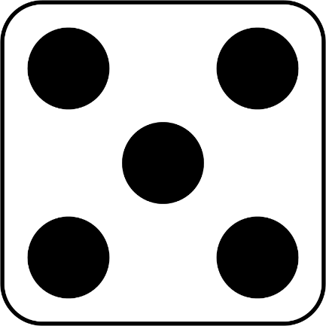
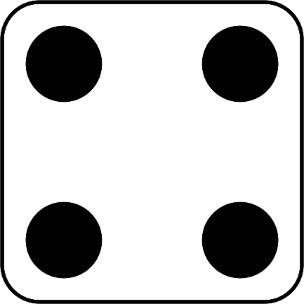
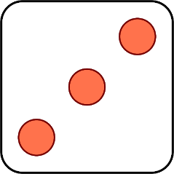
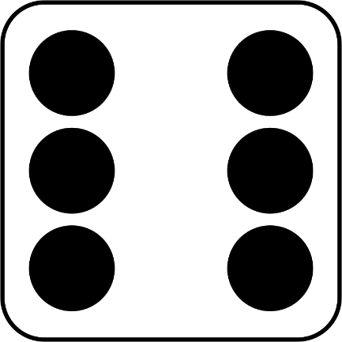
Vokabeln
Wie sagt man das auf Deutsch?
Februar
Mai
April
Januar
März
Juni
Notes:
Timing: 2 minutes [Slide 1/2]
Aim: to practise oral recall of the months of the year.
Procedure: 1. Explain that numbers 1-6 on the dice represent the first 6 months of the year. If necessary, remind pupils in English which month each picture represents.
2. Click for first ‘rolling’ dice to appear. Pupils chorally produce the German for the month represented by that number.
3. Repeat for all 6 rolls of the dice. 4. Move on to next slide to practise the months in the second half of the year in the same way.

Slide 8
Vokabeln
Wie sagt man das auf Deutsch?
August
November
Oktober
Juli
September
Dezember
Notes:
Timing: 2 minutes [Slide 2/2]

Slide 9
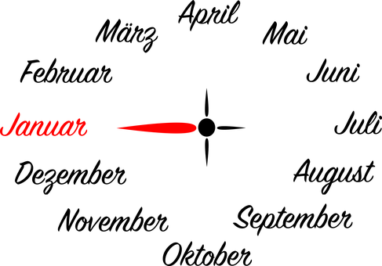
Vokabeln
Vokabeln lernen
Wörter
Sag die Wörter.
der Monat
[month]
der Plan
Notes:
Timing: 2 minutes
Aim: to present 2 further items of vocabulary for this week.
Procedure:
Click for each new word to appear, then again for the supporting picture and English to appear.
Practise repeating the words as a whole class.
9

Slide 10
wann questions
You already know the question words was (what), wie (how)
and wer (who).
Use wann to ask when:
Notice the difference in English and German word order here.
Wann besucht Oma die Schweiz?
When is Grandma visiting Switzerland?
Oma besucht im Juni die Schweiz.
We use im for ‘in’ with months.
Grandma is visiting Switzerland in June.
Notes:
Timing: 2 minutes
Aim: to introduce the question word wann and how to ask and answer about birthdays.
Procedure:
Click through the animations to recap other known question words (with actions if used) then introduce wann. A possible action for wann would be pointing at your watch.
Introduce the question and answer, eliciting the English translations and using the call-outs to explain the literal translations and word order differences.
Note: in is usually translated as in but with months we use im.
10

Slide 11
Wann hat er/sie Pläne?
Ronja and Lias are asking their friends and family when they have plans. Lias writes them in a calendar. Can you help him to complete the calendar?
 | A
1 | Jana hat im März Pläne.
2 | Gabriel hat im Januar Pläne.
3 | Mariem hat im Oktober Pläne.
4 | Leon hat im Juli Pläne.
Januar | Februar | März | April
Mai | Juni | Juli | August
September | Oktober | November | Dezember
Gabriel
Ronja (du)
Jana
1
2
3
4
Lothar (er)
Leonie (sie)
Leon
Oma (sie)
 | B
1 | Ich habe im Dezember Pläne.
2 | Er hat im Mai Pläne.
3 | Sie hat im Juni Pläne.
4 | Du hast im Februar Pläne, nicht wahr?
5 | Sie hat im August Pläne.
1
?
2
?
3
?
Mariem
Lias (ich)
4
?
5
?
Notes:
Timing: 5 minutes
Aim: to practise written recognition of months and written production of the verb haben in the context of plans.
Procedure:
Read the scenario as a class.
For Section A, pupils read the sentences given and decide where those 4 characters belong on the calendar. Give pupils 2 mins to discuss in pairs, then elicit answers and click to reveal their pictures on the calendar.
For Section B, pupils need to use the other information/pictures given on the calendar to complete the sentences 1-5 with the correct part of the verb haben. Remind them that Lias is speaking and therefore will be ‘ich’ and he is speaking to Ronja, who will therefore be ‘du’. The other characters will be ‘er’ or ‘sie’.

Slide 12
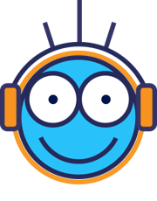
hören
Wann oder wer?
Hör zu und schreib A oder B.
 | A | B | Full answer
 | Ronja | im April
 | Mariem | im Oktober
 | im Dezember | Lothar
 | im September | Oma
 | Jana | im Juni
 | im Januar | Gabriel
1
Ronja hat im Februar Pläne.
2
Sie hat im Oktober Pläne.
3
Ich habe im Dezember Pläne.
4
Oma hat im August Pläne.
5
Jana hat im März Pläne.
6
Er hat im Januar Pläne.
Remember that the word order is different in German:
‘Ronja has in February plans.’
Notes:
Timing: 5 minutes
Aim: to practise aural comprehension of wann and wer questions.
Procedure:
1. Explain that pupils are listening to Lothar asking Lias about everyone’s plans.
2. Play audio 1. Pupils must choose whether the correct answer to the question would be A or B, based on whether they hear ‘when’ or ‘who’.
3. Play the audio again. This time, can pupils try to jot down a full sentence answer in German? Click to bring up call-out to remind them about word order. Show pupils how they can ‘steal’ the majority of the words they need from the question itself.
4. Click for answers and discuss difference in word order.
5. Repeat for items 2-6.
6. Elicit full sentence answers and click to bring up answers.
Transcript:
Wer hat im Februar Pläne?
Wann hat sie Pläne?
Wann hast du Pläne?
Wer hat im August Pläne?
Wer hat im März Pläne?
Wann hat er Pläne?
12

Slide 13
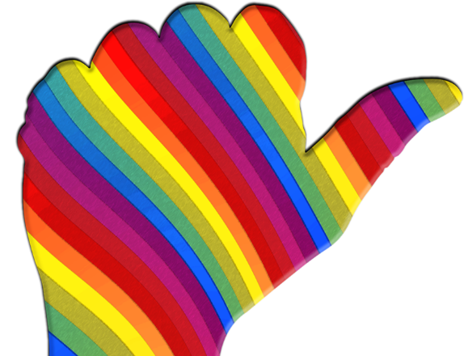
Kultur
Sag die Monate!
Many German-speaking children learn which months have 31 days by using their knuckles!
Januar (31)
März (31)
Mai (31)
Juli (31)
August (31)
Oktober (31)
Dezember (31)
September
November
Juni
Februar
April
Notes:
Timing: 2 minutes Aim: to practise oral production of the months; to demonstrate how German-speaking children learn which months have 31 days. Procedure: 1. Click to bring up the call out.
2. Click to reveal arrows and months one by one, with pupils repeating the months as they appear.
3. Play the animated sequence of months again. Pupils try to keep up with the animation, as they say the months. 4. Pupils say the year from start to finish independently using their knuckles.
13

Slide 14
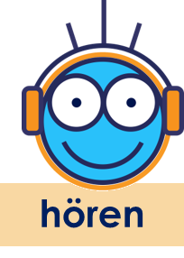
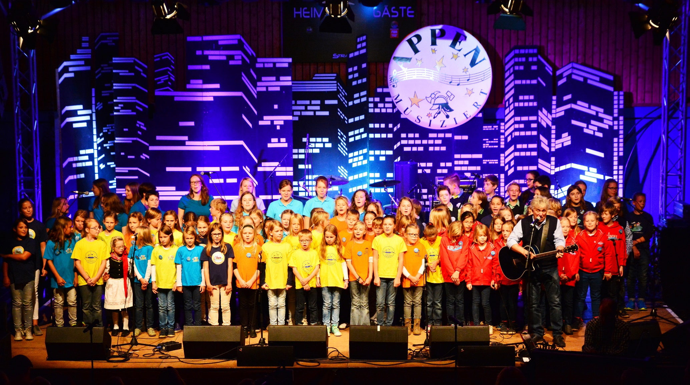
Hör zu und sing mit!
Rolf Zuckowski is a German musician. German children grow up knowing his catchy songs.
See if you can join in with the months of the year in this song!
Jahr- year
Uhr- clock, watch
Notes:
Timing: Optional 5 mins (also features in follow-ups)
Aim: to practise oral production of the months of the year in a memorable way.
Procedure: 1. Discuss the title of the song and read the sentences on the right about Rolf Zuckowski.
2. Play the video and invite pupils to sing along with the months. It is very repetitive and catchy.
Note:
The ideas in the compound noun ‘Jahresuhr’ may be understood from the two separate words, but finding an English equivalent can be tricky (yearly clock, calendar year; year’s clock?)
Word frequency of unknown words (1 is the most frequent word in German): Jahr [53] stehen 85] niemals [1402] still [1301] wecken [2578] uns [75] Lebenslust [N/A] anfangen [497] ganz [69] von [9] vorne [N/A] Source: Jones, R.L. & Tschirner, E. (2019). A frequency dictionary of German: core vocabulary for learners. Routledge
Photo attribution: Frank Schwichtenberg, CC BY-SA 3.0 <https://creativecommons.org/licenses/by-sa/3.0>, via Wikimedia Commons
Video link: https://www.youtube.com/watch?v=WJ0uJo5kJ04

Slide 15
Tschüss!
gelb
Notes:
15

